Slide 1

REALD SOGI at
Health Share of Oregon:
Process & Reflections
State of Oregon 2024 Data Equity Summit
Anthony Fox, PMP - Health Share of Oregon
Stephani Tyrance, MPH - Human Impact Partners

Slide 2

Project Team
Health Share
Cat Livingston MD, MPH
Bijoux Harrison-Doherty
James Wilson
Anthony Fox
Human Impact Partners
Stephani Tyrance MPH
Rebekah Gowler MSW, MPH

Slide 3

Containers for Equity Work...
Create the shape (practices, norms, values) that guide collective work
Reflect the values and principles of equity, justice, and belonging that are core to health and racial equity
Model on the small scale, what we want to see at the large scale
Principles of Container Building
Center everyone's full humanity
Integrate the head and the heart
Make the implicit, explicit
Make space for joy
Be emergent, flexible
We build containers for collective work so we can...
Effectively engage in difficult conversations about power, privilege, racism, and other systems of oppression.
Model and experience human-centered, healing spaces for ourselves, our colleagues, and our communities.

Slide 4
Health Share Values
Health Share Value | Application to our work with REALD SOGI
Member voice and experience are at the center of what we do. | Centering member experience and benefit in all decisions around REALD SOGI practice.
Health equity is achievable and requires deliberate action on our part. | Slowing down & challenging urgency Deliberate engagement with each aspect of REALD SOGI
Honoring our commitments. | Building frameworks that allow for deeper insights into inequities while working to minimize harm.
Using continuous improvement is vital to our effort. | Equity work as an iterative process – this work is always evolving and never "done."
Operating transparently and using data to guide our work. | Wrestling with challenges and sharing concerns and feedback. Building capacity for intersectional analyses
Working in partnership to maximize our resources. | Engagement with our Health Equity team, CAC & Human Impact Partners

Slide 5

REALD SOGI Overview
REALD: Race, Ethnicity, Language & Disability Data
SOGI: Sexual Orientation & Gender Identity Data
Specificity matters! ​
Disaggregated data can help identify inequities and gaps otherwise hidden in aggregated data and enhance understanding of specific communities. Explicitly to improve health care outcomes
​How is it an improvement over other demographic data?​
Expansion of existing fields and development of entirely new data (SOGI)​
New types of demographic questions; fully self-reported​
Allows for intersectional analysis on an entirely new level​
Greater response rate for R/E/L compared with legacy data (decreased missingness)

Slide 6
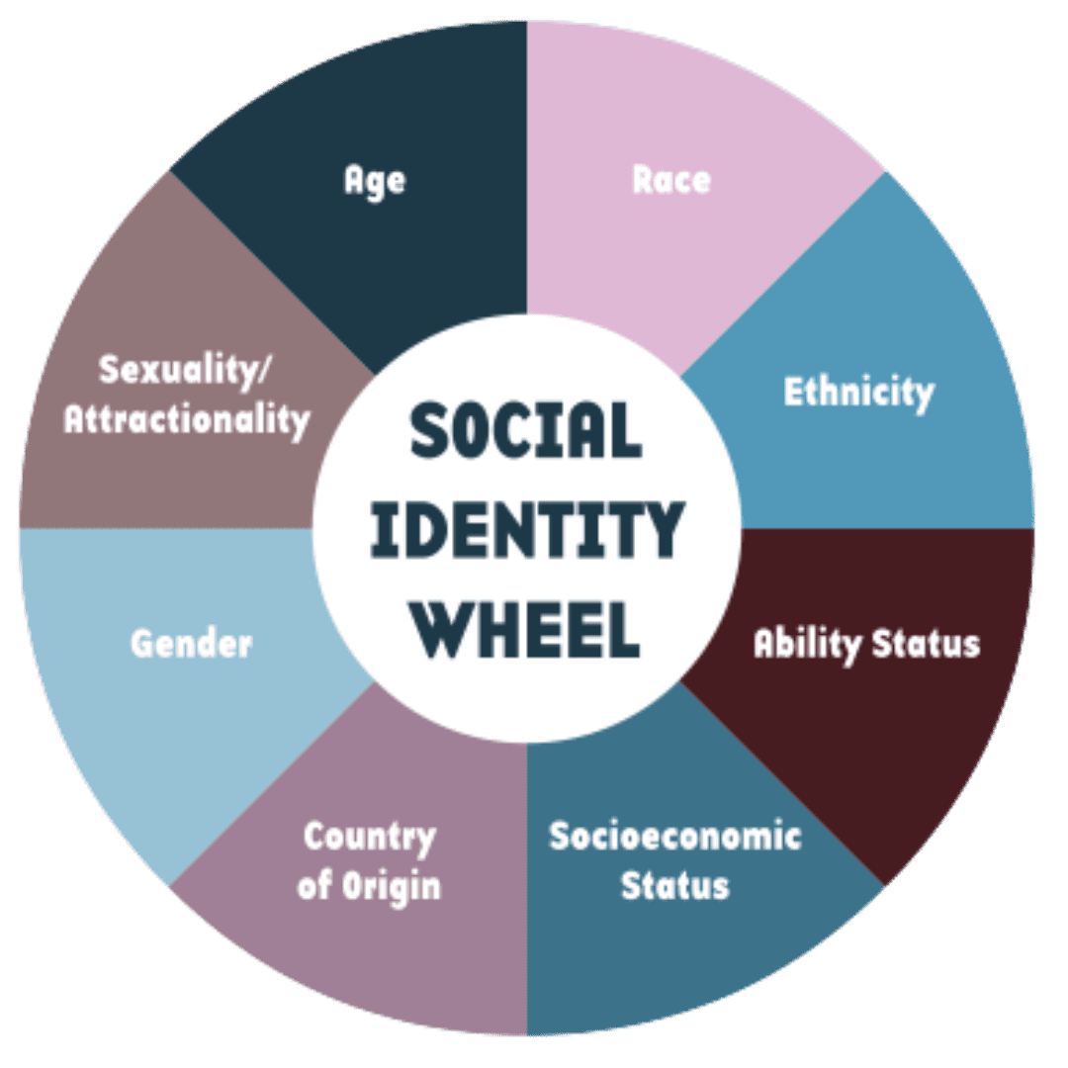
How we think about REALD SOGI data
  Positive and generative elements
    Intersectionality
  Naming demographics as social constructs & proxies for discrimination vs. rigid/opaque categories
  Naming and attempting to mitigate bias – creating frames for interpretation/display etc.
Complexities
The Power of Belonging: Understanding Social Identity | Applied Social Psychology (ASP)

Slide 7
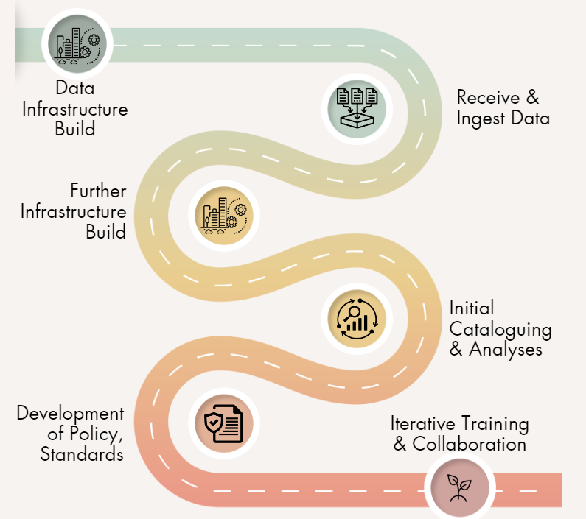
Health Share's REALD SOGI Roadmap

Slide 8
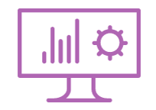
Data Infrastructure Build & Workload
Prior to Receiving Data:
Examine codebook & data (4-6 weeks)
Build reference tables (2-4 weeks)
Build REALDSOGI table (2 weeks)
After Receiving Data:
Integrate new fields (2-4 weeks)
Replace legacy fields (1 year+ - ongoing)
  Updating dashboards, internal/external reports etc.
Notes:
198 Fields!!! Robust novel demographic information
2. Codes are only helpful when there are descriptions that go along with them – 68 reference tables for all variables without binary format –
3. Table includes all fields PLUS descriptions for all fields that are not in binary format – reference tables from step 1 – over 250 fields in final table!
*Steps 1-3 done BEFORE data sent by OHA
4. Add *chosen* fields into existing demographic table
5. Replace existing fields for chosen demographics in internal and external reports – ongoing process, will take a LONG time

Slide 9
REALD SOGI vs. Legacy Demographics
# of Values
Data Type | Legacy Data | REALD SOGI | Notes
Race / Ethnicity | 8 | 55 | Additional ethnic categories are under development/consideration
Language | 58 | 1,400+ | Languages are added on an ongoing basis per member input
Disability | 11 | 14 | Additional fields include “Age Disability Acquired” and “Current Age v Age Disability Acquired”
Sexual Orientation | 0 | In development | OHA has not yet released this data.
Gender Identity | 0 | 13 | Additional fields include Gender Modality (Transgender, Cisgender etc.)
Notes:
Anthony then pass to Stephani

Slide 10
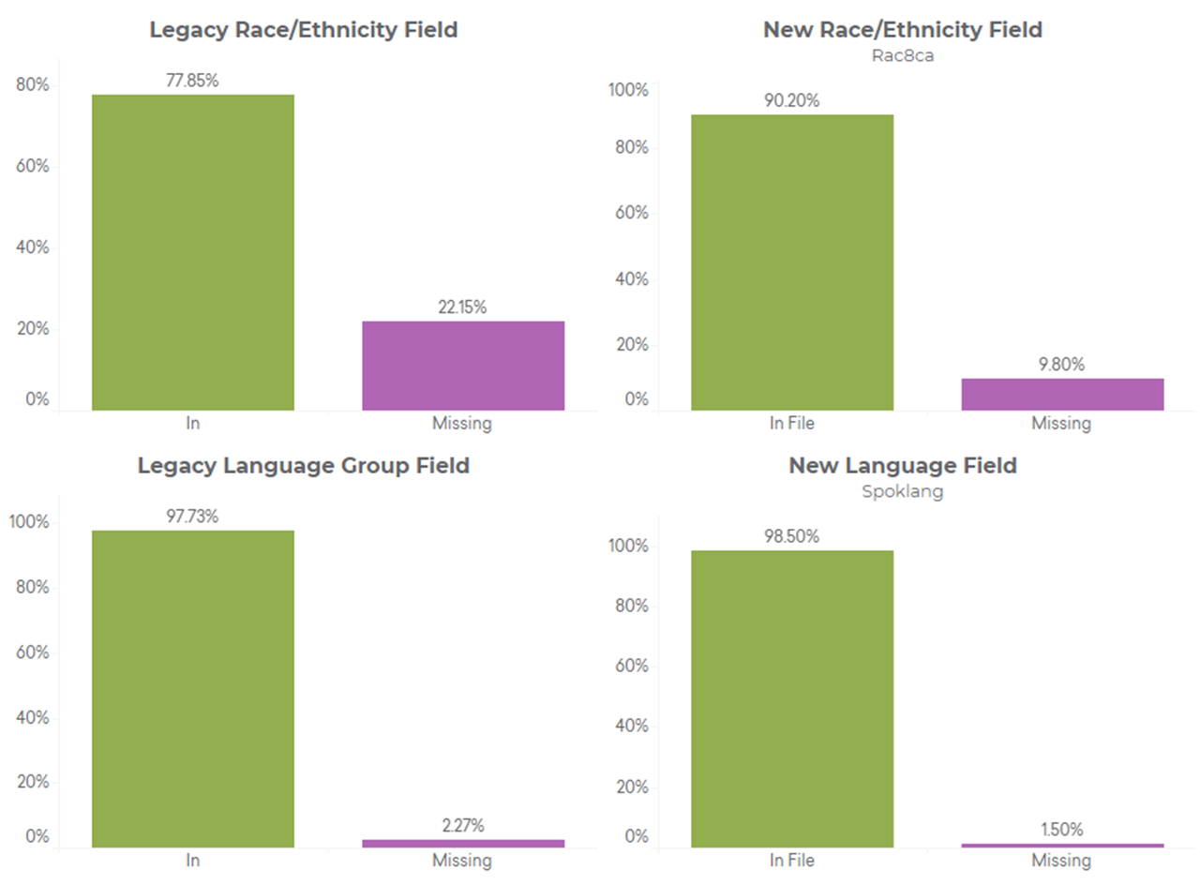
Improvements in Data Completeness

Slide 11
Development of Dashboard Aggregation Standards
Over the course of multiple meetings, Project Team reviewed and discussed an array of aggregation options to determine:
For our dashboards, what should our standard level of aggregation be for each element of REALD SOGI?
  What level of aggregation strikes the balance between actionable vs. manageable?
    Practical limitations of dashboard display vs. desire to fully aggregate
  Do we want to use fields with imputation?
  Do we want to use missing/unknown/decline/not understand/don't know responses?
How do we display demographic information?
How can we apply standards as a form of protection against misinformation and reduce potential for harm?
Notes:
Demographic information in the file is so vast and detailed that there was an obvious need to pare down which fields analysts across departments use for data analysis/reporting purposes
Because the new information from this file was so much more detailed than our current demographic information, we wanted to select fields to replace current/legacy information
Many variables included the option of imputation as well as the option to include unknown/not understand/decline
Walked through each element of REALD SOGI over the course of mult meetings etc.
Demonstration – look at all these fields!!! (e.g.: 1,400 languages!!)
How much detail vs redundancy for dashboard reporting
Offering more granular data on request (space issues with dashboards)
Data viz: Not comparing to white / alphabetize vs. prevalence
Practical imitations of dashboard display vs. desire to fully de-aggregate
What level of agg is going to allow actionable
Key questions we used to help make these decisions

Slide 12
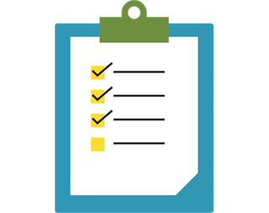
Where does the aggregation standard apply?
Health Share Dashboards
All dashboards will comply with established standards unless a use case warrants more/less granular data
Where does it not apply?
Analyses, data requests and other applications
Full disaggregation allows for highly nuanced intersectional analyses not previously possible.
Dashboard viewers can request disaggregated (population level) data.

Slide 13
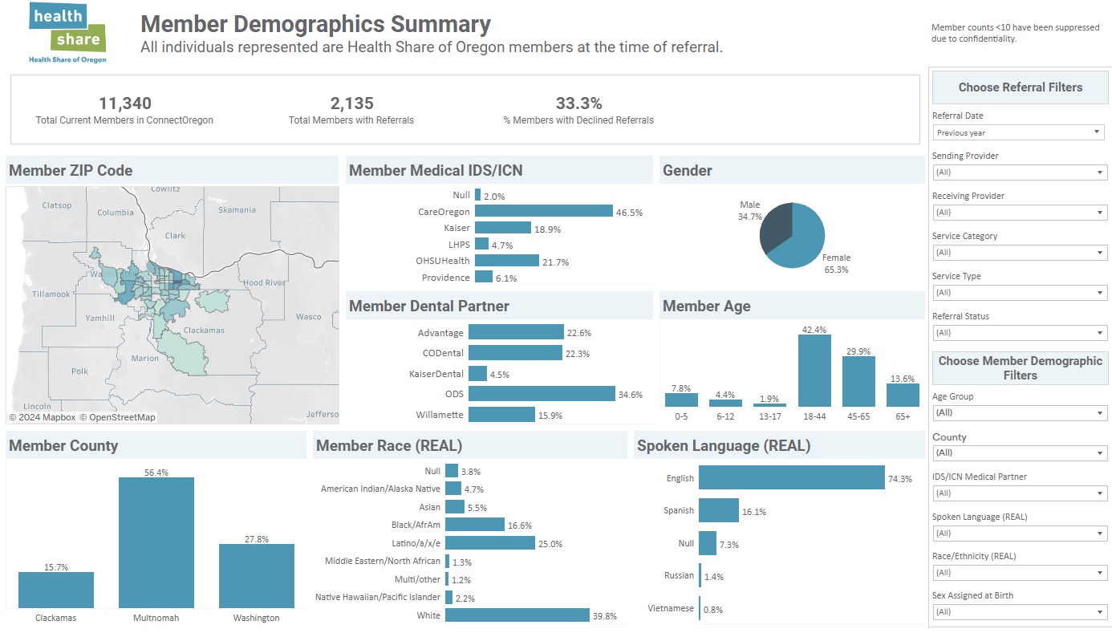
Dashboard Example with REAL Data

Slide 14
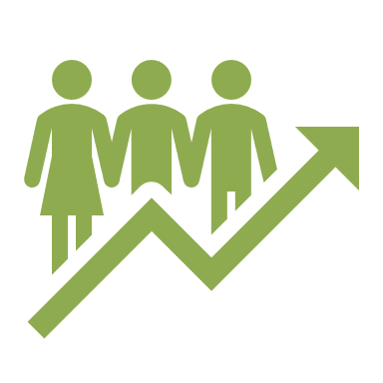



Data Equity & REALD SOGI Use Policy Elements
Data Analysis
Intersectionality
Disaggregation
Equity Lens Toolkit
Analysis guide in development
Data Display & Sharing:
Dashboard aggregation standards
Sensitive Data protocols
Intersectionality
Equity & Critical Thinking
Acknowledging potential harms and limits of data
Engaging community
Cultural sensitivity & interrogating biases
Transparent communication
Training:
Data equity training for analysts
Resources, workgroups, consulting
Notes:
Current now vs. Aspirational
Policy as invitation vs. Oversight
Why a policy?

Slide 15
Training
In recognition of the importance of common understanding and alignment in equity, fairness, and ethical data practices in data analysis and sharing of information Health Share Oregon Policy requires all analysts who create and share data to take part in Data Equity training within 90 days of hire.
Trainings
Blue Cross Blue Shield of Massachusetts Methods to Advance Health Equity
CareOregon Equity In Data Analysis
Oregon Health Authority REALD & SOGI Data Analytic Institute
We All Count: Data Equity Primer, Foundations of Data Equity, Advancing Data Equity Framework

Slide 16
Training Elements
Health Share Data Equity training gives analysts a common and approved set of principles on:
Data Aggregation and disaggregation
Avoiding over-simplification
Cultural Sensitivity
Community Engagement
Transparent Communication
Intersections of identity
Member Privacy
Sensitivity to reduce unintended harm
Notes:
Data Aggregation and disaggregation
Ensuring that we analyze member experience and outcomes in a meaningful way
Avoiding over simplification
Recognition of the diversity within groups, and seeking the root cause of disparities
Cultural Sensitivity
Consideration of cultural context and diverse background and experiences
Community Engagement
Engaging the communities whose experience is being studied
Transparent Communication
Providing disclosure of the sources, and analysis processes of data
Intersections of identity
Consideration of the multiple aspects of each person’s identity
Member Privacy
Ensuring individual’s health information is protected
and sensitivity to reduce unintended harm
Consideration of the potential harms inherent in reducing a person identity within a defined group.

Slide 17
Complex Challenges & Barriers
Topic | Challenge / Barrier | Possible solutions
(REAL)Disability Data | Limited insight into granularity / severity limitations of child/youth data | Building strategies to combine with claims data; childhood health complexity data
SOGI Data | Novel data collection prohibits robust response Sensitive data Issues with cisgender imputation | Protections around data visualization Combining with other data sources – always with context
Reporting Requirements | Requirement of REALD data inclusion in established reports Considerable front-end work for CCOs Data missingness issues High bar for reporting REALD SOGI to OHA | Transparent sharing to OHA about challenges

Slide 18
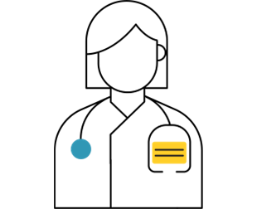
Concerns from Pediatric Clinicians
Youth SOGI data collection
Confidentiality not protected against potentially non-affirming parents/guardians.
  Presents threat of harm to some young people
Discussed at length during the REALD SOGI Rules Advisory Committee (2023/2024)
Central question: how do we balance the critical importance of diverse SOGI representation in data with safety for vulnerable populations?

Slide 19
Next steps –
Moving toward the vision of Health Equity and the best health for individuals and communities
Future development
Tiered Demonstration of data equity acumen – Foundational, Intermediate, Advanced (Health Share Data Analyst Guide)
Measuring disparities in access, treatment, and health outcomes
Engaging Providers in equity framework: Individual, Interpersonal, Institutional, Structural, and History inequity
Pay for Equity incentives
Addressing Health Inequities systematically

Slide 20
Questions?

Slide 21
All Together, All for You.

Slide 22
Thank you

