Slide 1

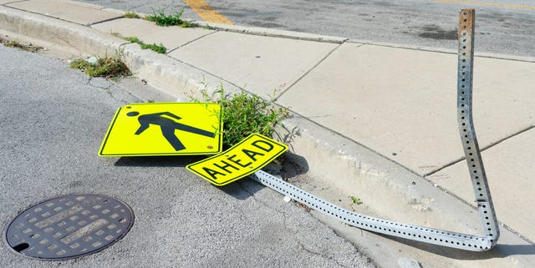
Data Equity Summit
Social Inequity and Pedestrian Injuries in Oregon
November 2024
Notes:
Title slide option 1
These photos are just examples. Please replace photos with your own.

Slide 2
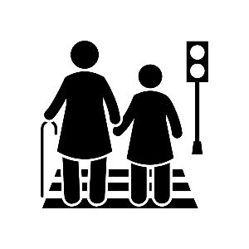
Agenda
Research Project Objectives & Background
Overview of Inputs to Crash Injury
Research Project Findings
Recommendations
Notes:
Further evidence of roadway design include FHWA Crash Modification Database and Methods in Highway Safety Manual including methods on predicting using SPFs

Slide 3

Research Project Objectives
Current Research Unit Project
Director’s office supported effort (& OTSC Support)
Research Objective 1: Understand disparities in pedestrian injury outcomes across Oregon
Research Objective 2: Measure how these disparities have changed over time
Research Objective 3: Inform the ODOT Transportation System Action Plan (TSAP) update
Other ODOT Efforts
OTC Strategic Action Plan acknowledges disparity of pedestrian injury rates for low income & communities of color
Active Transportation Unit implementing project selection process using measures of race and income
Equitable Active Safety Improvements Evaluation (EASIE)
Notes:
EASIE
- EASIE to develop recommendations which should focus on items that can be implemented quickly on the ODOT system, including but not limited to speed limit changes, signal improvements, signing, markings, illuminations, and other infrastructure solutions that benefit pedestrian and bicycle safety.
- The prioritization method should be data driven, consider social equity and work from the ODOT Office of Equity, and fill an existing gap within ODOT safety and active transportation programs.

Slide 4




Inputs to Crash Injury
Travel Activity & Behavior
More travel increases probability of crash
Humans make mistakes
Vehicle Design
Significant improvements in standard/available safety features
Weight and design becoming a problem for vehicle non-occupant
Road Design and Operation
Influences human behavior
Design & operation can alter crash risk
Travel Activity & Behavior
Vehicle Design
Road Design & Operation
Notes:
Interaction between these elements
Example: Vehicle HP influencing a drivers probability of speeding
Example: A 16 year old with undeveloped brain having higher probability of making poor decisions while driving
A roadway design influencing a persons decision to drive faster

Slide 5

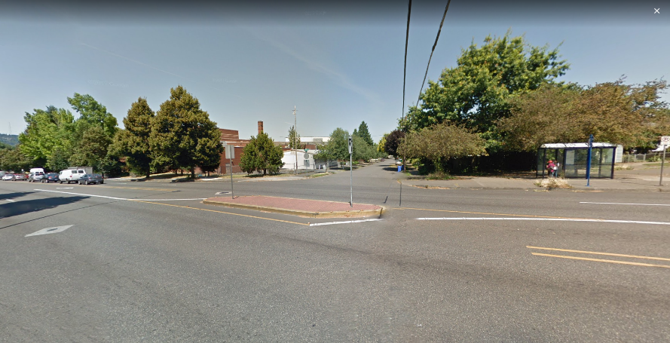

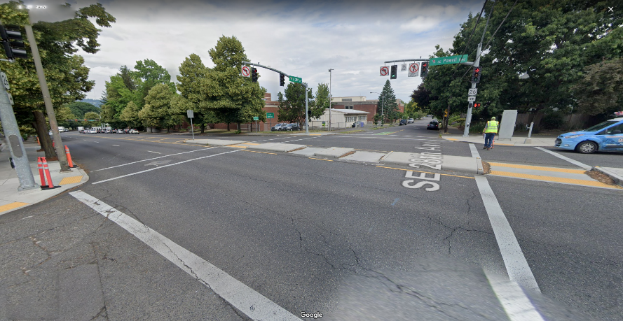
Moving Toward Systemic Approach
Road Design & Operation
Crash Modification Factors (CMFs)
Science based estimates of crash reduction potential
Safety Performance Functions (SPFs)
Mathematical equations that relate the number of crashes of different types to site characteristics (operations and geometry)
Before
After
Notes:
Further evidence of roadway design include FHWA Crash Modification Database and Methods in Highway Safety Manual including methods on predicting using SPFs

Slide 6
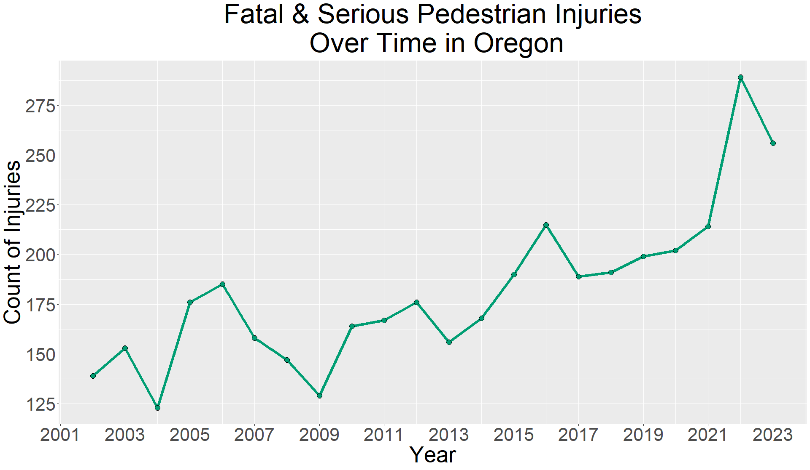
Pedestrian Injury In Context
Oregon
Pedestrian Injuries increasing overall (150 per year now 225 )
Increasing faster than motor vehicle injury
Pedestrian injuries up 45% in 20 years

Slide 7
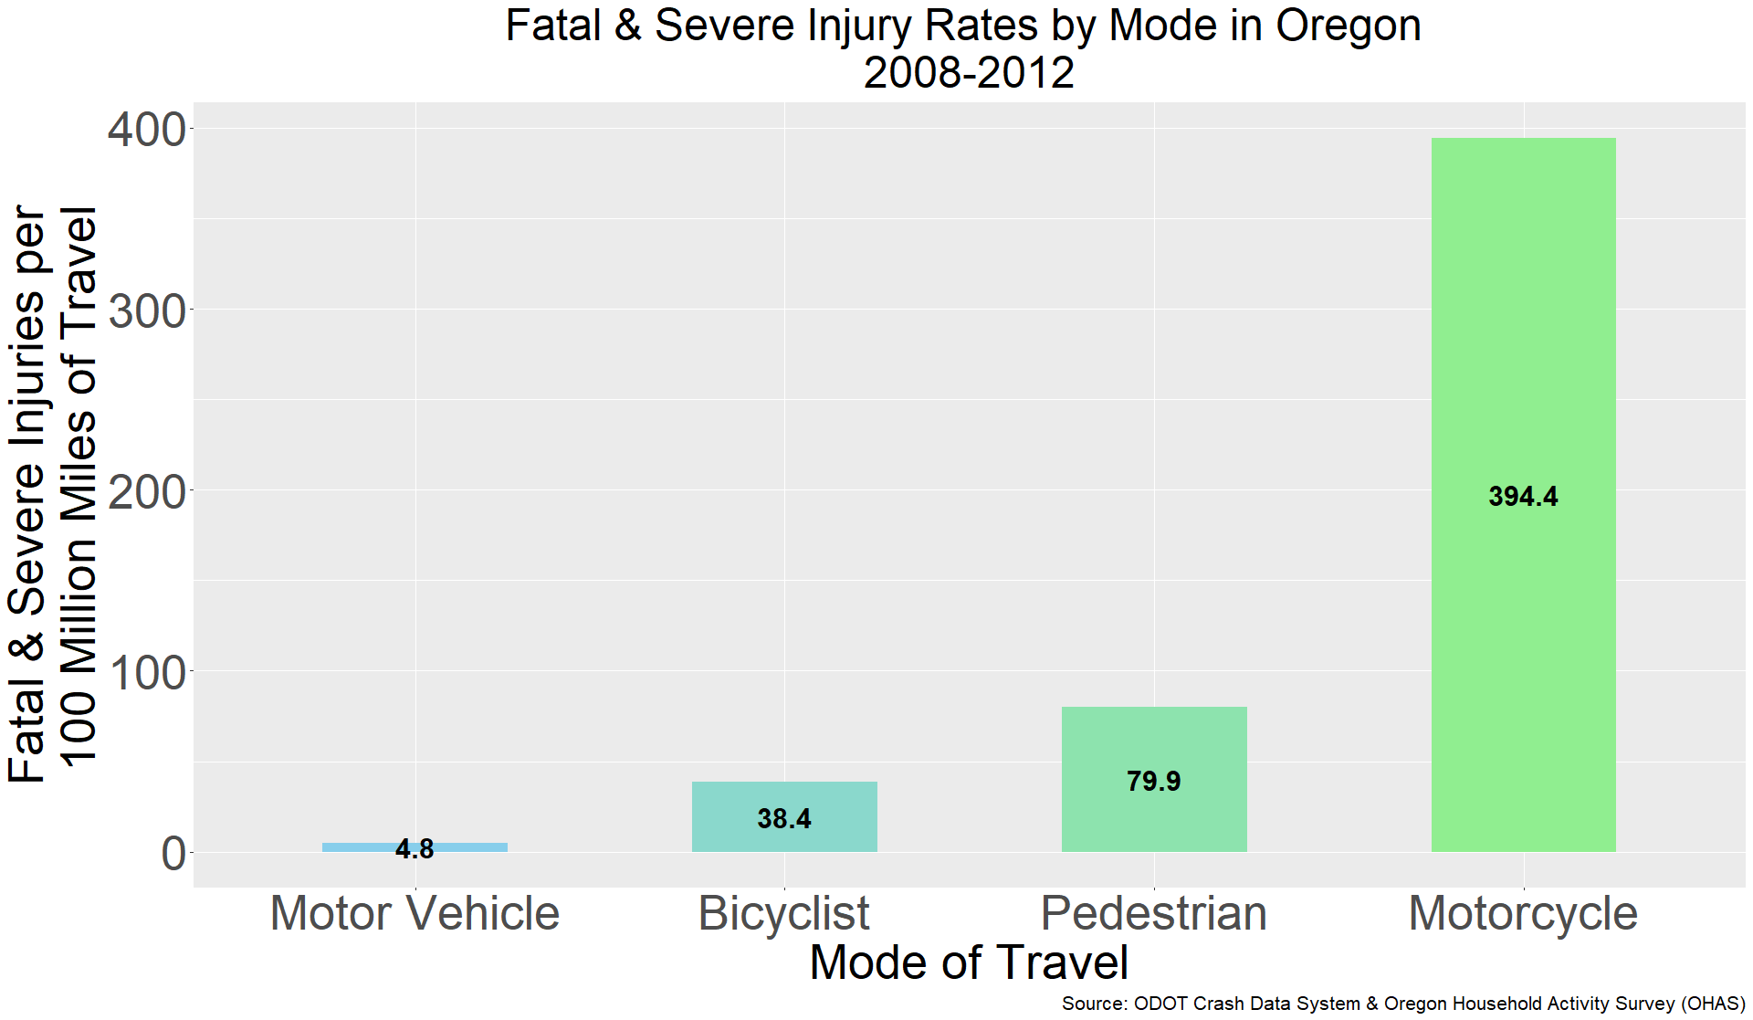
Why Injury Disparity by Mode of Travel?
Oregon
Pedestrians 30 times more at risk
Past Research
Studies in British Columbia, Wisconsin, and U.S. suggests pedestrians 1.5 to 12 times more at risk

Slide 8
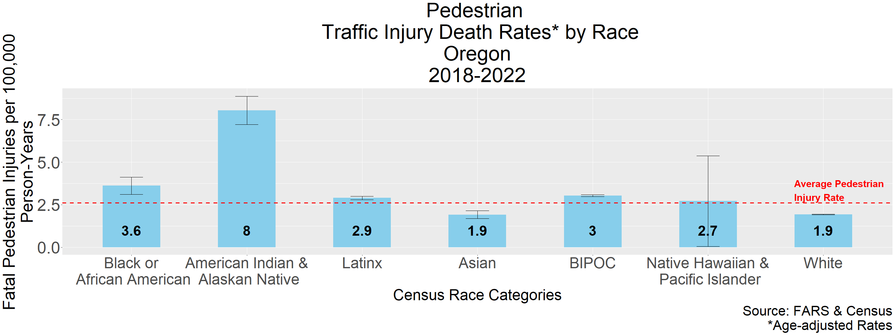
Pedestrian Injury Disparities by Race
Notes:
Use the systemic approach to help answer the question: Why are there disparities by race?
Explain chart….
- We find that BIPOC people tend to be lower income and more likely to walk and take transit and live in neighborhoods with more traffic.
NHPI removed from chart because of small numbers

Slide 9
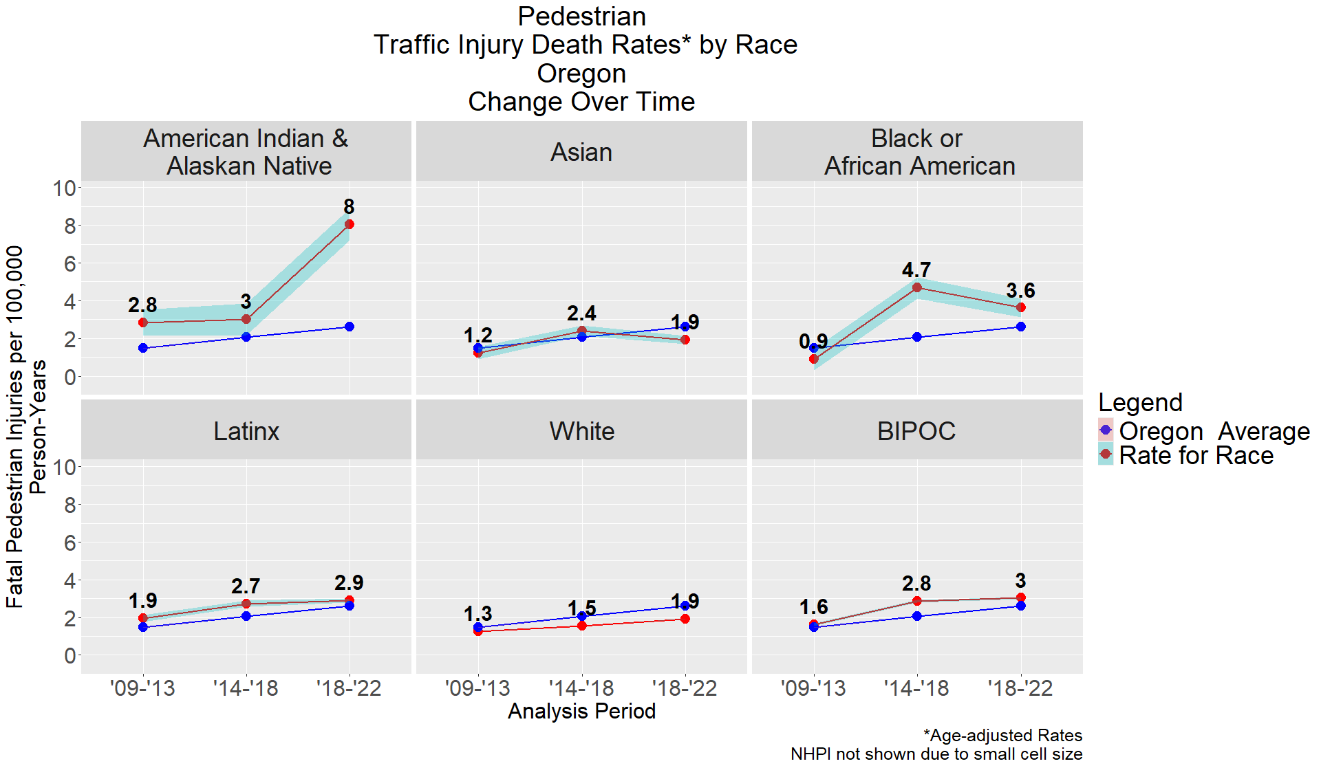
Pedestrian Injury Disparities by Race
Notes:
Use the systemic approach to help answer the question: Why are there disparities by race?
Explain chart….
- We find that BIPOC people tend to be lower income and more likely to walk and take transit and live in neighborhoods with more traffic.
NHPI removed from chart because of small numbers

Slide 10
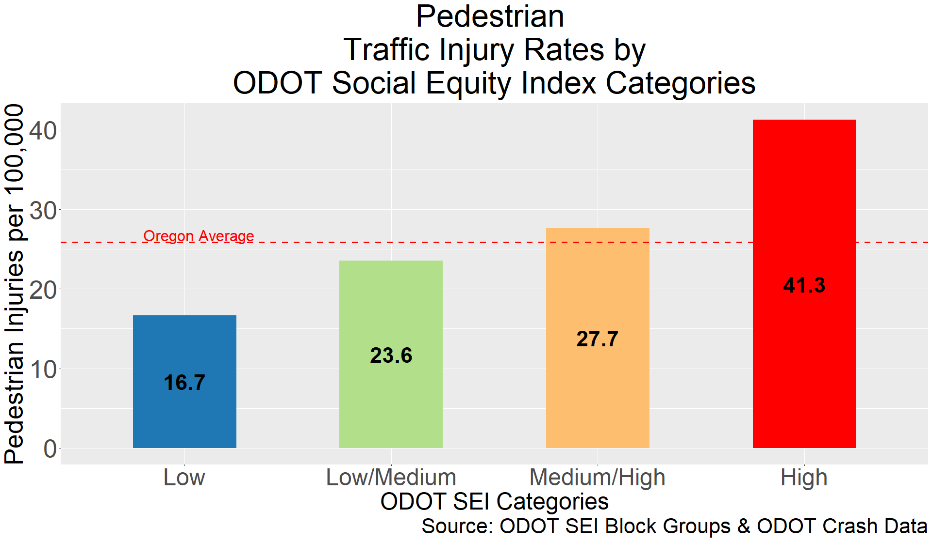
Pedestrian Injury Disparities ODOT SEI
870K Oregonians
21% of population
35% of fatal and severe pedestrian injuries
20% live in poverty
42% BIPOC
1.2 million Oregonians
29% of population
15% of fatal and severe pedestrian injuries
6% live in poverty
15% BIPOC
Notes:
Its not just about being BIPOC and its more about being poor.
We took another approach at assessing the ped injury disparity by looking at the count of ped injuries by census tract.
Tracts with more poor people and more people of color exhibited much higher rates of pedestrian injury
Explain chart
Arterial VMT concentration 3X higher than lowest tracts and nearly 2X the state average
Concentration of high speed roadways, 2X that of lowest level and 30% higher than state average
16% of people take transit, walk or bike in High tracts
6% of people take transit, walk or bike in low tracts

Slide 11
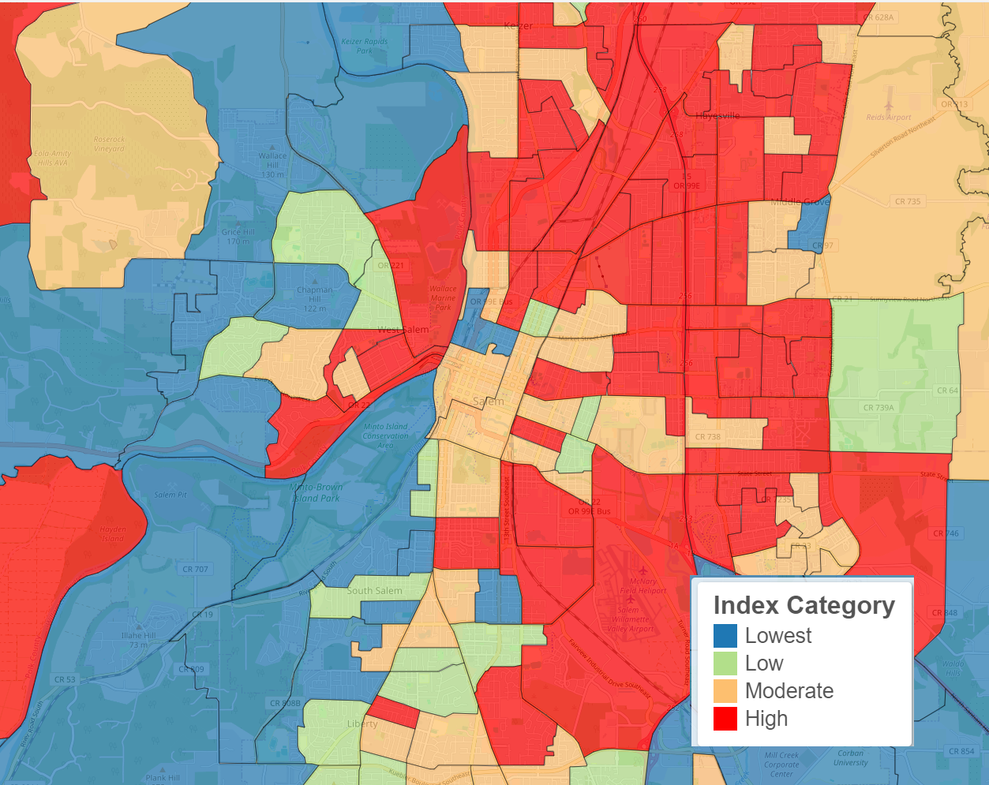
Map of ODOT SEI and Pedestrian Injury Rates
Salem-Keizer Urbanized Area
Notes:
Can see spatially how the categorization works – next slide for method details

Slide 12
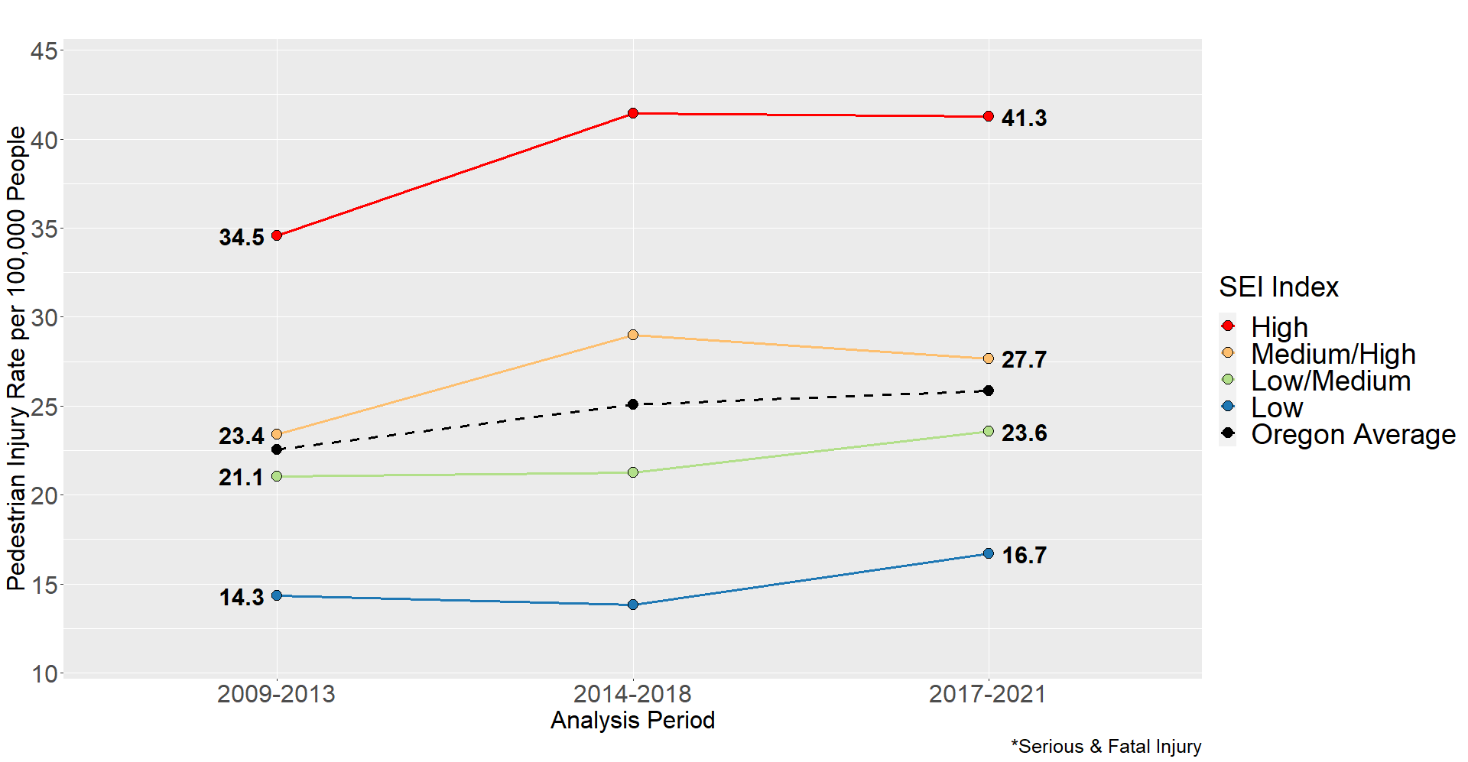
Pedestrian Injury Rates by SEI Over Time
Notes:
Can see spatially how the categorization works – next slide for method details

Slide 13
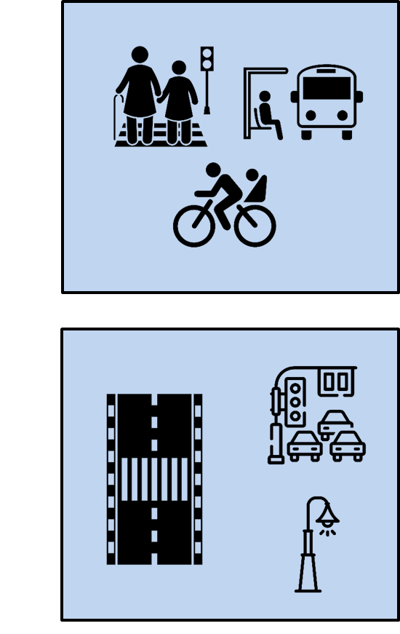
Pathways to Pedestrian Injury Disparity
Pathway 1: More walking and transit use in tracts with higher concentrations of low income people and Black, Indigenous, and People of Color
Pathway 2: A less hospitable environment for walking and taking transit in tracts with higher concentrations of low income people and Black, Indigenous, and People of Color
Notes:
More walking/transit
- People living at/below poverty walk 40% more miles per capita
Take transit and walk to work at higher rate
Less hospitable environment

Slide 14
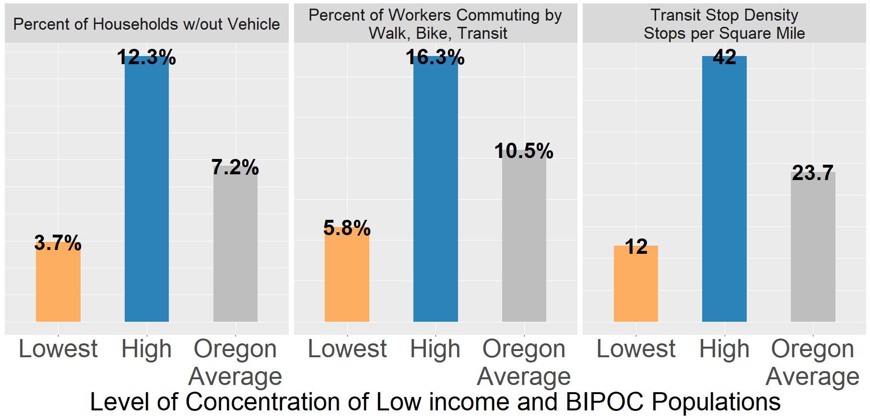


Pathway 1: More walking and transit use in tracts with higher concentrations of low income people and Black, Indigenous, and People of Color
Notes:
More walking/transit
- People living at/below poverty walk 40% more miles per capita
Take transit and walk to work at higher rate
Less hospitable environment

Slide 15



Pathway 2: A less hospitable environment for walking and taking transit in tracts with higher concentrations of low income people and Black, Indigenous, and People of Color
Oregon
Arterial vehicle volume in High Poverty & BIPOC tracts 68% higher than state average
Density of high speed roads in High poverty & BIPOC tracts 49% than state average
Past Research
89% of the streets in high-income areas had completed sidewalks while only 49% of streets had complete sidewalks in lower-income neighborhoods
75% of streets in high-income areas have street or sidewalk lighting compared to 54% in low income neighborhoods
13% of streets in high income areas have marked crosswalks whereas only 7% of streets had this feature in low income areas (Gibbs et al. 2012)
Notes:
More walking/transit
- People living at/below poverty walk 40% more miles per capita
Take transit and walk to work at higher rate
Less hospitable environment

Slide 16
Data and Methods
Data
Data from multiple source
No data source perfect
All data off the shelf
Some wrangling required
Notes:
Data
- Some contention about the very existence of disparities so important to look at this from multiple angles

Slide 17

Methods
FARS Rates
Simple
Easy to interpret
Employed an age-adjustment methodology common in public health
Z-Scoring Index
Simple
Easy to interpret
Used just two factors in index scoring
Statistical Analysis
More rigorous
Harder to interpret
Can be used to inform intervention strategy
Methods
Multiple ways to measure and assess
From simple to more sophisticated
https://github.com/JoshRoll/Pedestrian-Fatal_Injury_Rate
https://github.com/JoshRoll/Pedestrian-Injury-Disparity-Index-Analysis
Notes:
Methods
Multiple ways to measure and assess
From simple to more sophisticated

Slide 18

Recommendations for Data Practice
Roadway Data Collection
Implement a statewide database of pedestrian infrastructure (CFEC Multimodal Inventory may deliver this!)
Travel Activity Data Collection
Pedestrian traffic counts program
Travel activity survey should ensure proper representation of nonmotorized travel (lates Travel Survey may deliver this!)
Crash Data Elements
Follow Oregon Health Authority’s practice on REALD for severe injuries or link with Medicaid
Add vehicle details to vehicle crash record
Notes:
Roadway Data Collection
Multiple needs
Transportation Planning Rule update is going to require local agencies to report on bike ped projects and progress
LiDAR project aims to support this need
Travel Activity Data Collection
Multiple needs
AT selected a new KPM that will require these data
Travel survey should aim to represent average weekly travel, not average daily
Push button project aims to support this need
Crash Data Elements
Oregon Health Authority - REALD – Race, Ethnicity, Language and Disability
Add elements like weight, class, horsepower and design features to better understand vehicle characteristics and relationship to injury severity
Personal vehicle weight has increased by 26% between 1988 and 2018

Slide 19
Resources and Further Reading
ODOT Social Equity Index Documentation Page:
https://rpubs.com/ODOT_Research/ODOT_SEI_2023
TransGIS Web Map (see Planning & Climate Change Resilience):
https://gis.odot.state.or.us/transgis/
Work on Pedestrian Injury and Social Equity
Report Link:
https://www.oregon.gov/odot/Programs/ResearchDocuments/SPR%20841Injuries-Equity.pdf
Literature Review:
https://www.oregon.gov/ODOT/Programs/ResearchDocuments/SPR841LiteratureReview.pdf
Special Issue on Transportation & Environmental Racism:
https://www.sciencedirect.com/science/article/pii/S1361920922003856?via%3Dihub#bb0045
Portland State University Transportation Seminar Video:
https://trec.pdx.edu/events/professional-development/friday-transportation-seminar-topic-10292021
Other Analysis on Pedestrian Injury
Vehicle Design and Pedestrian Injury
https://rpubs.com/ODOT_Research/Pedestrian_Injury_Severity_Analysis

Slide 20

Questions
Questions?
Josh Roll Active and Sustainable Transportation Research Coordinator
Josh.F.Roll@odot.oregon.gov
Acknowledgments
Nathan McNeil
Research Associate
Portland State University
nmcneil@pdx.edu
Notes:
These photos are just examples. Please replace photos with your own.

