Slide 1
REALD and SOGI Demographic Data Equity in Practice
Notes:
KC
Good afternoon! Thank you for joining us for the first portion of this afternoon’s session on Data Analytics for Data Equity. I’m Kieran Chase, data equity research analyst on the REALD & SOGI team in OHA’s Equity & Inclusion division. I’m here with my colleague Marty, who serves as our sections SOGI Implementation Strategist.

Slide 2
Learning Objectives
Define REALD and SOGI
Describe
The equity impact of collecting detailed, inclusive demographic data
How data equity principles are operationalized in REALD & SOGI standards and implementation
Common concerns around collecting demographic data
Notes:
KC
Beginning with a brief overview of our plan for the next half hour,
We will begin by defining REALD & SOGI – if that’s a new acronym for you, I’m sure you’re not alone and you’re in the right place.
We will then take some time to describe the equity impact of collecting detailed, inclusive demographic data, we’ll spend some time discussing how the REALD & SOGI section operationalizes data equity principles while implementing demographic standards, and we’ll wrap up by discussing some common concerns that come up around collecting demographic data.

Slide 3
What is REALD and SOGI?
Notes:
KC
To begin, what exactly is REALD & SOGI?

Slide 4
REALD SOGI is a Set of Standards for Collecting and Reporting Demographic Data
Demographic data is used to define populations. Understanding social and health inequities requires that we have well-defined populations.
People and societies are complex, and demographic information is more useful when it reflects that complexity.
Communities brought forward legislation (HB 2134, HB 3159) to demand more inclusive, accurate demographic standards in Oregon.
Notes:
KC
REALD & SOGI is an acronym that stands for the components of a set of standards for collecting and reporting demographic data.
Once implementation is complete, REALD and SOGI data will be collected by all OHA programs and partners that collect demographic data, as well as by providers, insurers and CCOs.
Demographic data is used to define populations. Understanding social and health inequities requires that we have well-defined populations.
For example: it’s useful to know that rates of influenza vaccination are increasing. It’s more useful to know which groups of people are getting vaccinated at higher rates. Are rates increasing for everyone, or only for people within a specific age bracket? A certain racial/ethnic group? Women? Are there groups for whom vaccination rates are decreasing, but the overall increasing trend is masking their reality?
To answer questions like these, we need to collect people’s demographic information. But understanding who someone is (and how their identity informs their experiences and outcomes), is not simple.
People and societies are complex, and demographic information is more useful when it reflects that complexity.
Unfortunately, most historical efforts to collect demographic information has not reflected this complexity. And, more importantly, efforts to standardize data collection have tacked more toward simplicity than toward accuracy.

Slide 5
Enter: REALD & SOGI
Race
Ethnicity
(and)
Language
Disability
Sexual Orientation (or sexuality)
Gender Identity (or sex and gender)
Initial Standards adopted 2013
Updated 2020
Updated 2024
Draft Standards adopted during 2020-21 COVID-19 Pandemic Data Collection
Final Standards adopted 2024
REALD SOGI standards are subject to regular review and update via legislatively mandated Rulemaking.
Other demographic experiences (e.g., tribal affiliation) could be added in the future if proposed in legislation by community.
Notes:
KC
The letters in the acronym REALD stand for Race, ethnicity, language, and disability. Legislation mandating the creation of the REALD standards was brought forward in the early 2010s by community organizations seeking better data to represent their communities. Initial standards were set in 2013 and updated in 2020. In 2021, community organizations again brought forward legislation to amend the statute to include SOGI, which stands for sexual orientation and gender identity.
Because demographic experiences change over time, these standards are subject to regular update. The process of creating and updating standards involves considerable community engagement and feedback, which happens during rulemaking.
Obviously, these subjects – race, ethnicity, language, disability, sexual orientation, and gender identity – are not the only demographic experiences that shape people’s health and wellbeing. Other experiences may be added in the future, if communities bring forward legislation. You’ll be hearing more tomorrow about an initiative that engages with Oregon’s federally recognized tribal governments to include tribal affiliation information in these standards.

Slide 6
Community-Based Standards
REALD & SOGI standards were initiated by Oregon community organizations and developed in collaboration with diverse community partners, for the purpose of serving those communities.
Notes:
In terms of the process for establishing the REALD & SOGI standards themselves, community engagement and community leadership is the equity principle we focus on. The REALD & SOGI standards were initiated by Oregon community organizations and then were developed in collaboration with diverse community partners for the purpose of serving those communities.

Slide 7
Why collect demographic data?
Notes:
MA

Slide 8
Motivating Values: Why Collect Demographic Data?
We ask REALD and SOGI questions to...
Create safe, inclusive and welcoming environments
Recognize the diversity of the populations we serve
Support health and social equity efforts
Direct people to group-specific services and distribute resources
Shift social norms about and broaden our understanding of who is included and accepted in the populations we serve
Notes:
MA

Slide 9
Granular Data
OHA’s REALD and SOGI tool collects data that is much more granular (i.e., more specific identities represented) than most other standards
Granular data can always be aggregated or crossmapped to match less granular standards
The reverse is never true; can’t gain more detailed information from less detailed data
Aggregation and crossmapping is not always simple or straightforward; requires principled decision-making informed by community expertise and transparency about that decision making.
Notes:
MA
Because aggregation is possible, concerns about small numbers or small cell sizes during analytics should not be considered during data collection, or when creating data collection standards.

Slide 10
OHA’s REALD and SOGI Standards Data Equity Practices
Notes:
KC
So, having established some of our motivating values and commitments to collecting detailed, accurate data, we are going to jump into a discussion of how we operationalize data equity throughout these standards and their implementation.

Slide 11
REALD & SOGI Questionnaire Template
https://www.oregon.gov/oha/EI/REALD%20Documents/REALDSOGI_Survey.docx
Notes:
Kieran
First, here is a link to a printable template showing the complete standards – which you’ll receive in the materials from this presentation. I’m not going to spend time today outlining every question, but to give you a general sense – you can see the questionnaire is a few pages long, and includes questions about language, disability, race/ethnicity, and then sex, gender, sexual orientation.

Slide 12
Including Open-Ended Questions
How do you identify your race, ethnicity, tribal affiliation, country of origin, or ancestry? (Open Text Response)
Describe your gender in any way you prefer: (Open Text Response)
Describe your sexual orientation or sexual identity in any way you prefer: (Open Text Response)
If you identify as someone with a disability, or as having a physical, mental, emotional, cognitive, or intellectual condition, describe your disability or condition in any way you prefer: (Open Text Response)
Notes:
KC
The first item I want to draw your attention to is the use of open-text questions. One of the first pieces of feedback we received from communities is that, no matter how detailed and granular your demographic questions get, no matter how community-driven the process, there will always be people whose identities are not captured using a checkbox—this could be because their experience is wholly or partially absent from the list of checkboxes, or because the person does not believe in labels. So communities asked us to include space for individuals to write in responses and describe their identities using their own words.
The standards include these four questions, with space for written-in responses. [read the slide]
These questions appear in addition to the structured checkbox-style questions I’ll discuss on the next slide. Like all questions in REALD & SOGI, these open-text questions are optional and may be left blank.
Organizations serving the individual can use this data to better understand and provide services. During data processing for aggregation, we use this open-text data in a number of ways, for example, to help inform future changes to the standards by helping us identify experiences that are missing from the structured questions.

Slide 13
Structured Questions Granular, multi-select, community-informed
Which of the following describes your racial or ethnic identity? (Select all that apply from 72 options)
For adults:
What is your gender? (Select all that apply from 12 options)
What is your sexual orientation (Select all that apply from 10 options)
When providing information about language:
Electronic forms use ‘smart filtering’ to allow people to select from complete ISO list of 7000+ active, living languages
Using only a short list of common languages creates bias
Notes:
KC
In addition to open text, the standards include structured questions. While open-text questions create space for people to describe their experiences on their own terms, structured questions are necessary for defining populations and aggregating individuals into groups.
The structured questions in the REALD & SOGI standards are detailed. We ask “Which of the following describes your racial or ethnic identity” and provide 72 response options. That’s a lot of detailed information about race and ethnicity—more than people are often accustomed to seeing in such a questionnaire! This question is multi-select, meaning people are able to choose as many options as are relevant, and includes space for individuals to provide additional detail.
For individuals ages 12+ we ask “What is your gender” with 12 response options and “what is your sexual orientation” with 10 response options. Again, both questions allow individuals to select all that apply and include space to write-in other responses.
For all of these questions, the response options were deeply informed by community input and are intended to represent specific experiences, identities, and communities that are present here in Oregon.
The standards also ask people to indicate the languages they use at home and the languages they prefer for communication and written materials. During the process of establishing standards, it became clear that any effort to create a “short list” of languages to choose from would inevitably create bias and exclude people. The standards therefore include the full list of over 7,000 active, living languages identified by International Organization for Standardization, and electronic forms use ‘smart filtering’ technology to allow individuals to select the appropriate language or languages based on a few typed letters.

Slide 14
General Data Equity Practices in REALD & SOGI
Question ordering – language & disability first to identify access needs
All questions are optional and include response options: ‘Don’t know’ and ‘Don’t want to answer’. Some questions also include the option ‘Don’t know what this question is asking’.
Age-based skip logic is present throughout the survey to ensure that questions are age-appropriate.
Display logic and skip logic are used throughout to reduce survey fatigue & burden
Notes:
KC
Moving into general data equity practices deployed in the standards—
-The standards recommend ordering the questions with language and disability questions up front, because responses to these questions can help identify language or other access barriers that can be addressed so they don’t inhibit someone from answering the rest of the questions. This makes the survey more accessible.
-We understand that not every person is willing, able, or interested to provide demographic information. Every question in the REALD & SOGI standards is optional. Individuals can always select the response option ‘don’t know’ or ‘don’t want to answer’, and certain questions also include the option ‘don’t know what this question is asking.’
-There is considerable logic throughout the survey. Because certain questions are not age-appropriate for children, there is logic that skips or includes questions based on age. In addition, there are various pieces display and skip logic that helps to reduce fatigue for those filling out the survey.

Slide 15
Subject-Specific Data Equity Practices
Question about sex includes ‘intersex’ and ‘not listed’ options to capture underrepresented experiences
We ask about transgender status separately from asking about gender identity.
Ask a ‘primary race’ question to allow people with more than one racial or ethnic identity to choose whether to be represented using a primary racial identity or as ‘multiracial’ when data is aggregated.
Include questions about ‘disability’, ‘functional limitations’, and ‘accommodations’ to capture needs and experiences irrespective of personal identification with specific labels.
Notes:
MA

Slide 16
REALD and SOGI Community Grant
Grantees/partners will be community health organizations and community-based groups serving tribal communities, communities of color, LGBTQ+ people, people with disabilities, people who speak primary languages other than English and other underserved populations.
Receive training and funding to be able to provide culturally responsive/specific, trauma-informed trainings on the collection of REALD & SOGI data.
Notes:
MA

Slide 17
Community Workgroup
Comprised of 21 individuals with diverse identities and geographic locations in Oregon
Goals
To integrate communities’ perspectives into OHA decision making
Build community capacity to understand and utilize REALD &SOGI data
Support communities to promote data justice, equity, and community-responsiveness
Support sustainable practices in data validation in community to promote health equity
Notes:
MA

Slide 18
Common concerns with collecting demographic data
Notes:
KC

Slide 19
Privacy
Who can see an individual’s data? What control do individuals have over who sees their data? How is this different for minors vs. adults?
These concerns are relevant for all sensitive data and can be addressed through careful and intentional data privacy practices.
Notes:
KC

Slide 20
Autonomy, risk, and erasure
Though there are inherent risks in collecting any demographic data, not collecting it contributes to erasure
if we aren’t counting people and populations, we can’t know whether our systems are meeting their needs or causing harm to those people and populations.
When you ask demographic questions, you give a person the opportunity to choose how to answer. They may choose how or whether to participate in their own representation.​
Not collecting demographic data takes this choice away from individuals.
Notes:
KC

Slide 21
Backlash
Communities harmed by inequities may feel mistrustful of government.
People with certain belief systems may react with hostility when presented with certain demographic questions (e.g., about sexual orientation).
Equity work requires us to identify populations who experience inequities and center the experiences of those most harmed by these inequities.
Notes:
MA

Slide 22
Making meaning from demographic data
Notes:
MA

Slide 23
Using Data to Tell Stories
When analyzing data, important to keep meaning-making in mind
What questions are we trying to answer?
What stories are we using this data to tell about the people and populations who provided it?
Do these stories resonate with the communities they are about?
Are they strengths-based?
Do these stories reproduce stigma or perpetuate historical harm?
Notes:
MA

Slide 24
Thank you!
Marty Arrigotti, MPH
SOGI Implementation Strategist
Martin.A.Arrigotti@oha.oregon.gov
Kieran Chase, MPH
Data Equity and Analysis Research Analyst
Kieran.Chase2@oha.oregon.gov
REALD and SOGI Questions
OHAREALD.Questions@odhsoha.oregon.gov
bit.ly/oha-reald
OHA REALD and SOGI Website

Slide 25
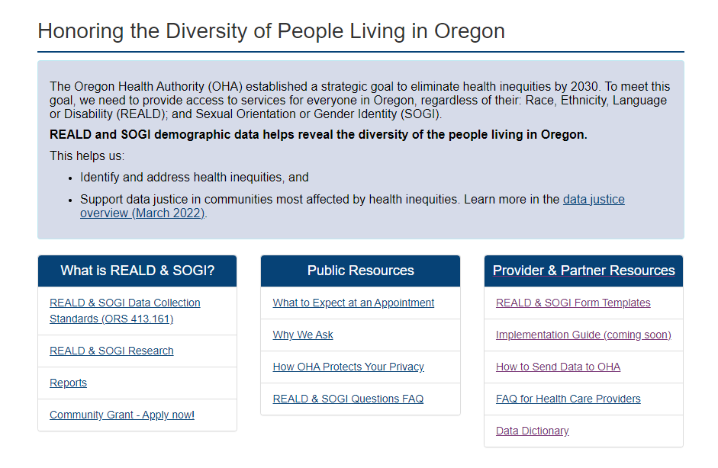
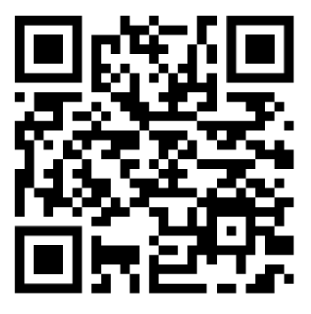
OHA REALD and SOGI website
OHA REALD and SOGI Website

