Slide 1
Building Capacity for Data Justice: Creation of ODE's Data Justice Stewards
Isabella Jacoby, Agency Director of Data Stewardship
Kathryn Torres, Program Analyst
Dan Farley, Assistant Superintendent of Research, Assessment, Data, Accountability, and Reporting
Notes:
Isabella
What are DJS?
More context - how did this come about? What happened, where did this start?

Slide 2
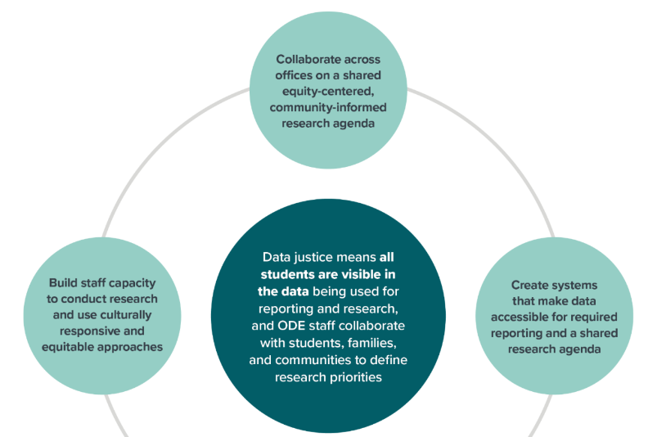
Origins
Notes:
Isabella
Longstanding agency commitment to educational equity
Need for greater collaborative data and research structures within the agency
Need for increased capacity to support a data justice strategy
External report identified some specific steps that were needed (excerpted above)

Slide 3
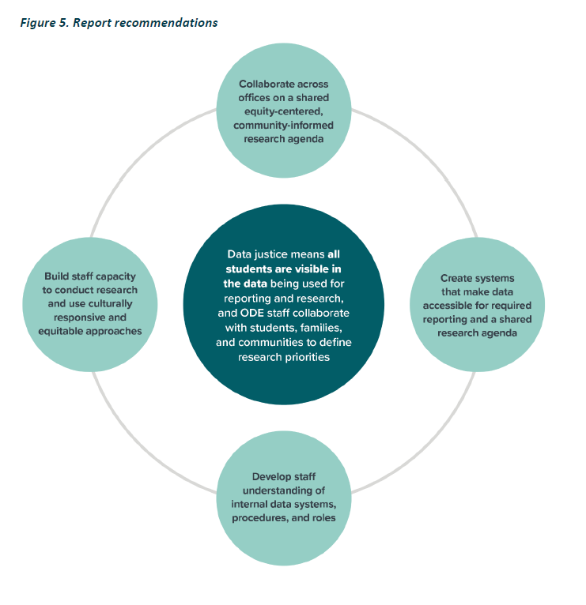
ODE Data & Research Architecture Project
Goal: Establish charters that design processes and procedures related to research requests, data activities, and implementation protocols to improve ODE’s data and research capacity to advance our equity goals and data justice strategy
Notes:
Isabella
The goal of developing an Agency-wide Data & Research Architecture is to establish charters that design processes and procedures related to research requests, data activities, and implementation protocols to improve ODE’s data and research capacity to advance equity goals and data justice strategy
Growth Areas:
ODE staff do not have sufficient access to ODE-validated aggregate data (tabular/graphic)
ODE does not have a long-term, agency-wide research agenda
ODE does not have an Institutional Review Board for external research projects (or internal, as needed)
ODE does not have a system to engage community members in data management decisions
ODE research is not coordinated
ODE researchers do not have a clear support system or way of connecting to validate decision making
Note - we do engage community members, but lack of a systematic method increases the overhead required to do so, increases the chances that faster-moving projects may not be engaged, and has the potential to oversample and overburden community members with existing relationships with ODE.

Slide 4

Why build a Data and Research Architecture?
State education agencies (SEAs) play a key role in prioritizing and advancing equity, and data can be one of the most powerful tools they have at their disposal (America’s Promise Alliance et al., 2017).
Data justice is central to ODE’s overall data strategy and education equity stance.
Data justice is “an approach that redresses ways of collecting and disseminating data that have invisibilized and harmed historically marginalized communities” (Coalition of Communities of Color).
Notes:
Isabella
“Data justice is an approach that
(1) Recognizes that mainstream/government data cannot sufficiently account for the needs, strengths, and desires of communities.
(2) Values diverse kinds of data (i.e., not only population-level quantitative data).
(3) Centers community-led ways of collecting, analyzing, storing, sharing, and using data as the most meaningful and impactful way for communities to be accurately represented and avoid erasure.
(4) Always views data to be in the service of catalyzing change and supporting community self-determination, rather than record-keeping and/or fulfilling agency-level requirements/agendas (e.g., compliance, funder guidelines, advancing programmatic initiatives, publicly reporting outcomes).”
In the spirit of collaboration and deference to community wisdom, we plan to ask our Data Justice Stewards to adopt an ODE definition of data justice as one of their first major roles.

Slide 5
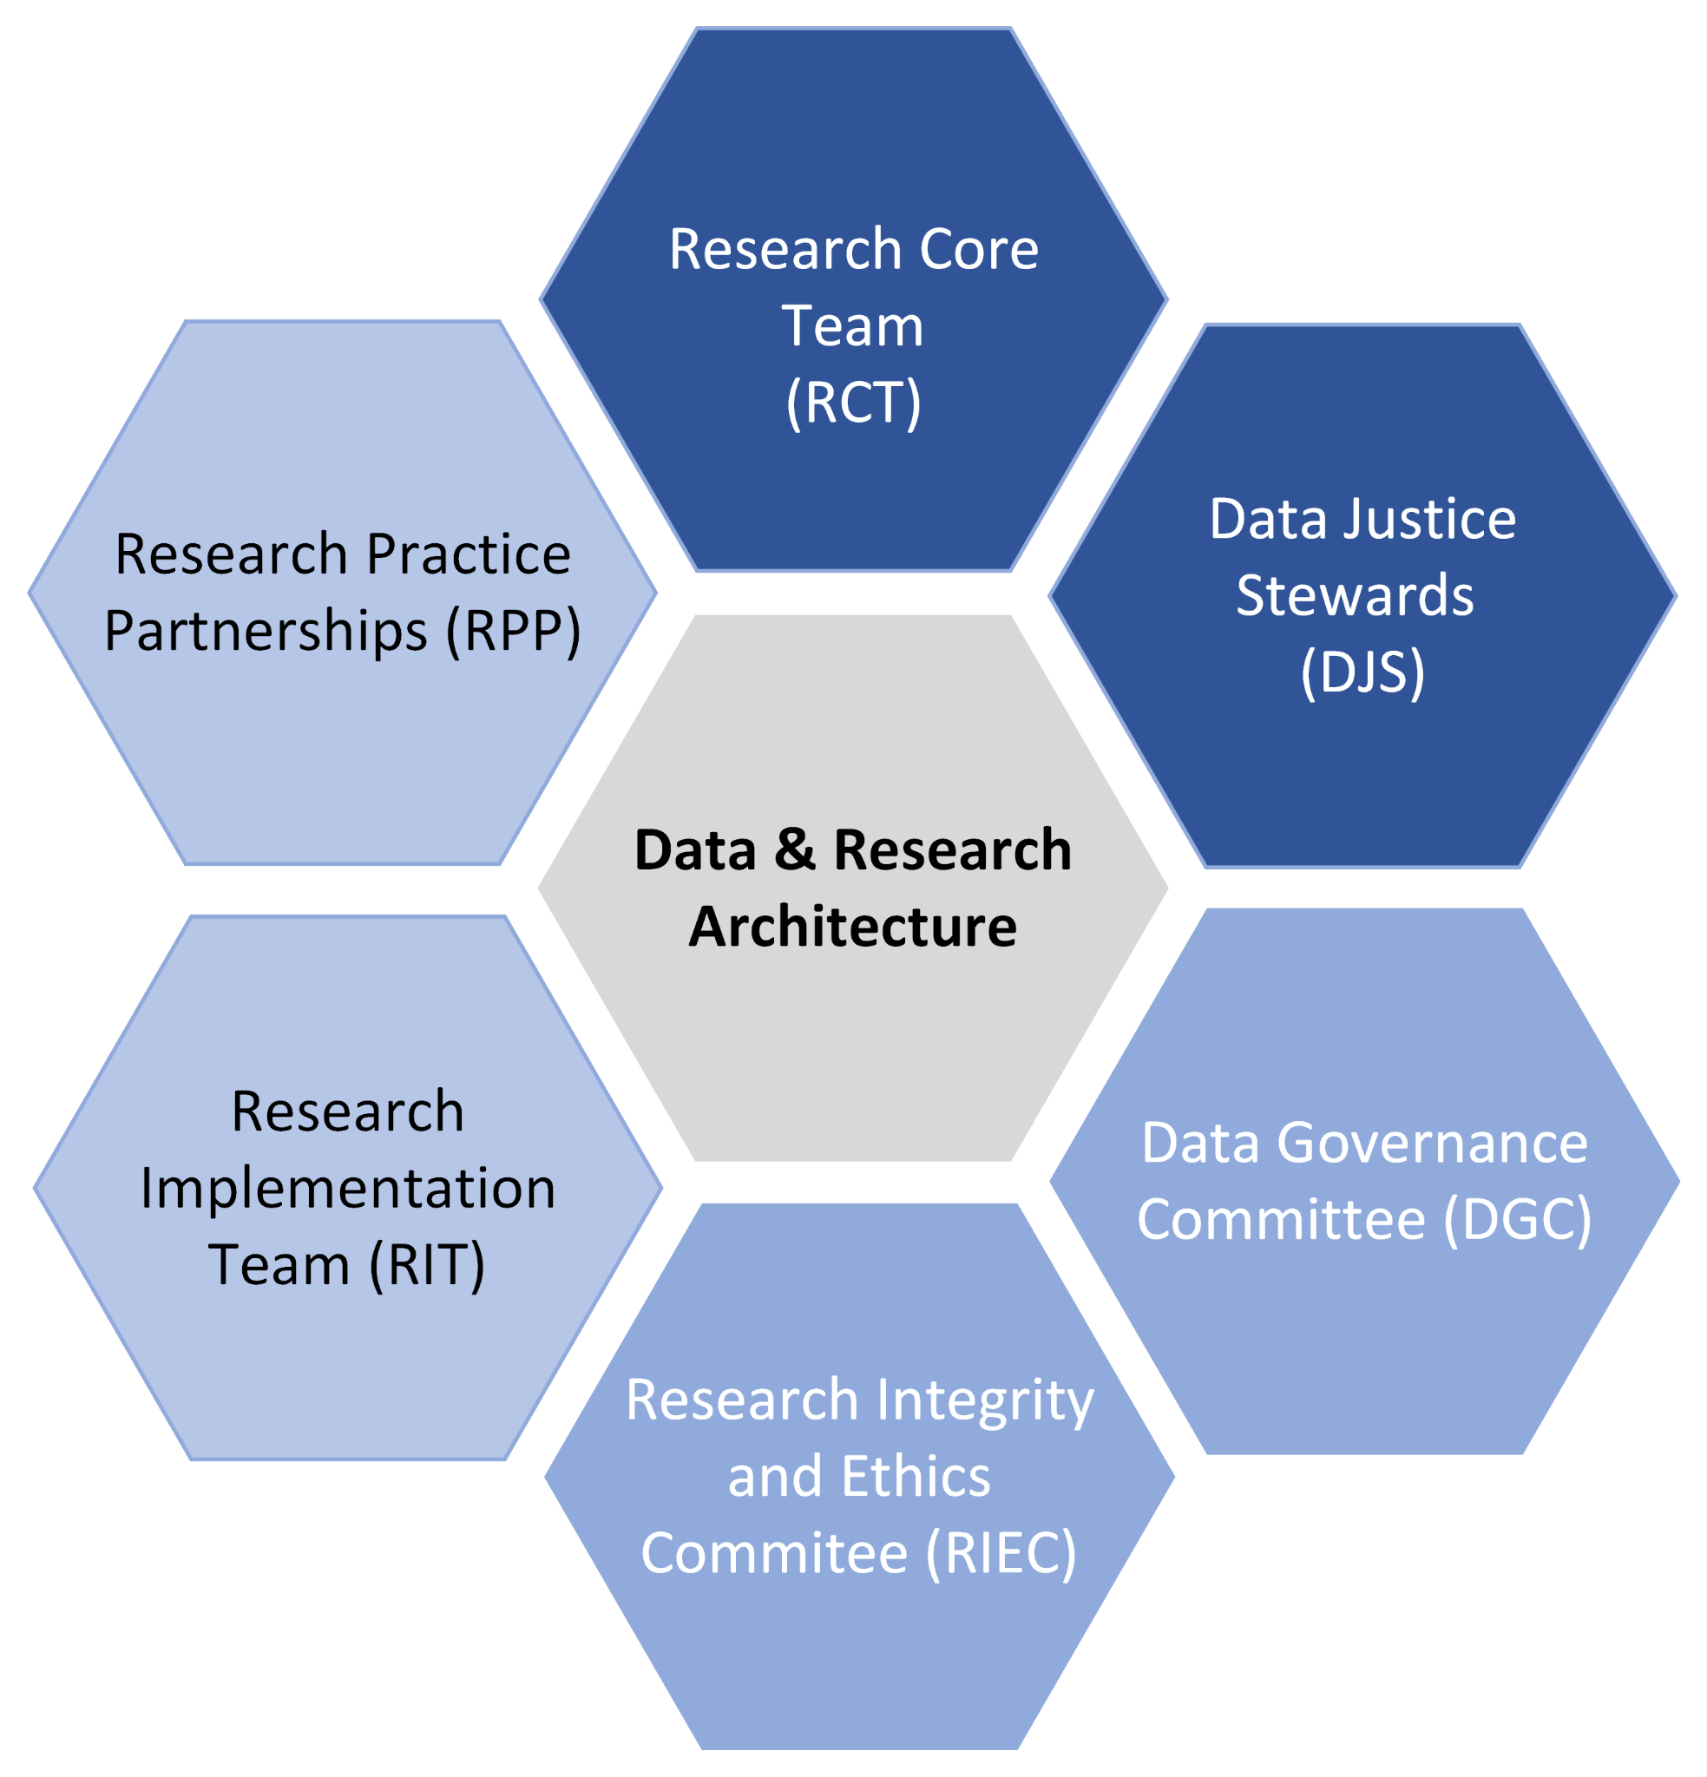
Data and Research Architecture
Notes:
Isabella
We came up with the design shown above, of which the Data Justice Stewards are one component. Other elements deal with internal collaboration, professional development opportunities, external data-sharing and partnerships, and agency data governance and agenda-setting.
We want the Data Justice Stewards to inform the shape of the other groups here, including informing what partnerships ODE enters into and what external research projects are supported with ODE data, so the final form of many elements here is pending their review (discussed later).

Slide 6
Key Tensions for Government Agencies
The context of state and federal requirements
Limitations of our ability to defer to community
Public records and record retention laws/rules
Statewide policies and stances
Notes:
Isabella
Limitations of an agency that exists in the context of state and federal requirements
Much of our base data collection and reporting work is driven by rules and laws, and we have limited ability to modify how that work is done
Ability/inability to defer to community recommendations in some circumstances
We have responsibilities to the legislature, to the state as a whole, and to the children we serve, that may supersede our ability to adopt community recommendations
Public records and record retention
Some data practices, such as allowing individuals to remove themselves from a dataset at any point, may run afoul of rules governing public records
We have to be cautious about what data we gather and hold, since public records law means that there
Authority to deviate from state policies and stances (e.g procurement, use of funds to compensate participants or buy food)

Slide 7
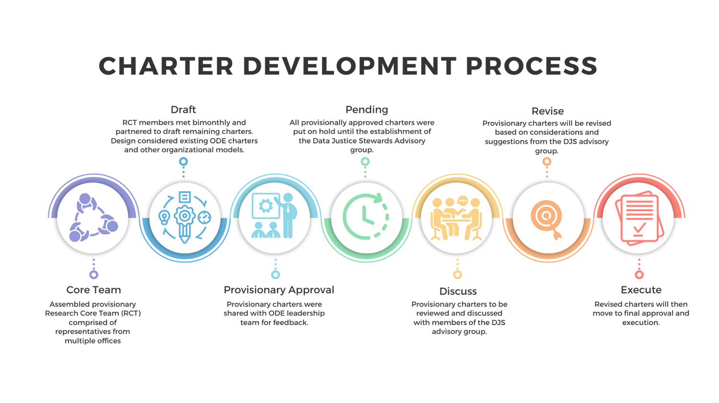
Charter development process
Phase I: Development | Summer/Winter 2023
Phase II: Internal Review | Spring 2024
Phase III: Preparation | Summer/Fall 2024
Phase IV: Final Review | Winter 2025
Notes:
Kat
– This processes started in the Summer of 2023, as an emerging side project based on the vision for a data and research architecture outlined by Dan Farley.
Charter development
RCT
Other charters
Agency leadership approval
Other charters pending DJS review
Communication strategies
Development Process
The first phase of charter development involved drafting the Research Core Team (RCT), Research Implementation Team (RIT), and Research Integrity and Ethics Committee (RIEC) charters, as well as, outlining key aspects and scope of work for Data Justice Stewards.
Following the successful development of these charters, work will begin on designing the Research Practice Partnership (RPP) charter and establishing alignment with the existing Data Governance Committee (DGC) charter. Following this initial drafting process, all charters will be reviewed by a selection of ODE staff and executive team members. Charters will receive provisional approval until they are reviewed and updated after feedback from the Data Justice Stewards. Dr. Williams has the authority to approve all charters.

Slide 8
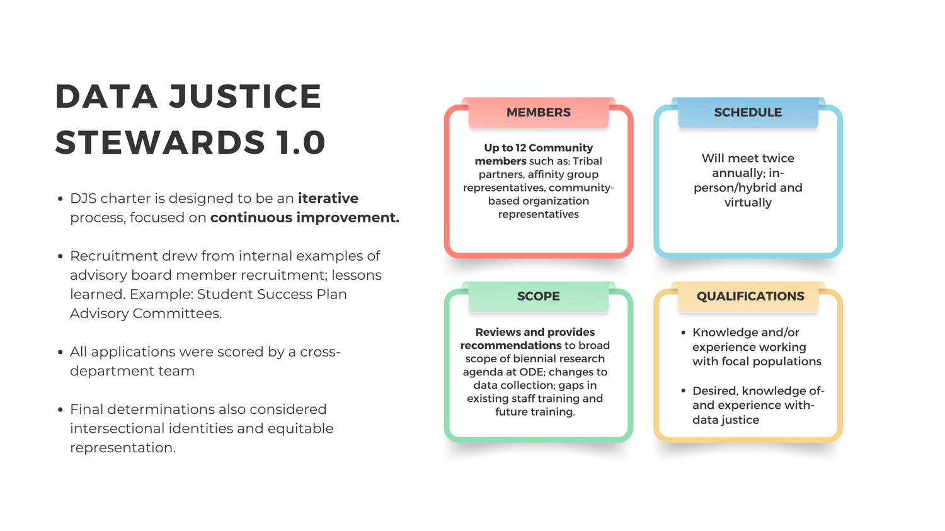
Data Justice Stewards 1.0
Notes:
Kat
DJS
Who/What are the Data Justice Stewards 1.0?
Emphasis on continuous improvement, iterative process
Purpose/SOW
How the limitations of governmental agency impact this work
Recruitment process
Key Areas:
Knowledge/exp working with focal populations
Desired, knowledge of- and experiences with- data justice
The advisory scope of the Data Justice Stewards does not include:​
Required federal or state reporting elements (where ODE does not have flexibility in design and inclusion decisions)​
Review of contracts, memorandums of understanding (MOUs), data sharing agreements (DSAs), intergovernmental agreements (IGAs), and other relevant agreements between agencies, vendors, and other parties​
Technical data architecture, including database design, cloud storage, etc.​
Internal data access protocols​
The operation of ODE-sponsored educational institutions, including ODE-sponsored charter schools, the Oregon School for the Deaf, and Youth Corrections/Juvenile Detention education programs​
State funding administration and allocation​
Access to non-publicly available data​
The Department seeks to form an Advisory Group of 12 members consisting of individuals residing in Oregon representing:​
A demonstrated commitment to racial equity, social and economic justice, diversity and inclusion;​
Personal and/or professional experience and knowledge in data justice, public policy, education policy, research or evaluation, algorithmic justice, and/or data;​
Prior experience or expertise in serving student focal groups; and​
Education and community partners, including parent, guardian, or caretaker of students in student focal groups; representatives of tribal governments and community-based organizations​

Slide 9
Data & Research Architecture Development Phases
Summer – Winter 2023
Spring 2024
Summer – Fall 2024
Winter 2024/25
Phase I : Development
Phase III: Preparation
Phase IV: External Review
Phase II: Internal Review
Data Justice Stewards are recruited and onboarded.
Data Governance Committee charter is revised.
Research Practice Partnership charter is drafted.
Provisional Research Core Team (RCT) is assembled
Data & Research Architecture Charters are identified and drafted by RCT.
Draft charters are reviewed by ODE staff and members of the E-team.
Charters are revised, sent for approval to Director of ODE.
Data Justice Stewards provide feedback on charters, overall architecture.
Charters are revised and finalized.
Notes:
Kat
Development Process
The first phase of charter development involved drafting the Research Core Team (RCT), Research Implementation Team (RIT), and Research Integrity and Ethics Committee (RIEC) charters, as well as, outlining key aspects and scope of work for Data Justice Stewards.
Following the successful development of these charters, work will begin on designing the Research Practice Partnership (RPP) charter and establishing alignment with the existing Data Governance Committee (DGC) charter. Following this initial drafting process, all charters will be reviewed by a selection of ODE staff and executive team members. Charters will receive provisional approval until they are reviewed and updated after feedback from the Data Justice Stewards. Dr. Williams has the authority to approve all charters.
Questions about this timeline and development process?

Slide 10

Lessons Learned from Recruitment
Be specific about the audience for the committee.
Draw from other advisory panel recruitment processes.
Allow more time for tribally-affiliated representatives.
Provide flexible application options (e.g., multiple modalities).
Flexible identification of race/ethnicity and other group membership.
Adjust timelines as needed!
Notes:
Kat
Lessons learned for DJS Recruitment
Be specific about the audience for the committee
Draw from other advisory panel recruitments
Allow more time for tribal representatives (takes longer to get permission from tribe)
Provide flexible application options (e.g. not just forms)
Flexible identification of R/E and other group membership

Slide 11

Next Steps: Kick-off Meeting
Guiding questions:
How can we be good partners in this work?
How can we not perpetuate inequities?
What are some key design considerations for process and facilitation?
Notes:
Kat
Design considerations
Meaningful engagement (spectrum of community engagement)
Inclusive data practices
Open meetings law
External (neutral facilitator)? Probably not going this direction
Accessibility of data (e.g., range data literacy)
Reach of DJS authority
Scoping data justice work and definitions

Slide 12
Recommendations for Others Engaged in this Work
Get Started
Invest the time, but don’t get stuck on perfection
Iterate and improve
Cast a wide net
Get agency leadership on board
Work towards dedicated staff and investments
Notes:
Isabella
Get started in whatever way you can. Use the momentum from initiatives, data justice “side projects” to find ways to build capacity in formal and informal ways (e.g., building a community of practice around data justice ideas, practices; attending data justice webinars and discussing as a team; etc.)
Invest the time up front to get clear on the scope of responsibilities, but don’t let a desire for perfection prevent the work from moving forward
Don’t remake the wheel - see what other state and federal agencies have done in these areas to get good ideas, spark innovation.
Clear about reach of authority
Not too set in stone
Iterate and improve over time
Plan for continuous improvement and flexibility.
Don’t be afraid to share drafts with your colleagues to get feedback.
Cast a wide net for recruitment and plan accordingly
Start with the end in mind - Consider multiple pathways and processes for recruitment.
Get agency leadership buy in and support - avoid duplicate efforts, make sure everyone
Work towards dedicated staff working on these efforts - make intentional investments in data equity. Have to start somewhere and build momentum to get dedicated funding and staff in the future.

Slide 13
Questions
Email ode.datajusticestewards@ode.oregon.gov

