Slide 1
OHA & HPA Data Equity Work
Ritu Dhungana; Jo Johnson

Slide 2

Shared Language
REALD: Race Ethnicity Language and Disability
SOGI: Sexual Orientation and Gender Identity
OHA: Oregon Health Authority
E&I: Equity and Inclusion Division
HPA: Health Policy and Analytics

Slide 3

Todays Agenda
1
Introductions
Data Equity Learning Collaboratives
HPA Data Equity Team
Wrap-up & Closing
2
3
4

Slide 4
Data Equity Learning Collaborative Context
Community Consultation
Consulted with Coalition of Communities of color
Understand the role of government in supporting data justice efforts
Learnings
Government does not do data justice
Government creates conditions for communities to do data justice
There is lot of work that needs to happen at an institutional level around building capacity to do data equity

Slide 5

OHA Data Equity Learning Collaborative
An effort to train, build capacity, and
network HPA employees who interact
with data.
A space for peers who are passionate about equity and interact with data to come together to study, learn,
explore with curiosity and engage
with the principles and application of data equity.

Slide 6
REALD & SOGI Data Equity Learning Collaborative: Objectives
Develop
Develop understanding of data equity principles and build the capacity of OHA-ODHS staff to practice data equity.
Instill
Instill the value of centering the community in data practices and build capacity of OHA-ODHS staff to identify how internal practices impact community wellbeing.
Foster
Foster internal partnerships and knowledge-sharing to promote a data equity-centered approach.
Inspire
Inspire participants to act individually and collectively as proactive change agents to address significant challenges and barriers to achieving optimal health.

Slide 7
Who should participate?
Encouraged members to join in groups of four people
Recommended including at least one member who is a manager or a person in leadership position
Encouraged folks who worked together regularly to participate as a group so they can advance data equity principles together
Encouraged participants to be curious about data equity.
Participants were expected to be able to fulfill the time commitment
Participants should be well-positioned to further data equity practices in their work areas and dedicated to the work it takes to learn and advance data equity principles.

Slide 8
Time Commitment
Attending learning sessions (1 hour every 2 weeks)
Preparing for learning sessions (2-3 hours per week for 9 months)
Presenting Project Commitment
Group (Squad) check-ins with the Data Equity Policy Advisor (1 hour every 3 months)
Post-series Community of Practice meetings

Slide 9
Cohort Presentation Objectives
Document and present the journey from Day 1 to the end of this program
Document and present The learnings
Present how SQUAD plan to implement the learnings in Their program/unit/ division with intent and commitment
Present how will the SQUAD keep themselves accountable to the presented intent and commitment

Slide 10
Accountability Plan
Every month the squad will do
A check in with other members of the squad
Discuss what is needed to build the intent and commitment presented in the learning collaborative
Every 3 months the squad will do
A check in with REALD & SOGI staff with an update on their learning implementation.
Submit the update in writing to the cohort

Slide 11
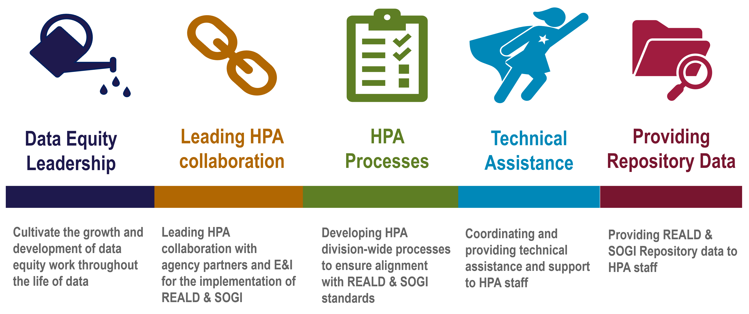
HPA Data Equity Team: What we do…
Notes:
1.) Team of 3 plus a manager;
2.) Funded by the Data Justice Act; HB 3159 with a collaboration of OHA’s E&I division and HPA’s Office of Health Information Technology and analytic infrastructure started in November 2022; just hit our 2 year mark.
3.) we have 5 main roles listed in our charter: Data Equity Leadership, HPA collaboration across the Agency; HPA processes to ensure we are in alignment with REALD & SOGI practices led by E&I; Provide TA on REALD & SOGI implementation for the division; coordinate HPA TA requests with E&I REALD & SOGI section and on other data equity TA questions; we will hopefully be able to in the future fllfill HPA data requests from the REALD & SOGI Repository held by E&I, currently we are facilitating the requests from HPA staff to E&I staff re the repositroy

Slide 12
HPA Data Equity Environmental Scan Pilot
Step1: Survey to HA & OHITAI
Step 2: Focus Groups with HA & OHITAI teams, individuals
Step 3: Interviews with Individual analysts
Analyze data; develop tools; trainings etc. Roll out to HPA programs
July
September- November
December
2024 onward
Notes:
This is an exciting project. We are working on a report right now for the survey we fielded in July.

Slide 13

Other HPA Data Equity Team Activities
Health Policy & Analytics Data Equity Learning Collaborative (DELC)
With Medicaid Partnership bringing in We All Count Primer & Foundations of Data Equity Training

Slide 14
Thank you
You can get this document in other languages, large print, braille or a format you prefer free of charge. Contact Jo Johnson at HPA.REALDSOGI@odhsoha.oregon.gov
Health Policy and Analytics
Data Equity Program
500 Summer St.
Salem, OR 97301
HPA.REALDSOGI@odhsoha.oregon.gov
HPA Data Equity Program

Slide 15
Data Equity and REALD & SOGI Resources:
E&I REALD & SOGI Website
Data Justice
HPA Data Equity OWL Page
Notes:
Show during closing?

Slide 16
HPA Data Equity Learning Collaborative
Curriculum & Structure
Text book: Data Feminism
Meet for 13 virtual sessions- October- May
Students meet in Squads of 4 or 5
Each squad is responsible for a capstone project and 5 minute presentation

