Slide 1
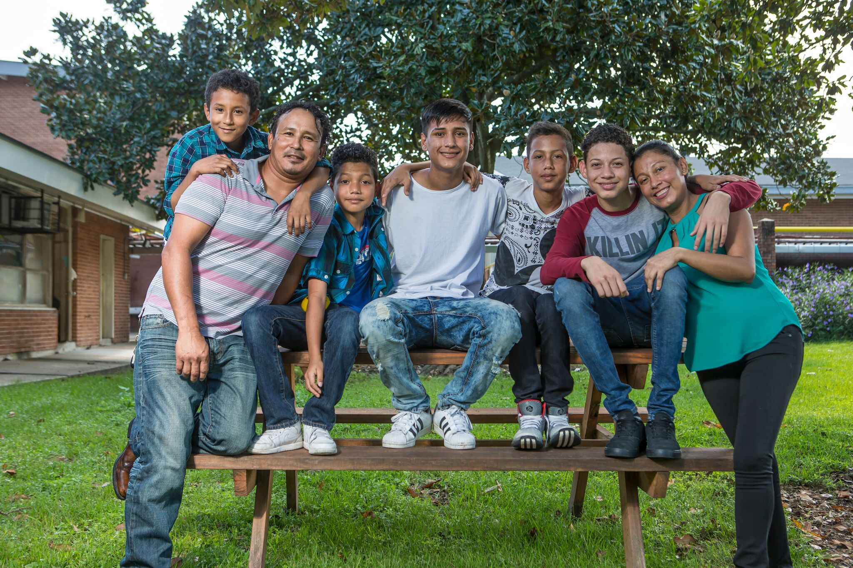


Building Data Equity Capacity with REALD and SOGI Learning Labs
Dr. Matt Friesen
REALD & SOGI Data Equity Manager
Office of Equity and Multicultural Services
Oregon Department of Human Services

Slide 2
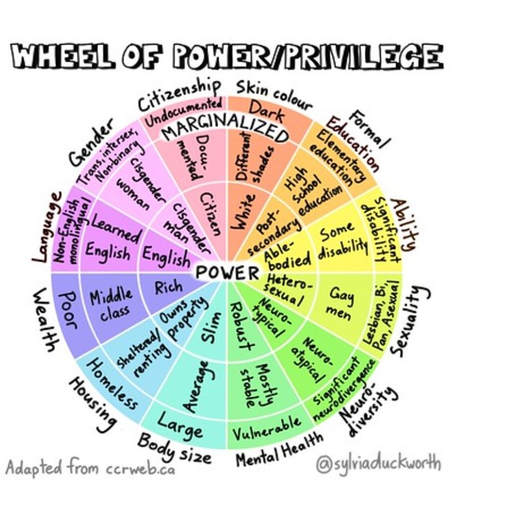
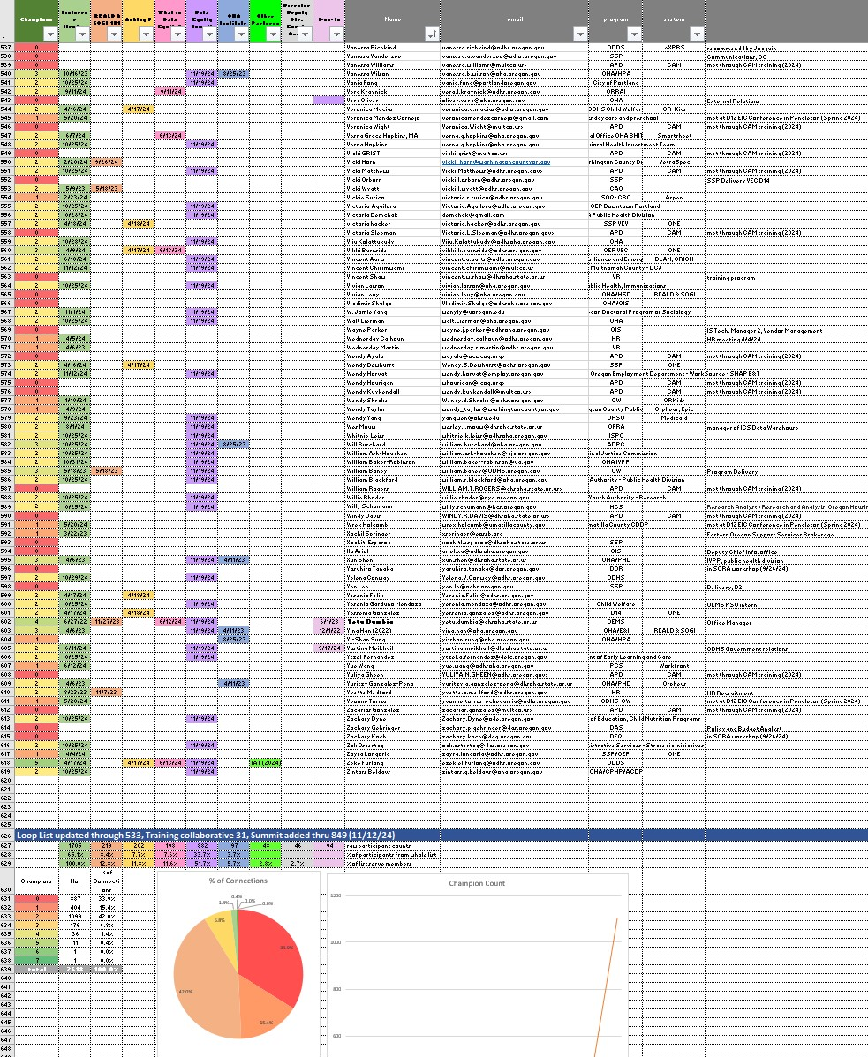
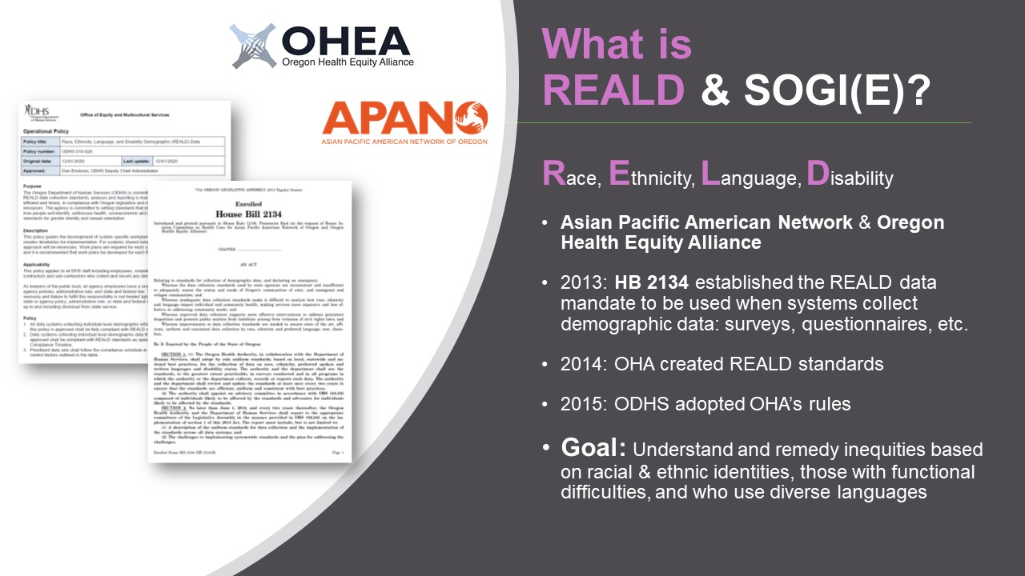
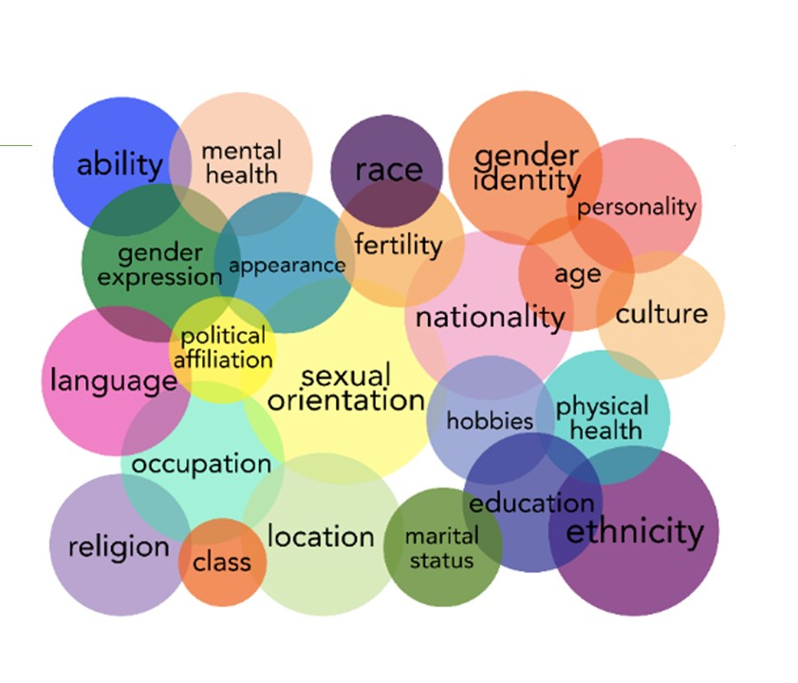
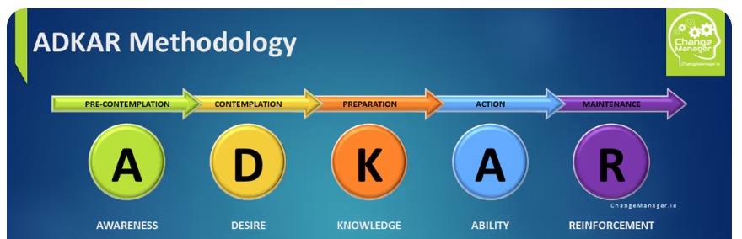
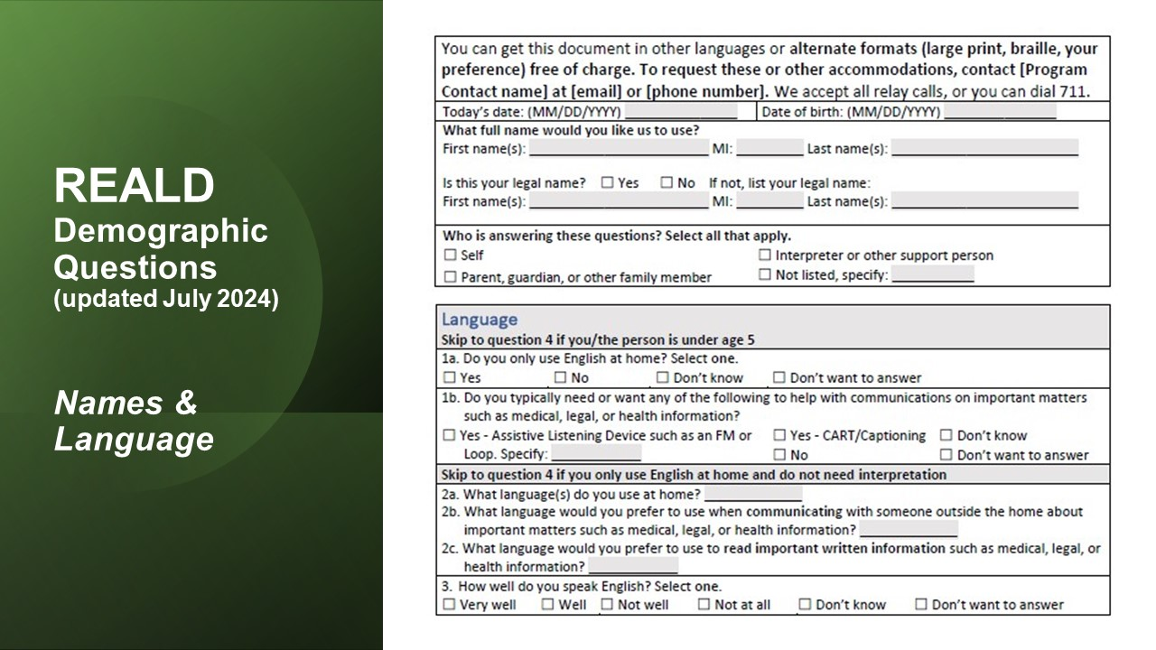
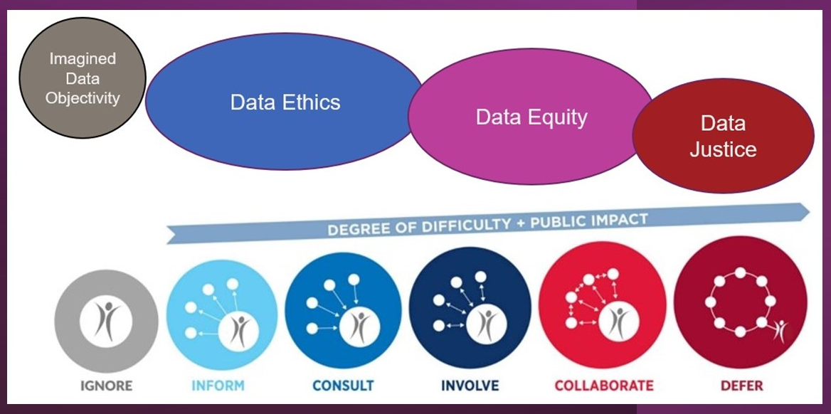
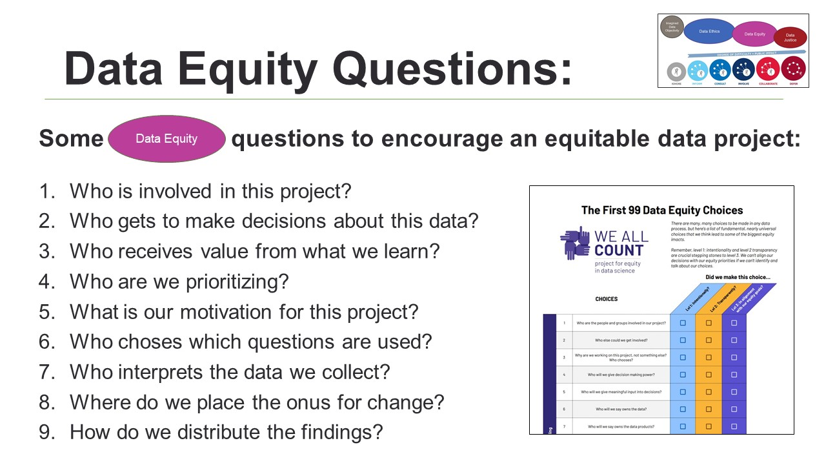
Using Learning Labs to Build REALD & SOGI Capacity in ODHS
Learning Labs
REALD & SOGI 101
What is Data Equity
How to ASK REALD & SOGI Questions
Change Management, Communication, Coalitions, Institution Building and more…

Slide 3
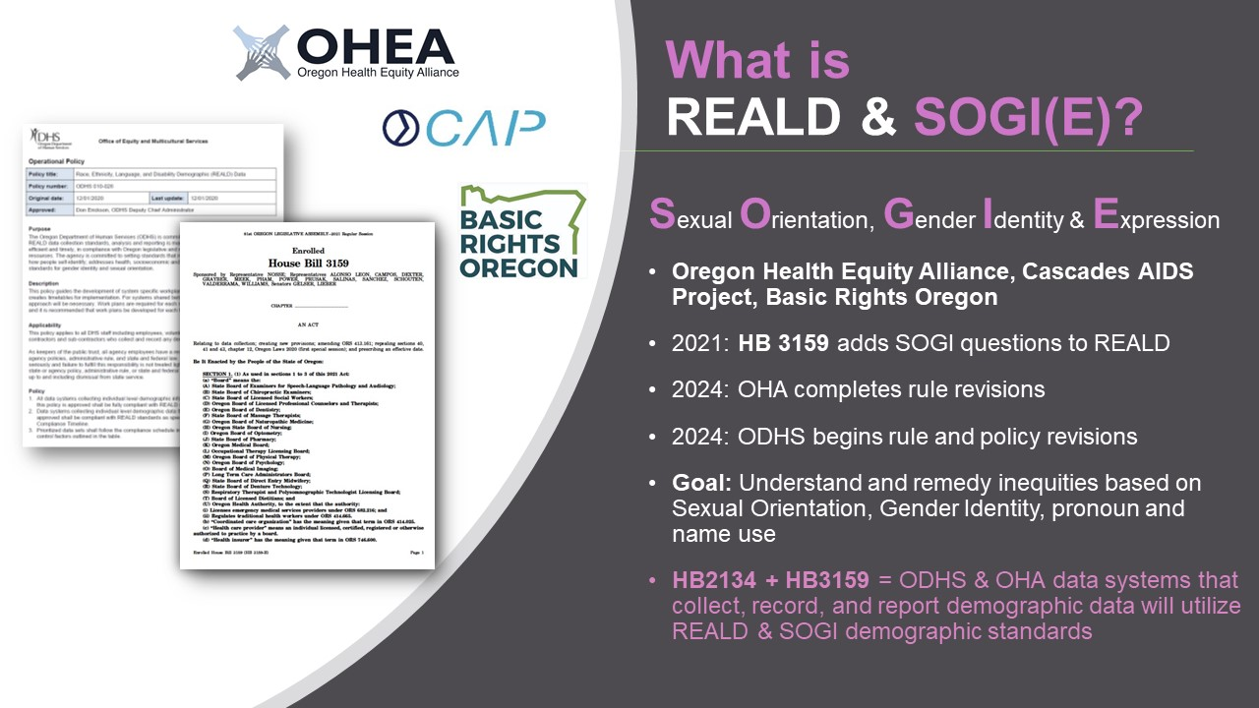
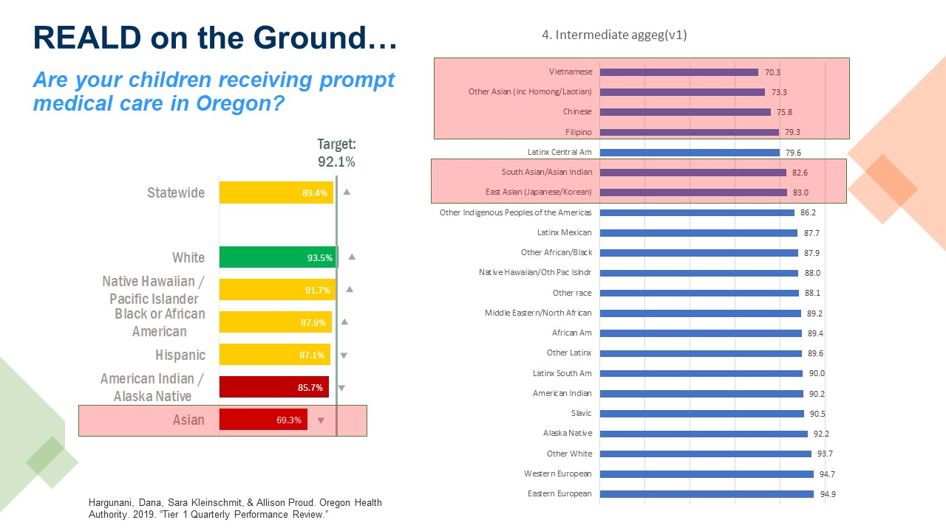
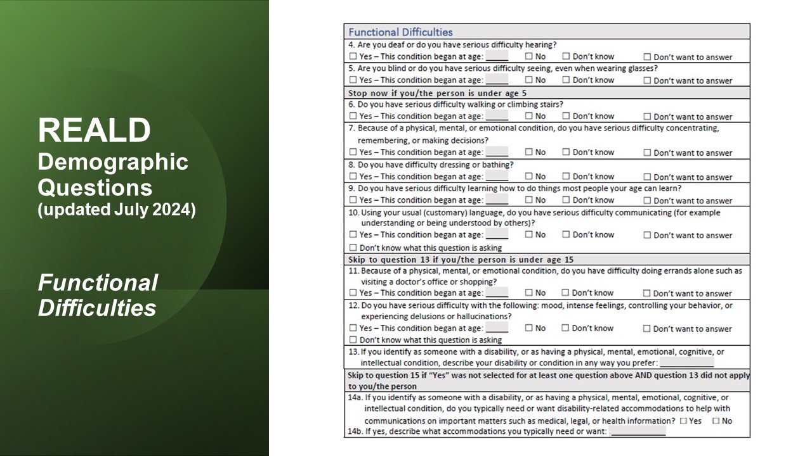
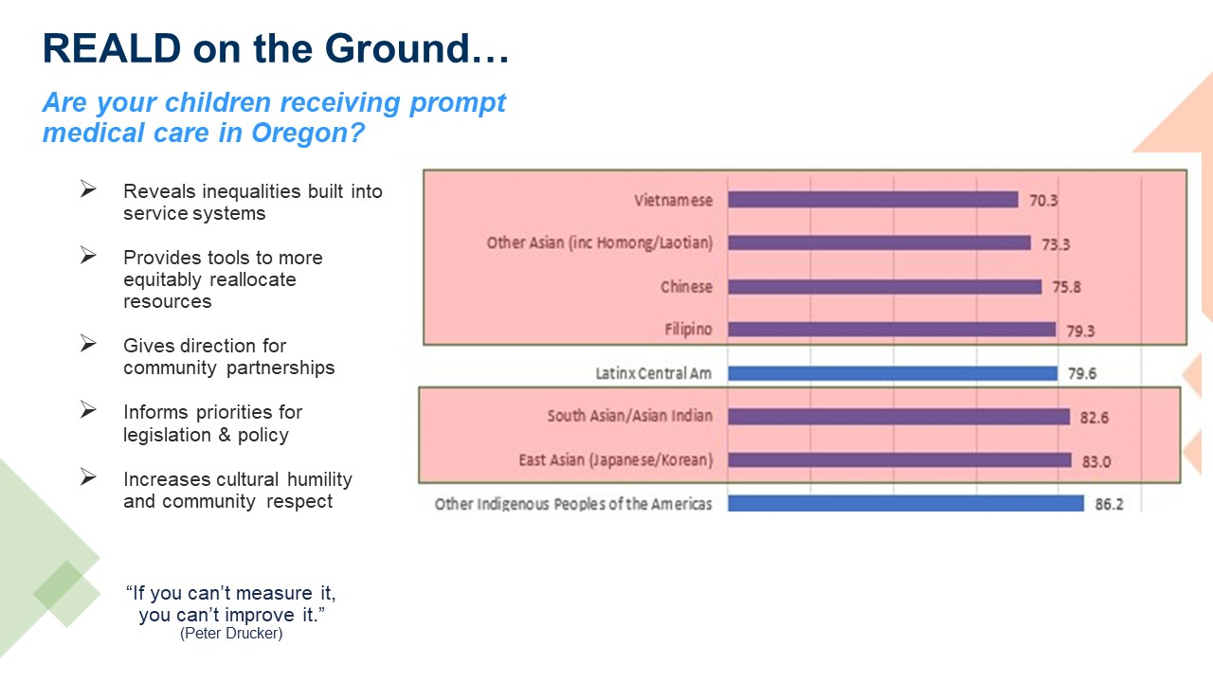
Using Learning Labs to Build REALD & SOGI Capacity in ODHS Learning Labs
REALD & SOGI 101
What is Data Equity
How to ASK REALD & SOGI Questions

Slide 4
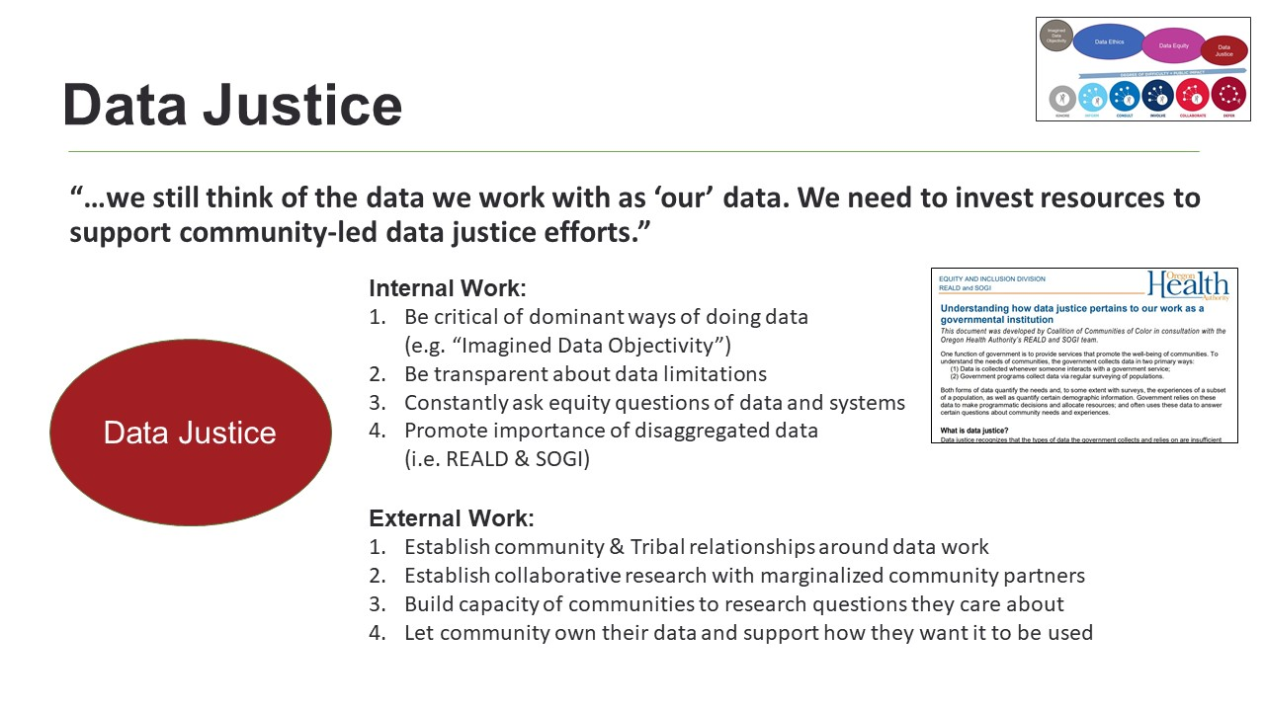
Using Learning Labs to Build REALD & SOGI Capacity in ODHS Learning Labs
REALD & SOGI 101
What is Data Equity
How to ASK REALD & SOGI Questions

Slide 5
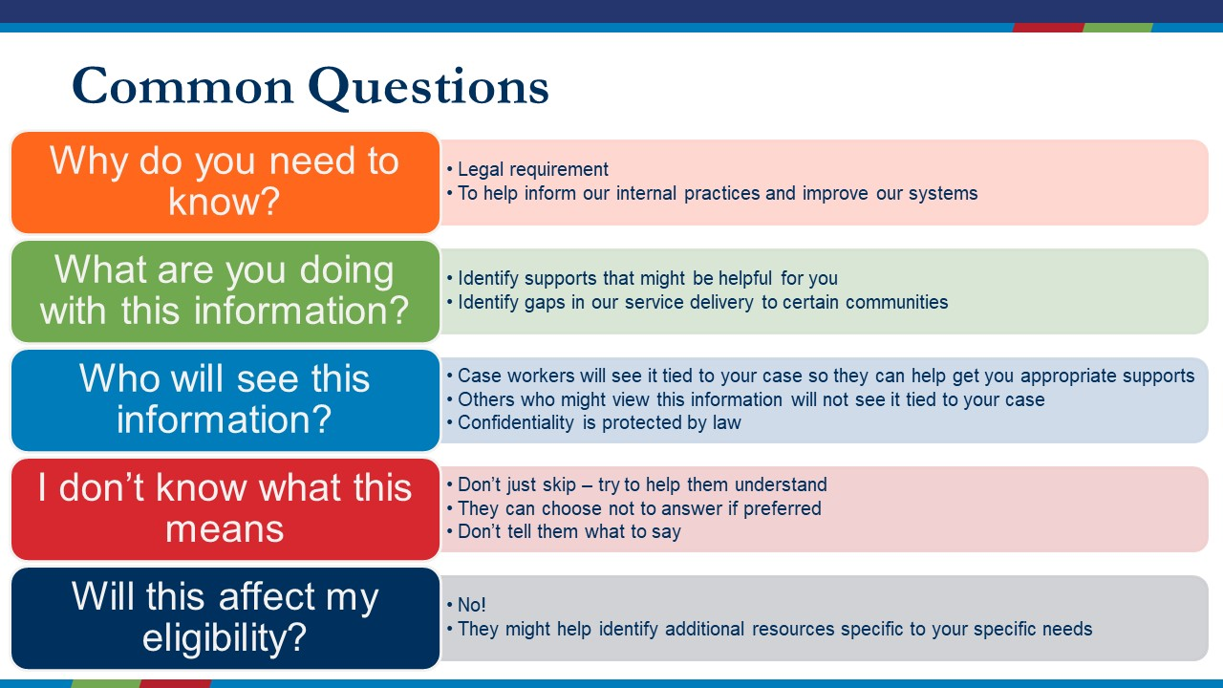
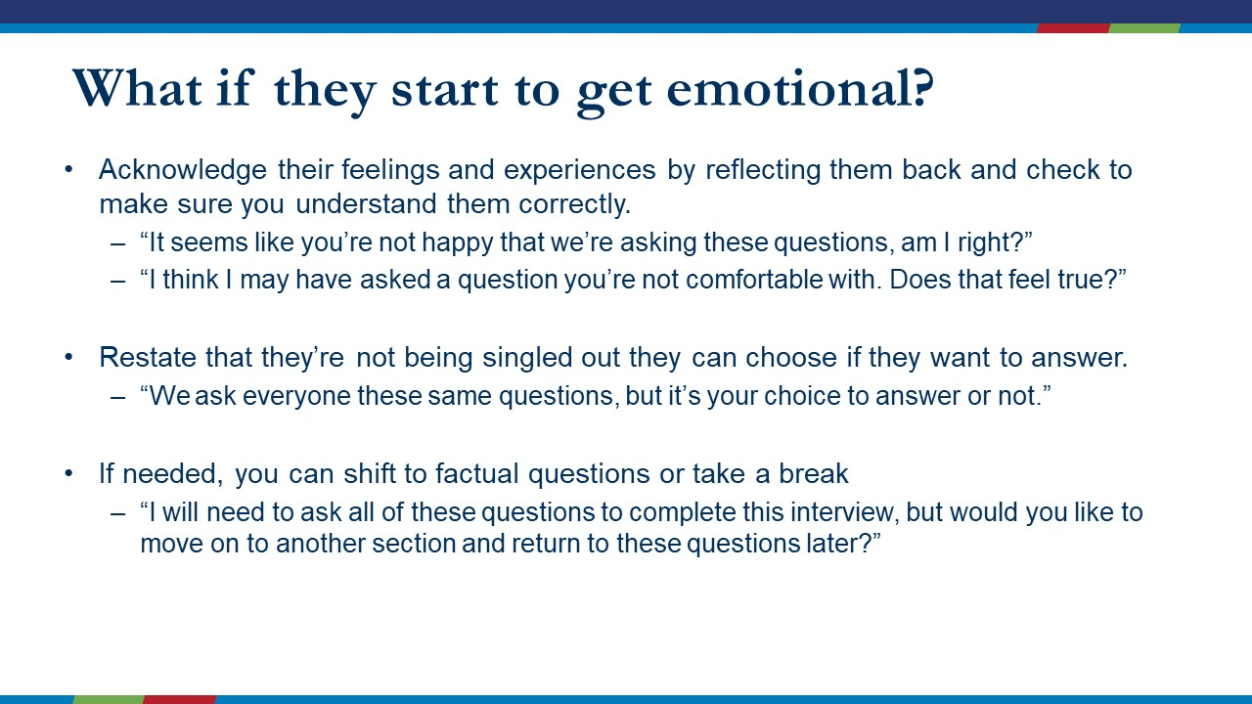
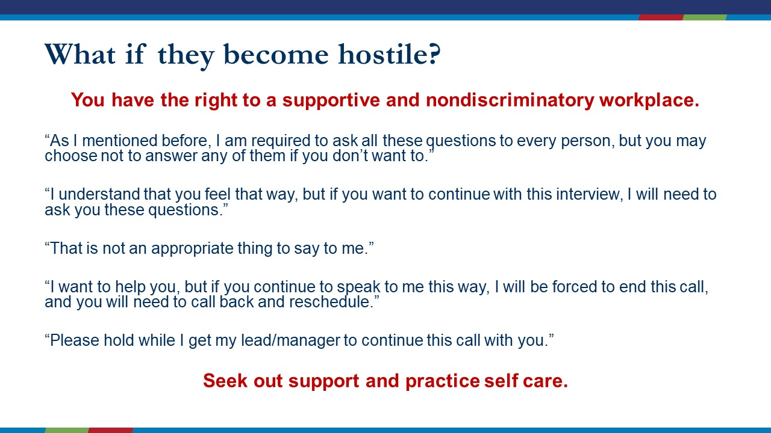
Using Learning Labs to Build REALD & SOGI Capacity in ODHS Learning Labs
REALD & SOGI 101
What is Data Equity
How to ASK REALD & SOGI Questions

Slide 6
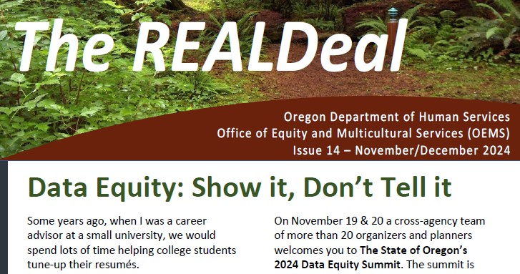
Using Learning Labs to Build REALD & SOGI Capacity in ODHS Change Management, Communication, Coalitions and more…
ADKAR Change Management
Communication
Coalition Building
Institution Building
Notes:
2 closing reflections…
Legislation & Rules say: will use these standards when collect demographic data – how do we integrate these questions…but intention is to use data to address service inequities & disproportionalities – so this work is more than just building standards: explaining purpose, helping people get excited, overcoming barriers, training in gathering data, creating storage systems, teaching analysis procedures, thinking about how to use,
Find myself bringing in more community organizing strategies

Slide 7
Building Data Equity Capacity with REALD and SOGI Learning Labs
Dr. Matt Friesen
REALD & SOGI Data Equity Manager
Office of Equity and Multicultural Services
Oregon Department of Human Services

