Slide 1
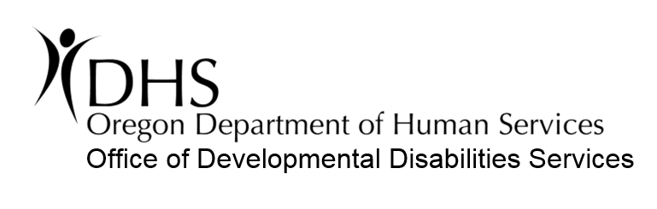
Individually-Based Limitations
Home and Community-Based Services:
Addressing Health and Safety with Individual Protections

Slide 2
What is HCBS?
HCBS means Home and Community-Based Services.
In Oregon, all services authorized by the Office of Developmental Disabilities Services (ODDS) are community-based.
HCBS means that individuals live and receive services in the community. HCBS requirements set rules to assure that people have the opportunity to have lives like everyone else.

Slide 3
The fundamentals of HCBS are:
Individuals have the opportunity to experience their community
Individuals have genuine choice and self-direction
Individuals are treated with dignity and respect;
and are free from coercion and restraint

Slide 4
What are the requirements of HCBS?
Under HCBS regulations, the settings where an individual resides and receives services must be integrated and support access to the community, including opportunities for the individual to:
Seek employment and work in competitive integrated employment settings
Engage in community life
Control personal resources
Receive services in the community

Slide 5
HCBS Requirements
Settings are selected by the individual (or the individual’s representative), from among available options.
Options must include:
An option of a private unit (bedroom) in a residential setting
The setting options must be:
Documented in the person-centered service plan;
Based on the individual’s needs and preferences;
For residential settings, based on the available resources of the individual for room and board;
For employment and non-residential day services, a non-disability specific setting option must be presented and documented in the ISP
Non-disability specific settings

Slide 6
HCBS Requirements
HCBS settings:
Ensure individual rights of privacy, dignity, respect, and freedom from coercion and restraint
Optimize, but do not regiment, individual initiative, autonomy, self-direction, and independence in making life choices including, but not limited to:
Daily activities
Physical environment
With whom to interact
Facilitate choice regarding services and supports, and who provides the services and supports

Slide 7
Provider-Owned, Controlled, or Operated Residential Settings
When an individual lives in the home of their provider, this is considered a “provider-owned, operated or controlled residential setting”. The home can be owned, rented, or leased by the provider.
If there is a relationship between the provider and the property owner or controller, this is considered provider-owned, controlled or operated.

Slide 8
Provider-Owned, Controlled, or Operated Residential Settings
In Oregon, provider-owned, controlled, or operated settings are usually:
Foster Care settings
24-Hour Residential Settings (Group homes)
Some Supported Living situations
Assisted Living Facilities

Slide 9
Provider-Owned, Controlled, or Operated Residential Settings
A setting is not considered provider-owned, controlled, or operated when:
An individual lives in a private home that the individual owns, rents, or leases from a third party that has no relationship to the service provider
An individual lives in the home of a family member* (even if the family member is a paid caregiver)
*A family member is a person legally related to the individual by blood, adoption, or marriage.

Slide 10
Specific Rules for Provider-Owned, Controlled or Operated Residential Settings
There are additional requirements for HCBS settings when the individual lives in the home of their provider. These rules are:
The setting is physically accessible to the individual
There is a Residency Agreement in place for each individual addressing protections for the individuals and the eviction and appeal processes
Each individual has privacy in his or her own unit

Slide 11
Specific Rules for Provider-Owned, Controlled or Operated Residential Settings
Rules continued:
Units (bedrooms) have doors lockable by the individual, with only the individual and appropriate staff having keys
In shared bedrooms, individuals have a choice in roommates
Individuals have the freedom to decorate and furnish their bedrooms
Individuals may have visitors of their choosing at any time
Individuals have the freedom and support to control their schedule and activities
Individuals have the freedom and support to have access to personal food at any time

Slide 12




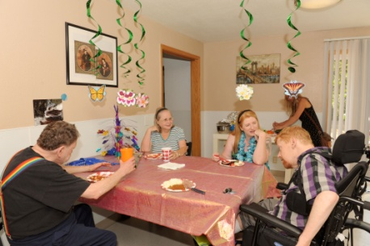

Specific Rules for Provider-Owned, Controlled or Operated Residential Settings
Schedule/Activities
Individuals have the freedom and support to control personal schedule and activities.
Decorations Individuals may furnish and decorate their bedroom or unit within the Residency Agreement.
Access to Food Individuals have the freedom and support to have access to personal food at any time.
Locks Individuals have locking bedroom doors with only the individual and appropriate staff having keys.
Visitors Individuals may have visitors of their choosing at any time.
Roommates Individuals sharing bedrooms have a choice in roommate.
The freedoms and protections above can only be limited if there is a current, significant health and safety risk.

Slide 13
Individually-Based Limitations (IBL’s)
When and How They Apply

Slide 14
What are Individually-Based Limitations?
There may be situations when an individual needs restrictions placed on certain Home and Community-Based protections due to a serious health or safety risk.

Slide 15
What are Individually-Based Limitations?
An “Individually-Based Limitation” is a restriction, prohibition, or strategy that serves as a barrier to the following Home and Community-Based freedoms of an individual residing in a residential service setting:
Freedom to furnish and decorate the bedroom
Visitors of the individual’s choosing at any time
Control of personal schedule and activities
Access to personal food at any time
Choice in bedroom roommate
Locks on bedroom (unit) door

Slide 16
Individually-Based Limitations
It is also considered a limitation when those responsible to provide supports withhold necessary assistance, resulting in the individual being limited in enjoying an HCBS protection.

Slide 17
Individually-Based Limitations may only be applied:
To address current significant health and safety risks;
With the consent of the individual (or their guardian); and
When the entire process identified in rule (OAR 411-004-0040) is followed.

Slide 18
Individually-Based Limitations may only be applied to these HCBS protections:
Lockable Bedroom or Unit Doors
Access to Personal Food
Decorating and Furnishing
Visitors
Choice of Roommate
Control Schedule and Activities

Slide 19
Essential Elements to Consider if an Individually-Based Limitation is appropriate
Current Issue
Significant Health and Safety Risk
Active Threat (Behavior or Medical Issue or Situational)
No Less Restrictive Alternative Available

Slide 20
Individually-Based Limitations: Best Practice Guidance Example
An individual:
uses a g-tube;
does not ingest solid foods orally; and
has an identified risk of aspiration.
There is a significant safety risk if the individual accesses solid foods and attempts to eat.
However, the individual is unable to independently access food and does not request access to food.
No restriction is being put upon the individual to limit access to food.
Although access to food has a potential risk, an “Individually-Based Limitation” is not necessary nor appropriate in this situation.

Slide 21
When should an Individually-Based Limitation be used?
Teams should support individuals to have the opportunity to fully enjoy the benefits and characteristic of community living.
This includes pro-active planning, education, and identification of opportunities with the individual.

Slide 22
When should an Individually-Based Limitation be used?
When pro-active approaches and positive interventions are not enough to address an individual’s safety…
a limitation may be an option.
Limitations may only be implemented as a last resort,
meaning there is no other less restrictive option to address the health and safety risk(s).
Positive, pro-active support strategies should always be considered and tried prior to the implementation of a limitation.

Slide 23
Individually-Based Limitations: Best Practice Guidance
Limitations generally should be reactive, meaning that a limitation is proposed and applied in response to a current and active threat to health and safety.
Limitations should not be applied in anticipation of a potential threat to health and safety.

Slide 24
Individually-Based Limitation- What is not a limitation?
An individual choosing to place restrictions on themselves without intervention from others to enforce the restriction is not considered a limitation.
Example: An individual may decide that they want to eat less junk food to improve health. The individual’s goal of improved health and the decision to not eat food that is unhealthy is not necessarily a limitation. The action is within the individual’s control and is not imposed upon the individual by another party. The individual is not restricted by anyone else preventing them from eating junk food.

Slide 25
Individually-Based Limitation- What is a limitation?
The intervention
(action or non-action)
by a care provider
is a critical determining factor if something is a limitation.

Slide 26
Individually-Based Limitation- What is not a limitation?: Unanticipated Situations
Providers are responsible to address the health and safety needs of individuals they serve. Providers may intervene in emergency or reasonably unanticipated situations to address health and safety.
The HCBS rules should not stop a provider from responding to unanticipated health or safety risk situations.
However, if the situation is reasonably anticipated and/or the intervention becomes routine, then this is an individually-based limitation and must be treated as such through the formal process.

Slide 27
Individually-Based Limitation- What is not a limitation? Consideration for Children in Residential Settings
When a child resides in a foster care or 24-hour residential service setting, the provider is responsible to act in the role of a parental figure.
A provider may apply or limit an HCBS protection in a manner that is consistent with typical parenting practice for a child of the same age without a disability.
If structure is imposed that is more restrictive than typical parenting practice for a non-disabled child of the same age, then this structure is considered a limitation and the requirements for process and documentation apply (OAR 411-004-0020(3))

Slide 28
Requirements for Individually-Based Limitations OAR 411-004-0040
When a limitation is applied based on a current, significant health and safety risk, an ODDS-approved form must be incorporated in the person-centered planning process.

Slide 29
Requirements for Individually-Based Limitations OAR 411-004-0040
The Individual Support Plan (ISP) must document all of the following:
The need justifying the limitation;
The positive interventions used prior;
What has been tried but didn’t work;
A description of the limitation that is proportionate to the assessed need;
Regular collection and review of data measuring the ongoing effectiveness of the limitation;
Time limits for reviews of the limitation to determine if the limitation remains necessary (minimum annual basis);
The informed consent of the individual, or the individual’s legal guardian;
An assurance the limitation will not cause harm to the individual.

Slide 30
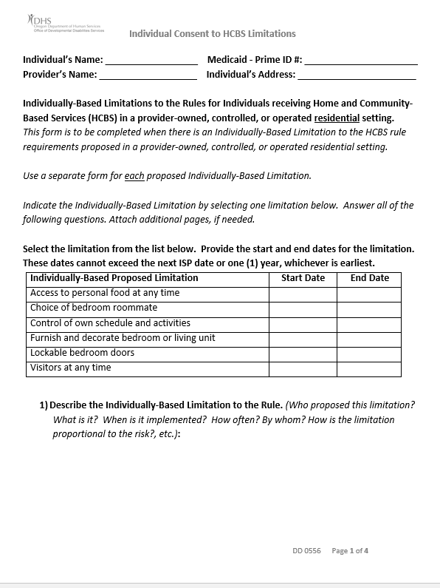
Individually-Based Limitations: Documentation Use this form (attach it to the ISP)

Slide 31
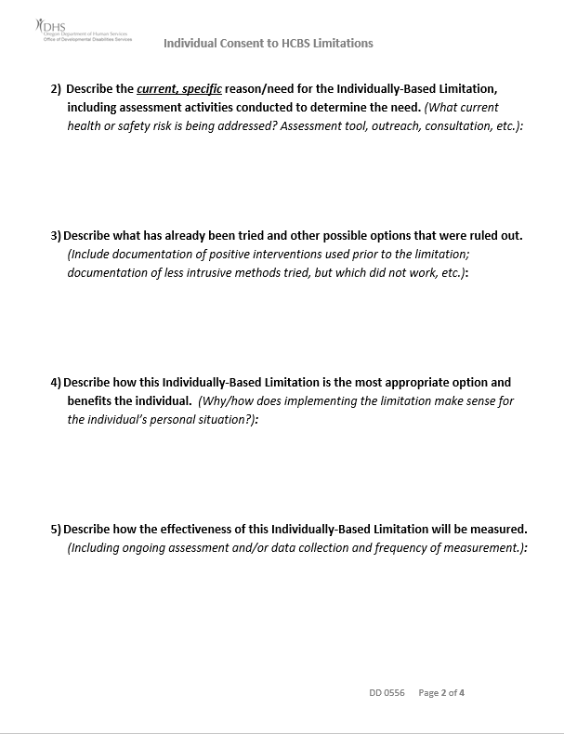
Individually-Based Limitations: Documentation Use this form (attach it to the ISP)

Slide 32
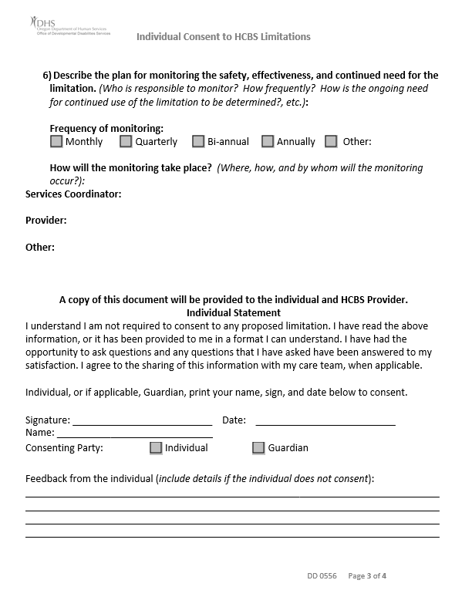
Individually-Based Limitations: Documentation Use this form (attach it to the ISP)

Slide 33
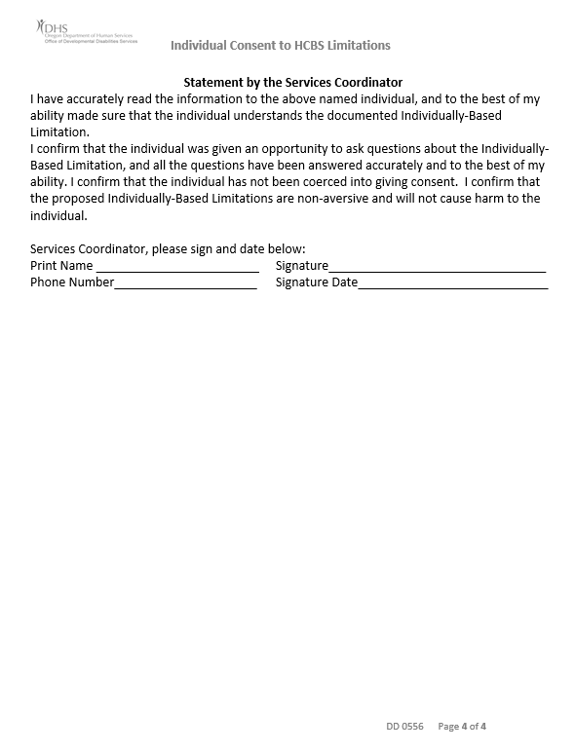
Individually-Based Limitations: Documentation Use this form (attach it to the ISP)

Slide 34
Individually-Based Limitations: Responsibilities of the Services Coordinator
Facilitating the limitations discussion
Completing the “Consent to Individually-Based Limitation” form (including ensuring that all of the requirements are in place)
Providing a copy of the form to the individual and the provider (the form should also be attached to the ISP)
Monitoring the usage and tracking of the Individually-Based Limitation

Slide 35
Individually-Based Limitations: Responsibilities of the Residential Service Setting Provider
Maintaining a copy of the completed and signed form documenting the consent to the limitation
Regular collection and review of data to measure the ongoing effectiveness and continued need for the limitation
Requesting a review when a new limitation, or change of an existing limitation, appears to be needed

Slide 36
Individually-Based Limitations: Best Practice Guidance
When a team is considering a limitation to address a significant health and safety risk for one individual in the home, the limitation may not result in a barrier or limit for other individuals in the home who do not require such structure.
For example: One individual in the home may need limited access to foods based on behavioral and medical issues. If the team determines that the least restrictive and most appropriate structure for the individual is to lock the fridge, this practice may not result in other individuals experiencing limited access to personal foods at any time when those other individuals do not require such restrictions.

Slide 37
Individually-Based Limitations: Best Practice Guidance Example
An individual needs access to foods limited based on behavioral and medical needs.
The team determines the least restrictive, most appropriate structure is to lock the fridge.
This practice may not result in a barrier to other individuals having access to personal foods at any time if they do not require such restrictions.

Slide 38
Consent to Individually-Based Limitations
An Individually-Based Limitation may not be applied without an individual’s consent.
In Oregon, individuals are presumed to have capacity unless otherwise determined by a court.
If an individual has a guardian, then the individual‘s guardian may consent to a limitation.
Supported decision-making may be used to assist the individual in understanding and consenting to a limitation.

Slide 39
Consent to Individually-Based Limitations
A guardian, designated representative, or team cannot override an individual who objects to a limitation when the individual has the capacity to make an informed decision.
An Individually-Based Limitation cannot be used prevent bad choices.

Slide 40
Individually-Based Limitations & The ISP process
Incorporating IBL Requirements into the ISP Planning Process

Slide 41
IBL’s and the ISP
Ideally, Individually-Based Limitations are identified through the natural course of the ISP planning process.
The Risk Identification Tool and Risk Management Plan are key components of the ISP which aid in the identification of Individually-Based Limitations.
When a limitation is considered and/or consented to, this should be indicated on the Risk Management Plan by marking the appropriate boxes.

Slide 42
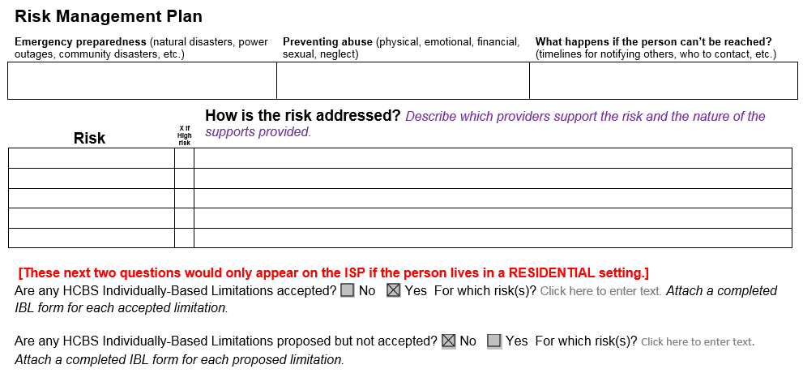
IBL’s and the ISP (Risk Management Plan)

Slide 43
Can an Individually-Based Limitation be identified outside of the ISP process?
An individually-based limitation can be identified or proposed by anyone on the individual’s team at any time. It is likely that the individual’s service provider will initiate a request for the team to consider a limitation.
The Services Coordinator must facilitate the process, ensuring that:
The proposed limitation is the most appropriate and least restrictive means to address the identified assessed need of the individual
The required steps and documentation are completed prior to the implementation of the limitation
The individual consents to the limitation

Slide 44
Individually-Based Limitations: Timelines

Slide 45
Individually-Based Limitations will begin rolling out in January 2017
October 2016-December 2016: IBL Trainings
January 2017: IBLs begin being implemented for ISPs effective March 2017 or later
March 2017- February 2018: IBLs are included in ISPs
March 2018-Ongoing:
New IBLs are implemented as needed
September 2018:
Final deadline for full compliance by providers
New limitations that are identified after an individual’s 2017 ISP must go through the formal process before being implemented.

Slide 46
Individuals requiring limits prior to IBL roll-out
The ISP planning process should be utilized to address current health and safety needs of individuals.
The “Consent to Individually-Based Limitations” form is not required prior to the roll out in 2017.
(For ISP’s effective prior to March 1, 2017)
Structures in place that could be a considered a limitation should be:
Identified in the ISP (Risk Management Plan);
Supported by an assessed need;
Consented to by the individual or their guardian.

Slide 47
Individually-Based Limitations: Other Questions

Slide 48
When is an Individually-Based Limitation not allowed?
Individually-Based Limitations may not be implemented when the:
Individual (or the guardian) does not consent.
Limitation is not supported by a specific assessed need related to a significant health and safety risk.
Limitation is being implemented for convenience of the provider or as a means to avoid implementing changes required by HCBS.
Alternative, less intrusive methods of addressing the health and safety risk(s) have not been explored and ruled out.

Slide 49
When is an Individually-Based Limitation not an Individually-Based Limitation?
Individually-Based Limitations are only applicable to the six identified HCBS protections for individuals residing in provider-owned, controlled, or operated residential settings.
Individuals may have structures and strategies identified in their plan to address other health and safety issues. Such strategies may exist, but they are not considered Individually-Based Limitations.
Additionally, structures and supports that individuals may have identified in their Risk Management Plan are not required to fall into one of the six Individually-Based limitation categories to exist.

Slide 50
Other Restrictions…
Individually-Based Limitations are:
Non-transferable;
Specific and unique to each residential setting;
Not automatically transferred with an individual to a new residential setting.
Whenever an individual in a residential setting moves, limitations must be re-done and cannot be automatically adopted in the new home environment.

Slide 51
Variances- is a variance required when there is an Individually-Based Limitation in place?
It depends…

Slide 52
Does an IBL require a variance?
In most situations, a variance is not needed when there is an IBL in place.
However, there are a few situations when an variance may be need in addition to the IBL.
If implementation of the limitation results in the provider being unable to meet a licensing requirement, then a variance is needed.

Slide 53
Does an IBL require a variance? Examples
Locks on Doors
A lock is not installed on the door. This is an IBL, but also needs a variance as the provider is requesting an exemption to the requirement of having locking bedroom doors.
Variance needed
The locking mechanism on the bedroom door is inactivated or disengaged. This is an IBL. This does not require a variance as well because the locking mechanism still exists and is available. The provider meets the licensing requirement.
Variance not needed

Slide 54
Resources
Please check out the HCBS webpage for additional resources and information related to HCBS:
http://www.oregon.gov/DHS/SENIORS-DISABILITIES/HCBS/Pages/index.aspx
For questions or comments, contact us at:
HCBS.Oregon@state.or.us

