Slide 1

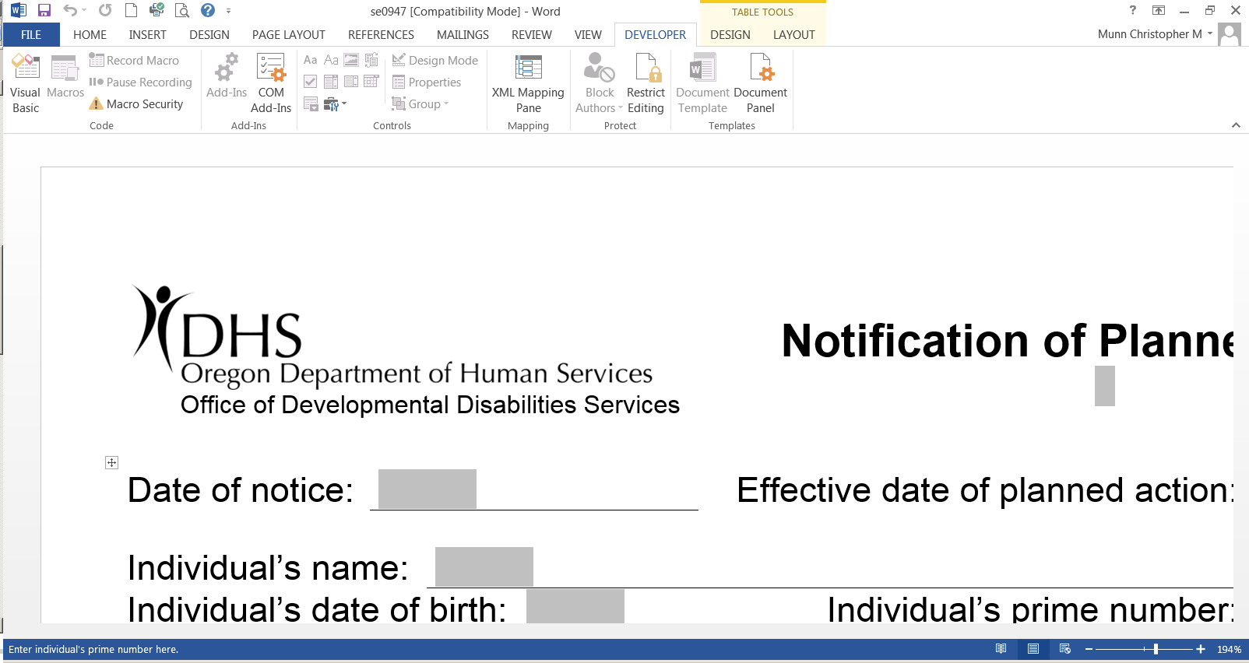
ODDS HCBS Individually-Based Limitations:
Technical assistance call-ins
Have questions about the Individually-Based Limitations process? Join us for a conference call!
Please note: The times and phone numbers vary by date.
Tuesday June 6th 10:00-11:00
1-877-873-8017,
Thursday June 15th 1:00 – 2:00
1- 877-873-8017
Tuesday June 20th 10:00 – 11:00
1-877-848-7030
Thursday July 6th 1:00 – 2:00
1-877-848-7030
Tuesday July 11th 10:00 – 11:00
1-877-848-7030
Thursday, July 20th 1:00 – 2:00
1-877-873-8017
Tuesday July 25th 1:00 – 2:00
1-877-848-7030
Guest code 772325#
Guest code 772325#
Guest code 458900#
Guest code 458900#
Guest code 458900#
Guest code 772325#
Guest code 458900#
Send us your questions by email ahead of time:
Kirsten.G.Collins@state.or.us
Rose.K.Herrera@state.or.us
Please visit our hcbs website for more information:
http://www.oregon.gov/DHS/SENIORS-DISABILITIES/HCBS/Pages/index.aspx

