Slide 1
ODDS Services Overview
Service Eligibility review for Eligibility Workers
Notes:
The intended audience for this presentation is OEP/AAA Eligibility Workers, the intent is to provide a high-level overview of Intellectual and Developmental Disability services and the role that ODDS CMs play.

Slide 2

ODHS and ODDS
The Office of Developmental Disability Services (ODDS) is a division of the Oregon Department of Human Services (ODHS)
ODDS oversees services for individuals diagnosed with Intellectual and Developmental Disabilities (I/DD)
Supported by Case Management Entities (CMEs):
Community Developmental Disabilities Programs (CDDPs)
Brokerages
Notes:
The Office of Developmental Disabilities Services is a division of ODHS just like OEP and APD agencies. ODDS is responsible for service eligibility and service planning for individuals with an Intellectual and Developmental Disabilities diagnoses. Financial eligibility remains the responsibility of OEP and AAA eligibility workers.
ODDS contracts with governmental and non-governmental entities to provide case management services, the term for these contracted parters is Case Management Entities (CMEs). There are two classifications of CMEs; Community Developmental Disabilities Programs (CDDPs) and Brokerages.

Slide 3
Who Provides ODDS Case Management Services
Community Developmental Disabilities Programs (CDDP)
Support Service Brokerages
Children’s In-Home Intensive Services (CIIS)
“Service Coordinators”
Serves children and adults birth to death
Adults 65+ can choose APD/AAA or CDDP/brokerage
“Personal Agents”
Adults age 18+
Medically fragile
Medically involved
Intensive behavior
CME
CME
ODDS specialized team; not a CME
Notes:
Within the Community Developmental Disabilities Programs (CDDPs), Service Coordinators provide case management services for children and adults.
Within the Support Services Brokerages, Personal Agents provide case management services for adults only.
The Children’s Intensive In-Home Services (CIIS) team is an ODDS specialized team, which is not part of CMEs, and provides case management services for children and families who care for their children with significant disabilities requiring complex care needs in their homes and provides services based on the needs of the child and family.

Slide 4
Case Management Entities (CMEs)
Community Developmental Disabilities Programs (CDDP)
Serves children and adults birth to death
Support Service Brokerages
Adults age 18+
Children’s In-Home Intensive Services (CIIS)
“Service Coordinators”
Adults 65+ can choose APD/AAA or CDDP/brokerage
“Personal Agents”
Medically fragile
Medically involved
Intensive behavior
Part of ODDS, not a CME
Notes:
Community Developmental Disabilities Programs, or CDDPs, are often contracted with local county governments statewide to do the eligibility and service planning for I/DD services. The CDDP works with the individual to identify providers, go over medical history, and get releases of information to request medical records. While medical records are being requested, they’ll also help the person apply for Medicaid, if they haven’t already.
Brokerages are similar to CDDPs except they don’t provide services to children under age 18. Brokerages are private businesses which provide case management and service coordination to adults who are receiving I/DD services in their home or community. They do the same work as CDDPs as far as completing service eligibility determinations, helping with Medicaid applications and renewals, and completing Oregon Needs Assessments (ONA) and Individual Support Plans (ISP). Brokerage service coordinators/case managers are called “Personal Agents,” often referred to as PAs. Personal agents develop ISPs, connect the person to community resources, and maintain regular contact with the person to make sure the service plan is meeting their needs and goals, making adjustments as necessary.
Children’s In-Home Intensive Services or CIIS offers flexible, family-centered and culturally sensitive case management services. CIIS assists families who care for their children with significant disabilities requiring complex care needs in their homes and provides services based on the needs of the child and family.

Slide 5

I/DD Service Eligibility
Have an intellectual or developmental disability (I/DD)
Oregon Needs Assessment (ONA)
Often require an individual be eligible for OHP (MAGI or OSIPM)
Notes:
The first thing they need is an intellectual or developmental disability diagnosis that meets ODDS standards.
They need to be assessed using the Oregon Needs Assessment, or ONA. An ONA is used to identify the kind of support the person needs. It also identifies potential risks that need to be addressed in their individual support plan, any exceptional needs they may have, and service payment rates.
An ONA assessment is equivalent to a CA/PS assessment used by APD/AAA case managers to determine service eligibility.
Although most of the I/DD service types we see have a medical requirement; meaning the person needs to be eligible for OHP because that’s what helps pay for their services. There are also several General Fund service types that can be standalone.

Slide 6

Service Coordinator and Personal Agent Roles
Individual Support Plan (ISP)
Assess:
Functional daily living support needs
Medical, behavioral, and supervision needs
Living situation and safety considerations
Functional support needs
Determines appropriate service plan and level of support
Notes:
Separate from the ONA, everyone has a person-centered Individual Support Plan (ISP) as a part of their intellectual and developmental disabilities (I/DD) service plan. An ISP helps each person experiencing I/DD live the life they want. The I/DD service coordinator or personal agent updates the ISP at least yearly or as needed if the person’s physical or emotional support needs change throughout the year. It includes things like important people in their life, goals, what kind of services they want and who they want to provide them. ​
​
One of the main things that I/DD services provides is help with activities of daily living (ADLs) and instrumental activities of daily living, or IADLs. Activities of daily living (ADLs) are things like help moving around their home, getting up and down from furniture, using the bathroom, eating, bathing, personal hygiene, dressing and grooming, and providing cognitive and behavioral supports. Instrumental activities of daily living (IADLs) are things like medication management, cleaning the house, laundry, cooking, shopping, and support with transportation. I/DD services can also include supports with communication and social skills.

Slide 7

I/DD Services for Adults and Children
Adults under age 65 and children are served by ODDS CMEs
Adults over age 65 can choose APD/AAA or ODDS CMEs
Children are served by ODDS CDDPs or CIIS
Notes:
CDDPs and brokerages work with different age groups, and age can also help determine whether an adult gets their services through ODDS or APD.​
​
Children and adults under age 65 get their services through ODDS, but sometimes APD/AAA services can be opened for under 65 adults while I/DD eligibility is determined. APD is the only payor for a nursing facility, so if a person (including children) receiving I/DD services needs a nursing facility payment, the CME will coordinate with the local APD/AAA case manager. As long as the person already has OHP, there’s nothing for you as eligibility workers to do when that happens, but it’s something to be aware of. ​
​
Individuals over age 65 can choose to be served by the APD/AAA office or ODDS, as long as they meet the eligibility requirements for both programs. It is important to note, they cannot receive services under both programs at the same time. But they can transition between the two. For example, it’s fairly common for someone receiving I/DD services living in a residential care facility to turn 65 and transfer to APD services, rather than disrupting their living situation and asking the person to move to a new facility, APD will become the payor so they can stay where they live. ​
​
Children under the age of 18 without a CIIS qualifier are served by CDDPs. The intent of CIIS is to provide individualized supports and services to ensure health and safety in the family home and prevent out of home placement. CIIS has three specialized programs that supplement the services that are available through the State Medicaid Plan and other federal, state and local programs, as well as the natural supports that families and communities provide. ​
​
​
Medically fragile:​
The Medically Fragile Program serves children who have extremely intense medical and nursing needs, are generally dependent on specialized medical technology to survive and require a hospital level of care. Their providers are usually registered nurses (RN) or overseen by RNs to ensure safety. ​
​
Medically involved​
The Medically Involved Program serves children who require moderate to full support with all of their routines and daily activities such as grooming, bathing, dressing, elimination and mobility supports. This can include children requiring specialized medical intervention such as respiratory treatment, tube feeding or seizures. ​
​
Intensive behavior:​
The Intensive Behavior Program serves children who demonstrate challenging behaviors, such as aggression, self-injury, elopement and sleep disturbances, which require constant adjustments to their environment and routines to maintain safety in their home.

Slide 8
Service Settings
Own or Family Home
Host Home
24-hour
Residential
Foster
Home
Notes:
In general, people receiving I/DD services can choose between in-home or residential services, and there are several options available under those two umbrellas.​
​
People who choose in-home services live in their own home. They can choose to work with a Personal Support Worker, or PSW, who is employed by the person experiencing I/DD and is paid by ODDS, very similar to homecare workers in the consumer-employer program with APD. They can also choose to work with Direct Support Professionals, or DSPs, who are employed by privately owned agencies. ODDS contracts with the agencies to provide Medicaid services. ​
​
Residential care​
Residential care consists of group homes, host homes, foster care, and supported living homes in​ local communities which provide 24-hour supports and supervision. Group homes for children have 24-hour awake staffing; some homes for adults are staffed on site 24/7 and some are not – it depends on the needs of the group. Services are planned, delivered and supervised within a framework of maintaining and improving health and safety while working to increase independence and self-confidence. Residential providers support people in interactions with their peers, developing skills like cooking, shopping, and cleaning, education, and transitioning to adulthood.​
​
Host homes​
The next option are host homes, they are similar to foster homes in that the child lives in a single-family home with a family that is not their own. The children served usually have intensive behavioral support needs that require more structure and support than what may be available in their family home. Most host homes will only serve 1-2 children at a time. ​
​
Foster Care​
There is also foster care for children with developmental disabilities which provides 24 hours of support and services in a family home, but not in the home of the parent or guardian. Certified and trained foster families help children with their activities of daily living, providing supervision and guidance in a nurturing setting to maintain the child's health and safety while working to increase levels of self confidence and independence. Foster providers support children in their school programs, in community activities, in adult transition planning and when it is a part of the child's individual plan, and maintaining connection with the child's family. It’s important to note that foster care placement can be voluntary and does not always mean the child is under Child Welfare guardianship. ​

Slide 9
ODDS Technical Assistance Unit (TAU)
Updates I/DD SELG coding in DHR
Report retroactive liability changes
Email: DD-Eligibility.ENROLLMENT@odhsoha.oregon.gov
Notes:
TAU is responsible for updating the service record (SELG) in DHR for individuals receiving I/DD services, entering the patient liability (or offset) into eXPRS, and overall coordinating the flow of information necessary to determine and maintain DD eligibility. They receive plan of care forms from CDDPs and Brokerages, coordinate Level of Care determinations with Service Coordinators, and oversee communications with APD|AAA local offices to ensure the correct medical TOAs have been authorized to match I/DD service categories. ​
​
TAU needs to be notified when a change in ONE results in a retroactive patient liability change so that the liability amount can be updated in MMIS. ​
​

Slide 10
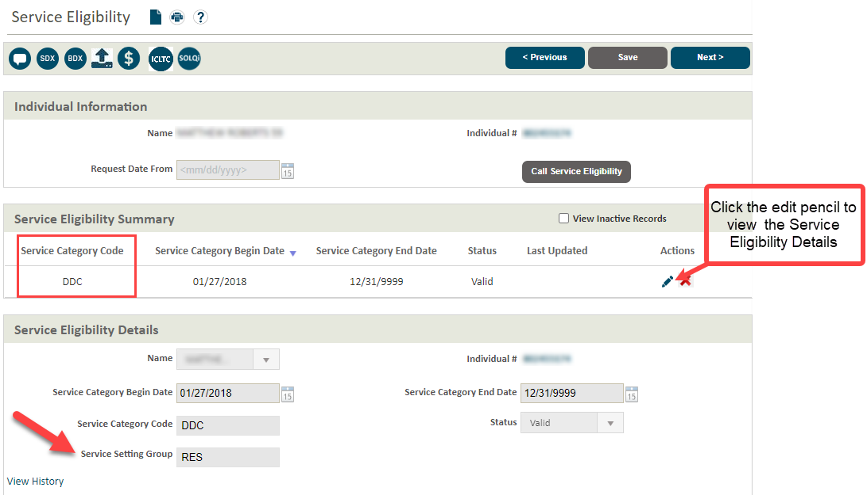
Service Eligibility in ONE
Notes:
​
How can you tell if someone is getting I/DD services, so you know when to notify TAU in the first place? The answer is by looking at the Service Eligibility screen, which is in the Non-Financial Information Service Eligibility screen. ​Service category codes tells us what kind of medical program the person is enrolled in and what kind of services they’re receiving. ​
If you click on the edit pencil on the screen, the service eligibility details panel will open and there will be some more information, including the person’s care setting – which is the service setting group. ​
Here we can see this person has a DDC service category and RES service setting group. That means they’re getting OSIPM and I/DD services in a residential care facility. ​
A couple of other examples of common service categories you will see are: DDK and FSG. DDK means the person is getting MAGI and I/DD services; FSG is used when a child is getting family support services. The Service Categories for Eligibility Worker QRG does a great job of listing out the different service categories and when TAU needs notified.

Slide 11
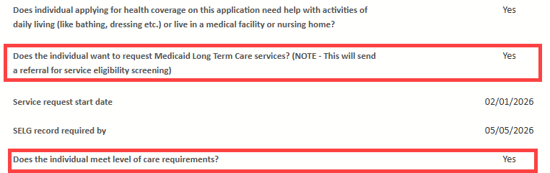
Eligibility Worker Role
Complete financial eligibility in ONE
Coordinate eligibility with CDDPs and brokerages
LTC Service Request task
Notes:
OHP eligibility for I/DD services is the same as it is for any other long-term services and supports program. ​
Only spouses who are both applying for LTC need to be on separate cases. ​
We can have multiple adults/children in the household receiving services on the same case. ​
Example: parent receiving LTC through APD and children getting I/DD services can (and should) all be on the same case. ​
We do not determine when ODDS services begin (e.g. the SELG start date).

Slide 12

Offset / Patient Liability
Individuals may pay a portion of their monthly service cost
Individuals receiving in-home services do not pay a liability/offset
Email ODDS Technical Assistance Unit (TAU) when liability changes retroactively
Notes:
Just like long-term care services through APD, people receiving I/DD services may be required to pay a portion of their monthly service cost. You probably know this as the “patient liability,” “client obligation” or “pay-in” but in the world of I/DD it’s often referred to as an “offset.” It all means the same thing – it’s the amount the individual has to pay towards the cost of their care. The liability is based on the person’s income, care setting, and allowable deductions like out-of-pocket medical costs. People receiving in-home services don’t have to pay a liability, but individuals living in a residential care facility may have to. The individual is responsible for paying the liability directly to the facility every month. ​
​
ONE sends current and future month liability information to MMIS and eXPRS, which is the I/DD equivalent of Oregon ACCESS. If the liability change affects retro months, then an email need to sent to TAU so the liability can be manually updated in MMIS.

Slide 13
Key Takeaways
ODDS contracts with Community Developmental Disabilities Programs (CDDPs) and Support Services Brokerages to support eligibility and service planning for I/DD services.
Service Coordinator and Personal Agents focus on service eligibility and planning
Service eligibility and Financial eligibility are separate but coordinated
Both determinations are required before services begin
Understanding ODDS roles improves collaboration and outcomes
Notes:
Understanding the role of ODDS case managers helps eligibility workers provide clear expectations to families and improve cross-program coordination.

Slide 14
Communication tools
Each local area will have an identified email address to use for case coordination by May 2026
If you don’t have contact information for the person’s Service Coordinator or Personal Agent, use the email address located in ZIP Matrix (eff May 2026)
Point of Contact Toolkit includes an email template and naming conventions to ensure timely processing of emailed requests.
The ODDS/OEP Cross-Program Terminology Guide is a tool to help connect OEP and ODDS verbiage to support clearer communication.
Information sharing between OEP, AAAs, Brokerages and CDDPs is allowed without any additional forms or permissions to coordinate benefits and services. See the OEP-IM-25-014 and DD-IM-26-007 for additional details and guidance.
Notes:
OEP and CMEs are establishing and identifying a standardized, monitored shared inbox for each local office/area, giving staff a clear and consistent way to connect across programs.​
These inboxes support communication between Brokerages, CDDPs, AAA, and OEP, reducing confusion about where to send questions and get connected to the right staff member.​ ​
All Point of Contact inboxes will be established by the beginning of May 2026. The Point of Contact Toolkit has tools and templets to support cross program communication​ ​
An OEP CME AAA crosswalk was developed and is being absorbed into the ZIP Matrix. The crosswalk will contain the point of contact email addresses as well as identify what county, zip, or city a brokerage or CDDP serves, just like we have for APD and SSP offices. The general office information has a tentative go-live date of the end of March with the point of contact email address being added by May. ​ ​
There is also the new ODDS/OEP Cross Program Terminology guide to help support those conversations. ​
​
Information sharing between OEP, AAAs, Brokerages and CDDPs is allowed without any additional forms or permissions to coordinate benefits and services. Information can be shared to the minimum necessary standard to coordinate care between partnering agencies. See the OEP-IM-25-014 and DD-IM-26-007 for additional details and guidance.

Slide 15
Thank you!
Cross Program Training Update Request Form
15

