Slide 1
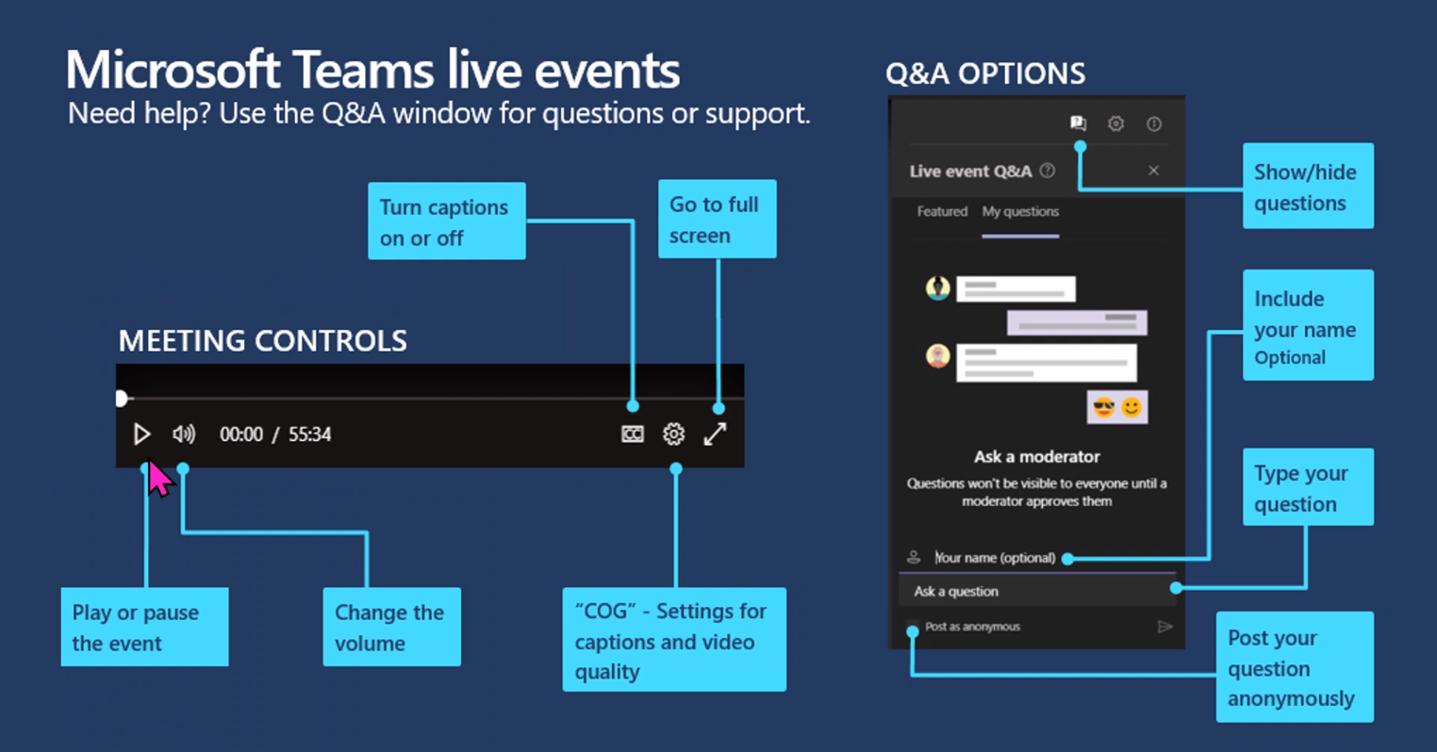

Slide 2
APD/AAA Q&A
Q&A Wrap Up
6/10/2021

Slide 3

APD/AAA LTC Services & ONE Q&A Series
This series of APD learning sessions is directed toward an audience of Case Managers. If you are an eligibility worker, this will give you an understanding how Case Managers and Eligibility Workers work together in ONE.
Thursdays, 3:00-4:30 PST
Please type your questions in the Q&A with as much detail as possible before submitting. Questions will be answered after the presentation.
Questions should be specific to the topic of the session. For case specific discussion or questions, contact APD Medicaid Policy.
Recordings will be made available on CM Tools/ONE System Information & Resources. Please note content is subject to change based on system changes.

Slide 4
APD/AAA LTC & ONE Q&A Series
Presenters & Panelists for the Series
Erika Mooney, APD Medicaid Policy Analyst
Katie Turner, ET Process Consultant – APD
Christine Maciel , LTCSS Policy
Donitta Booth , LTCSS Policy
Heather Burkus, APD Medicaid Policy Analyst
Hilary Thompson, ET Process Consultant – AAA
Lisa Bouchell, LTCSS Policy
Mat Rapoza, APD LTSS Policy Manager
Serena Sischo, APD Medicaid Policy Analyst
Traci Lerner, LTCSS Policy
Facilitator: Christy Jo Williams, ET Portfolio Manager – APD
Q&A Moderator: Trevor Waskin, APD Direct Service Manager

Slide 5
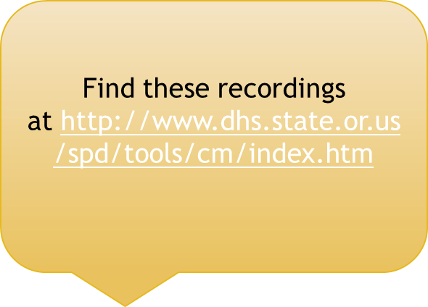
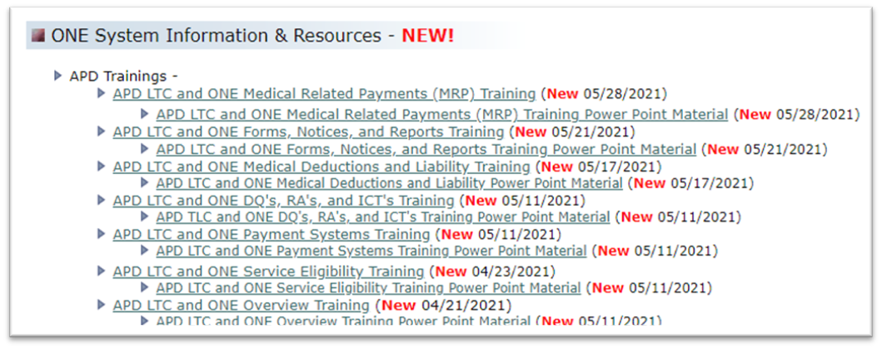
Overview of Sessions 1-4
APD LTC and ONE Overview
General calculations (DQ's, Patient Liability, Participant Fee)
Medical (TOA) Hierarchy in ONE
APD LTC and ONE Service Eligibility
Service TOA's in ONE
SELG Records
Actions done in ONE vs Oregon Access
APD LTC and ONE Payment Systems
512 and Troubleshooting Payments
SFMU and Troubleshooting Payments
APD LTC and ONE DQ's, RA's, and ICT's
Where to find these in ONE
How ICT's work in ONE

Slide 6
Overview of Sessions 5-8
APD LTC and ONE Medical Deductions and Liability
How ONE calculates the Patient Liability and Participant Fee
OIM's in ONE
APD LTC and ONE Forms, Notices, and Reports
Who sends what notice
What notices need to be sent
How do I find notices sent by ONE
What Reports are helpful to Case Managers
APD LTC and ONE Medical Related Payments (MRP's)
Which payments require approvals
Ongoing vs one-time payments
APD LTC and ONE Renewals
Renewal timelines and notices
Passive vs Active renewals

Slide 7
Voter Registration by CM's
Do CMs need to cover Voter Registration?
  Any action by the CM outside of the eligibility process which is a qualifying event for NVRA is still the responsibility of the CM.
  CMs are responsible for NVRA actions when they complete a reassessment mid-cert or accept any change of mailing or residence address.
  The do not have to ask about NVRA as part of the cert/recert process, which is the bulk of the qualifying events, but the rest is within their responsibility.
SELG Reminders
Clarification – We should not align the SELG review date with the financial renewal date . ONE will actually "unalign" the renewal dates if you attempt to do so.
Impacts to OPI – It is business process for workers to let Oregonians know if they are eligible for both OHP Plus and OPI that they should work with their Case Manager to pick which program they would like to receive?
  CMs should work with individuals to assist them with choosing which program they would like to pursue and provide the as much info as we can so they're not blindsided later in the process.
Updates to SELG, do I need to tell EW to run EDBC?
  No, you do not. There is a task (SELG Update Received) if ONE cannot act on the SELG change systematically. However, for urgent requests and payment issues you might need to follow local processes
Notes:
1) If the case is in an Active Approved status and an SELG update is received, ONE should automatically re-evaluate eligibility as part of a nightly batch process
2) If the case is not in an Active/Approved status when the SELG update is received, a task will be generated advising EWs that eligibility should be re-evaluated.
3) If there is an urgent client or payment issue, CMs may want to reach out to an EW to have eligibility in ONE re-evaluated ASAP.

Slide 8
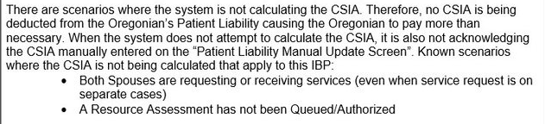
CSIA and 457Ds
20-111 | Community Spouse Income Allowance (CSIA) not being correctly deducted from Patient Liability
Withdrawing a LTC Request:
OAR 461-175-0340 says that a basic decision notice is required when a request to withdraw an application is received (whether orally or in writing). A completed and signed 457D serves as the basic decision notice; however, it is not required.
That said, LTC Policy has requested that CMs get a signed 457D when an assessment has been completed (as a best practice).
Notes:
When both spouses are applying, they each must be requesting on their own case, and a household member on each other's cases
For example, Case 1 has Spouse 1 as applying, Spouse 2 as not applying. Case 2 has Spouse 2 as applying, and Spouse 1 as not applying
Current issue with CSIA in these scenarios, follow the below IBP

Slide 9
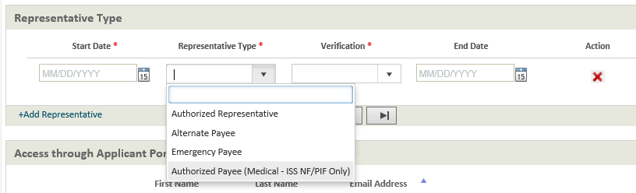
Recent Changes: NF/PIF and ISS changes
Alternate payee for Medical Cash payments (6/3/21 build release) : This applies to NF/PIF and ISS payments that are generated from the ONE Eligibility Rules Engine.
ONE will now allow staff to select the individual eligible to receive the payment or any of the following: The Head of Household (regardless of age), an adult member of the case, an Authorized Payee designated in the Representative screens (Type= Authorized Payee (Medical – NF/PIF Only).
If staff do not select a Payee, and the individual eligible to receive the payment is under 18 years old, the payment will fail. Note that staff can elect to choose the minor to receive the payment.

Slide 10
Recent Changes
Service Categories
Evaluation of NMAGISERV and MSERV - Individuals receiving Waivered and K Plan services must be evaluated for additional financial eligibility criteria (Asset Transfer and Home Equity Value). The NMAGISERV and MSERV TOAs represent evaluation of these additional financial eligibility criteria. In the past, NMAGISERV/MSERV were being evaluated for State Plan Personal Care (SPPC) and General Fund Service eligibility categories, even though these recipients were not required to meet the NMAGISERV/MSERV criteria.
ONE has been modified so that it no longer evaluates for NMAGISERV/MSERV when the recipient service eligibility does not require the evaluation. The Service Categories for which NMAGISERV/MSERV will no longer be evaluated are:
BPA
BPD
BPM
BPO
DDG
FSG
FSL
OPI

Slide 11
Pending Questions
APD LTC and ONE Payment Systems
OPI change of income, wants to apply for OSIPM, what process do we take?
  Follow your existing local process for coordinating OPI benefits and then provide individual information about how to apply for medical. If they are already receiving benefits in ONE, see the APD/AAA Office Internal Communications ETOP
APD LTC and ONE Medical Related Payments (MRPs)
Do we still send PIF payments to people in ALFs when they do not have the necessary funds to have personal money?
  The rules around this special needs payment have not changed – see OAR 461-155-0700 for more info
APD LTC and ONE Renewals
What do we do if we get the MED 044 back with no indication of a change or no change?
  Follow the instructions on the Renewals and Recertifications QRG
Are case managers or are eligibility workers responsible for doing ICP 6-month reviews now?
  Case Managers do the ICP 6-month review. It does not have anything to do with their financial eligibility

Slide 12
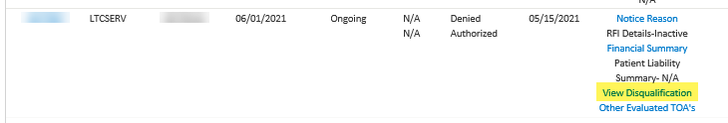
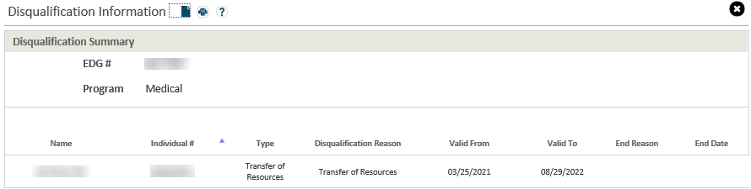
Pending Questions continued
APD LTC and ONE DQ's, RA's, and ICT's
  Where in ONE do we see the DQ timeframe?
  For the ICT accounts. ONE pends for an Income Cap Trust to move forward with approving benefits. How do we get around the ICT being required if DQ must be served before services can begin?
    This has been logged as a defect, and an IBP is in progress

Slide 13
Pending Questions continued
APD LTC and ONE Forms, Notices, and Reports
SPL eligible but not financially eligible, wait until day 45 to send 540?
    No, we don't need wait until day 45, CMs should send the service denial notice as soon as they become aware the individual is ineligible
APD LTC and ONE Medical Deductions and Liability
Waiving liability in MMIS for a new consumer
  This is a common practice for NF residents, but should only be done for the initial month.

Slide 14
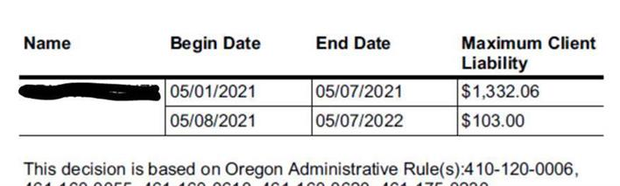
Pending Questions continued
APD LTC and ONE Medical Deductions and Liability
What happened to liability the month client moved from one setting to another, like moving from NF to ACH or ACH to home?
  If an SELG change in service setting is received mid-month and with no break in overall service eligibility aid, ONE will follow adverse action if the liability is larger. If the new liability is lower, it will apply the new amount beginning the date the setting changes.
  As far as what the client should actually pay, we don't pro-rate liability, but the service payment for the respective provider/settings is pro-rated. If the liability for the previous setting/provider has been exhausted or used up by the pro-rated service amount, we generally zero out the liability for the new setting because realistically they would have nothing with which to pay (especially if going from NF to CBC). If it wasn't, then technically they should be refunded and apply the remainder towards the new setting. If it’s then not used up by the new provider’s pro-rated service amount, then they should be refunded by that provider. That said, we know that CMs usually just zero it out in this scenario because clients have no control over when they will receive refunds.

Slide 15
Demo and Q&A
Notes:
Demo:
- Service eligibility
- Notice reasons, financial summary, patient liability
- Payment status/issued
- Electronic Case File
- Notices sent

