Slide 1
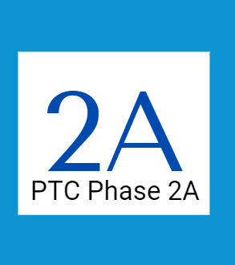
Local Office Workshop
Provider Time Capture Phase 2A

Slide 2

Agenda
Overview portion
Overview of changes
Overview of what is not changing
Workshop portion
Payroll batch changes
Payroll entry changes
STIQ screen changes
Voucher editing changes
Support avenues
Q&A portion

Slide 3
Phase 2A timeline
March 2024
Start User Acceptance Testing (UAT)
May-July 2024
Communications and Phase 2A Workshops, other materials
July 19, 2024
Go-Live
Testing
Implementation
Mar-24 Apr-24 May-24 Jun-24 Jul-24

Slide 4
PTC Phase 2A changes
Payroll processing will change
No more pulling payroll batches
Voucher updates will change
No more editing OR PTC DCI authorizations manually
The STIQ screen changes and new STSS screen
The under/overpayment process will change
What is changing?

Slide 5
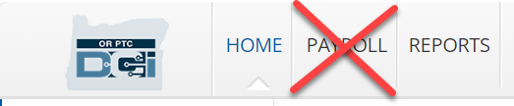
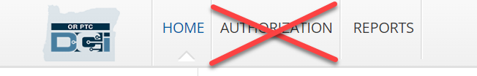
Changes to OR PTC DCI Roles/Permissions
No more Payroll Team Role
No more Authorization Permissions

Slide 6
What is NOT changing?
Most major areas of work will not change with Phase 2A
The way providers and consumers use the system will not change
Providers will not be widely informed of the change to avoid confusion or information overload
Additional trainings are being developed by OHCC to assist providers with technology-related PTC challenges (this is unrelated to Phase 2A)
Voucher creation in Mainframe will not change
Relinking and unlinking will not change
Profile maintenance in OR PTC DCI will not change
Managing or monitoring of time/mileage entries will not change
Local office ability to run reports in OR PTC DCI will not change

Slide 7
When will the changes happen?
Change implemented | Description of change
July 19, 2024 | Staff can no longer run payroll batches and no longer have access to Payroll Role in OR PTC DCI. Payroll role profiles will be inactivated. The PTC Support Team starts emailing payroll batches to offices for manual entry into STIM. The batches will only contain historical entries, starting with entries worked on or before July 13, 2024.
July 22, 2024 | Staff can use the UATH screen to edit vouchers. Authorization permissions in OR PTC DCI will be removed. STIQ screen changes and new STSS screen implemented in Mainframe.
July 28, 2024 | Time and mileage worked starting on this date and going forward will begin to be processed automatically. Time and mileage worked after this date is no longer editable in STIM. Historical entries from before this date will be emailed to offices for manual entry.

Slide 8

Payroll Batch Changes

Slide 9
Payroll Batch changes overview
Staff who currently have an OR PTC DCI profile that allows them to download payroll batches (the payroll team role) will no longer have access to this profile after Phase 2A Go-Live
If you only have a payroll profile, but will still need access after Phase 2A Go-Live, we suggest talking to your manager about requesting a supervisor role in OR PTC DCI
Staff will no longer run payroll batches
The PTC Support Team will run statewide batches daily to capture all entries made before and after go-live

Slide 10
Payroll Batches: What is changing and what is not changing?
Changing:
Staff no longer run payroll batches
Staff no longer have payroll roles in OR PTC DCI
Not changing:
For entries worked before July 28, 2024, payroll batches will be pulled manually by the PTC Support Team. Local office staff will need to input these entries into STIM (more about this in a moment)
Payroll processing dates will not change

Slide 11
How to troubleshoot batch questions
For entries worked before July 28, 2024 :
Check batch file sent to local office
Check STIM screen to make sure the entries were input correctly
Check entries in OR PTC DCI (through Punch Entry Details report or Entries tab)
For entries worked on or after July 28, 2024:
Check STIQ screen for errors
Check STIM screen to make sure the entries came through correctly
Check entries in OR PTC DCI (through Punch Entry Details report or Entries tab)

Slide 12
How to run a punch entry details report
Log into OR PTC DCI and go to the Reports tab.
Hover over the COA Reports tab and select Punch Entry Details Report.
You must narrow down the report. Type in a date range, client name (consumer), employee name (provider), and any other categories that would narrow it down. To troubleshoot entries from a specific provider, selecting a date range and provider name should be enough.
Select “Include Canceled and Rejected Punches” to include all entries.
Select Search.
To learn more about how to create the report and how to use it for troubleshooting, see the Punch Entry Details Report Guide for Staff.

Slide 13
What to look for if late payment reported
Were all entries input before the provider deadline (3 business days after the last day of the pay period)?
Late input of time/mileage is extremely common
Run punch entry details report and compare the created date to the service date: was the created date before the provider’s submission deadline?
If all entries were input on time, were all entries entered into STIM (either manually for pre-Phase 2A or automatically for post-Phase 2A)?
If entries were input on time but are missing from STIM, check payroll batches sent to your office as a batch may have been missed (completely or partially).
If there was a late payment not due to provider error, the provider should file a late payment form with OHCC (complete the Late or Partial Payment Request Form).

Slide 14

Payroll Entry Changes

Slide 15
Payroll Entry changes: entries before Go-Live
Entries made for time/mileage worked before July 28, 2024:
A designated email inbox for your office will receive payroll batches from the PTC Support Team.
Your branch’s entries must be entered into STIM by designated staff in your local office.
If your branch does not handle payroll entry, then the office that does handle them will receive the batch files
The email address that receives batches has been assigned to your office: APD-IM-24-025 New Shared Payroll Email Addresses

Slide 16
Payroll Entry changes: entries after Go-Live
Entries made for time/mileage worked after July 28th:
The PTC Support Team will run payroll batches daily
Payroll batches will be processed automatically in STIM
Staff can view these entries in STIM but cannot make changes

Slide 17
Payroll Entry: What is changing and what is not changing?
Changing:
You’ll receive batches from the PTC Support Team instead of a member of your office’s staff who run batches
Batches will come in daily and will be smaller
STIQ screen changes and new STSS screen (more in a moment)
Entries worked after Phase 2A Go-Live will not be entered in STIM by staff
Not changing:
For entries with a date of service prior to Phase 2A Go-Live, nothing about entering the time in STIM will change
Entries received via payroll batch will be treated the same as you treat entries now
Entries that would be rounded in STIM currently must still be rounded after Phase 2A
See slides 10-14 of Oct 2023 PTC Webinar presentation.

Slide 18

New HCW Payroll Inboxes
If your office processes payroll in STIM, there should be a new HCW Payroll email inbox set up for your office. These email inboxes will receive payroll batches from the PTC Support Team.
Your office must have staff designated to checking the email inbox.
Entries from your branch must be entered into STIM! Any entry missed or entered late will result in a late paycheck for the provider and possible late payment penalty fees.
See APD-IM-24-025 New Shared Payroll Email Addresses

Slide 19
How to manage the payroll batches
During July and August 2024, each shared payroll email inbox must be checked daily!
The email inbox will receive batches daily with entries from multiple branches, and any entries from your branch these must be entered into STIM as soon as possible to meet payment deadlines.
Starting September 2024:
A staff member must check the designated email inbox regularly
You may receive batches as frequently as daily
How often the local office should open the batch reports and input entries into STIM is determined by your local office
Tip: Your office may want to complete these actions at the same frequency as your office currently runs payroll batches.

Slide 20
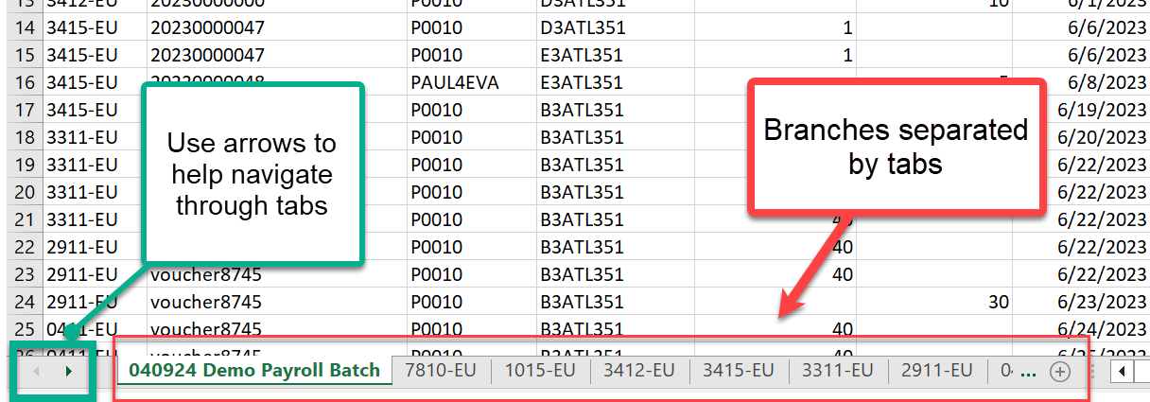
More about the payroll batches
PTC Support will send batch emails with attached Excel batch files based on program (APD/AAA, OPI, HSD) rather than by branch. Rarely, an individual batch may be sent to only your branch (emergency batches, large file size batches, etc.). Some offices who complete STIM entry for multiple branches will receive only batch files for those branches.
Batch files sent by program (or otherwise with multiple branches) will have branches separated by tab.
Branch file names will usually follow the naming convention of ProgramName_DD.MM.YYYY, for example, APDAAA_07.19.2024.
Example of batch with a tab for each branch

Slide 21
Types of batches
Frequency/Timeframe | Entry type | How entries go to Mainframe
Daily (M-F) from 7/19/24-7/26/24; Then daily (M-F), starting 7/29/24 | Historical entries worked up until 7/13/24; Then historical entries worked up until 7/27/24. | Batches emailed by PTC Support Team to offices. Staff manually enter into STIM.
Daily (M-F), starting 8/27/24 | Historical entries from 7/28 through last day of previous pay period. | Entries are processed in Mainframe using new automation; Any errors will be suspended in the STIQ screen in Mainframe
Once per pay period, one business day after the provider submission deadline for the pay period (four business days after the end of the pay period) | Timely entries (entries entered by the provider entry deadline) worked after go-live. | Entries are processed in Mainframe using new automation; Any errors will be suspended in the STIQ screen in Mainframe
As needed | Emergency batch for a provider: For permanently terminated/resigned provider number or APS suspensions only. Requests come from Central Office. Only needed when the provider has recent time/mileage entries. NOT for a provider who stops working for a consumer, or for a local office error or delay. Late pay due to error or delay could lead to late payment penalty fees. | Entries are processed in Mainframe using new automation; Any errors will be suspended in the STIQ screen in Mainframe

Slide 22

STIQ Screen Changes & New STSS Screen

Slide 23
STIQ screen changes & new STSS screen
The Mainframe STIQ screen will hold suspensions/errors for entries worked after Phase 2A Go-Live.
Details of suspensions/errors will be visible on the STSS screen.
Entry suspensions/errors may be more common at first, but we believe they will become rare.
It is important to have a process for checking for any suspensions/errors to make sure nothing is missed.
Staff will have access to the STSS screen on 7/22/24.

Slide 24
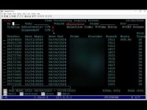
Intro to STIQ screen

Slide 25
STIQ screen errors, part 1 of 3
Mileage entered in decimals:
If a provider inputs mileage as a decimal instead of a whole number, this will not go through to STIM.
For mileage entries worked after Phase 2A Go-Live, all mileage entries for a single pay period will be rolled up into one entry.
Any mileage entries entered as a decimal amount will not come through for payment in STIM.
The decimal mileage entry will show on the STIQ screen as a suspense error and the entry details will be viewed on the STSS screen.
The local office staff member must cancel all mileage entries in OR PTC DCI for that pay period. The local office staff member must then recreate one mileage entry that equals the total mileage claimed rounded up to the nearest whole number.
See APD-IM-24-027 Miles in Whole Numbers in OR PTC DCI for more information.

Slide 26
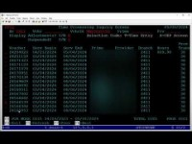
Miles in Decimals Error

Slide 27
STIQ screen errors, part 2 of 3
Mileage entries without hourly entries error:
Per policy, mileage cannot be claimed without hours also being claimed for that pay period.
If a mileage entry comes through in a batch, but no hourly entries were made for that pay period, then the mileage entry will be suspended in the STIQ screen. Details can be found on the STSS screen.
In this situation, the local office will need to cancel the mileage entries and ask the provider to resubmit their mileage and submit time entries in OR PTC DCI for the pay period.

Slide 28
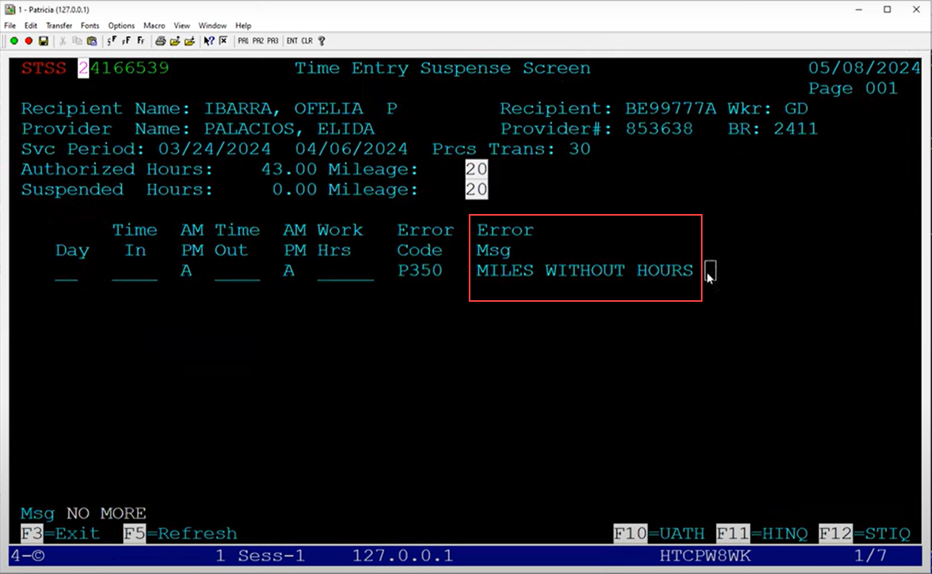

Slide 29
STIQ screen errors, part 3 of 3
Entry amount exceeds remaining balance error:
If a provider makes an entry for more than the remaining balance on the authorization, it will go to the STIQ screen as an error.
For this error to occur, the entry would have to be made around the same time that the authorization is being edited down.
If the entry needs to be approved, the voucher must be edited to accommodate the entry. This will result in an underpayment, which will be processed automatically.
If the entry should not be approved, local office staff should cancel or edit the entry in OR PTC DCI to be within the authorized hours.
This type of error should be rare.

Slide 30

Mainframe Voucher Changes (UATH)

Slide 31
Update Authorization Screen (UATH), part 1 of 3
Starting July 22nd, mainframe vouchers will be editable in UATH. This means you will no longer need to void and reissue vouchers to make most types of changes.
Go to HINQ with the prime or provider number and find the voucher number. Look up the voucher number in UATH.
Edit the voucher and save your changes.
Mainframe voucher edits will automatically come through to OR PTC DCI in real time. This means you will not need to make edits to OR PTC DCI authorizations.
Note: Staff cannot access UATH until July 22nd

Slide 32
Update Authorization Screen (UATH), part 2 of 3
What can be edited when voucher is in 30 status?
Begin Date
End Date
Increase or Decrease of Hours
Increase, decrease, or add miles to voucher
Rate Change (will pull in the latest rate from the rate table)
Branch (MUST match the service branch in SELG)
What can be edited when voucher is in 36 or 46 status?
Increase or Decrease of Hours
Increase, decrease, or add miles to voucher
Rate Change (will pull in the latest rate from the rate table)
End Date (move back only)

Slide 33
Update Authorization Screen (UATH), part 3 of 3
What you cannot edit in UATH:
Procedure code/service code (requires void and reissue)
ONGO branch (update in ONIQ/ONGO to match SELG branch)
Dates cannot go outside of the pay period

Slide 34
How to edit in UATH
From a blank DHR screen, type UATH and the voucher number and hit enter
The dates, hours, and miles will be highlighted.
Update any of the highlighted fields by simply typing over the field with the new value.
Press enter and then F9 to save the changes.
Note: This will not update ONGO! If ONGO needs to be updated as well, you must go to the ONIQ screen and update the ONGO to match.

Slide 35
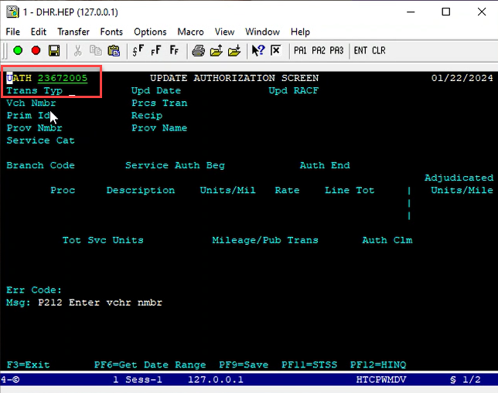
1

Slide 36
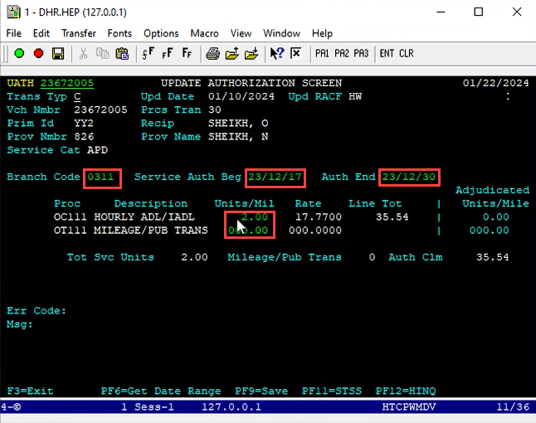
2

Slide 37
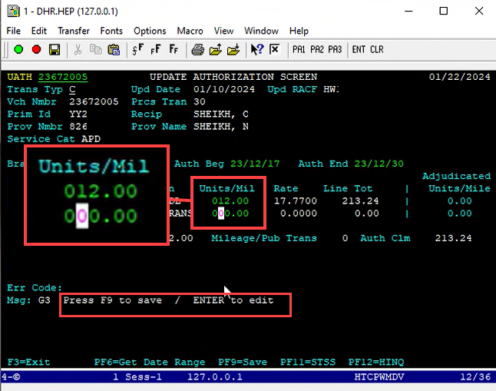
3

Slide 38
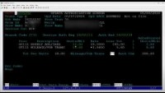
UATH screen overview (30 status)

Slide 39
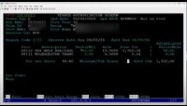
UATH screen overview (36 status)

Slide 40
UATH errors
Claimed hours/miles exceed requested initial balance
Update made in UATH but branch does not match SELG branch
Entries exist after requested end date/prior to requested start date
Requested end date/start date overlaps with another authorization
End date cannot be before start date
Service hours exceed allowed hours (hours must be prorated)

Slide 41
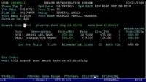
UATH errors

Slide 42
Update ONGO through ONIQ screen
If a voucher is updated and the changes will be ongoing until the ONGO expires, then follow these steps:
Navigate to ONIQ screen
Select the ONGO record to be updated
Update the information to match the voucher*
Press enter and F9 to save
*If miles need to be removed or added, the ONGO will need to be ended and a new ONGO created.

Slide 43
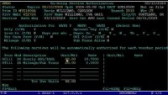
Edit ONGO

Slide 44
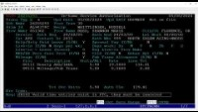
Voiding the voucher will reject the PTC authorization

Slide 45
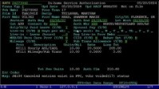
New: 17 Status Voucher

Slide 46

Authorizations Widget and Auth Entries Report

Slide 47
No more authorization tab or authorization details
Since staff will no longer need to edit authorizations, the option to view authorization details directly in OR PTC DCI will be going away with Phase 2A.
The best way to view authorization information will be via the authorizations widget on the dashboard.

Slide 48
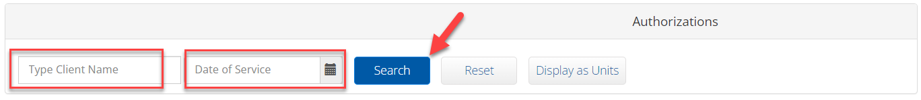
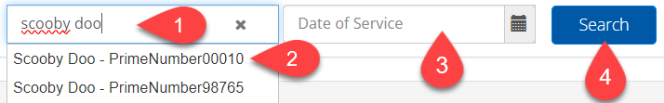
Authorizations Widget, part 1 of 3
Authorizations Widget on your OR PTC DCI Dashboard (home page):
Type the consumer’s name
Select the consumer
Type or select the relevant date
Click Search

Slide 49
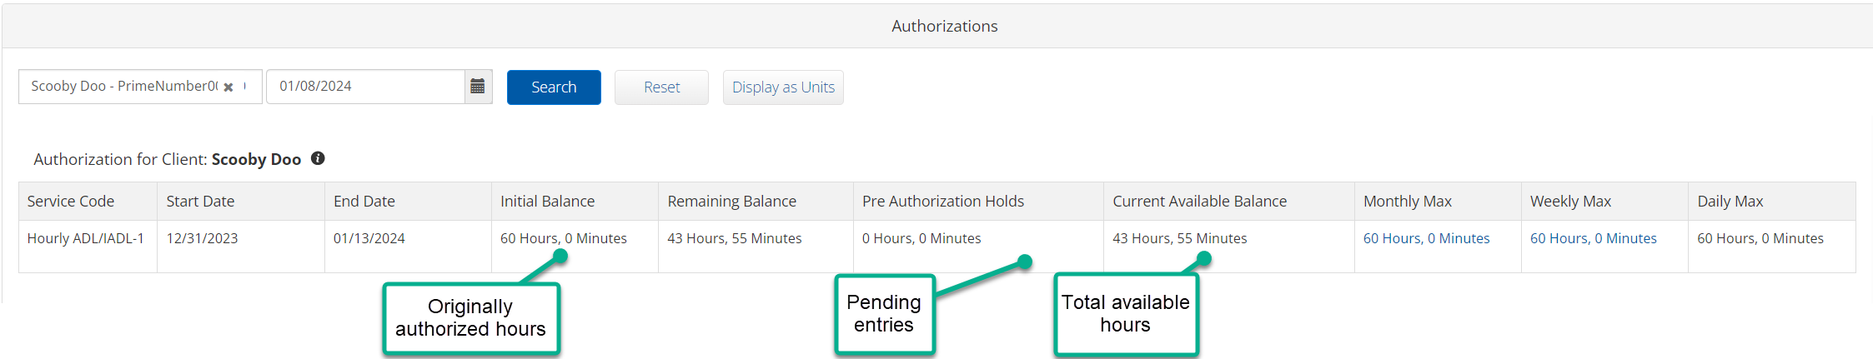
Authorizations Widget, part 2 of 3
Authorizations Widget Guide

Slide 50
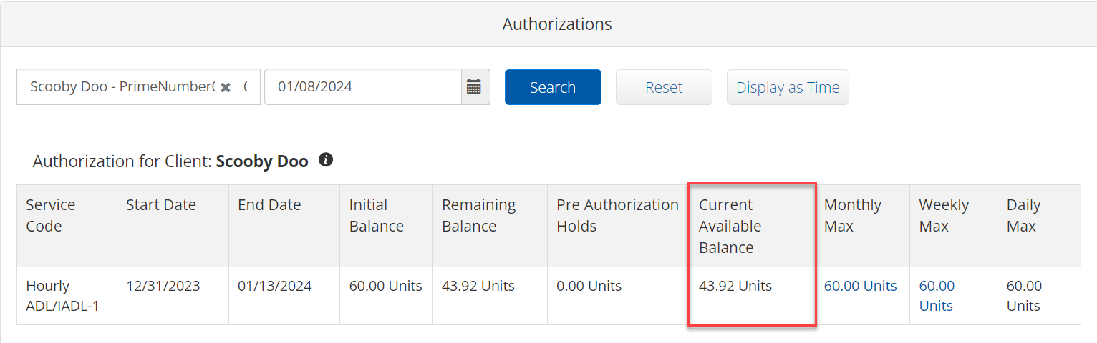
Authorizations Widget, part 3 of 3
The current available balance amount shown will be rounded down to the nearest whole minute when displayed as time. For the most accurate remaining amount, use the current available balance in units and use the conversion chart.
Time Conversion Chart - Minutes to Decimal Hours

Slide 51
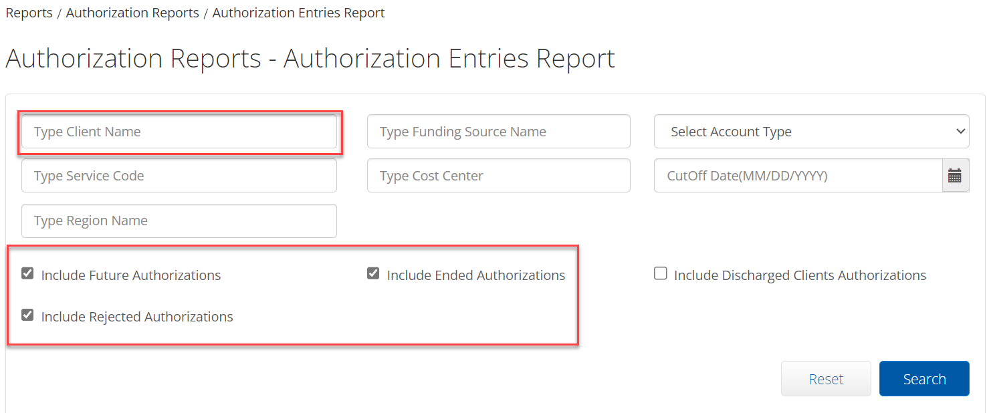
Authorization Entries Report, part 1 of 2
To view the Authorization ID for comparison against the voucher ID in Mainframe, we suggest using the Authorization Entries Report.
Go to Reports Tab and select Authorization Reports, then Authorization Entries Report.
Type the consumer’s name in Type Client Name field and any additional parameters.
We recommend including future authorizations, rejected authorizations, and ended authorizations. Click Search
Download the report.

Slide 52
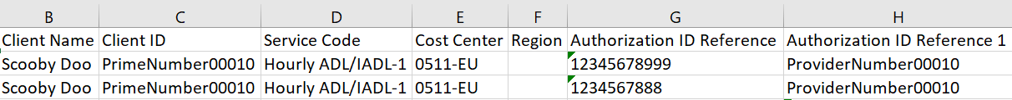
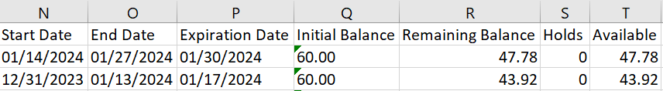
The report contains the consumer’s name, Prime number, service code, cost center, voucher number, and provider number. It also shows the start and end date, initial balance, and remaining balance.
Authorization Entries Report, part 2 of 2

Slide 53

Under/overpayment Changes

Slide 54
Underpayment Changes, part 1 of 2
Underpayments for entries worked before Phase 2A Go-Live will be completed using the current process except that:
The batch will be pulled by the PTC Support Team and emailed to the local office for processing.
Remember that this process involves a referral to the Provider Relations Unit (PRU).

Slide 55
Underpayment Changes, part 2 of 2
Underpayments for entries worked after Phase 2A Go-Live will usually be processed automatically.
If the provider was already paid and they enter historical time that is within their authorized hours, the underpayment will be processed automatically.
If an entry exceeded the authorized hours, the voucher must be edited to accommodate the entry. This will result in an underpayment, which will be processed automatically.

Slide 56
Overpayments, part 1 of 2
For an overpayment for time worked before Phase 2A Go-Live, the entry must be canceled or edited in OR PTC DCI.
An entry for a negative amount will be pulled into a payroll batch by the PTC Support Team and emailed to the local office for processing. This will result in staff needing to delete or edit the entry in STIM.
Edit the voucher down to the approved authorized hours/miles.
If a voucher needs to be voided that already has time claimed against it in OR PTC DCI, Mainframe will not allow the voucher to be voided until the entries are cancelled in OR PTC DCI.
Report Overpayment to PRU.
PRU completes the overpayment recoupment.

Slide 57
Overpayments, part 2 of 2
For entries worked after Phase 2A Go-Live, the process must start with cancelling or editing entries in OR PTC DCI that resulted in overpayment.
The time/mileage will be backed out of STIM through automated processes.
Edit the voucher down to the approved authorized hours/miles.
If a voucher needs to be voided that already has time claimed against it in OR PTC DCI, Mainframe will not allow the voucher to be voided until the entries are cancelled in OR PTC DCI.
Report Overpayment to PRU.
PRU must still be involved to complete the overpayment recoupment.
The Overpayment Voucher Report will help manage/monitor overpayments.

Slide 58

Phase 2A Go-Live Support

Slide 59
Timing of changes
Change implemented | Description of change
July 19, 2024 | Staff can no longer run payroll batches and no longer have access to Payroll Role in OR PTC DCI.
July 19, 2024 | The PTC Support Team will begin running daily payroll batches for time/mileage worked on or before July 13th. The PTC Support Team will send these batches to the local offices at designated email addresses.
July 22, 2024 | Staff previously determined (by BOTS/OIS, not the PTC Team) to need access are granted access to the new UATH and STSS Mainframe screens. Staff can edit vouchers in Mainframe and view any payment suspensions/errors.
July 22, 2024 | Authorization permissions removed. Staff can no longer access authorization details directly in OR PTC DCI. Staff should use the Authorizations Widget, Authorization Entries report, or Punch Entry Details report to troubleshoot authorization questions or issues.
July 28-Aug 10, 2024 | First pay period that will be paid using newly developed automation. From this pay period going forward, time/mileage worked will not be entered manually by local office staff into STIM. Historical entries from before this pay period will still be entered manually into STIM.

Slide 60
Resources for troubleshooting
Authorizations Widget Guide for Staff
Punch Entry Details Report Guide for Staff
Time Entry Management Guide
Reports Guide
Provider Cannot Claim Time or Reports Incorrect Payment (updates coming soon)
Troubleshooting Guide
Check out PTC Staff Tools or PTC Staff Tools (OWL site- scroll down to PTC info) for all PTC resources for staff

Slide 61
Support after Phase 2A Go-Live
PTC Phase 2A Command Center
PTC Support Box – PTC.Support@odhsoha.Oregon.gov for Phase 2A questions, and for everything else!
Outgoing updates and clarifications as needed (emails and transmittals)

Slide 62
Phase 2A Command Center Schedule
July 22-July 26 – Monday through Friday, 7am-5pm
July 29-Aug 16 – Mon, Wed, Fri 8am-12pm
July 29-Aug 16 – Tues, Thu 1pm-5pm
Link to Join Command Center
Only click the link during Command Center hours, when you are ready to ask a Phase 2A related question

