Slide 1
All Roads Transportation Safety (ARTS) Program
Christina McDaniel-Wilson, P.E.
State Traffic Safety Engineer
Oregon Department of Transportation
August, 2020
Notes:
The principles and purpose of ARTS and HSIP are:
The program goal is to reduce fatal and serious injury crashes.
The program must include all public roads.
The program is data driven and blind to jurisdiction.
Both traditional “hot spot” methodology and systemic methodology will be used
The process will be overseen by ODOT Regions.
The ARTS program primarily uses federal funds from the Highway Safety Improvement Program (HSIP).

Slide 2
Between 2014 and 2018, Oregon averaged 1,900 fatal and serious injury crashes each year
Notes:
The ARTS program is intended to address safety needs on all public roads in Oregon. Half of the fatal and serious injury (F&A) crashes occur on non-state roadways. Between 2014 and 2018, F&A crashes averaged 1,900 per year statewide.
The principles and purpose of the ARTS program are set to fulfill the requirements of the federal Highway Safety Improvement Program (HSIP):
The program goal is to reduce fatal and serious injury crashes.
The program must include all public roads.
The program is data driven and blind to jurisdiction.
Both traditional “hot spot” methodology and systemic methodology will be used
The ARTS program primarily uses federal funds from the Highway Safety Improvement Program (HSIP) and the process is overseen by the regions.
“About half the fatal and serious injuries in Oregon occur on non-state roadways”

Slide 3
50% of Oregon’s Fatal and Serious injury crashes occur on local agency roads
Notes:
About 50% of the F&A crashes occur on local agency roads. By working collaboratively with local road jurisdictions (cities, counties, MPO’s and tribes) ODOT expects to increase awareness of safety on all roads, promote best practices for infrastructure safety, complement behavioral safety efforts and focus limited resources to reduce fatal and serious injury crashes in the state of Oregon. The program will fund all public roads and be data driven to achieve the greatest benefits in crash reduction.
“there are 1700 fatalities and serious injuries in Oregon per year”

Slide 4
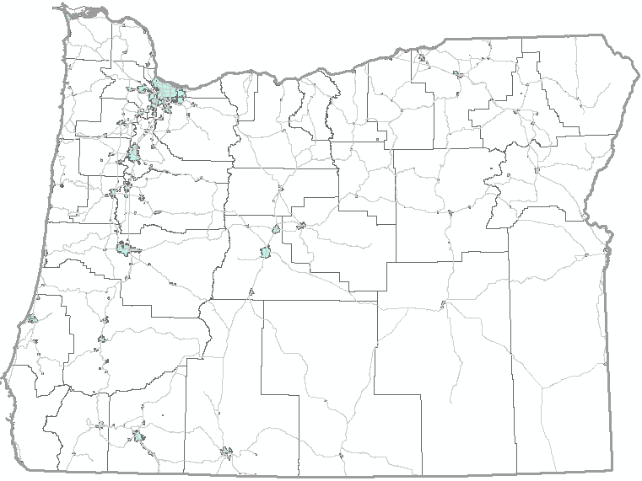
Statewide Averages
State Highways
931 fatal and serious injury crashes per year;
8,000 miles
City Streets
548 fatal and serious injury crashes per year;
11,000 miles
49%
29%
County Roads
418 fatal and serious injury crashes per year;
33,000 miles
22%
2014 – 2018 Fatal and Serious Injury crash data
Notes:
On average, about 50% of fatal and serious injury (F&A) crashes statewide occur on state highways, ~30% on city streets and ~20% on county roads. While cities streets (for some cities, main street is a state highway) are typically urban and county roads are typically rural, state highways capture a mix of both urban and rural location types. In urban areas, these crashes generally occur at intersections and include vulnerable users. In rural locations, these crashes are typically flagged as roadway departure crashes.
“ODOT, cities and counties agreed on principles for the program”

Slide 5
Vulnerable Users
On average, between 2014 and 2018:
One quarter of the fatal and severe injury crashes each year involved vulnerable users (pedestrian, bicycle and motorcycle)
Fatal crashes have been steadily increasing, especially for pedestrians and motorcyclists
2014 – 2018 Fatal and Serious Injury crash data
Notes:
“Vulnerable road user” is a term applied to those most at risk in traffic. Pedestrians, pedal cyclists, and motor cyclists are accordingly considered as vulnerable since they benefit from little or no external protective devices that would absorb energy in a collision. Over the last five years, the number of F&A crashes involving a vulnerable user has been steading increasing, about one quarter of the F&A crashes each year involve a vulnerable user.

Slide 6
ARTS is a data driven process targeted at reducing Fatal and serious injuries
Notes:
MAP 21 stresses that the Highway Safety Improvement Program (HSIP) is a data driven process that reduces fatalities and serious injuries. Most highway projects incorporate or improve one or more design features or elements that relate to highway safety, such as guardrail, intersection geometry, signing and pavement markings or other similar elements. HSIP is not meant as a tool to bring roadways up to standard, improve the perceived safety of the roadway or to repair deferred maintenance. HSIP funds are only for locations or corridors where it is determined that the specific project action can, with confidence, produce a measurable and significant reduction in fatalities or serious injuries.
HSIP requires a data driven process that focuses on identifying safety problems through data analysis, identifying effective countermeasures to address the problems and prioritizing the projects. HSIP funds are used to deliver focused benefits for safety within the realities of constrained funding. To achieve the maximum benefit, the focus of the program is on cost effective use of the funds, priority will be given to projects having better returns on the investment in terms of reducing fatalities and serious injuries. Each application is required to use 2014 – 2018 crash data and apply countermeasures from the ODOT CRF list.
“safety can mean many things to different people”

Slide 7
Using proven Safety Countermeasures and prioritizing based on benefit/cost (B/C) or cost effectiveness index (CEI), most good for dollar spent
Notes:
The objective of ARTS and HSIP is to significantly reduce the occurrence of fatalities and serious injuries.
A data-driven approach uses crash data, risk factors, or other data supported methods to identify possible locations to achieve the greatest benefits.
All Projects shall:
Address a specific Safety problem contributing to fatalities and serious injuries
Use countermeasures that correct or substantially improve the fatal and serious injury problem
Use ODOT crash data to establish the Benefit/Cost ratio
Use ODOT Benefit Cost method or Cost Effectiveness Index for (Systemic pedestrian and bicycle applications)
Be prioritized based on the Benefit/Cost Ratio for developing the 150% list
Use only countermeasures from the approved ODOT Crash Reduction Factor list
Projects must include written support from the Road Jurisdiction if the project is proposed by another agency
The Benefit Cost Ratio and Cost Effectiveness Index must be based on the 2014 – 2018 crash data
“criteria are standards, rules or tests on which a judgment or decision can be based”

Slide 8
Using traditional hot spot methods we will target locations with histories of fatal and serious Injury crashes
Notes:
The traditional approach to safety is to identify “hot spot” locations, and then identify measures to implement by diagnosing the “hot spot”.
Hot Spot projects shall:
Address a location with a crash history of at least one fatal or serious injury crash within the last five years.
Use only approved “Hot Spot” countermeasures as listed in the ODOT Crash Reduction factors list
Be prioritized based on Benefit Cost
“traditional approach to safety”

Slide 9
Using the Systemic approach we will target low cost measures that can be widely implemented at multiple locations
Notes:
The systemic approach identifies a few proven low-cost measures to be widely implemented, then implements the measures where there is evidence that they would be most useful. The systemic measures have been proven to successfully reduce the occurrence of fatal and serious injury crashes. The sites may be selected from ODOT’s list of priority corridors for Roadway Departure, Intersections or Pedestrian/Bicycle crashes.
Systemic Projects shall:
Use only approved “Systemic” countermeasures as listed in the ODOT Crash Reduction factors list
Not require the acquisition of significant amounts of right of way (more than 10% of project costs), preferably no right of way.
Be prioritized based on Benefit Cost or Cost Effectiveness Index (CEI) for the Pedestrian and Bicycle applications
Systemic Projects should:
Have a history of fatal or serious injury crashes or a risk of high severity crashes and preferably used on priority corridors from systemic plans.
“this approach may identify locations or corridors not typically identified through traditional hot spot analyses”

Slide 10
ARTS
Hot Spot
(50%)
Systemic
(50%)
Roadway Departure
(50%)
Intersection
(35%)
Bike/Ped
(15%)
The statewide ARTS program funding goal is split 50/50 between Hot Spot and Systemic application types
Notes:
Regions are encouraged to spend 50% of their funding on hotspot projects and 50% on systemic projects. Systemic funding is intended to be used for roadway departure, intersections and pedestrian/bicycle type projects. ARTS will give regions the flexibility to determine the appropriate splits between systemic types of projects for their regions.
Systemic funding is intended to be used for roadway departure, intersections and pedestrian/bicycle type projects. ARTS will give regions the flexibility to determine the appropriate splits between systemic types of projects for their regions.
“funds are split to each region based on the amount of fatalities and serious injuries occurring in the region on all public roads”

Slide 11
Safety funding is allocated to each region based on the proportion of F&A crashes then further split 49% / 51 % between State and Local agency roads
Notes:
The safety funds are split to each region based on the proportion of fatal and serious injury crashes occurring in the region on all public roads. The region funding is then further split 49% / 51% between state and local agencies.
“there will be two separate processes for selecting projects, one for hot spots and one for systemic”

Slide 12
Project selection will be through a competitive application process
Notes:
Process for project selection
The process for submitting project proposals will be a competitive application process. Each jurisdiction, including ODOT, will be invited to submit projects for improvements from a large list of proven countermeasures. These submittals will be for Hot Spots and three Systemic categories: roadway departure, intersections and pedestrian/bicycle. The intent is that the ODOT regions will refine the list of submitted projects to about 150% of funding available. Regions will prioritize the project list, in order to finalize a draft list for field scoping, based on program purpose of reducing fatal and serious injuries using:
Benefit/Cost ratios for Hotspot, Systemic Roadway Departure and Systemic Intersection applications and
Cost Effectiveness Index (CEI) for pedestrian and bicycle applications
“there will be two separate processes for selecting projects, one for hot spots and one for systemic”

Slide 13
Once a refined list of projects are selected for each region a multi- disciplinary assessment will assure the right measure for the location
Notes:
Developing a list of prioritized projects
Once the refined 150% lists are ready, all projects (both hot spot and systemic) will go through a multi-discipline assessment to verify the solution. A multi-disciplinary team, including the owner of the facility, will assure the best countermeasure is chosen to mitigate fatal and serious injury crashes. The projects will also be scoped to verify the costs and any possible barriers to implementation. A finalized list of prioritized projects can then be produced with the best solution and the best cost.
Once the list is prioritized and a final 100% list is produced region’s will work with local jurisdictions to determine the delivery methods, delivering agency and timelines (applicable funding year). For project involving local agencies, the ODOT Regions will work with jurisdictions to develop an Intergovernmental Agreement. The delivering agency will be accountable for timely and fiscally responsible delivery.
The process for ARTS project selection will run concurrently with the Statewide Transportation Improvement Program (STIP) development process for the 2024-2027 STIP. The draft STIP 150% list should be complete by the end of July 2021.
“all projects will go through a multi-discipline assessment to verify the solution”

Slide 14
All applications require a 7.78% local match, and must use countermeasures from ODOT’s CRF List
Notes:
The Federal Highway Safety Improvement Program (HSIP) currently requires a 7.78% match for projects. Within the ARTS program ODOT will require participating agencies to contribute a 7.78% match to the project. In the past, local jurisdictions were highly encouraged to use State Funded Local Projects (SFLP) however, because of funding limitations, all projects should be scoped for federal delivery.
“the federal funding source currently requires a match”

Slide 15
Project selection for the 2024-2027 STIP is kicking off starting in the Summer of 2020
Notes:
Regions will meet with Local Agencies to discuss program purpose and goals starting in the summer 2020.
ODOT Regions use ARTS process to develop project lists in collaboration with local agencies
Field scoping is expected to begin in the early part of 2021
150% list due April 2021
Final lists for STIP due July 2022(following closely with the STIP development process for the 2024-27 STIP).
Follow 2024-27 STIP process to incorporate Safety projects for 2025, 2026 and 2027 (anticipated to be complete in 2022).
Delivery timeline of individual projects dependent on schedule, funding and responsible agency (anticipate agencies will complete PS&E in the funding year).

Slide 16
For more information, please contact:
Angela Kargel
ODOT Traffic Services Engineer
Angela.J.Kargel@odot.state.or.us
503-986-3594
or
Christina McDaniel-Wilson
ODOT State Traffic Safety Engineer
Christina.A.McDaniel-Wilson@odot.state.or.us
503-986-3573

