Slide 1
Informing the Capital Investment Plan
South Central Oregon Area Commission on Transportation
Notes:
Title Slide: Option 4

Slide 2
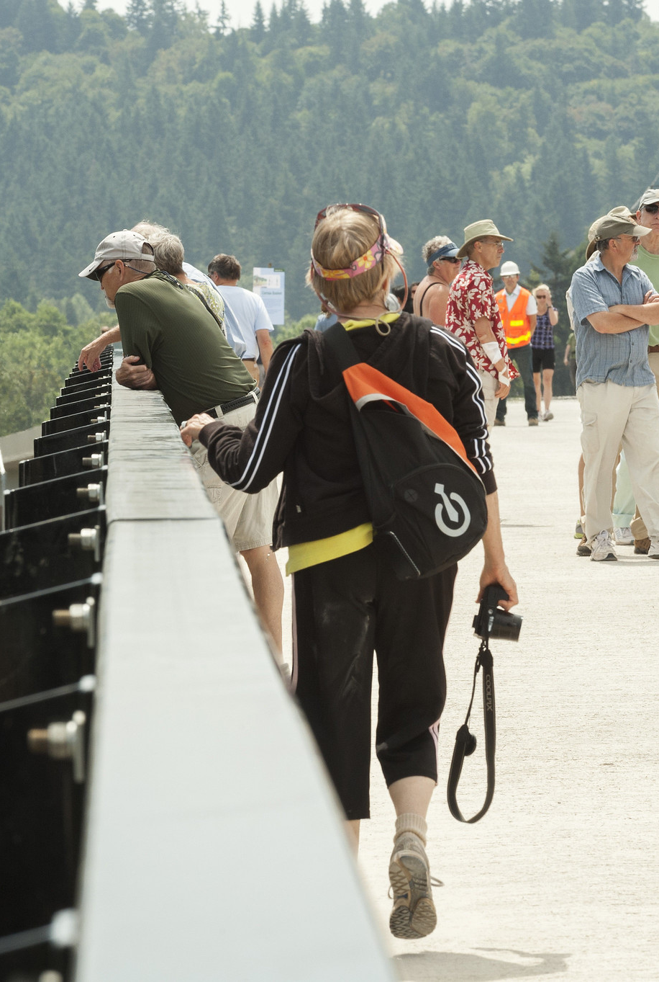
ACT Role in the CIP
Inform CIP development
Make recommendations for the prioritization and weighting of goals (e.g. State of Good Repair, Safety, Mobility) that will be used to help screen investments
Recommendations shared with OTC and used in their final decision
Update every 3-5 years
Identify needs and investment opportunities that are high-interest to the ACT
Sent to OTC and ODOT to consider for inclusion in the CIP (is not a guarantee of inclusion or funding)
ACTs to update every 2 years
Comment on draft CIP

Slide 3
Timeline and Process
Identify ACT needs & investments of interest
Provide feedback on how goals should be prioritized
Review OTC goal priorities & receive guidance on developing ACT needs / investments
Continue discussions on ACT needs / investments
Review draft and finalize
Review draft CIP and provide comments
Share interests with OTC
ACT Timeline and Process
Aug Sep Oct Nov Dec 2025
Jan Feb Mar Apr
Mid-2026
Late-2026
ODOT/OTC Timeline and Process
Finalize CIP
OTC sets goal priorities
ODOT officially starts CIP process, including identifying investment concepts
Consider ACT interests and concepts identified (from management systems and plans), screen and prioritize investments
Harmonize and iterate list; and conduct outreach on draft CIP

Slide 4
Final Preferred Scenario Capital Investment Plan Policy Goal Weights
Goals
Stewardship / SOGR
Maintains asset lifecycle
Maintains infrastructure
Improves resilience (seismic & climate)
Safety
Reduces fatalities and serious injuries
Implements crash reduction strategies
Mobility
Travel time improvements
Improved reliability
Accessibility
Completes a critical connection
Improves multimodal access
Supports moving people of all abilities
Sustainability and Climate
Transitions to cleaner vehicles and fuels
Reduces VMT
Increase low and no emission modes
Equity
Expand access to essential services
SOGR-27%
Safety-38%
Notes:
Amanda and Tova

Slide 5
Identify Needs and Investments of Interest
Per ACT Guidance document:
ODOT staff will share heat maps and facilitate discussion on significant potential investments needs and/or opportunities for years 5-10 of the CIP
Identify the top 3-5 needs and investments of highest interest to the ACT, considering:
Reasonableness: an engineering solution is possible and affordable
Urgency: there is an immediate and clear need for the investment
Regional and statewide benefit(s): the investment would have clear benefits that are evident within the ACT and beyond
Alignment with OTC investment priorities: investment ties directly to the outcomes (e.g. safety, state of good repair, etc.)
Identify other needs and investments of interest on the state system (no more than 10), using same considerations
Refine initial list with ODOT Region support
Submit to OTC in April/May 2026

Slide 6
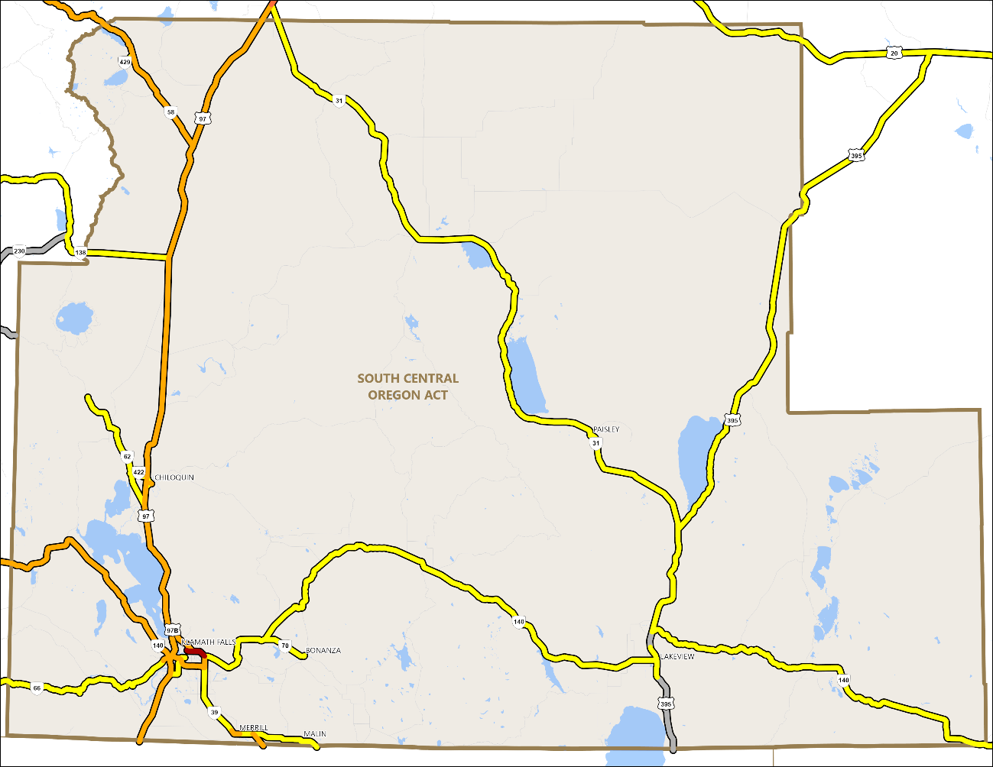
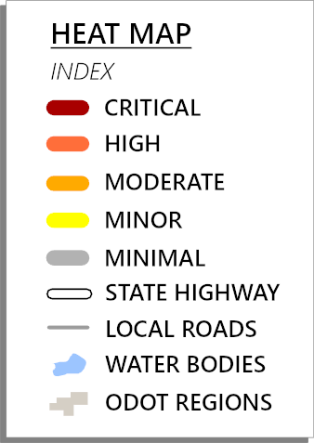
Identify Top 3-5 Priority Investments
ODOT CIP Heat Map
Safety
State of Good Repair
Mobility
Access
Climate
Equity
*Investments recently completed or underway may not be reflected on this map.
*Investments recently completed or underway may not be reflected on this map.

Slide 7
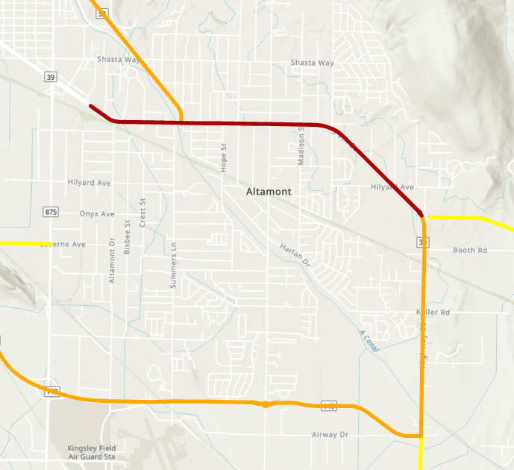
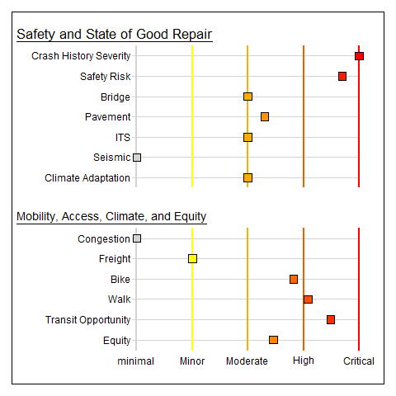
OR39 Klamath Falls

Slide 8
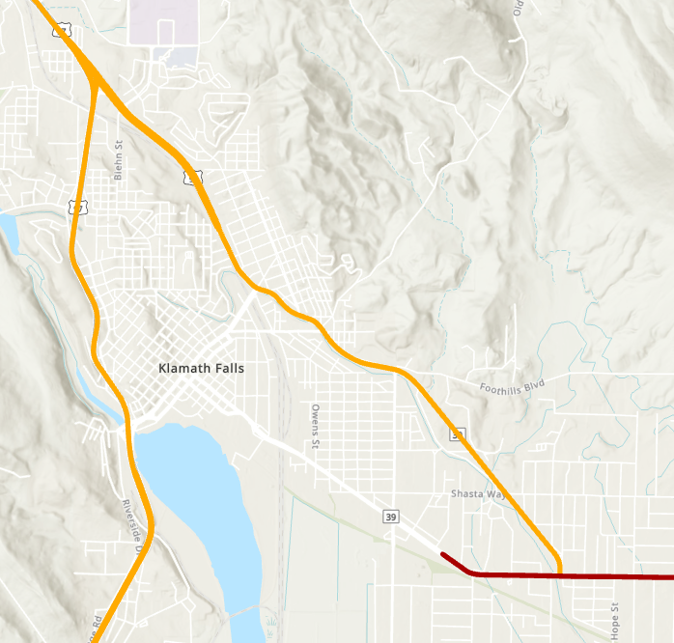
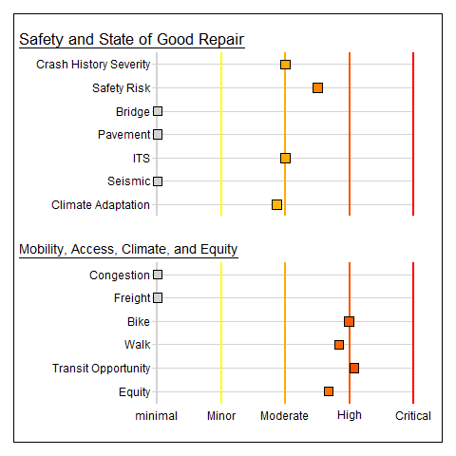
Business US97 Klamath Falls

Slide 9

US97 Consistently High Scoring
Notes:
Safety issues on US97
https://www.bendsource.com/news/a-dangerous-road-21319403

Slide 10
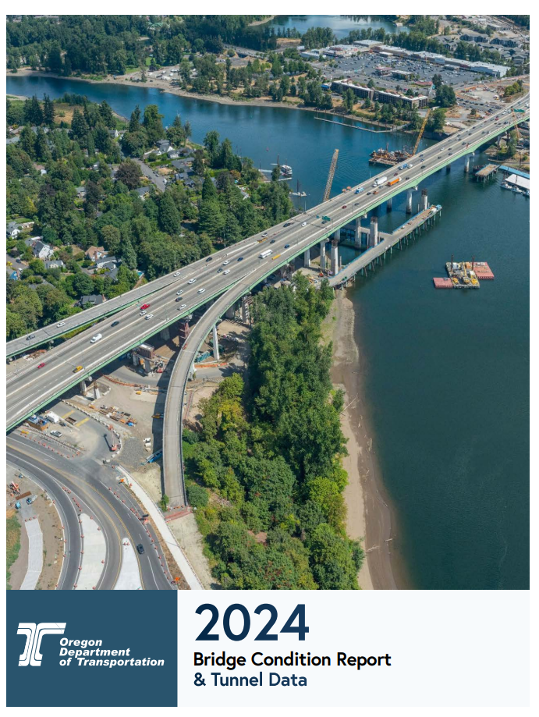
Data-Driven Investment Opportunities
There are significant asset needs within each ACT boundary that are identified through management systems and data.
With projected funding levels these assets will not be funded to the levels they need.
The CIP does not change funding amounts required to go to certain assets and categories such as:
Bridge
Pavement
Culverts
Safety
Multi-modal

Slide 11
Major Asset Needs
Bridge
OR140 bridge replacement at Canal, MP 31.40, Lake
OR140 bridge replacement at Canal, MP 30.67, Lake
OR140 bridge replacement at Twentymile Creek, Lake
Pavement
US97: Modoc Point - Algoma Paving, Klamath
US97: Shady Pine Rd - N. K. Falls Interchange Paving, Klamath

Slide 12
Major Asset Needs
Safety
OR 39 South Sixth street
US 97 Chemult to Klamath Falls
US 97 at Dan O’Brien Way
Freight
OR 140 to Lakeview
US 97 Passing Lanes
Pedestrian/Bicycle
OR 140 Lakeview

Slide 13
Draft Priority List:
 | Name | Description
1 | U.S. 97: Safety Enhancements, Passing Lanes & Divided Highway | Add passing lanes, shoulder widening, median barrier, and addiitonal safety features (e.g., rumble stips & variable speed limit) targeting the segment between mile posts 214 and 240 first, specifically the segment within the 230's.
2 | O.R. 140: Deep Creek - Deep Creek Curves | This segment of Highway 140E is not a designated freight route due to a segment know as the Deep Creek Curves. This project aims to remove the freight restriction through curve correction & highway widening, opening the route to freight coming from the East and the South.
3 | O.R. 39: South 6th Street Modernization & "Y Junction" Intersection Improvements | Safety & congestion upgrades; omplete modernization of South 6th Street; sidewalks, bike lanes, signal upgrades, center median island, undergrounding of utilities, street lighting, & roundabout at "Y-Junction" at KCC & at OR39 and the South Side Bypass.
4 | O.R. 140E: Lakeview Pedestrian Improvements & Streetscape | Construct bike lanes, sidewalks, lighting, enhanced pedestrian crossings, and additional streetscape features on O.R. 140 from the Lake County Fairgrounds entrance to the existing sidewalks in Lakeview (just over 1/4 of a mile)
5 | U.S. 97 @ Dan O'Brien Way Intersection | Construct roundabout to replace existing intersection, to include separated slip/ truck lane to Port of Entry for CMVs.

