Slide 1

South Central Oregon Area Commission on Transportation

Slide 2
Funding/Budget Challenges
Why Transportation Agencies Are Cutting Maintenance

Slide 3
Lake County Project/Investment Needs

Slide 4
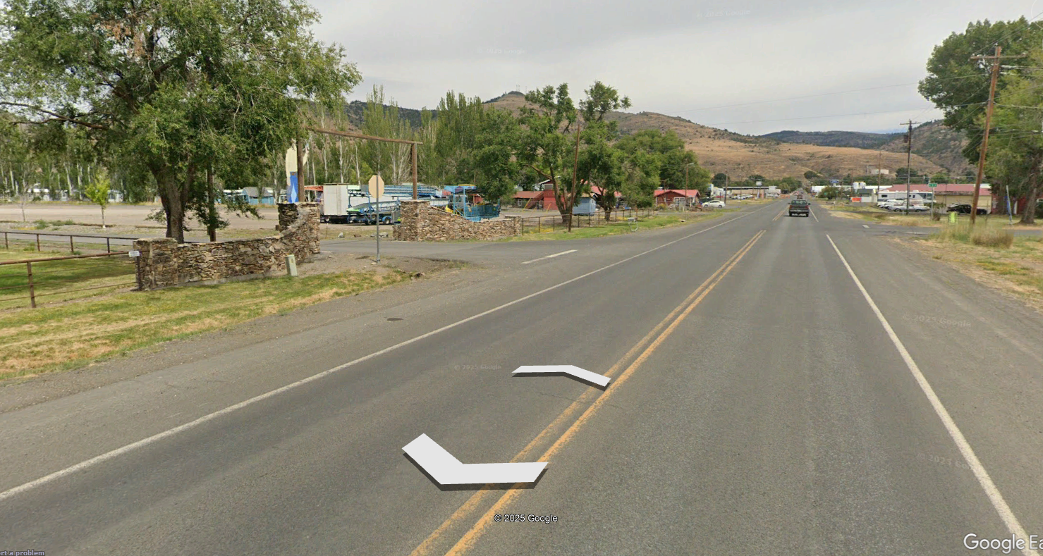
Highway 140: Lakeview Multimodal & Streetscape Improvements

Slide 5
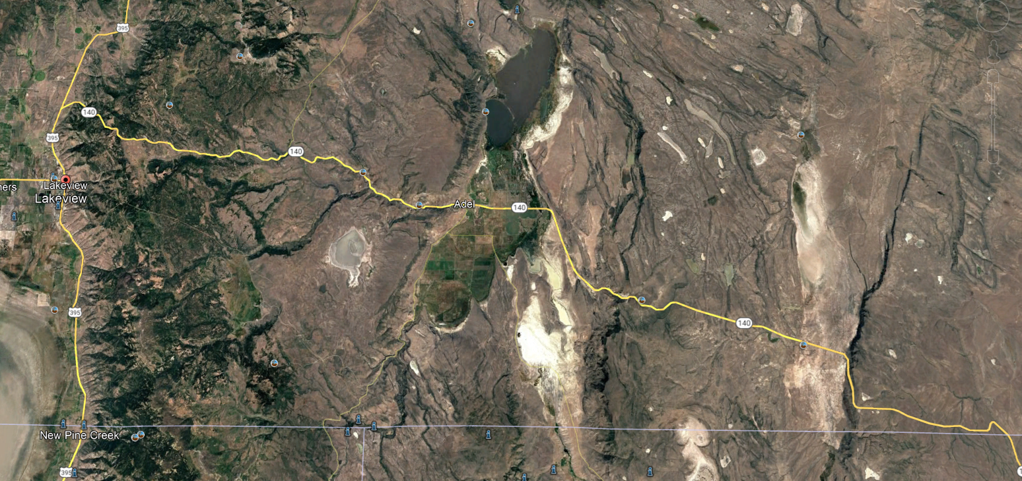
Highway 140E Designation as Freight Route

Slide 6
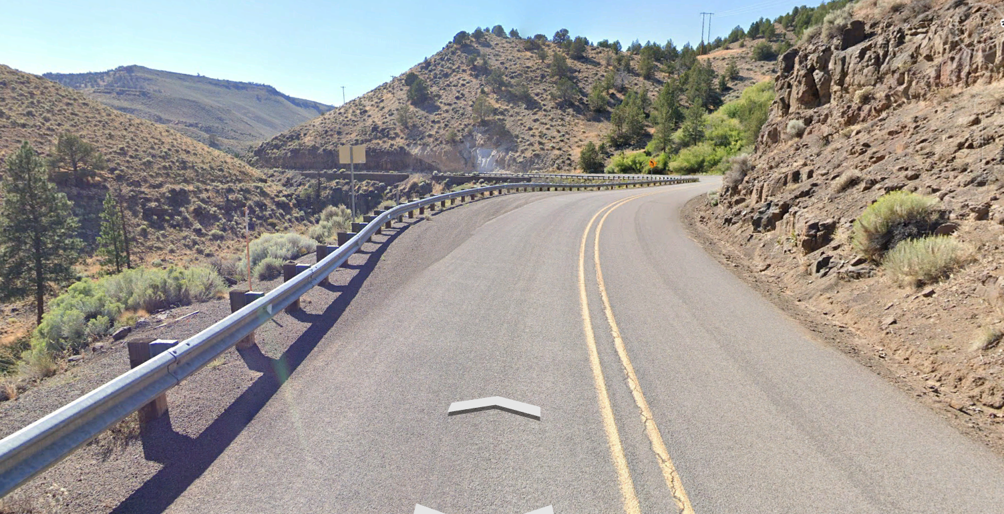
Highway 140E Deep Creek Curves

Slide 7
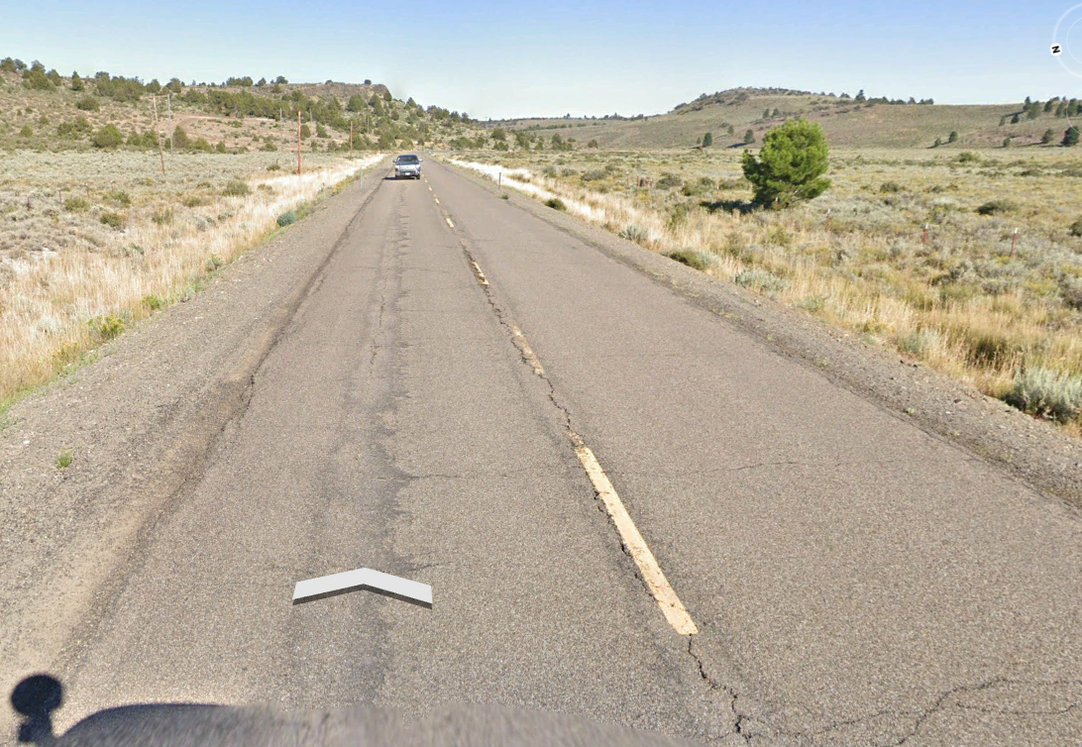
Highway 140E Shoulders

Slide 8
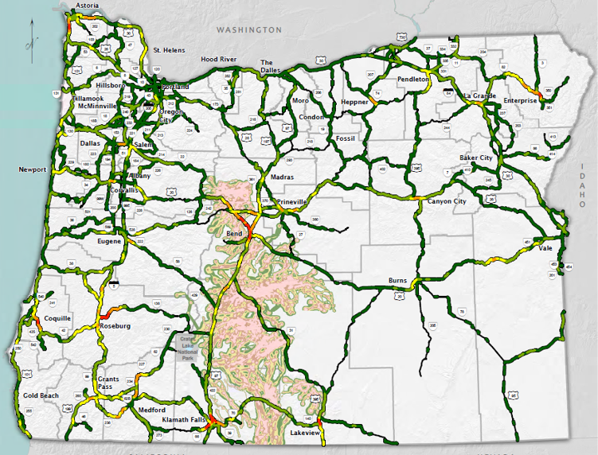
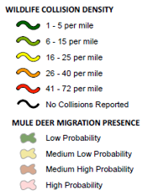
Wildlife Crossings & Fencing

Slide 9
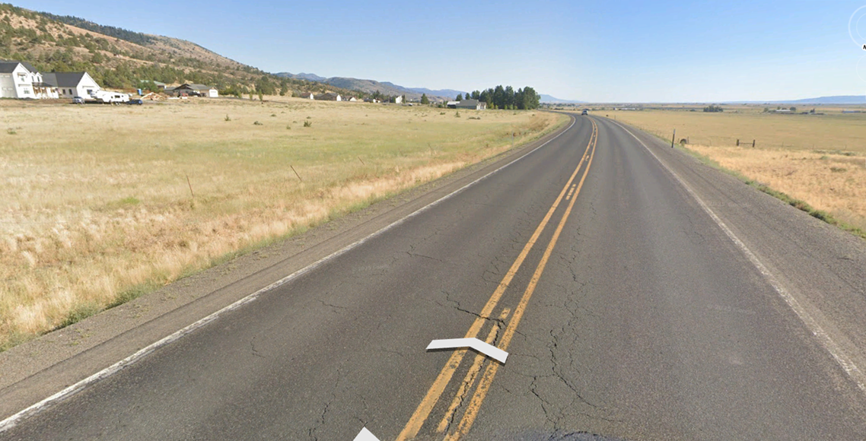
Wildlife Crossings & Fencing (U.S. 395 North)

Slide 10
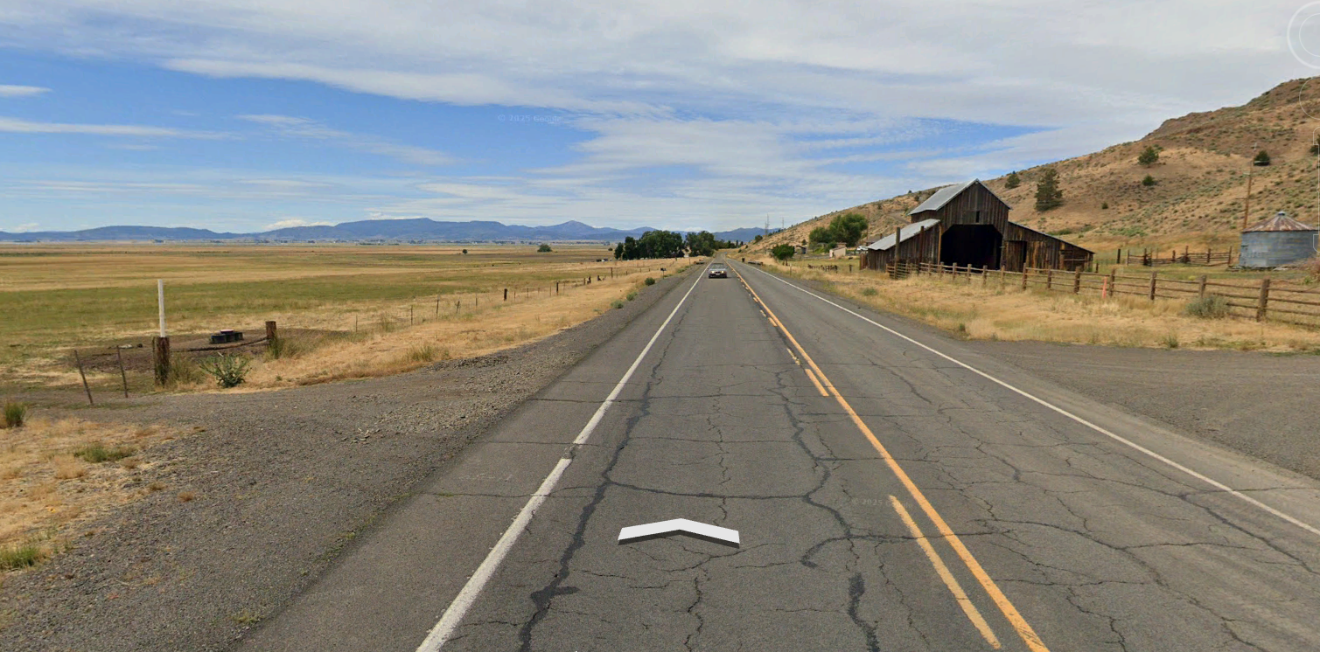
Wildlife Crossings & Fencing (U.S. 395 South)

Slide 11

Lake County Projects in Development/Design
Highway 140E Bridges (Mud & Blue Creek)
Deep Creek Curve Correction Advanced Investigation
Hwy. 20 Timber Bridges @ Riley (Silver Creek). This is Harney County, with impacts to Lake County residents.
EV Charging Facilities – ODOT & Beyond

Slide 12
Needed Preservation of Existing Facilities
Highway 140E: Quartz Mtn. Summit – NF-3733 (MP 67 – 73)
U.S. 395: Valley Falls – California State Line (Prioritize Lakeview to County Rd. 2-14 if phased)
Highway 140E: Warner Summit – Adel
Highway 31: County Road 4-15 – Weaver Lane (Picture Rock Pass)

Slide 13
Everything ODOT
https://www.oregon.gov/odot/pages/index.aspx

Slide 14
Questions?

