Slide 1
Build America Buy America in 2023
Michael Dennee, Contract Services Group Coordinator
Notes:
Title Slide: Option 1

Slide 2
What has changed
Build America Buy America requires that all iron, steel, manufactured products, and construction materials used in construction projects are produced in the US
Since FHWA already has a long-standing Buy America program, the requirements for iron and steel are still the same as they have always been
There is also an interpretation of manufactured products that was made with the original Buy America. Based on this interpretation there are no additional requirements for manufactured products (manufactured products fall under the 1983 FHWA waiver, at this time)
Notes:
Title Slide: Option 4

Slide 3
What has changed
Implementation of the new Build America Buy America requirements will be focused on the use of Construction Materials on projects
Non-ferrous metals
Plastic and polymer-based products
Glass
Lumber
Drywall
Notes:
Title Slide: Option 4

Slide 4
What has changed
Specific items that Build America Buy America does not apply
Temporary items
Asphalt products
Cement and cementitious products
Aggregates
Aggregate additives
Notes:
Title Slide: Option 4

Slide 5
Implementation
• New specification 00160.20(d) must be included in Certified LPA PS&E packages submitted to ODOT for federal authorization on or after November 10, 2022. • For any project with federal authorization on or after November 10, 2022, Certified LPAs must update (by addendum or change order if necessary) 00165.35 to revise subsection (d) and add new subsection (e)to reference the applicable certificate of materials origin forms. Updated 00165.35(d) and (e) must be included in Certified LPA PS&E packages submitted to ODOT for federal authorization after the revised effective date of this bulletin (101_62-Rev-1).
Notes:
Title Slide: Option 4

Slide 6
Implementation
• The updated PS&E checklist is required for use on projects that kick-off on or after November 10, 2022. To avoid re-work, an earlier version of the checklist may be used for projects already underway provided the Certified LPA clearly notes in the Buy America section of the checklist (4.f.) that it has also complied with the requirement to include the Build America Buy America specification in 00160.20(d), revised 00165.35(d), and new 00165.35(e). • Construction contracts for projects that have received federal authorization prior to November 10, 2022, are not impacted.
Notes:
Title Slide: Option 4

Slide 7
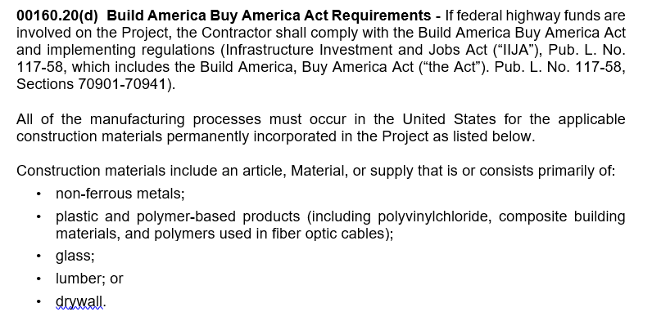
Notes:
Title Slide: Option 4

Slide 8
Implementation
Build America Buy America does not allow for any de minimis amount of foreign construction material incorporated in projects
The allowances for foreign iron or steel from Buy America still remains the same
Because of these differences there will be two forms that are required (depending on the type of material)
Form 734-2126 – Certificate of Materials Origin
Form 734-5378 – Construction Materials CMO
Notes:
Title Slide: Option 4

Slide 9
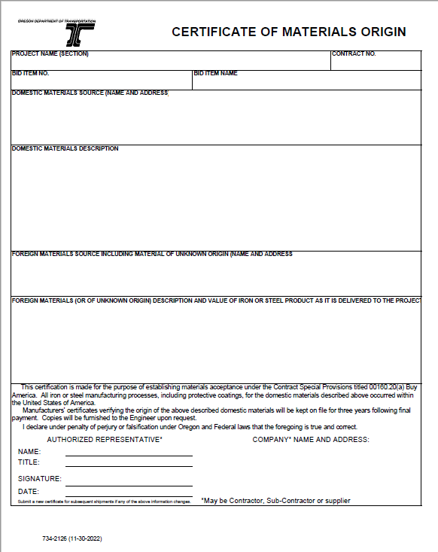
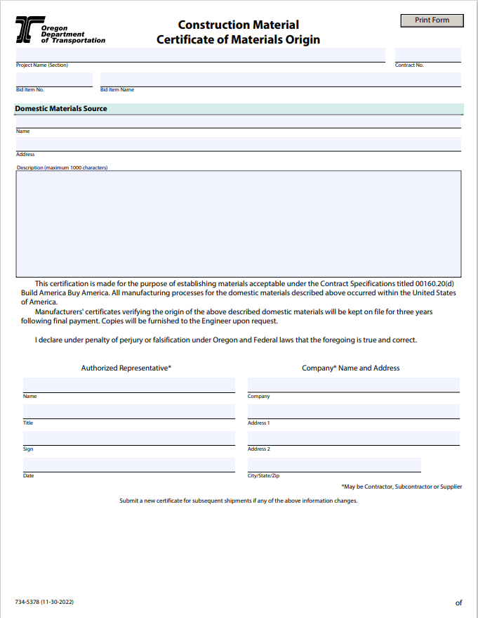
The old Certificate of Materials Origin (CMO)

Slide 11
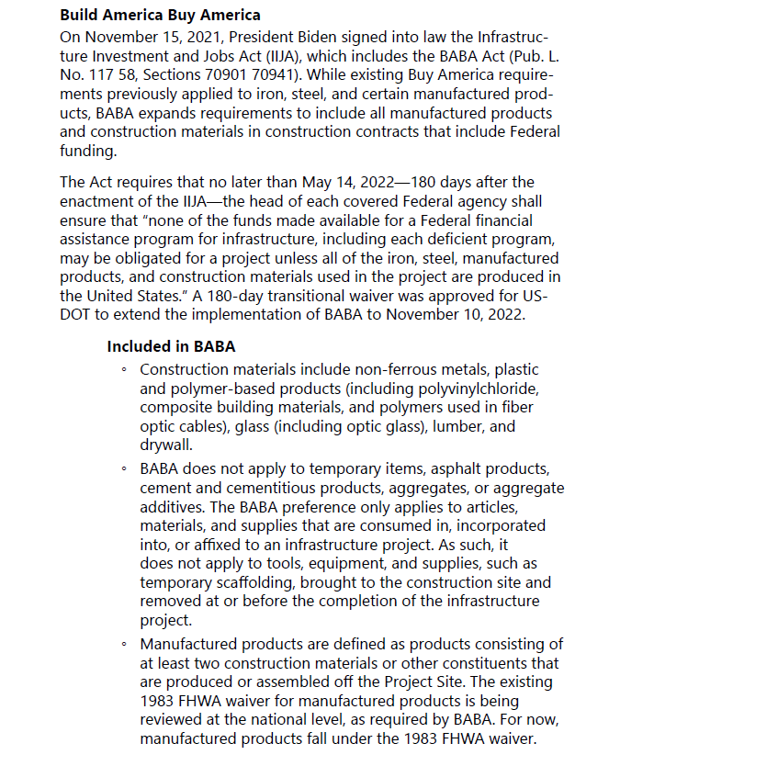
New language is ready to be posted as part of the Construction Manual (Chapter 12B starting on page 11)
This will be your best reference for implementation of the Build America Buy America requirements
Anything that we need to change as this is being implemented will be modified in the Construction Manual so that RE Offices have information to enforce the requirements
Please contact us if the guidance in the Construction Manual does not follow the guidance that you have heard – so that we can clarify and make adjustments to the Construction Manual as necessary

Slide 12
Pay Item List
Complete list of all pay items
Organized by Specification #
45 Pages of pay item information
Identifies how each pay item is addressed

Slide 13
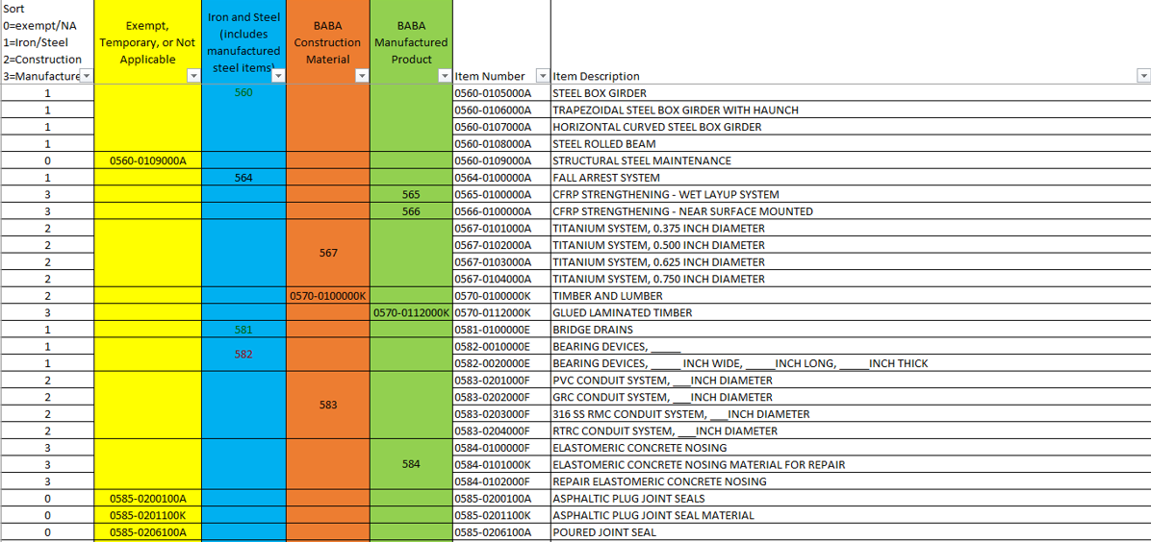
Bid Items List
Notes:
HOW TO CHANGE THE BACKGROUND PICTURE
Go to the DESIGN tab on the ribbon.
In the Customize section, choose the icon with the paint bucket called FORMAT BACKGROUND.
The FORMAT BACKGROUND menu will open on the right side of your page. Make sure to select the radial button next to PICTURE OR TEXTURE FILL. Under the “Insert Picture from” section, choose FILE, CLIPBOARD, or ONLINE as appropriate.
Select a picture that fits the background space. Preferably in a landscape orientation.
Select your image, and press open.
Your picture will appear in the background!

Slide 14
Blue Sheet Materials
Represents all materials covered by the Blue Sheets for traffic signals
Organized by equipment categories
2 pages of information
Identifies how each signal material is addressed

Slide 15
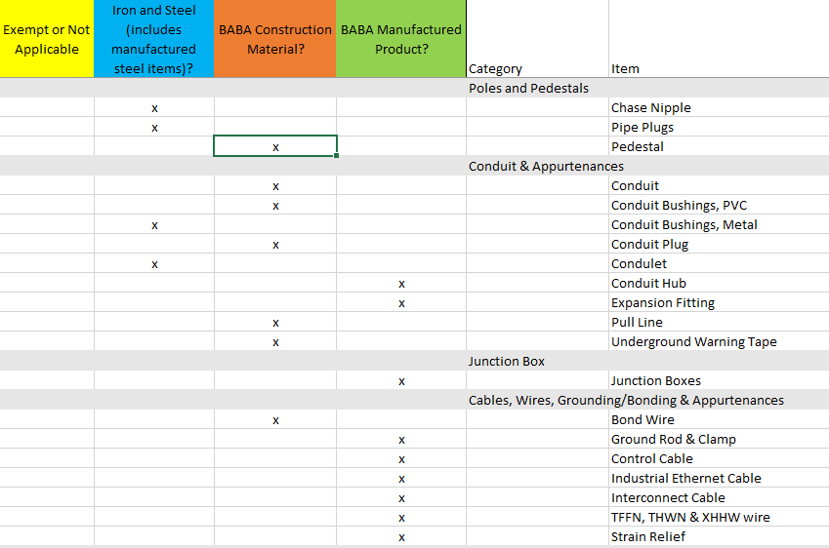
Blue Sheets list

Slide 16
QPL
Identifies in the “Remarks” column which QPL items will require a CMO for either steel or construction materials

Slide 17
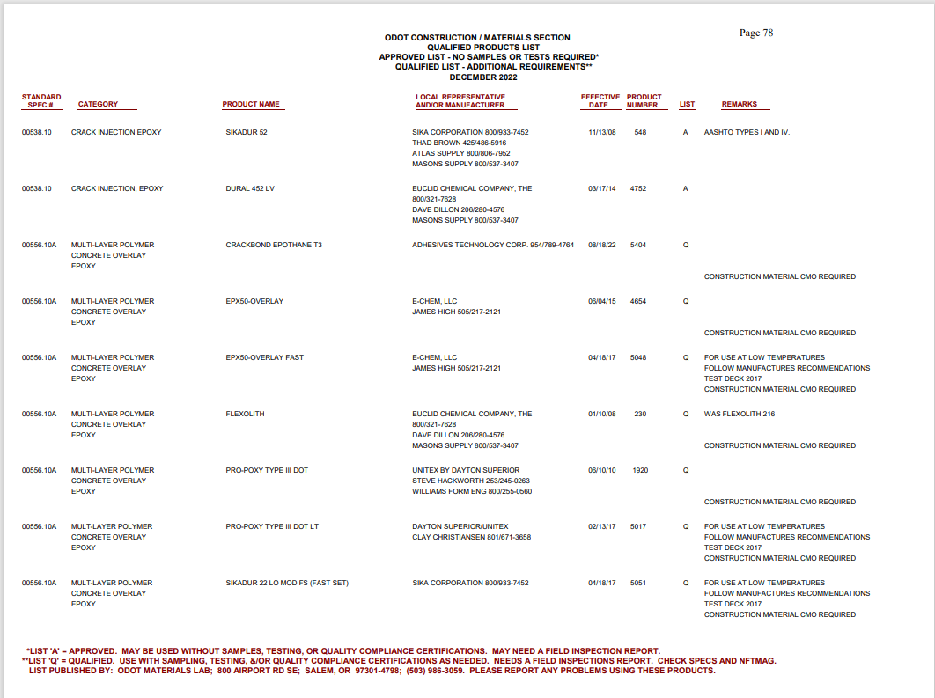
QPL items List

Slide 18
Non Field Tested Materials Guide
At this time the NTMAG refers to the spreadsheet of Pay Items
The NTMAG will be updated to specifically show which items require the CMO form for Construction Materials

Slide 19
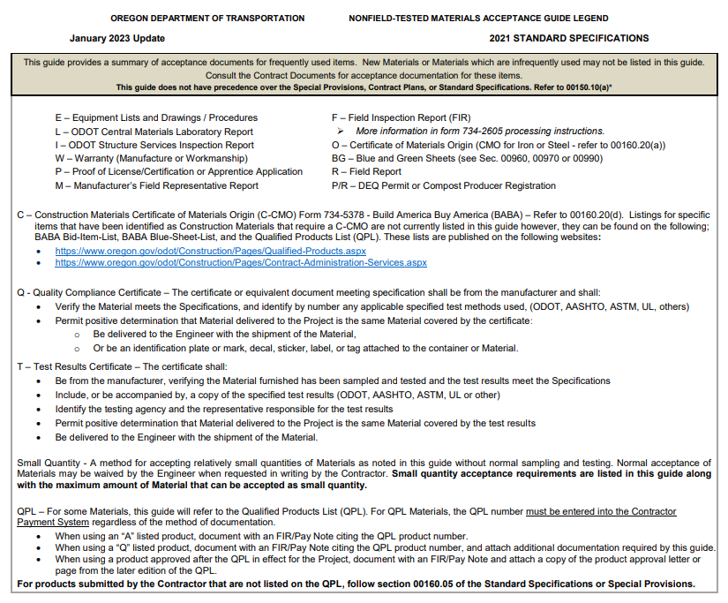
The updated Non field materials acceptance guide

Slide 20
Resources:
IIJA: https://www.congress.gov/117/plaws/publ58/PLAW-117publ58.pdf
BABA: IIJA Division G, Title IX, Sections 70901-70941
Office of Management and Budget Memo MB-22-11: https://www.whitehouse.gov/wp-content/uploads/2022/04/M-22-11.pdf
Contact Information:
General Information & Certificate of Material Origin (CMO) Forms:
Mike Dennee
Michael.J.Dennee@odot.oregon.gov
503-580-2013
Specifications:
Dan Anderson
Daniel.A.Anderson@odot.oregon.gov or ODOTSpecifications@odot.oregon.gov
503-986-3777
Qualified Products List (QPL)
Dean Chess
Dean.M.Chess@odot.oregon.gov
503-986-3059

Slide 21
Questions?

