Slide 1
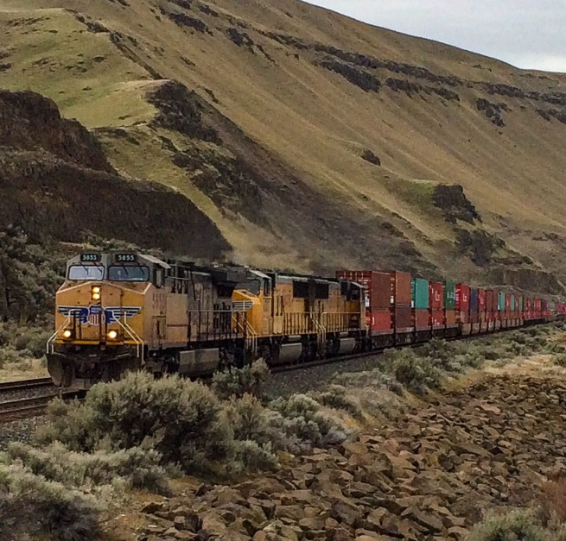
Connect Oregon
Program Overview
Presented by: John Boren – Freight Program Manager
January 3, 2024
Notes:
Title slide option 1
These photos are just examples. Please replace photos with your own.

Slide 2
Program Overview
Prior to current cycle
Connect Oregon is an initiative established by the 2005 state legislature to invest in non-highway modes of transportation.
7 competitive cycles between 2005-22
  Over $463 million awarded
  221 projects awarded
Most recent cycle ran from 2021-22
  $46 million in funds awarded - $130 million requested
Program unique to Oregon – no federal Funding
Notes:
These photos are just examples. Please replace photos with your own.

Slide 3
Connect Oregon 8 Status
Oregon Transportation Commission selected projects in May 2022
21 projects selected
  14 projects on schedule
  4 complete, closed out/pending close out
  2 expected complete before end of year
  1 canceled
Most projects to be completed by Summer 2025
Notes:
1 canceled – Teevin Bros. out of Rainier because it no longer made business sense for them to continue – canceled projects funds get reallocated next competitive cycle

Slide 4

Next Cycle Key Facts
Transportation projects eligible for funding
Rail, marine or aviation capital improvements
Projects chosen must show economic benefits to state; lower transportation costs
~$46 million available for funding
Applications will be due late February 2024

Slide 5
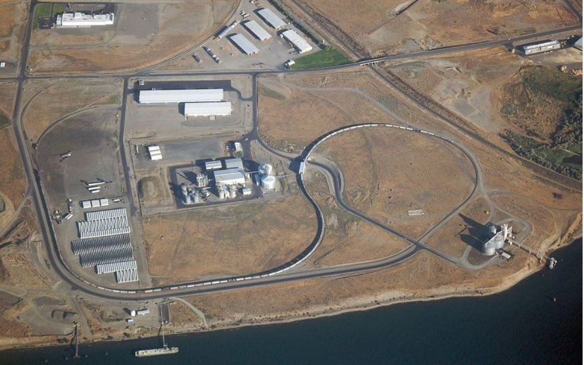
Review process
OTC anticipated to select projects in September 2024
Received, eligibility determined
Modal Staff Review
RSTs
Modal Committees
ACTs
Final Review Committee
Oregon Transportation Commission

Slide 6
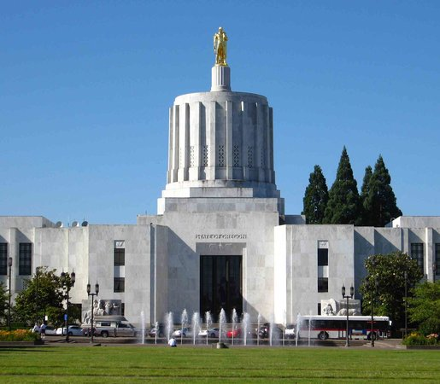
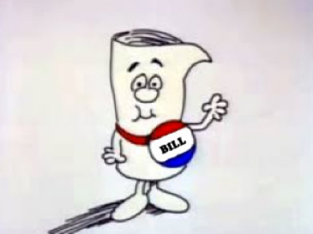
Small process changes this round
Summary
Final Review Committee Streamline
Project Size Discussion
Applicant req clarification
ACT/Modal Committee Consistency
Notes:
These photos are just examples. Please replace photos with your own.

