Slide 1
INSTRUCTIONS 1
PURPOSE FOR USING THE MOBILITY TEMPLATES
The templates are intended to standardize mobility presentations so that information is provided in an efficient way that makes the best use of everyone’s time during the meetings. Using these templates ensures the stakeholders have all the necessary information to make their recommendation to the agency.
WHICH TEMPLATE SHOULD I USE?
Work Zone Temporary Impacts Presentation Template: Used to communicate work zone safety impacts and temporary restrictions during project development, construction (for updates) and maintenance. Use this template to seek support for sign-off of the Mobility Considerations Checklist
ORS 366.215 Presentation Template: Used for Stakeholder Forum presentations, required under OAR Chapter 731, Division 12. Each slide is designed to present the required information listed in the ORS 366.215 Guidance Document. If your reduction includes a roadway reconfiguration (e.g. travel lane reductions and other striping changes) this template includes slides for those changes as well.
Delete this and all INSTRUCTION slides before beginning your presentation.
Notes:
Delete this and all INSTRUCTION slides before beginning your presentation.

Slide 2
INSTRUCTIONS 2
WHICH TEMPLATE SHOULD I USE? (Cont’d)
Permanent (NON-ORS 366.215) Impacts Template: Used for sharing new permanent size and/or weight restrictions that are considered "high" impact for permanent impacts that are NOT subject to ORS 366.215, per the Project Review Criteria in Appendix C of the Mobility Advisory Committee Charter.
Intersection Improvements Template: Used for early communication with the Mobility Advisory Committee/ Stakeholder forum. The intent of the slides are to share issues/problems with the current intersection, and seek early input on options for potential solutions before a final treatment is decided.
Roundabout Template: Used for proposed roundabouts that are subject to freight industry input, per Highway Directive DES-02. Each slide is designed to present the required information needed for Stakeholder Forum Support (for roundabouts located on Reduction Review Routes) and freight industry support on roundabout sizing.
Roadway Reconfiguration Template: Used for projects proposing a roadway reconfiguration only (not in conjunction with a proposed reduction in vehicle-carrying capacity on a Reduction Review Route subject to ORS 366.215). These include road diets, travel lane reductions, lane width changes, etc. If the roadway configuration is included with a Reduction in Vehicle Carrying Capacity, use the ORS 366.215 presentation template instead (the template includes roadway reconfiguration slides).
Delete this and all INSTRUCTION slides before beginning your presentation.
Notes:
Delete this and all INSTRUCTION slides before beginning your presentation.

Slide 3
INSTRUCTIONS 3
HOW DO I KNOW WHICH SPECIFIC INFORMATION TO INCLUDE IN EACH SLIDE?
Instructions are provided, where appropriate, in the Notes section at the bottom of each slide. The Notes should display by default when you open the template. If not, select “View” from the top ribbon and toggle the “Notes” button in the “Show” section. Delete the instruction notes and replace them with your own, as appropriate.
WHAT IF I NEED ADDITIONAL SLIDES TO COVER ALL OF MY PLANNED CONTENT?
Keep your content as concise as possible. However, if you need additional slides (e.g. to display multiple stages of a large project), duplicate the appropriate slides provided in the template. If you need an additional slide that is not included in the, template, contact the Mobility Services Team for suggestions on how best to provide the information.
HOW DO I SEND MY COMPLETED PRESENTATION TO THE MOBILITY TEAM?
Submit your presentation using the Agenda Request/Meeting Materials Form on the Mobility Program internal SharePoint site. The form will prompt you to answer some questions about your agenda topic and the meeting date you would like to present. Documents must be submitted at least three weeks prior to the meeting. (Outside consultants should provide their presentation to the appropriate Region Mobility Liaison, who can submit your presentation on your behalf. Contact information for the Region Mobility Liaisons can be found on the Statewide Mobility Program website.)
Delete this and all INSTRUCTION slides before beginning your presentation.
Notes:
Delete this and all INSTRUCTION slides before beginning your presentation.

Slide 4
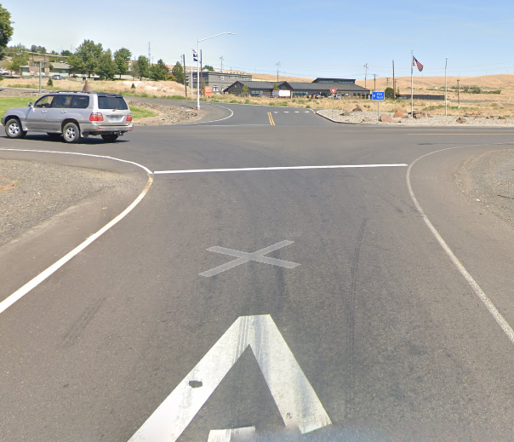
PROJECT NAME Proposed Intersection Improvements & Potential ORS 366.215 Impact
Presenter(s) Name(s):
Other Notes: (e.g. ARTS, HB 2017 project, STIP Project, Interchange Area Management Plan, etc.)
Replace with your own project photo
Mobility Advisory Committee Meeting Date: MM/DD/YYYY
Notes:
Cover Page:
Update this slide with your own information and photo/image that represents the intersection project.
If the proposed roundabout is NOT located on a Reduction Review Route subject to ORS 366.215, remove the second part of the subtitle referencing the statute.

Slide 5
AGENDA
Topics:
Location & Traffic Volumes
Issues to be addressed, crash history, & improvements tried previously
Existing Intersection Design/Cross Sections
Over-dimension freight activity & nearby pinch points
Potential solutions being considered
Next Steps
Objective: Seek early stakeholder input on intersection improvement options
Notes:
Update this slide with your own information and image.
Make sure all images have Alt Text added for accessibility. (Right Click on photo →Format Picture → Size and Properties)
Agenda: The agenda should have, at a minimum, the following topics:
Location map, highway name(s), mile point(s) and traffic volumes (including % of truck traffic). This should be a broad view that includes connecting secondary routes and (if applicable) other nearby roundabouts (existing and proposed) on the same corridor.
Description of the safety and operational issues to be addressed by the intersection improvements, including any improvements that had been tried previously (but failed to address the issues). Crash history data for the intersection can also be discussed in this topic.
A description of the existing intersection includes a diagram of the intersection design and cross sections (including existing structures).
A summary of over-dimension activity for the location, including a history of single trip permits issued for the corridor, District guidelines for permitted loads, and annual permitted loads that are allowed to use the route(s). Also provide a summary of pinch points near the intersection.
Potential traffic control alternatives and concepts that are being considered for the intersection (include a summary of pros and cons for each).
A map showing potential alternate routes for over-dimension vehicles to bypass the intersection (if applicable, otherwise remove from agenda).
Next steps for the project.
Objective: The objective for the intersection improvement project should be to seek early input from mobility stakeholders on intersection improvement options and concepts.

Slide 6
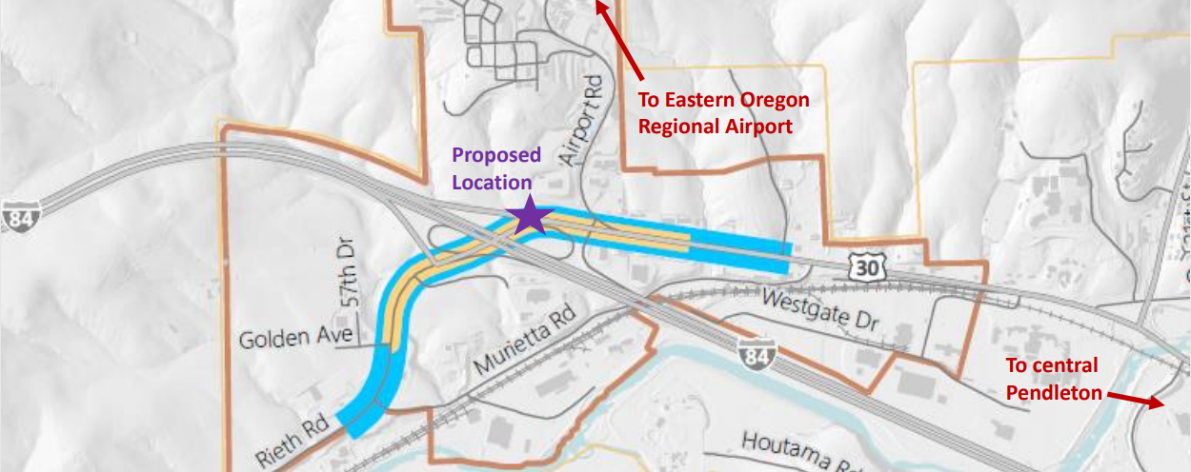
PROJECT NAME
Location | Signed Route No. | Hwy No. | Mile Point | ADT | % Truck Traffic
EXAMPLE
Notes:
Update this slide with your own information and map image.
Project Location:
Provide a location map showing a broad view that includes connecting secondary routes and (if applicable) other nearby roundabouts (existing and proposed) on the same corridor. The slide should also provide the following info:
Location name
Signed Route Number
Highway Number
Mile Point Location
Average Daily Traffic volume (ADT)
% of traffic that is trucks/freight
If necessary, you can include an additional slide that shows a closer view of the location, to show nearby features/routes in greater detail. Make sure map image has Alt Text added for accessibility. (Right Click on photo →Format Picture → Size and Properties)

Slide 7
PROJECT NAME Location Details
Roadway Characteristics
Type of roadway & number of lanes
Grade type (flat, hills, both)
Straight, curved, or both
Annual Over-Dimension Permits
Annual Width allowed daytime: ## feet
Annual Width allowed nighttime: ## feet
Single Trip Over-Dimension Permits
Width allowed daytime without District Approval: ## feet
Width allowed nighttime without District Approval: ## feet
Notes:
Update this slide with your own information.
Roadway Characteristics:
Provide the type of roadway (e.g. interstate/multilane highway, 2-lane highway); indicate the grade type; and indicate if the roadway straight or if are there curves.
Annual Over-Dimension Permits:
Indicate the allowable daytime and nighttime widths for the route. Refer to the following maps (or contact the Mobility Services Team if you need assistance finding this information):
Daylight Width Map: https://www.oregon.gov/odot/ProjectDel/Mobility/DaylightWidthMap.pdf
Nighttime Width Map: https://www.oregon.gov/odot/ProjectDel/Mobility/NighttimeWidthMap.pdf
Single Trip Over-Dimension Permits
Indicate the maximum width allowed to be issued by CCD OD Permits Staff without having to seek District Approval. This information can be found in the State and District Guidelines document (or contact the Mobility Services Team if you need assistance finding this information): https://www.oregon.gov/odot/MCT/Documents/pilotcarguide.pdf

Slide 8
PROJECT NAME Project Purpose and Scope
Provide a brief summary of the project purpose and scope.
Notes:
Provide a brief summary of the purpose and scope of the project.

Slide 9
Safety Issues to be Addressed
PROJECT NAME
Issue Description
Issue Description
Issue Description
Notes:
Update this slide with your own information
Use this slide to summarize safety issues/concerns associated with the existing intersection.

Slide 10
Operational Issues to be Addressed
PROJECT NAME
Issue Description
Issue Description
Issue Description
Notes:
Update this slide with your own information
Use this slide to summarize operational issues/concerns associated with the existing intersection.

Slide 11
Improvements previously attempted at this intersection
PROJECT NAME
Date Implemented | Improvement | Result
MM/YYYY
Notes:
Update this slide with your own information
Use this slide to describe improvements that were previously tried with this intersection to address the issues.

Slide 12
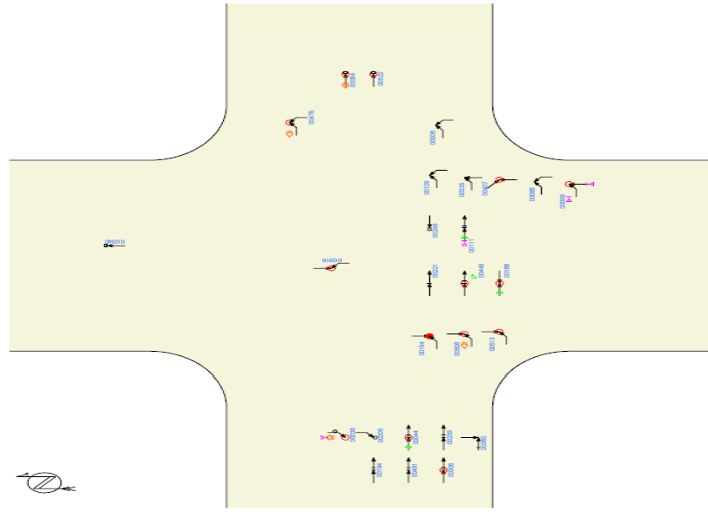
PROJECT NAME Crash History
## total crashes YYYY-YYYY
## injury crashes
## fatal crashes
## rear end crashes
Additional relevant detail
Additional relevant detail
Additional relevant detail
EXAMPLE
Notes:
Update this slide with your own information
Use this slide to provide crash history for the intersection. If available, you can also provide an image showing the location and types of crashes that took place in the intersection (be sure to replace this example image with your own, or remove it).

Slide 13
PROJECT NAME Single Trip Over-Dimension Permit Summary
Analysis duration: __ years
Total STPs issued (including trips): ____ permits
District Guidelines for Over-Dimension Loads:
Daytime Width Allowed (without district approval) | Nighttime Width Allowed (without district approval) | Overall Length Allowed (without district approval) | Other Comments
___ feet | ___ feet | ___ feet
Notes:
Update this slide with your data.
Use this slide to summarize Single-Trip Over-Dimension Data and District Guidelines. Single-Trip Over-Dimension Data can be requested from the Mobility Team (please note that requests can take two weeks or longer, depending on the amount of data that needs to be analyzed). Use the information from the report provided by the Mobility Services Team to complete this slide.
Single Trip Permit Data helps stakeholders understand the types and frequency of over-dimension freight that uses the route where the intersection is located.
Remove this slide if you are not yet ready to present permit data.

Slide 14
PROJECT NAME Single Trip Over-Dimension Permit Summary: Wide Loads
Most wide loads were issued for <insert load type from permit report>
Widest load was for a <insert load type from report> at ___ wide.
Majority of permits were between ____ and ____wide.
Overall Width | Number of single-trip permits issued
Notes:
Update this slide with your data.
Use this slide to present Single-Trip Over-Dimension Data for overwidth loads. Single-Trip Over-Dimension Data can be requested from the Mobility Team (please note that requests can take two weeks or longer, depending on the amount of data that needs to be analyzed). Use the information from the single trip permit report provided by the Mobility Services Team to complete this slide.
Single Trip Permit Data helps stakeholders understand the types and frequency of over-dimension freight that uses the route where the intersection is located.

Slide 15
PROJECT NAME Single Trip Over-Dimension Permit Summary: Long Loads
Most wide loads were issued for <insert load type from permit report>
Longest load was for a <insert load type from report> at ___ long.
Majority of permits were between ____ and ____long.
Overall Length (incl. overhang) | Number of single-trip permits issued
70’ or less
71’ to 80’
81’ to 90’
91’ to 100’
101’ to 110’
111’ to 120’
Over 120’
Notes:
Update this slide with your data.
Remove this slide if this data is not relevant or necessary.
Use this slide to present Single-Trip Over-Dimension Data for overlength loads. Single-Trip Over-Dimension Data can be requested from the Mobility Team (please note that requests can take two weeks or longer, depending on the amount of data that needs to be analyzed). Use the information from the single trip permit report provided by the Mobility Services Team to complete this slide.
Single Trip Permit Data helps stakeholders understand the types and frequency of over-dimension freight that uses the route where the intersection is located.

Slide 16
PROJECT NAME Single Trip Over-Dimension Permit Summary: Vehicle Combinations
Vehicle Combinations | Number of single-trip permits issued
Truck (Solo Vehicle) or Self Propelled Units (like cranes)
Doubles
Truck-Tractor + Semitrailer or Truck-Tractor +Tow-Away Unit
Truck + Trailer
Log Truck + Pole Trailer
Heavy Haul Combination (Truck-Tractor/Jeep/Semitrailer/Booster)
Toter + Mobile Home
Pickup Truck + Trailer
Notes:
Update this slide with your data.
Use this slide to present Single-Trip Over-Dimension Data for vehicle combinations. Single-Trip Over-Dimension Data can be requested from the Mobility Team (please note that requests can take two weeks or longer, depending on the amount of data that needs to be analyzed). Use the information from the single trip permit report provided by the Mobility Services Team to complete this slide.
Single Trip Permit Data helps stakeholders understand the types and frequency of over-dimension freight that uses the route where the intersection is located.

Slide 17
PROJECT NAME Single Trip Over-Dimension Permit Summary: High Loads
Tallest load was for a <insert load type from report> at ___ high.
Majority of permits were between ____ and ____high.
Overall Height | Number of single-trip permits issued
14’00” or less (legal height)
14’01” to 14’06”
14’07” to 15’00”
15’01” to 15’06”
15’07” to 16’00”
16'01" to 17'00"
17'01 to 17'06"
Over 17’06”
Notes:
Update this slide with your data.
Remove this slide if this data is not relevant or necessary.
Use this slide to present Single-Trip Over-Dimension Data for overheight loads. Single-Trip Over-Dimension Data can be requested from the Mobility Team (please note that requests can take two weeks or longer, depending on the amount of data that needs to be analyzed). Use the information from the single trip permit report provided by the Mobility Services Team to complete this slide.
Single Trip Permit Data helps stakeholders understand the types and frequency of over-dimension freight that uses the route where the intersection is located.
Remove this slide if this data is not necessary to share.

Slide 18
PROJECT NAME Single Trip Over-Dimension Permit Summary: Heavy Loads
The heaviest load was issued for <insert load type from permit report> at ___lbs.
Most of the loads were between ______ lbs and __________ lbs.
Gross Weight | Number of single-trip permits issued
80,000 lbs. or less (legal weight)
80,000 lbs. to 98,000 lbs.
98,001 lbs. to 120,000 lbs.
120,001 lbs. to 140,000 lbs.
140,001 lbs. to 160,000 lbs.
160,001 lbs. to 180,000 lbs.
180,001 lbs. to 200,000 lbs.
200,001 lbs. to 250,000 lbs.
Over 250,000 lbs.
Notes:
Update this slide with your data.
Remove this slide if this data is not relevant or necessary.
Use this slide to present Single-Trip Over-Dimension Data for overweight loads. Single-Trip Over-Dimension Data can be requested from the Mobility Team (please note that requests can take two weeks or longer, depending on the amount of data that needs to be analyzed). Use the information from the single trip permit report provided by the Mobility Services Team to complete this slide.
Single Trip Permit Data helps stakeholders understand the types and frequency of over-dimension freight that uses the route where the intersection is located.
Remove this slide if this data is not necessary to share.

Slide 19
PROJECT NAME Annual Over-Dimension Permit Data
Widths Allowed | Overall length Allowed: Long logs/ poles/piling permit, w/out steerable axles | Overall Length Allowed: Mobile/ modular unit permit | Overall Length Allowed: Unladen heavy haul combination permit | Overall Length Allowed: 1/2 wheelbase rear overhang permit for truck tractor and semitrailer combos)
Daytime annual width: Nighttime annual width:
Notes:
Update this slide with your data.
Use this slide to present information about annual over-dimension permits that can (or cannot) use the routes where the intersection is located. This information can be requested from the Mobility Services Team (please note that requests can take two weeks or longer, depending on the amount of data that needs to be analyzed). Use the information from the report provided by the Mobility Services Team to complete this slide.
Annual Permit Data helps stakeholders understand the types and frequency of over-dimension freight that uses the route where the intersection is located.

Slide 20
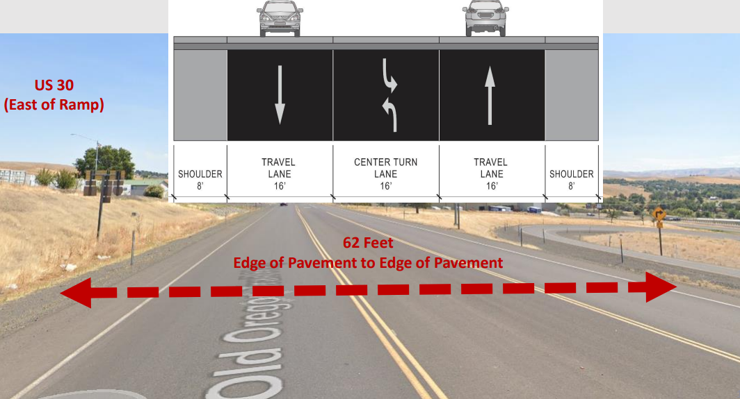
PROJECT NAME Existing Condition & Cross Section
Notes:
Replace the image on this slide with your own information and customize as appropriate.
Describe the current conditions of the roadways in the intersection. Include cross sections of the existing roadways that shows the overall horizontal clearance (curb to curb), vertical clearance (if applicable), and include lane widths, median widths, bicycle lane widths, shoulder widths, etc. Use duplicate this slide as necessary to show all directions of the intersection.

Slide 21
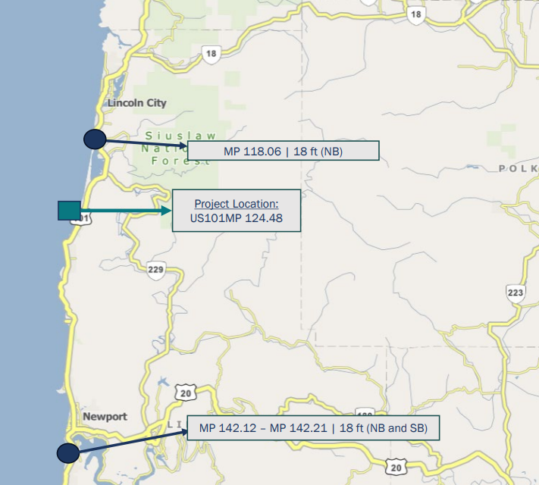
PROJECT NAME Pinch Point Information
Pinch point
Pinch point
Pinch point
EXAMPLE
Notes:
Update this slide with your own information / photos and customize as appropriate.
Provide Information about pinch points on the highway(s) near the project area. Include the width (and vertical clearance, if applicable) of the pinch point and mile point. You may also include a map that illustrates
Note: The Mobility Services Team can provide you with vertical clearance pinch point information. Contact the Mobility Services Team if you’d like to request this information.
the pinch points in relation to the project location.

Slide 22
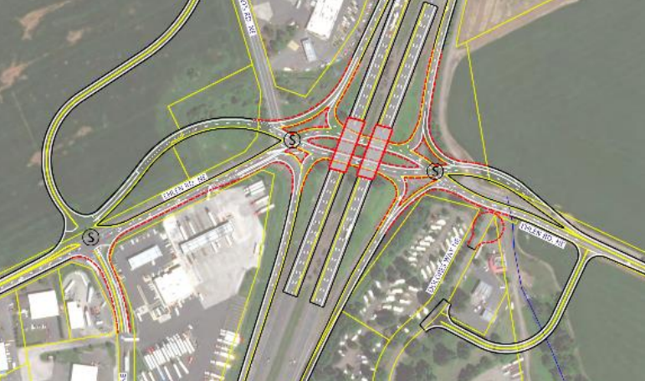
PROJECT NAME Alternative #1
Details
Details
Details
EXAMPLE
Notes:
Replace the image with your own conceptual drawing.
Use this slide to provide a conceptual drawing/image of Alternative 1. If necessary, use the bulleted list to provide some details about the alternative (e.g. pros, cons, approximate cost, etc.).

Slide 23
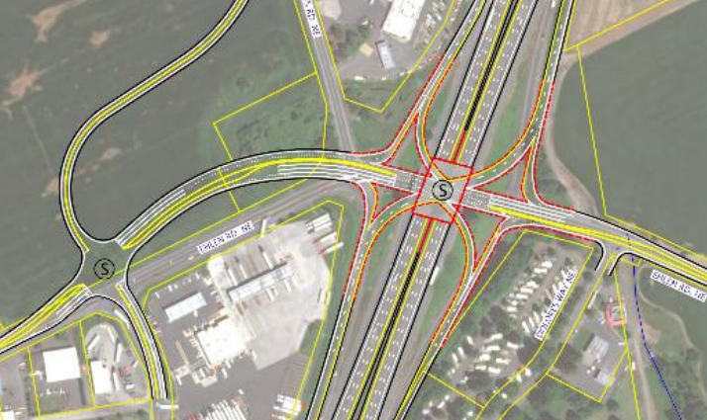
PROJECT NAME Alternative #2
Details
Details
Details
EXAMPLE
Notes:
Replace the image with your own conceptual drawing.
Use this slide to provide a conceptual drawing/image of Alternative 2. If necessary, use the bulleted list to provide some details about the alternative (e.g. pros, cons, approximate cost, etc.).

Slide 24
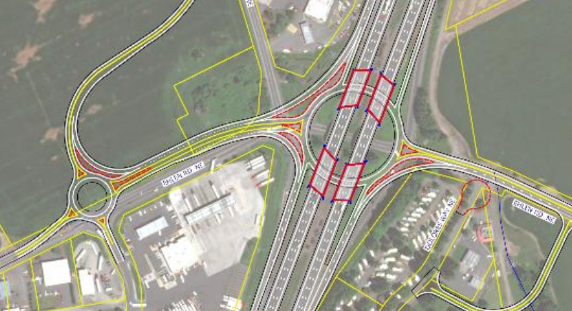
PROJECT NAME Alternative #3
Details
Details
Details
EXAMPLE
Notes:
Replace the image with your own conceptual drawing.
Use this slide to provide a conceptual drawing/image of Alternative 3. If necessary, use the bulleted list to provide some details about the alternative (e.g. pros, cons, approximate cost, etc.).
Duplicate this slide to add additional alternatives, if necessary.

Slide 25
PROJECT NAME Summary of Alternatives Considered
Option | Pros | Cons | Approx. Cost
Option 1: Summary |  |  | $##,###,###
Option 2: Summary |  |  | $##,###,###
Option 3: Summary |  |  | $##,###,###
Notes:
Update this slide with your own information.
Use this slide to summarize the different intersection improvement alternatives that are being considered as part of the Intersection Traffic Control Study.
In the table provided, summarize each option, pros, cons and costs (if available). If more options were considered than can fit in the table, duplicate this slide and continue to list additional options.

Slide 26
NEXT STEPS
Action item detail.
Action item detail.
Bring proposed design back to MAC for input and Stakeholder Forum support.
Replace with your own project photo
Notes:
Use this slide to describe next steps for the intersection evaluation. If the project is located on a Reduction Review Route subject to ORS 366.215, the project likely will need to come back to the committee to seek Stakeholder Forum Support.

Slide 27
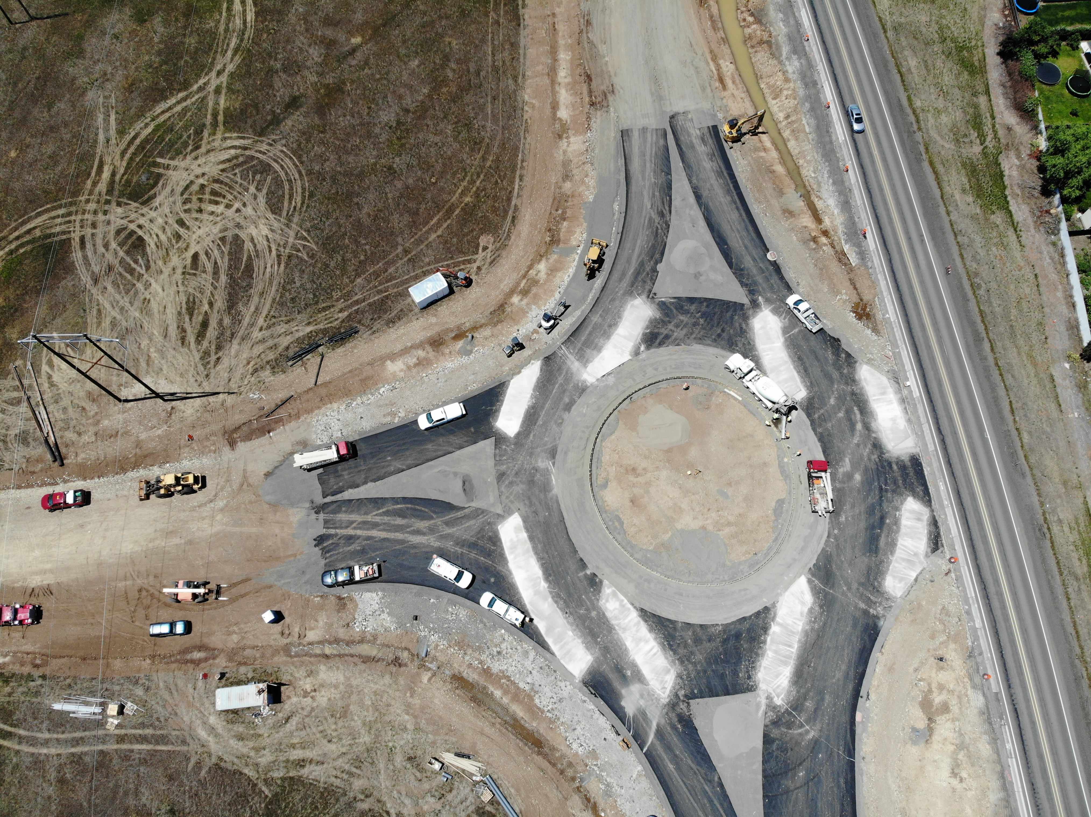
THANK YOU
Notes:
Replace this picture with your own image or diagram if you’d like.
HOW TO CHANGE THE BACKGROUND PICTURE
Go to the DESIGN tab on the ribbon.
In the Customize section, choose the icon with the paint bucket called FORMAT BACKGROUND.
The FORMAT BACKGROUND menu will open on the right side of your page. Make sure to select the radial button next to PICTURE OR TEXTURE FILL. Under the “Insert Picture from” section, choose FILE, CLIPBOARD, or ONLINE as appropriate.
Select a picture that fits the background space. Preferably in a landscape orientation.
Select your image, and press open.
Your picture will appear in the background!

