Slide 1
INSTRUCTIONS 1
PURPOSE FOR USING THE MOBILITY TEMPLATES
The templates are intended to standardize mobility presentations so that information is provided in an efficient way that makes the best use of everyone’s time during the meetings. Using these templates ensures the stakeholders have all the necessary information to make their recommendation to the agency.
WHICH TEMPLATE SHOULD I USE?
Work Zone Temporary Impacts Presentation Template: Used to communicate work zone safety impacts and temporary restrictions during project development, construction (for updates) and maintenance. Use this template to seek support for sign-off of the Mobility Considerations Checklist
ORS 366.215 Presentation Template: Used for Stakeholder Forum presentations, required under OAR Chapter 731, Division 12. Each slide is designed to present the required information listed in the ORS 366.215 Guidance Document. If your reduction includes a roadway reconfiguration (e.g. travel lane reductions and other striping changes) this template includes slides for those changes as well.
Delete this and all INSTRUCTION slides before beginning your presentation.
Notes:
Delete this and all INSTRUCTION slides before beginning your presentation.

Slide 2
INSTRUCTIONS 2
WHICH TEMPLATE SHOULD I USE? (Cont’d)
Permanent (NON-ORS 366.215) Impacts Template: Used for sharing new permanent size and/or weight restrictions that are considered "high" impact for permanent impacts that are NOT subject to ORS 366.215, per the Project Review Criteria in Appendix C of the Mobility Advisory Committee Charter.
Intersection Improvements Template: Used for early communication with the Mobility Advisory Committee/ Stakeholder forum. The intent of the slides are to share issues/problems with the current intersection, and seek early input on options for potential solutions before a final treatment is decided.
Roundabout Template: Used for proposed roundabouts that are subject to freight industry input, per Highway Directive DES-02. Each slide is designed to present the required information needed for Stakeholder Forum Support (for roundabouts located on Reduction Review Routes) and freight industry support on roundabout sizing.
Roadway Reconfiguration Template: Used for projects proposing a roadway reconfiguration only (not in conjunction with a proposed reduction in vehicle-carrying capacity on a Reduction Review Route subject to ORS 366.215). These include road diets, travel lane reductions, lane width changes, etc. If the roadway configuration is included with a Reduction in Vehicle Carrying Capacity, use the ORS 366.215 presentation template instead (the template includes roadway reconfiguration slides).
Delete this and all INSTRUCTION slides before beginning your presentation.
Notes:
Delete this and all INSTRUCTION slides before beginning your presentation.

Slide 3
INSTRUCTIONS 3
HOW DO I KNOW WHICH SPECIFIC INFORMATION TO INCLUDE IN EACH SLIDE?
Instructions are provided, where appropriate, in the Notes section at the bottom of each slide. The Notes should display by default when you open the template. If not, select “View” from the top ribbon and toggle the “Notes” button in the “Show” section. Delete the instruction notes and replace them with your own, as appropriate.
WHAT IF I NEED ADDITIONAL SLIDES TO COVER ALL OF MY PLANNED CONTENT?
Keep your content as concise as possible. However, if you need additional slides (e.g. to display multiple stages of a large project), duplicate the appropriate slides provided in the template. If you need an additional slide that is not included in the, template, contact the Mobility Services Team for suggestions on how best to provide the information.
HOW DO I SEND MY COMPLETED PRESENTATION TO THE MOBILITY TEAM?
Submit your presentation using the Agenda Request/Meeting Materials Form on the Mobility Program internal SharePoint site. The form will prompt you to answer some questions about your agenda topic and the meeting date you would like to present. Documents must be submitted at least three weeks prior to the meeting. (Outside consultants should provide their presentation to the appropriate Region Mobility Liaison, who can submit your presentation on your behalf. Contact information for the Region Mobility Liaisons can be found on the Statewide Mobility Program website.)
Delete this and all INSTRUCTION slides before beginning your presentation.
Notes:
Delete this and all INSTRUCTION slides before beginning your presentation.

Slide 4
PROJECT NAME Highway Local Name/Location/Nearby Town Key #
Project Type: (e.g. paving, bridge deck repair, preservation, etc.)
Presenter(s) Name(s):
Other Notes: (e.g. Safety Pilot Project, HB 2017 project, etc.)
Replace with your own project photo
Mobility Advisory Committee Meeting Date: MM/DD/YYYY
Notes:
Update this slide with your own information.
Cover Page:
Include the following information: project name, local highway name, key number, project type, presenter name(s), and meeting date. If the project is a Work Zone Safety Pilot Project, or is a House Bill Project, indicate this in the “Other Notes” bullet.
Objective(s):
What is the outcome you are seeking? (e.g. Mobility Considerations Checklist sign off? Stakeholder input on staging options?)
Also include a photo or image that represents the project as well.
Make sure images have Alt Text added for accessibility. (Right Click on photo →Format Picture → Size and Properties)

Slide 5
PROJECT NAME Agenda
Topics:
Topic 1 Summary
Topic 2 Summary
Topic 3 Summary
Objective: Seeking support for Mobility Considerations Checklist Sign-off.
Notes:
Update this slide with your own information.
Topics: What topics are you planning to share and discuss? (e.g. project information, mobility impacts, construction schedule, staging options, etc).
For new (first time shared) projects: Is it informational only at this time? Are you seeking input on potential traffic control alternatives? Do you want to get input on vertical clearances? Do you plan on coming back to a future meeting, or are you looking for final support of the project and a signed Mobility Considerations Checklist?
For projects that have been previously shared: Remind the group about what has been shared, when it was shared, what support has already been given, and any action items still pending. Are the action items satisfied once shared with the group at this meeting?
Example:
Committee met on December 1, 2016. This meeting was mostly informational but the project team wanted input on whether or not they needed to increase the VC for a new auxiliary lane that would be lower than existing. The group supported no change as the existing lanes were not reducing capacity.
Committee met on February 14, 2017 to discuss staging and detour routes. Stakeholders supported two weekend ramp closures, but want to make sure the detour routes work for WB67’s and oversize loads. Stakeholders asked the team to do some modeling. Stakeholders support night work (10 pm to 5 am) for the week nights (Monday through Thursday) not to exceed 8 weeks. The project team agreed to come back and share the detour route modeling.
Today: The project team is back to share the detour route modeling at this meeting and get support from stakeholders and a signed Checklist.

Slide 6
Project Name Previous MAC Meeting Presentations
Meeting Date
Discussion summary & action items
Meeting Date
Discussion summary & action items
Meeting Date
Discussion summary & action items
Meeting Date
Discussion summary & action items
Notes:
If your project has been shared with the MAC more than once (including separate work sessions), use this slide to provide a timeline summary of previous presentations so the committee understands how the project got to this point.
Remove this slide if your project has not yet been shared with the committee.
Customize the timeline as needed. Fill in the milestone markers (or add additional markers if needed) to indicate the dates of previous MAC meetings, and a sentence that describes what was discussed, action items, etc. Remove any milestones that are not needed.

Slide 7
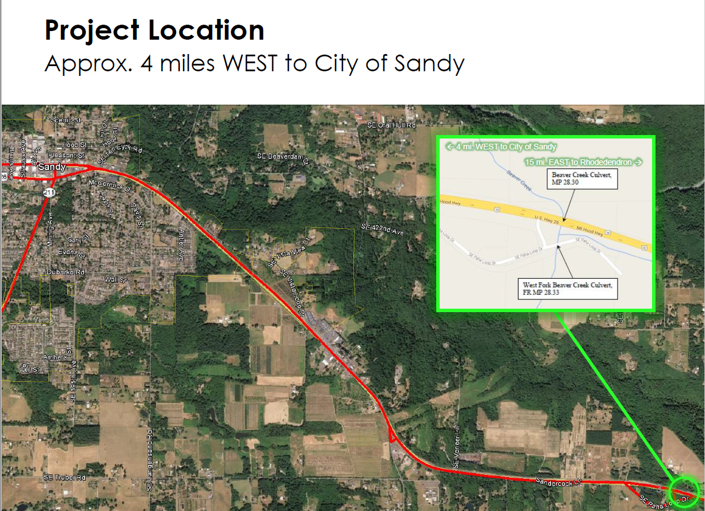
PROJECT NAME Location Information (including map, mile points & nearest city/landmark)
Notes:
Update this slide with your own information.
Project Location:
Include a map of the project location, and provide a brief description at the top of the slide that includes the nearest city or landmark.
Make sure map image has Alt Text added for accessibility. (Right Click on photo →Format Picture → Size and Properties)

Slide 8
PROJECT NAME Location Details
Roadway Characteristics
Type of roadway & number of lanes
Grade type (flat, hills, both)
Straight, curved, or both
Traffic Conditions
ADT:
Truck Count:
Annual Over-Dimension Permits
Annual Width allowed daytime: ## feet
Annual Width allowed nighttime: ## feet
Single Trip Permits
Width allowed daytime without District Approval: ## feet
Width allowed nighttime without District Approval: ## feet
Notes:
Update this slide with your own information.
Roadway Characteristics:
Provide the type of roadway (e.g. interstate/multilane highway, 2-lane highway); indicate the grade type; and indicate if the roadway straight or if are there curves.
Traffic Conditions:
Provide ADT and truck counts.
Update this slide with your own information.
Roadway Characteristics:
Provide the type of roadway (e.g. interstate/multilane highway, 2-lane highway); indicate the grade type; and indicate if the roadway straight or if are there curves.
Traffic Conditions:
Provide ADT and truck counts.
Annual Over-Dimension Permits:
Indicate the allowable daytime and nighttime widths for the route. Refer to the following maps (or contact the Mobility Services Team if you need assistance finding this information):
Daylight Width Map: https://www.oregon.gov/odot/ProjectDel/Mobility/DaylightWidthMap.pdf
Nighttime Width Map: https://www.oregon.gov/odot/ProjectDel/Mobility/NighttimeWidthMap.pdf
Single Trip Over-Dimension Permits
Indicate the maximum width allowed to be issued by CCD OD Permits Staff without having to seek District Approval. This information can be found in the State and District Guidelines document (or contact the Mobility Services Team if you need assistance finding this information): https://www.oregon.gov/odot/MCT/Documents/pilotcarguide.pdf

Slide 9
PROJECT NAME Project Purpose & Scope
Purpose/Scope:
Provide a brief summary of the project purpose and scope.
Issues to be addressed:
Issue/Concern
Detail
Detail
Issue/Concern
Detail
Detail
Issue/Concern
Detail
Detail
Notes:
Provide a brief summary of the purpose and scope of the project, and list issues and concerns that the project will address.

Slide 10
PROJECT NAME Project Schedule
Current Phase (Project Milestone):
Advanced Plans Due Date:
PS&E Date:
Bid Opening Date:
# of Construction Seasons:
Construction Timeline Summary
Notes:
Update this slide with your own information.
Project Schedule:
Indicate the phase that the project is currently in (e.g. DAP, Advanced Plans, etc).
Provide the bid opening date, PS&E date, number of construction seasons, and a high level construction timeline.

Slide 11
PROJECT NAME Traffic Control Options Considered
Option Summary
Brief Description, including pros, cons & cost.
Option Summary
Brief Description, including pros, cons & cost.
Preferred Option Summary
Brief Description, including pros, cons & cost.
Notes:
Update this slide with your own information.
Traffic Control Alternatives:
For large projects where you are seeking input on different traffic control options, use this slide to show the traffic control options that are being considered, with a brief explanation of the preferred option.

Slide 12
PROJECT NAME Construction Staging Information
Stage | Phase | MP Range | Anticipated Duration | Work Summary Very brief (word or phrase) to describe work | Are there restrictions? Y or N | Windows of Opportunity for unrestricted movement between stages/phases? Describe.
Notes:
Update this slide with your own information.
Remove this slide if the project does not have multiple stages/phases.
Construction Staging Information:
For projects with multiple construction stages, use this slide to summarize the different stages/phases of work.
Duplicate this slide as necessary to include all stages/phases.

Slide 13
PROJECT NAME Lane Closures
Single lane closures, with one-lane, one-way traffic.
19’ horizontal clearance w/ soft barriers, located on a curve.
Restricted to 16’ wide loads.
Wider loads may be accommodated on a case-by-case basis with advanced notice.
Lane closures allowed daily, anytime. Estimated duration 4 weeks.
Notes:
Update this slide with your own information, or remove if lane closures are not planned. Duplicate this slide as needed to cover all lane closures
Mobility Impacts: Lane Closures
Describe lane closures and include pictures of staging diagrams that show the width for the open traffic lane(s) (including lane and shoulder widths), and the width for workers/construction.
The diagram should reflect the useable paved width for the open traffic lane(s) between barrier(s), equipment, or traffic control devices. *Width generally refers to the paved width of the lane and any shoulders which are capable of supporting the freight traffic loads without failure. On a case-by-case basis, unpaved/aggregate shoulders may be determined to be useable.
Indicate what the resulting width restriction will be, and whether wider loads can be accommodated through the work zone (either unannounced or with advanced notice on a case-by-case basis). When only a single travel lane is maintained for the open travel lane, show what the resulting overwidth load restriction(s) will be. Locations on a straight section require a 2’ buffer for overwidth loads, and 3’ if on a curve. Example: 15’ width on a tangent = 13’ wide load restriction. 15’ width on a curve = 12’ wide load restriction. Note: A buffer more than 3’ may be needed if curvature exceeds 5 degrees or due to other special circumstances.
Include allowable closure times per specifications, and estimated number of weeks/months closures/restrictions are needed.
Be prepared to speak to what the anticipated duration of the highway restriction notice submittal will be.
If using images, make sure they have Alt Text added for accessibility. (Right Click on photo →Format Picture → Size and Properties)

Slide 14
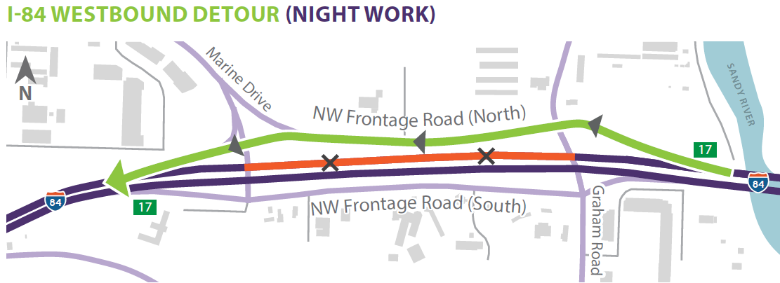
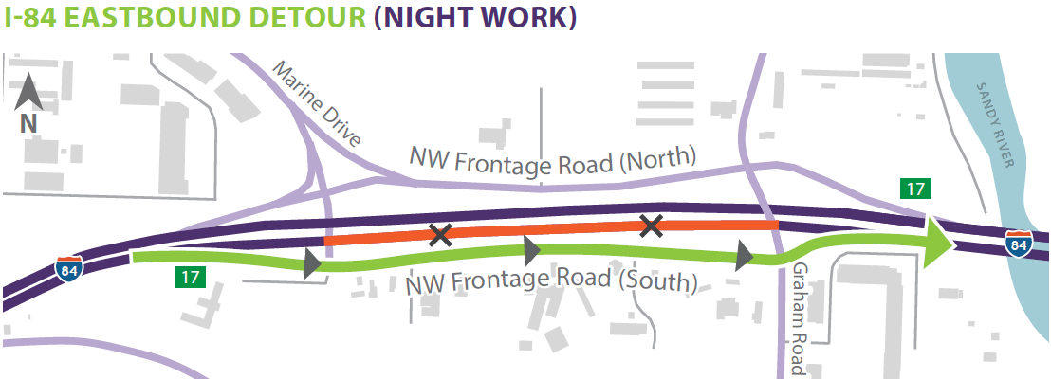
PROJECT NAME Full Closure w/Detour
Provide a description of the detour and closure schedule. Example:
When I-84 westbound is closed, traffic will take exit 17 to NW Frontage Road & re-enter I-84 WB. WB I-84 closure allowed for one consecutive Fri & Sat night in Sept. 2022; 10 p.m. to 6 a.m. each night.
Provide a description of the detour and closure schedule. Example:
When I-84 eastbound is closed, traffic will take exit 17 to NW Frontage Road & re-enter I-84 EB. EB I-84 closure allowed for one consecutive Fri & Sat night in Oct. 2022; 10 p.m. to 6 a.m. each night.
Notes:
Update this slide with your own information., or remove if full closure w/ detour is not planned.
Mobility Impacts – Full Closure w/Detour:
Include a map of the detour for passenger vehicles and freight. Have the sign plan available in case stakeholders request to see it.
Provide details of closure. Include allowable closure days, hours, and months per specifications.
Include number of weekday and/or weekend closures allowed, and which month(s) they are estimated to occur.
Be prepared to speak to what the anticipated duration of the highway restriction notice submittal will be.
A viable detour route for freight that is affected by the closure is required:
When speaking about this slide, address the following information about the detour:
Has it been used by freight and over-dimension units before?
Verify whether it is approved for the same type of freight and oversize loads that currently use the route that’s being closed. This includes standard freight (WB67s) and oversize loads operating under an annual or single trip permit.
Ensure it has been checked/cleared of any width, height, weight, or length restrictions (and truck turning movements have been evaluated).
Ensure it has been approved by the appropriate jurisdiction (e.g. city, county, or ODOT District Office).
Ensure it will be available and free of any project related restrictions at the same time.
If the detour cannot accommodate all freight/oversize load traffic, what is the alternate route that be used?
Contact the Mobility Team at MCTDMOBILITYTEAM@odot.state.or.us to obtain annual and single trip oversize permit information, or truck modeling templates to evaluate turning movements.
Additional Considerations:
Provide estimated delay/travel time.
How will the detour route affect emergency services response times?
Will vehicles transporting hazardous materials be able to use the planned detour route?
Is there another detour route available if something happens to the proposed detour route?
If using images, make sure they have Alt Text added for accessibility. (Right Click on photo →Format Picture → Size and Properties)

Slide 15
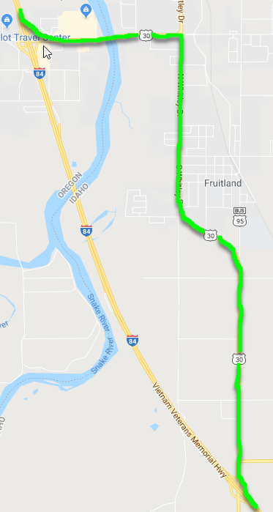
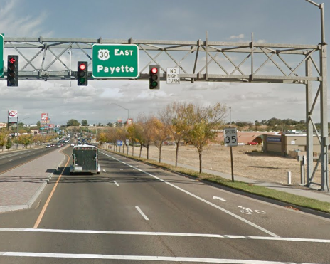
PROJECT NAME Detour Route for Restricted Overwidth Loads
Loads greater than 12ft in width use US95/US30, between Ontario, OR & Fruitland, ID.
Idaho confirmed the route will be available.
Route will result in additional 5 minutes of travel time.
Replace with your own project photo
Notes:
Update this slide with your own information, or remove if a separate detour for over-dimension loads is not necessary.
Identify alternate routes for loads that cannot be allowed through the work zone (for crossovers, for example).
Evaluate/determine if it’s approved for the same type of loads that currently use the route that’s being restricted. This includes oversize loads operating under an annual or single trip permit.
Insert a map of the detour route.
Ensure it has been checked/cleared of any width, height, weight, or length restrictions (and truck turning movements have been evaluated).
Contact the Mobility Team to obtain annual and single trip oversize permit information, or truck modeling templates.
Ensure it has been approved by the appropriate jurisdiction (e.g. city, county, or ODOT District Office).
Ensure it will be available and free of any project related restrictions at the same time.
Additional Considerations:
Provide estimated delay/travel time.
How will the work affect emergency services response times?

Slide 16
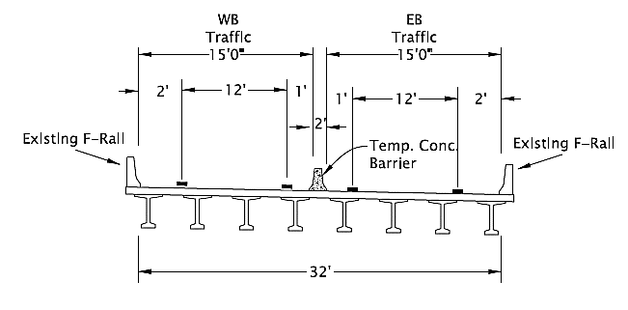
PROJECT NAME Full Closure w/Crossover
15 ft Minimum Width (12ft Wide Load Restriction)
June 16 – August 12, 2022
Notes:
Update this slide with your own information, or remove if full closure w/crossover is not planned.
Mobility Impacts During Construction - Full Closure w/Crossover
Describe the closure area(s) and where traffic will be crossed over. Include pictures of staging diagrams that show the width for the open traffic lane(s) (including travel lane and shoulder widths).
The diagram should reflect the useable paved width for the open traffic lane(s) between barrier(s), equipment, or traffic control devices. *Width generally refers to the paved width of the lane and any shoulders which are capable of supporting the freight traffic loads without failure. On a case-by-case basis, unpaved/aggregate shoulders may be determined to be useable.
When only a single travel lane is maintained for one direction, show what the resulting overwidth load restriction(s) will be. Locations on a tangent require a 2’ buffer for overwidth loads, and 3’ if on a curve. Example: 15’ width on a tangent = 13’ wide load restriction. 15’ width on a curve = 12’ wide load restriction. Note: A buffer more than 3’ may be needed if curvature exceeds 5 degrees or due to other special circumstances.
Include allowable closure times per specifications, and estimated number of weeks/months closures/restrictions are needed.
Provide detour information on next slide.
If using an image/graphic, make sure it has Alt Text added for accessibility. (Right Click on photo →Format Picture → Size and Properties)

Slide 17
PROJECT NAME Multiple Stages/Phases, Lane Closures & Full Road Closures Summary
Stage | Phase(s) | Work Summary & Milepoint | Const. Year | Approx. Duration | Barrier Type & Width Between Barrier | Work Zone Tangent/ Curve? | Planned Restrictions and/or closures | Allowable Days/ Hours
Stage # | Phase # | Very brief (word or phrase) to describe work & milepoint location | YYYY | Indicate how long the restriction will be in place (in weeks or months) | EXAMPLE: Soft barrier; 19-feet |  | List the restrictions/ closures planned during the stage. | List the days/hours each day that the contractor will be allowed to restrict.
Stage 1 | Phase 1 | Guardrail (MP 20.5 – 22.34) | 2022 | 6 weeks | Soft barrier; 19-feet | Tangent | Staging from Single Lane closures will provide 19 feet of width between barriers for traffic, resulting in 17 foot width load restriction. | Weekly, Monday through Thursday from 7 am to 7 pm daily. No work (Fri/Sat/Sun)
Stage 2 | Phase 1a | Paving (MP 22.34 – 28.06) | 2023 | 6 months | Soft barrier; 19-feet Day 14 feet night | Tangent | Intermittent lane closures. Staging provides 19 feet of width between barriers resulting in 17-foot load width restriction during the day; and 14-foot of width during the night resulting in 12-foot load width restriction. | Sunday night to Friday mornings: Nighttime work: 7 pm to 7 am Daytime work is 7 am to 7 pm
EXAMPLES
Notes:
***FOR RAMP CLOSURES --- USE THE SUMMARY TABLE PROVIDED IN SLIDE 17***
For projects with multiple stages and a variety of lane closures and/or full road closures, include this summary table for the different stages and lane closures/full road closures.
Update this slide with your own information / remove the examples and instructions provided.
Duplicate this slide as necessary to summarize all stages and phases of the project.
Only provide impacts that result in a restriction (no need to include lane closures/width reductions that will not result in a restriction).
No restriction means that there is at least 22 feet of horizontal clearance for one travel lane or 28 feet of horizontal clearance for two travel lanes.

Slide 18
PROJECT NAME Ramp Closure With Detour
I-84 WB Exit 17 Off-Ramp Closure (estimated June 2024)
Detour: WB traffic to exit at NW 238th Dr. (Exit 16), turn left over the freeway, and then take I-84 EB to the next Exit 17 (Marine Dr/257th Ave)
Closure allowed 11pm to 5am Monday thru Thursday (duration 1-2 nights).
Notes:
Update this slide with your own information, or remove if ramp closures are not planned. Duplicate this slide as needed for each ramp closure/detour that is planned.
Include a map of the detour for passenger vehicles and freight. Have the sign plan available in case stakeholders request to see it.
List the ramps by name, number, and whether they are “on” or “off” ramps.
Provide allowable closure months/days/hours per specifications.
Indicate estimated number of closures needed, and which month/year they are estimated to occur.
A viable detour route for freight that is affected by the ramp closure is required:
Has the detour been used by freight before?
Evaluate/determine if it’s approved for the same type of freight and oversize loads that currently use the route that’s being closed. This includes standard freight (WB67s) and oversize loads operating under an annual or single trip permit.
Ensure the proposed freight/oversize detour has been checked/cleared of any width, height, weight, or length restrictions (and truck turning movements have been evaluated).
Ensure it has been approved by the appropriate jurisdiction (e.g. city, county, or ODOT District Office).
Ensure it will be available and free of any project related restrictions at the same time.
Contact the Mobility Team at MCTDMOBILITYTEAM@odot.state.or.us to obtain annual and single trip oversize permit information, or truck modeling templates to evaluate turning movements.
Additional Considerations:
Provide estimated delay/travel time.
How will the detour route affect emergency services response times?
Will vehicles transporting hazardous materials be able to use the planned detour route?
Is there another detour route available if something happens to the proposed detour route?
If using an image/graphic, make sure it has Alt Text added for accessibility. (Right Click on photo →Format Picture → Size and Properties)

Slide 19
PROJECT NAME Summary of Ramp Closures
Ramp | Work Summary | Const. Year | Approx. Duration | Allowable Days/Hours | Detour
Ramp #, Direction, On or Off Ramp | Very brief (word or phrase) to describe work | YYYY | MM/DD – MM /DD | Example: Sunday night thru Friday morning between 6 p.m. and 9 a.m. | Traffic will take….
Ramp #, Direction, On or Off Ramp | Very brief (word or phrase) to describe work | YYYY | MM/DD – MM /DD | Example: Sunday night thru Friday morning between 6 p.m. and 9 a.m. | Traffic will take….
Ramp #, Direction, On or Off Ramp | Very brief (word or phrase) to describe work | YYYY | MM/DD – MM /DD | Example: Sunday night thru Friday morning between 6 p.m. and 9 a.m. | Traffic will take….
Ramp #, Direction, On or Off Ramp | Very brief (word or phrase) to describe work | YYYY | MM/DD – MM /DD | Example: Sunday night thru Friday morning between 6 p.m. and 9 a.m. | Traffic will take….
Notes:
Update this slide with your own information, or remove if no ramp closures are planned.
For projects that have multiple ramps, summarize them in this table. Duplicate this slide as necessary to include all of the ramps in the project.
Mobility Impacts During Construction – Describe Ramp Closures:
Indicate the detour for passenger vehicles and freight. Have maps and the sign plan available in case stakeholders request to see it.
List the ramps by name, number, and whether they are “on” or “off” ramps.
Provide allowable closure months/days/hours per specifications.
Indicate estimated number of closures needed, and which month/year they are estimated to occur.
A viable detour route for freight that is affected by the ramp closure is required:
Has the detour been used by freight before?
Evaluate/determine if it’s approved for the same type of freight and oversize loads that currently use the route that’s being closed. This includes standard freight (WB67s) and oversize loads operating under an annual or single trip permit.
Ensure the proposed freight/oversize detour has been checked/cleared of any width, height, weight, or length restrictions (and truck turning movements have been evaluated).
Ensure it has been approved by the appropriate jurisdiction (e.g. city, county, or ODOT District Office).
Ensure it will be available and free of any project related restrictions at the same time.
Contact the Mobility Team at MCTDMOBILITYTEAM@odot.state.or.us to obtain annual and single trip oversize permit information, or truck modeling templates to evaluate turning movements.
Additional Considerations:
Provide estimated delay/travel time.
How will the detour route affect emergency services response times?
Will vehicles transporting hazardous materials be able to use the planned detour route?
Is there another detour route available if something happens to the proposed detour route?
If using an image/graphic, make sure it has Alt Text added for accessibility. (Right Click on photo →Format Picture → Size and Properties)

Slide 20
PROJECT NAME Weight, Height, Length Restrictions
Restriction Type | Current Roadway Restrictions | Proposed Roadway Restrictions | Proposed Duration | Allowable days/hours
Weight Restriction
Height Restriction
Length Restriction
Notes:
Update this slide with your own information.
Weight, Height, *Length Restrictions:
Will there be any weight, height, or length restrictions for freight either temporarily during construction, or permanently? If so, include a slide describing these.
Examples could include temporary falsework or traffic signals over the highway; narrow work zones with excessive degree of curvature; lane closure on a weight restricted bridge that requires heavy loads to straddle center line; etc.
*If planning a length restriction, consult with the Mobility Team first before building your slide as there are many different factors to consider for these restrictions.
Provide photos, as necessary, to illustrate the restriction.

Slide 21
PROJECT NAME Estimated Paving Production
Option | Paving Days EB | Paving Days WB | Paving Rate (Tons/Day)
Single Lane Closures – 12 hr shift (DAYS) | 63 | 66 | 1,320
Crossover – 12 hr shift (DAYS) | 42 | 44 | 1,980
Crossover – 24 hr shift or double pavers (DAYS) | 21 | 22 | 4,000
Anticipate a 16-20% cost savings over traditional traffic control using single lane closures option.
Estimated $2.1M savings based on programmed construction funding.
Notes:
Update this slide with your own information (the information in the table is provided as an example).
Estimated paving production:
For paving projects, provide details of estimated paving production for different traffic control options (which includes number of shifts/days and paving rate), and estimated cost savings.

Slide 22
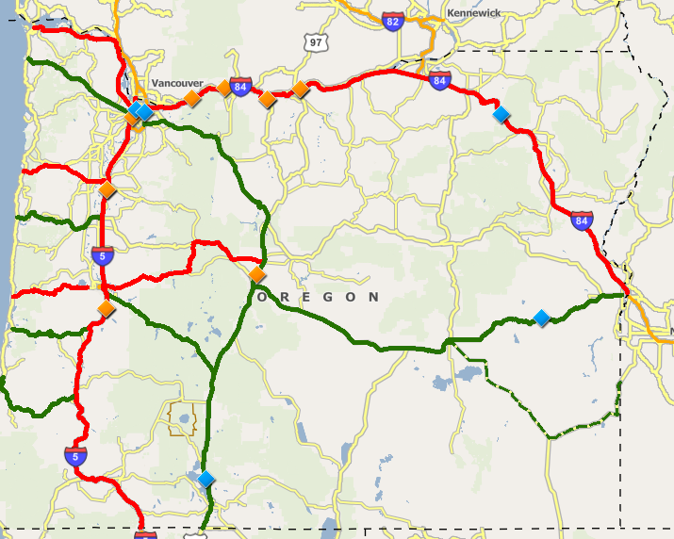
PROJECT NAME Critical Route Pair & Oversize Load Accommodation
Projects Taking Place at the Same Time on the Critical Route Pair
Project Name: Restriction summary
Project Name: Restriction summary
Project Name: Restriction summary
Project Name: Restriction summary
Project Name: Restriction summary
Project Name: Restriction summary
Summary
I-5 is a critical route paired with OR 212, U.S. 26, and U.S. 97.
The paired routes will NOT have any concurrent restrictions during this project.
Oversized loads may be accommodated through the work zone on a case-by-case basis with advance notice.
There is a 2-week window between stages 2 & 3 when traffic will be unrestricted.
EXAMPLE
Notes:
Update this slide with your own information.
IF YOUR PROJECT IS NOT ON A CRITICAL ROUTE PAIR, Remove the map and corresponding project summary table. Move the summary text box to the middle of the slide and provide the following:
Indicate that the project does not take place on a Critical Route Pair route.
Provide oversize load accommodation information:
Can wider loads be allowed through the work zone by moving by traffic control devices or equipment out of the way if needed?
If yes, would this require advance notice/coordination? How much advance notice?
If no advance notice is required, how much of a delay is anticipated to get the load through (and would regular vehicle traffic be detained in order to do this)? Is there a staging area available for the oversize load?
Can windows be provided during certain days/hours when oversize loads could move through without any restrictions? If so, describe when the windows take place.
Critical Route Pair GIS Map Snapshot and project information
Is the project on a critical route pair? Refer to Table 1 - Critical Route Pairs in the Mobility Procedures Manual.
Will there be any projects taking place on the paired route at the same time as this one that also has restrictions (and/or delays that exceed allowable thresholds)? Provide a snap shot taken from the CRP GIS Map to show projects taking place at the same time on the critical route pair. (https://geo.maps.arcgis.com/apps/webappviewer/index.html?id=e0d5397ac42e423f964d218842bfa78a). Refer to the map instructions to filter the map by the year(s) that work is taking place. Update the arrows and project descriptions on the slide to highlight projects taking place at the same time on the CRP.
Complete the Summary information in the provided text box, as shown in the example.
Can wider loads be allowed through the work zone by moving by traffic control devices or equipment out of the way if needed?
If yes, would this require advance notice/coordination? How much advance notice?
If no advance notice is required, how much of a delay is anticipated to get the load through (and would regular vehicle traffic be detained in order to do this)? Is there a staging area available for the oversize load?
Can windows be provided during certain days/hours when oversize loads could move through without any restrictions?
An important concept that affects mobility practices is critical route pairs. If the route that is identified on the list of critical route pairs (see Table 1 below) needs to be temporarily restricted, ODOT will take steps to make sure that the paired critical route on the list is not restricted. For instance, on the Portland to Coast Route, if US 30 needs to be restricted, ODOT will make sure that Hwy 26 is not restricted during that same period.
It is essential to communicate within a region, between regions, and statewide in development, construction, and maintenance to ensure an identified alternate critical route pair will not be concurrently restricted. A local detour is acceptable if it provides the shortest practical distance and will accommodate vehicles of the same weight and dimensions that are normally allowed on the route under construction.

Slide 23
PROJECT NAME Work Zone Safety Strategies Identified
Road closures
Law enforcement presence
Automated flagging devices
Construction speed zone reductions
Radar speed trailers
Accelerated construction strategies
Notes:
Update this slide with your own information.
Work Zone Safety Considerations:
Describe the work zone safety strategies being implemented per the Work Zone Safety Guiding Principal and documented in the Work Zone Decision Tree.

Slide 24
PROJECT NAME Bicycle & Pedestrian Safety Strategies Identified
Strategy Description
Strategy Description
Strategy Description
Strategy Description
Insert a diagram or map of proposed pedestrian walkways and bicycle paths through the work zone.
Notes:
Update this slide with your own information.
Bicycle and Pedestrian Safety Considerations:
Describe any plans to safely accommodate pedestrians and bicyclists through the work zone, if applicable. Provide a diagram or map showing pedestrian and bicycle routes as appropriate.

Slide 25
PROJECT NAME Summary of All Proposed Restrictions from Presentation
Required
Size/Weight Restriction or Road/Ramp Closure Information | Affected Direction of Travel | Work Summary Very brief (word or phrase) to describe work | Const. Year | Approx. Restriction Duration | Allowable Closure Days/Hours | Annual Oversize Loads Restricted?(Y or N) | Can Oversize loads be accommodated?
Single Lane closures with 19 feet of between barriers for traffic, resulting in 17 foot width load restriction. | NB | Paving work. | 2023 | 06/10 – 07/01 | Sun nights thru Fri mornings btwn 6 p.m. and 9 a.m. | No (Contact Mobility if you need help answering this) | Answer with either: No Yes – All Unannounced loads (20 mins or less) Yes – w/ advance notice
 |  |  | YYYY | MM/DD – MM /DD
 |  |  | YYYY | MM/DD – MM /DD
 |  |  | YYYY | MM/DD – MM /DD
 |  |  | YYYY | MM/DD – MM /DD
EXAMPLE
Notes:
Use this table to summarize all of the planned restrictions and closures planned during the project including:
Width restrictions (include barrier type and available width between barrier)
Vertical clearance restrictions
Length restrictions
Weight Restrictions
Ramp Closures
Full or directional road closures
Duplicate this slide as needed to allow for all of the restrictions/closures planned in the project.

Slide 26
PROJECT NAME Links to Additional Project Information
Insert description and link
Insert description and link
Insert description and link
Notes:
Update this slide with your own information.
Provide a description and hyperlink (include the entire hyperlink) to pages and documents with more information. These could include:
Project website
Project Fact Sheet
Links to related news articles, videos, photos, etc.

Slide 27
PROJECT NAME Next Steps
Questions
Follow-up items
Request support for Project Mobility Considerations Checklist Sign-Off
Shouldn't we have a slide that explains what the route allows as far as annual and single trip permits? Or, is that supposed to be slide 21?
Notes:
Update this slide with your own information.
Identify next steps, follow-up items, and whether you’ve gained support of the project (or if you need to come back to another committee meeting).

Slide 28
THANK YOU
Notes:
Replace this picture with your own image or diagram if you’d like.
HOW TO CHANGE THE BACKGROUND PICTURE
Go to the DESIGN tab on the ribbon.
In the Customize section, choose the icon with the paint bucket called FORMAT BACKGROUND.
The FORMAT BACKGROUND menu will open on the right side of your page. Make sure to select the radial button next to PICTURE OR TEXTURE FILL. Under the “Insert Picture from” section, choose FILE, CLIPBOARD, or ONLINE as appropriate.
Select a picture that fits the background space. Preferably in a landscape orientation.
Select your image, and press open.
Your picture will appear in the background!

