Slide 1
INSTRUCTIONS 1
PURPOSE FOR USING THE MOBILITY TEMPLATES
The templates are intended to standardize mobility presentations so that information is provided in an efficient way that makes the best use of everyone’s time during the meetings. Using these templates ensures the stakeholders have all the necessary information to make their recommendation to the agency.
WHICH TEMPLATE SHOULD I USE?
Work Zone Temporary Impacts Presentation Template: Used to communicate work
zone safety impacts and temporary restrictions during project development, construction (for updates) and maintenance. Use this template to seek support for sign-off of the Mobility Considerations Checklist
ORS 366.215 Presentation Template: Used for Stakeholder Forum presentations, required under
OAR Chapter 731, Division 12. Each slide is designed to present the required information listed in the ORS 366.215 Guidance Document. If your reduction includes a roadway reconfiguration (e.g. travel lane reductions and other striping changes) this template includes slides for those changes as well.
  Delete this and all INSTRUCTION slides before beginning your presentation.
Notes:
Delete this and all INSTRUCTION slides before beginning your presentation.

Slide 2
INSTRUCTIONS 2
WHICH TEMPLATE SHOULD I USE? (Cont’d)
Permanent (NON-ORS 366.215) Impacts Template: Used for sharing new permanent size
and/or weight restrictions that are considered "high" impact for permanent impacts that are NOT
subject to ORS 366.215, per the Project Review Criteria in Appendix C of the Mobility Advisory
Committee Charter.
Intersection Improvements Template: Used for early communication with the Mobility Advisory Committee/
Stakeholder forum. The intent of the slides are to share issues/problems with the current intersection, and seek early
input on options for potential solutions before a final treatment is decided.
Roundabout Template: Used for proposed roundabouts that are subject to freight industry input, per Highway Directive DES-02. Each slide is designed to present the required information needed for Stakeholder Forum Support (for roundabouts located on Reduction Review Routes) and freight industry support on roundabout sizing.
Roadway Reconfiguration Template: Used for projects proposing a roadway reconfiguration only (not in conjunction with a proposed reduction in vehicle-carrying capacity on a Reduction Review Route subject to ORS 366.215). These include road diets, travel lane reductions, lane width changes, etc. If the roadway configuration is included with a Reduction in Vehicle Carrying Capacity, use the ORS 366.215 presentation template instead (the template includes roadway reconfiguration slides).
  Delete this and all INSTRUCTION slides before beginning your presentation.
Notes:
Delete this and all INSTRUCTION slides before beginning your presentation.

Slide 3
INSTRUCTIONS 3
HOW DO I KNOW WHICH SPECIFIC INFORMATION TO INCLUDE IN EACH SLIDE?
Instructions are provided, where appropriate, in the Notes section at the bottom of each slide. The Notes should display by default when you open the template. If not, select “View” from the top ribbon and toggle the “Notes” button in the “Show” section. Delete the instruction notes and replace them with your own, as appropriate.
WHAT IF I NEED ADDITIONAL SLIDES TO COVER ALL OF MY PLANNED CONTENT?
Keep your content as concise as possible. However, if you need additional slides (e.g. to display multiple stages of a large project), duplicate the appropriate slides provided in the template. If you need an additional slide that is not included in the, template, contact the Mobility Services Team for suggestions on how best to provide the information.
HOW DO I SEND MY COMPLETED PRESENTATION TO THE MOBILITY TEAM?
Submit your presentation using the Agenda Request/Meeting Materials Form on the Mobility Program internal SharePoint site. The form will prompt you to answer some questions about your agenda topic and the meeting date you would like to present. Documents must be submitted at least three weeks prior to the meeting. (Outside consultants should provide their presentation to the appropriate Region Mobility Liaison, who can submit your presentation on your behalf. Contact information for the Region Mobility Liaisons can be found on the Statewide Mobility Program website.)
  Delete this and all INSTRUCTION slides before beginning your presentation.
Notes:
Delete this and all INSTRUCTION slides before beginning your presentation.

Slide 4
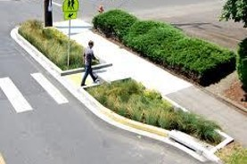
PROJECT NAME
Potential Permanent Impact
(Non-ORS 366.215 Impacts)
Presenter(s) Name(s):
Other Notes: (e.g. HB 2017 project, Intersection Improvement, etc.)
Replace with your own project photo
Mobility Advisory Committee
Meeting Date: MM/DD/YYYY
Notes:
Update this slide with your own information and photo/image that represents your project or Proposed Action.
This presentation template should be used for projects that have the potential to permanently impact a state highway that is NOT designated as a Reduction Review Route subject to ORS 366.215.
Note: Proposed roundabouts for non-Reduction Review Routes should use the Roundabout Template.
Use this template for sharing new permanent size and/or weight restrictions that are considered "high" impact for permanent (Non-ORS 366.215) impacts, per the Project Review Criteria in Appendix C of the Mobility Advisory Committee Charter:
New permanent size, weight, or height restrictions that create new pinch points or do not meet mobility horizontal width or vertical clearance standards per the highway design manual.
Permanent restrictions that result in significant mobility impacts.
New permanent size, weight, or height restrictions that create new pinch points or do not meet highway design standards on a freight route per the Highway Design Manual and the Traffic Structures Design Manual.
A permanent reduction in horizontal clearance that also includes a proposed road diet, lane reconfiguration/lane reduction, traffic calming, or other project types that reduce the number of travel lanes or travel lane widths.

Slide 5
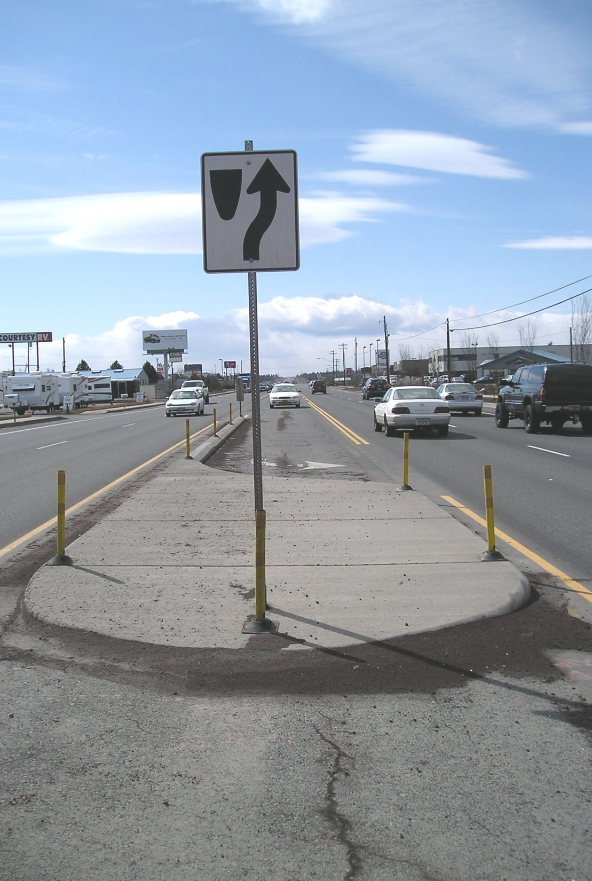
AGENDA
  Topics:
      Location
      Problem/Issues & Proposed Action(s)
      Proposed Clearance Reductions & Design Guidance
      Existing & Proposed Cross-sections
      Highway Design Manual Guidance for Roadway Reconfiguration
      Over Dimension Permit Data
      Pinch Point Information
      Summary of Proposed Changes
  Objective:
  Seeking support for proposed permanent impacts
Replace with your own project photo
Notes:
Remove or update the photo as appropriate to match your project
Update the agenda topics as appropriate to match your presentation. For example, remove the Highway Design Manual Guidance for Roadway Reconfiguration if your project does not include a roadway reconfiguration.
Objective should be to seek Stakeholder Support for the proposed permanent impacts identified in the presentation.

Slide 6
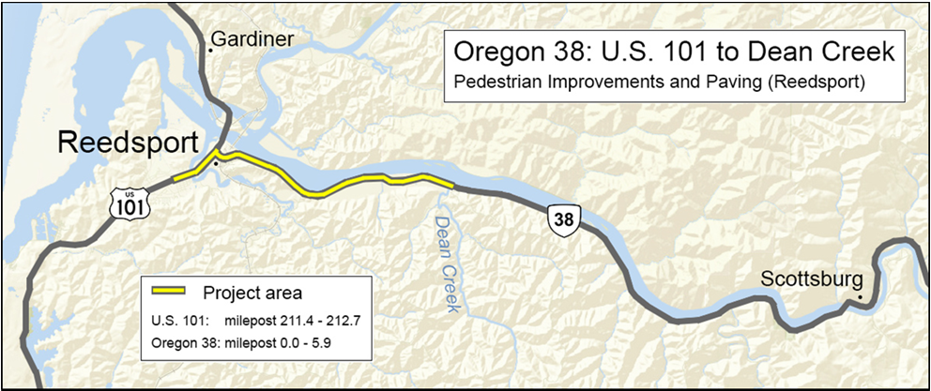
PROJECT NAME
Location (including mile points & nearest city/landmark)
Replace with your own project map
Notes:
Update this slide with your own information.
Project Location:
Include a map of the project location, and provide a brief description at the top of the slide that includes the nearest city or landmark.
Make sure map image has Alt Text added for accessibility. (Right Click on photo →Format Picture → Size and Properties)

Slide 7
PROJECT NAME
Location Details
Roadway Characteristics
  Type of roadway & number of lanes
  Grade type (flat, hills, both)
  Straight, curved, or both
  Traffic Conditions
  ADT:
  Truck Count:
Annual Over-Dimension Permits
  Annual Width allowed daytime: ## feet
  Annual Width allowed nighttime: ## feet
  Single Trip Over-Dimension Permits
  Width allowed daytime without District Approval: ## feet
  Width allowed nighttime without District Approval: ## feet
Notes:
Update this slide with your own information.
Roadway Characteristics:
Provide the type of roadway (e.g. interstate/multilane highway, 2-lane highway); indicate the grade type; and indicate if the roadway straight or if are there curves.
Traffic Conditions:
Provide ADT and truck counts.
Annual Over-Dimension Permits:
Indicate the allowable daytime and nighttime widths for the route. Refer to the following maps (or contact the Mobility Services Team if you need assistance finding this information):
Daylight Width Map: https://www.oregon.gov/odot/ProjectDel/Mobility/DaylightWidthMap.pdf
Nighttime Width Map: https://www.oregon.gov/odot/ProjectDel/Mobility/NighttimeWidthMap.pdf
Single Trip Over-Dimension Permits
Indicate the maximum width allowed to be issued by CCD OD Permits Staff without having to seek District Approval. This information can be found in the State and District Guidelines document (or contact the Mobility Services Team if you need assistance finding this information):
https://www.oregon.gov/odot/MCT/Documents/pilotcarguide.pdf

Slide 8
PROJECT NAME
Project Purpose, Scope, Issues
Scope:
Provide a brief summary of the project purpose and scope.
Issues & Concerns to be addressed (including Safety & Access considerations):
Issue/Concern
  Detail
  Detail
Issue/Concern
  Detail
  Detail
Issue/Concern
  Detail
  Detail
Notes:
Provide a brief summary of the purpose and scope of the project, and list issues and concerns that the project will address.

Slide 9
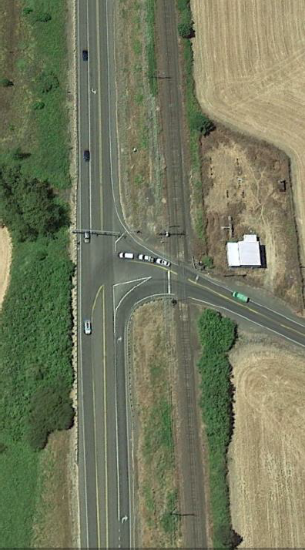
PROJECT NAME
Proposed Changes
Proposed Safety Improvements:
Left Turn Acceleration Lanes
Replace with your own project photo
Sight Distance
Signing & Striping
Notes:
Update this slide with your own information / photos and customize as appropriate.
Use this slide to describe the proposed changes associated with your project.

Slide 10
PROJECT NAME
Summary of Options Under Consideration
Option | Pros | Cons | Approx. Cost
Option 1: Summary |  |  | $##,###,###
Option 2: Summary |  |  | $##,###,###
Option 3: Summary |  |  | $##,###,###
Notes:
Update this slide with your own information (or remove if not presenting different design options)
If you are planning to get input from the MAC on different options/solutions for this project, use this slide to briefly describe each one.
In the table provided, summarize each option, pros, cons and costs (if available). If more options were considered than can fit in the table, duplicate this slide and continue to list additional options.

Slide 11
PROJECT NAME
Proposed Vertical Clearance Reductions
Location (Route & MP) | Proposed Feature | Existing VC (Feet) | Proposed VC (Feet) | Design Standard (Feet) | New Pinch Point Created? Y or N
Notes:
Use this slide to describe any proposed changes in vertical clearance (VC) that do not meet standards and/or creates new pinch points.
Remove this slide if the project does not include any vertical clearance changes.
In the first column, describe the location (including Route and milepoint)
In the second column, indicate the proposed feature that will result in reduced vertical clearance.
In the third column, indicate the existing vertical clearance at the location (indicate “No Limit” if there is no existing structure at the location)
In the third column, indicate what the proposed vertical clearance will be once the work is completed.
In the fourth column, indicate what the ODOT design standard is (per the Highway Design Manual) for the minimum vertical clearance based on the type of structure to be built and the route type (e.g. Interstate, NHS, High Route, etc).
In the last column, indicate if the proposed vertical clearance will create a new pinch point on the route (Y or N). Be sure to include pinch point information in slide 23 of this template.

Slide 12
PROJECT NAME
Proposed Horizontal Clearance Reductions
Location (Route & MP) | Proposed Feature | Existing HC (Feet) | Proposed HC (Feet) | Design Standard (Feet) | New Pinch Point Created? Y or N
Notes:
Use this slide to describe any proposed changes in horizontal clearance (HC) that do not meet standards and/or create new pinch points.
Remove this slide if the project does not include any horizontal clearance changes.
In the first column, describe the location (including Route and milepoint)
In the second column, indicate the proposed feature that will result in reduced horizontal clearance.
In the third column, indicate the existing horizontal clearance at the location.
In the third column, indicate what the proposed horizontal clearance will be once the work is completed.
In the fourth column, indicate what the ODOT design standard is (per the Highway Design Manual) for the minimum horizontal clearance on this particular route and location.
In the last column, indicate if the proposed horizontal clearance will create a new pinch point on the route (Y or N). Be sure to include pinch point information in slide 23 of this template.

Slide 13
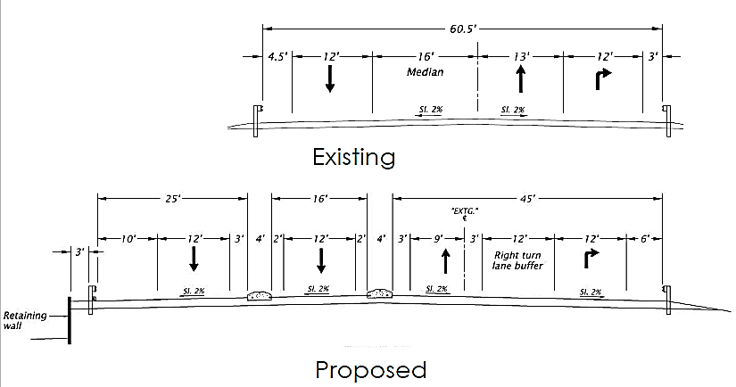
PROJECT NAME
Existing & Proposed Roadway Cross Sections
Add some details, if necessary.
Notes:
Update this slide with your own information / photos and customize as appropriate.
Cross Sections need to include the overall vertical clearance (if applicable) and/or horizontal clearance (curb to curb or edge-of-pavement to edge of pavement), and include lane widths, median widths, bicycle lane widths, shoulder widths, etc.
If possible, provide both existing and proposed on the same slide. Otherwise, provide them on separate slides if it makes the cross sections easier to see.
Duplicate this slide as needed, to provide additional cross sections to show all proposed permanent reductions and/or design options within your project area.

Slide 14
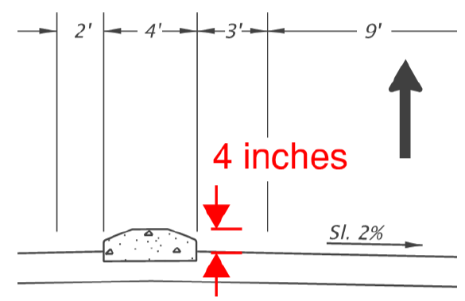
PROJECT NAME
Additional Cross Sections
Mountable traffic separator cross section:
Notes:
Update this slide with your own information / photos and customize as appropriate.
Provide additional cross sections for your project, as necessary (or remove this slide, if not needed).

Slide 15
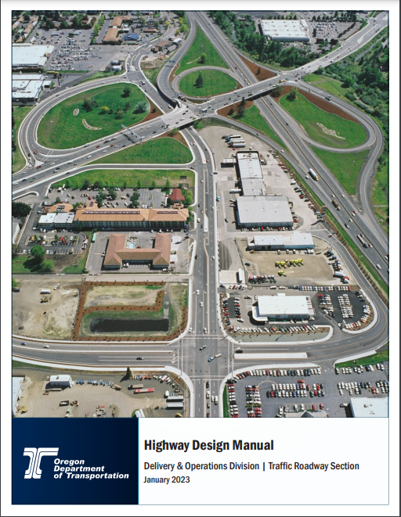
ODOT Highway Design Manual Guidance for
<<Insert Urban Context>>
Target Traffic Speed: ## - ## MPH
Design Element | HDM Guidance
Travel Lane
Two-Way-Left-Turn Lane
Right Turn Lane (Including shy distances)
On Street Bicycle Lane (not including buffer)
Bicycle/Street Buffer
On-Street Parking
Curb/Gutter
Raised Median - No Turn Lane (incl. shy distances)
Notes:
REMOVE THIS SLIDE IF YOUR PROPOSED REDUCTION IN HORIZONTAL CLEARANCE DOES NOT INCLUDE A ROADWAY RECONFIGURATION (E.G. ROAD DIET, LANE REDUCTIONS, LANE WIDTH REDUCTIONS, ETC.).
Use this slide to describe the Highway Design Manual (HDM) Guidance that applies to the urban context for your particular project area, so that the committee understands the standards that were used for the proposed roadway reconfiguration that is included with the proposed reduction in horizontal clearance.
Indicate the appropriate urban context in the title at the top. Urban contexts include:
Traditional Downtown/Central Business District
Urban Mix
Commercial Corridor
Residential Corridor
Suburban Fringe
Rural Community
Change/replace/add the design element categories in the table as appropriate to match the relevant design elements planned for the project (for example, remove On-Street Parking Width if that is not a planned element for your project).

Slide 16
PROJECT NAME
Bicycle Facility Recommendation
Urban Context: | ADT: | Traffic Speed: | Recommended Bike Facility:
Notes:
REMOVE THIS SLIDE IF YOUR PROPOSED REDUCTION IN HORIZONTAL CLEARANCE DOES NOT INCLUDE A ROADWAY RECONFIGURATION (E.G. ROAD DIET, LANE REDUCTIONS, LANE WIDTH REDUCTIONS, ETC.).
Update this slide with your data.
If the roadway reconfiguration includes adding bicycle lanes, use this table to show the type of bicycle facility that is appropriate for the project location, based on ODOT’s Highway Design Manual Guidance.
If bicycle lanes are not planned as part of the roadway reconfiguration or striping changes, remove this slide.

Slide 17
PROJECT NAME
Single Trip Over-Dimension Permit Summary
Analysis duration: __ years
Total STPs issued (including trips): ____ permits
District Guidelines for Over-Dimension Loads:
Daytime Width Allowed (without district approval) | Nighttime Width Allowed (without district approval) | Overall Length Allowed (without district approval) | Other Comments
___ feet | ___ feet | ___ feet
Notes:
Update this slide with your data.
Remove this slide if OD Permit Data is not needed
Use this slide to summarize Single-Trip Over-Dimension Data and District Guidelines.
Single-Trip Over-Dimension Data can be requested from the Mobility Team (please note that requests can take two weeks or longer, depending on the amount of data that needs to be analyzed). Use the information from the report provided by the Mobility Services Team to complete this slide.
Single Trip Permit Data helps stakeholders understand the types and frequency of over-dimension freight that uses the route where the project is located.
Remove this slide if you do not need to present permit data.

Slide 18
PROJECT NAME
Single Trip Over-Dimension Permit Summary: Wide Loads
Most wide loads were issued for <insert load type from permit report>
Widest load was for a <insert load type from report> at ___ wide.
Majority of permits were between ____ and ____wide.
Overall Width | Number of single-trip permits issued
Notes:
Update this slide with your data.
Remove this slide if OD permit data is not necessary to share with stakeholders
Use this slide to present Single-Trip Over-Dimension Data for wide loads. Single-Trip Over-Dimension Data can be requested from the Mobility Team (please note that requests can take two weeks or longer, depending on the amount of data that needs to be analyzed). Use the information from the single trip permit report provided by the Mobility Services Team to complete this slide.
Single Trip Permit Data helps stakeholders understand the types and frequency of over-dimension freight that uses the route where the project will be located.
Remove this slide if you do not need to present permit data.

Slide 19
PROJECT NAME
Single Trip Over-Dimension Permit Summary: Long Loads
Most wide loads were issued for <insert load type from permit report>
Longest load was for a <insert load type from report> at ___ long.
Majority of permits were between ____ and ____long.
Overall Length (incl. overhang) | Number of single-trip permits issued
70’ or less
71’ to 80’
81’ to 90’
91’ to 100’
101’ to 110’
111’ to 120’
Over 120’
Notes:
Update this slide with your data.
Remove this slide if OD permit data is not necessary to share with stakeholders
Use this slide to present Single-Trip Over-Dimension Data for long loads.
Single-Trip Over-Dimension Data can be requested from the Mobility Team (please note that requests can take two weeks or longer, depending on the amount of data that needs to be analyzed). Use the information from the single trip permit report provided by the Mobility Services Team to complete this slide.
Single Trip Permit Data helps stakeholders understand the types and frequency of over-dimension freight that uses the route where the project will be located.
Remove this slide if you do not need to present permit data.

Slide 20
PROJECT NAME
Single Trip Over-Dimension Permit Summary: Vehicle Combinations
Vehicle Combinations | Number of single-trip permits issued
Truck (Solo Vehicle) or Self Propelled Units (like cranes)
Doubles
Truck-Tractor + Semitrailer or Truck-Tractor +Tow-Away Unit
Truck + Trailer
Log Truck + Pole Trailer
Heavy Haul Combination (Truck-Tractor/Jeep/Semitrailer/Booster)
Toter + Mobile Home
Pickup Truck + Trailer
Notes:
Update this slide with your data.
Remove this slide if OD permit data is not necessary to share with stakeholders
Use this slide to present Single-Trip Over-Dimension Data for vehicle combinations.
Single-Trip Over-Dimension Data can be requested from the Mobility Team (please note that requests can take two weeks or longer, depending on the amount of data that needs to be analyzed). Use the information from the single trip permit report provided by the Mobility Services Team to complete this slide.
Single Trip Permit Data helps stakeholders understand the types and frequency of over-dimension freight that uses the route where the project will be located.
Remove this slide if you do not need to present permit data.

Slide 21
PROJECT NAME
Single Trip Over-Dimension Permit Summary: High Loads
Tallest load was for a <insert load type from report> at ___ high.
Majority of permits were between ____ and ____high.
Overall Height | Number of single-trip permits issued
14’00” or less (legal height)
14’01” to 14’06”
14’07” to 15’00”
15’01” to 15’06”
15’07” to 16’00”
16'01" to 17'00"
17'01 to 17'06"
Over 17’06”
Notes:
Update this slide with your data.
Remove this slide if OD permit data is not necessary to share with stakeholders
Use this slide to present Single-Trip Over-Dimension Data for High Loads (if appropriate for the project).
Single-Trip Over-Dimension Data can be requested from the Mobility Team (please note that requests can take two weeks or longer, depending on the amount of data that needs to be analyzed). Use the information from the single trip permit report provided by the Mobility Services Team to complete this slide.
Single Trip Permit Data helps stakeholders understand the types and frequency of over-dimension freight that uses the route where the project will be located.
Remove this slide if you do not need to present permit data.

Slide 22
PROJECT NAME
Single Trip Over-Dimension Permit Summary: Heavy Loads
The heaviest load was issued for <insert load type from permit report> at ___lbs.
Most of the loads were between ______ lbs and __________ lbs.
Gross Weight | Number of single-trip permits issued
80,000 lbs. or less (legal weight)
80,000 lbs. to 98,000 lbs.
98,001 lbs. to 120,000 lbs.
120,001 lbs. to 140,000 lbs.
140,001 lbs. to 160,000 lbs.
160,001 lbs. to 180,000 lbs.
180,001 lbs. to 200,000 lbs.
200,001 lbs. to 250,000 lbs.
Over 250,000 lbs.
Notes:
Update this slide with your data.
Remove this slide if OD permit data is not necessary to share with stakeholders
Use this slide to present Single-Trip Over-Dimension Data for Heavy Loads (if appropriate for the project).
Single-Trip Over-Dimension Data can be requested from the Mobility Team (please note that requests can take two weeks or longer, depending on the amount of data that needs to be analyzed). Use the information from the single trip permit report provided by the Mobility Services Team to complete this slide.
Single Trip Permit Data helps stakeholders understand the types and frequency of over-dimension freight that uses the route where the project will be located.
Remove this slide if you do not need to present permit data.

Slide 23
PROJECT NAME
Annual Over-Dimension Permit Data
Widths Allowed | Overall length Allowed: Long logs/ poles/piling permit, w/out steerable axles | Overall Length Allowed: Mobile/ modular unit permit | Overall Length Allowed: Unladen heavy haul combination permit | Overall Length Allowed: 1/2 wheelbase rear overhang permit for truck tractor and semitrailer combos)
Daytime annual width: Nighttime annual width:
Notes:
Update this slide with your data.
Use this slide to present information about annual over-dimension permits that can (or cannot) use the routes where the project is located. This information can be requested from the Mobility Services Team (please note that requests can take two weeks or longer, depending on the amount of data that needs to be analyzed). Use the information from the report provided by the Mobility Services Team to complete this slide.
Annual Permit Data helps stakeholders understand the types and frequency of over-dimension freight that uses the route where the project will be located.
Remove this slide if you do not need to present permit data.

Slide 24
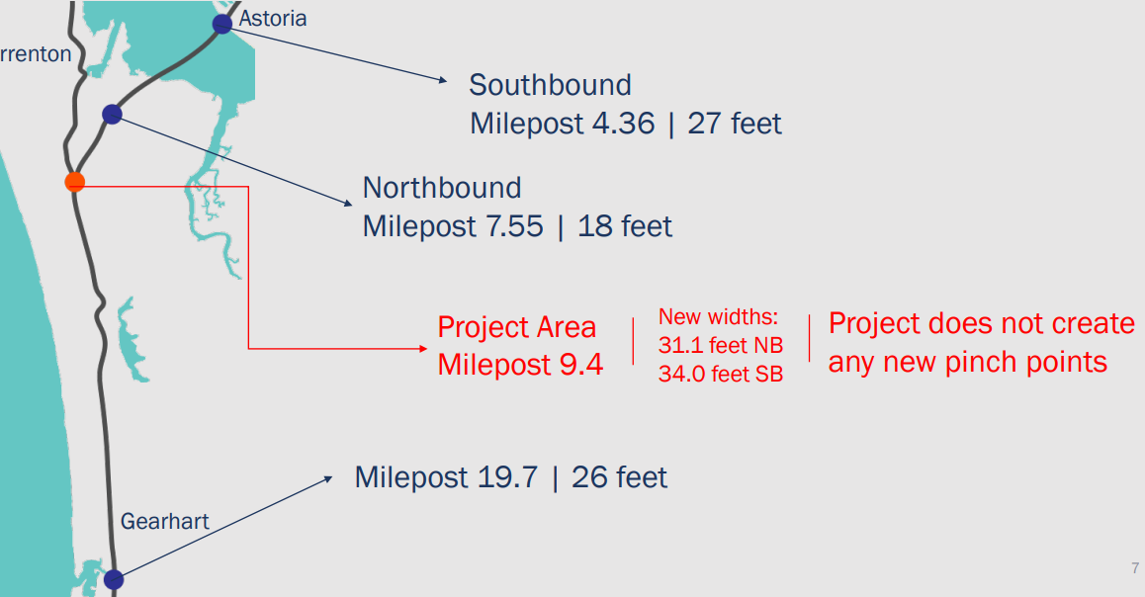
PROJECT NAME
Pinch Point Information
EXAMPLE
Pinch point
Pinch point
Pinch point
Notes:
Update this slide with your own information / photos and customize as appropriate.
Provide Information about pinch points on the highway(s) near the project area. Include the width (and vertical clearance, if applicable) of the pinch point and mile point. You may also include a map that illustrates the pinch points in relation to the project location.
Note: The Mobility Services Team can provide you with vertical clearance pinch point information. Contact the Mobility Services Team if you’d like to request this information.

Slide 25
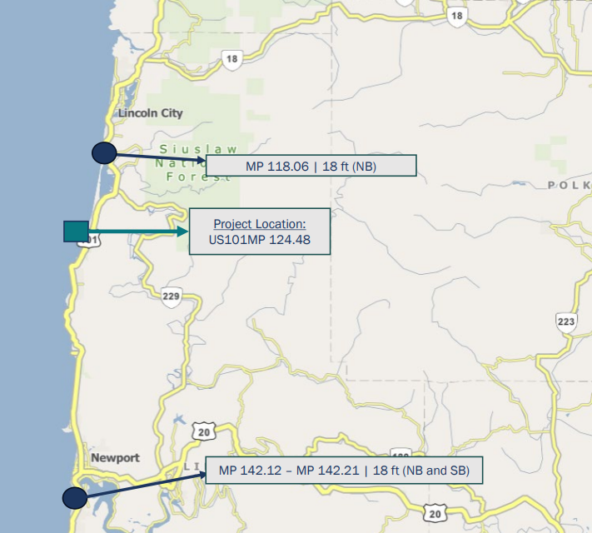
PROJECT NAME
Pinch Point Information
Pinch point
Pinch point
Pinch point
EXAMPLE
Notes:
Update this slide with your own information / photos and customize as appropriate.
Provide Information about pinch points on the highway(s) near the project area. Include the width (and vertical clearance, if applicable) of the pinch point and mile point. You may also include a map that illustrates the pinch points in relation to the project location.
Note: The Mobility Services Team can provide you with vertical clearance pinch point information. Contact the Mobility Services Team if you’d like to request this information.

Slide 26
PROJECT NAME
Summary of Changes
Summarize your changes in either sentence, bulleted list, or use the follow chart. Customize your information as appropriate.
Location | Existing Width or Height (ft) | Proposed Width or Height (ft) | Reduction (ft)
Notes:
Update this slide with your own information customize as appropriate.
Remind the committee what the existing and proposed clearances are, and provide the resulting reduction.
Duplicate this slide as necessary, to list all proposed permanent reductions within the project area.

Slide 27
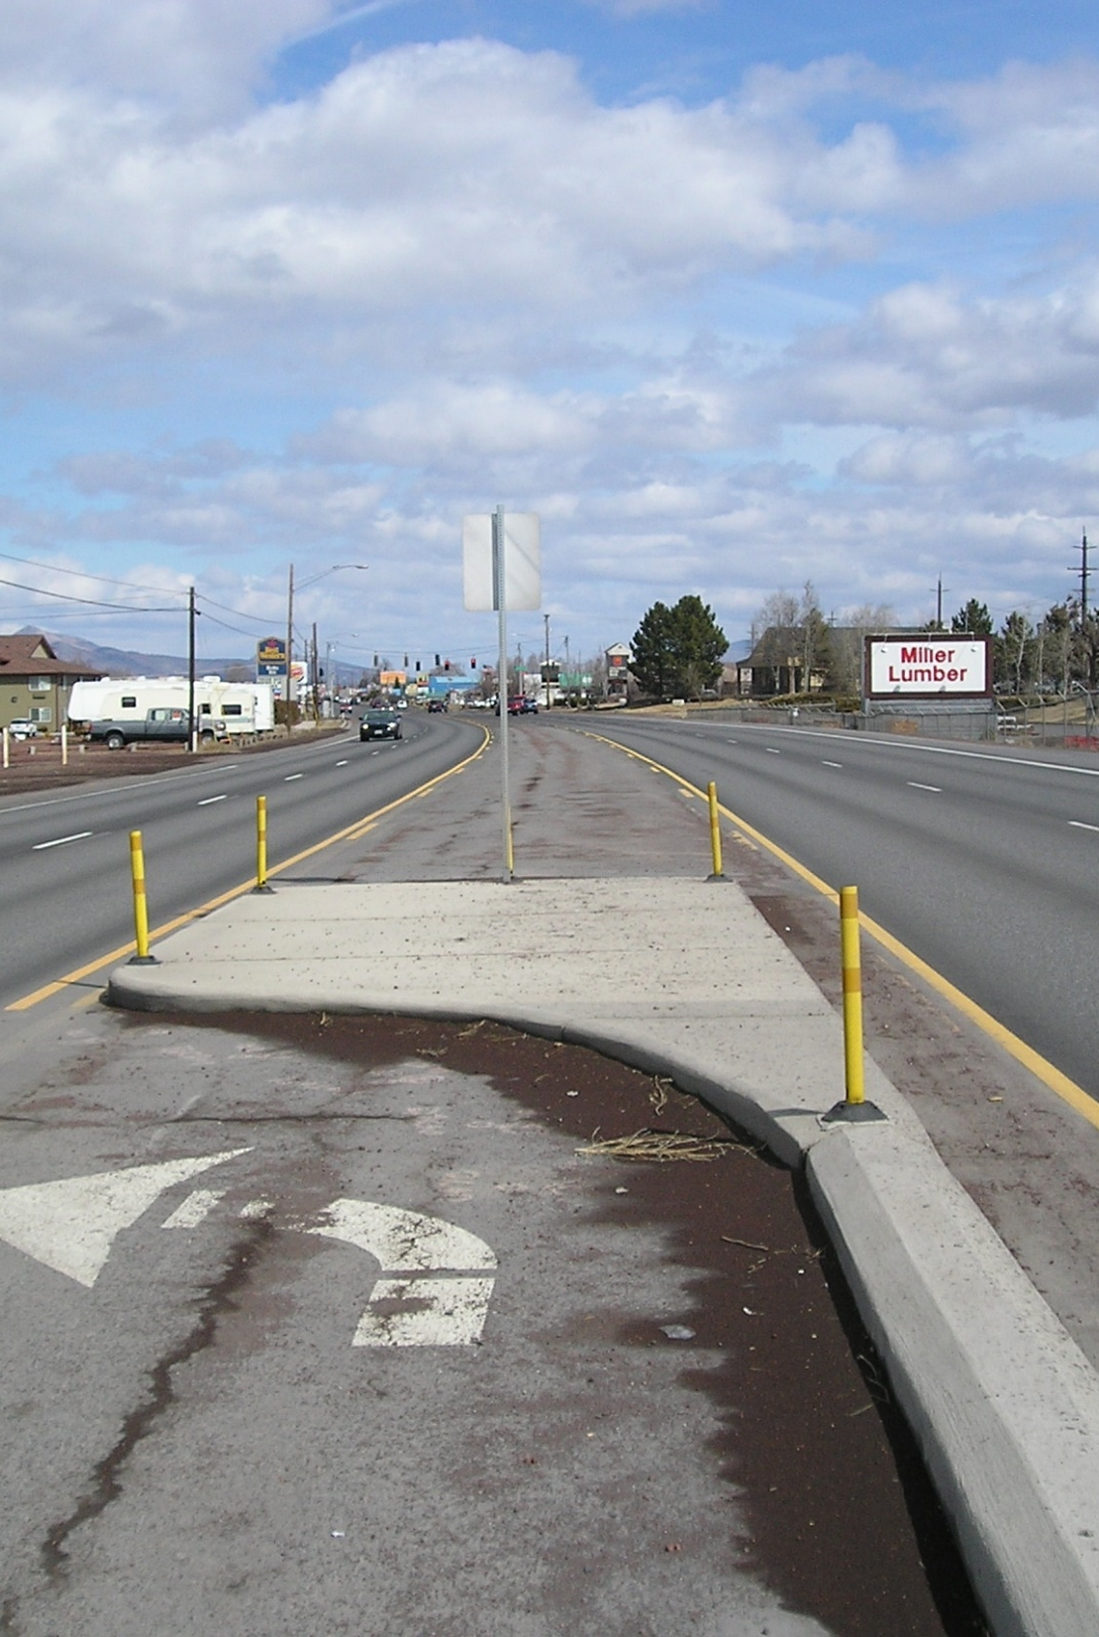
NEXT STEPS
Replace with your own project photo
Notes:
Indicate any relevant next steps that are appropriate for the project (e.g. return to the MAC to present temporary work zone impacts, etc.)

Slide 28
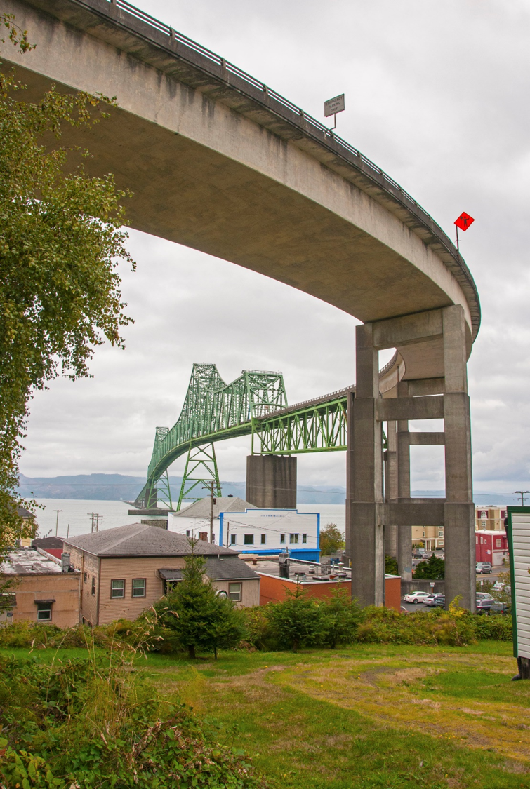
THANK YOU
Notes:
Replace this picture with your own image or diagram if you’d like.
HOW TO CHANGE THE BACKGROUND PICTURE
Go to the DESIGN tab on the ribbon.
In the Customize section, choose the icon with the paint bucket called FORMAT BACKGROUND.
The FORMAT BACKGROUND menu will open on the right side of your page. Make sure to select the radial button next to PICTURE OR TEXTURE FILL. Under the “Insert Picture from” section, choose FILE, CLIPBOARD, or ONLINE as appropriate.
Select a picture that fits the background space. Preferably in a landscape orientation.
Select your image, and press open.
Your picture will appear in the background!

