Slide 1
INSTRUCTIONS 1
PURPOSE FOR USING THE MOBILITY TEMPLATES
The templates are intended to standardize mobility presentations so that information is provided in an efficient way that makes the best use of everyone’s time during the meetings. Using these templates ensures the stakeholders have all the necessary information to make their recommendation to the agency.
WHICH TEMPLATE SHOULD I USE?
Work Zone Temporary Impacts Presentation Template: Used to communicate work
zone safety impacts and temporary restrictions during project development, construction (for updates) and maintenance. Use this template to seek support for sign-off of the Mobility Considerations Checklist
ORS 366.215 Presentation Template: Used for Stakeholder Forum presentations, required under
OAR Chapter 731, Division 12. Each slide is designed to present the required information listed in the ORS 366.215 Guidance Document. If your reduction includes a roadway reconfiguration (e.g. travel lane reductions and other striping changes) this template includes slides for those changes as well.
  Delete this and all INSTRUCTION slides before beginning your presentation.
Notes:
Delete this and all INSTRUCTION slides before beginning your presentation.

Slide 2
INSTRUCTIONS 2
WHICH TEMPLATE SHOULD I USE? (Cont’d)
Permanent (NON-ORS 366.215) Impacts Template: Used for sharing new permanent size
and/or weight restrictions that are considered "high" impact for permanent impacts that are NOT
subject to ORS 366.215, per the Project Review Criteria in Appendix C of the Mobility Advisory
Committee Charter.
Intersection Improvements Template: Used for early communication with the Mobility Advisory Committee/
Stakeholder forum. The intent of the slides are to share issues/problems with the current intersection, and seek early
input on options for potential solutions before a final treatment is decided.
Roundabout Template: Used for proposed roundabouts that are subject to freight industry input, per Highway Directive DES-02. Each slide is designed to present the required information needed for Stakeholder Forum Support (for roundabouts located on Reduction Review Routes) and freight industry support on roundabout sizing.
Roadway Reconfiguration Template: Used for projects proposing a roadway reconfiguration only (not in conjunction with a proposed reduction in vehicle-carrying capacity on a Reduction Review Route subject to ORS 366.215). These include road diets, travel lane reductions, lane width changes, etc. If the roadway configuration is included with a Reduction in Vehicle Carrying Capacity, use the ORS 366.215 presentation template instead (the template includes roadway reconfiguration slides).
  Delete this and all INSTRUCTION slides before beginning your presentation.
Notes:
Delete this and all INSTRUCTION slides before beginning your presentation.

Slide 3
INSTRUCTIONS 3
HOW DO I KNOW WHICH SPECIFIC INFORMATION TO INCLUDE IN EACH SLIDE?
Instructions are provided, where appropriate, in the Notes section at the bottom of each slide. The Notes should display by default when you open the template. If not, select “View” from the top ribbon and toggle the “Notes” button in the “Show” section. Delete the instruction notes and replace them with your own, as appropriate.
WHAT IF I NEED ADDITIONAL SLIDES TO COVER ALL OF MY PLANNED CONTENT?
Keep your content as concise as possible. However, if you need additional slides (e.g. to display multiple stages of a large project), duplicate the appropriate slides provided in the template. If you need an additional slide that is not included in the, template, contact the Mobility Services Team for suggestions on how best to provide the information.
HOW DO I SEND MY COMPLETED PRESENTATION TO THE MOBILITY TEAM?
Submit your presentation using the Agenda Request/Meeting Materials Form on the Mobility Program internal SharePoint site. The form will prompt you to answer some questions about your agenda topic and the meeting date you would like to present. Documents must be submitted at least three weeks prior to the meeting. (Outside consultants should provide their presentation to the appropriate Region Mobility Liaison, who can submit your presentation on your behalf. Contact information for the Region Mobility Liaisons can be found on the Statewide Mobility Program website.)
  Delete this and all INSTRUCTION slides before beginning your presentation.
Notes:
Delete this and all INSTRUCTION slides before beginning your presentation.

Slide 4
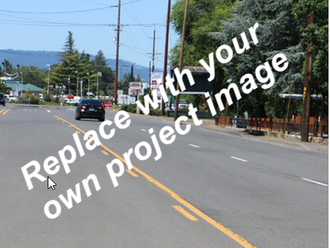
PROJECT NAME
Proposed Roadway Reconfiguration
Presenter(s) Name(s):
Other Notes: (e.g. ARTS, HB 2017 project, STIP Project, etc.)
Mobility Advisory Committee
Meeting Date: MM/DD/YYYY
Notes:
List the presenter(s) and provide any other notes about the project.
Replace the image with a photo that represents the project. Make sure the image has Alt Text added for accessibility. (Right Click on photo →Format Picture → Size and Properties)

Slide 5
AGENDA
  Topics:
    Location & Traffic Volumes
    Project Purpose & Scope
    Design Guidelines for Project Area
    Existing & Proposed Roadway Cross Sections
    Over-Dimension Freight Activity
    Alternatives Considered
    Summary of Changes
    Objective:
    Seeking input for proposed roadway reconfiguration
Notes:
Update this slide with your own information.
Agenda: The agenda should have, at a minimum, the following topics:
Location map, highway name(s), mile point(s) and traffic volumes (including % of truck traffic). This should be a broad view that includes connecting secondary routes and (if applicable).
Description of the issues and concerns to be addressed by the roadway reconfiguration.
A description of the Guidelines used for the proposed striping, per the Blueprint for Urban Design (BUD) manual.
A description of the existing and proposed roadway cross sections that provides travel lane widths, shoulder widths, bicycle lane widths, turn lane widths, etc.
A summary of over-dimension freight activity for the location, including a history of single trip permits issued for the corridor, District guidelines for permitted loads, and annual permitted loads that are allowed to use the route(s). Also provide a summary of pinch points near the intersection.
Alternatives considered from the proposed striping configuration.
Summary of striping changes.
Next steps for the project.
Objective: The objective for the intersection improvement project should be to seek support for the proposed road diet/lane reconfiguration.

Slide 6
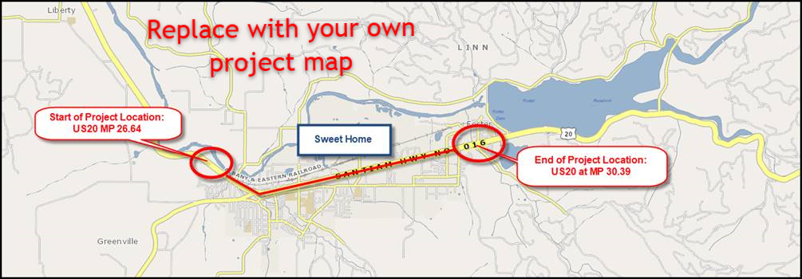
PROJECT NAME
Location | Signed Route No. | Hwy No. | Mile Point(s) | ADT | % Truck Traffic
Notes:
Update this slide with your own information and map image.
Project Location:
Provide a location map showing a broad view that includes connecting secondary routes. The slide should also provide the following info:
Location name
Signed Route Number
Highway Number
Mile Point Location
Average Daily Traffic volume (ADT)
% of traffic that is trucks/freight
If necessary, you can include an additional slide that shows a closer view of the location, to show nearby features/routes in greater detail.
Make sure map image has Alt Text added for accessibility. (Right Click on photo →Format Picture → Size and Properties)

Slide 7
PROJECT NAME
Project Purpose & Scope
Purpose/Scope:
Provide a brief summary of the project purpose and scope.
Issues to be addressed:
Issue/Concern
  Detail
  Detail
Issue/Concern
  Detail
  Detail
Issue/Concern
  Detail
  Detail
Notes:
Provide a brief summary of the purpose and scope of the project, and list issues and concerns that the project will address.

Slide 8
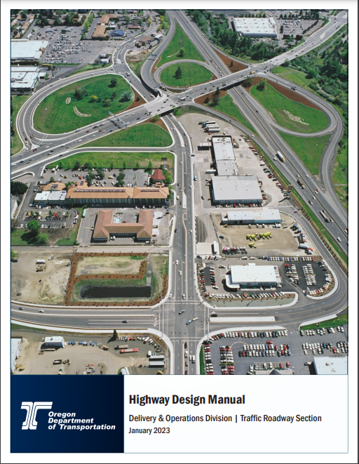
ODOT Highway Design Manual Guidance for
<<Insert Urban Context>>
Target Traffic Speed: ## - ## MPH
Design Element | HDM Guidance
Travel Lane
Two-Way-Left-Turn Lane
Right Turn Lane (Including shy distances)
On Street Bicycle Lane (not including buffer)
Bicycle/Street Buffer
On-Street Parking
Curb/Gutter
Raised Median - No Turn Lane (incl. shy distances)
Notes:
Use this slide to describe the Highway Design Manual (HDM) Guidance that applies to the urban context for your particular project area, so that the committee understands the standards that were used for the proposed roadway reconfiguration that is included with the proposed reduction in horizontal clearance.
Indicate the appropriate urban context in the title at the top. Urban contexts include:
Traditional Downtown/Central Business District
Urban Mix
Commercial Corridor
Residential Corridor
Suburban Fringe
Rural Community
Change/replace/add the design element categories in the table as appropriate to match the relevant design elements planned for the project (for example, remove On-Street Parking Width if that is not a planned element for your project).

Slide 9
PROJECT NAME
Bicycle Facility Recommendation
Urban Context: | ADT: | Traffic Speed: | Recommended Bike Facility:
Notes:
REMOVE THIS SLIDE IF YOUR PROPOSED REDUCTION IN HORIZONTAL CLEARANCE DOES NOT INCLUDE A ROADWAY RECONFIGURATION (E.G. ROAD DIET, LANE REDUCTIONS, LANE WIDTH REDUCTIONS, ETC.).
Update this slide with your data.
If the roadway reconfiguration includes adding bicycle lanes, use this table to show the type of bicycle facility that is appropriate for the project location, based on ODOT’s Highway Design Manual Guidance.
If bicycle lanes are not planned as part of the roadway reconfiguration or striping changes, remove this slide.

Slide 10
PROJECT NAME
Single Trip Over-Dimension Permit Summary
Analysis duration: __ years
Total STPs issued (including trips): ____ permits
District Guidelines for Over-Dimension Loads:
Daytime Width Allowed (without district approval) | Nighttime Width Allowed (without district approval) | Overall Length Allowed (without district approval) | Other Comments
___ feet | ___ feet | ___ feet
Notes:
Update this slide with your data.
Use this slide to summarize Single-Trip Over-Dimension permit data and District Guidelines.
Single-Trip Over-Dimension Data can be requested from the Mobility Team (please note that requests can take two weeks or longer, depending on the amount of data that needs to be analyzed). Use the information from the report provided by the Mobility Services Team to complete this slide.
Single Trip Permit Data helps stakeholders understand the types and frequency of over-dimension freight that uses the route where the proposed roundabout will be located.
Remove this slide if you are not yet ready to present permit data.

Slide 11
PROJECT NAME
Single Trip Over-Dimension Permit Summary: Wide Loads
Most wide loads were issued for <insert load type from permit report>
Widest load was for a <insert load type from report> at ___ wide.
Majority of permits were between ____ and ____wide.
Overall Width | Number of single-trip permits issued
Notes:
Update this slide with your data.
Use this slide to present Single-Trip Over-Dimension Data for wide loads. Single-Trip Over-Dimension Data can be requested from the Mobility Team (please note that requests can take two weeks or longer, depending on the amount of data that needs to be analyzed). Use the information from the single trip permit report provided by the Mobility Services Team to complete this slide.
Single Trip Permit Data helps stakeholders understand the types and frequency of over-dimension freight that uses the route where the proposed roadway reconfiguration will be located.

Slide 12
PROJECT NAME
Single Trip Over-Dimension Permit Summary: Long Loads
Most wide loads were issued for <insert load type from permit report>
Longest load was for a <insert load type from report> at ___ long.
Majority of permits were between ____ and ____long.
Overall Length (incl. overhang) | Number of single-trip permits issued
70’ or less
71’ to 80’
81’ to 90’
91’ to 100’
101’ to 110’
111’ to 120’
Over 120’
Notes:
Update this slide with your data.
Remove this slide if it is not necessary.
Use this slide to present Single-Trip Over-Dimension Data for long loads (if appropriate for your project). Single-Trip Over-Dimension Data can be requested from the Mobility Team (please note that requests can take two weeks or longer, depending on the amount of data that needs to be analyzed). Use the information from the single trip permit report provided by the Mobility Services Team to complete this slide.
Single Trip Permit Data helps stakeholders understand the types and frequency of over-dimension freight that uses the route where the proposed roadway reconfiguration will be located.

Slide 13
PROJECT NAME
Single Trip Over-Dimension Permit Summary: Vehicle Combinations
Vehicle Combinations | Number of single-trip permits issued
Truck (Solo Vehicle) or Self Propelled Units (like cranes)
Doubles
Truck-Tractor + Semitrailer or Truck-Tractor +Tow-Away Unit
Truck + Trailer
Log Truck + Pole Trailer
Heavy Haul Combination (Truck-Tractor/Jeep/Semitrailer/Booster)
Toter + Mobile Home
Pickup Truck + Trailer
Notes:
Update this slide with your data.
Use this slide to present Single-Trip Over-Dimension Data for vehicle combinations. Single-Trip Over-Dimension Data can be requested from the Mobility Team (please note that requests can take two weeks or longer, depending on the amount of data that needs to be analyzed). Use the information from the single trip permit report provided by the Mobility Services Team to complete this slide.
Single Trip Permit Data helps stakeholders understand the types and frequency of over-dimension freight that uses the route where the proposed roadway reconfiguration will be located.

Slide 14
PROJECT NAME
Single Trip Over-Dimension Permit Summary: High Loads
Tallest load was for a <insert load type from report> at ___ high.
Majority of permits were between ____ and ____high.
Overall Height | Number of single-trip permits issued
14’00” or less (legal height)
14’01” to 14’06”
14’07” to 15’00”
15’01” to 15’06”
15’07” to 16’00”
16'01" to 17'00"
17'01 to 17'06"
Over 17’06”
Notes:
Update this slide with your data.
Remove this slide if overheight loads are not relevant to the project
Use this slide to present Single-Trip Over-Dimension Data for High Loads (if appropriate for your project). Single-Trip Over-Dimension Data can be requested from the Mobility Team (please note that requests can take two weeks or longer, depending on the amount of data that needs to be analyzed). Use the information from the single trip permit report provided by the Mobility Services Team to complete this slide.
Single Trip Permit Data helps stakeholders understand the types and frequency of over-dimension freight that uses the route where the proposed roadway reconfiguration will be located.

Slide 15
PROJECT NAME
Single Trip Over-Dimension Permit Summary: Heavy Loads
The heaviest load was issued for <insert load type from permit report> at ___lbs.
Most of the loads were between ______ lbs and __________ lbs.
Gross Weight | Number of single-trip permits issued
80,000 lbs. or less (legal weight)
80,000 lbs. to 98,000 lbs.
98,001 lbs. to 120,000 lbs.
120,001 lbs. to 140,000 lbs.
140,001 lbs. to 160,000 lbs.
160,001 lbs. to 180,000 lbs.
180,001 lbs. to 200,000 lbs.
200,001 lbs. to 250,000 lbs.
Over 250,000 lbs.
Notes:
Update this slide with your data.
Remove or hide this slide if overweight loads are not relevant to the project
Use this slide to present Single-Trip Over-Dimension Data for heavy loads (if appropriate for your project). Single-Trip Over-Dimension Data can be requested from the Mobility Team (please note that requests can take two weeks or longer, depending on the amount of data that needs to be analyzed). Use the information from the single trip permit report provided by the Mobility Services Team to complete this slide.
Single Trip Permit Data helps stakeholders understand the types and frequency of over-dimension freight that uses the route where the proposed roadway reconfiguration will be located.

Slide 16
PROJECT NAME
Annual Over-Dimension Permit Data
Widths Allowed | Overall length Allowed: Long logs/ poles/piling permit, w/out steerable axles | Overall Length Allowed: Mobile/ modular unit permit | Overall Length Allowed: Unladen heavy haul combination permit | Overall Length Allowed: 1/2 wheelbase rear overhang permit for truck tractor and semitrailer combos)
Daytime annual width: Nighttime annual width:
Notes:
Update this slide with your data.
Use this slide to present information about annual over-dimension permits that can (or cannot) use the routes where the project is located. This information can be requested from the Mobility Services Team (please note that requests can take two weeks or longer, depending on the amount of data that needs to be analyzed). Use the information from the report provided by the Mobility Services Team to complete this slide.
Annual Permit Data helps stakeholders understand the types and frequency of over-dimension freight that uses the route where the proposed roadway reconfiguration will be located.
Remove this slide if you are not yet ready to present permit data.

Slide 17
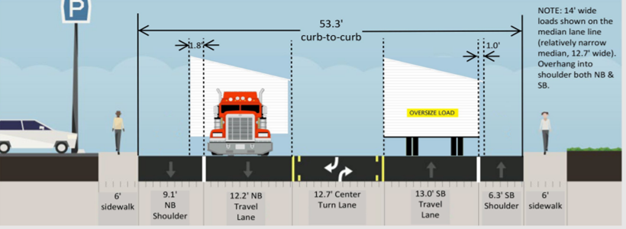
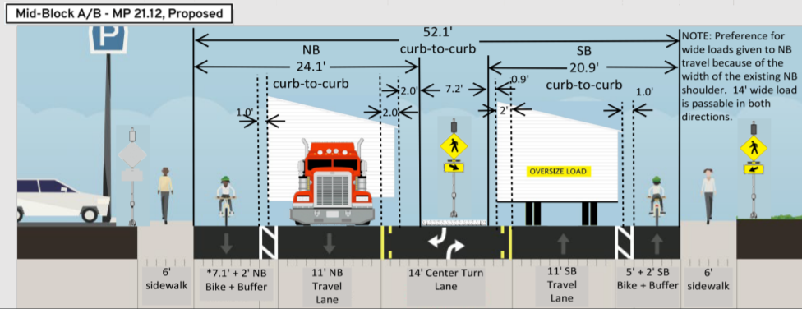
PROJECT NAME
Existing & Proposed Roadway Cross Sections
Existing
Proposed
Notes:
Update this slide with your own information / photos and customize as appropriate.
Cross Sections need to include the overall horizontal clearance (curb to curb), and include lane widths, median widths, bicycle lane widths, buffer widths, shoulder widths, etc.
If possible, provide both existing and proposed cross sections on the same slide. Otherwise, provide them on separate slides if it makes the cross sections easier to see.
Duplicate this slide as necessary to show additional existing/proposed cross sections within the project area.

Slide 18
PROJECT NAME
Alternatives Considered
Alternative | Pros | Cons
Alternative description
Alternative description
Alternative description
Alternative description
Notes:
Update this slide with your own information.
Use this slide to describe the different improvement alternatives that were considered before landing on the proposed roadway reconfiguration. Alternatives considered could include (but not limited to):
Alternative bicycle facilities.
Adjusting parking lane width
Adjusting the buffer space between the bicycle lane and travel lane
Adjusting bicycle lane width
Adjusting travel lane width
Adjusting left turn lane width

Slide 19
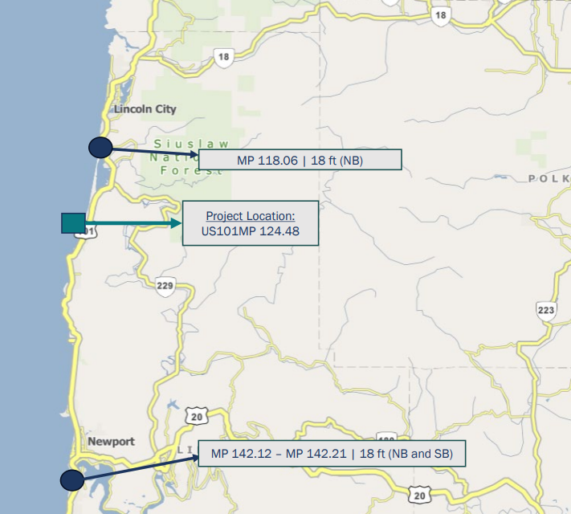
PROJECT NAME
Pinch Point Information
Pinch point
Pinch point
Pinch point
EXAMPLE
Notes:
Update this slide with your own information / photos and customize as appropriate.
Provide Information about pinch points on the highway(s) near the project area. Include the width (and vertical clearance, if applicable) of the pinch point and mile point. You may also include a map that illustrates
Note: The Mobility Services Team can provide you with vertical clearance pinch point information. Contact the Mobility Services Team if you’d like to request this information.
the pinch points in relation to the project location.

Slide 20
PROJECT NAME
Summary of Changes
Design Element | Existing | Proposed
Travel Lane Width(s) (NB or WB)
Travel Lane Width (s) (SB or EB)
Two-Way-Left-Turn Lane Width
Number of travel lanes (NB or WB)
Number of travel lanes (SB or EB)
Bicycle Lane Width
Bicycle Lane Buffer Width
Shoulder Width (NB or WB)
Shoulder (SB or EB)
Pedestrian Refuge Island Width
Parking Lane Width
Notes:
Update this slide with your own information customize as appropriate.
Remind the committee what the existing conditions are and what the proposed changes will be for the project. Update/Change/Add design elements to the table as appropriate.

Slide 21
THANK YOU
Notes:
Replace this picture with your own image or diagram if you’d like.
HOW TO CHANGE THE BACKGROUND PICTURE
Go to the DESIGN tab on the ribbon.
In the Customize section, choose the icon with the paint bucket called FORMAT BACKGROUND.
The FORMAT BACKGROUND menu will open on the right side of your page. Make sure to select the radial button next to PICTURE OR TEXTURE FILL. Under the “Insert Picture from” section, choose FILE, CLIPBOARD, or ONLINE as appropriate.
Select a picture that fits the background space. Preferably in a landscape orientation.
Select your image, and press open.
Your picture will appear in the background!

