Slide 1
INSTRUCTIONS 1
PURPOSE FOR USING THE MOBILITY TEMPLATES
The templates are intended to standardize mobility presentations so that information is provided in an efficient way that makes the best use of everyone’s time during the meetings. Using these templates ensures the stakeholders have all the necessary information to make their recommendation to the agency.
WHICH TEMPLATE SHOULD I USE?
Work Zone Temporary Impacts Presentation Template: Used to communicate work
zone safety impacts and temporary restrictions during project development, construction (for updates) and maintenance. Use this template to seek support for sign-off of the Mobility Considerations Checklist
ORS 366.215 Presentation Template: Used for Stakeholder Forum presentations, required under
OAR Chapter 731, Division 12. Each slide is designed to present the required information listed in the ORS 366.215 Guidance Document. If your reduction includes a roadway reconfiguration (e.g. travel lane reductions and other striping changes) this template includes slides for those changes as well.
  Delete this and all INSTRUCTION slides before beginning your presentation.
Notes:
Delete this and all INSTRUCTION slides before beginning your presentation.

Slide 2
INSTRUCTIONS 2
WHICH TEMPLATE SHOULD I USE? (Cont’d)
Permanent (NON-ORS 366.215) Impacts Template: Used for sharing new permanent size
and/or weight restrictions that are considered "high" impact for permanent impacts that are NOT
subject to ORS 366.215, per the Project Review Criteria in Appendix C of the Mobility Advisory
Committee Charter.
Intersection Improvements Template: Used for early communication with the Mobility Advisory Committee/
Stakeholder forum. The intent of the slides are to share issues/problems with the current intersection, and seek early
input on options for potential solutions before a final treatment is decided.
Roundabout Template: Used for proposed roundabouts that are subject to freight industry input, per Highway Directive DES-02. Each slide is designed to present the required information needed for Stakeholder Forum Support (for roundabouts located on Reduction Review Routes) and freight industry support on roundabout sizing.
Roadway Reconfiguration Template: Used for projects proposing a roadway reconfiguration only (not in conjunction with a proposed reduction in vehicle-carrying capacity on a Reduction Review Route subject to ORS 366.215). These include road diets, travel lane reductions, lane width changes, etc. If the roadway configuration is included with a Reduction in Vehicle Carrying Capacity, use the ORS 366.215 presentation template instead (the template includes roadway reconfiguration slides).
  Delete this and all INSTRUCTION slides before beginning your presentation.
Notes:
Delete this and all INSTRUCTION slides before beginning your presentation.

Slide 3
INSTRUCTIONS 3
HOW DO I KNOW WHICH SPECIFIC INFORMATION TO INCLUDE IN EACH SLIDE?
Instructions are provided, where appropriate, in the Notes section at the bottom of each slide. The Notes should display by default when you open the template. If not, select “View” from the top ribbon and toggle the “Notes” button in the “Show” section. Delete the instruction notes and replace them with your own, as appropriate.
WHAT IF I NEED ADDITIONAL SLIDES TO COVER ALL OF MY PLANNED CONTENT?
Keep your content as concise as possible. However, if you need additional slides (e.g. to display multiple stages of a large project), duplicate the appropriate slides provided in the template. If you need an additional slide that is not included in the, template, contact the Mobility Services Team for suggestions on how best to provide the information.
HOW DO I SEND MY COMPLETED PRESENTATION TO THE MOBILITY TEAM?
Submit your presentation using the Agenda Request/Meeting Materials Form on the Mobility Program internal SharePoint site. The form will prompt you to answer some questions about your agenda topic and the meeting date you would like to present. Documents must be submitted at least three weeks prior to the meeting. (Outside consultants should provide their presentation to the appropriate Region Mobility Liaison, who can submit your presentation on your behalf. Contact information for the Region Mobility Liaisons can be found on the Statewide Mobility Program website.)
  Delete this and all INSTRUCTION slides before beginning your presentation.
Notes:
Delete this and all INSTRUCTION slides before beginning your presentation.

Slide 4
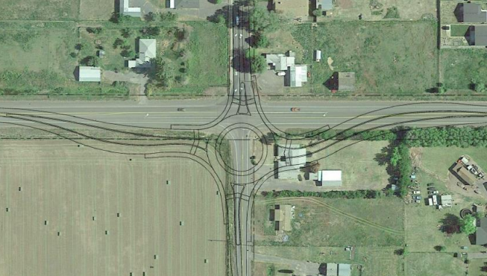
ROUNDABOUT PROJECT NAME
Proposed Roundabout & Potential ORS 366.215 Impact
Presenter(s) Name(s):
Other Notes: (e.g. HB 2017 project, STIP Project, etc.)
Replace with your own project photo
Mobility Advisory Committee
Meeting Date: MM/DD/YYYY
Notes:
Cover Page:
Update this slide with your own information and photo/image that represents the proposed roundabout.
If the proposed roundabout is NOT located on a Reduction Review Route subject to ORS 366.215, remove the second part of the subtitle referencing the statute.

Slide 5
AGENDA
Replace with your own project photo
  Topics:
    Location
    Issues & Options Considered
    Existing Conditions & Proposed Design
    Design Vehicle, Accommodation Vehicle(s)
    OD Permit Data
    Pinch Points
    Over-Dimension Bypass
    Summary of Proposed Changes
    Next Steps
    Objective:
    Seeking Stakeholder Forum Support for Proposed Action subject to ORS 366.215.
    Seeking Freight Industry support for Conceptual Approval and a Memorialized Agreement on Roundabout Sizing
    (Per Highway Directive DES-02).
Notes:
Update this slide with your own information and image.
Make sure your image has Alt Text added for accessibility. (Right Click on photo →Format Picture → Size and Properties)
Agenda: The agenda should have, at a minimum, the following topics:
Location map, highway name and mile points. This should be a broad view that includes connecting secondary routes and (if applicable) other nearby roundabouts (existing and proposed) on the same corridor.
Description of the problem or issues that require the proposed intersection improvement, as well as options considered (including pros, cons and costs for each option).
A description of the existing conditions and proposed design that includes:
A diagram of the existing intersection and cross sections (including existing structures)
A diagram of the proposed Roundabout Design (which includes the diameter, curb-to-curb widths, curb types, and the total width of truck aprons).
A diagram showing a cross section of the proposed roundabout.
The design vehicle and accommodation vehicle(s) used in developing the roundabout design, and a slide showing AutoTurn analysis of different vehicle types going through the roundabout.
A summary of single trip over-dimension permits issued for the route.
A summary of pinch points near the proposed roundabout.
A description or diagram of any planned bypass routes for over-dimension vehicles (if applicable).
A summary of the overall proposed changes (e.g. chart summarizing existing and proposed widths for traffic movement through the intersection).
Objective: The objective for a proposed roundabout presentation should be to seek a Memorialized Agreement on Roundabout Sizing (per Highway Directive DES-02). However, if the proposed roundabout is located on a Reduction Review Route subject to ORS 366.215, the objective should be to seek Stakeholder Forum Support for the Proposed Action (remove this objective if the roundabout is NOT located on a RRR). If the roundabout is located on a Reduction Review Route, the Mobility Services Team will only issue an ORS 366.215 Record of Support for the project (which also serves as a memorialized agreement for meeting DES-02).

Slide 6
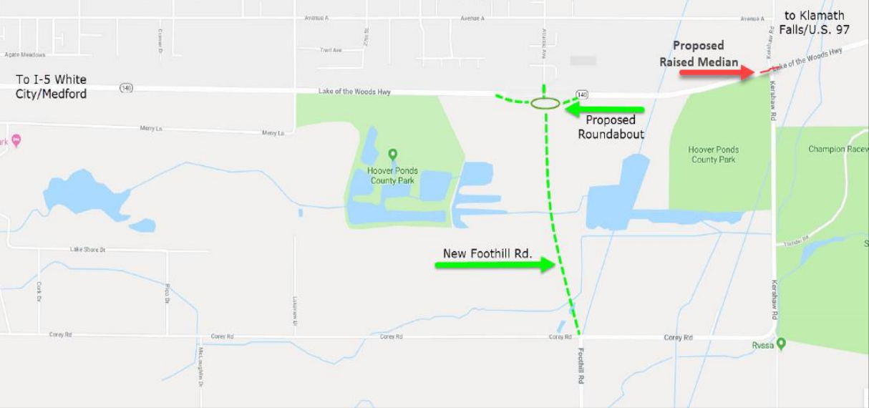
ROUNDABOUT PROJECT NAME
Location | Signed Route No. | Hwy No. | Mile Point | ADT | % Truck Traffic
Atlantic Ave. Intersection | OR140 | Hwy 270 | 1.70 | 5,000 | 20%
Notes:
Update this slide with your own information and map image.
Project Location:
Provide a location map showing a broad view that includes connecting secondary routes and (if applicable) other nearby roundabouts (existing and proposed) on the same corridor. The slide should also provide the following info:
Location name
Signed Route Number
Highway Number
Mile Point Location
Average Daily Traffic volume (ADT)
% of traffic that is trucks/freight
If necessary, you can include an additional slide that shows a closer view of the location, to show nearby features/routes in greater detail. Make sure map image has Alt Text added for accessibility. (Right Click on photo →Format Picture → Size and Properties)

Slide 7
PROJECT NAME
Location Details
Roadway Characteristics
  Type of roadway & number of lanes
  Grade type (flat, hills, both)
  Straight, curved, or both
Annual Over-Dimension Permits
  Annual Width allowed daytime: ## feet
  Annual Width allowed nighttime: ## feet
  Single Trip Over-Dimension Permits
  Width allowed daytime without District Approval: ## feet
  Width allowed nighttime without District Approval: ## feet
Notes:
Update this slide with your own information.
Roadway Characteristics:
Provide the type of roadway (e.g. interstate/multilane highway, 2-lane highway); indicate the grade type; and indicate if the roadway straight or if are there curves.
Annual Over-Dimension Permits:
Indicate the allowable daytime and nighttime widths for the route. Refer to the following maps (or contact the Mobility Services Team if you need assistance finding this information):
Daylight Width Map: https://www.oregon.gov/odot/ProjectDel/Mobility/DaylightWidthMap.pdf
Nighttime Width Map: https://www.oregon.gov/odot/ProjectDel/Mobility/NighttimeWidthMap.pdf
Single Trip Over-Dimension Permits
Indicate the maximum width allowed to be issued by CCD OD Permits Staff without having to seek District Approval. This information can be found in the State and District Guidelines document (or contact the Mobility Services Team if you need assistance finding this information):
https://www.oregon.gov/odot/MCT/Documents/pilotcarguide.pdf

Slide 8
ROUNDABOUT PROJECT NAME
Project Purpose, Scope, Issues
Scope:
Provide a brief summary of the project purpose and scope.
Issues & Concerns to be addressed (including Safety & Access considerations):
Issue/Concern
  Detail
  Detail
Issue/Concern
  Detail
  Detail
Issue/Concern
  Detail
  Detail
Notes:
Provide a brief summary of the purpose and scope of the project, and list issues and concerns that the project will address (including safety and access considerations for roundabouts proposed on Reduction Review Routes subject to ORS 366.215).

Slide 9
ROUNDABOUT PROJECT NAME
Intersection Improvement Options Considered
Option | Pros | Cons | Cost
Option 1: Summary |  |  | $##,###,###
Option 2: Summary |  |  | $##,###,###
Option 3: Summary |  |  | $##,###,###
Option 4: Summary |  |  | $##,###,###
Notes:
Update this slide with your own information.
Use this slide to describe the different intersection improvement alternatives that were considered as part of the Intersection Traffic Control Study that is conducted during the Conceptual Approval process.
In the table provided, summarize each option, pros, cons and costs (if available). If more options were considered than can fit in the table, duplicate this slide and continue to list additional options.

Slide 10
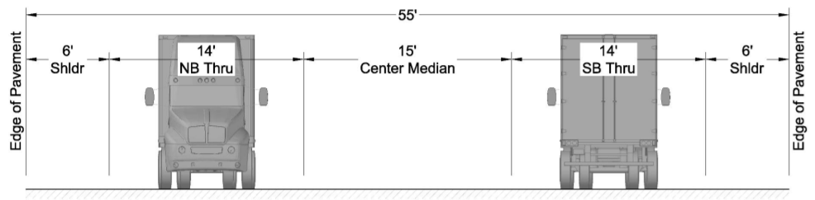
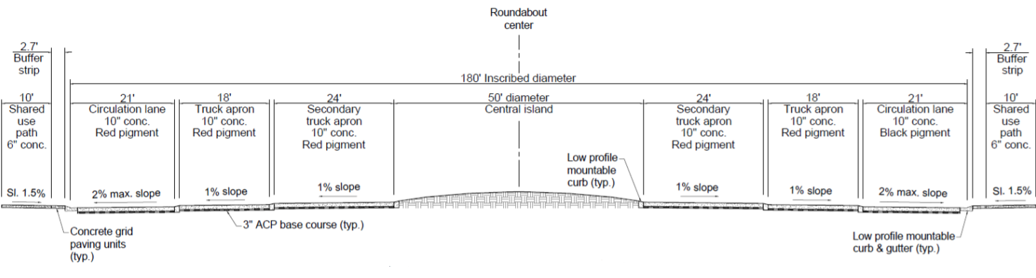
ROUNDABOUT PROJECT NAME
Existing Condition & Proposed Cross Sections
Existing
Proposed
Notes:
Update this slide with your own information / photos and customize as appropriate.
Provide cross sections for the existing roadway and the proposed roundabout cross-section (on the same slide, if possible). (Provide the same slide for each direction of the roundabout, as appropriate).
Include cross sections of the existing roadways that shows the overall horizontal clearance (curb to curb), vertical clearance (if applicable), and include lane widths, median widths, bicycle lane widths, shoulder widths, etc.

Slide 11
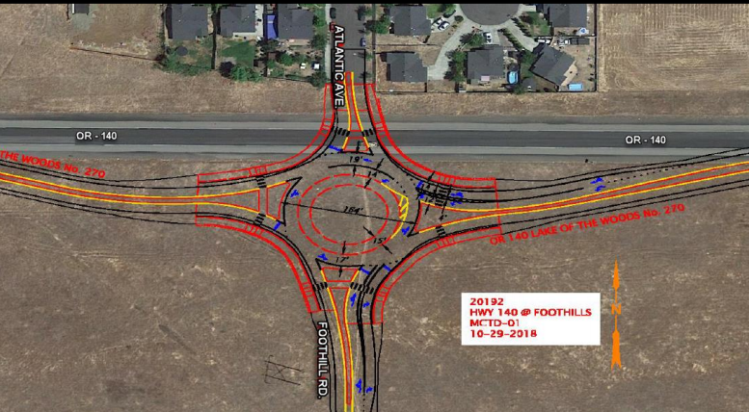
ROUNDABOUT PROJECT NAME
Conceptual Drawing
Notes:
Update this slide with your own information / photos and customize as appropriate.
Provide a conceptual drawing that shows the proposed roundabout superimposed over the proposed location. This image is also helpful if the existing route will be used as a proposed truck bypass.

Slide 12
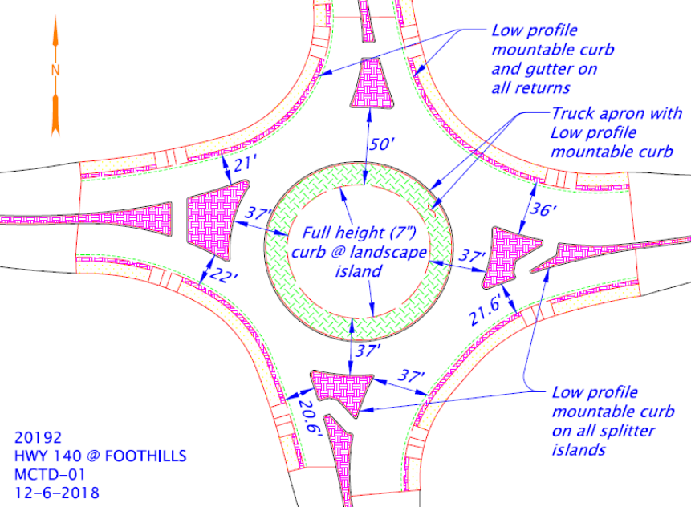
ROUNDABOUT PROJECT NAME
Proposed Roundabout Design
Design Element | Measurement
Inscribed Diameter
Truck Apron Diameter
Truck Apron Width
Central Island Diameter
Central Island Curb Height
Circulating Roadway Cross Slope
Truck Apron Cross Slope
Splitter Island & Truck Apron Curb Heights
Mountable Curbs
Narrowest Pinch Point (curb to curb) for each travel direction
Travel Lane Widths
Notes:
Update this slide with your own diagram and information. Customize as appropriate.
If available at the time of the Mobility meeting, use this slide to provide the dimensions of the proposed roundabout design.
This slide should include the following information in the provided table:
Inscribed Diameter
Truck Apron Diameter
Truck Apron Width
Central Island Curb Height
Circulating Roadway Cross Slope
Truck Apron Cross Slope
Splitter Island & Truck Apron Curb Heights
Indicate which curbs are mountable
Narrowest curb-to-curb pinch points for each direction within the roundabout
Travel lane widths within the roundabout.

Slide 13
ROUNDABOUT PROJECT NAME
Design Vehicle & Accommodation Vehicle Summary
Design Vehicle | Accommodation Vehicle
Truck-tractor/semitrailer with 53’ trailer (WB-67) Overall Length: 73.5 feet Overall Width: 8.5 feet | Windfarm Transformer Transport Overall Length: 195 feet, 8 inches Overall Width: 16 feet
Proposed design will accommodate vehicles at least _____ feet long or _______ feet wide.
Loads exceeding these dimensions will use the following bypass (or alternate route):
<Insert truck bypass or alternate route directions>
Notes:
Update this slide with your own diagram and information. Customize as appropriate.
Use this slide to describe the design vehicle and accommodation vehicle(s) used for the proposed roundabout. Also include AutoTurn analysis diagrams in the following slides showing the turning movement of the vehicles going through the Roundabout.
Include the following vehicle information in the table provided:
Vehicle type
Trailer length (if available)
Overall length
Overall width
Also indicate the largest vehicle (overall length and/or overall width) that can traverse the roundabout without having to use an alternate route or bypass. Provide directions for the larger vehicles that would use the alternate route or bypass.
The design vehicle is the largest typical vehicle using the roadway that is able to traverse the roundabout in a normal fashion. An accommodation vehicle is a larger over-dimension vehicle that is not prevented from passing through the roundabout but it will do so in a non-typical fashion (e.g. can still be ‘accommodated’ by an assortment of ways like stopping all other traffic to let the OD vehicle through, driving across the roundabout center island or any number of other ways).

Slide 14
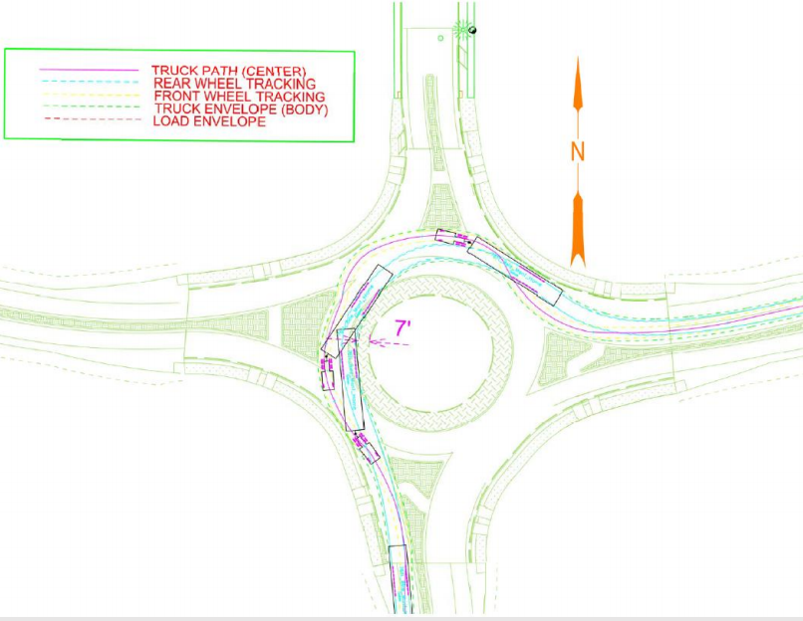
ROUNDABOUT PROJECT NAME
Design Vehicle Turning Movements
Design Vehicle
Tractor Trailer/Semitrailer with 53 foot trailer (WB 67): Overall Length: 73.5 feet Overall Width: 8.5 feet
Notes:
Update this slide with your own diagram and information. Customize as appropriate.
Use this slide to show the turning movement of the design vehicle used for the proposed roundabout. The design vehicle is the largest typical vehicle using the roadway that is able to traverse the roundabout in a normal fashion.

Slide 15
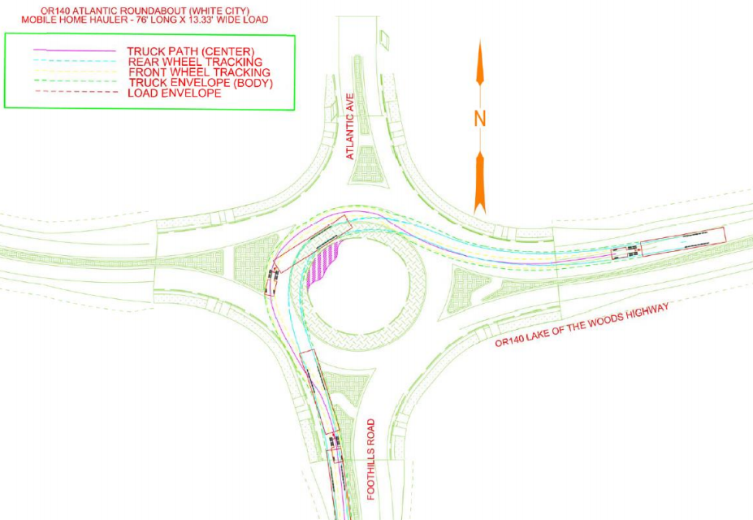
ROUNDABOUT PROJECT NAME
Accommodation Vehicle Turning Movements
Accommodation Vehicle
Mobile Home Hauler with 70 foot mobile home: Overall Length: 101.58 feet Overall Width: 13.33 feet
Notes:
Update this slide with your own diagram and information. Customize as appropriate.
Use this slide to show the turning movement of the accommodation vehicle(s) used for the proposed roundabout. Duplicate this slide as necessary to show more vehicles.
An accommodation vehicle is a larger over-dimension vehicle that is not prevented from passing through the roundabout but it will do so in a non-typical fashion (e.g. can still be ‘accommodated’ by an assortment of ways like stopping all other traffic to let the OD vehicle through, driving across the roundabout center island or any number of other ways).

Slide 16
ROUNDABOUT PROJECT NAME
Additional Vehicle Turning Movements
Additional Vehicle
Brief description with overall length and width
Notes:
Update this slide with your own diagram and information. Customize as appropriate.
Trucking industry stakeholders often request to see turning movements of other common over-dimension vehicles that frequently use the state highway system. Diagrams for these vehicles can be requested from the Mobility Services Team. Use this slide to show the turning movement of these additional vehicles. Duplicate the slide as necessary.

Slide 17
ROUNDABOUT PROJECT NAME
Single Trip Over-Dimension Permit Summary
Analysis duration: __ years
Total STPs issued (including trips): ____ permits
District Guidelines for Over-Dimension Loads:
Daytime Width Allowed (without district approval) | Nighttime Width Allowed (without district approval) | Overall Length Allowed (without district approval) | Other Comments
___ feet | ___ feet | ___ feet
Notes:
Update this slide with your data.
Use this slide to summarize Single-Trip Over-Dimension Data and District Guidelines. Single-Trip Over-Dimension Data can be requested from the Mobility Team (please note that requests can take two weeks or longer, depending on the amount of data that needs to be analyzed). Use the information from the report provided by the Mobility Services Team to complete this slide.
Single Trip Permit Data helps stakeholders understand the types and frequency of over-dimension freight that uses the route where the intersection is located.
Remove this slide if you are not yet ready to present permit data.

Slide 18
ROUNDABOUT PROJECT NAME
Single Trip Over-Dimension Permit Summary: Wide Loads
Most wide loads were issued for <insert load type from permit report>
Widest load was for a <insert load type from report> at ___ wide.
Majority of permits were between ____ and ____wide.
Overall Width | Number of single-trip permits issued
Notes:
Update this slide with your data.
Use this slide to present Single-Trip Over-Dimension Data for overwidth loads. Single-Trip Over-Dimension Data can be requested from the Mobility Team (please note that requests can take two weeks or longer, depending on the amount of data that needs to be analyzed). Use the information from the single trip permit report provided by the Mobility Services Team to complete this slide.
Single Trip Permit Data helps stakeholders understand the types and frequency of over-dimension freight that uses the route where the intersection is located.

Slide 19
ROUNDABOUT PROJECT NAME
Single Trip Over-Dimension Permit Summary: Long Loads
Most wide loads were issued for <insert load type from permit report>
Longest load was for a <insert load type from report> at ___ long.
Majority of permits were between ____ and ____long.
Overall Length (incl. overhang) | Number of single-trip permits issued
70’ or less
71’ to 80’
81’ to 90’
91’ to 100’
101’ to 110’
111’ to 120’
Over 120’
Notes:
Update this slide with your data.
Remove this slide if this data is not relevant or necessary.
Use this slide to present Single-Trip Over-Dimension Data for overlength loads. Single-Trip Over-Dimension Data can be requested from the Mobility Team (please note that requests can take two weeks or longer, depending on the amount of data that needs to be analyzed). Use the information from the single trip permit report provided by the Mobility Services Team to complete this slide.
Single Trip Permit Data helps stakeholders understand the types and frequency of over-dimension freight that uses the route where the intersection is located.

Slide 20
ROUNDABOUT PROJECT NAME
Single Trip Over-Dimension Permit Summary: Vehicle Combinations
Vehicle Combinations | Number of single-trip permits issued
Truck (Solo Vehicle) or Self Propelled Units (like cranes)
Doubles
Truck-Tractor + Semitrailer or Truck-Tractor +Tow-Away Unit
Truck + Trailer
Log Truck + Pole Trailer
Heavy Haul Combination (Truck-Tractor/Jeep/Semitrailer/Booster)
Toter + Mobile Home
Pickup Truck + Trailer
Notes:
Update this slide with your data.
Use this slide to present Single-Trip Over-Dimension Data for vehicle combinations. Single-Trip Over-Dimension Data can be requested from the Mobility Team (please note that requests can take two weeks or longer, depending on the amount of data that needs to be analyzed). Use the information from the single trip permit report provided by the Mobility Services Team to complete this slide.
Single Trip Permit Data helps stakeholders understand the types and frequency of over-dimension freight that uses the route where the intersection is located.

Slide 21
ROUNDABOUT PROJECT NAME
Single Trip Over-Dimension Permit Summary: High Loads
Tallest load was for a <insert load type from report> at ___ high.
Majority of permits were between ____ and ____high.
Overall Height | Number of single-trip permits issued
14’00” or less (legal height)
14’01” to 14’06”
14’07” to 15’00”
15’01” to 15’06”
15’07” to 16’00”
16'01" to 17'00"
17'01 to 17'06"
Over 17’06”
Notes:
Update this slide with your data.
Remove this slide if this data is not relevant or necessary.
Use this slide to present Single-Trip Over-Dimension Data for overheight loads. Single-Trip Over-Dimension Data can be requested from the Mobility Team (please note that requests can take two weeks or longer, depending on the amount of data that needs to be analyzed). Use the information from the single trip permit report provided by the Mobility Services Team to complete this slide.
Single Trip Permit Data helps stakeholders understand the types and frequency of over-dimension freight that uses the route where the intersection is located.
Remove this slide if this data is not necessary to share.

Slide 22
ROUNDABOUT PROJECT NAME
Single Trip Over-Dimension Permit Summary: Heavy Loads
The heaviest load was issued for <insert load type from permit report> at ___lbs.
Most of the loads were between ______ lbs and __________ lbs.
Gross Weight | Number of single-trip permits issued
80,000 lbs. or less (legal weight)
80,000 lbs. to 98,000 lbs.
98,001 lbs. to 120,000 lbs.
120,001 lbs. to 140,000 lbs.
140,001 lbs. to 160,000 lbs.
160,001 lbs. to 180,000 lbs.
180,001 lbs. to 200,000 lbs.
200,001 lbs. to 250,000 lbs.
Over 250,000 lbs.
Notes:
Update this slide with your data.
Remove this slide if this data is not relevant or necessary.
Use this slide to present Single-Trip Over-Dimension Data for overweight loads. Single-Trip Over-Dimension Data can be requested from the Mobility Team (please note that requests can take two weeks or longer, depending on the amount of data that needs to be analyzed). Use the information from the single trip permit report provided by the Mobility Services Team to complete this slide.
Single Trip Permit Data helps stakeholders understand the types and frequency of over-dimension freight that uses the route where the intersection is located.
Remove this slide if this data is not necessary to share.

Slide 23
ROUNDABOUT PROJECT NAME
Annual Over-Dimension Permit Data
Widths Allowed | Overall length Allowed: Long logs/ poles/piling permit, w/out steerable axles | Overall Length Allowed: Mobile/ modular unit permit | Overall Length Allowed: Unladen heavy haul combination permit | Overall Length Allowed: 1/2 wheelbase rear overhang permit for truck tractor and semitrailer combos)
Daytime annual width: Nighttime annual width:
Notes:
Update this slide with your data.
Use this slide to present information about annual over-dimension permits that can (or cannot) use the routes where the proposed roundabout will be located. This information can be requested from the Mobility Services Team (please note that requests can take two weeks or longer, depending on the amount of data that needs to be analyzed). Use the information from the report provided by the Mobility Services Team to complete this slide.
Annual Permit Data helps stakeholders understand the types and frequency of over-dimension freight that uses the route where the intersection is located.

Slide 24
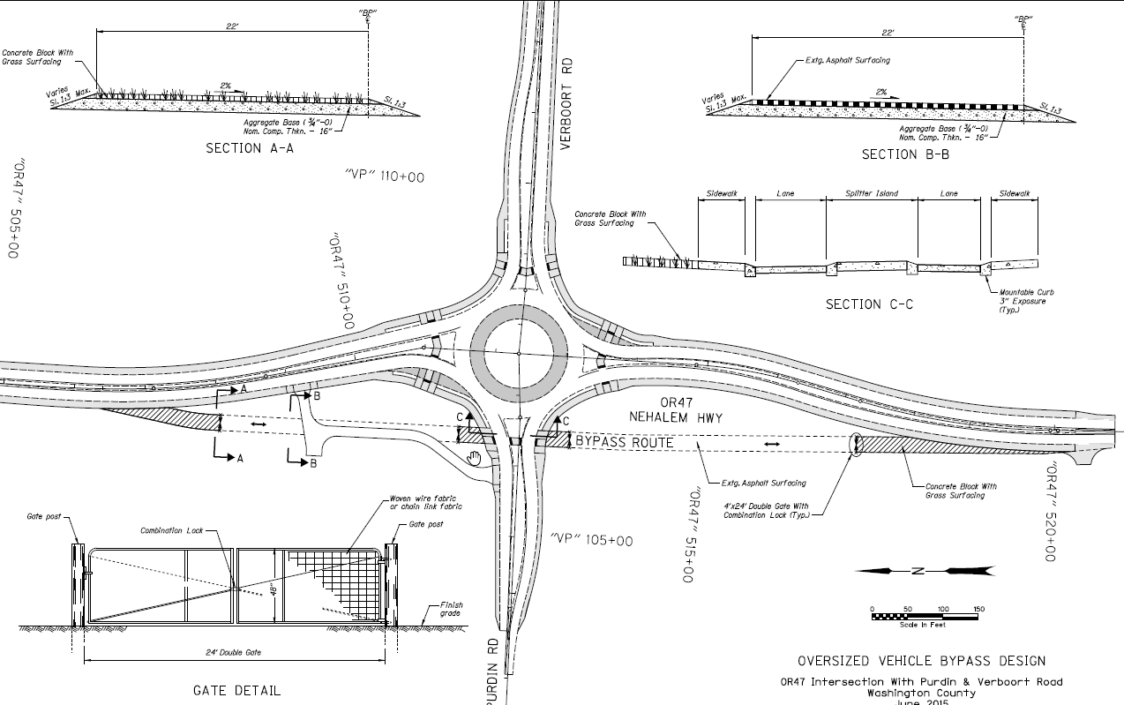
ROUNDABOUT PROJECT NAME
Over-Dimension Alternate Route (or Bypass) Details
Provide a map of the alternate route or diagram of the bypass on the left.
Indicate the size of OD vehicles required to use the alternate route or bypass (overall length and/or width)
Provide any accommodation requirements (e.g. access to gated entry, pilot vehicles, etc. Are there county roads requiring permits?)
Notes:
Update this slide with your own information customize as appropriate.
If the proposed roundabout includes a bypass for over-dimension vehicles, use this slide to describe details about the bypass including:
The overall length and/or width of OD vehicles that would be required to use the bypass instead of traversing the roundabout.
Additional accommodation requirements for OD vehicles to use the bypass (e.g. how will they open the gate? Are there pilot car requirements? Etc.)

Slide 25
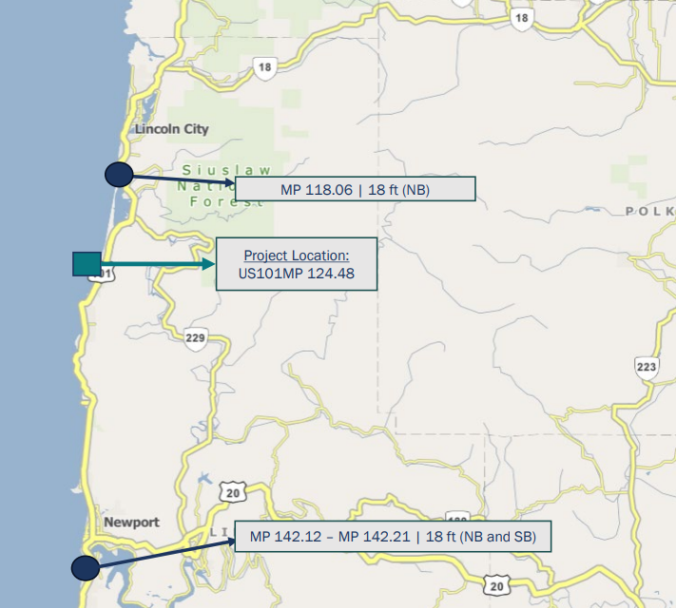
PROJECT NAME
Pinch Point Information
Pinch point
Pinch point
Pinch point
EXAMPLE
Notes:
Update this slide with your own information / photos and customize as appropriate.
Provide Information about pinch points on the highway(s) near the project area. Include the width (and vertical clearance, if applicable) of the pinch point and mile point. You may also include a map that illustrates
Note: The Mobility Services Team can provide you with vertical clearance pinch point information. Contact the Mobility Services Team if you’d like to request this information.
the pinch points in relation to the project location.

Slide 26
ROUNDABOUT PROJECT NAME
Summary of Changes
Summarize your changes in the following chart. Customize your information as appropriate.
Proposed Design Feature | Existing Curb-to-Curb Width EB & WB | Proposed Curb-to-Curb Width – WB through movement | Proposed Curb-to-Curb Width – EB through Movement | Proposed Curb-to-Curb Width Reduction
Roundabout | 44 Feet | 21 Feet | 21.6 Feet | 22.4 – 23 Feet
Notes:
Update this slide with your own information customize as appropriate.
Use this slide to remind the committee what the existing and proposed clearances are, and provide the resulting reduction. Use the best format that works for your project (e.g. table, bulleted list or map/graphic, etc)
Remove this slide if clearances for the proposed design are not yet available.

Slide 27
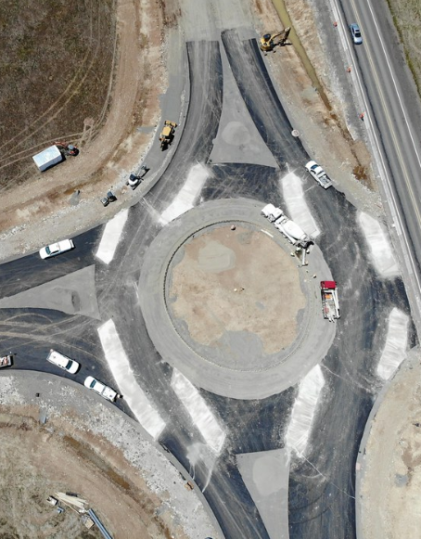
NEXT STEPS
Mobility Team to write a Record of Support? Or… ?
Notes:
If the proposed roundabout is located on a Reduction Review Route (subject to ORS 366.215) and the Stakeholder Forum Supports the proposed design, then the Mobility Team will write a Record of Support. If the stakeholder forum does not support the change then the Director & Chief Engineer will make a decision. Refer to the ORS 366.215 Guidance Document for more details on potential next steps in the review process.
Next steps might also include returning to the committee to share more specific design details, accommodation vehicles and other considerations.

Slide 28
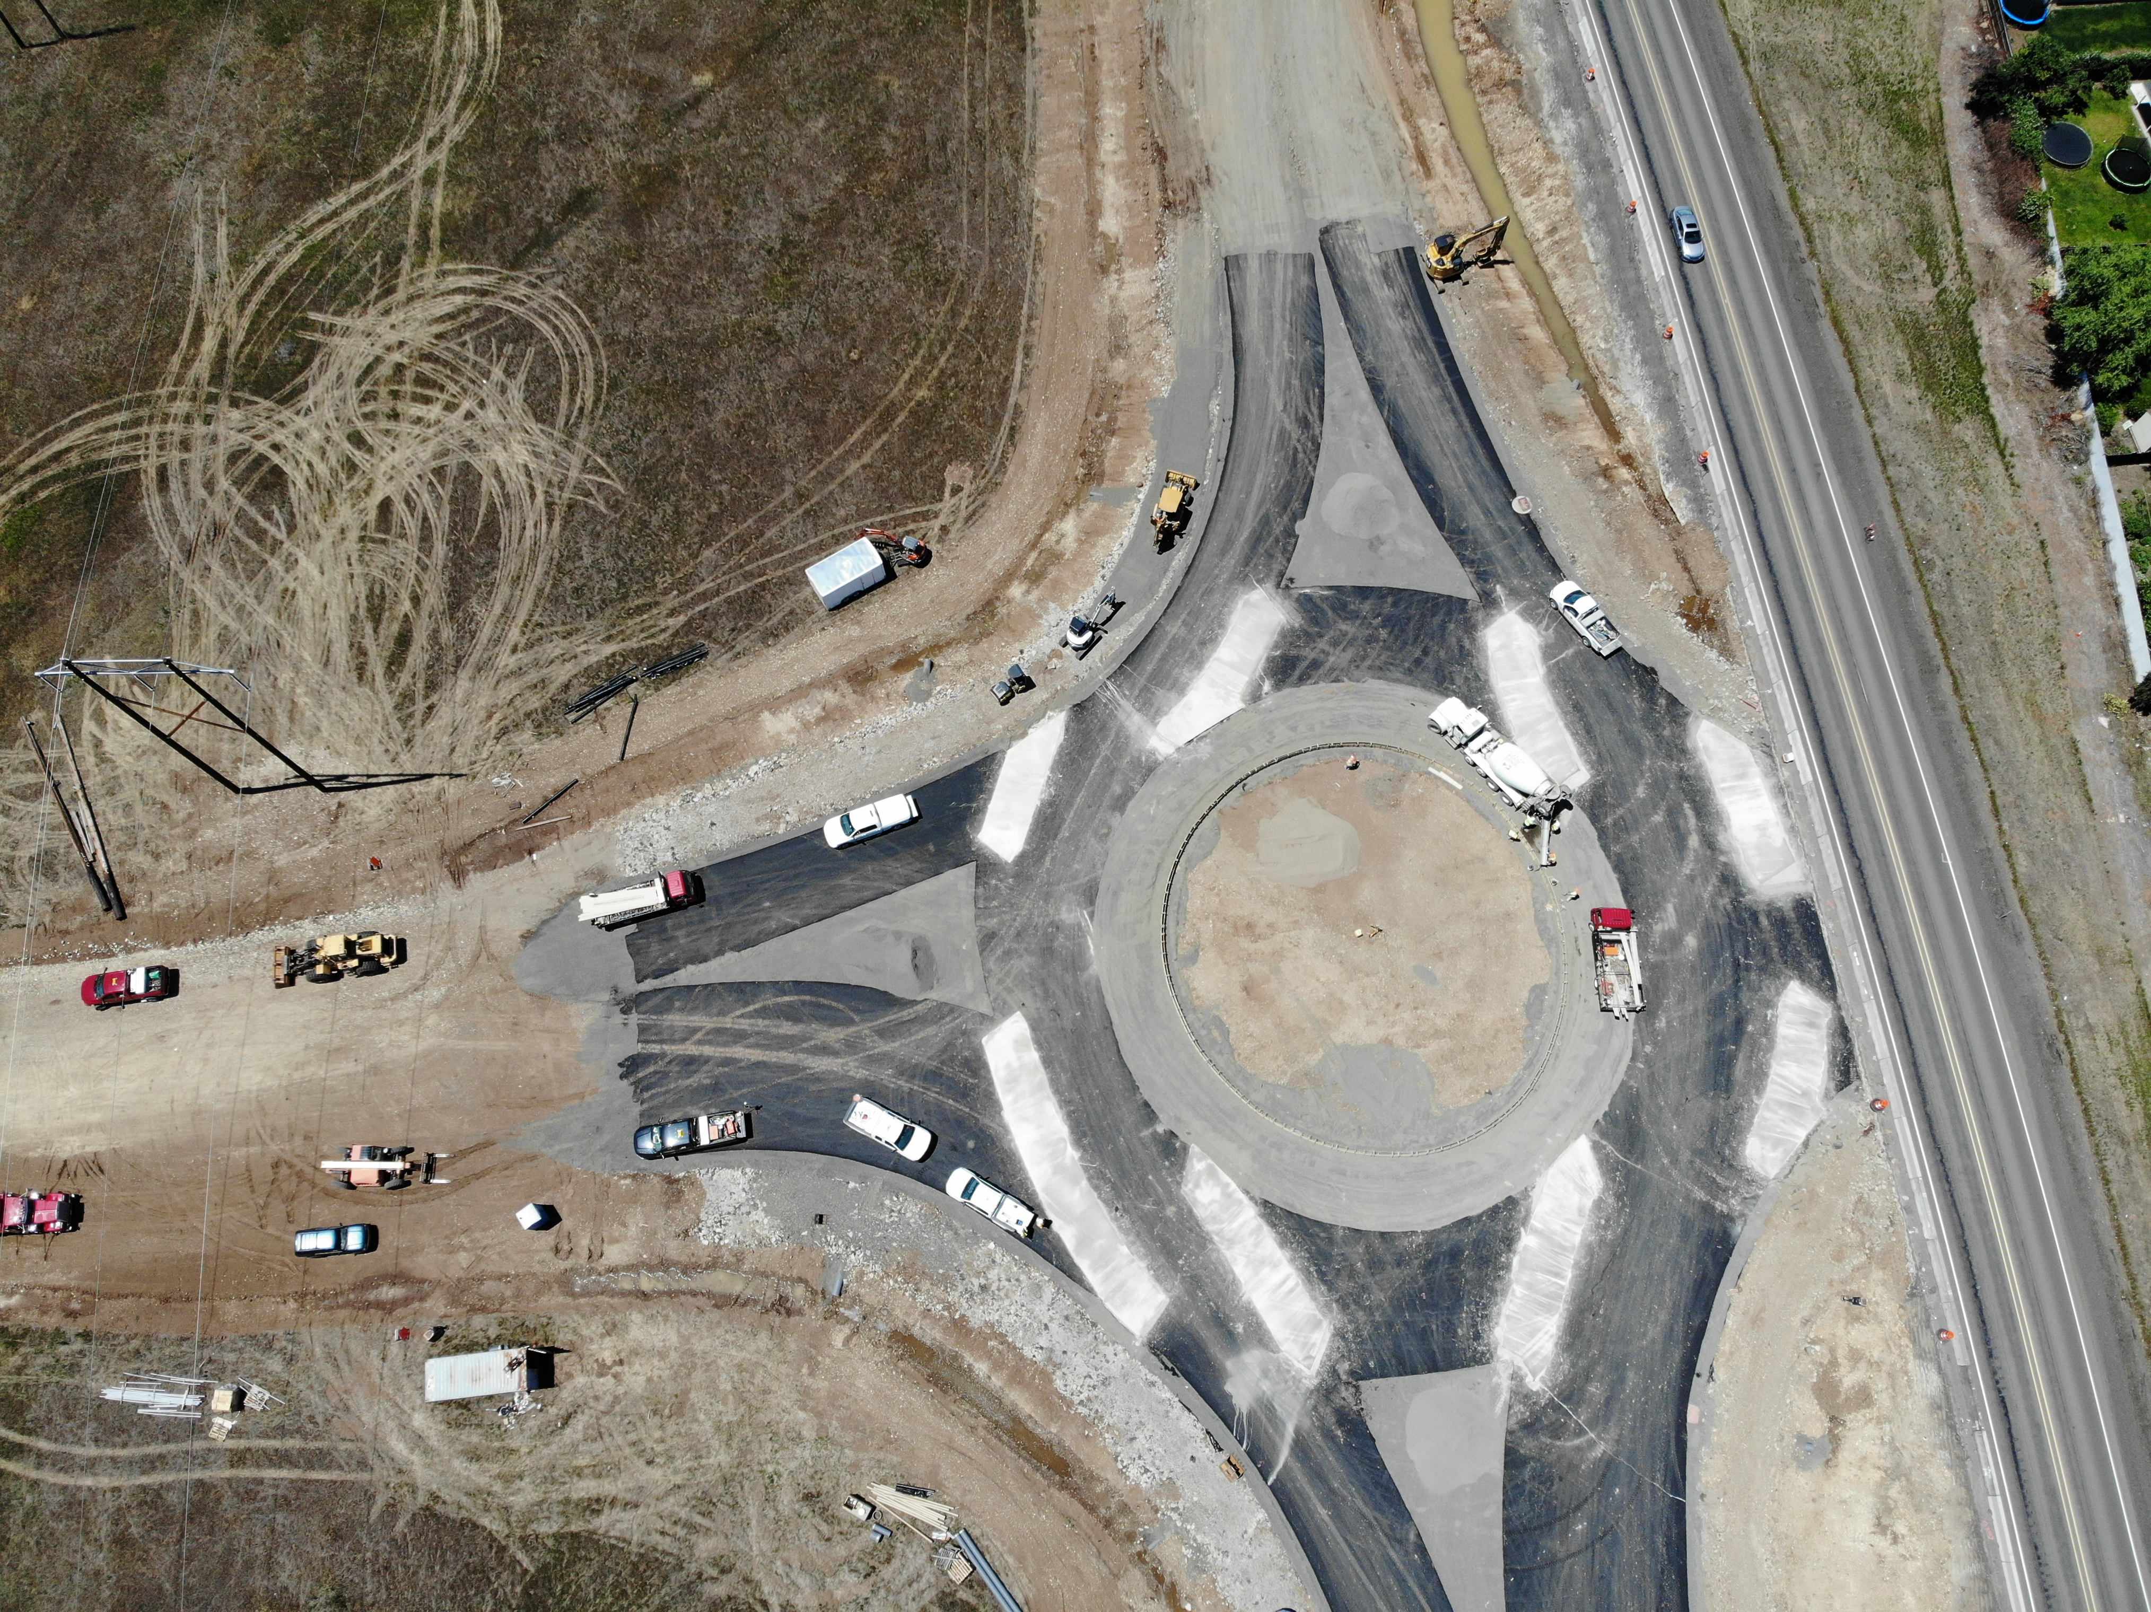
THANK YOU
Notes:
Replace this picture with your own image or diagram if you’d like.
HOW TO CHANGE THE BACKGROUND PICTURE
Go to the DESIGN tab on the ribbon.
In the Customize section, choose the icon with the paint bucket called FORMAT BACKGROUND.
The FORMAT BACKGROUND menu will open on the right side of your page. Make sure to select the radial button next to PICTURE OR TEXTURE FILL. Under the “Insert Picture from” section, choose FILE, CLIPBOARD, or ONLINE as appropriate.
Select a picture that fits the background space. Preferably in a landscape orientation.
Select your image, and press open.
Your picture will appear in the background!

