Slide 1



HB 4132 – Sec 6 - CVSO Program
Rules Advisory Committee
September 28, 2026
PRESENTED BY
Jay R. DeFillipo, Legislative Director

Slide 2
RAC
Overview
\
A Rules Advisory Committee (RAC) is a public-involvement body used by Oregon state agencies to assist in the development, review, and refinement of administrative rules. RACs ensure that rulemaking is transparent, informed, and representative of the communities affected.
Statutory Authority
ORS 183.333 - Establishes RACs as a tool for public involvement in rulemaking. Agencies may appoint RACs to assist in drafting rules and must ensure membership represents affected persons and communities.
HB 3569 (2025) - Updates RAC requirements, including mandatory invitations to legislative sponsors for rules implementing new legislation.
*** Please remember all RAC meetings are recorded and available for public review
INTRODUCTIONS

Slide 3
RAC
Members / Observors
\
Name | Occupation | RAC Position
Jay DeFillipo | ODVA Legislative Director | RAC Facilitator
Sheronne Blasi | Division Chief – Strategic Partnerships | ODVA SME
Rebecca Miller | Washington County Supervisor | Member
Ted Thorne | Wallowa County VSO | Member
Shelia Balbin | Multnomah County Supervisor | Member
Brent Demoe | Polk County Supervisor | Member
Joby Reily | Lane County VSO | Member
Nicholas Torres | Tillamook County VSO | Member
Katie Plumb | Crook County Supervisor | Member
James JP Pereyra | Lake County VSO | Member
Mary Newman-Keys | Douglas County VSO | Member
Marco Oswald | United Veterga Groups of Oregon Leg Director | Member
Rep. Evans | OR Dist 20 Representative | Non-voting Member

Slide 4
Roles and Responsibilities
\
RAC members agree to fulfill their responsibilities through attending and participating in meetings, studying available information, and providing input to ODVA. Members agree to participate in good faith and to act in the best interest of the group and its charge.
Members are expected to consider a range of issues and options to address them, discuss the pros and cons of the issues/options presented, and seek to develop recommendations reflecting the “sense of the group.”
Members acknowledge that the group is an advisory body to ODVA and that its role is to provide advice and frame policy choices. Rulemaking authority rests with the Department.
Members are responsible for:
· Reviewing background materials to understand the issues for discussion at RAC meetings.
· Working collaboratively with one another to explore issues and develop recommendations.
· Considering the perspectives and input of other stakeholders and the public and including them in recommendations as appropriate.

Slide 5
Membership
\
RAC Participation and term of service is at ODVA’s discretion. Membership is intended to represent a diversity of expertise, skillsets, and viewpoints. Members may be represented by alternates and must provide notice to the rule's coordinator or facilitator at least 24 hours before the meeting.
The RAC will convene on September 28th, 2026, and is expected to meet at least 5 times. Unless requested by ODVA and agreed to by the RAC, the RAC’s responsibilities will conclude at that time.
Date | Event | Topic
9/28 | RAC meeting 1 | Introductions and 1st look DRAFT Rules
10/5 | RAC meeting 2 | Prompt questions, Review 30.500 - 30.515
10/12 | RAC meeting 3 | Final prompt questions, Review 30.520 - 30. 560
10/19 | RAC meeting 4 | Fiscal Impact and Review 30.536 - 30. 630
10/26 | RAC meeting 5 | Vote on final version of proposed rules
11/2 | RAC meeting 6 | If needed
Mid December | Public Comment
Mid January | ODVA Executive Review
End of January | Permanent Rules

Slide 6
Agency Contact
Agency Legislative Director and Rules Advisory Committee Chair
Jay R. DeFillipo
Jay.defillipo@odva.Oregon.gov, Phone Office 971-388-9016

Slide 7
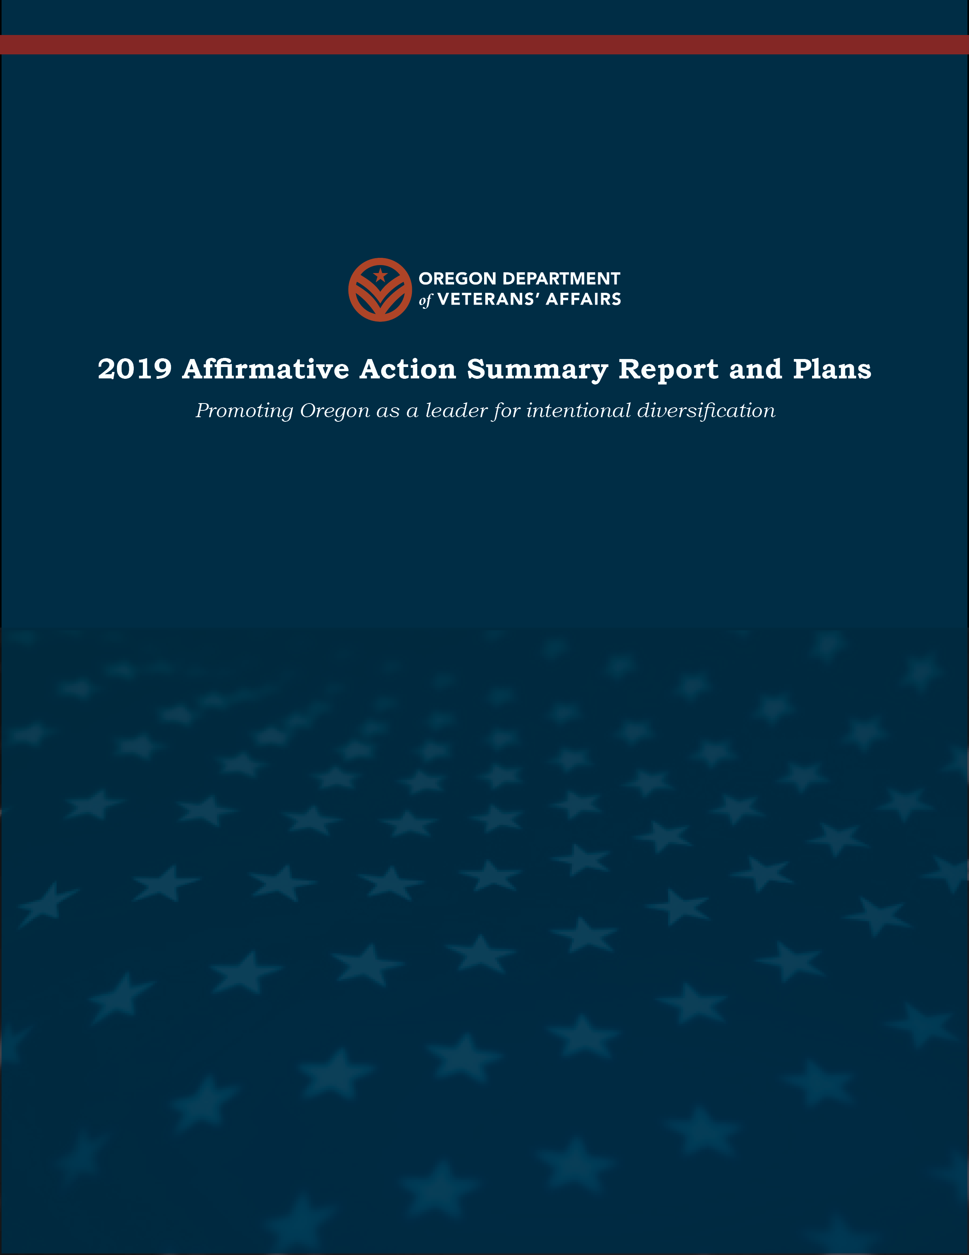
QUESTIONS

