Slide 1
Safety Net Capacity Grant Program
Helping Oregon’s children and teens connect to care
Josie Silverman-Méndez, MPH
Program Coordinator
Community Partner Outreach Program
Health Systems Division
josie.j.silverman@state.or.us
503-983-3739
Notes:
Also known as ¡Soy sano! in Spanish

Slide 2
I’m healthy!
A grant program that increases the capacity of Oregon’s safety net system to offer free health care services to children and teens who:
Do not qualify for full Oregon Health Plan benefits or Qualified Health Plans and
Are under 19 years old.
Notes:
Children and teens served through I’m healthy!:
Do not qualify for full Oregon Health Plan benefits (through the Oregon Health Authority) or Qualified Health Plans (through Oregon’s Health Insurance Marketplace) due to immigration status.
May be enrolled in CAWEM or CAWEM Plus and still qualify, since CAWEM and CAWEM Plus are emergency Medicaid programs and not full Oregon Health Plan benefits.
May also be enrolled in KP CHP/private market plans since these are not state or federal health insurance programs.
Do not have to meet certain income criteria (i.e. there is no household income limit in order to access I’m healthy! free health care services).

Slide 3
Timeline
Started: January 2017
Ends: December 2017
What comes next? Cover All Kids!
I’m healthy! serves as a pathway to Cover All Kids
Additional information on Cover All Kids at the end of today’s presentation

Slide 4
Safety Net Providers
Nonprofit clinics such as federally qualified health centers
Core mission is to provide primary and preventive health care to people who are underserved, regardless of their ability to pay
Community-based organizations such as culturally specific social service, leadership development and advocacy groups
Have established relationships and trust with the communities they serve

Slide 5
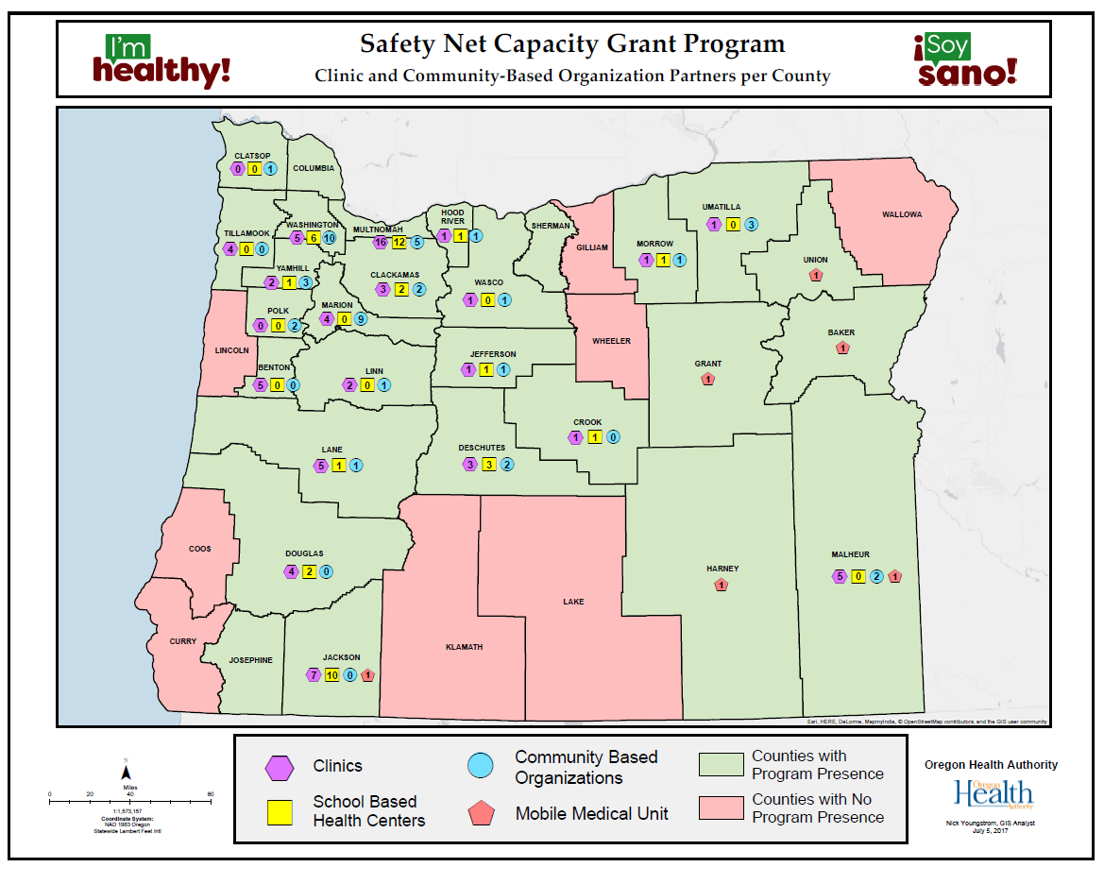
Grant-Funded Partners
Notes:
We have funded more than 30 organizations serving 27 of Oregon’s 36 counties.

Slide 6
Services Provided
Nonprofit clinics: Provide free primary and preventive health care services
Community-based organizations:
Provide outreach and education
Screen children/teens for eligibility
Provide referrals to partner clinics (special focus on new patients)
Including assistance scheduling appointments and follow-up

Slide 7
Free Health Care Services
Primary and preventive care services provided at no-cost to the patient:
Physical
Vision
Dental
Mental
Behavioral
Enabling (e.g., transportation support)
Notes:
I’m healthy! free health care services do not include:
Prescription medications
Ancillary services (i.e. labs and imaging)
Services provided on referral to specialists
Services provided on referral to ED
Any other services provided on referral outside of the safety net clinic system

Slide 8
Clinic Partners
All provide physical health services
Not all provide vision, dental, mental, behavioral and/or enabling services
Go to www.imhealthy.org for the I’m healthy! partner directory
See each clinic site location for type(s) of free health care services offered
PDF (by county)

Slide 9
How to Connect
Use the I’m healthy! partner directory:
If there’s an I’m healthy! community-based organization/referral partner in your area, call it for information, screening and referral.
If there’s no I’m healthy! community-based organization/referral partner in your area, call an I’m healthy! clinic directly to schedule an appointment.

Slide 10
Goal
After initial referral is met, child/teen has established medical home for on-going primary and preventive health care.
Referral
Initial appointment
Established medical home
Ongoing source of primary & preventive health care

Slide 11
Cover All Kids
SB 558
Passed on July 7, 2017
Takes effect January 1, 2018*
Expands Oregon’s Medicaid program to include coverage for children and teens (under 19), regardless of immigration status
Oregon is 7th state in the nation to do this
Impacts an estimated 17,000 children and teens
Community Partner Outreach Program to lead implementation
Additional information coming soon
*Oregon Health Plan enrollment will not commence until this date

Slide 12
Learn more at www.imhealthy.org.
Questions?
Thank you!

