Slide 1
Tips for Applying to Become a THW
3/25/2026

Slide 2
Traditional Health Worker (THW) types
Birth Doula
Community Health Worker (CHW)
Peer Support Specialist (PSS)
Peer Wellness Specialist (PWS)
Personal Health Navigators (NAV)
Tribal Traditional Health Worker (TTHW)

Slide 3
Traditional Health Worker (THW) sub-types
Peer Support Specialist (PSS)
Peer Wellness Specialist (PWS)
Adult Addictions
Adult Mental Health
Youth Support
Family Support
Adult Addictions
Adult Mental Health
Youth Support
Family Support

Slide 4
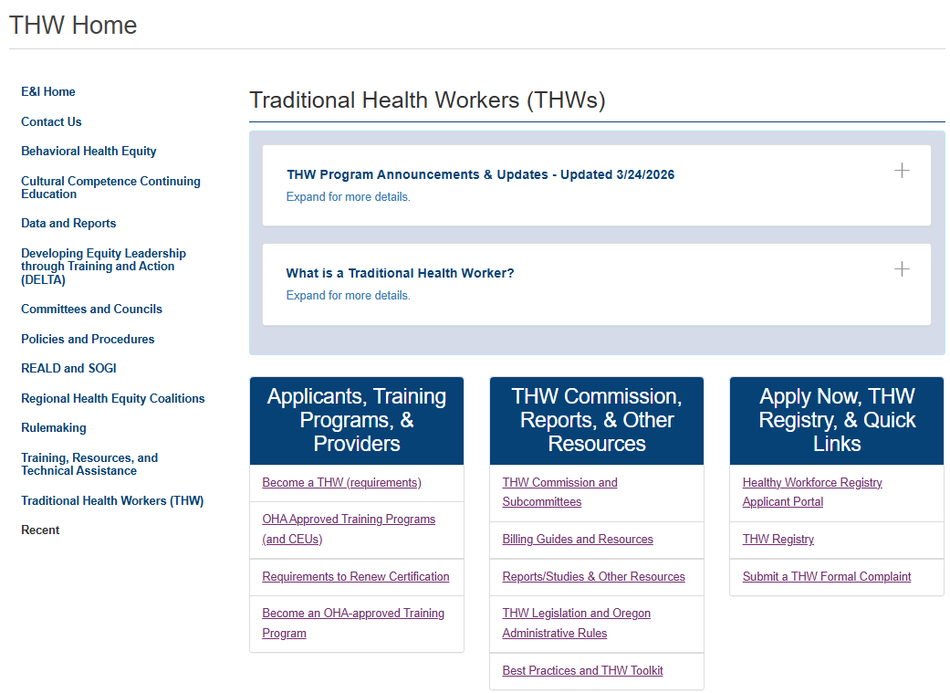
Equity and Inclusion Webpage – (https://www.oregon.gov/oha/EI/Pages/THW-Home.aspx)

Slide 5
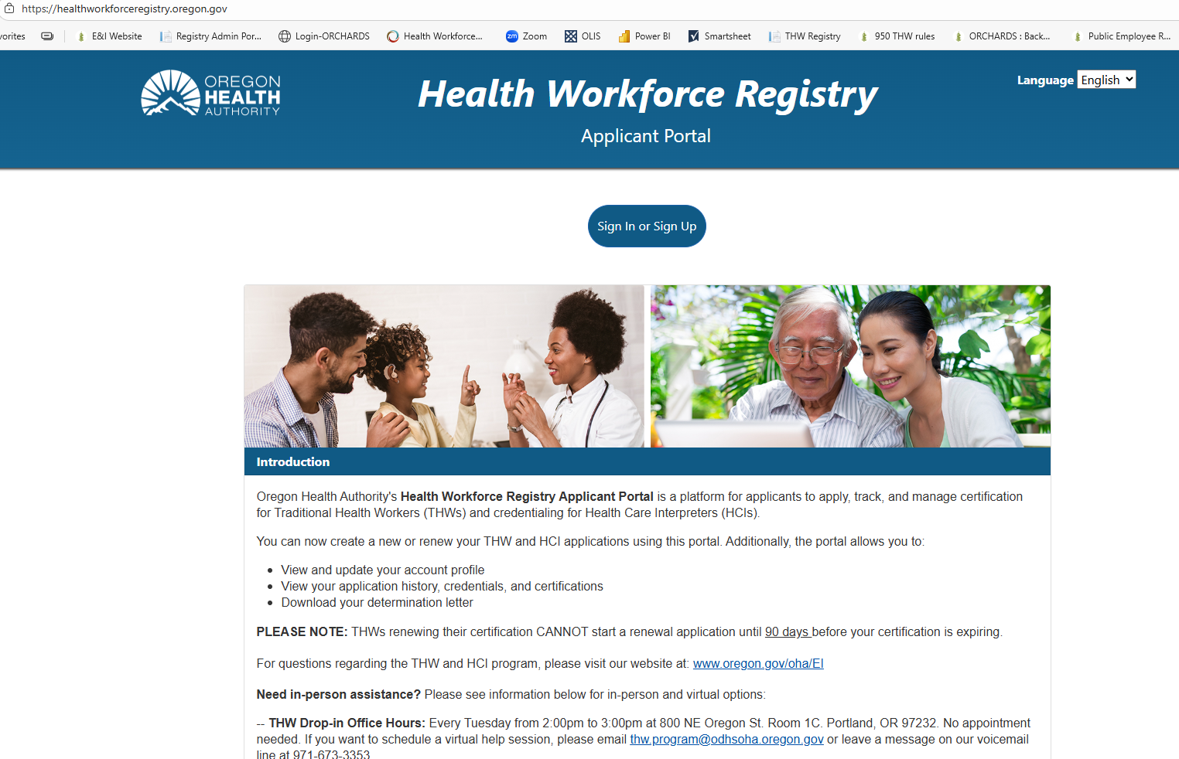
Health Workforce Registry Applicant Portal – (https://healthworkforceregistry.oregon.gov/)

Slide 6
Steps in the Application Process
Create account in Health Workforce Registry
Complete a new or recertification application in registry
OHA THW Staff reviews application for completeness and submits a background check request to ORCHARDS BCU
ORCHARDS BCU emails applicant information to give consent
Background check is performed (If fingerprints are needed, OHA THW staff will email fingerprint letter)
Determination will be sent to OHA THW Staff and they will email a determination letter to applicant

Slide 7
Estimated Timeline (total 4 to 6 weeks)
Once application is submitted in the portal, OHA THW Staff review the application (up to 1 week)
When consent is received, The BCU will determine if fingerprints are needed. OHA staff will email the applicant letter, if requested. When all information is received, the background check continues. This process takes 4 to 6 weeks
The BCU will notify THW staff when there is a determination. If approved, a determination letter with the THW Registry Number will be sent to the applicant via email. If an applicant doesn’t pass, the BCU will send a letter with instructions
If all required documents are in the application, a THW staff member submits a background check request to the Background Check Unit (BCU) and the BCU will immediately email the applicant requesting consent
Occasionally, more information from the applicant is requested. The BCU will notify both the applicant and the THW staff member when more information is needed through a letter.

Slide 8
Need to Know
You only have SEVEN (7) days to log in to the ORCHARDS BCU applicant portal and give your consent to run your background check
Not everyone will need to get fingerprinted
If you are asked to get fingerprints, you have around one month to get your fingerprints submitted. The deadline is in the letter.
Check your junk/spam folders! ORCHARDS BCU and OHA THW emails often get sent there
Applications in English and Spanish should be submitted in the Health Workforce Registry Portal. Only applications in other languages can be emailed to thw.program@odhsoha.oregon.gov

Slide 9
Reminders
Recertification applications require the completion of:
The Continuing Education Requirements for each worker type
1.5 hours of OHA Approved Oral Health Training
Three (3) hours of OHA Approved Suicide Prevention Training
If certification has lapsed more than 6 months, you can a complete competency skills test
You cannot use CEUs for more than one worker type
The exception is the oral health training and suicide prevention training

Slide 10
Other Important Information…
OHA THW Program
Does not process background checks nor appeals
Has no access to background check results
Cannot submit consent for you
BCU ORCHARDS
Is a separate division – shared services between agencies
Has separate portal
Processes background check appeals

Slide 11
Tips
Use a computer or a laptop to give consent if it is not working on your phone
Submitting the “weigh-test” documents during the background consent process is the best way to get a quicker background check turnaround
If additional supplemental documents are needed by ORCHARDS BCU, you can send to the thw.program@odhsoha.oregon.gov email address and staff are able to upload for you
Don’t forget to include your Oral Health Certificate with the hours indicated. Make sure it has your name on it.

Slide 12
Questions? Contact us
Email: thw.program@odhsoha.oregon.gov
Message Line: 971-673-3353
Please note that our phone number connects to a messaging service and does not connect to directly to staff.
Tips:
The fastest way to receive a response is to email us

Slide 13
Thank you
THW Drop-in Office Hours: Every Tuesday from 2:00pm to 3:00pm at 800 NE Oregon St. Room 1C. Portland, OR 97232. No appointment needed.
To schedule a virtual help session, please email thw.program@odhsoha.oregon.gov or leave a message on our voicemail line at 971-673-3353
Email: thw.program@odhsoha.oregon.gov

