Slide 1
An Overview of the Eastern Oregon Coordinated Care Organization
Update & Status Report
September 2016

Slide 2
Introduction
Medicaid
Coordinated Care Organizations
2016 Incentive Measures
Eastern Oregon CCO
How the Money Flows
Community Benefit Initiative Reinvestments
Distribution
Requirements

Slide 3
Medicaid
Medicaid is a health insurance program for low-income individuals and families who meet certain eligibility requirements.
Funded jointly by states and the federal government
Overseen by the federal government (Centers for Medicare & Medicaid) and operated at the state level (Oregon Health Authority)
Centers for Medicare & Medicaid (CMS)
Federal Level
State Level
Oregon Health Authority (OHA)
Coordinated Care Organization (CCO)
Local Level
Please note:
Medicare is a health insurance program for elderly and certain disabled Americans. The program is operated solely by the Federal Government.
Notes:
With the Affordable Care Act came the expansion of the Medicaid Program. According to CMS, “Medicaid […] is one of the largest payers for health care in the United States.” https://www.medicaid.gov/about-us/about-us.html
Medicaid is a health insurance program for low-income individuals and families who meet certain eligibility requirements.
The program is overseen by the federal government and is operated at the state level.
The Medicaid program is funded jointly by states and the federal government
At the federal level, the Centers for Medicare and Medicaid are responsible for implementing several state-based health coverage programs, including the Medicaid program.
At the state level, in accordance with federal requirements, the Oregon Health Authority is responsible for our state Medicaid program, known as the Oregon Health Plan (OHP).
At the local level, the OHA contracts with Coordinated Care Organizations (CCOs) to manage and deliver health care to those eligible for Medicaid. At this level, incentive metrics are used to ensure that CCOs are being held accountable for the money they receive.

Slide 4
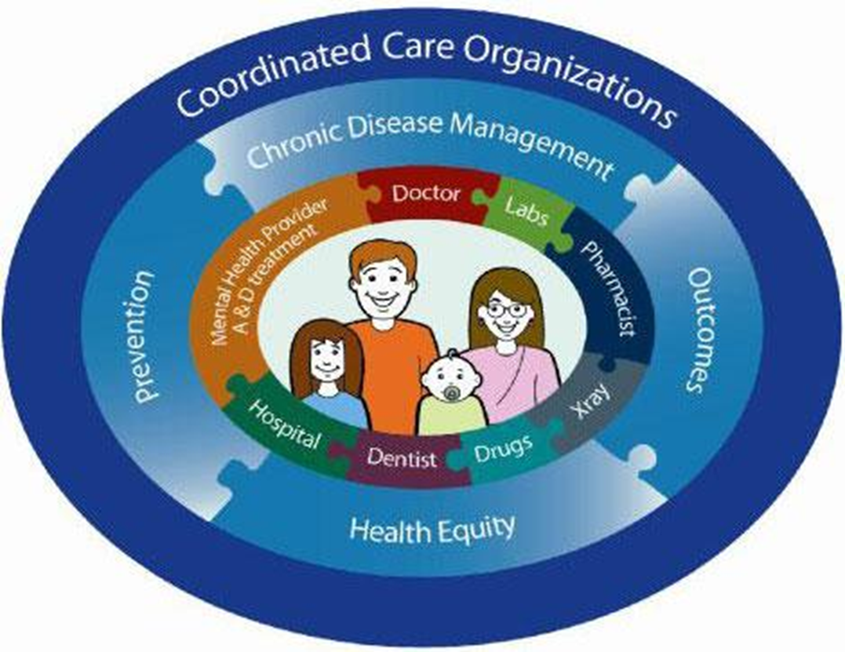
What is a CCO?
A Coordinated Care Organization (CCO) is a health care network of all types of providers, who work together in their local communities to deliver patient-centered care for people on the Oregon Health Plan (Medicaid).
CCOs financially integrate and provide coordinated care, including:
Physical health
Behavioral health (mental health and addiction services)
Oral health
Social services

Slide 5
2016 Incentive Measures
Alcohol and Drug Misuse Screening (SBIRT)
ED Visits
Developmental Screening (0-36 months)
Follow-up after hospitalization for Mental Illness
Dental, Mental, Physical Health Assessments for Children in DHS Custody
Effective Contraceptive Use
CAHPS Survey – Access to Care
CAHPS Survey – Satisfaction with Care
Dental Sealants
Patient-Centered Primary Care Home Enrollment
Colorectal Cancer Screening
Timeliness of Prenatal Care
Adolescent Well-Care Visits
Depression Screening and Follow Up Plan
Diabetes: HbA1c Poor Control
Controlling High Blood Pressure
Childhood Immunization Status Combo 2
Cigarette Smoking Prevalence
Notes:
Oregon’s Health System Transformation:
(How Does the OHA Make Sure that the Budgets are Not Abused?)
• In a traditional insurance company, gathering premiums and then NOT spending that money on patient care creates a profit.
• The global budget allocated to CCOs is similar to a premium, based on the Oregon Health Plan Eligibility Categories and Rate Groups.
• However, the OHA withholds a portion of the global budget and created a Quality Pool – incentive payments to CCOs based on reaching benchmarks or making improvements on incentive measures, which are health outcome measures shown to help the CCOs achieve the Triple Aim.
• The CCO’s gain back the money withheld if they meet certain measures (metrics)

Slide 6
Service Area Quick Facts
 | July 2015 County Census Population | July 2016 EOCCO Population | Population Percentage
Baker | 16,005 | 3,736 | 23%
Gilliam | 1,859 | 332 | 18%
Grant | 7,185 | 1,436 | 20%
Harney | 7,200 | 1,745 | 24%
Lake | 7,829 | 1,686 | 22%
Malheur | 30,380 | 9,066 | 30%
Morrow | 11,190 | 2,676 | 24%
Sherman | 1,680 | 344 | 20%
Umatilla | 76,531 | 17,981 | 23%
Union | 25,790 | 5,673 | 22%
Wallowa | 6,856 | 1,588 | 23%
Wheeler | 1,358 | 270 | 20%
Grand Total | 193,863 | 46,533 | 24%
Region: 12 Rural Counties
Total Region Population: 193,863
Total EOCCO Population: 46,533 Members
Per County Range:
270 – 17,981 Members
Geographic Area:
49,923 square miles
10 of the 12 counties are “frontier”

Slide 7
Clinical Advisory Panel
Mark Spencer, MD
Amy Boudreau, MD PhD
Don Benschoter DMD
Daniel Allen PA-C
Susan Rice, MD
Sarah Laiosa DO
Keith DeYoung MD
Gary Trupp, MD
Center for Medicare and Medicaid Services (CMS)
Oregon Health Authority
Transformation Center
GOBHI Medical Director
Moda Medical Director
EOCCO Owners (1 of 16 CCOS in Oregon)
Support Staff
Grande Ronde Hospital
St. Alphonsus Hospital
Pendleton IPA
Yakima Valley Farm Workers
GOBHI
Moda Health
Good Shepherd Hospital
St. Anthony’s Hospital
EOCCO Board of Directors
Integrations Team
Carlos Olivares, Yakima Valley Farm Workers (Umatilla)
Megan Gomeza, RCAC Chair (Malheur)
Chris Siegner, Symmetry Mental Health (Harney)
Dennis Burke, Good Shepherd (Umatilla)
Diane Kilkenny, Public Health (Morrow)
Bruce Carlson, MD (Umatilla)
Renee Grandi, MD (Wallowa)
Robin Richardson, Moda Health
Russ Demianew, Pendleton IPA (Umatilla)
Harold Geller, St. Anthony Hospital (Umatilla)
Jim Mattes, Grande Ronde Hospital (Union)
Ken Kestner, County Commissioner (Lake)
Kevin Campbell, GOBHI (Chair)
Larry Davy, Wallowa Memorial Hospital (Wallowa)
Mike Smith, County Commissioner (Sherman)
Ray Gibbons, St. Alphonsus Hospital (Baker and Malheur)
Vicki Winters, Children Services (Gilliam County)
Transformation Plan
Early Learning Hubs
Data Team
Regional Community Advisory Council
LCAC Rep, County Commissioner
EOHLA
public health
hospital
community
mental health
Regional Community Health Assessment
Regional CHIP
Primary care
12 Local Community Advisory Councils
Baker
Gilliam
Grant
Lake
Malheur
Morrow
Umatilla
Union
Wheeler
Wellness promotion, oral health, housing, behavioral health
Children & adolescent health, CRC, reduction of health stigma
Harney
Behavioral health, SDH, children & families
Maternal & child health
Sherman
Wallowa
Maternal & Child Health
Weight, mental health, chronic disease, safety, A&D use
Vaccinations, oral health & breast cancer screening
Mental health & children’s health education & promotion
Obesity & Chronic Disease Mgmt.
Oral & mental health, physical activity & senior services
Clinicians & access, mental, oral and children’s health
“At-risk” youth, oral health, physical activity

Slide 8
How the Money Flows: OHA $ CCOs
The Global Budget
Quality Measure Fund Risk Contract Surplus
LCAC Fund Risk Contract Surplus
Involves capitation rates – a predetermined payment amount that depends on OHP eligibility status and is paid to the CCOs on a per member per month (PMPM) basis
Based on program eligibility for traditional Medicaid members by category
Members included as part of the Affordable Care Act expansion population are not under the global budget
The Quality Pool
Incentive Measure Quality Pool Distribution
Incentive Measure Challenge Pool Distribution
Involves incentive payments – a portion of the budget withheld that places CCOs “at risk” for loses and rewarded for savings
Based on Incentive Measure Performance
The CCO’s are allowed to keep the “savings” and reinvest in prevention, promotion and other activities
The Financial Promise from OHA to CMS to Allow Global Budgets:
In 2015, OHA met its obligation to CMS to reduce average growth of spending by 2%
Notes:
The Oregon Health Authority (OHA) pays CCOs to provide health coverage to individuals under OHP, using the following payment methods: Global Budget (Capitated Payments) and Quality Pool (Incentive Payments)
The Global Budget involves capitation rates – a predetermined payment amount that depends on OHP eligibility status and is paid to the CCOs on a per member per month (PMPM) basis.
Based on program eligibility for traditional Medicaid members by category
Members included as part of the Affordable Care Act expansion population are not under the global budget
In addition to the global budget, to ensure that CCOs are accountable for health outcomes of the population they serve, OHA created a quality pool to incentivize CCOs that meet incentive measure targets
The Quality Pool involves incentive payments – a portion of the budget withheld that places CCOs “at risk” for loses and rewarded for savings
Based on Incentive Measure Performance
The CCO’s are allowed to keep the “savings” and reinvest in prevention, promotion and other activities.

Slide 9
2015 EOCCO Risk Contract Surplus/Incentive Measure Settlement Distribution

Slide 10
EOCCO Community Benefit Initiative Reinvestments
LCAC Community Benefit Initiative Reinvestments:
$593,744 (Total)
Distributed evenly by county:
$237,498 = $19,791.50 each
Distributed based on EOCCO population by county:
$356,246 = details on next slide
Transformation Community Benefit Initiative Reinvestments:
$1,000,000 (Total)
Competitive grants

Slide 11
Projected 2016 LCAC Community Benefit Initiative Reinvestments Distribution
County | July 2016 EOCCO Population | 2016 LCAC Community Benefit Initiative Reinvestments (Based on Enrollment) | 2016 LCAC Community Benefit Initiative Reinvestments (Evenly Distributed) | Total
Baker | 3,736 | $ 28,601.96 | $ 19,791.50 | $ 48,393.46
Gilliam | 332 | $ 2,541.72 | $ 19,791.50 | $ 22,333.22
Grant | 1,436 | $ 10,993.69 | $ 19,791.50 | $ 30,785.19
Harney | 1,745 | $ 13,359.32 | $ 19,791.50 | $ 33,150.82
Lake | 1,686 | $ 12,907.63 | $ 19,791.50 | $ 32,699.13
Malheur | 9,066 | $ 69,407.22 | $ 19,791.50 | $ 89,198.72
Morrow | 2,676 | $ 20,486.84 | $ 19,791.50 | $ 40,278.34
Sherman | 344 | $ 2,633.59 | $ 19,791.50 | $ 22,425.09
Umatilla | 17,981 | $ 137,658.42 | $ 19,791.50 | $ 157,449.92
Union | 5,673 | $ 43,431.19 | $ 19,791.50 | $ 63,222.69
Wallowa | 1,588 | $ 12,157.36 | $ 19,791.50 | $ 31,948.86
Wheeler | 270 | $ 2,067.06 | $ 19,791.50 | $ 21,858.56
Total | 46,533 | $ 356,246.00 | $ 237,498.00 | $ 593,744.00

Slide 12
Requirements of the Community Benefit Initiative Reinvestments
Prior to disbursement, LCACs must describe:
What Incentive Measures are being targeted by the initiative.
Why the initiative will help the EOCCO meet its Incentive Measure targets.
How the implementation process and outcomes of the initiative will be tracked and measured.
After disbursement, LCACs must complete:
Quarterly Progress Reports on the initiative’s progress, such as what barriers have been identified and how the LCAC intends to overcome them.
Annual Report

