Slide 1
Health Care Cost Growth Trends in Oregon, 2020-2021 2023 Sustainable Health Care Cost Growth Target Annual report
Report Chart Pack
Originally published May 2023 Revised December 29, 2023

Slide 2
Full report and databook online at: https://www.oregon.gov/oha/HPA/HP/Pages/cost-growth-target-reports.aspx
Oregon’s Sustainable Health Care Cost Growth Target Program
In 2019, the Oregon Legislature established the Sustainable Health Care Cost Growth Target Program, which sets a statewide target for the annual per person growth rate of total health care spending in the state. The program also monitors and publishes reports on health care cost increases and factors driving these trends.
For more information: https://www.oregon.gov/oha/HPA/HP/Pages/Sustainable-Health-Care-Cost-Growth-Target.aspx

Slide 3
Chapter I Cost Growth Trends
Chapter I. Health Care Cost Growth Trends, 2020-2021 Statewide and by Market

Slide 4
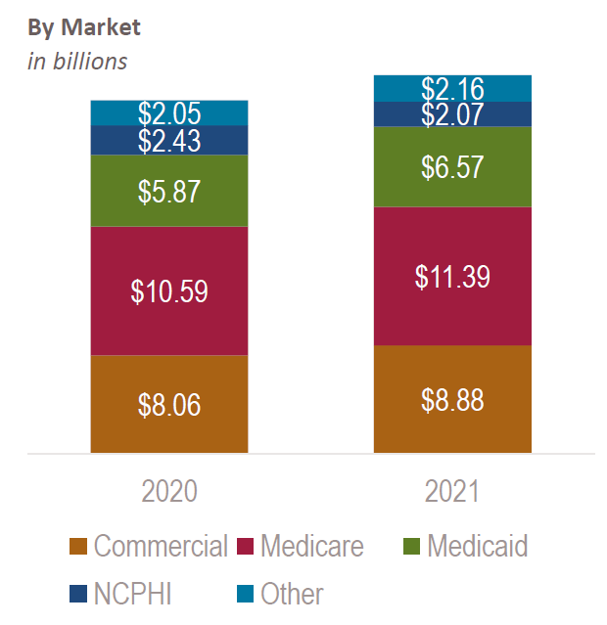
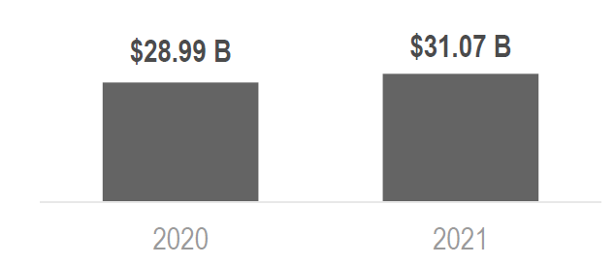
Health care spending in Oregon, 2020-2021
Total health care spending, statewide in billions

Slide 5
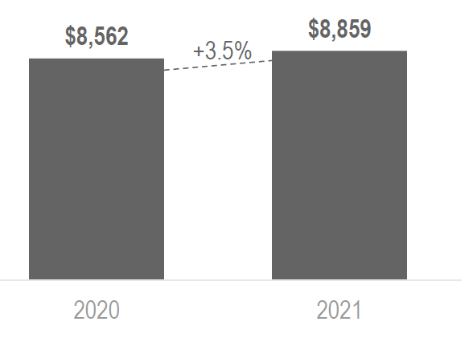
Total Health Care Expenditures (THCE), per person per year, statewide, 2020-2021
Total health care expenditures per person per year grew 3.5% in Oregon between 2020-2021

Slide 6
Total health care expenditures per person per year in Oregon, by market, 2020-2021

Slide 7
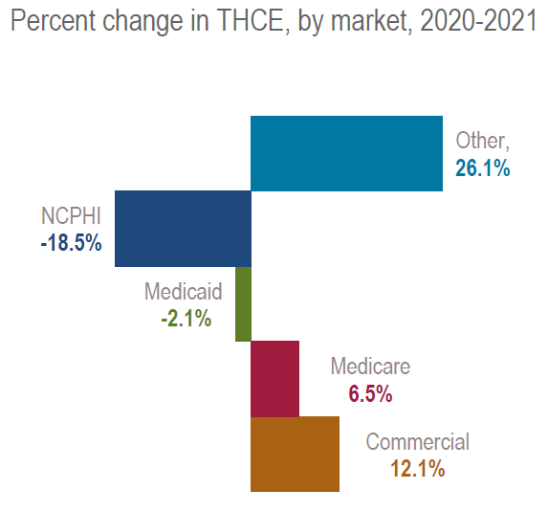
Growth in total health care expenditures, by market, 2020-2021

Slide 8
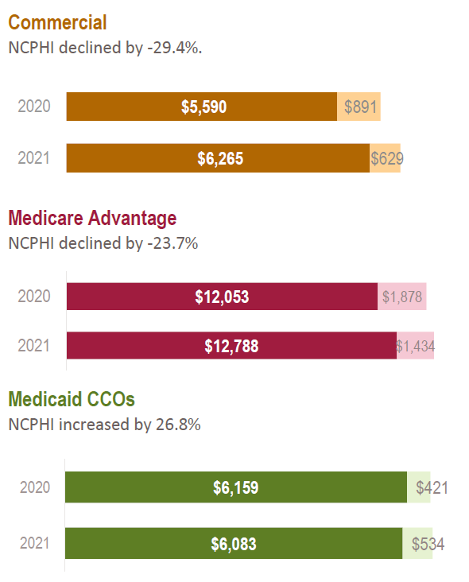
Net cost of private health insurance (NCPHI) by market, 2020-21

Slide 9
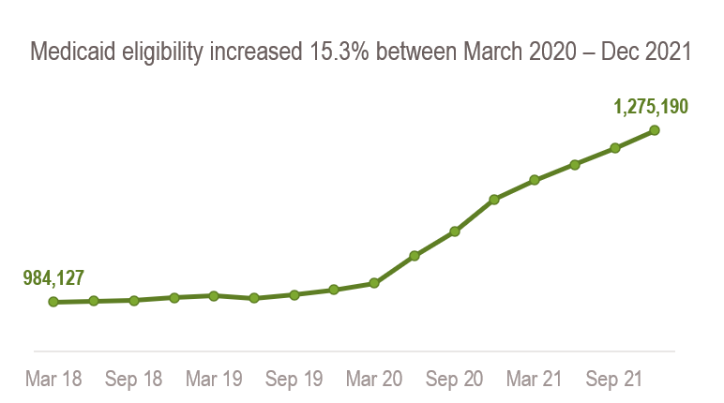
The link between enrollment and total health care spending in the Medicaid market
Between 2020 and 2021, total health care spending in the Medicaid market increased 12%, to $6.57 billion. This was most likely due to the continued increase in enrollment resulting from the Public Health Emergency.
On a per-person basis, Medicaid spending declined
-0.2%, from $6,489 to $6,475.
Revised December 29, 2023 to correct an error in the Medicaid eligibility chart.

Slide 10
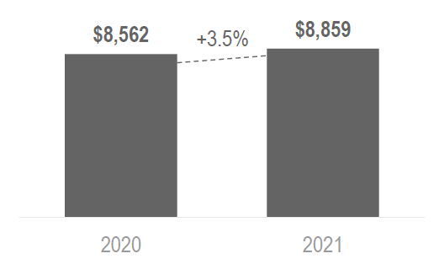
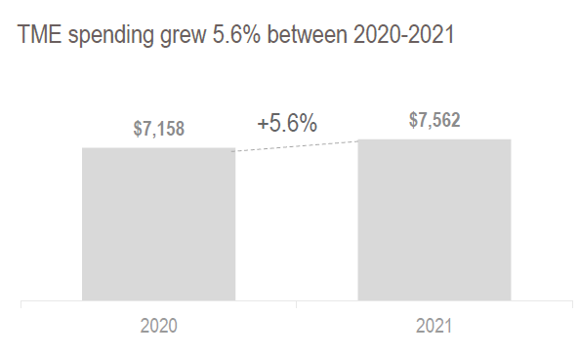
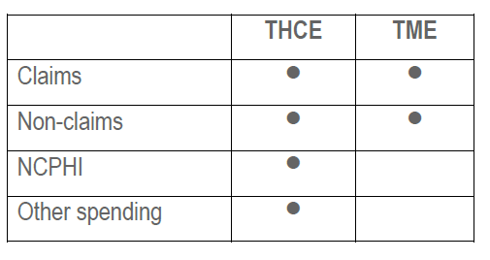
Two measures for health care spending: Total Health Care Expenditures (THCE) and Total Medical Expenses (TME)

Slide 11
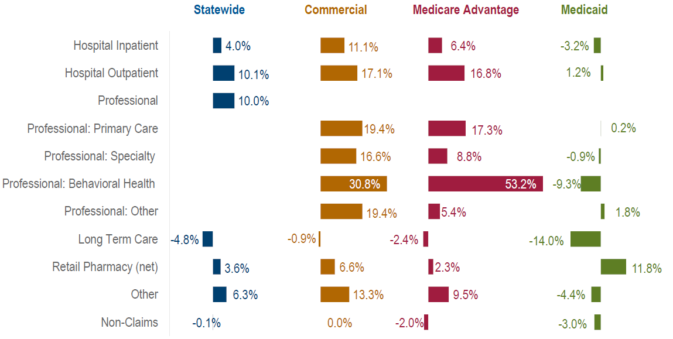
Growth in total medical expenses spending by service category, statewide and by market (unadjusted), 2020-2021

Slide 12
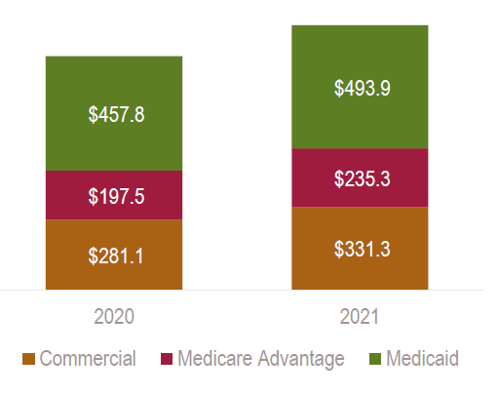
Amount saved in pharmacy rebates each year, by market, 2020-2021
In millions

Slide 13
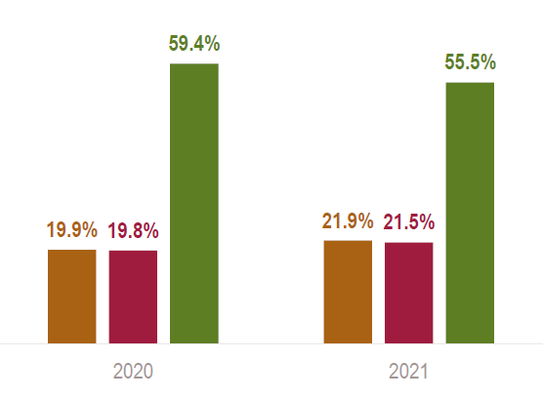
Pharmacy rebates as a percent of gross retail pharmacy spending, by market, 2020-2021

Slide 14
Chapter I Cost Growth Trends
Chapter II. Health Care Cost Growth Trends, 2020-2021 by Payers and Market

Slide 15
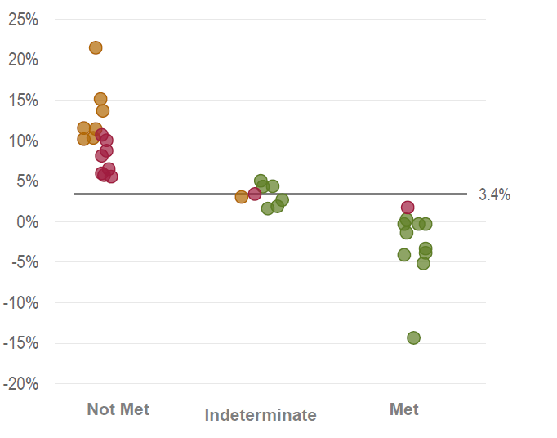
Payer performance in relation to the cost growth target, by market, 2020-2021

Slide 16
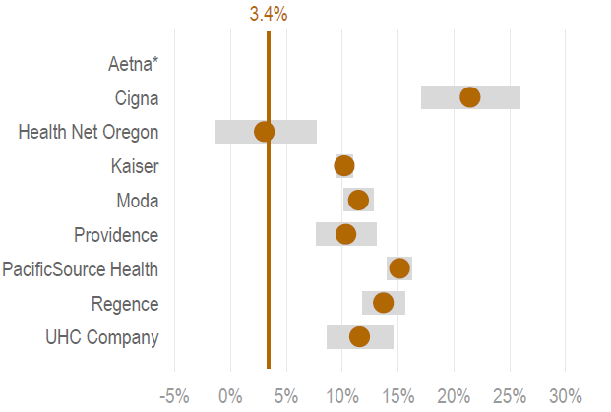
Cost growth for commercial payers, 2020-2021

Slide 17
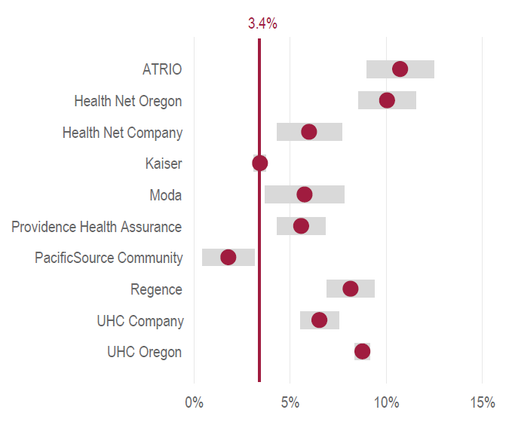
Cost growth for Medicare Advantage payers, 2020-2021

Slide 18
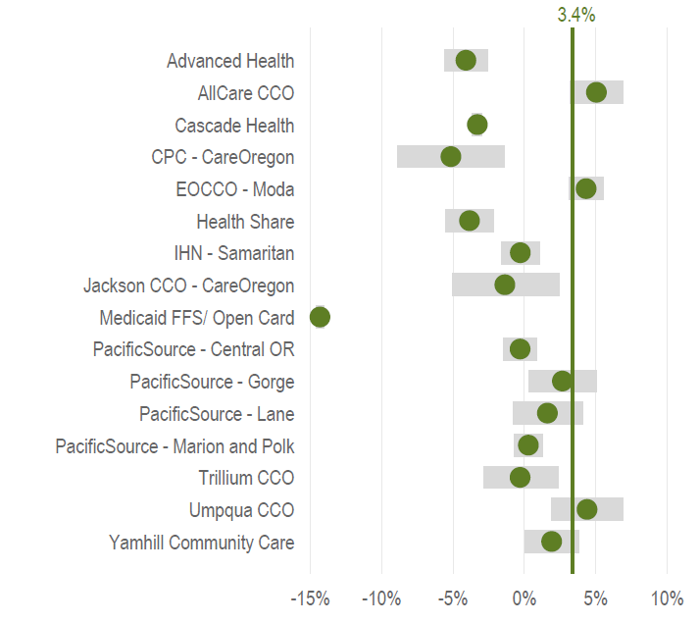
Cost growth for Medicaid payers, 2020-2021

Slide 19
Chapter I Cost Growth Trends
Chapter III. Health Care Cost Growth Trends, 2020-2021 by Provider Organization and Market

Slide 20
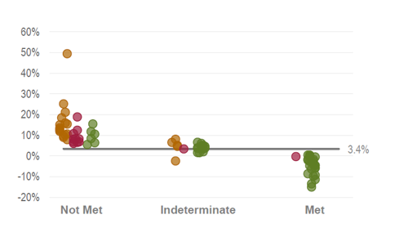
Provider organization performance in relation to the cost growth target by market, 2020-2021

Slide 21
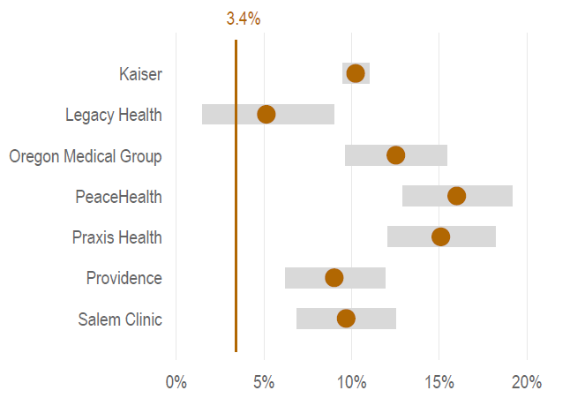
Commercial cost growth for large provider organizations, 2020-2021
Provider organizations with more than 20,000 attributed patients

Slide 22
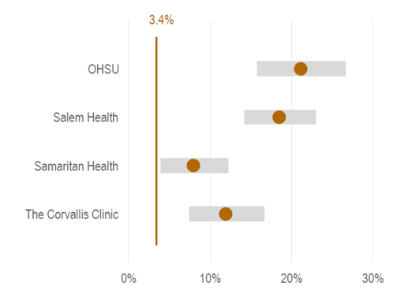
Commercial cost growth for mid-sized provider organizations, 2020-2021
Provider organizations with 10,000 to 20,000 attributed patients

Slide 23
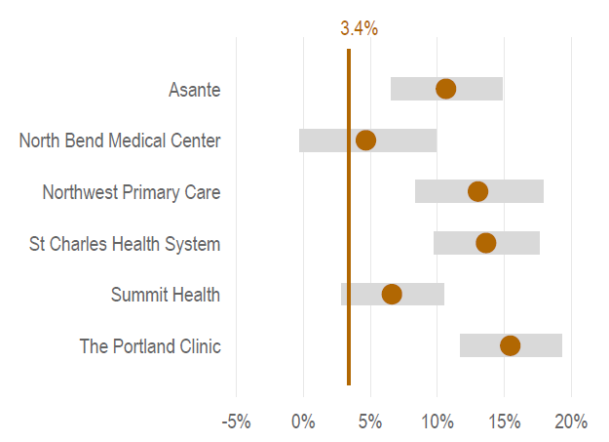
Commercial cost growth for smaller provider organizations, 2020-2021
Provider organizations with less than 10,000 attributed patients

Slide 24
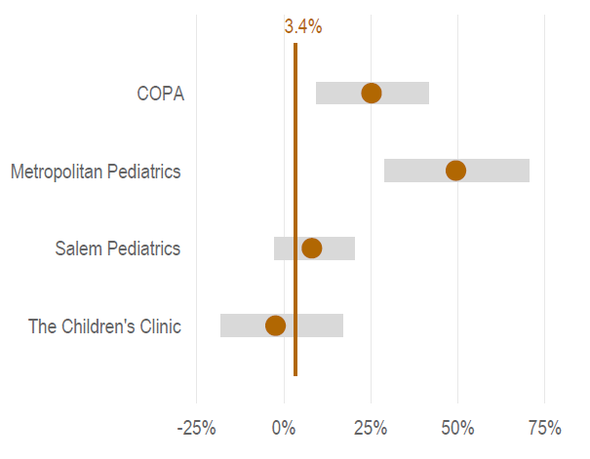
Commercial cost growth for pediatric provider organizations, 2020-2021

Slide 25
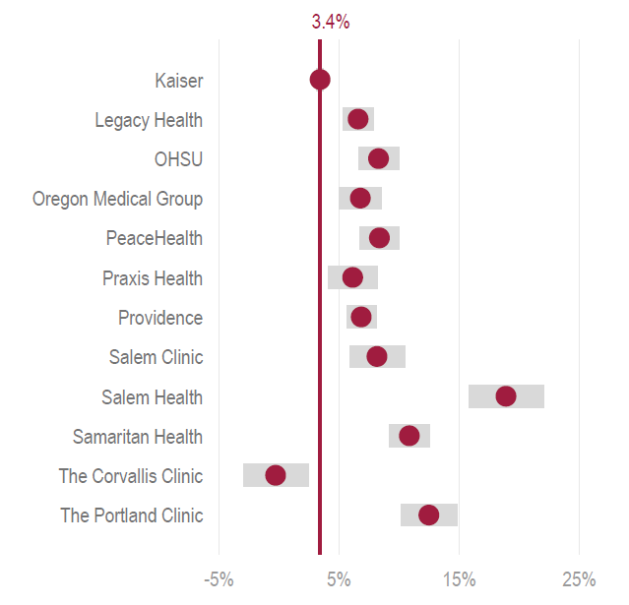
Medicare Advantage cost growth for provider organizations, 2020-2021

Slide 26
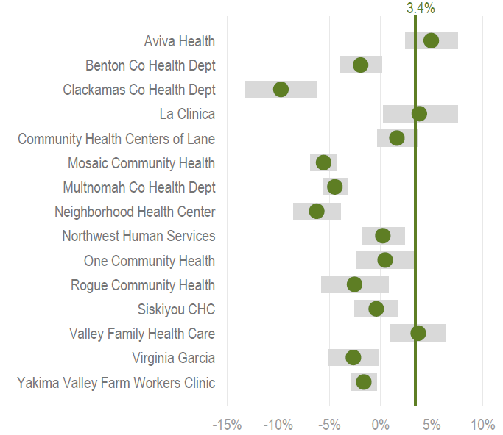
Medicaid cost growth for federally-qualified health centers (FQHCs), 2020-2021

Slide 27
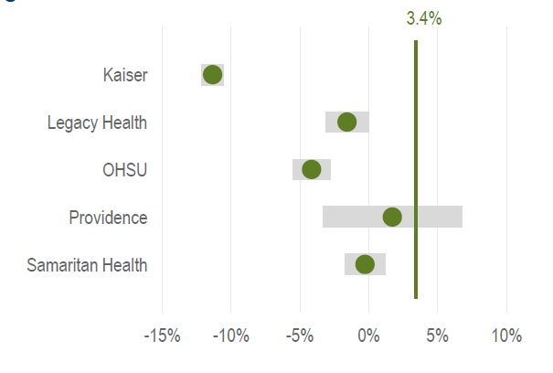
Medicaid cost growth for large provider organizations. 2020-2021
Provider organizations with more than 20,000 attributed patients

Slide 28
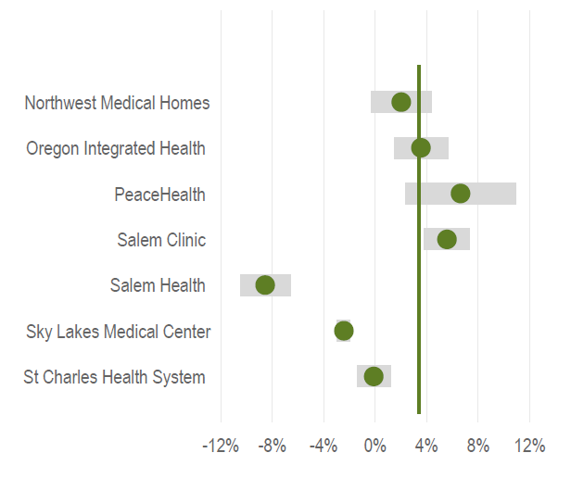
Medicaid cost growth for mid-sized provider organizations, 2020-2021
Provider organizations with 10,000 to 20,000 attributed patients

Slide 29
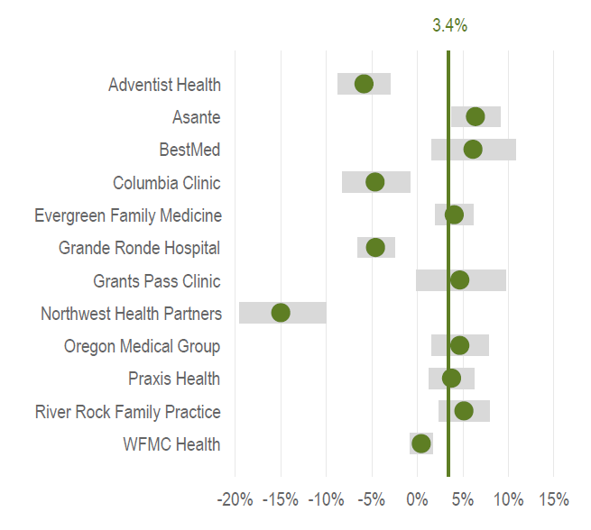
Medicaid cost growth for smaller provider organizations, 2020-2021
Provider organizations with less than 10,000 attributed patients

Slide 30
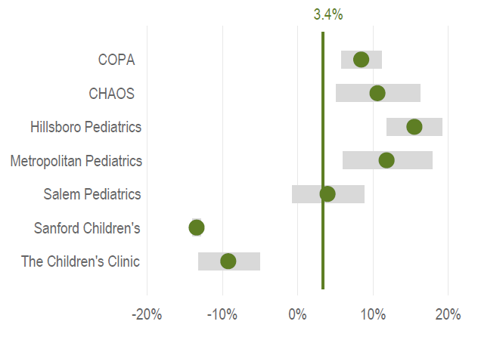
Medicaid cost growth for pediatric provider organizations, 2020-2021

Slide 31
Databook and Methodology
All data is available in the public databook posted online.
See the full report for all notes on data sources and methodology.
Suggested Citation: Oregon Health Authority. Health Care Cost Growth Trends in Oregon, 2020-2021. Portland, OR. May 2023. For questions about this report, please contact: HealthCare.CostTarget@oha.oregon.gov

