Slide 1
Health Care Cost Growth Trends in Oregon, 2018-2020 2022 Sustainable Health Care Cost Growth Target Annual report
Report Chart Pack
May 2023

Slide 2
Full report and databook online at: https://www.oregon.gov/oha/HPA/HP/Pages/cost-growth-target-reports.aspx
Oregon’s Sustainable Health Care Cost Growth Target Program
In 2019, the Oregon Legislature established the Sustainable Health Care Cost Growth Target Program, which sets a statewide target for the annual per person growth rate of total health care spending in the state. The program also monitors and publishes reports on health care cost increases and factors driving these trends.
For more information: https://www.oregon.gov/oha/HPA/HP/Pages/Sustainable-Health-Care-Cost-Growth-Target.aspx

Slide 3
Chapter I Cost Growth Trends
Chapter I. Health Care Cost Growth Trends, 2018-2020 Statewide and by Market

Slide 4
Total health care spending in Oregon, 2018-2020, billions

Slide 5
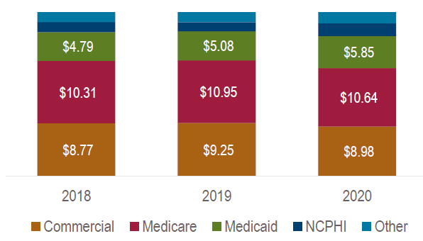
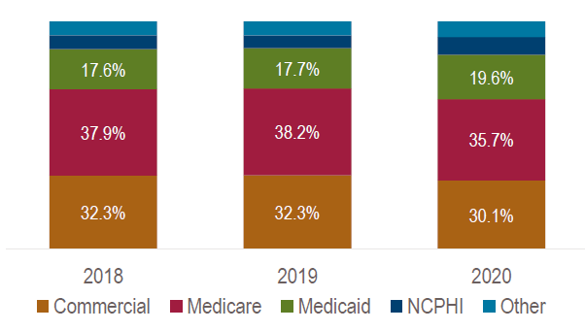
Total health care spending in Oregon, by market, 2018-2020
Total spending in billions
Total spending as a percentage of total

Slide 6
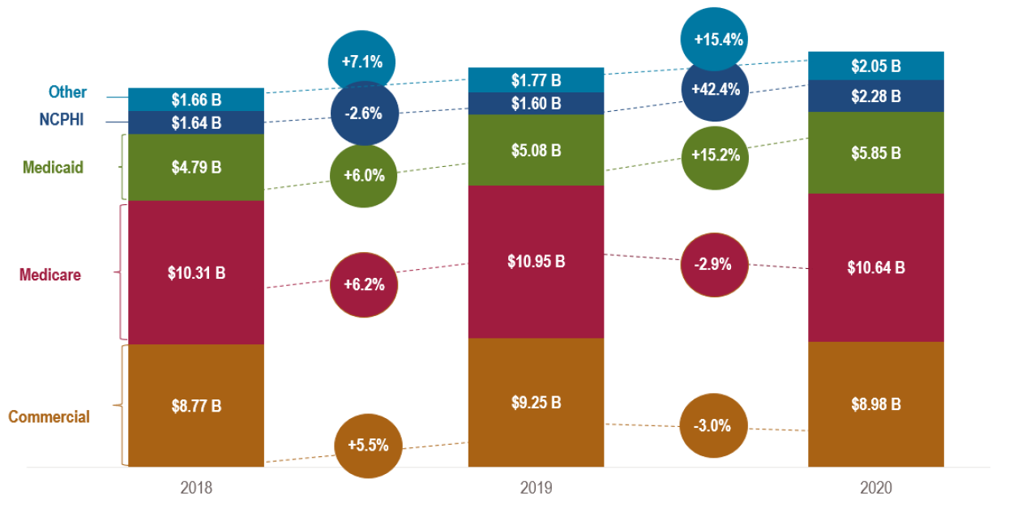
Growth rate in total health care spending and total spending in billions, by market, 2018-2020

Slide 7
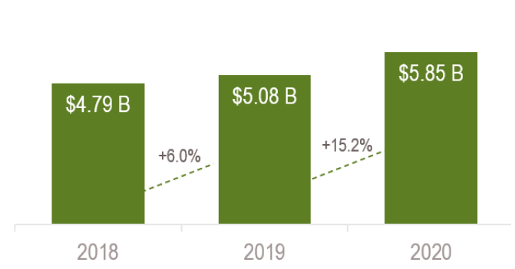
Total Medicaid spending and the Public Health Emergency
Growth rate in total health care spending and total spending in billions, Medicaid, 2018-2020
Increased growth in Medicaid spending from 2019-2020 relative to 2018-2019 likely reflected increased enrollment due to the Public Health Emergency
Medicaid eligibility by quarter, 2018-2020

Slide 8
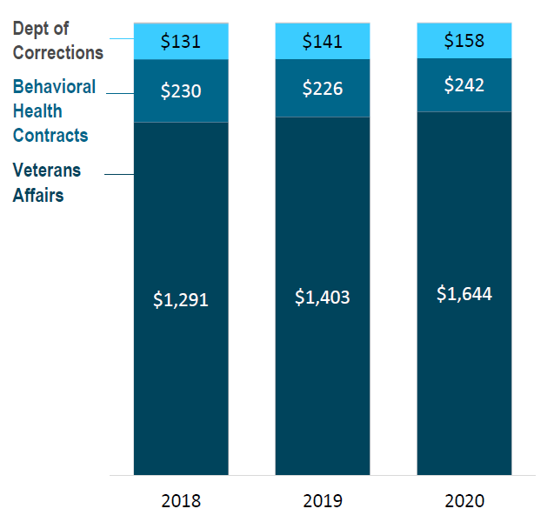
Total health care spending – Other Spending, 2018-2020
Total spending is in millions

Slide 9
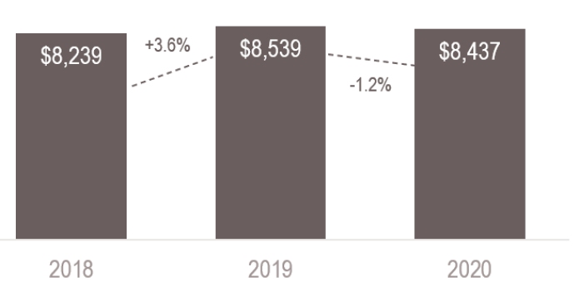
Total Health Care Expenditures (THCE), and growth rate in Oregon, per person per year, 2018-2020

Slide 10
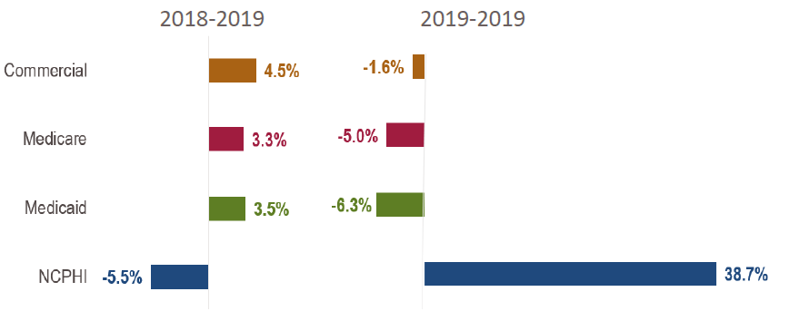
Total Health Care Expenditures in Oregon, per person per year, by market, 2018-2020
Total per person per year spending, by market
Growth in per person per year spending, by market

Slide 11
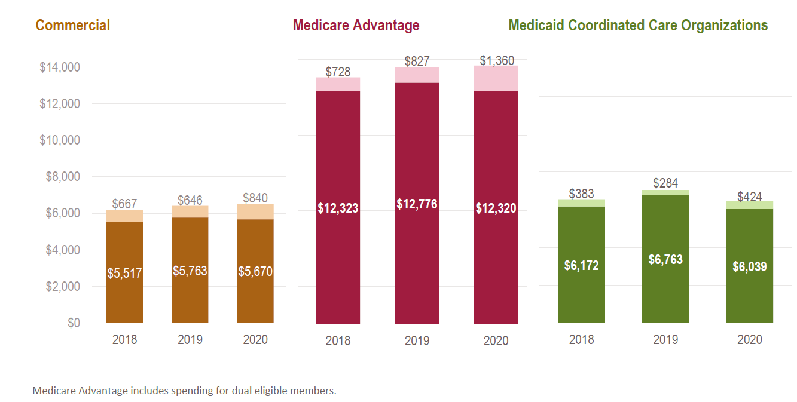
Total Health Care Expenditures, by market, with the Net Cost of Private Health Insurance (NCPHI, lighter bars) per person per year, 2018-2020

Slide 12
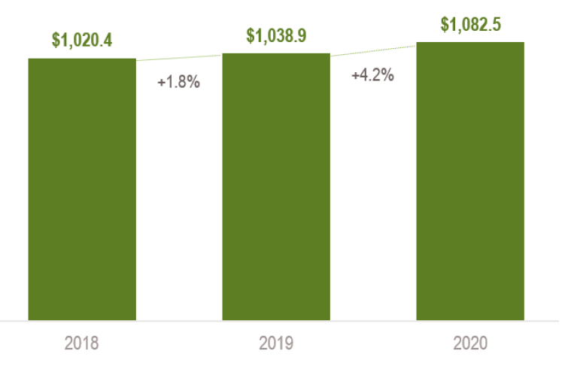
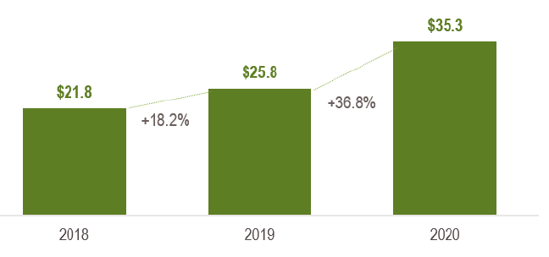
Other Medicaid Coordinated Care Organization (CCO) spending, 2018-2020
Medicaid CCO spending in Qualified Direct Payments and Hospital Reimbursement Adjustments*, in millions
Medicaid CCO spending on Health-Related Services**, in millions
* In addition to the claims and non-claims payments Medicaid CCOs make to provider organizations that are described in more detail in chapter II, they also make serval types of payments that can be included in Total Health Care Expenditures for the Medicaid market. Qualified Directed Payments (QDPs) and Hospital Reimbursement Adjustments (HRAs) are CMS-approved incentive payments designed to improve quality and access to health care services for Medicaid members.
** Health-related services (HRS) are non-covered services that are offered as a supplement to covered benefits under Oregon’s Medicaid State Plan to improve care delivery and overall member and community health and well-being.

Slide 13
Chapter I Cost Growth Trends
Chapter II. Health Care Cost Growth Trends, 2018-2020 by Service Category

Slide 14
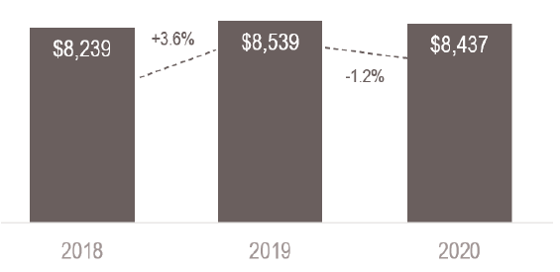
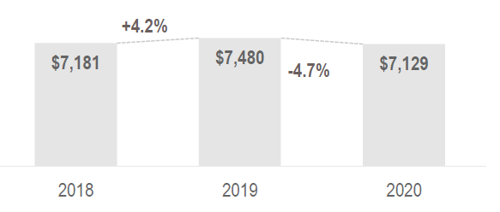
Total medical expenses (TME), statewide, 2018-2020
Total Health Care Expenditures (THCE), statewide per person per year, 2018-2020
Total Health Care Expenditures (THCE) includes the Net Cost of Private Health Insurance (NCPHI) and Other Spending.
Total Medical Expenses (TME) statewide per person per year, 2018-2020
Total Medical Expenses (TME) is a subset of THCE that does not include the NCPHI or Other Spending categories. It includes medical claims and non-claims spending.

Slide 15
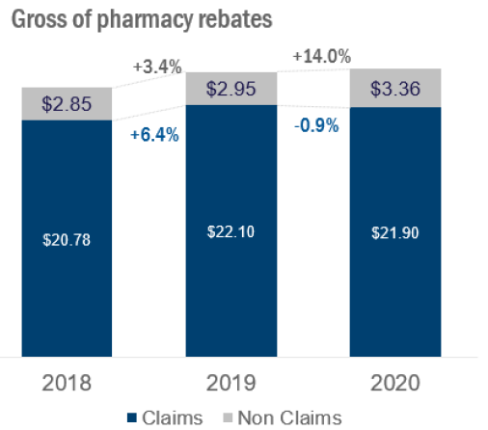
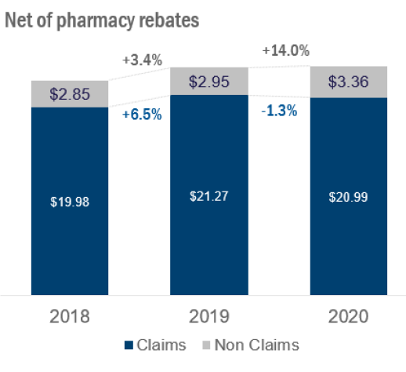
Total Medical Expenses – total dollars spent, in billions, statewide, 2018-2020
Gross of pharmacy rebates means that the cost of pharmacy rebates has not been subtracted from the amount paid for retail pharmacy by the payer.
Net of pharmacy rebates means that the amount received by payers in pharmacy rebates has been subtracted from the total amount spent on retail pharmacy.

Slide 16
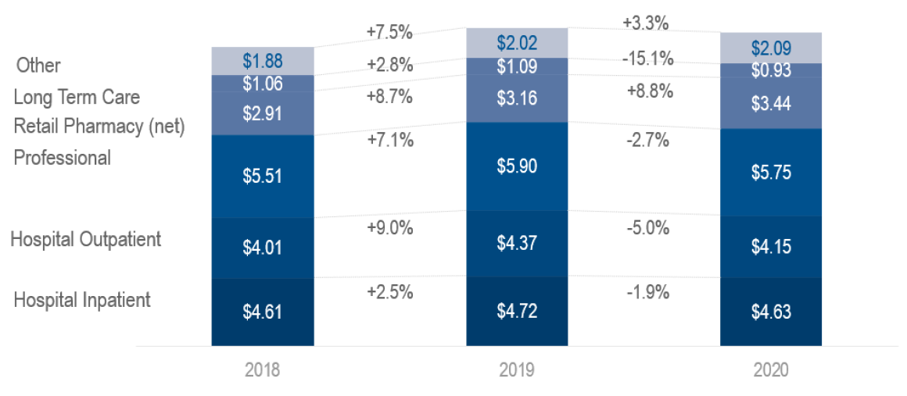
Total Medical Expenses – total claims spending, statewide, 2018-2020
Spending reported net of pharmacy rebates, in billions

Slide 17
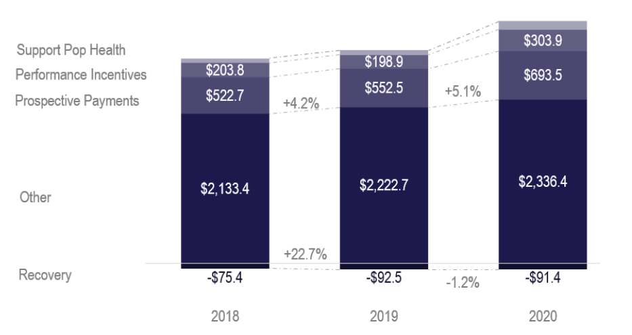
Total Medical Expenses – non-claims spending categories, statewide, 2018-2020
Spending reported in millions

Slide 18
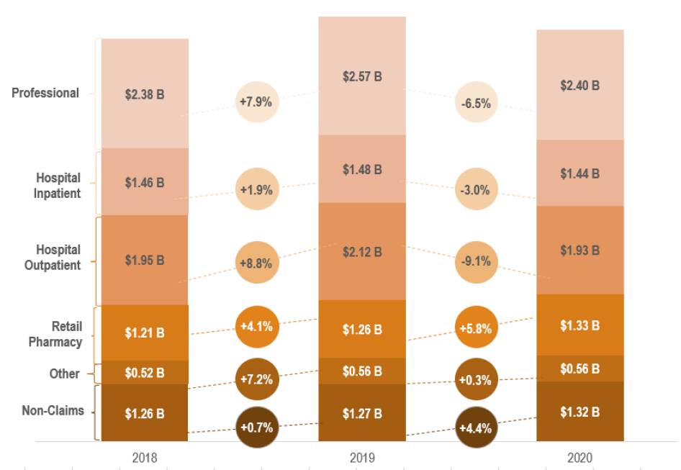
Total Medical Expenses – total spending, Commercial, 2018-2020
Spending reported net of pharmacy rebates, in billions

Slide 19
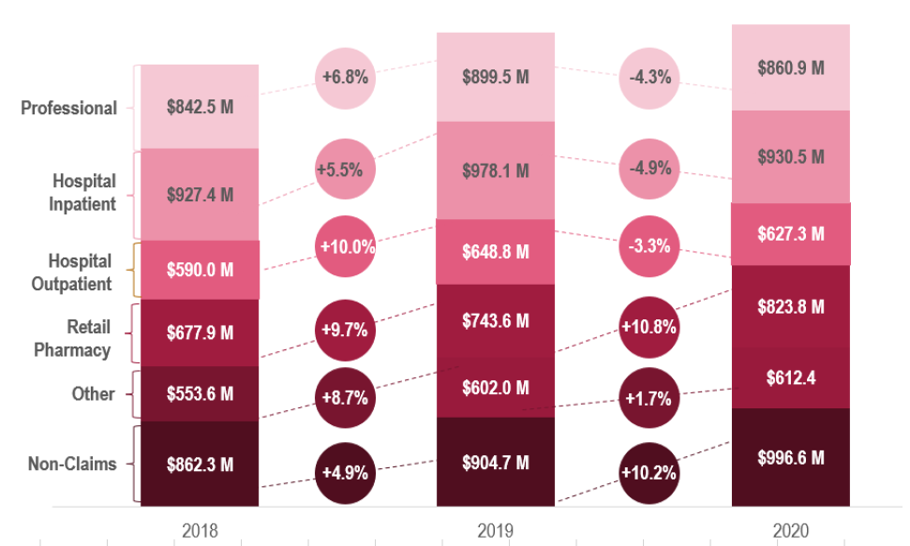
Total Medical Expenses – total spending, Medicare Advantage, 2018-2020
Spending reported net of pharmacy rebates, in millions

Slide 20
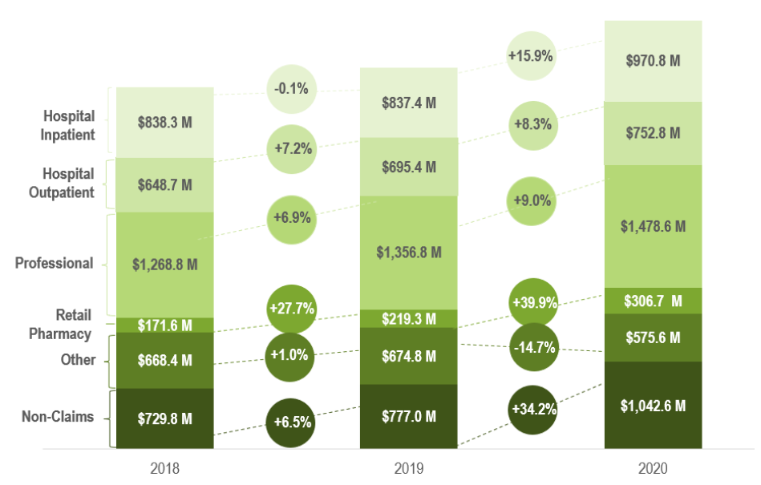
Total Medical Expenses – total spending, Medicaid, 2018-2020
Spending reported net of pharmacy rebates, in millions

Slide 21
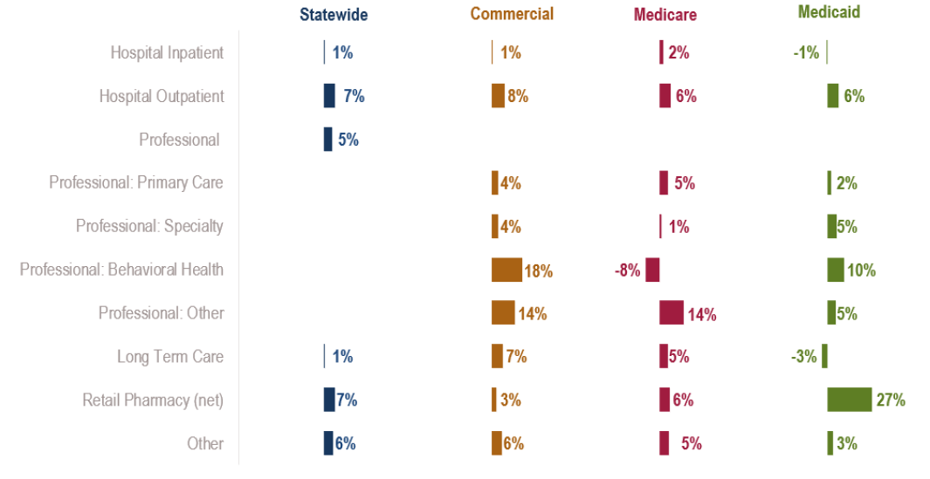
Total Medical Expenses – growth in per person per year spending, by category and market, 2018-2019

Slide 22
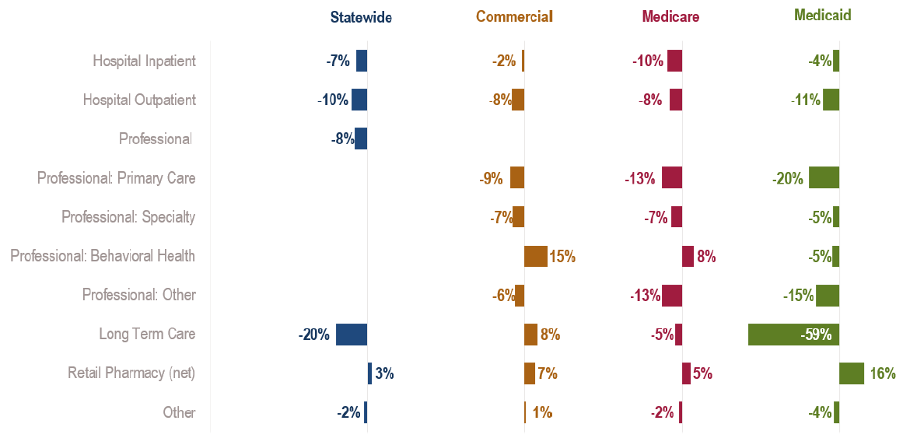
Total Medical Expenses – growth in per person per year spending, by category and market, 2019-2020

Slide 23
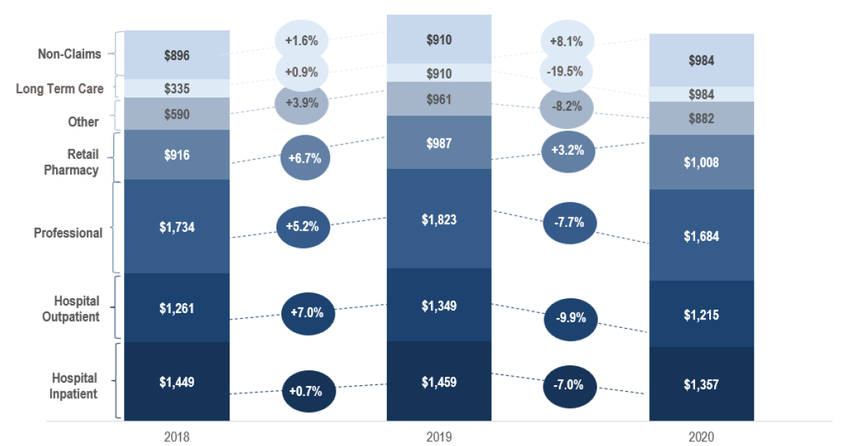
Total Medical Expenses – per person per year spending by service category, statewide, 2018-2020

Slide 24
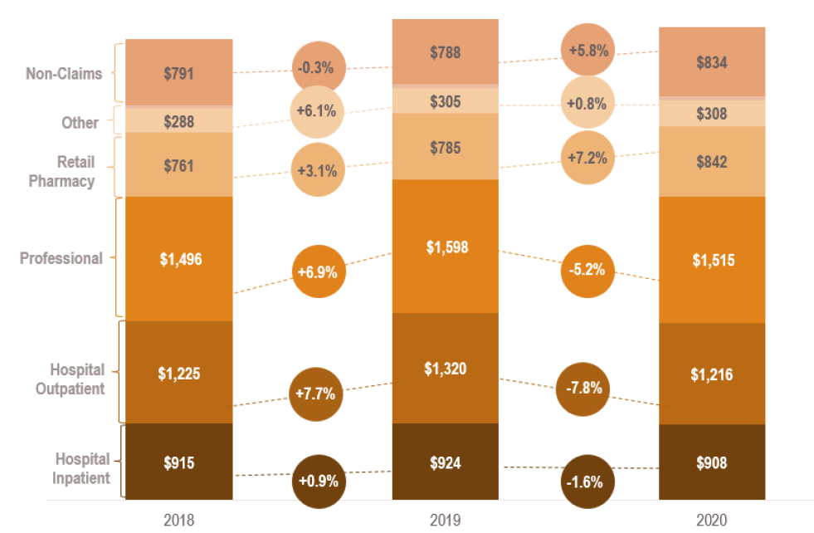
Total Medical Expenses – per person per year spending by service category, Commercial, 2018-2020

Slide 25
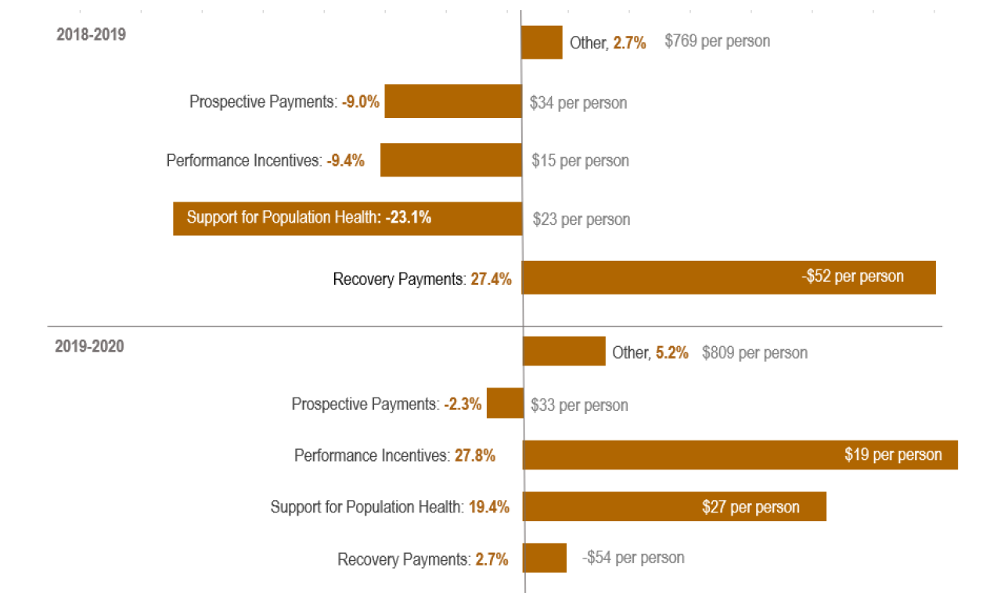
Total Medical Expenses – non-claims growth and cost per person per year, Commercial, 2018-2020

Slide 26
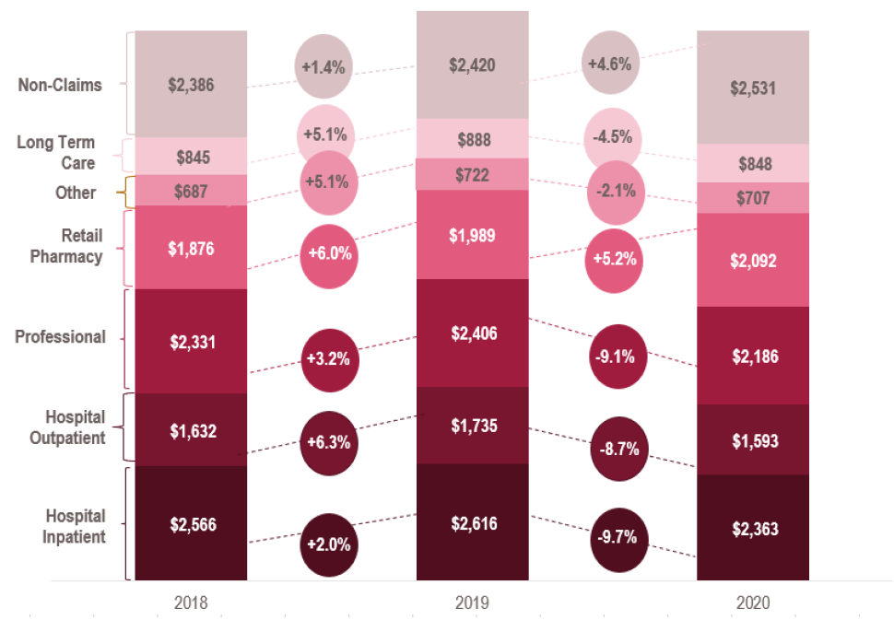
Total Medical Expenses – per person per year spending by service category, Medicare Advantage, 2018-2020

Slide 27
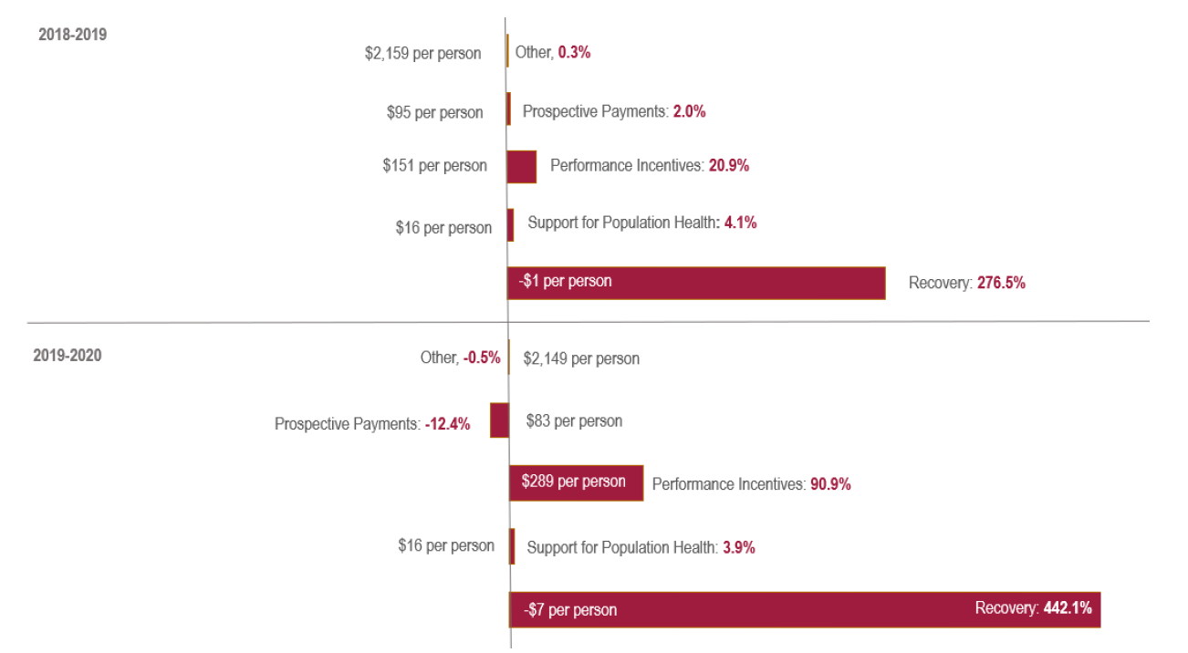
Total Medical Expenses – non-claims growth and cost per person per year, Medicare Advantage, 2018-2020

Slide 28
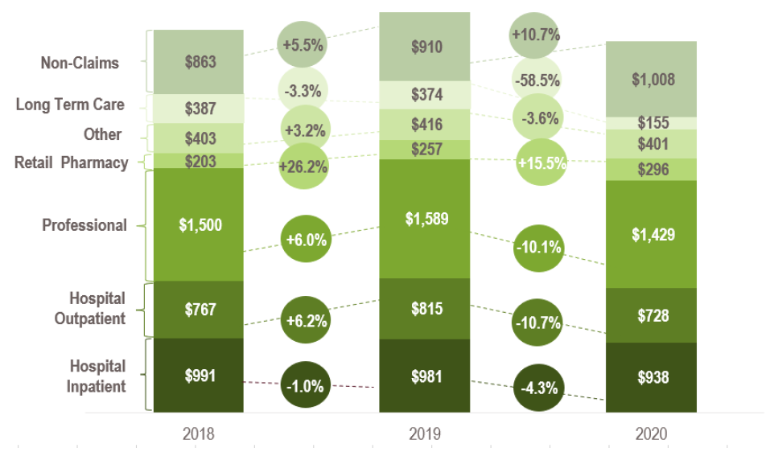
Total Medical Expenses – per person per year spending by service category, Medicaid, 2018-2020

Slide 29
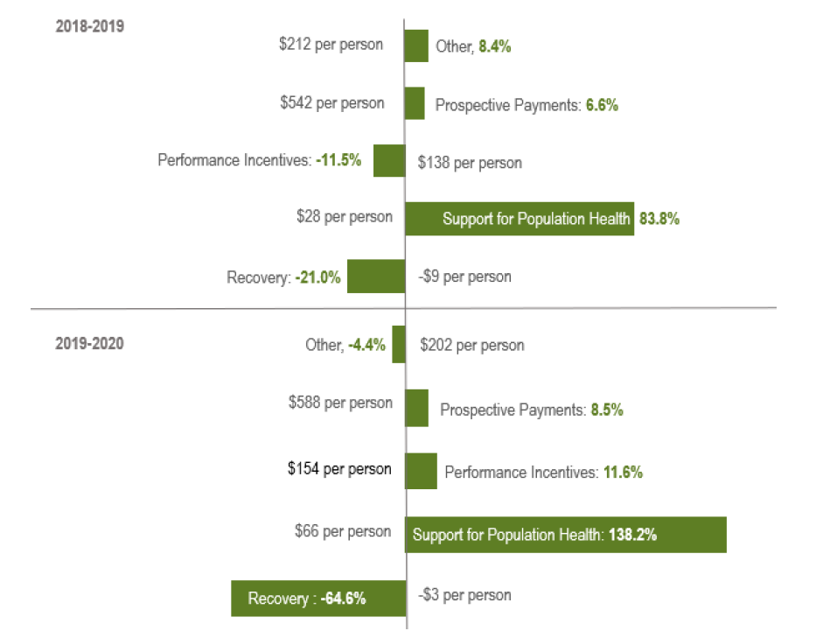
Total Medical Expenses – non-claims growth and cost per person per year, Medicaid, 2018-2020

Slide 30
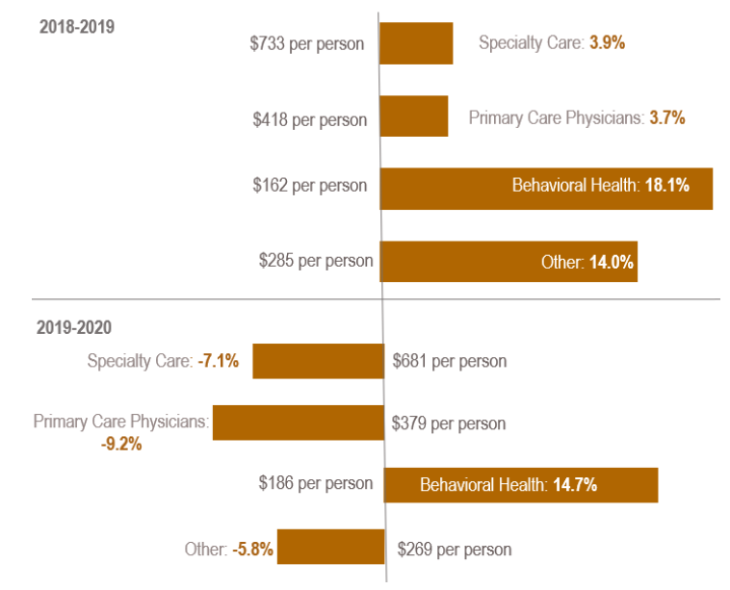
Total Medical Expenses – claims professional services spending by subcategory, Commercial, 2018-2020

Slide 31
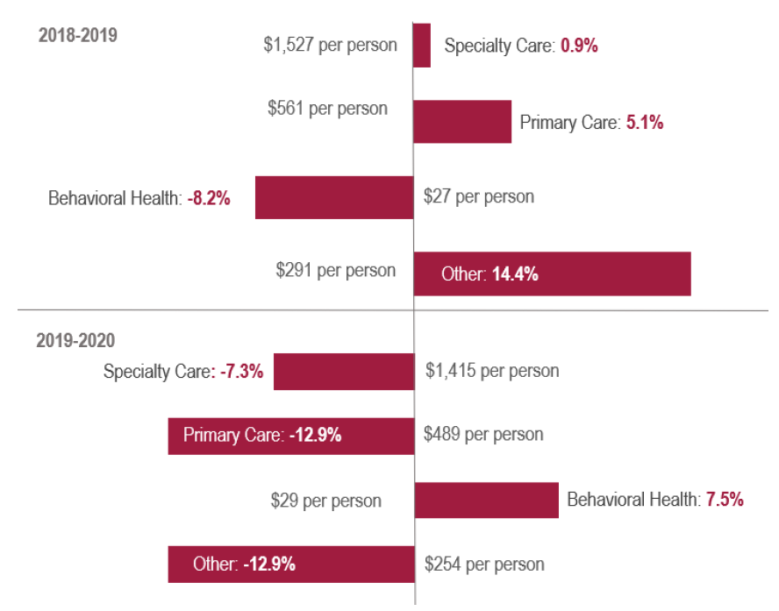
Total Medical Expenses – claims professional services spending by subcategory, Medicare Advantage, 2018-2020

Slide 32
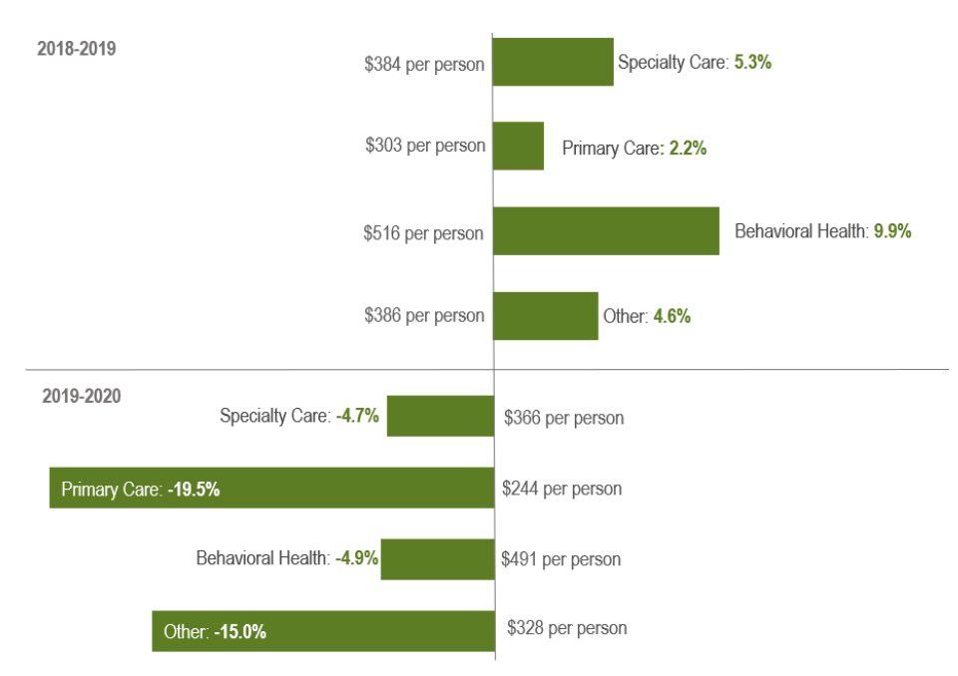
Total Medical Expenses – claims professional service spending by subcategory, Medicaid, 2018-2020

Slide 33
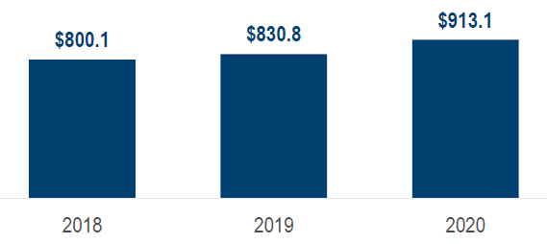
Pharmacy rebates spending, statewide, 2018-2020
Total rebates in millions

Slide 34
Pharmacy rebates as a percent of retail pharmacy spending, 2018-2020
Statewide, about 21% of spending for retail pharmacy was returned to payers and PBMs through rebates.
By market, Medicaid recoups a majority of prescription drug costs through rebates, due to federal and state policies.

Slide 35
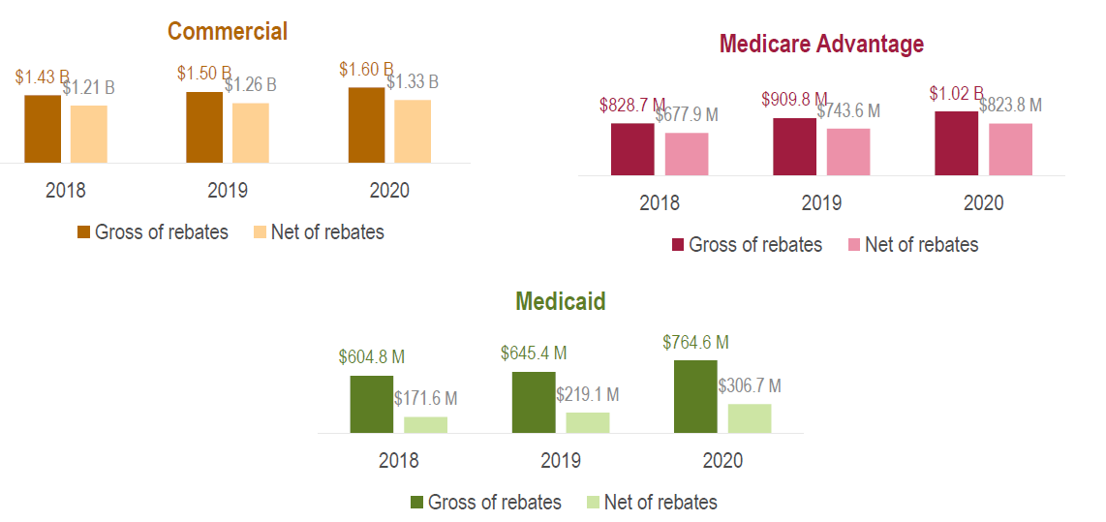
Retail pharmacy spending gross (before) and net (after) pharmacy rebates, by market, 2018-2020
Even with pharmacy rebates taken into account, pharmacy spending continues to grow in each market

Slide 36
Chapter I Cost Growth Trends
Chapter III. Health Care Cost Growth Trends, 2018-2020 Payer and Provider Level
(de-identified)

Slide 37
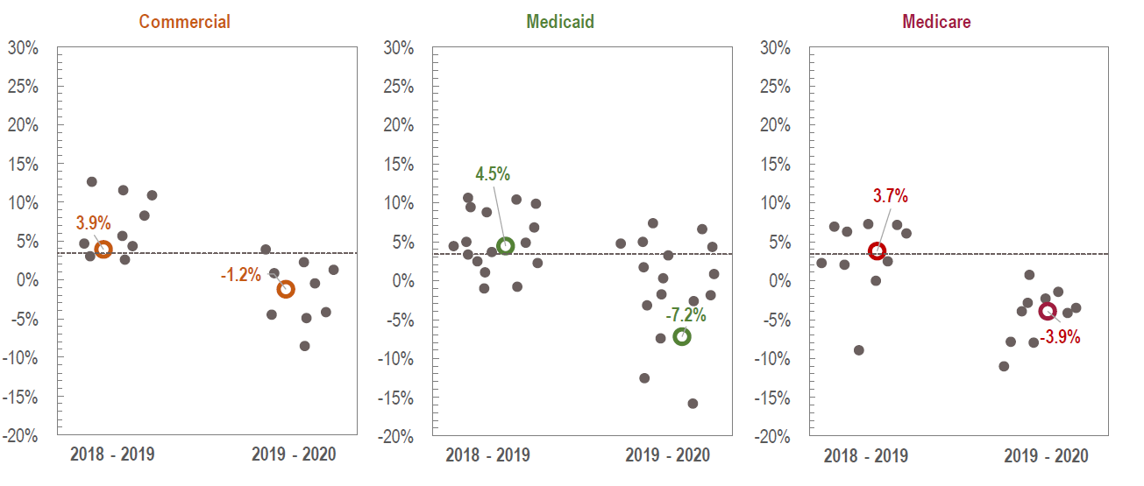
Total Medical Expenses – cost growth for de-identified payers, compared to the statewide average for each market, 2018-2020

Slide 38
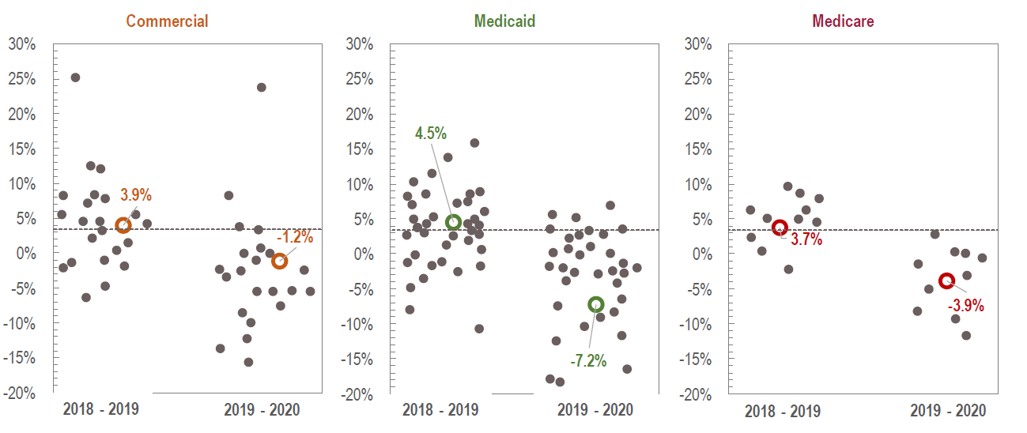
Total Medical Expenses – cost growth for de-identified provider organizations, compared to the statewide average for each market, 2018-2020

Slide 39
Databook and Methodology
All data is available in the public databook posted online.
See the full report for all notes on data sources and methodology.
Suggested Citation: Oregon Health Authority. Health Care Cost Growth Trends in Oregon, 2018-2020. Portland, OR. May 2023. For questions about this report, please contact: HealthCare.CostTarget@oha.oregon.gov

