Slide 1

Health Care Cost Trends State and Market-Level Cost Growth in Oregon, 2013-2019
Report Chart Pack
July 2022

Slide 2
Full report is online at: https://www.oregon.gov/oha/HPA/HP/Cost%20Growth%20Target%20documents/cost-trends-report-2013-2019.pdf
Oregon’s Sustainable Health Care Cost Growth Target Program
In 2019, the Oregon Legislature established the Sustainable Health Care Cost Growth Target Program, which sets a statewide target for the annual per person growth rate of total health care spending in the state. The program will also monitor and publish reports on health care cost increases and factors driving these trends. For more information: https://go.usa.gov/xzFpX

Slide 3
Chapter I Cost Growth Trends
Chapter I - Cost Growth Trends

Slide 4
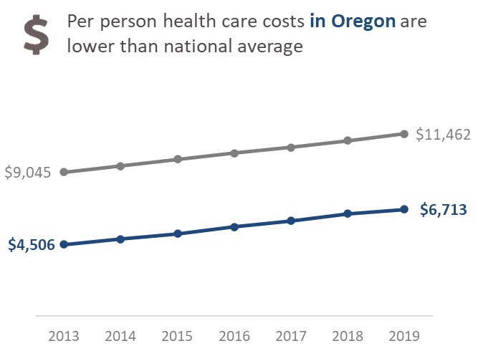
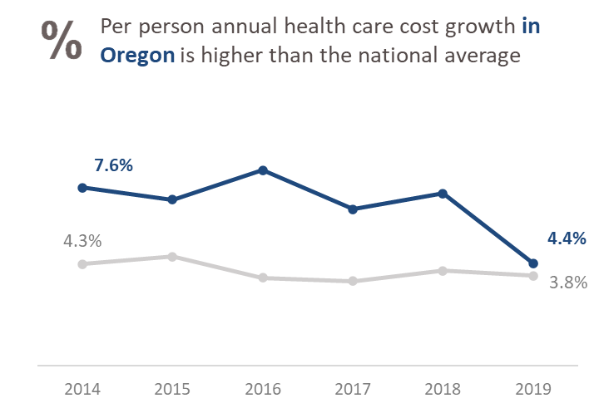
Annual Growth in Per Person Health Care Costs, Statewide
National Health Expenditure Data from CMS, Table 1, National Health Expenditures Per Capita. https://www.cms.gov/Research-Statistics-Data-and-Systems/Statistics-Trends-and-Reports/NationalHealthExpendData/NationalHealthAccountsHistorical. Data last modified December 15, 2021.

Slide 5
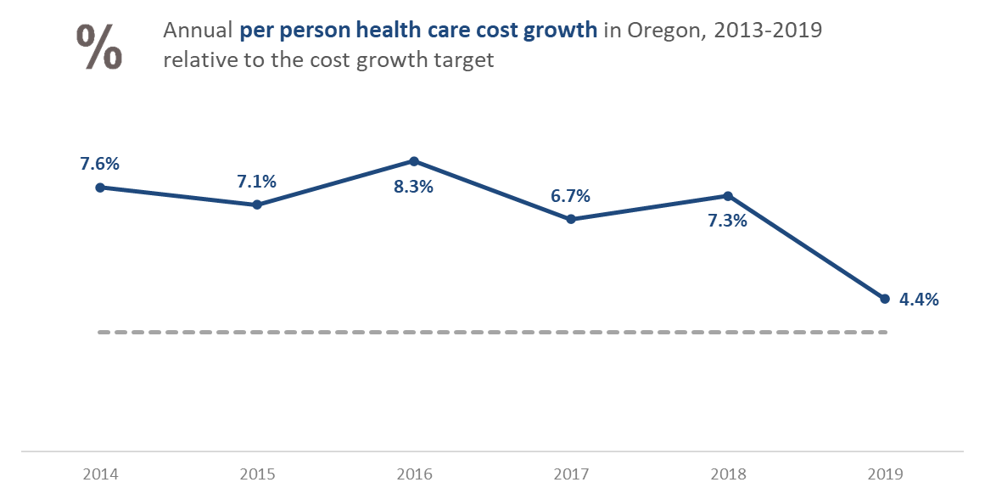
Oregon’s Cost Growth Relative to the Future Cost Growth Target

Slide 6
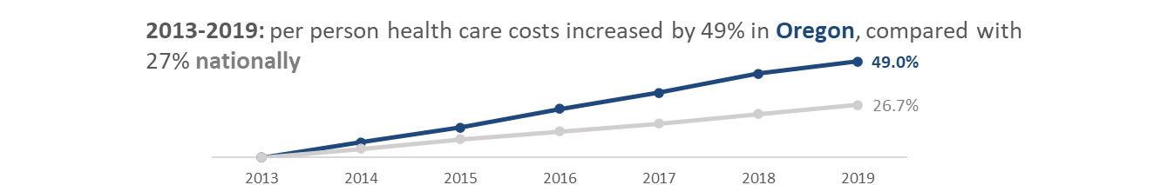

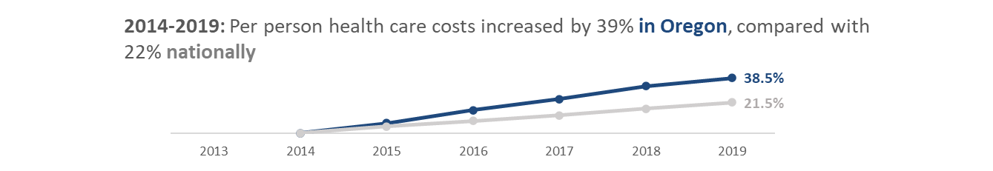
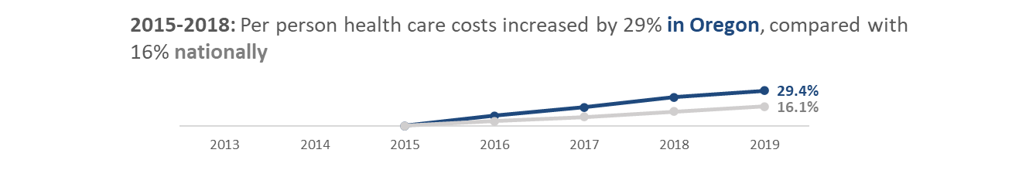
Cumulative Growth in Per Person Health Care Costs, Statewide

Slide 7
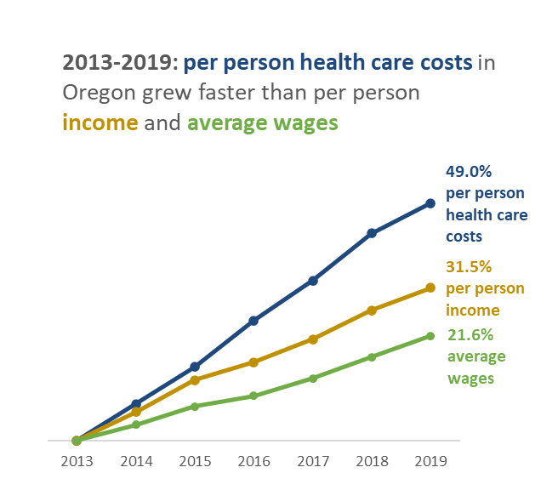
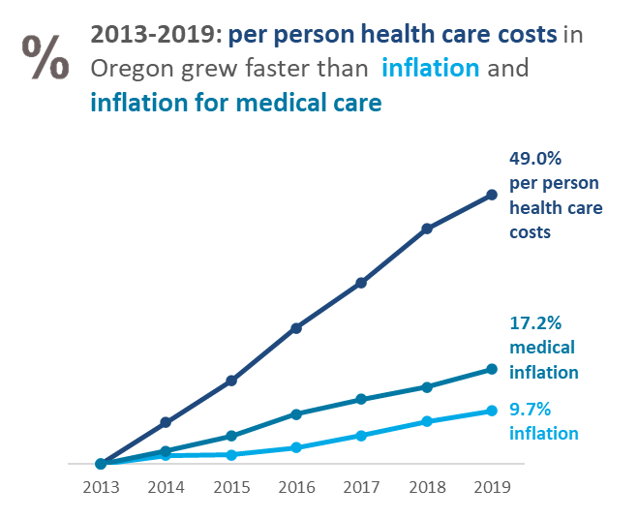
Cumulative Growth in Per Person Health Care Costs & Economic Indicators
Per person income and average wage data from the Oregon Economic Forecast data tables. https://www.oregon.gov/das/OEA/Pages/forecastecorev.aspx. Inflation is reported as the consumer price index (CPI) – all urban consumers, and CPI- medical care. https://fred.stlouisfed.org/series/CPIMEDSL#0. Data pulled March 14, 2022.

Slide 8
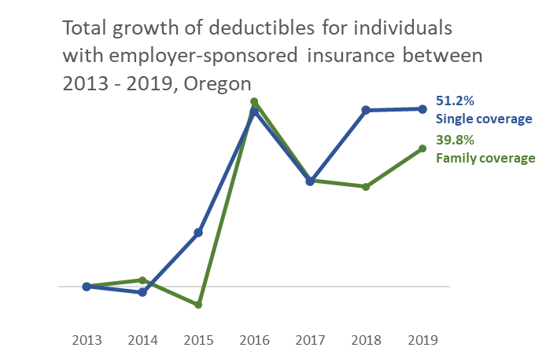
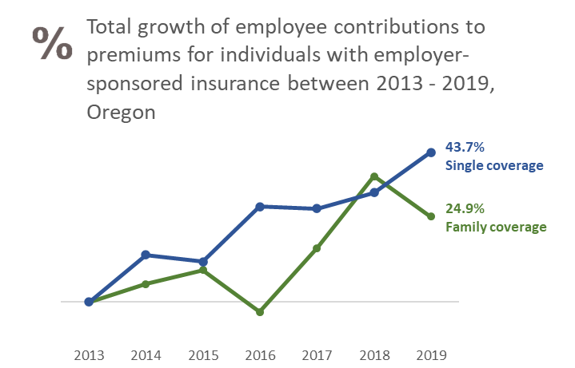
Cumulative Growth in Commercial Insurance Deductibles & Premiums
Premium and deductible data from the Medical Expenditures Panel Survey (MEPS) Insurance Component. https://meps.ahrq.gov/mepsweb Patient responsibility as share of median income from The Commonwealth Fund, State Trends in Employment and Premium Deductibles. Nov 2020. https://www.commonwealthfund.org/sites/default/files/2020-11/Collins_state_premium_trends_2020_db_1.pdf. Data pulled September 24, 2021.

Slide 9
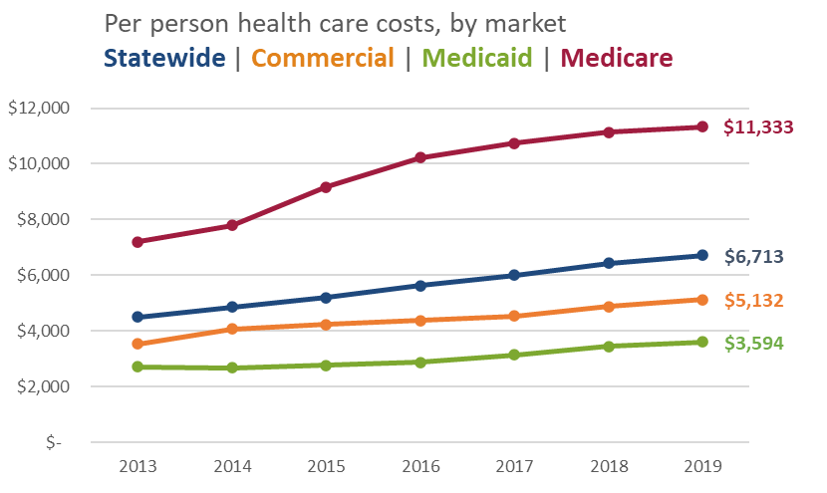

Annual Growth in Per Person Health Care Costs, by Market

Slide 10
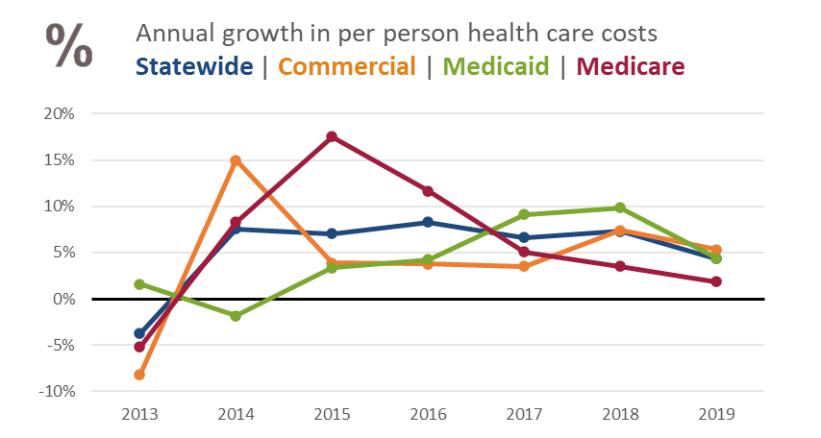
Annual Growth in Per Person Health Care Costs, by Market

Slide 11
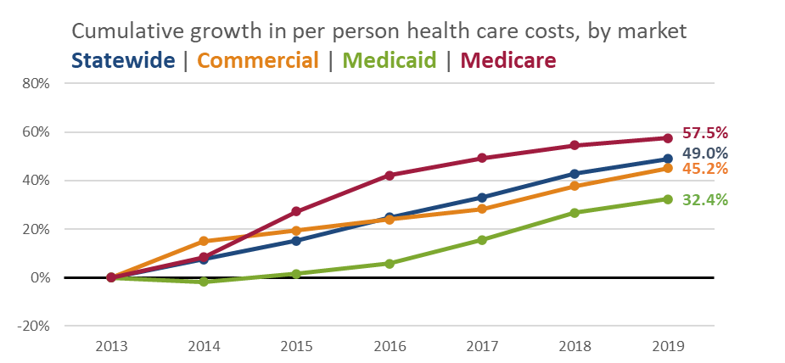
Cumulative Growth in Per Person Health Care Costs, by Market

Slide 12
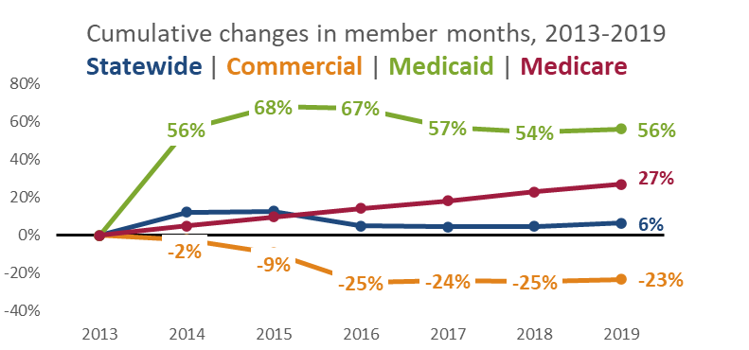

A Closer Look at Enrollment

Slide 13
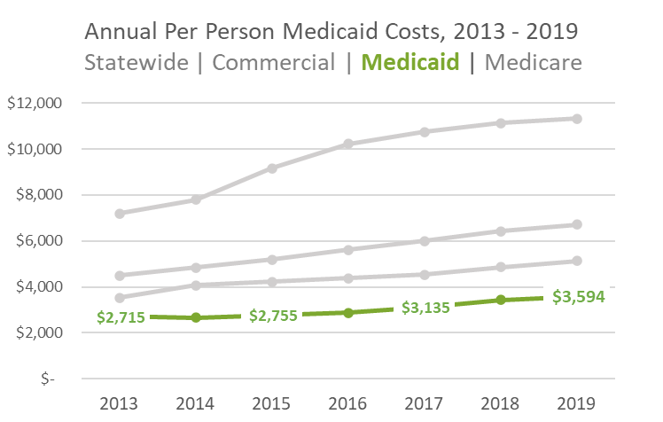
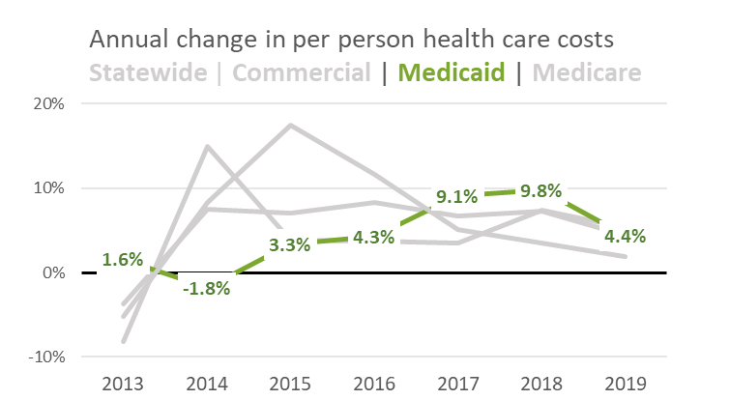
A Closer Look at Medicaid Cost Growth
See the full report for more information and the key policy changes in Medicaid from 2013 to 2019.

Slide 14
Chapter II - Cost Growth Trends by Service Category

Slide 15
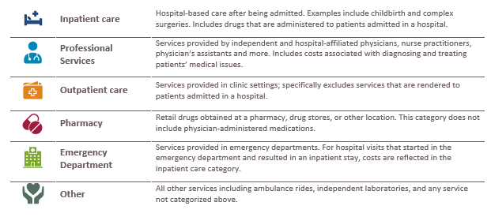
Defining Service Categories

Slide 16
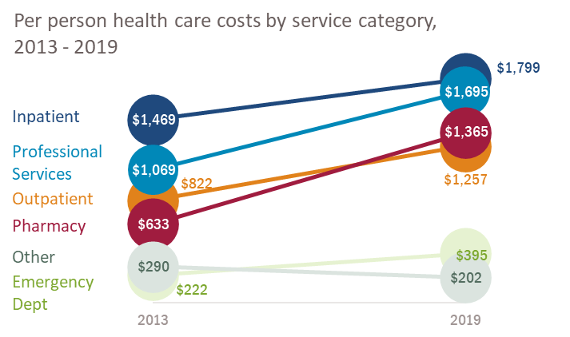
Per Person Cost Growth by Service Category, Statewide

Slide 17
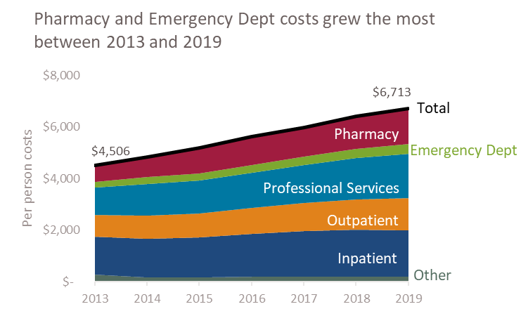
Per Person Cost Growth by Service Category, Statewide

Slide 18
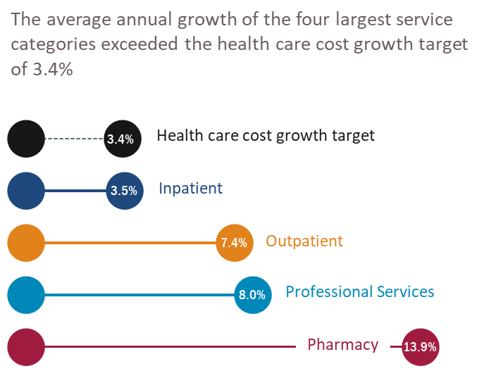
Statewide Service Category Cost Growth Relative to the Future Cost Growth Target

Slide 19
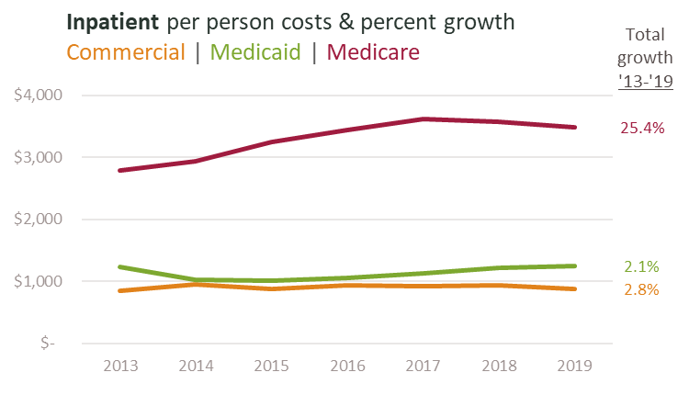
Inpatient Care – Per Person Cost Growth

Slide 20
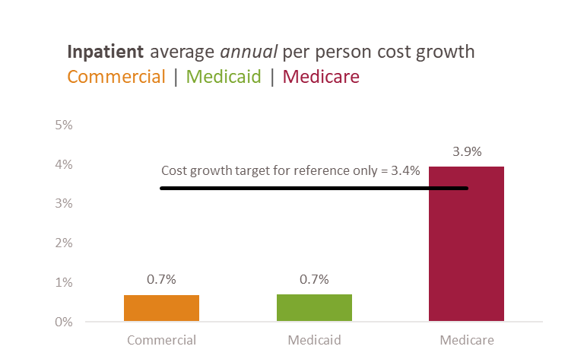
Inpatient Care – Per Person Cost Growth

Slide 21
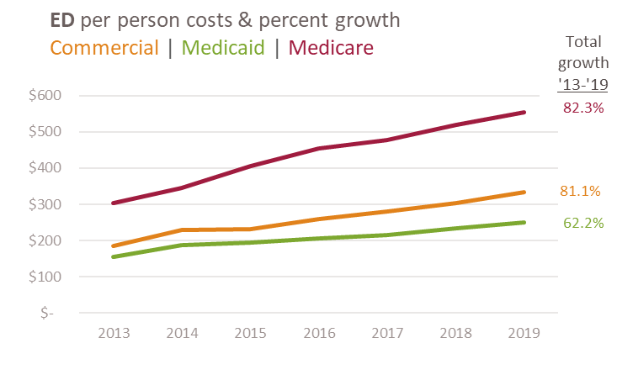
Emergency Department - Per Person Cost Growth

Slide 22
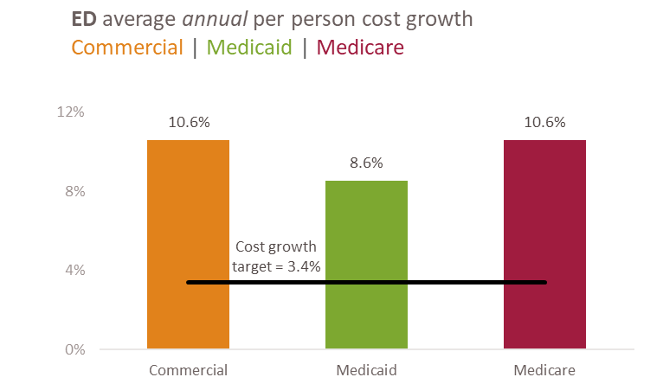
Emergency Department - Per Person Cost Growth

Slide 23
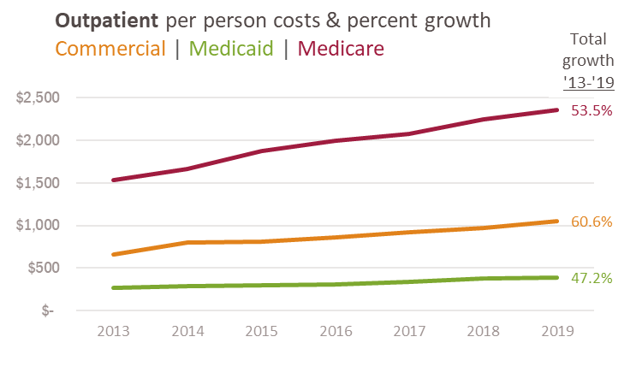
Outpatient - Per Person Cost Growth

Slide 24
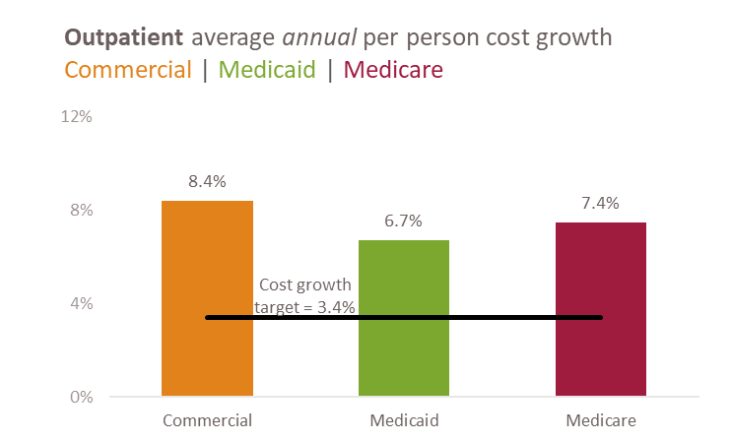
Outpatient - Per Person Cost Growth

Slide 25
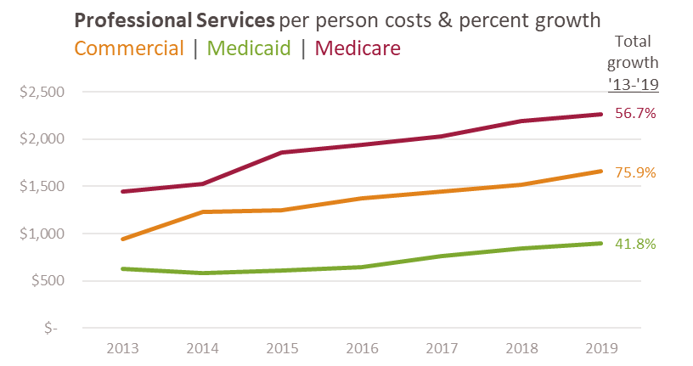
Professional Services - Per Person Cost Growth

Slide 26
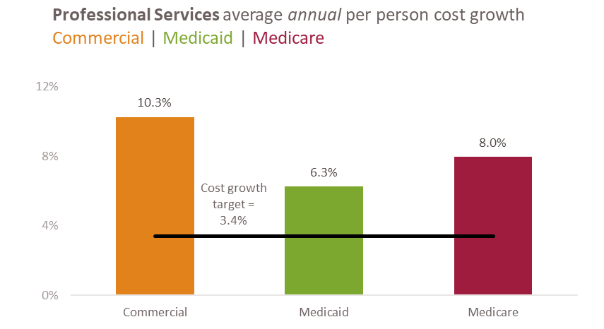
Professional Services - Per Person Cost Growth

Slide 27
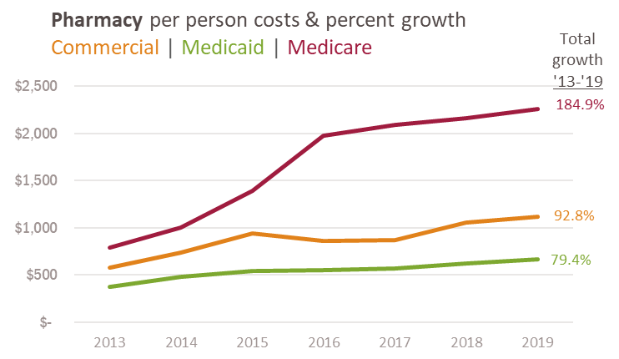
Pharmacy - Per Person Cost Growth

Slide 28
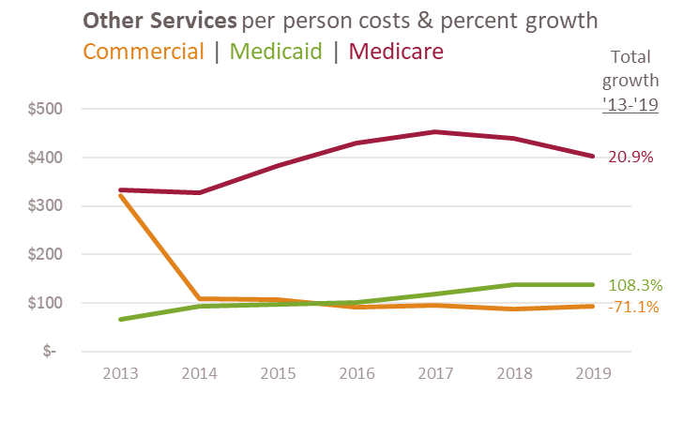
Other - Per Person Cost Growth

Slide 29
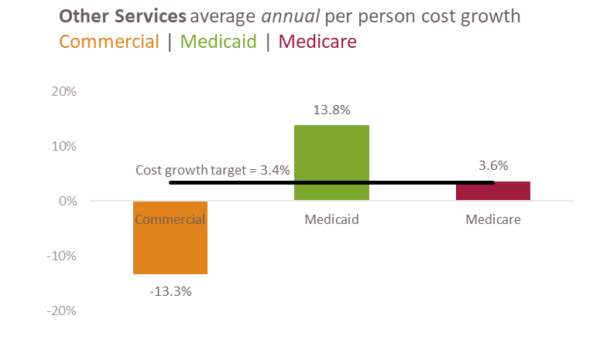
Other - Per Person Cost Growth

Slide 30
Chapter III - Identifying Cost Growth Drivers

Slide 31
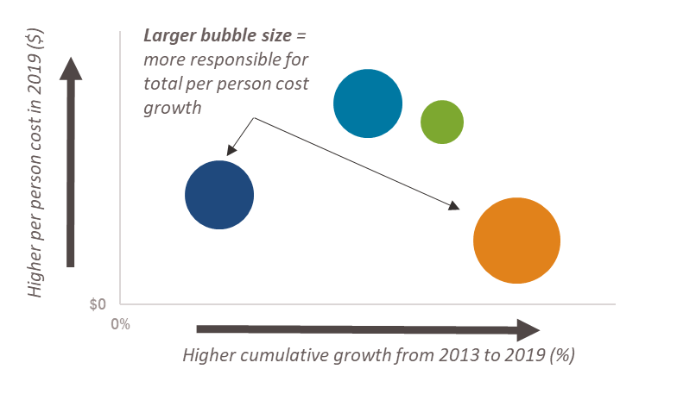
How to read the following charts

Slide 32
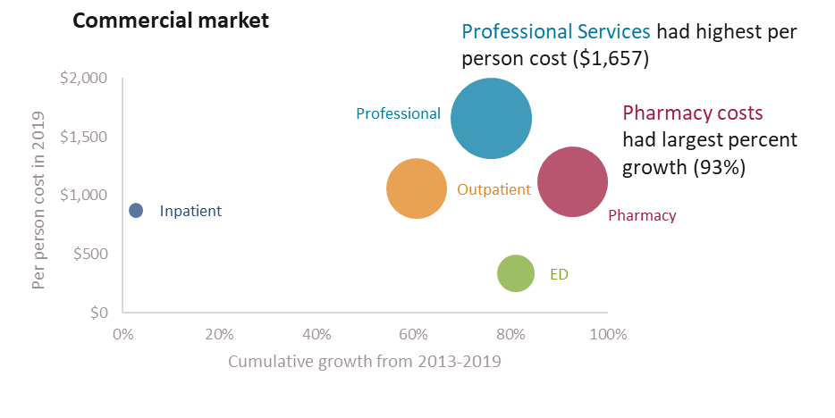
Cost Drivers in the Commercial Market

Slide 33
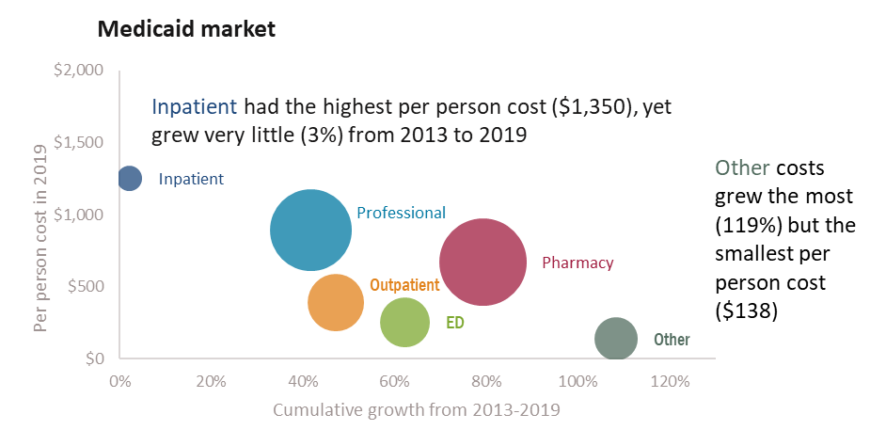
Cost Drivers in the Medicaid Market

Slide 34
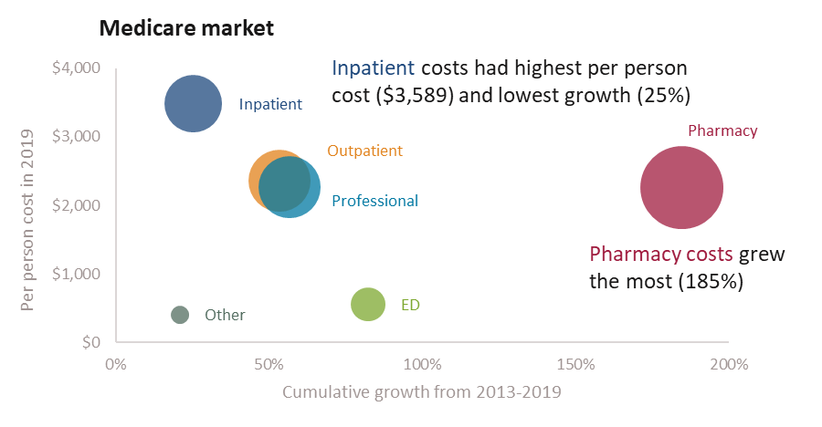
Cost Drivers in the Medicare Market

Slide 35
Appendices & Methodology
See the full report for all data tables and the methodology
For more information about Medicaid’s various 3.4% cost growth measures, see Background – The Health Care Cost Trends Report & Measuring Medicaid Cost Growth
Suggested Citation: Oregon Health Authority. Health Care Cost Trends: State and Market-Level Cost Growth in Oregon, 2013-2019. Portland, OR. July 2022. For questions about this report, please contact: HealthCare.CostTarget@odhsoha.oregon.gov

