Slide 1
Early Childhood Suspension and Expulsion Prevention Program
Katrina Miller
Infant and Early Childhood Mental Health Specialist

Slide 2
New Legislation Passed in 2021
HB2166:
Reduce the use of suspension and expulsion and
Reduce disparities in the use of suspension and expulsion
SB236:
Bans suspension and expulsion, effective July 1, 2026;
Calls for a study on suspension and expulsion

Slide 3

A Systems Problem
Suspension and expulsion is a complex system-level problem that requires a complex system-level response.
Photo by Eilis Garvey on Unsplash

Slide 4
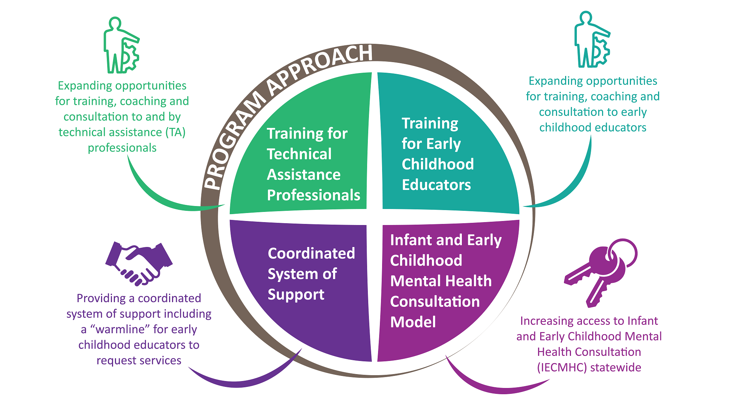
Program Approach

Slide 5
Early Childhood Suspension & Expulsion Prevention Program
Support the ECE workforce: expand training, coaching, and consultation to increase ECE providers ability to implement anti-bias, culturally responsive and inclusive practices to support young children’s social-emotional development and positive racial identity development.
Technical Assistance: Provide additional training, coaching, and consultation to the broader system of Technical Assistance providers to ensure they have the skills to support ECE programs implementation of foundational social-emotional, anti-bias, culturally responsive, and inclusive practices.

Slide 6
Early Childhood Suspension & Expulsion Prevention Program
Infant and Early Childhood Mental Health Consultation (IECMHC):
  Create statewide access to IECMHC for child, classroom, and program-level supports
  Ensure IECMHC services are culturally responsive and trauma-informed
  Increase the cultural and racial diversity of the IECMHC workforce
Coordinated System of Support
  Develop and implement a “Warmline” to serve as a central access point for ECE providers to request services to support a child
  Develop an interagency, multi-level coordinated system of response to assign IECMHC and TA to respond to Warmline requests in a timely manner. The process will be developed regionally, and will focus on ensuring services are aligned, relevant to the situation while avoiding unnecessary duplication, and that data is shared.

Slide 7
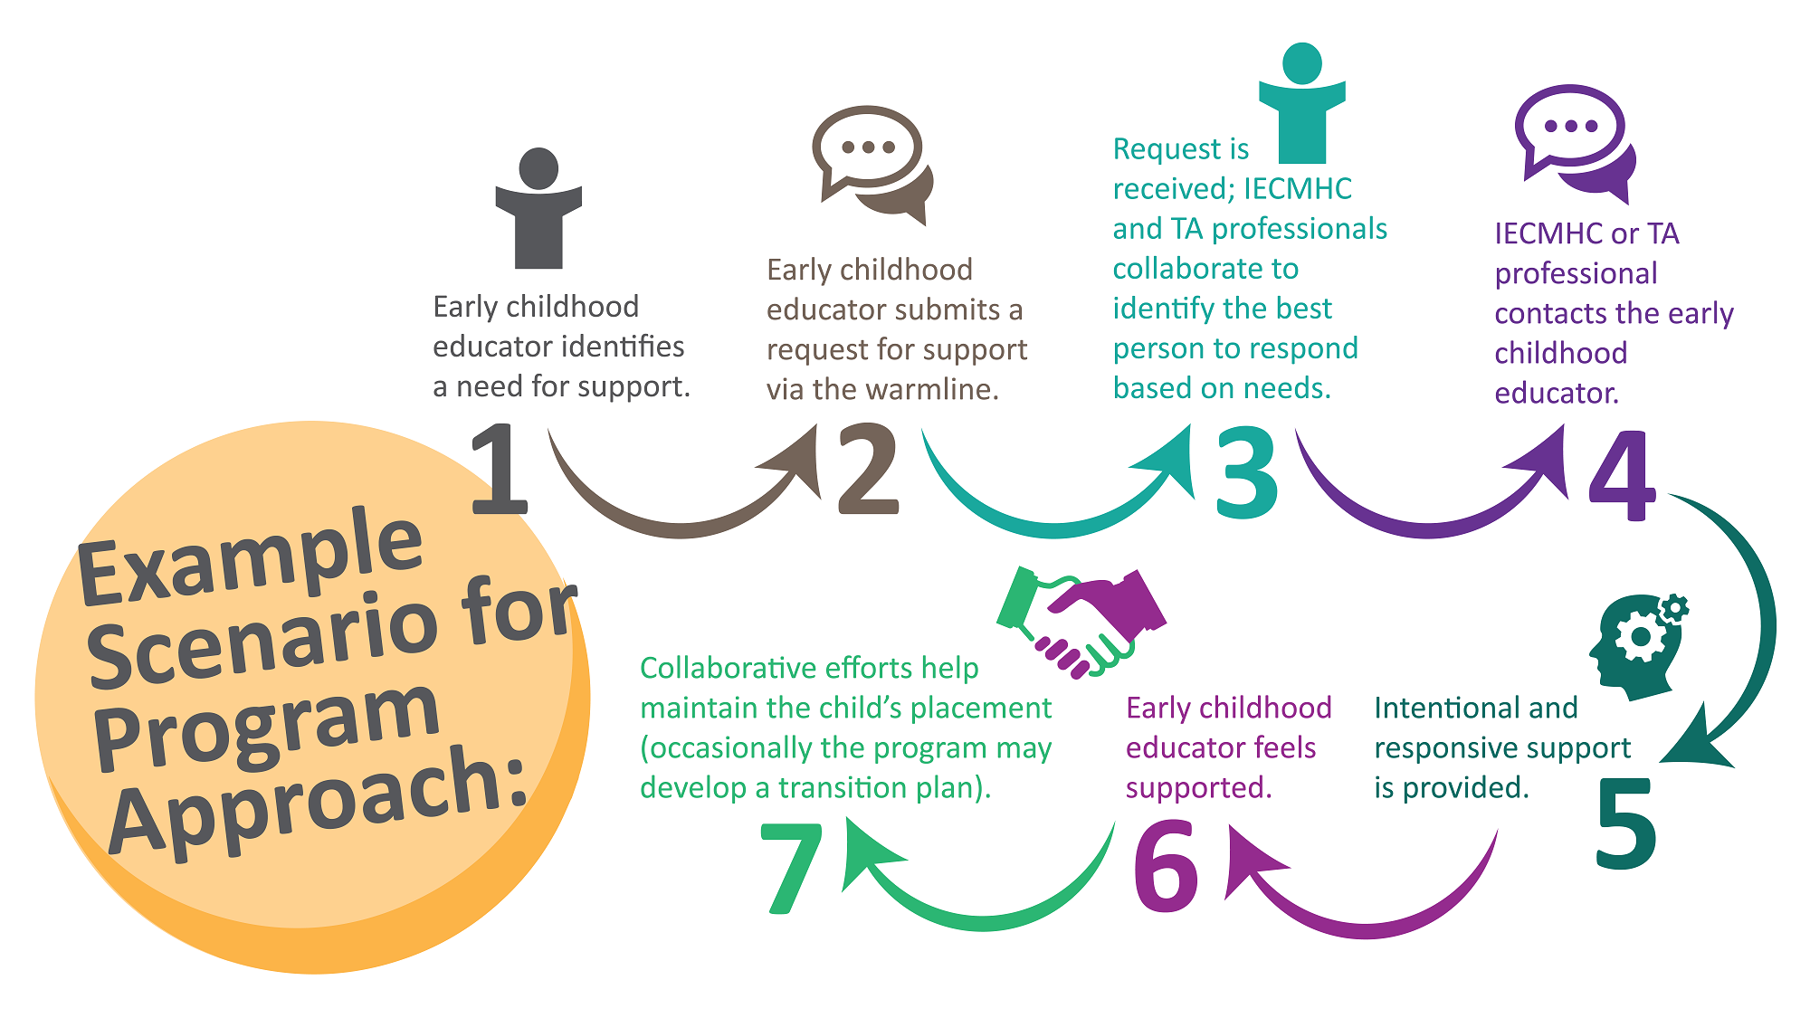
Example

Slide 8
Early Childhood Suspension & Expulsion Prevention Program
Structure
Central Entity: Trauma Informed Oregon
  Help lead community engagement work
  Help ELD build out the details of the IECMHC Model
  Help guide the development of the Coordinated System of Support
IECMHC Regional Service Providers
  15 regions across the state
  Using the same geographical boundaries as CCR&R regions
  RFA in-development
Lots of Coordination and Collaboration with System Partners!

Slide 9
Early Childhood Suspension and Expulsion Program
Another way of thinking about these areas of focus:
multi-tiered systems of support.
Within the overall early learning system:
Infant and Early Childhood Mental Health Consultation
EI/ECSE
Pyramid Model
Foundational ECE workforce training
Child Care Licensing
Intervention
Prevention
Promotion

Slide 10
Early Childhood Suspension and Expulsion Program
Another way of thinking about these areas of focus:
multi-tiered systems of support.
Broader cross-system/cross-sector alignment:
Public Health
Community Mental Health
Higher Education
Intervention
Prevention
Promotion

Slide 11
Contact
Katrina Miller, LCSW
Infant and Early Childhood Mental Health Specialist
Early Childhood Suspension and Expulsion Prevention Program
Katrina.miller@ode.Oregon.gov

