Slide 1


Value-Based Payment Models Deep Dive
3/17/2017
Dale Jarvis, CPA
dale@djconsult.net

Slide 2
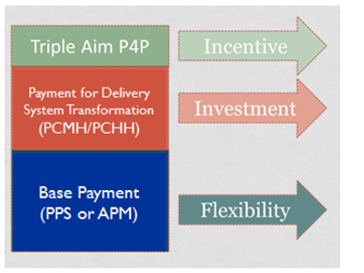

Value-Based Payment At-A-Glance
Transformation Funding Layer = Seed Funding.
Let’s dig into the other two layers.

Slide 3
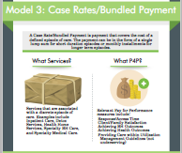
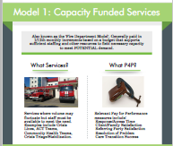
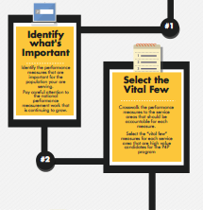
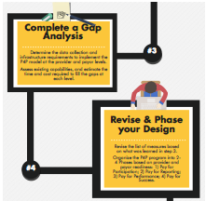
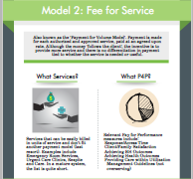
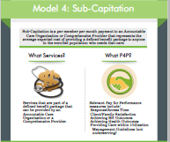
Unpacking the VBP Layers
Layer 1
  The Base Payment Layer
  There are 4 Base Payment Models
  One Size Does Not Fit All
Layer 3
  The Bonus/Shared Savings Layer
  Married at the Hip with Key Performance Measures
  Needs to be a Substantial % of the Total Payment
http://azpaymentreform.weebly.com/

Slide 4
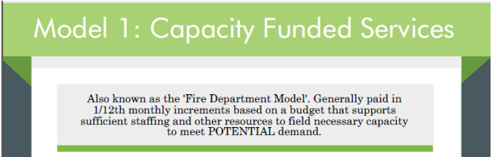
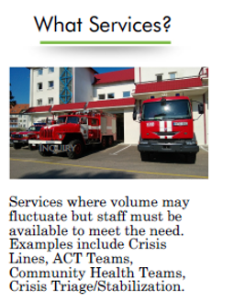
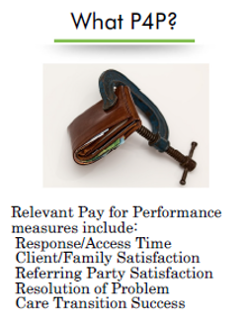

Slide 5
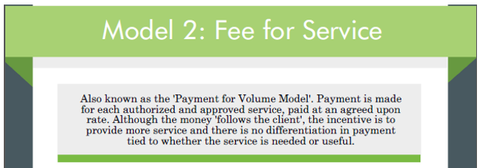
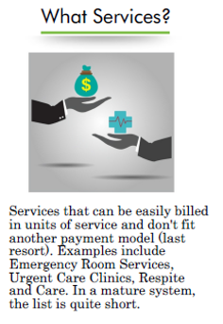
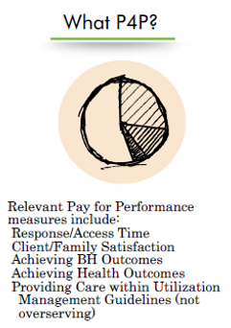

Slide 6
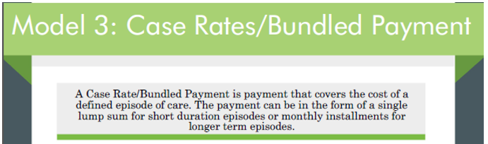
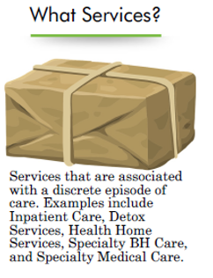
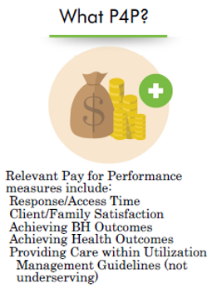

Slide 7
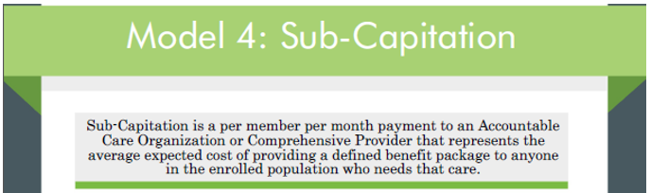
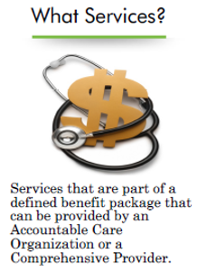
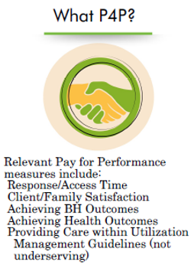

Slide 8
Base Payment: One-Size Doesn’t Fit All

Slide 9


Questions for the Group
How many of you are using a Bundled Payment/ Case Rate?
How many of you are using Capitation?
What’s working, what’s not?

Slide 10


Bonus/Shared Savings Layer
Two Groups of Outcomes
  Systemwide Outcomes:
    Follow-up after hospitalization.
    Reduction in inpatient admissions per 1,000.
    Reduction in the increase in total health spending per person
  Individual Outcomes:
    Is Dale’s depression score under 10
    as measured by the PHQ-9 Tool?
    Is Dale’s diabetes under control?

Slide 11
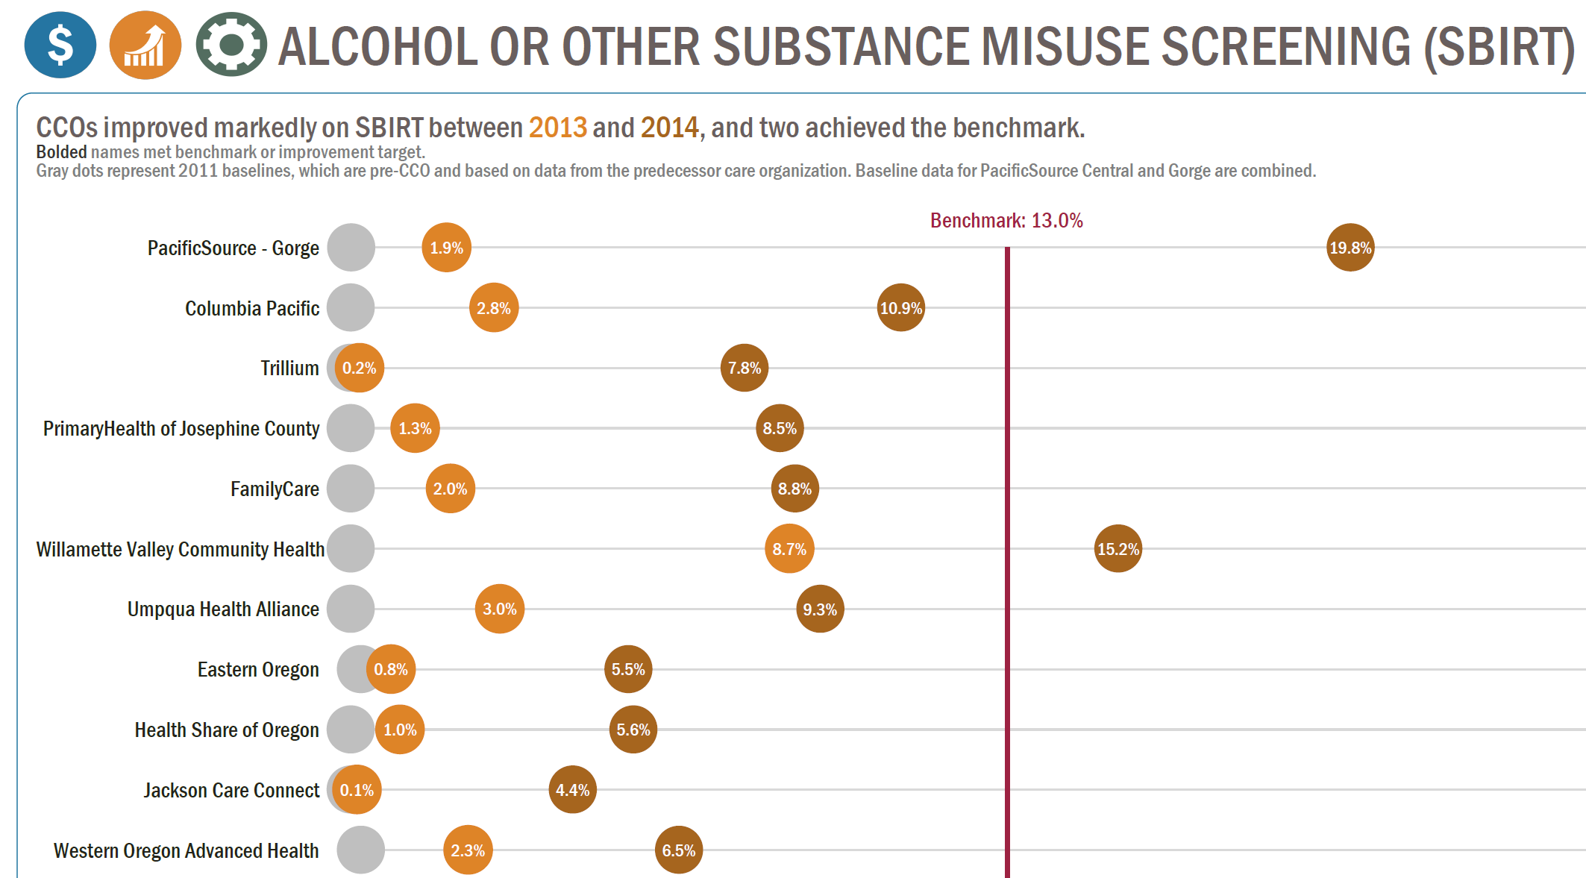
System Outcomes Example

Slide 12
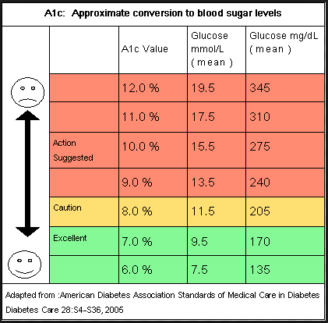
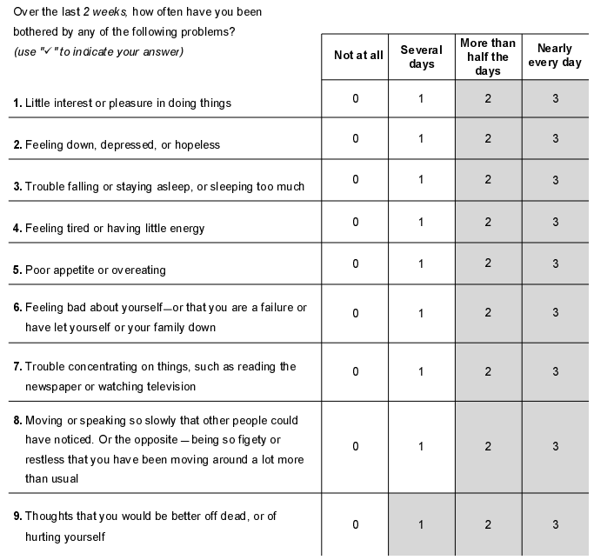
Individual Outcomes Examples

Slide 13
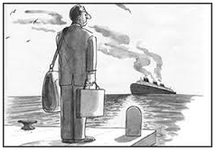
Where Many are Missing the Boat
People Getting Better (as measured by Individual Outcomes),
Results in improved outcomes.
The primary focus should be on Individual Outcomes (Outcomes-Informed Care),
With System Outcomes serving as a high level reality check.

Slide 14
5 Steps: Outcomes-Informed Care
Care Plan Co-Created with the Client Contain Two Types of Goals
  Personal Goals (e.g., return to employment)
  Measurable Clinical Outcomes Goals related to the primary behavioral health problems that interfere with reaching personal goals and that are the target of treatment
Clinical interventions are supported by research:
  Therapeutic Alliance
  Behavioral Health Outcomes, using Evidence-Based Practices (EBPs) when available
The clinician and client work together:
  Build the Therapeutic Alliance
  Move toward the personal goals and clinical outcomes
Client progress measured on a regular basis
  Tools with standardized, validated clinical rating scale
Secret Sauce: If expected progress isn’t being made, the Care Plan is Changed

Slide 15

Outcomes-Informed Care
Care Plan Co-Created with the Client Contain Two Types of Goals
Clinical interventions are supported by research
The clinician and client work together
Client progress measured on a regular basis
If expected progress isn’t being made, the Care Plan is Changed
Questions:
  How many of you have implemented outcomes informed care to fidelity for all five steps?
  How many of you do something that’s in the ballpark?
  How many of you have money attached to the model?
  Is it working?

Slide 16

Connecting Outcomes to Pay for Performance
Identify the most important Outcomes to measure.
Develop the Benchmark Metric for each Outcome
(the goal).
Identify the Baseline Metrics for each Measure for each Provider (where are you now).
Measure Frequently.
You earn your Bonus if you:
  Show Improvement, or
  Hit the Benchmark
  (you’re already there).
Sounds a lot like the OHA Incentive Metrics program.

Slide 17
Best Practice Sequencing of a P4P Program
Pay for Participation
  “We agree to participate in developing a ‘quality contract’ that describes the P4P design and measures.”
Pay for Reporting
  Additional payments to support the cost of moving to a P4P including implementation and use of health information technology.
Pay for Performance
  Pay for hitting process targets (X% of
  patients have had breast cancer exams
  and colorectal exams).
Pay for Outcomes
  Paying for whether the care is “working”
    Pay for X% of patients with A1c levels
    under 7.
    Pay a share of emergency room cost reduction.
Notes:
There are OHA incentive payments going to the clinics.

Slide 18
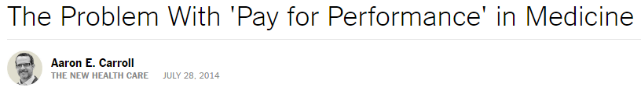

P4P Caveat/Controversy

Slide 19

What’s controversial?
“In reality we’re seeing
disappointingly mixed results.”
“Sometimes it’s because
providers don’t change the
way they practice medicine.”
“Sometimes it’s because even when they do, outcomes don’t really improve.”
“While the improvements seen in 260 hospitals in a P4P project outpaced those of 780 not in the project, 5 years later all those differences were gone.”

Slide 20
Questions for the Group
How many of you are using a Pay for Performance Layer?
How did you phase your P4P layer in?
How big is your P4P layer?
Is it working?
Why or why not?

Slide 21
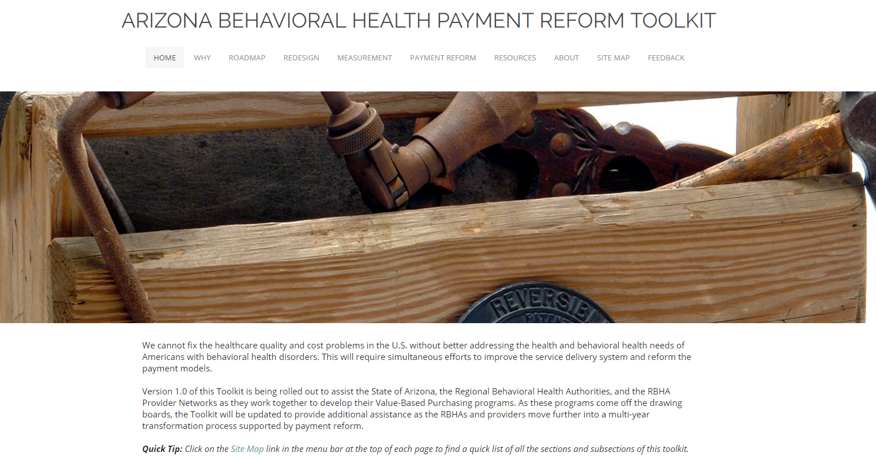
Useful Resource
http://azpaymentreform.weebly.com/

