Slide 1
Measure 110
Behavioral Health Resource Networks
Request for Grant Proposals Webinar
November 15, 2021

Slide 2
Welcome!
Today’s goals:
  Introductions to the OHA staff
  Provide background and information on Measure 110
  Provide information on the structure and function of Behavioral Health Resource Networks (BHRN’s)
  Answer your questions
  Direct you to further information

Slide 3
Introductions
Angela Carter, ND: Program Manager for Measure 110
Jessica Carroll: Program Lead for Measure 110
Coral Ford: Contracts and Procurement
Walter Bailey: Advisory Council Coordinator
We are all here to help you and answer questions as best as we are able
We understand that you may have frustrations with the grants process. We want to hear from you to improve our process, but we ask that you bring your concerns directly to us and not use this forum to assure that everyone has time to ask questions and receive information.

Slide 4
Contacts
For questions about the request for grant proposals:
(503) 373-7313
For general questions about Measure 110:
OHA.Measure110@dhsoha.state.or.us
For assistance connecting with resources for grant proposals:
For accessibility questions or concerns, or to receive the RFGP in a different format:
dhs-oha.publicationrequest@state.or.us
503-378-3486 (voice)
503-378-3523 (TTY)
BRENDA.L.PEARSON@dhsoha.state.or.us
coral.d.ford@dhsoha.state.or.us

Slide 5
Measure 110
November 2020, Oregon voters passed by referendum Measure 110, or the Drug Addiction Treatment and Recovery Act.
The purpose of Measure 110 is to make screening, health assessment, treatment and recovery services for Substance Use Disorder available to all those who need and want access to those services; and to adopt a health approach to substance use by removing criminal penalties for low-level drug possession.

Slide 6
Measure 110
Oregon Health Authority (OHA) established a Treatment and Recovery Services fund, financed with cannabis revenues, to fund new statewide Recovery Centers and Community Access to Care grants. $302 million for the 21-23 biennium.
2 grants programs:
  Grants program to fund the ARC’s now BHRN’s
  Grants program to increase access to community-based services: Access to Care

Slide 7
Measure 110
Established:
  Oversight and Accountability Council to oversee the distribution of the grants, with OHA providing technical, logistical and all other necessary supports to the council.
  A 24/7 Telephone Recovery Line, which is staffed by Lines for Life

Slide 8
Senate Bill 755
Renamed Addiction Recovery Centers to Behavioral Health Resource Networks (BHRNs)
Established the authority of the Oversight and Accountability Council to distribute grants to providers that would ensure access to culturally specific and linguistically responsive care for historically underserved populations.
Added details surrounding the newly created Class E Violation.
Established Secretary of State Auditing Requirements.
Clarified possession of substances and differentiated Class E violations, Class A misdemeanors, and felony charges depending on the quantity of substances in possession.

Slide 9
Oversight and Accountability Council (OAC)
The OAC represents a departure from previous councils and advisory groups. The council has authority to make the decisions about the chapter 944 rules and the grants awards
22 members with a diverse set of experiences, the majority of Council Members have lived experience
The Council has held themselves to a higher standard than required by statute and through weekly meetings have accomplished an impressive body of work in a relatively short amount of time

Slide 10
Behavioral Health Resource Networks
$278 million dollars dedicated to creating the BHRNs this biennium
4% of this is set aside for the 9 Federally Recognized Tribes for use for BHRNs or Access to Care programs
Funding will support the creation of county-based networks of care for substance use disorder and harmful substance use.
M110 will continue to receive funding annually from cannabis revenue to perpetuate grant funding for the BHRNs in Oregon

Slide 11
Behavioral Health Resource Networks
Behavioral Health Resource Networks (BHRN’s) will be a network of entities or single entity providing specified and unified services related to the healthy management of substance use concerns.
The following organizations may establish a BHRN together or individually and are eligible to apply for funding:
  Nonprofits
  Private Businesses
  Local Governments
  Nine Federally Recognized Tribes of Oregon
  Urban Indian Health Program

Slide 12
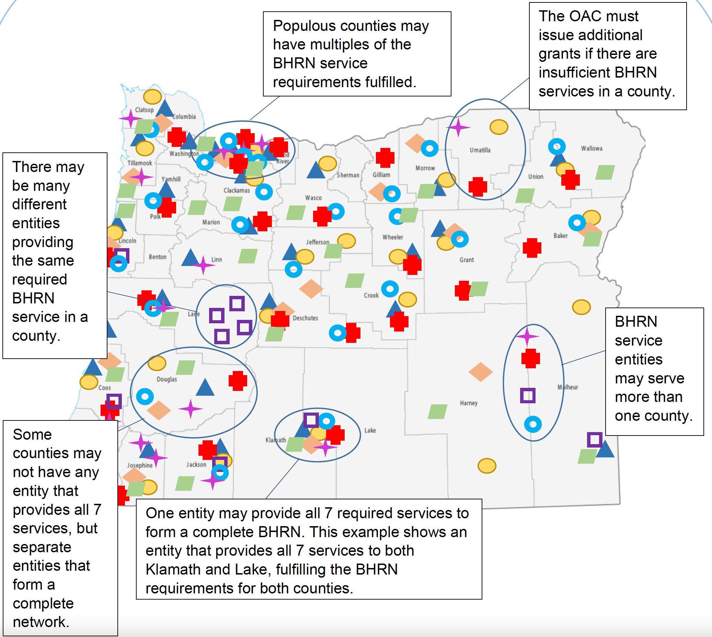
Behavioral Health Resource Networks

Slide 13
Behavioral Health Resource Networks
BHRN grant funding cannot supplant other funding sources. BHRNs must bill insurance for services where possible before using grant funds.
BHRNs are required to provide services that are:
  Trauma-Informed
  Harm Reduction focused
  Client-Based choices
  Individualized
  Culturally Specific
  Linguistically Responsive
  Free of charge to the client

Slide 14
Behavioral Health Resource Networks
Services to be provided must include but are not limited to:
Screening for health and social service needs
Screening and referral for substance use disorder
Access to an individualized intervention plan
Case management
Low-barrier substance use disorder treatment
Harm reduction services
Peer-supported services
Housing
Mobile and virtual outreach
Referral to appropriate outside services

Slide 15
Behavioral Health Resource Networks
Grant Funds may also be used to build capacity to establish BHRNs, including but not limited to:
infrastructure development
operations
startup costs
workforce expansion
technical assistance
  including but not limited to:
    building capacity for culturally and linguistically responsive services through education and training, metrics collection, program compliance and reporting.

Slide 16
BHRN Grants Timeline
October 20, 2021
January 10, 2021
November 9, 2021
December 9, 2021
February, 2022
February, 2022
RFGP for BHRNs Approved by OAC
Responses Due
Notification to Applicants
RFGP Posted
Review Completed
Executed Contracts

Slide 17
Timeline
OHA posted the RFGP on November 9th, 2021 on OregonBuys
https://oregonbuys.gov/bso/external/bidDetail.sdo?docId=S-44300-00001209&external=true&parentUrl=close
OHA will gather questions submitted and post a Question and Answer document on OregonBuys by approximately November 19, 2021.
OHA will release an Evaluation Rubric, which includes evaluation criteria by approximately November 19, 2021. The Evaluation Rubric will be issued through an Addendum to this RFGA on OregonBuys.

Slide 18
Timeline
Grant Applications must be submitted to the OHA by December 9, 2021 at 5:00 pm (PST). Applications must be sent via email to the RFGA SPC at coral.d.ford@dhsoha.state.or.us.
OAC will review Grant Applications as they arrive. No decisions will be made until all applications are received, read and scored to ensure equity.
OAC will connect interested county/tribal entities, and reach a final determination of awards by approximately January 10, 2022.
OHA anticipates that Grant Agreements will be effective as early as February 10, 2022, but this date is subject to change.

Slide 19
BHRN Tools
BHRNs will receive a template for the following:
  MOUs between entities
  ROI’s between entities
  ROI’s between the BHRN screeners, the OHA and the Courts
  Operational Policies
  Reporting

Slide 20
BHRN MOU Requirements
BHRNs will collaborate to create Memorandums of Understanding (MOU) between all entities outlining policies pertaining to:
  Referrals between entities
  Entity Roles
  Client Confidentiality
  Reporting agreements
  Communication Plans
  Dispute Resolution
MOU’s must be received by the OHA within 30 days of grant agreements

Slide 21
BHRN Policy Requirements
BHRN entities will create policies as outlined in Chapter 944 using a template provided by the OHA
  Culturally and Linguistically Specific Services
  Culturally and Linguistically Responsive Services
  Accessibility for People with Intellectual and Developmental Disabilities
  Accessibility for People with Physical Disabilities
  Gender Affirming and Responsive Care
  LGBTQIA2S+ Affirming and Inclusive Services
  Youth Friendly and Inclusive Services
  Patient Centered and Non-Stigmatizing Services, including on use of person-first, non-stigmatizing language
  Trauma informed engagement and care
  Services for parents with young children

Slide 22
BHRN Reporting Requirements
Financial recordkeeping subject to inspection and audit by the Secretary of State Audits Division upon request.
Additional financial reporting shall be followed as outlined in each grant agreement or contract.
(A) Number of clients with substance use disorder receiving services from each network or recipient;
(B) Average duration of client participation and client outcomes;
(C) The number of individuals seeking assistance from the network or recipients who are denied or not connected to substance use disorder treatment and other services, and the reasons for the denials;
(D) The average time it takes for clients to access services and fulfill their individual intervention plan and the reason for any delays, such as waiting lists at referred services;
(E) Whether the average time to access services to which clients are referred, such as housing or medication assisted treatment, has increased or decreased since network or recipient received funding; and
(F) Demographic data on clients served, including self-reported demographic data on race, ethnicity, gender, and age. Each network or funding recipient shall collect data in accordance with OAR 943 Division 070.
(b) Each BHRN funding recipient will submit a summary of how demographics are collected, including any tools used and the staff person or network entity who will collect the data. The summary shall include justification for the approach.
(c) Additional client, client service, and client outcome reporting requirements shall be followed as outlined in each grant or funding agreement or contract.
(d) Licensed or certified behavioral health treatment providers that are part of a network or a recipient of grants or funds, shall report the entry of all clients on the mandated state data system.

Slide 23
BHRN Insurance Requirements
Prior to Grant Agreements being signed, Recipient entities must provide proof through a Certificate of Insurance, of meeting the minimum Insurance Requirements, which includes:
  $1,000,000 per occurrence and $2,000,000 in the aggregate in Commercial Liability Insurance; and
  $1,000,000 per occurrence and $2,000,000 in the aggregate in Professional Liability Insurance.
All non-governmental entities submitting an application must be registered with the Oregon Secretary of State.

Slide 24
BHRNs Grant Questions
Subsection 1: Demographics questions for the BHRNs
Subsection 2: Detailed Questions for the full BHRN
Subsection 3: Individual Entities questions
A. Substance Use Disorder Treatment
B. Peer support, mentoring, and recovery services
C. Housing Services
D. Harm Reduction Intervention
E. Supported Employment
Subsection 4. Proposed Budget

Slide 25
Subsection 1: Demographics questions for the BHRNs

Slide 26
Demographics
Please create a spreadsheet of the following information for each of the entities in the BHRN:
County or Tribal area proposed for the BHRN (If your entity will serve more than one county or tribal area, please submit your part of the application with each BHRN application for each area):
Tribe/Entity name(s) within the proposed BHRN:
Entity(s) name DBA (if different from above):
Fiscal sponsor organization(s) name (if applicable):
Address(es):
Tax ID, EIN or FIN for each org in the BHRN:
Contact name(s) for each entity:
Contact email(s) and phone(s) for each entity:
Authorized signature name(s) for each entity:
Authorized signature email(s) for each entity:
Number of individuals currently served on average per month:
List all Population(s) that your entity focuses on serving:
Please list the services each entity will provide

Slide 27
Subsection 2: Detailed Questions for the full BHRN

Slide 28
Detailed Questions
How will you work together?
We are looking for collaboration in this section between BHRN entities on how the group will create an appropriate holistic setting for care and support to take place.
It may serve to think about these questions in context of the MOUs that will be required.

Slide 29
Subsection 3: Individual Entities Questions
A. Substance Use Disorder Treatment
B. Peer support, mentoring, and recovery services
C. Housing Services
D. Harm Reduction
E. Supported Employment

Slide 30
Individual Entities Questions
Each entity will fill out the section according to what services they will provide.
If an entity will provide more than one service, they should fill out each appropriate section for the entity
If multiple entities will provide the same service in a BHRN, each entity shall fill out the appropriate section
If an entity will take part in multiple BHRNs, they must submit the appropriate questions with each county’s BHRN grant application

Slide 31
A. Substance Use Disorder Treatment

Slide 32
B. Peer Support, Mentoring, and Recovery Services

Slide 33
C. Housing Services

Slide 34
D. Harm Reduction

Slide 35
E. Supported Employment

Slide 36
Budget
Please provide an 18-month budget for each entity in the BHRN using the template provided in the RFGP
Budgets should be decentralized and specify the needs of each entity individually
Grant agreements will be dependent on BHRN membership, but funds will be received by each entity individually

Slide 37
Contacts
For questions about the request for grant proposals:
(503) 373-7313
For general questions about Measure 110:
OHA.Measure110@dhsoha.state.or.us
For assistance connecting with resources for grant proposals:
For accessibility questions or concerns, or to receive the RFGP in a different format:
dhs-oha.publicationrequest@state.or.us
503-378-3486 (voice)
503-378-3523 (TTY)
BRENDA.L.PEARSON@dhsoha.state.or.us
coral.d.ford@dhsoha.state.or.us

Slide 38

Questions?

Slide 39
Thank You

