Slide 1
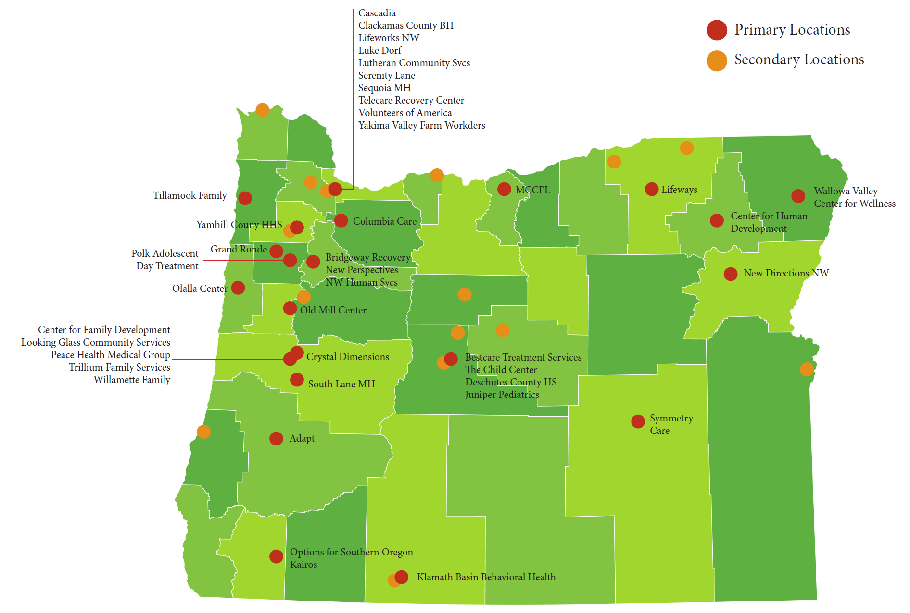
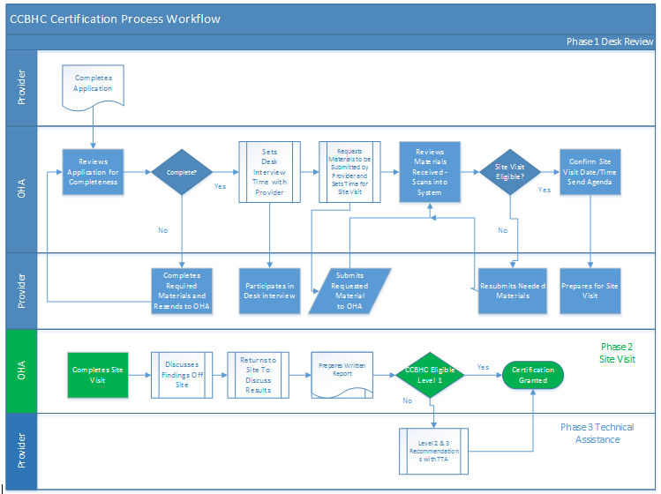
State of Oregon - CCBHC Learning Collaborative Meeting 8:30am – 3:00pm, May 13, 2016 Riverhouse Hotel, Bend, OR
Kathy Reynolds
Dale Jarvis
Emily Watson

Slide 2



Introductions
Who we are…
Who you are…

Slide 3
Survey Respondents that are “Very Interested” or “Somewhat Interested”

Slide 4

Remember the January 22nd Learning Community Meeting in Eugene
In contrast to that meeting, we come to Bend bearing many answers.

Slide 5


Meeting Objectives
(1) Provide providers with a clear picture on the application and certification process for CCBHC status
(2) Review 10 key steps for providers to address in becoming a CCBHC
(3) Answer at least 100 questions
(4) Organize the Regional Learning Collaboratives
(5) Identify next steps for all meeting participants

Slide 6
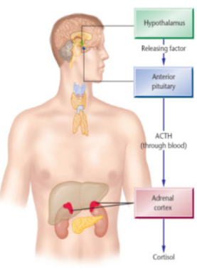
Ground Rules
Warning…
Emerging body of research about the relationship between stress and
Heart disease, diabetes, other chronic health conditions and early mortality…
We recommend:
Taking as many individual breaks as you need (in addition to the planned breaks).
Write down questions as they come up; we will be stopping every few slides to field questions.
Keep breathing.
Have fun.
Neuroendocrine System

Slide 7
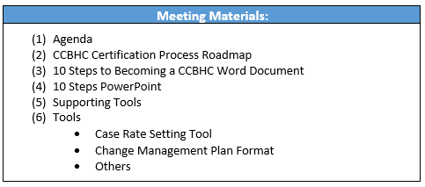
Meeting Materials

Slide 8
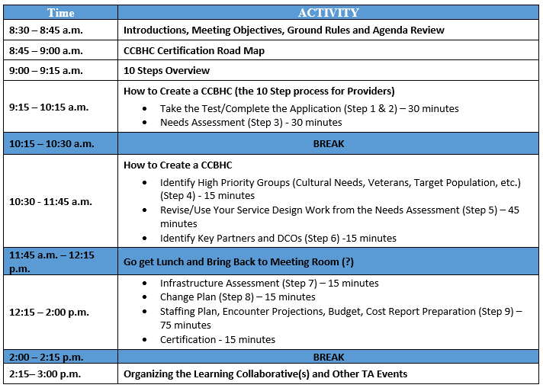

Agenda Review

Slide 9
CCBHC Certification Roadmap
Let’s start our content discussion by walking through the OHA CCBHC Certification Process.
This is hot off the presses!
If you love flowcharts, you’ll love this.

Slide 10
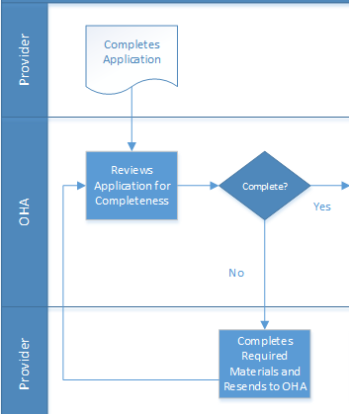
Phase 1: Desk Review
The first parts of the workflow are straightforward:
Complete the Application.
OHA Reviews the Application.
If it’s complete, it moves forward.
If it’s not complete, you are notified about what’s missing.
You complete the required material and send it to OHA.

Slide 11

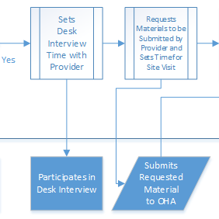
Phase 1: Desk Review
Once the completed Application is in the hopper…
A Desk Interview is completed by OHA with the Provider.
During this process
A list of additional material is requested
A Site Visit appointment is made

Slide 12

Key Question
Question: What’s being Certified?
Answer:
Certification is at the Organization Level, with one or more sites included in the certification application.
Each organization looking to become a CCBHC will need to state the organization’s name, main location(s) and any satellite locations which be considered part of the CCBHC.
All CCBHC locations must provide all core services (screening and assessment, treatment planning, outpatient mental health and substance use services) with ready access to the remaining required services.
Note: You should be providing services in the community (e.g. school, nursing home, supported housing site), which are not satellites and don’t’ require the provision of all core services.
Programs that provide non-CCBHC services (e.g. residential treatment) are not included in the certification process.
Questions?

Slide 13
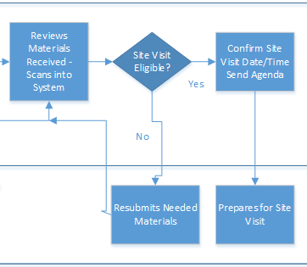
Phase 1: Desk Review
This is followed by the a site visit eligibility determination.
And preparation for the Site Visit.
Let’s talk about the Material that will be examined…

Slide 14
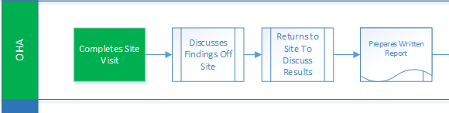
Phase 2: Site Visit
The Site Visit process will include two visits.
The Site Visit.
A second visit to discuss the Results.
Let’s talk more about the material that will be examined…

Slide 15

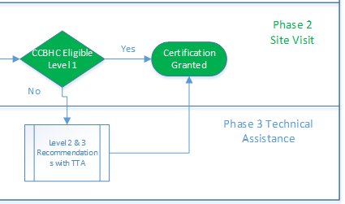
Phase 2: Site Visit
Based on the Site Visit process, an Organization will receive…
Eligible for Level 1 (Fully Certified – No Recommendations)
Eligible for Level 2 ( Fully Certified – With Recommendations and Approved Corrective Action Plan)
Level 3 (Not Certified, Major Corrective Action Required, Won’t Make it Into the Demo)
Questions

Slide 16

Updates on Certification Activities
Applications received to date?
Application deadline to be in the pilot?
How soon after application will desk review/site visit be scheduled?
How long will the site visit take? Will there really be two site visits or will the site visit team work on recommendations in room by themselves and then reconvene the group to provide recommendations?

Slide 17
CCBHC Certification Roadmap
What Questions do you have?

Slide 18


10 Step Overview
When you review the CCBHC criteria, they describe in many ways a high performing Oregon Behavioral Health system.
It’s almost as if the feds took the best of what you’re doing and created a national model.
An organization that has primary responsibility for the MH/SUD needs of the Medicaid enrollees in a defined geographic region,
Providing comprehensive person-centered care,
Tracking and using data to improve care, and
Overseeing other provider organizations to support the effort.

Slide 19
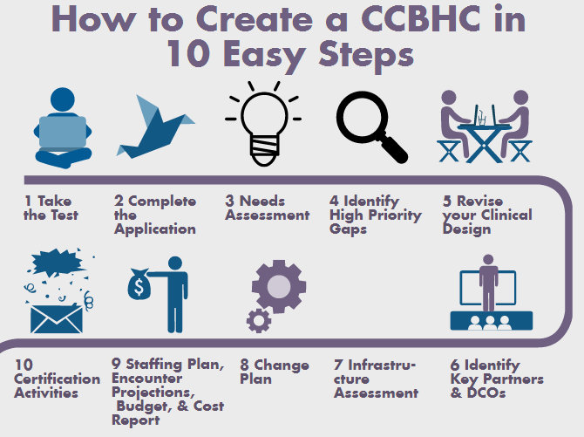

Slide 20

Digging into the 10 Steps

Slide 21

Step 1: Take the Test
The CCBHC Demonstration Program was not necessarily meant to include every provider in a state AT THIS TIME.
It is a demonstration program and the federal guidance mandated that State certify two organizations to participate in the demonstration phase of the project.
Our observation is that Oregon and the other states we know about are only planning to certify centers that are truly certifiable.

Slide 22
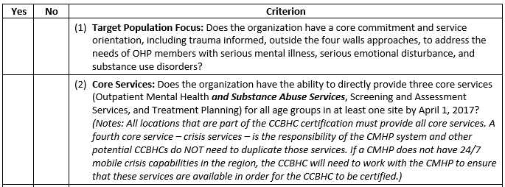
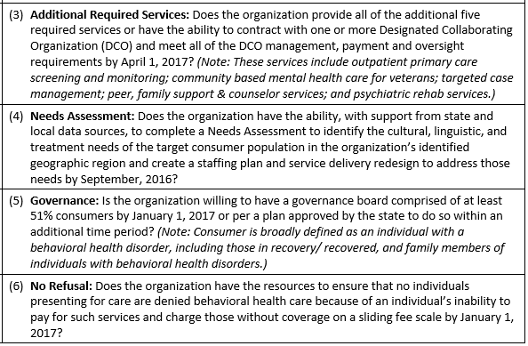
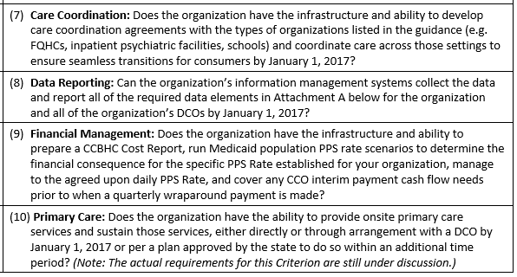
The 10 Question Test

Slide 23
Key Question
Question: What’s the Target Population?
Answer:
We know that SAMHSA is interested in prioritizing the needs of individuals with SMI/SED.
To be certified, an organization will need to demonstrate the capacity to serve all populations with behavioral health disorders – mild/moderate/serious/severe, children/adolescents/transition age/adults/elders, active duty military and veterans, and all cultures and ethnic groups in your service area.
Questions?

Slide 24
Key Question
Question: What about the 51% Consumer Rule for Board Members?
Answer:
That’s the rule unless the prospective CCBHC is comprised of a governmental or tribal entity or a subsidiary or part of a larger corporate organization that cannot meet these requirements for board membership, the state will specify the reasons why the CCBHC cannot meet these requirements and the CCBHC will have or develop an advisory structure and other specifically described methods for consumers, persons in recovery, and family members to provide meaningful input to the board about the CCBHC's policies, processes, and services.
Consumer Definition Draft: Adults with MH/SU disorders, Adults recovering/recovered from MH/SU disorders, family members of the above.
Questions?

Slide 25
Step 1: Take the Test
Questions
How many of you have taken the test?
How many of you who took the test gave your agency a “YES” for:
All 10 Questions
7, 8 or 9 Questions
6 or fewer Questions
What questions do you have about this Step?

Slide 26
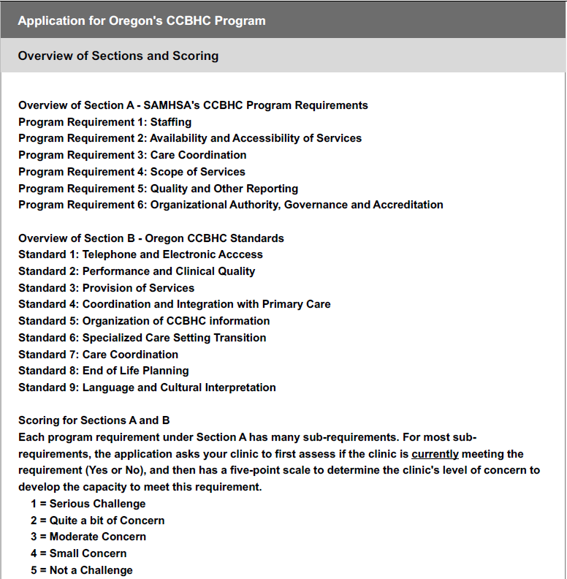
Step 2: Complete the Application
Questions
How many of you have a copy of the application?
How many of you have started working on the application?
How many of you have completed the applications?
How many of you have submitted the application?
Knowing that we’re going to talk about a number of items on the application, what questions do you have about the application?

Slide 27
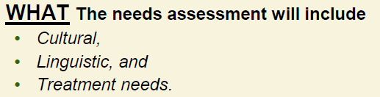


Step 3: Needs Assessment
From SAMHSA
Added Note: With the help of the Prospective CCBHCs.

Slide 28
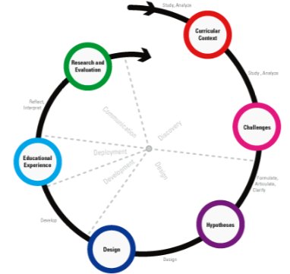
Needs Assessment – Other Key Ideas
The state can’t do all this work on it’s own.
Each CCBHC needs to complete a state approved needs assessment as part of it’s certification requirements; and then use the results to design their staffing plan and practice changes that will them to CCBHC certification.
Data from the state should inform the CCBHC needs assessment. Each CCBHC should NOT have to compile data that’s available to the state.
Data from the CCBHCs should inform the state needs assessment; this information is rolled into the state needs assessment.

Slide 29

Prospective CCBHC Needs Assessment
We are working on this document and will solicit input before it’s released.
We will be providing data to support you in completing your Needs Assessment.
Behavioral Health Resource Mapping Project data (coming soon in draft form)
Behavioral Health Town Hall data
Oregon’s Health Professional Shortage Areas data
You will likely want to use existing Community Needs Assessments from your CCO, local hospitals, health departments, etc.

Slide 30

Prospective CCBHC Needs Assessment
We will likely be asking you about:
What are your Service Area’s Needs, Capacity, and Gaps?
By Age,
By Race/Ethnicity, and
By Treatment Need

Slide 31

Prospective CCBHC Needs Assessment
We understand that this is a tall order and, in many cases, could take a year or more to complete.
It will be important for each organization to work with available data and consider this a rapid needs assessment process that will provide good enough information to complete your clinical redesign, staffing plan and budget.
Questions?

Slide 32



Key Question
Question: Is it possible for multiple organizations to be certified within a Geographic Region?
Answer:
Oregon will consider certifying more than one CCBHC in a geographic region.
However, the need for more than one CCBHC (especially if there is any overlap in population services) MUST be clearly documented in the needs assessment.
Referencing criteria 1.a.2, SAMHSA has clearly indicated a CCBHC’s staff needs to be appropriate in size and compensation for the population to be served by the CCBHC. Year 1 would serve as a planning year.
Question: How do multiple potential CCBHCs within a region address the Needs Assessment?
Answer: Good question. We don’t have a definitive answer, but it might be a good idea for them to coordinate their needs assessment activities to ensure that, collectively, their staffing plan will align with need.

Slide 33

Step 4: Identify High Priority Gaps
It is not reasonable to expect that limited additional funding for the CCBHC Demonstration Program will provide enough resources to close all of the identified gaps, especially when we already know from the AOCMHP Behavioral Health Gap Analysis that there are significant gaps in the number served that will require several hundred million dollars to close.
Begin to think about what’s needed to Close the Gaps, including:
Additional Staffing
Additional Services (the “Big 9” plus Care Coordination)
Hours of Operation and Timely Access
Additional Training

Slide 34
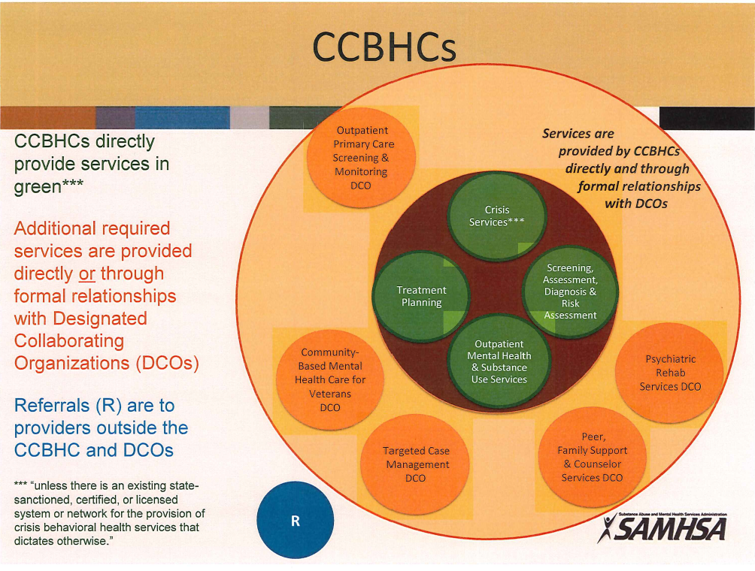
Key Question
Question: What are the “Big 9” Services
Answer:
See the diagram.
Note that Crisis Services are part of an existing state system and not required of every CCBHC.
Questions?

Slide 35

Step 4: Identify High Priority Gaps
This Step involves a two-part activity:
Brainstorm: What are the potential strategies you could roll out to address the gaps in the areas in the Needs Assessment?
Prioritize: Assuming that you will be able to receive a modest amount of additional revenue to support your CCBHC Program, what are the highest priority strategies that are both feasible (we have the space, can hire the people, etc.) and actionable (we have enough control over closing the gap that we can actually move the needle)?
Questions?

Slide 36

Step 5: Revise Your Clinical Design
For many organizations, CCBHC-ness requires changes in…
What care is provided (9 services plus care coordination)
How care is provided (trauma informed, team-based, outcomes-based)
Where care is provided (in diverse locations, including in community settings)
Who provides care (more paraprofessionals, peer professionals, etc.)
Process Mapping
Use a multidisciplinary team
Identify key clinical processes/ workflows to change
Diagram the as is state
Diagram the to be state
Identify the changes to make
Develop a plan to test the changes

Slide 37
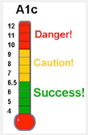

Key Question
Question: What Clinical Design Changes Might be in my Future?
Answer: It depends. How ready is your organization to…
Meet your clients’ outpatient mental health and substance use disorder needs at each CCBHC site?
Provide more than token peer support and peer counselor services and family supports?
Provide (or ensure the provision of) primary care screening and monitoring of key health indicators and health risk, including tracking A1c, blood pressure, cholesterol, and BMI scores?
Meet the requirements for serving members of the armed forces and veterans?

Slide 38


Key Question
Question: What are the onsite Primary Care requirements?
Answer:
OHA is proposing that as a condition to become certified as a CCBHC, the applicant must agree to meeting the 20 hours a week requirement in Year 2;
Year 1 would serve as a planning year.
Question: Does this apply to each main CCBHC location?
Answer: Yes
Question: Does this apply to each CCBHC Satellite?
Answer: ….

Slide 39

Key Question
Question: What will it take for your organization to be able to ramp up the required Care Coordination system and agreements, knowing that you must have care coordination agreements with:
FQHCs,
Inpatient psychiatric and SUD facilities,
Schools,
Department of Veterans Affairs treatment centers,
Inpatient acute care hospitals, and
Other community services including juvenile and criminal justice agencies;
And then be able to coordinate care across those settings to ensure seamless transitions for clients?

Slide 40
Step 5: Revise Your Clinical Design
We understand that this could take many months to complete and that kind of time is not available.
It will be important to prioritize a small number of workflows that are relevant to the highest priority gaps.
Complete a rapid clinical design process.
Keeping the design work as simple as possible.
We anticipate that this will be an important topic for the Learning Collaborative.
Question: How many of you have this skill set inside your organization?
Question: What other methods have you used for clinical redesign?
What questions do you have?

Slide 41

Step 6: Identify Key Partners and DCOs
Key Partners Small Group Exercise
Consider the organizations in your service area that you are required to coordinate care with.
FQHCs, Inpatient psychiatric and SUD facilities, Schools, Department of Veterans Affairs treatment centers, Inpatient acute care hospitals, and Other community services including juvenile and criminal justice agencies;
Question: Which ones will offer the biggest challenge to creating formal care coordination agreements with?

Slide 42

Step 6: Identify Key Partners and DCOs
As you consider your Application, Needs Assessments, Key Gaps, & Clinical Redesign…
Are there organizations you need to enter into a Designated Collaborating Organization (DCO) relationship with in order to provide all of the nine required services?
Question: How many of you will need 1 or more DCOs?
Question: For those who raised their hand to the last question, how many of you currently have the infrastructure to manage contracts with DCOs (using the 5 finger method)?

Slide 43

Step 7: Infrastructure Assessment
Once the previous activities are completed, it’s time to assess what infrastructure changes are needed to support your CCBHC. Examining each change through the lens of “what financial, administrative, contracting, technology gaps do we have” will likely result in something like the following:
We need to put in place people and processes to complete a periodic needs assessment;
We need new technology to support care management, services in the field, data collection, and outcomes-based care;
We need to reengineering our contracting function to support care coordination agreements;
We need to build a mini-managed care company to manage our DCO contracts;
We need to revise our financial and billing systems to support PPS-1.
Question: What’s one thing I’ve missed?

Slide 44
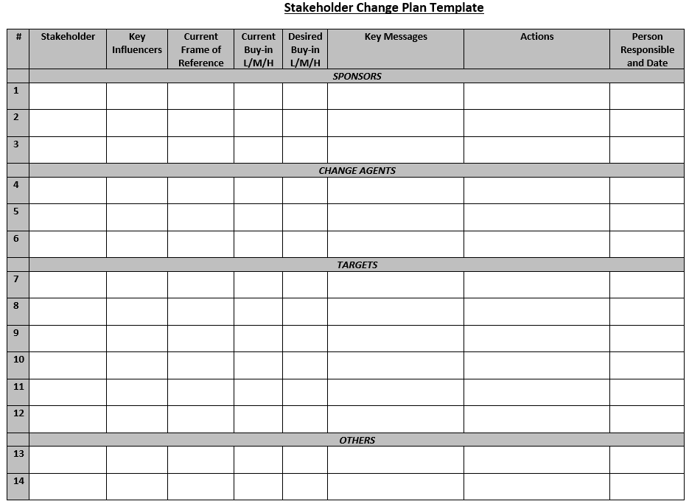
Step 8: Change Plan
You now may have an impossibly long list of improvements to make.
Time for a Change Plan and a CCBHC Project Manager (if you don’t already have one).
Each Change Project will need a Workplan with:
A Lead
A Project Team
Tasks
Resources
Timeline
We are providing a Stakeholder Change Checklist and Plan Template and will be doing a webinar on this topic.

Slide 45

Step 9: Staffing Plan, Encounter Projections, Budget & Cost Report Preparation
You’ve done your Needs Assessment and Clinical Redesign
Now what?
Here’s a some suggested process.
Feel free to use it, modify it, do something completely different.

Slide 46
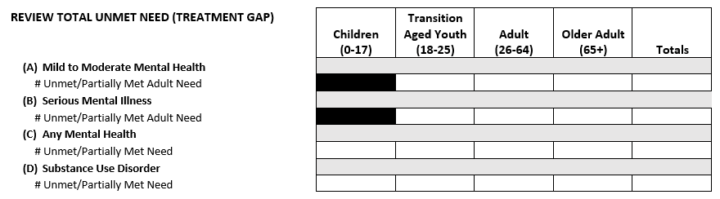
Task 1: What’s the Need in My Service Area?
Use the data from the forthcoming OHA Resource Mapping Tool to help estimate unmet need.

Slide 47
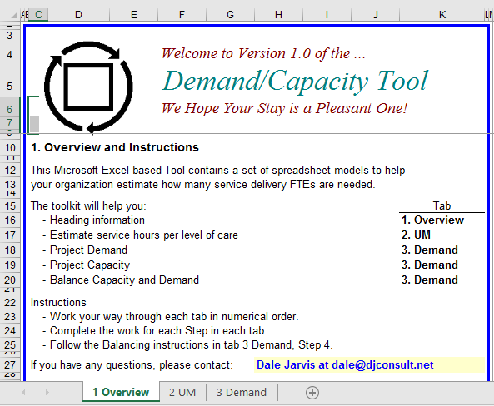
Task 2: What is My Staffing Plan?
Use with the Demand/Capacity Tool.
We will be doing a webinar to show you how to use the 3 tabs.

Slide 48
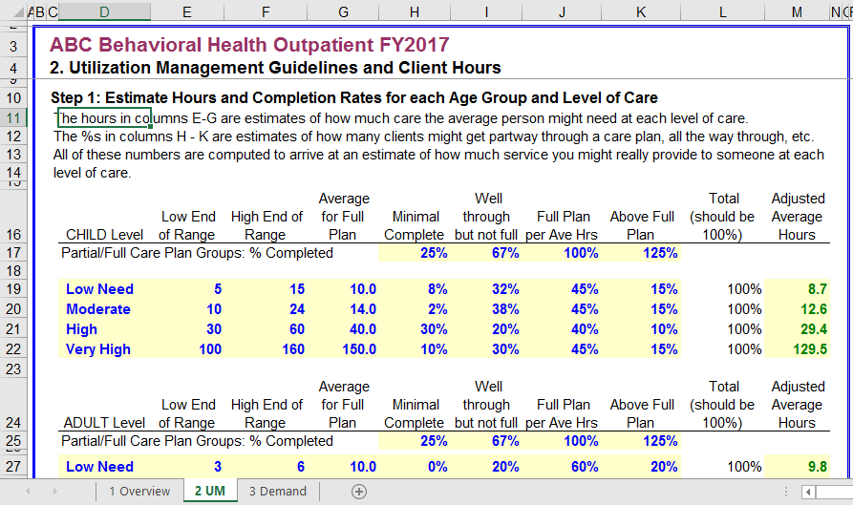
Task 2: What is My Staffing Plan?

Slide 49
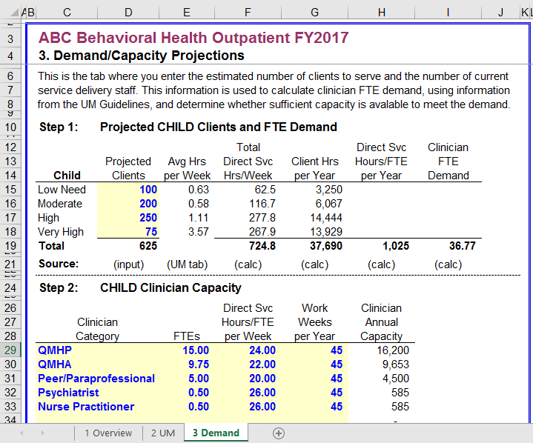
Task 2: What is My Staffing Plan?

Slide 50
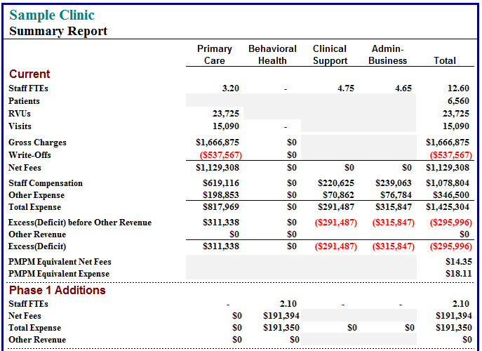
Task 3: How Does my Budget Change?
Identifying addition costs for:
Additional Staffing
Additional Infrastructure
Other Operating Costs
Identifying potential cost reductions for:
Change in Staffing Mix
Clinical Redesign Efficiencies

Slide 51
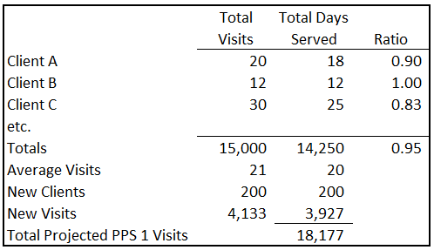
Task 4: How Many PPS-1 Visits Will I Have?
Translation: What are the implications of:
Being able to bill for only one visit per day?
Being able to bill for new types of services (maybe)?
Not necessarily being able to bill for Care Coordination?
We will be doing a webinar on this topic once the visit enumeration work is completed.

Slide 52
Questions on Tasks 1 – 4?

Slide 53
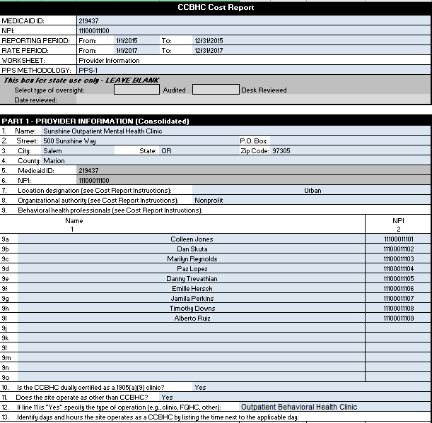

Task 5: Cost Report Preparation
Let’s spend a bit more time on the Cost Report today.
We will also have webinars on Cost Report preparation.
Make sure you have the most current version from:
https://www.medicaid.gov/medicaid-chip-program-information/by-topics/financing-and-reimbursement/223-demonstration-for-ccbhc.html

Slide 54
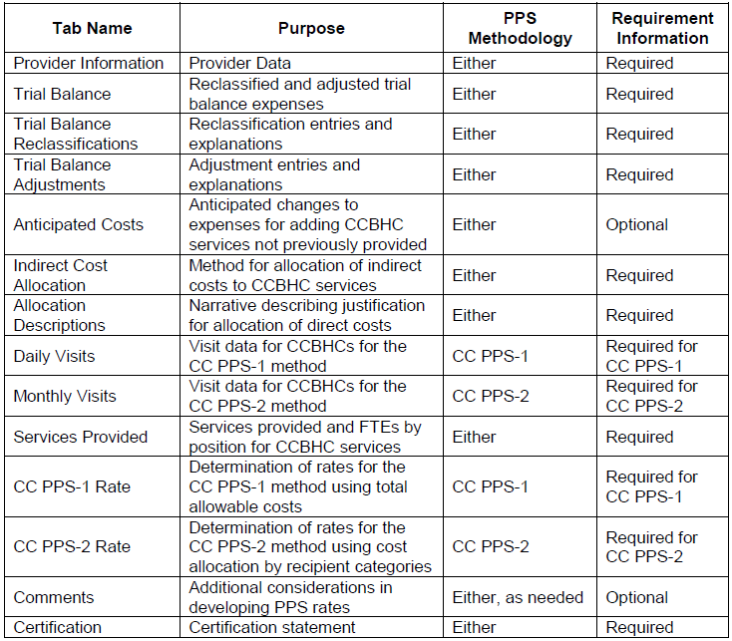
Fourteen Tabs
9 Key Tabs (green)
3 Maybe Tabs (orange)
2 No Tabs (red)

Slide 55
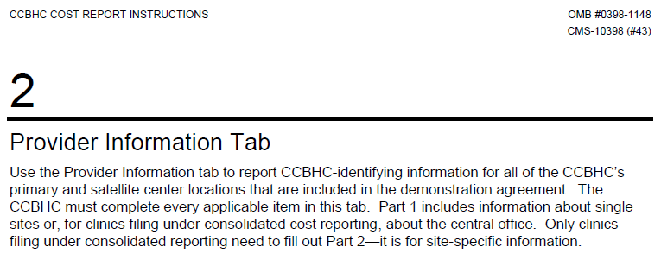
Provider Information
This section has excellent instructions.
You need to gather data for a recent 12 month period for entry into the Cost Report.
Make sure to list all CCBHC and DCO clinicians’ Names with their NPI numbers. If you have more than 15, continue the list on the Comments tab.
Part 1 is for the “Main Clinic”; Part 2 is for all other sites/satellites.
Line 12: If you are a FQHC or have Residential, Inpatient or other non-CCBHC services at one of your CCBHC sites, enter “Yes”.

Slide 56
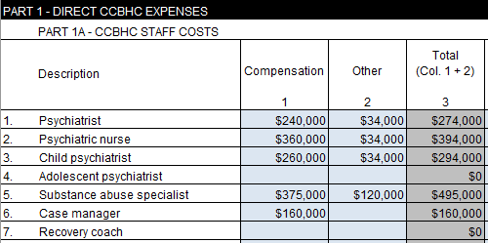
Trial Balance Tab
You need to take the expense portion of your 12 month trial balance and reorganize it to fit into the Trial Balance tab.
This may require slicing and dicing your existing trial balance to fit.
For example, you may not report costs by clinician type on your trial balance.
You need to create a set of workpapers that reconciles your trial balance numbers to the CCBHC Trial Balance.
Notes:
They have multiple trial balances that they can put together.

Slide 57
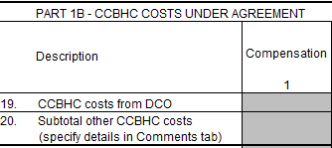
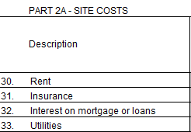
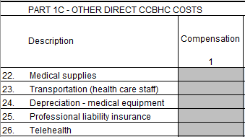
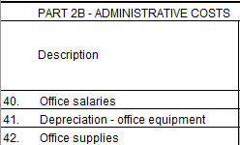
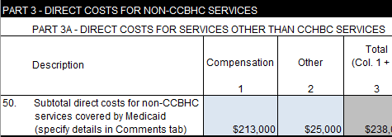
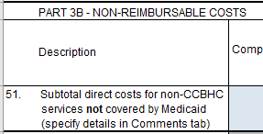
Trial Balance (continued)
You also need to slice and dice your trial balance as follows:
Part 1A: CCBHC Staff Costs
Compensation
Other
Part 1B: Costs Under Contract
DCO costs for CCBHC Services (probably not on your trial balance)
Part 1C: Other Direct CCBHC Costs
Other costs from your trial balance
Part 2A: Your Indirect Site Costs
Part 2B: Your Indirect Administrative Costs
Part 3A: Your non-CCBHC Service Costs (e.g. Residential)
Part 3B: Non-Reimbursable Cost (per Medicaid Cost Principles)
Remember to create Workpapers that show the translation between your trial balance and the CCBHC Trial Balance

Slide 58
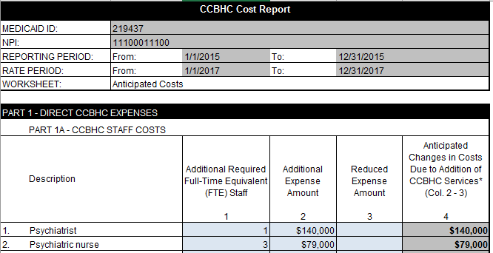
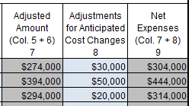
Anticipated Costs Tab
This section is where you enter NEW costs for your CCBHC and your NEW DCO best friends (if relevant).
This tab follows the same format as the Trial Balance tab.
The totals from this tab are copied back into the Trial Balance, column 8.

Slide 59
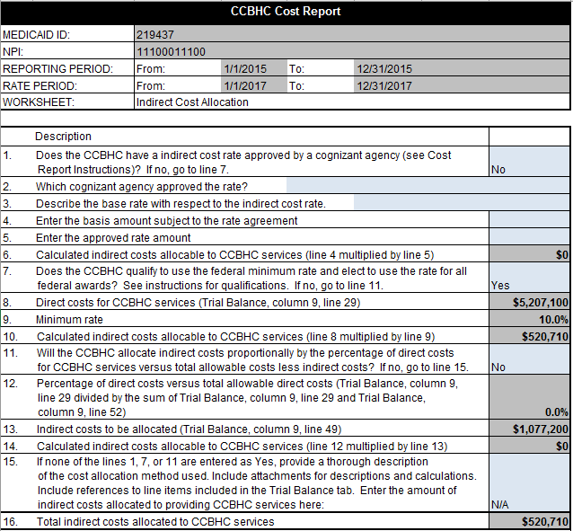
Indirect Cost Allocation
This is filled out differently if,
You have an existing Federal Indirect Cost Rate “approved by a cognizant agency”
You don’t
If you have an existing Federal Indirect Cost Rate, you enter information on that rate.
If not, there are formulas on this tab that calculate the Rate and the Indirect Costs.
These Costs are pulled over into the PPS-1 Rate tab.

Slide 60
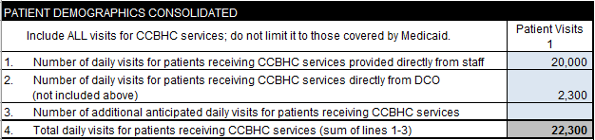
Daily Visits Tab
As we’ve said, a “visit” is not necessarily a visit.
If there are two or more CCBHC services provided on a given day, you “bundle” those services into a “daily visit”.
This is true even if a patient received multiple CCBHC services at multiple sites.
E.g. You only count one service per day.
You include Historical Visits from your Base Year and Anticipated Daily Visits
Historical in Lines 1 and 2.
Anticipated in Line 3.

Slide 61
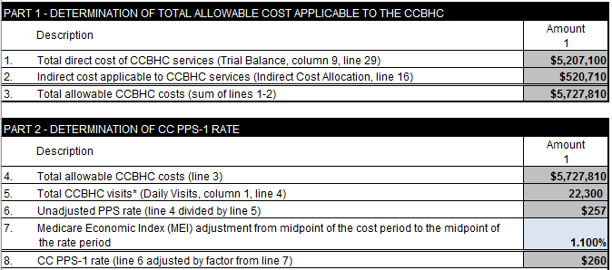
CC PPS-1 Rate Tab
This tab is all formulas except for line 7. It spits out your PPS-1 Rate.
Line 7 contains the “inflation factor” and the data is from: https://www.cms.gov/Research-Statistics-Data-and-Systems/Statistics-Trends-and-Reports/MedicareProgramRatesStats/MarketBasketData.html

Slide 62


Key Question
Question: Does my CCO have to pay me PPS-1 if they are already paying using an alternative payment model such as subcapitation or case rate?
Answer: No
OHA will “honor” the APM working going on in Oregon.
Here’s an initial idea of how it will work:
The CCO pays their APM to the CCBHC.
OHA pays the CCBHC PPS-1 for Open Card OHA Members.
The CCBHC Reports all of their Medicaid Revenue to OHA for the Quarter.
Note that a CCBHC may need to allocate their capitation payment between CCBHC services and non-CCBHC services (e.g. residential).
The CCBHC Reports their CCBHC PPS-1 Visits to OHA.
OHA does the math.
If the Visits X the PPS-1 Rate is higher than the Medicaid Payments, OHA cuts a Wraparound Payment check.
If the Medicaid Payments are greater than the PPS calculation, the story ends.
Whew, that’s a lot. Soak on this. Do you have any Questions?

Slide 63

Step 10: Certification Activities
This is the part of the process where your organization works internally as well as with the State, the consultants, and your peers to complete the activities on your Change Plan.
As mentioned earlier, it will be important to have an overall CCBHC Project Manager to manage the workplan, guide the effort, solve problems, work with the senior management team to remove barriers, adjust the plan when needed, and do whatever it takes to get to the finish line.
This is one step that, while listed last, is something you will begin working on as soon as you complete the Oregon CCBHC Application, if not before.

Slide 64

Organizing the Learning Collaboratives and Training and Technical Assistance Events
Original Approved Proposal
Regional Face to Face LC meetings with providers applying from that region (Level 1 and Level 2)
Individual TTA from Westat identified in site visits and approved by the State initially for demonstration site participants (Level 2)
Webinar series on completing the tens steps with several group coaching calls for organizations not in the demonstration phase but wanting to become CCBHCs in the future (Level 3)
Does this still make sense?
Will there be enough sites for regional LC meetings?
Recommendations from the group.

