Slide 1
Oregon Certified Community Behavioral Health Clinic (CCBHC) Cost Report Training
January 2026
Presented by

Slide 2
Meeting Objectives
Overview of the CCBHC Prospective Payment System (PPS) Rate.
Overview of Terms and Documentation.
Overview of CCBHC Cost Report Process.
Guidance on Next Steps.

Slide 3
Background of CCBHC

Slide 4
Protecting Access to Medicare Act of 2014 Effective April 1, 2014 (P.L. 113-93, Section 223)
Set standards for states to transform the delivery of behavioral health and primary health screening services through the CCBHC model.
Authorized a two-year, eight state Medicaid CCBHC demonstration.
Established criteria for states to certify community behavioral clinics to participate in the demonstration.
Provided guidance on the development of a PPS to support the CCBHC array of comprehensive services.
Requires a national evaluation of the demonstration and annual reports to Congress.

Slide 5
Bipartisan Safer Communities Act (BSCA) of 2022
Since 2014, over $1.1 billion appropriated to develop and expand CCBHCs through:
Direct grants to eligible providers: Expansion; Planning, Development, and Implementation; and Improvement and Advancement.
Planning grants to states.
State Medicaid demonstration.
Added two additional demonstration states for a total of 10.
2022 BSCA:
Extends the existing CCBHC Medicaid demonstration through September 30, 2025.
Expands the CCBHC Medicaid demonstration to an additional 10 states every two years. New states have a four-year demonstration period.
Allocates planning grant funds for states to develop Medicaid demonstration proposals. States wanting to participate in the demonstration must first apply for the planning grant.

Slide 6
Nine Core Services
Crisis mental health services, including:
24-hour mobile crisis teams.
Emergency crisis intervention.
Crisis stabilization.
Screening, assessment, and diagnosis including risk management.
Person-centered treatment planning.
Outpatient mental health and substance use disorder services.
Outpatient primary care screening and monitoring of key health indicators and health risk.

Slide 7
Nine Core Services Cont
Targeted case management.
Psychiatric rehabilitation services.
Peer support, counseling services, and family support services.
Community-based mental health care for members of the armed forces and veterans, particularly in rural areas; care consistent with minimum Veterans Administration guidelines.

Slide 8
CCBHC Reimbursement Elements

Slide 9
CCBHC PPS Rate Elements
Rate Element | Description | CCBHC Cost Report
Certified Clinic (CC) PPS-1 Base Rate | Daily Rate – Uniform payment per day, regardless of the intensity of services or individual needs of clinic users. | Utilized to calculate the PPS base rate. To be completed by CCBHCs. Format developed by the Centers for Medicare & Medicaid Services (CMS).
Base Rate Update Factor | Medicare Economic Index (MEI) adjustment or rebasing. | Rates will be adjusted with MEI or by being rebased.
Quality Bonus Payment | Optional bonus payment for CCBHCs that meet quality measures. | N/A

Slide 10
CCBHC PPS-1 Rate Calculation
Single Rate Calculation
Direct Costs (Trial Balance Tab)
Indirect Costs
(Indirect Cost Tab)
MEI
Daily Visits
(Daily Visits Tab)

Slide 11
Terms and Documents to Know

Slide 12
Terms to Know
Cost/Expense
Amounts that are paid to purchase or obtain something.
Revenue
Income for the facility either through regularly provided services or other means. Includes:
Standard patient care revenue.
Donations/grants.
Miscellaneous revenue.
Visit
An instance of providing an allowed service to a patient.
Fixed Assets
Assets which are purchased for long-term use and are not likely to be converted quickly into cash, such as land, buildings, and equipment.
Anticipated Cost
Costs that are not currently being incurred by a provider in their current facility certification; however, will need to be incurred to operate as a CCBHC.

Slide 13
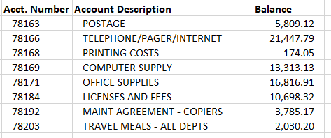
Documents to Know – Trial Balance
A trial balance is a report/document that generates the balances for all income, expense, and asset accounts.
Trial balances include:
Account number.
Account name.
Account balance.

Slide 14
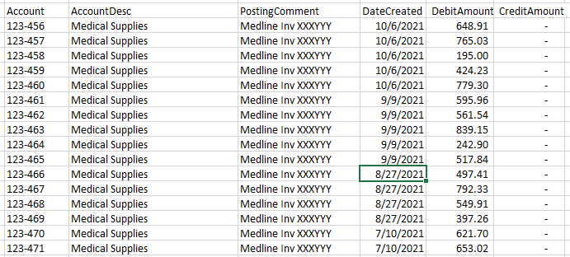
Documents to Know – General Ledger Detail
A general ledger (GL) detail is a report that shows the individual journal entries for every account listed on the trial balance. Typically organized by account.
GLs include:
Attributes of the trial balance.
Individual entries that make up the account balance.
Entry date.
Description.
Amount.

Slide 15
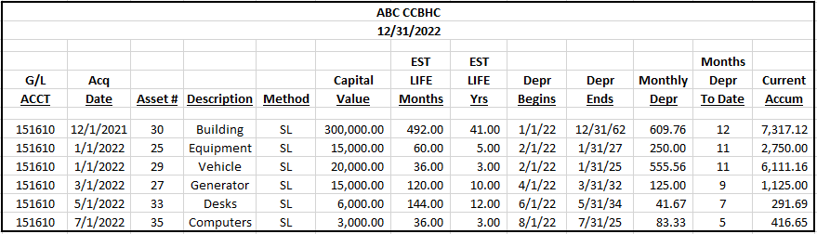
Documents to Know – Depreciation Schedule
A depreciation schedule is a listing of fixed assets at the facility.
Depreciation schedules include:
Asset descriptions.
Place in service date.
Estimated useful life.
Depreciation method.
Depreciation expense for the year.

Slide 16
What Is Included On a Cost Report?

Slide 17
Data On a Cost Report
Costs
Direct.
Direct patient care.
Directly related to CCBHC.
Direct but not related to CCBHC.
Indirect.
Non-Allowable.
Anticipated.
Visits
General Provider Information

Slide 18
Direct Costs
What is a direct cost?
A cost that has a direct health care impact to a patient.
Patient-facing costs.
Not administrative or overhead.
Examples of direct costs:
Nursing salaries.
Medical supplies.

Slide 19
Direct Care Costs
This section only applies if a facility plans to provide services other than CCBHC approved services.
Directly Related to Patient Care | Directly Related to CCBHC | Direct Non-CCBHC
Direct costs related to ALL services provided (CCBHC and non-CCBHC). Nurse salaries providing services to all patients. | Direct costs ONLY related to CCBHC-approved services. Salaries for staff providing ONLY CCBHC services. | Direct costs related to providing non-CCBHC services.

Slide 20
Indirect Costs
Costs incurred by a facility that are not directly related to providing patient care. Typically, indirect costs are for the overall operation of the facility.
Also known as overhead or administrative costs.
Examples of indirect costs:
Business office salaries.
Maintenance.
Utilities.
Legal and accounting services.
Insurance.

Slide 21
Allowable Costs
Per CMS Pub 15-1: 2102.2:
These include all necessary and proper costs which are appropriate and helpful in developing and maintaining the operation of patient care facilities and activities. Necessary and proper costs related to patient care are usually costs which are common and accepted occurrences in the field of the provider’s activity. They include personnel costs, administrative costs, costs of employee pension plans, normal standby costs, and others.

Slide 22
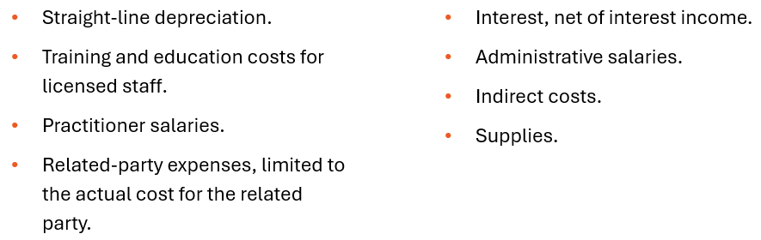
What is an Allowable Cost?
2 CFR 200 Subpart E Cost Principles
All payments to providers of services must be based on the reasonable cost of services covered under Medicare and related to the care of beneficiaries.
Reasonable cost includes all necessary and proper costs incurred in furnishing the services, subject to principles relating to specific items of revenue and cost.
Including, but not limited to:

Slide 23
Non-Allowable Costs
Per CMS Pub 15-1: 2102.3 Costs Not Related to Patient Care:
Costs not related to patient care are costs which are not appropriate or necessary and proper in developing and maintaining the operation of patient care facilities and activities. Costs which are not necessary include costs which usually are not common or accepted occurrences in the field of the provider’s activity.

Slide 24
What is NOT an Allowable Cost?
2 CFR 200 Subpart E Cost Principles
Bad debt.
Charity.
Courtesy allowances.
Political contributions.
Legal fees associated with a judgement granted as a result of unlawful activity.
Lobbying costs.
Marketing and fundraising costs.
Value of services provided by non-paid workers.
Travel costs that are not for business purposes.
Costs not related to patient care.

Slide 25
Anticipated Costs
What are anticipated costs?
Costs that are not currently being incurred that a provider anticipates needing to incur during the cost report period to provide CCBHC services or bring facility up to CCBHC standards.
Examples of anticipated costs:
New staff.
Outreach Coordinator.
Law Enforcement Coordinator.
New medical equipment.
Electronic health record (EHR) costs.
Health information exchange expenditures.
Anticipated costs COULD be ANY cost that will be incurred as a CCBHC that is not currently being incurred.

Slide 26
CCBHC Cost Report

Slide 27
CCBHC Cost Report Regulations
CCBHC Cost Report and Instructions:
https://www.medicaid.gov/media/173116
https://www.medicaid.gov/medicaid/financial-management/downloads/ccbhc-cost-rpt-instr.pdf
When reporting costs, the CCBHC must adhere to:
45 Code of Federal Regulations (CFR) §75 Uniform Administrative Requirements, Cost Principles, and Audit Requirements for U.S. Department of Health and Human Services Awards.
2 CFR 200 Uniform Administrative Requirements, Cost Principles, and Audit Requirements for Federal Awards.

Slide 28
Cost Report Walkthrough
The cost report must be prepared on the accrual basis of accounting.
All requested information in the tabs must be provided.
Round all amounts to the nearest whole dollar.

Slide 29
Cost Report Schedules
Provider Information
Trial Balance
Trial Balance Reclassifications
Trial Balance Adjustments
Anticipated Costs
Daily Visits
Services Provided
Comments (as needed)
CC PPS-1 Rate
Certification
Allocation Descriptions (as needed)
Indirect Cost Allocation

Slide 30
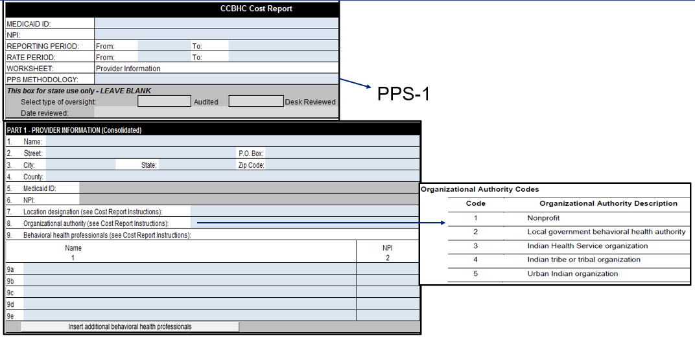
Provider Information – Part I
Use the Provider Information tab to report CCBHC identifying information for the CCBHC’s primary center location.
Part I is for single sites or central office information.

Slide 31
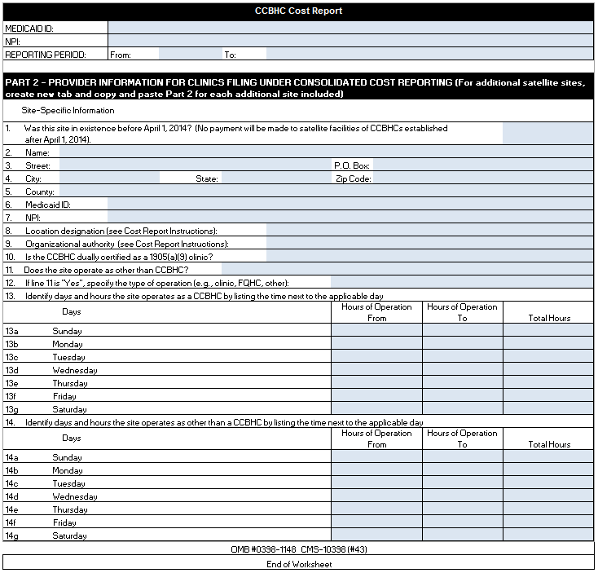
Provider Information – Part II
Part II is used if the entity is filing a consolidated report and should be completed for every additional site.
The tab should be copied for each location.

Slide 32
Steps to Creating a Crosswalk and Mapping
Step 1
List all trial balance accounts.
Should include all CCBHC allowable services and visits, regardless of payer.
Step 2
Identify the appropriate cost report line and description beside each trial balance account (see cost report instructions).
Step 3
Summarize costs by cost report cost line.

Slide 33
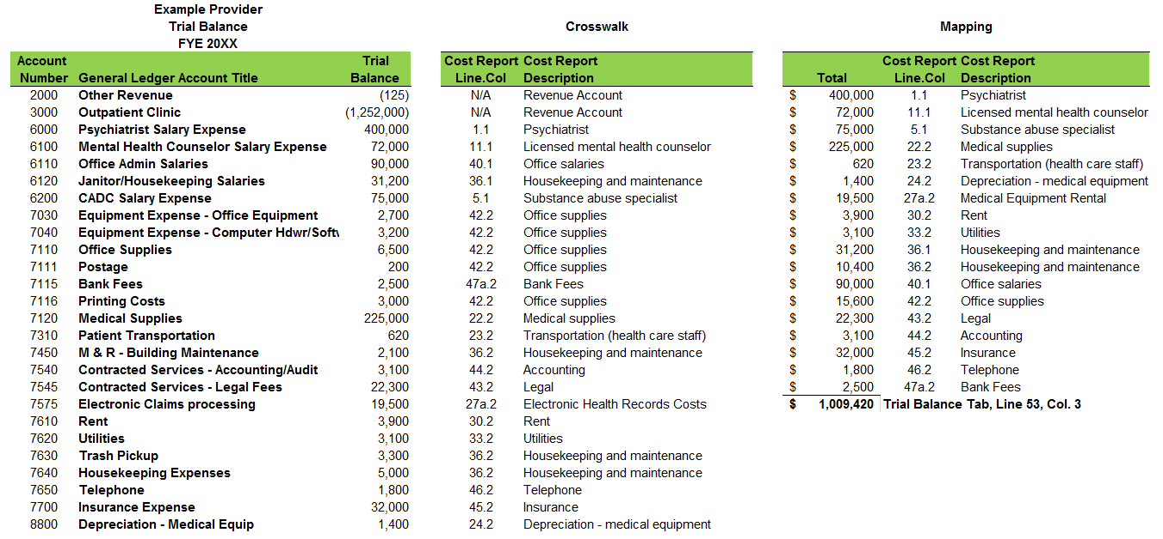
Mapping Process
Step 1
Step 2
Step 3

Slide 34
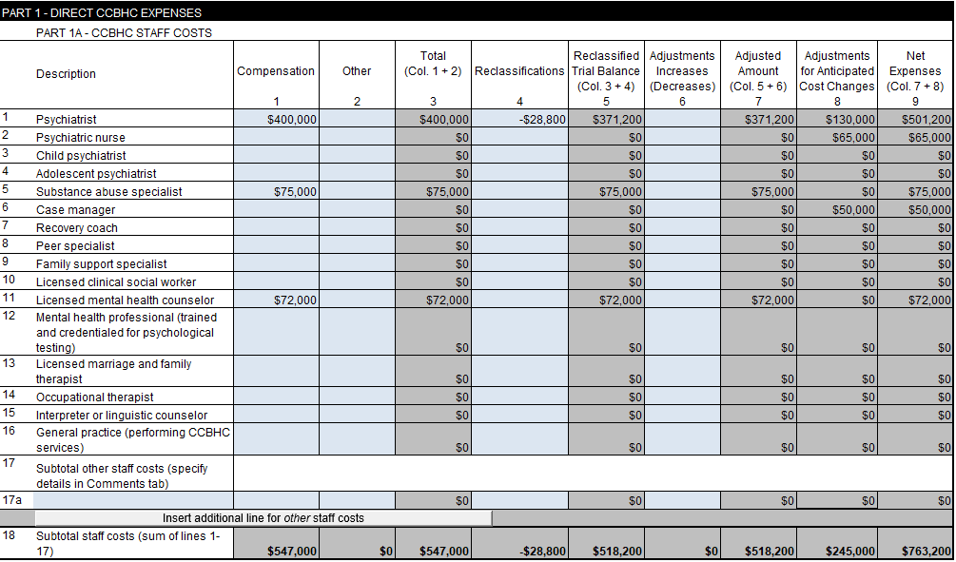
Trial Balance Part 1A
This information must correspond with
mapping of trial balance costs.
This information must correspond with the Trial Balance Reclassifications/Adjustments Tab(s).
CCBHC Staff Costs
This section is used to report CCBHC staff costs and also shows:
Staff reclassifications.
Adjustments.
Adjustments for anticipated cost changes.

Slide 35
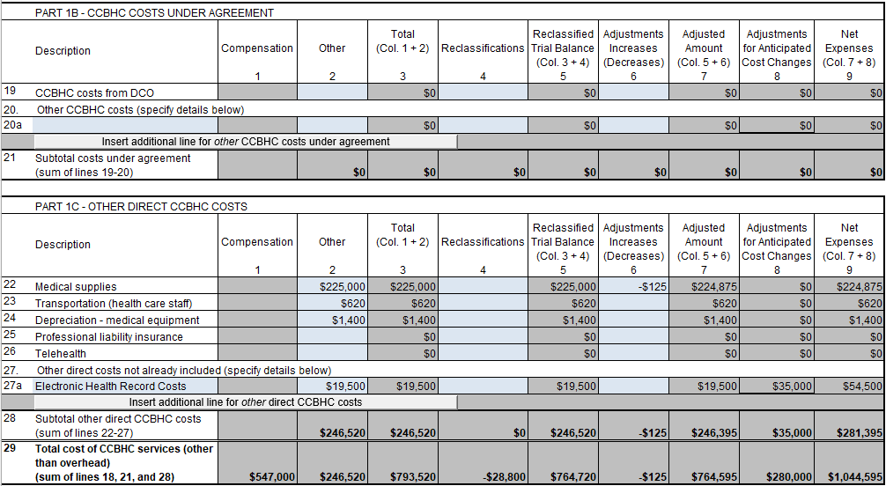
Trial Balance Part 1B and 1C
This information must correspond with
mapping of trial balance costs.
This information must correspond with the Trial Balance Reclassifications/Adjustments Tab(s).
CCBHC Costs Under Agreement & Other Direct CCBHC Costs

Slide 36
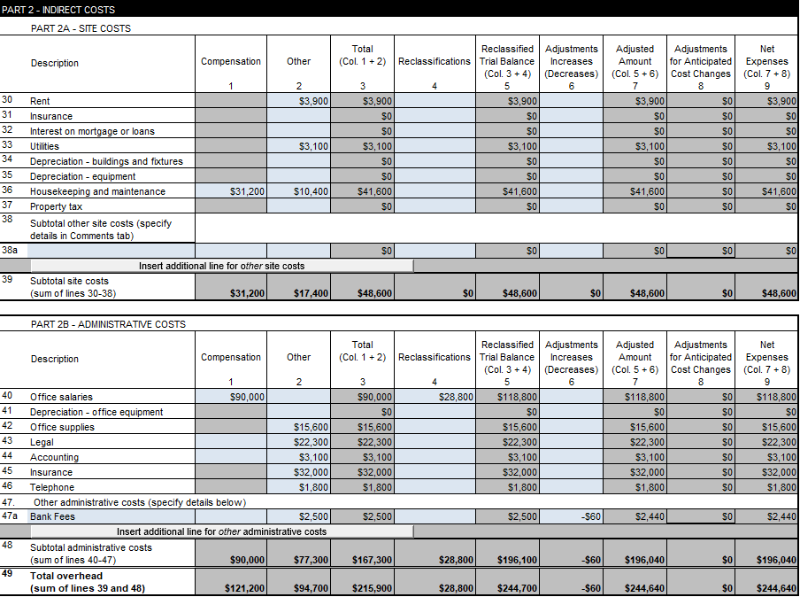
Trial Balance Part 2A and 2B
This information must correspond with
mapping of trial balance costs.
This information must correspond with the Trial Balance Reclassifications/Adjustments tab(s).
Indirect Costs
Indirect Costs – Costs incurred to support the providing of a service:
Rental costs.
Utility costs.
Administrative personnel costs.

Slide 37
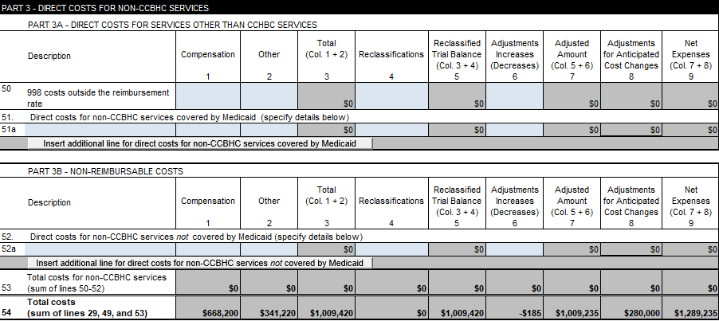
Trial Balance Part 3A and 3B
This section is used to report direct costs for non-CCBHC services – covered
and non-reimbursable by Medicaid.
Direct Costs for Non-CCBHC Services

Slide 38
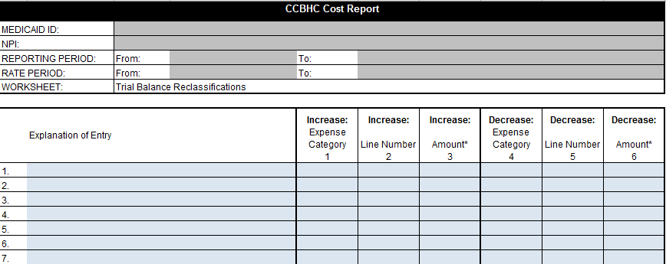


Trial Balance Reclassification
Used to reclassify the expenses listed on the Trial Balance tab.
Reclassify costs where expenses are applicable to more than one expense category.
Example

Slide 39
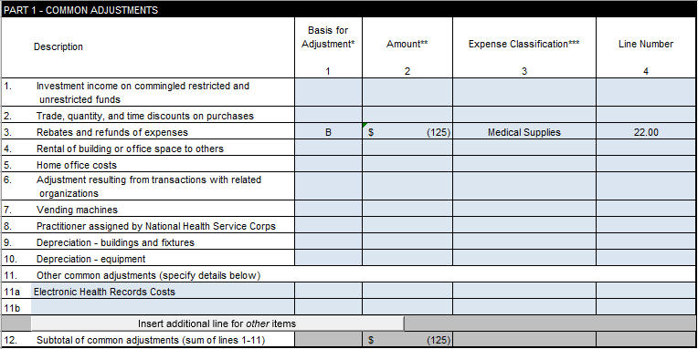
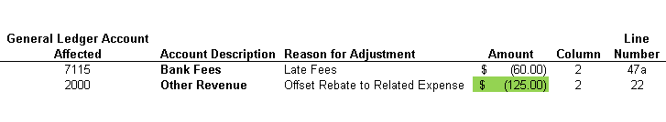
Trial Balance Adjustments
Example
45 CFR 75.406 Applicable Credits – Applicable credits refer to those receipts or reduction of expenditure type transactions that offset or reduce expense items allocable to the federal award as direct or indirect Facilities & Administrative costs.
Examples of such transactions are purchase discounts, rebates, or allowances; recoveries or indemnities on losses; insurance refunds or rebates; and adjustments of overpayments or erroneous charges.

Slide 40
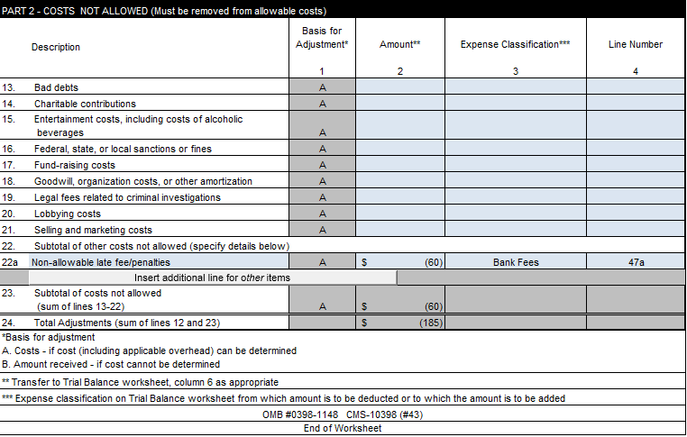
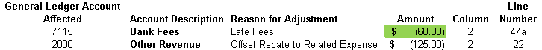
Trial Balance Adjustments Cont.

Slide 41
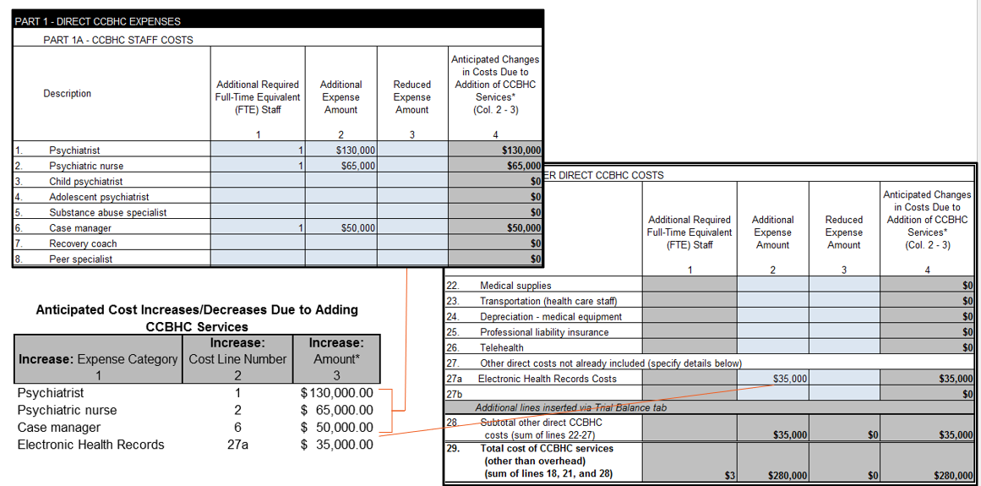
Anticipated Costs
Used to add or change the expenses listed on Trial Balance tab to allow for services not previously offered but required as a CCBHC.
Estimate changes in cost and full-time equivalents (FTEs) providing CCBHC services.

Slide 42
Anticipated Cost Documentation
Description of costs.
Reason that cost is not included in the reporting year.
Support for any estimates/allocations utilized to determine the costs.

Slide 43
Anticipated Cost Examples
Adding costs for psychiatry services and related FTE staffing needs.
Adding FTE Substance Abuse Counselors/Licensed Clinical Social Worker/Intake/Case Managers.
Estimating the cost of new vehicle, divided by four years (useful life per American Hospital Association), necessary to provide mobile crisis response.
Upgrades made to EHR system.

Slide 44
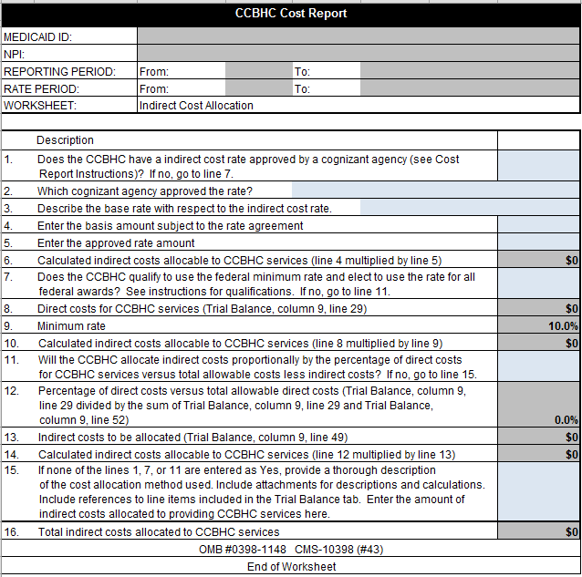
Indirect Cost Allocation
Use to identify the method used for calculating allocable indirect costs to CCBHC services.
The worksheet can be used for the following methods of allocation:
Federally approved indirect cost rate by a cognizant agency. Should be used if one is assigned.
*Minimum rate for qualifying entities (10%).
Proportionate allocation by percentage of direct costs.
Other – where the entity must provide a description and justification of the allocation method.
* Eff. 10/1/2024, the de minimis rate increased from 10% to 15%.

Slide 45
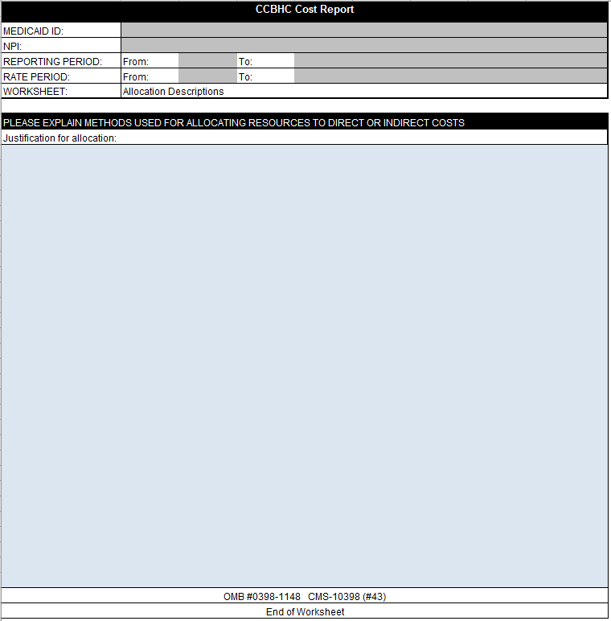
Allocation Descriptions
The purpose of this tab is to expedite cost report review and to limit the questioning of costs.
This tab allows the clinic to describe, in detail, the calculations and methods to support the allocation of direct and indirect costs.
Data reported in this tab should support allocations in the Trial Balance, Reclassifications, and Adjustments tabs.
Additional anticipated daily visit calculations/estimations
should be included on this tab.

Slide 46
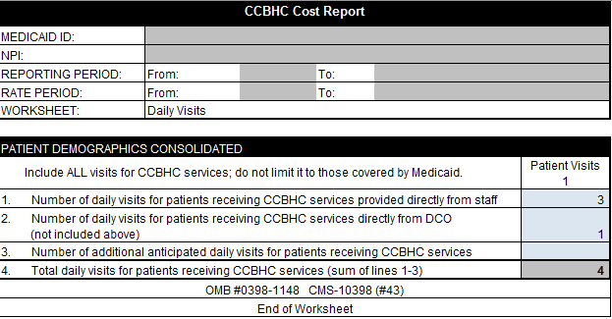
Daily Visits
Use this tab to report the total annual number of daily CCBHC visits delivered to all clinic users that receive demonstration services; include daily visits of designated collaborating organizations (DCOs)* and services delivered to non-Medicaid beneficiaries.
*A DCO is an entity that is not under the direct supervision of the CCBHC but is engaged in a formal relationship with the CCBHC and delivers services under the same requirements as the CCBHC.

Slide 47
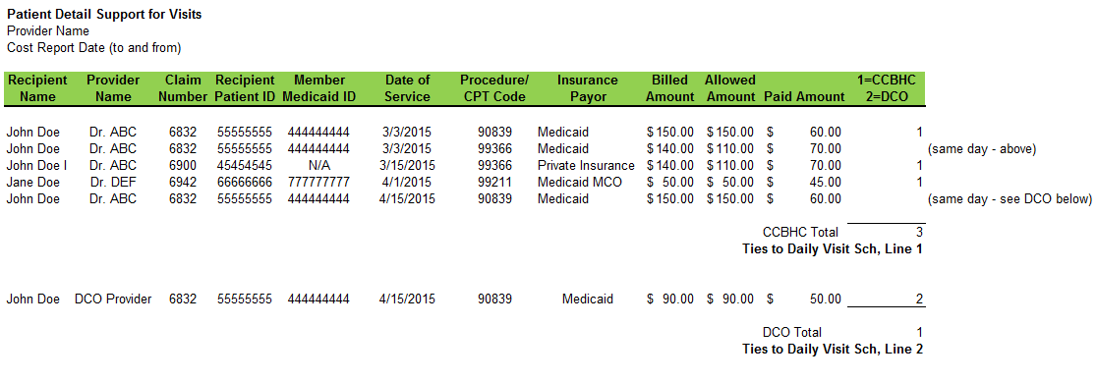
Detailed Visits Report and Enumeration
A visit may only be enumerated when at least one of the statutorily required services, as specified at section 223 (a)(2)(D), is provided in accordance with federal guidelines at a CCBHC service delivery site.
The totals on the Patient Daily Visit Report should tie to lines 1 and 2 of the Daily Visits Schedule of the CCBHC cost report. Line 3 (additional anticipated daily visits) should be explained in the Allocation Descriptions tab.

Slide 48
Visit Documentation
The Substance Abuse and Mental Health Services Administration (SAMHSA) requires a CCBHC to establish or maintain a health information system that includes, but is not limited to, EHRs.
All activities that trigger an enumerated visit must be documented in the clinic user’s medical record.
The DCO* must provide all data to the CCBHC required for the CCBHC to bill for demonstration services.
*A DCO is an entity that is not under the direct supervision of the CCBHC but is engaged in a formal relationship with the CCBHC and delivers services under the same requirements as the CCBHC.

Slide 49
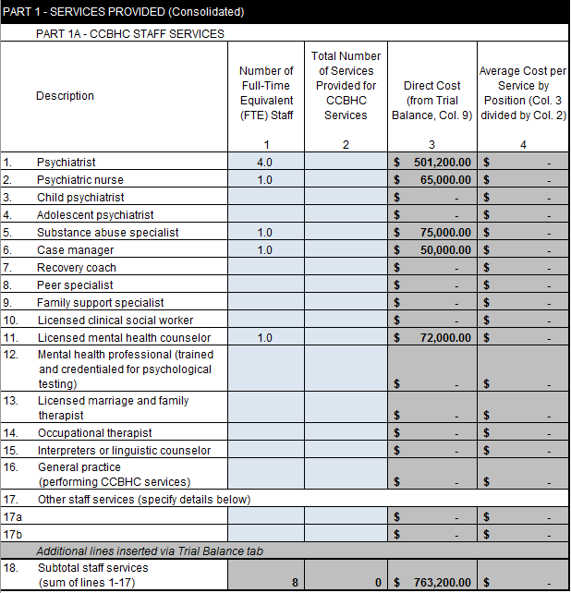
Services Provided
Use the Services Provided tab to report the number of FTEs and the number of services provided for CCBHC services for each type of practitioner.

Slide 50
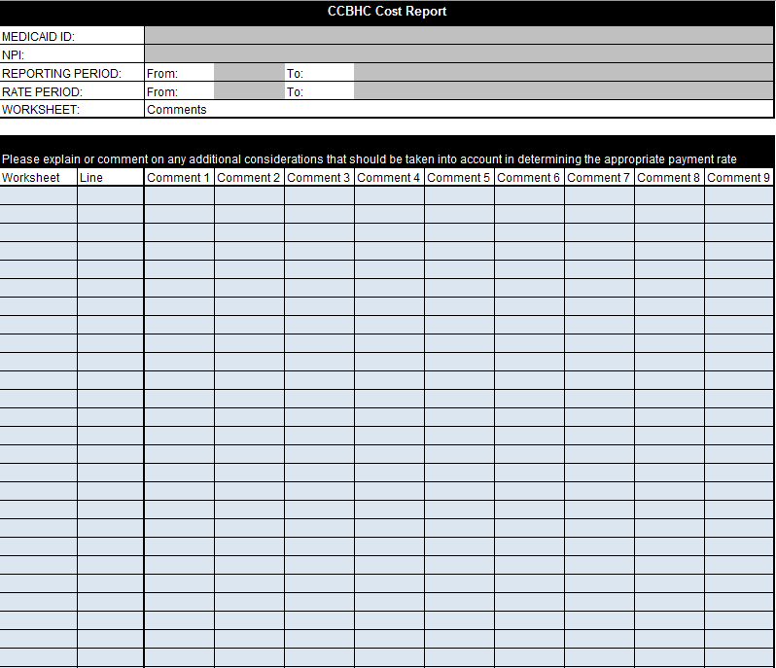
Comments
Use the Comments tab to explain any cost anomalies, entries in “Other (specify)” lines in Trial Balance, Trial Balance Adjustments, Services Provided, or any other considerations the State should make regarding the expenses used to determine the payment rate.

Slide 51
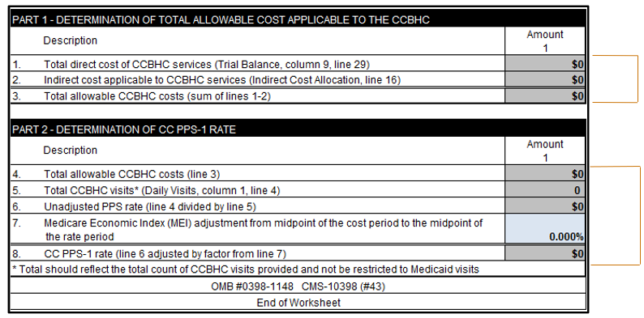
CC PPS-1 Rate
Used to determine the all-inclusive CCBHC payment rate per daily visit for the reporting period for states selecting the CC PPS-1 rate method.
Determination of total allowable costs applicable to CCBHC.
Determination of PPS-1 rate.

Slide 52
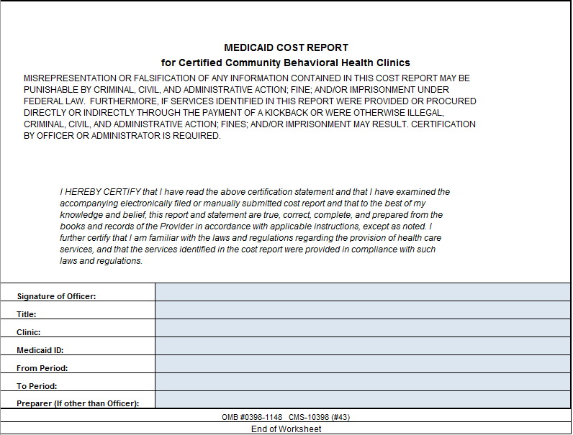
Certification
Cost reports must include certification from the chief executive officer, chief financial officer, or an authorized delegate.
Cost reports will be rejected and returned for resubmission if not completed properly.

Slide 53
Items Likely to be Requested with Submission
Trial balance.
Crosswalk from trial balance to cost report.
Depreciation schedule.
Claims detail to confirm daily visit count.
Federal indirect rate support, if applicable.
Signed certification statement.
Explanations and support for allocations, adjustments, and reclassifications.
Support for any DCO costs and visits.
Explanations and support for anticipated costs and visits reported.
Detailed support on FTE and number of services provided.
Audited financial statements.

Slide 54
Additional Resources
SAMHSA’s CCBHC Page:
https://www.samhsa.gov/certified-community-behavioral-health-clinics
CCBHC Cost Report and Instructions:
https://www.medicaid.gov/media/173116
https://www.medicaid.gov/medicaid/financial-management/downloads/ccbhc-cost-rpt-instr.pdf

