Slide 1
Exploration of Early RGPG Support Options and Approaches: Information Scan Covering Trends in Gaming, Alcohol, and Mental Health
September 20, 2023 - Final

Slide 2
Table of Contents
Learning from the Sober Curious Movement
3
Executive Summary
25
Objectives & Methodology
Societal Shift on Mental Health and Well-Being
9
31
Prevalence and Nature
of Early Support Resources & Tools
Moving Forward:
Opportunities to Explore Further
11
33
Research About Evaluation, Self-Help, and Communication Channels
21
35
Appendix

Slide 3
Executive Summary: Background
The Oregon Lottery’s Responsible Gaming Code of Practice states the following goals:
Provide information and tools to help players make informed choices and enjoy Lottery games in a responsible way
Ensure that people affected by gambling issues know how to access help
As a means of reinforcing its commitment to these goals, the Oregon Lottery (OSL) is conducting research to better understand opportunities to increase the set of tools, resources and services available to people who are questioning or concerned about their gaming and considering making changes – but may not be receptive to considering problem gambling (PG) treatment.
This document reflects the first phase of this research in which OSL is conducting a literature scan to better understand the current PG prevention and support landscape. Because there is limited literature available regarding PG prevention support addressing earlier stages of awareness and consideration, this literature scan includes exploring insights that can be gained from better understanding the range of tools and support available to those considering a change to their alcohol consumption (the “sober curious” movement).

Slide 4
Executive Summary: Key Elements of Early Support Options for Alcohol Consumption and Gaming
The availability of information and resources varied between the gambling vs alcohol spaces – resources were more abundant for those seeking information and/or considering a change in their alcohol consumption.
A very popular approach to early support and contemplation in the alcohol space is the sober curious movement which takes an exploratory self-help approach.
The table below summarizes key elements of early support/prevention activities observed for gaming versus alcohol consumption. Similarities and differences are also called out:
Gambling | Alcohol
Both use the stages of change framework to evaluate where an individual is on the change spectrum (see page 10) Both use similar strategies, actions and tools to help guide change: self-help, self-reflection, mental health, cognitive behavior therapy, motivational interviewing
Differences: Those that seek help are most frequently directed to treatment Limited social media content / challenges (e.g. Dry January challenge) Limited social media engagement with treatment provider accounts (e.g. OCPR/OCPG Facebook posts) Search for gambling help turns up mixed – and potentially detrimental - results (e.g. app store displayed gambling tracking apps and online slot machine apps) | Differences: Variety of treatment and early consideration self-help options Plenty of social media content and engagement Resources outside of treatment (self-help, social media challenges, social media content, dating apps, social events, etc.) Search for help with alcohol turns up relevant resources without mixed messages

Slide 5
Executive Summary: Sober Curiosity Offers Flexibility and Motivation
The strategies and actions used in the Sober Curious space align with strategies and actions used in the gambling prevention and treatment space, the difference is that the Sober Curious movement is delivered in a more positive, inclusive way.
The sober curious approach offers the following:
There’s something that motivates you to change, not an assessment that labels you (no stigma)
Self-guided exploration of self, including behaviors (you’re in control)
Flexibility in finding what works for you
Doesn’t require you to be in a treatment setting
Easy to recruit others to join you in your journey (support/community)
Fun and engaging ways to try it out (e.g. dry January, sober spring)
While prevention and treatment providers use PG screeners to categorize a player’s behaviors, player-facing assessments can be used to raise awareness and promote specific strategies and actions (e.g. changing thoughts, limiting, planning, etc.).
Hoosier Lottery’s Positive Play content is a good example of this.

Slide 6
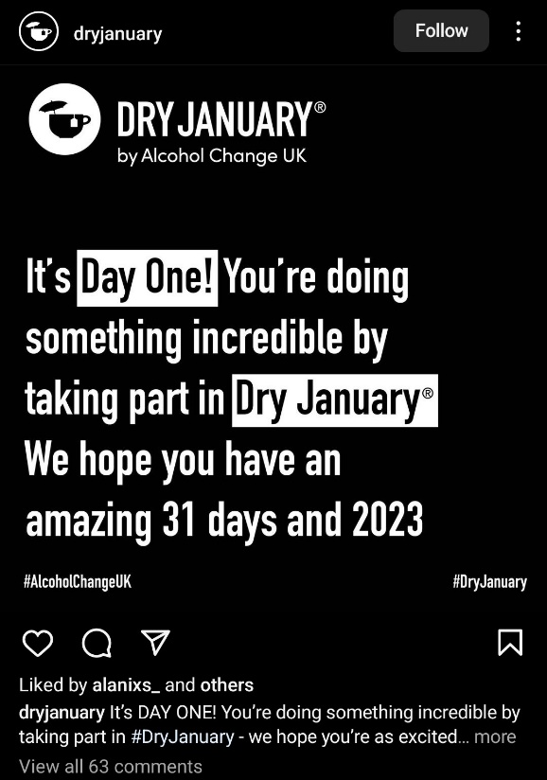
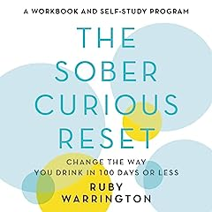
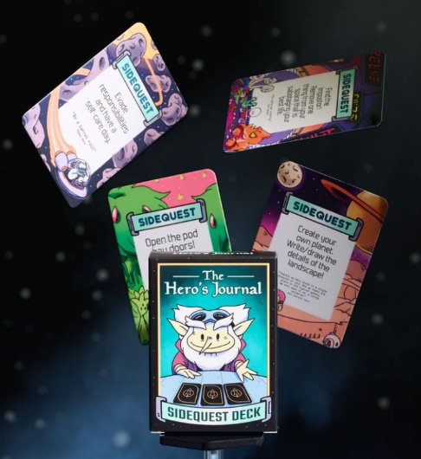


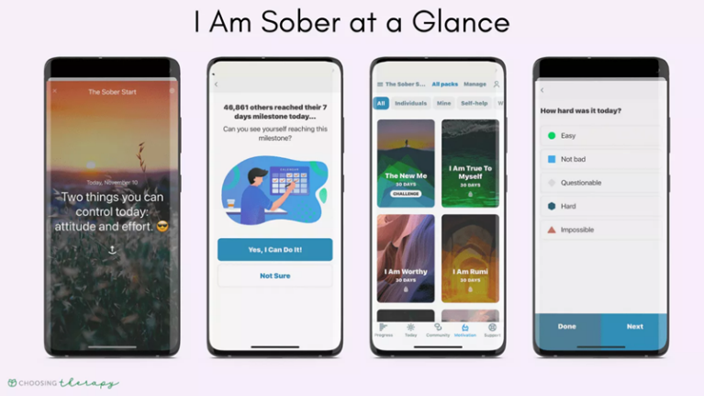
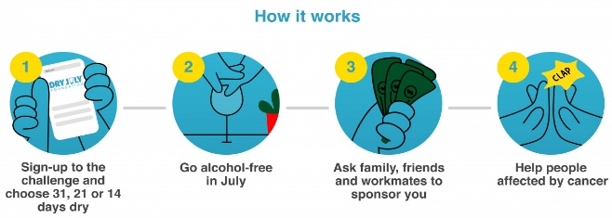
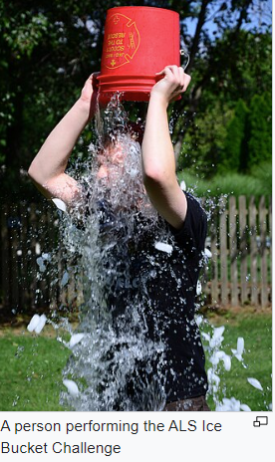
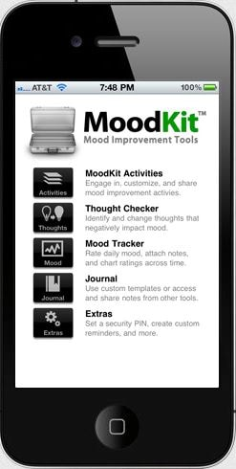
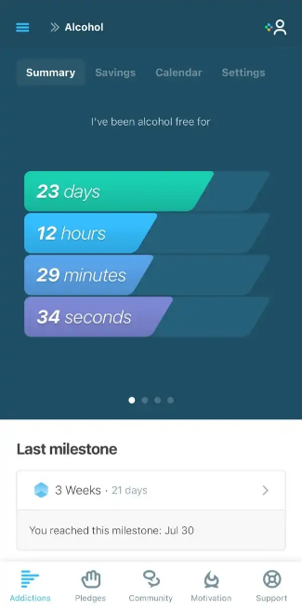
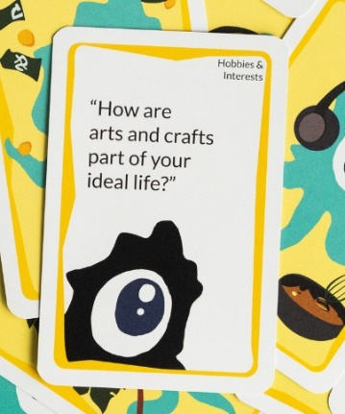
Executive Summary: Explore New Alternatives with Care
A variety of strategies and tools available for those considering a change in their alcohol consumption could be applied within the gambling space - but must be done with care – for example:
Determining which entities are most appropriate to initiate a social media challenge or partner with existing apps
Determining how best to engage/communicate with individuals who do not identify as having problem gambling – and which entities are best positioned to deliver these messages
Create Social Media Challenges | Enable Self-Reflection | Encourage Exploration / Trying New Things | Aligning with Social Causes | Partnering with Existing Apps | Creating an Ambassador Network to Amplify Content
Dry January, Sober Spring, etc. | Apps, workbooks, journals, etc. | Adventure cards, apps that get you out of your comfort zone | Join a challenge and have family/friends sponsor you to support a cause you care about | Promote free self-care apps, partner with existing apps, promote free apps available via health care provider, ability to integrate into Convenience app?, etc. | Finding gambling prevention enthusiasts to amplify tips and advice on how to reduce gambling harms on social media.
Notes:
https://www.healthline.com/health/pink-noise-sleep#compared-to-other-colors
https://www.webmd.com/sleep-disorders/pink-noise-sleep
https://www.nytimes.com/interactive/2022/09/23/well/mind/brown-noise.html#:~:text=Over%20the%20last%2020%20years,especially%20for%20people%20with%20A.D.H.D.

Slide 7



Executive Summary: Language Matters!
What is being said (or written on screen) must match the imagery. For example, if the message is related to encouraging limits, images of those enjoying gambling are not consistent with that intent.
Use positive/affirming language
Remove ambiguity/clear call to action; easy to understand
Removing stigmatizing language / normalize talking about gambling
Focus on what you’ll gain, not what you’ll lose
Focus on positive reinforcement / motivation
Empower them / show they’re capable of change / give them the tools
Right message at the right time
Source: The Power of Language in Addiction Treatment and Responsible Gambling webinar (Dr. Rory Pfund, Dr. Michael Wohl)

Slide 8
Executive Summary: Strategies for Change Observed by Gambling Research Australia
The current problem gambling prevention and treatment programs point to professional help with the end goal of abstaining from gambling.
Based on research from Gambling Research Australia, most problem gamblers prefer the self-help route vs. going into a treatment program. Self-help isn’t for everyone and is not an effective approach for those with severe gambling harm/behavior.
Gambling Research Australia pointed out different strategies and actions based on where someone is on the stage of change spectrum:
Participants in the earlier stages of change were more likely to use “planning” and “setting limits” strategies - Includes taking steps to be more aware of their gambling (gambling strategy, what they spend, time spent, and setting limits) and taking care of themselves.
Participants in later stages were more likely to use “changing thoughts,” “health and well-being”, and “self-assessment” strategies - Focused on changing how you think about gambling.
“Changing Thoughts” was among the top 5 strategies, regardless of what stage of change there were in.

Slide 9

Objectives & Methodology
Objectives:
Scan and compile information related to contemplation and “sober curiosity” within the alcohol consumption space with the goal of better understanding trends and resources used to support people in this phase.
Early support options within the alcohol space were explored in addition to the limited literature related to early support/tools in the gambling behavior space
Identify potential similarities and differences in sober curiosity behaviors and support when considering these concepts for alcohol vs. gambling behavior
Methodology:
The following sources were used as part of this information scan
Online research for gambling forums, studies/literature
World Lottery Association (WLA) and state lottery websites
Problem Gambling Treatment sites (OPGR, OCPG, NCPG)
App store searches to gauge the prevalence of resources via mobile
Learnings from Oregon Lottery RGPG Message Testing - 2017
Sober Curious book / Sober Curious Reset Workbook

Slide 10
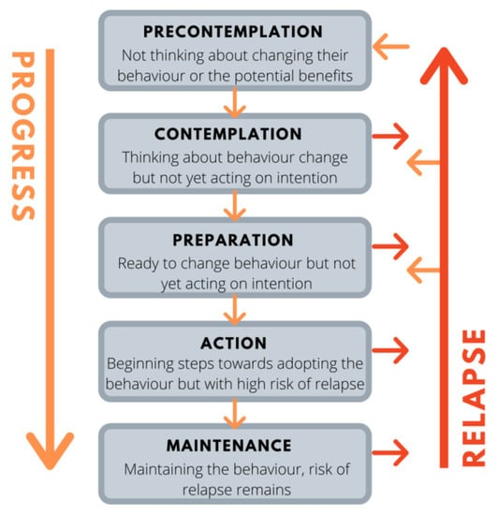
Clarifying Terminology
Stages of Change Framework
The following terms are used throughout this document to describe tools and approaches for providing early support within the alcohol and gaming spaces:
Stages of change: support and treatment framework utilized in alcohol, substance, and gambling treatment programs.
Pre-Contemplation: the first stage of change; person does not recognize that a behavior change may be needed
Contemplation: the second stage of change; person is thinking about change but has not acted on change
Sober Curious: coined term in the alcohol space to describe the exploration of a person’s relationship with alcohol and tools/resources to guide change outside of a traditional treatment program
Sources: National Library of Medicine, Brief Interventions and Brief Therapies for Substance Abuse; NBI Bookshelf: Enhancing Motivation for Change in Substance use Disorder Treatment; Stages of Change Framework graphic from FutureLearn.com; Sober Curious by Ruby Warrington
Termination – leaving the cycle of change

Slide 11

Prevalence and Nature of Early Support Resources & Tools
11

Slide 12
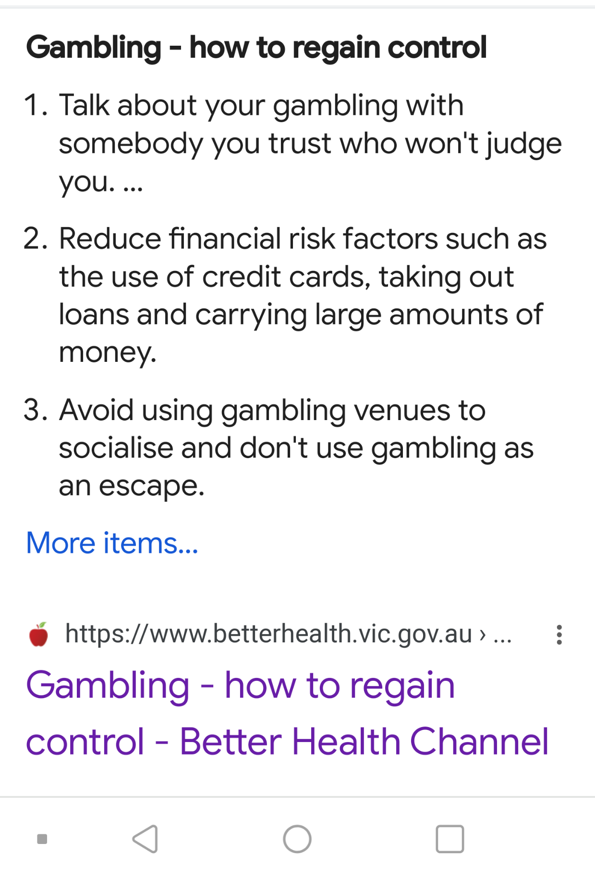
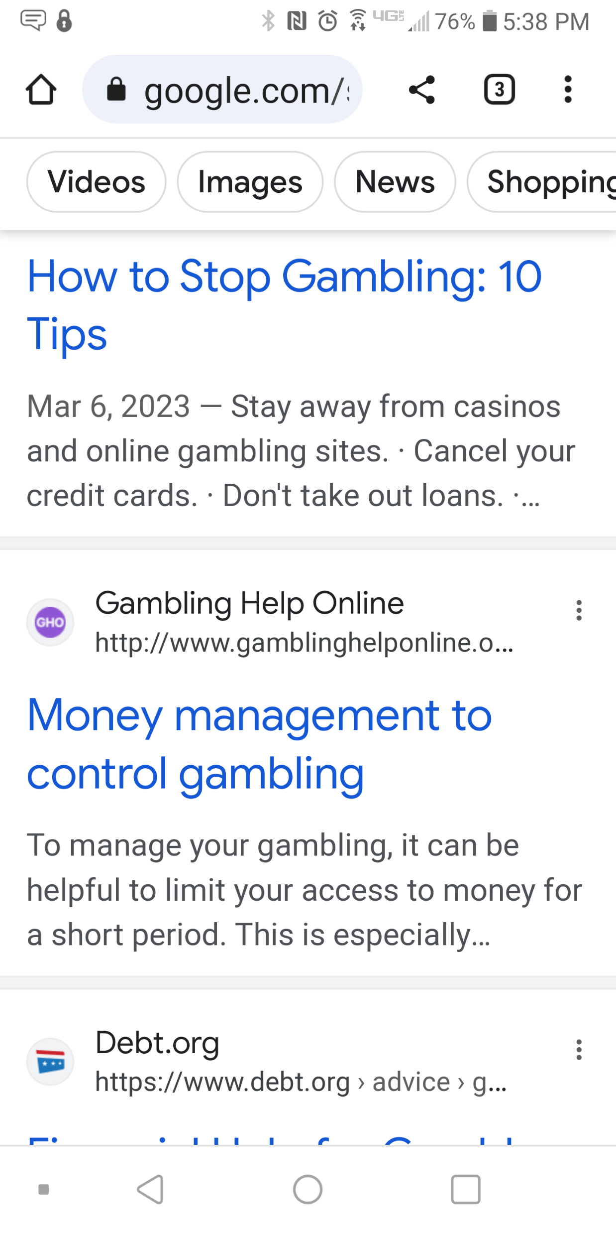
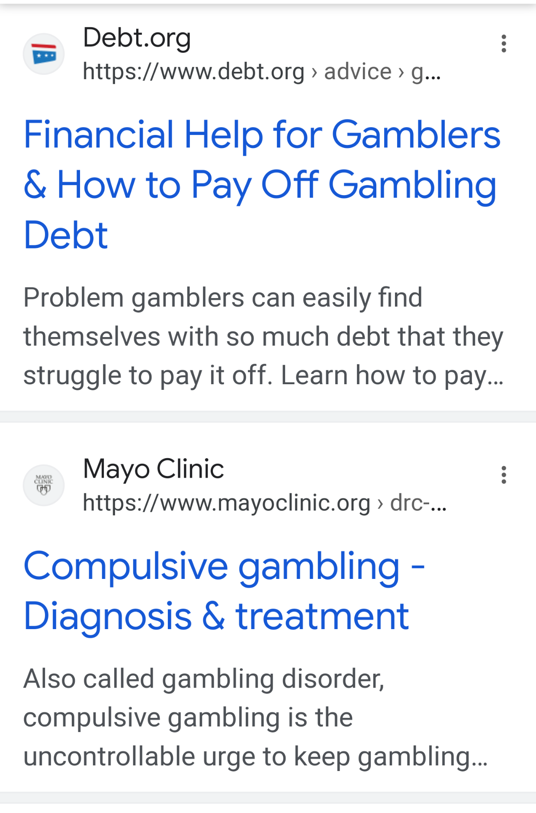
Search Results: “Manage my gambling”
The majority of links resulting from a search on “manage my gambling” reflected messages about addiction, how to stop gambling, and obtaining financial help.
The key exception to these messages was the first link returned for the Victoria Department of Health’s Better Health Channel. While most other sites used language such as “addiction,” “compulsive,” and “how to stop,” the Better Health site presented messaging such as “assessing your gambling” and “strategies for change.” (refer to next slide for more details)

Slide 13
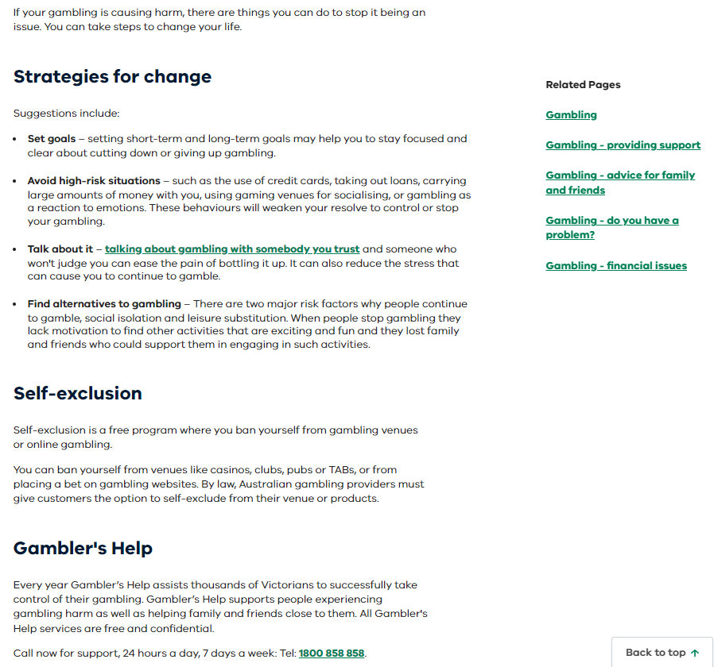
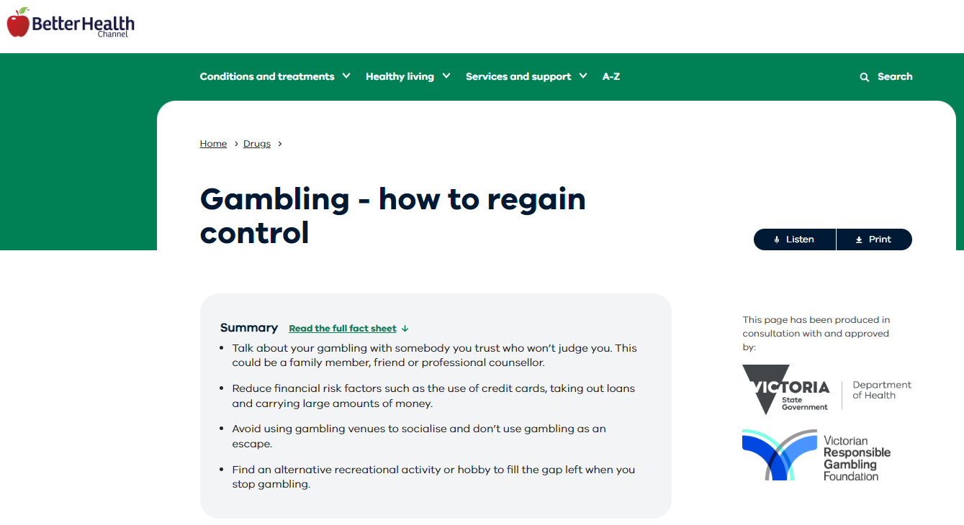
Learnings from Victoria’s Better Health Channel
The Better Health Channel is managed by the Victoria Department of Health, State Government of Victoria, Australia.
As illustrated in the website images presented here, the language used is inclusive of gamblers across the change spectrum – from seeking advice to better manage or cut down on gambling to deciding to seek treatment and/or give up gambling.
Source: Victoria Department of Health Better Health Channel
Notes:
https://www.betterhealth.vic.gov.au/

Slide 14
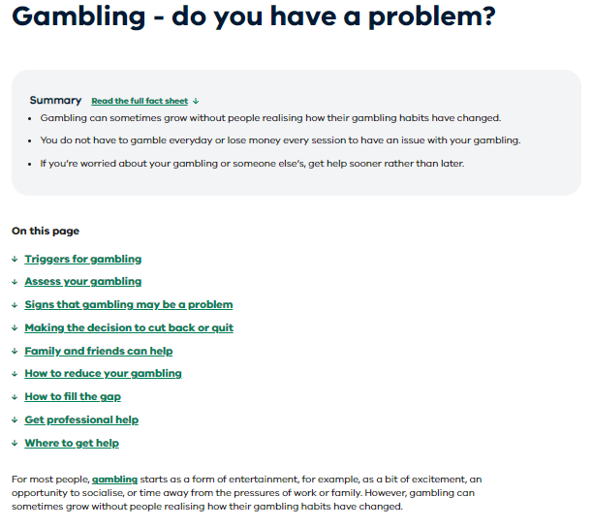
Learnings from Victoria’s Better Health Channel
The Better Health Channel uses the following approach:
Does not assume that the gambler needs and/or is ready for treatment
Meets the gambler where they are in their change journey
Provides a variety of support options, including an assessment tool and information, offering social/entertainment alternatives to gambling, promoting self-care, and providing multiple links to help lines/professional help.
More information from the website can be found in the appendix of this document.
Source: Victoria Department of Health Better Health Channel

Slide 15
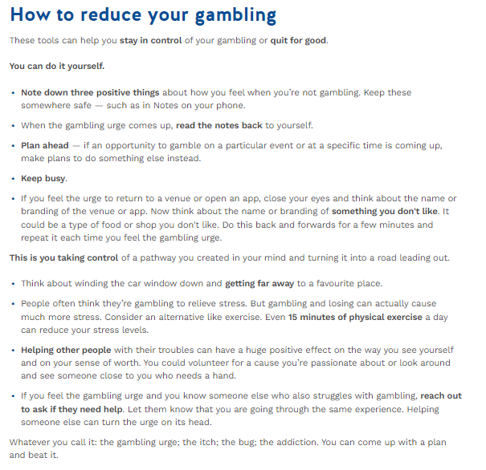
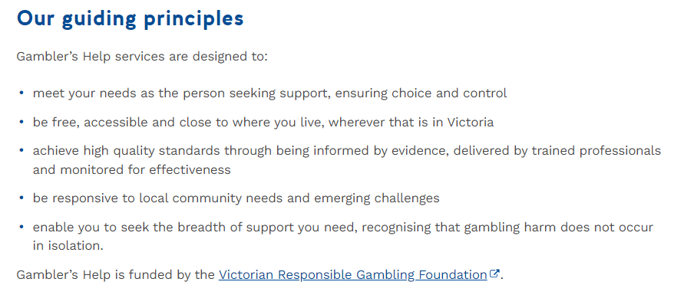
Victoria’s Gambler’s Help Site
In reviewing search results for “cut down on gambling,” another Victoria, Australia site was an exception amidst several sites with headlines using words/phrases like “addiction” and “stop gambling.”
While the content on the Gambler’s Help website was also focused on supporting players to stop gambling, its initial messages focused on “reduction” and “meeting your needs…ensuring choice and control.”
More information from the website can be found in the appendix of this document.
Source: Gambler’s Help website

Slide 16
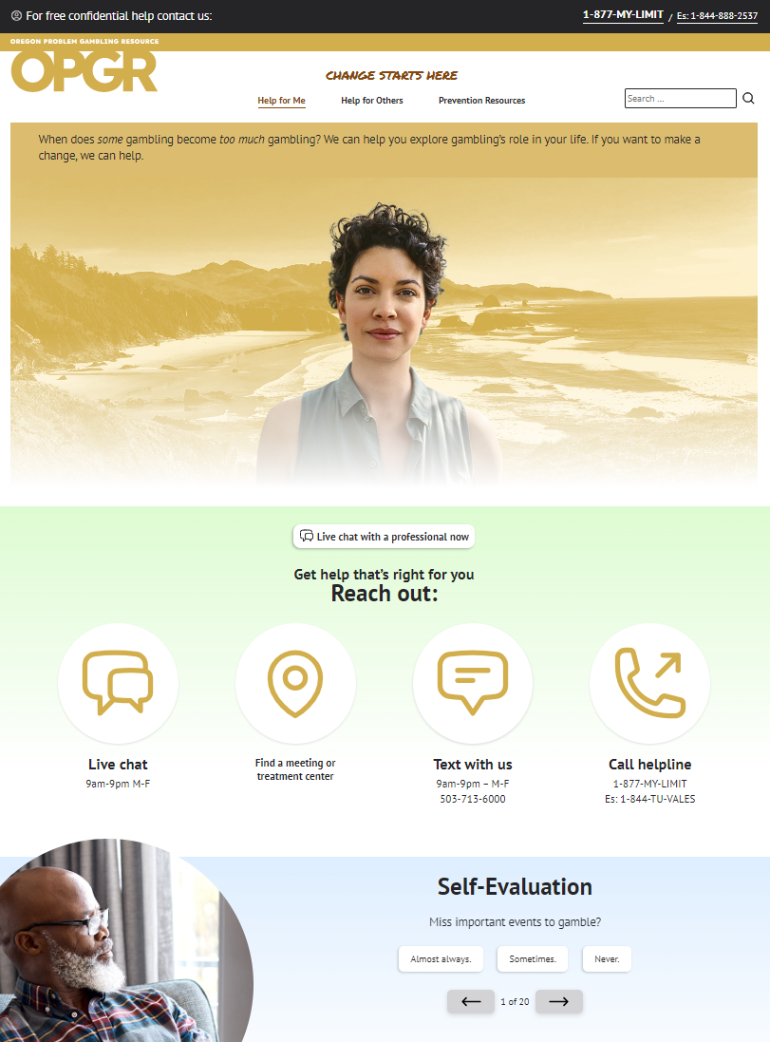
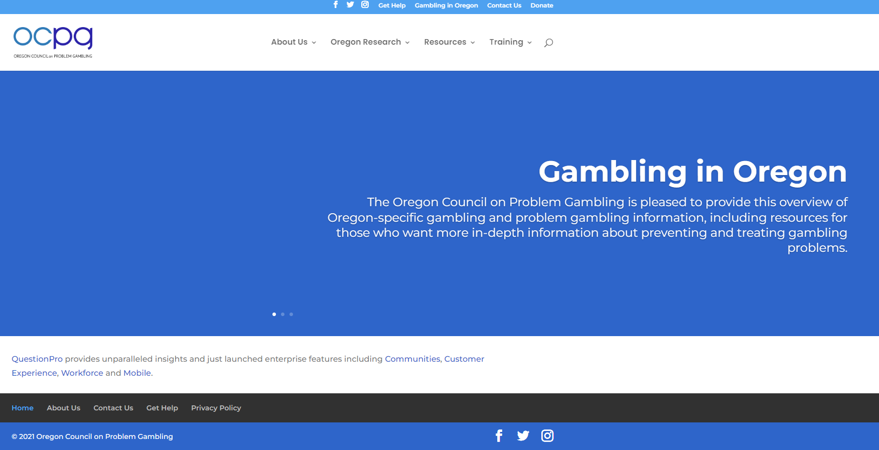
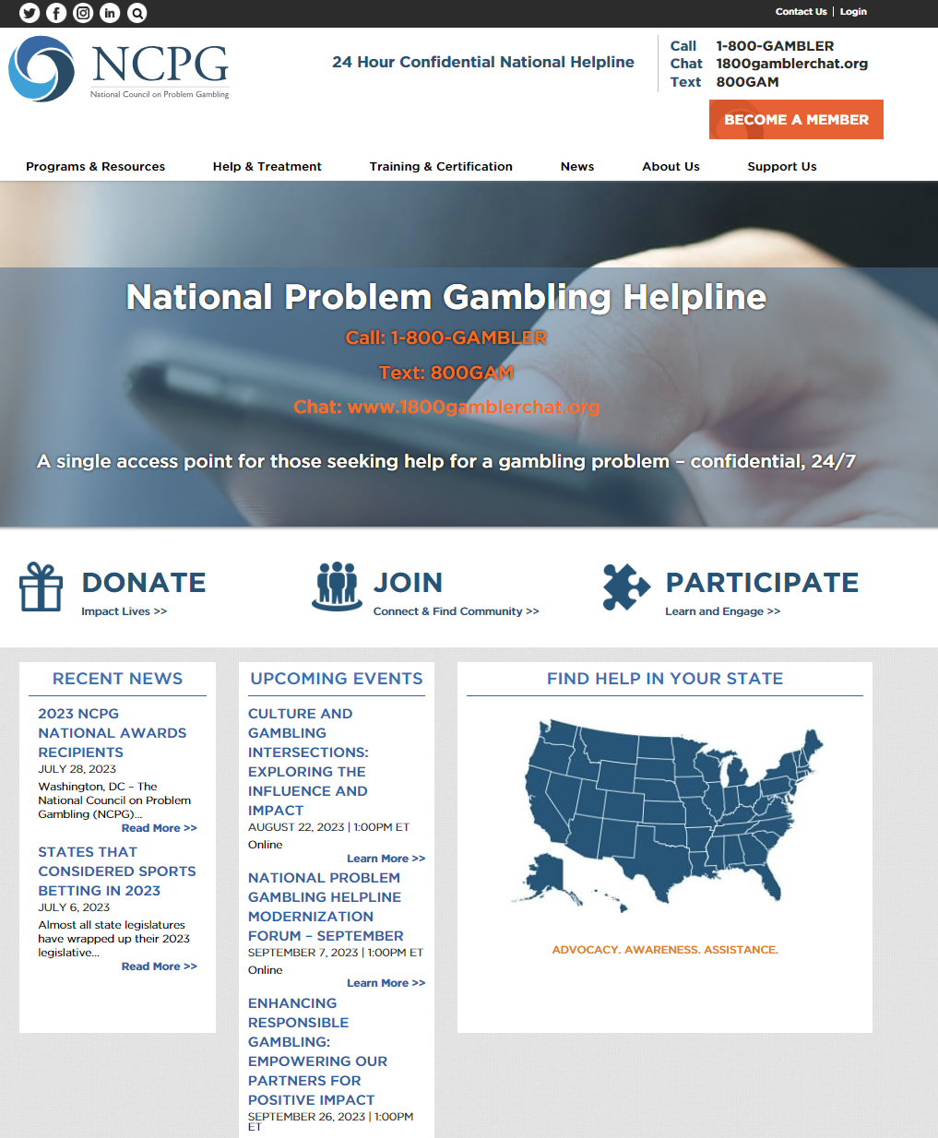
Searches for Gambling Advice/Help Often Point to Treatment
Google searches for gambling advice or gambling help point to problem gambling treatment services or responsible gambling content.
OPGR, OCPG and NCPG have social media accounts, however, engagement is low.
OPGR Facebook content is limited (1 post in 2023*, 7 in 2022) and engagement is low.
NCPG is much more active, however, their content is directed to treatment providers.
Oregon Problem Gambling Resource (OPGR)
Oregon/National Council of Problem Gambling (OCPG / NCPG)
OCPG social media content has industry/ treatment field and player resource content.
OPGR is player-facing; has a Facebook account, however, it has limited posts (7 in 2022) and content engagement is low.
NCPG social media content has industry/ treatment field content.
Source: Websites for OPGR, OCPG, NCPG; *counts as of August 17, 2023
Notes:
https://www.opgr.org/
https://www.ncpgambling.org/
https://oregoncpg.org/

Slide 17
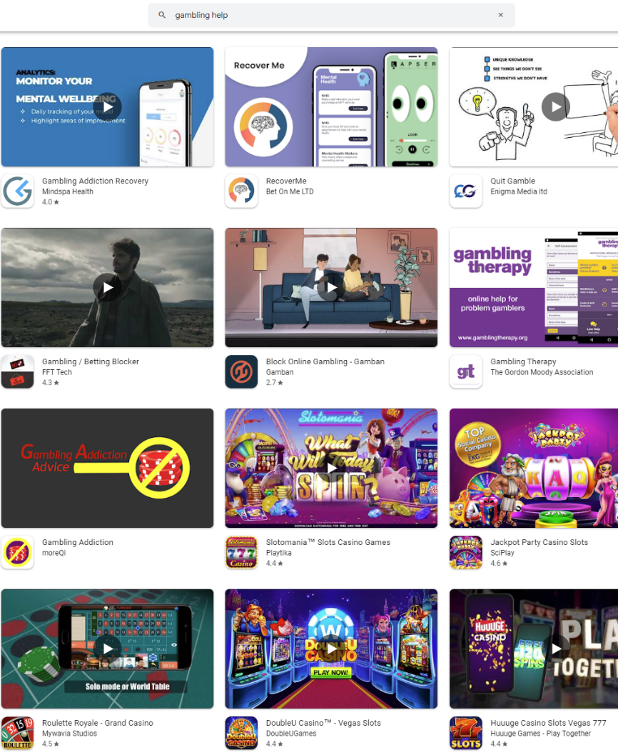
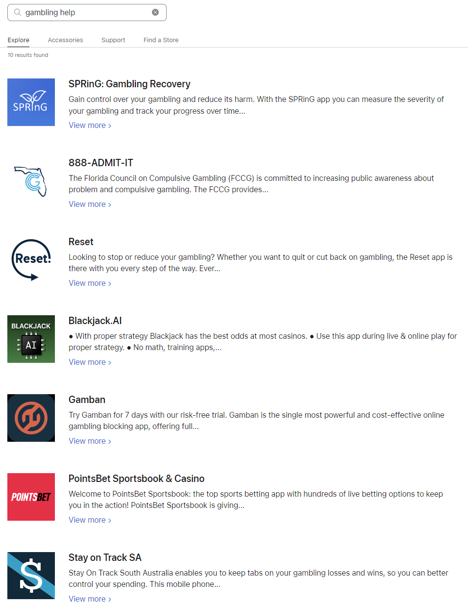
Gambling Resources Not as Abundant or as Diverse as Alcohol Resources
Gambling Help App Search
A quick search for gambling help in Android and IOS app stores shows a few resources to quit gambling, then slot game apps available!
Searching for gambling help on Instagram once again brings up very mixed messages – some potentially harmful: Posts from individuals going through recovery, RGPG providers, and gamblers offering gambling tips.
Source: Android / IOS app store search

Slide 18
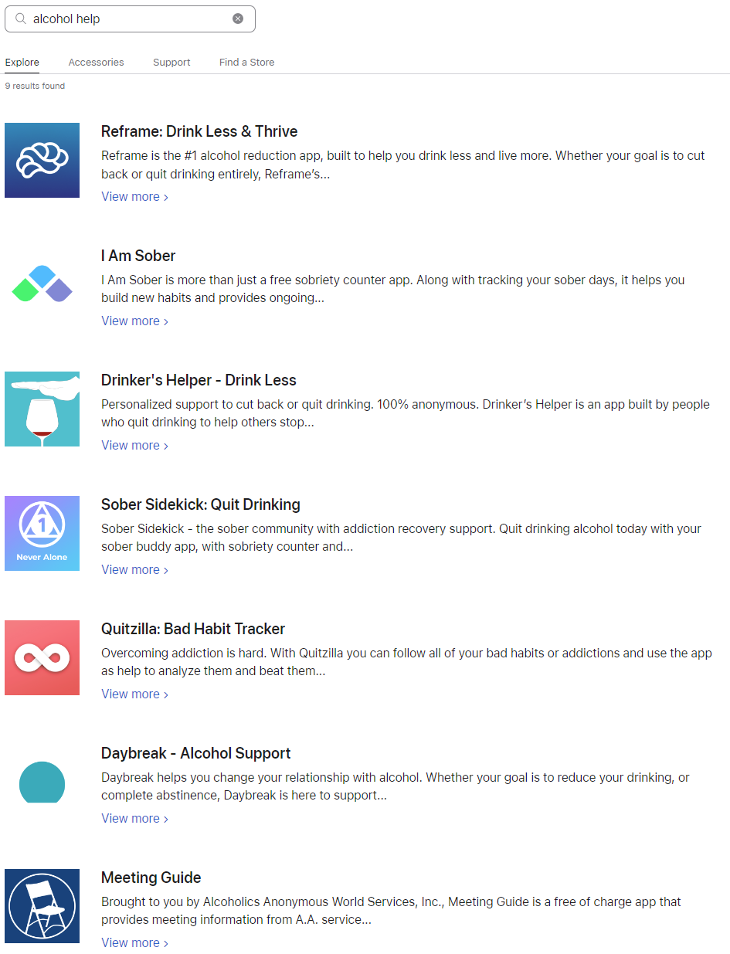
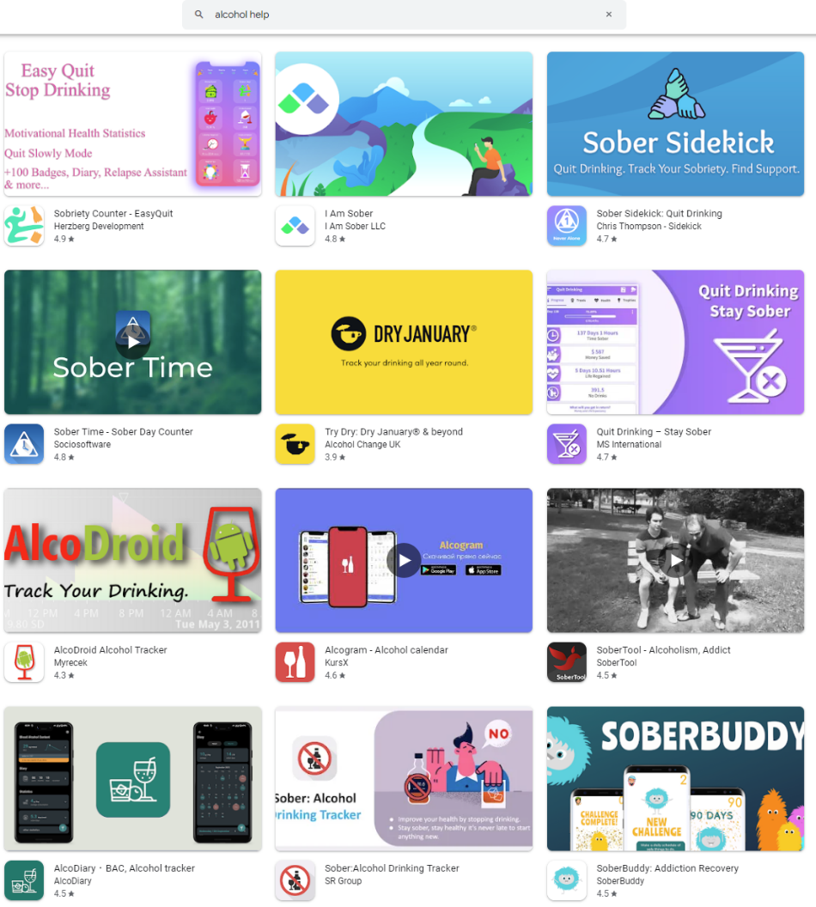
Gambling Resources Not as Abundant or as Diverse as Alcohol Resources
Alcohol Help App Search
A quick search for alcohol help in Android and IOS app stores shows a variety of options – reduce drinking, dry January, and quitting resources. Additional exploration of the alcohol space / sober curiosity is provided in the next section.
Play Store options for “alcohol help” resulted in apps reflecting a broad array of support tools with hopeful, more casual, and sometimes even playful images and messaging.
Source: Android / IOS app store search

Slide 19

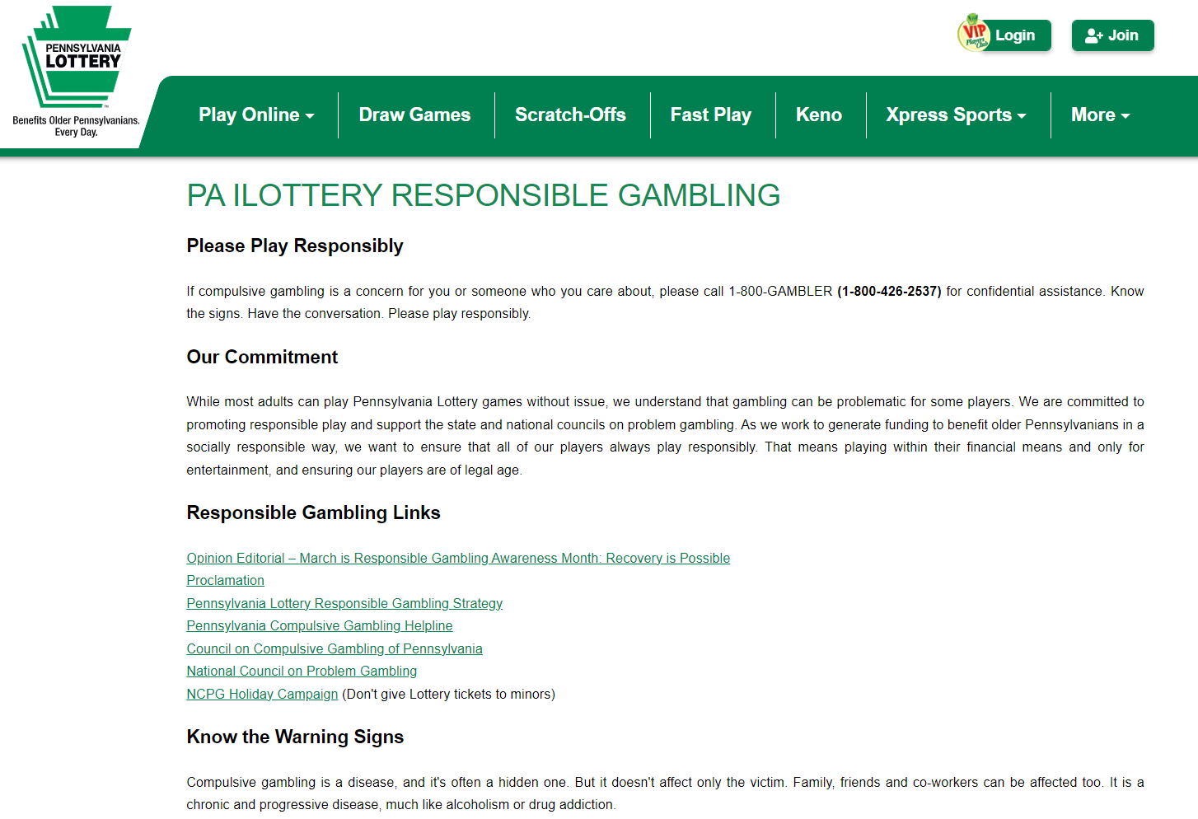
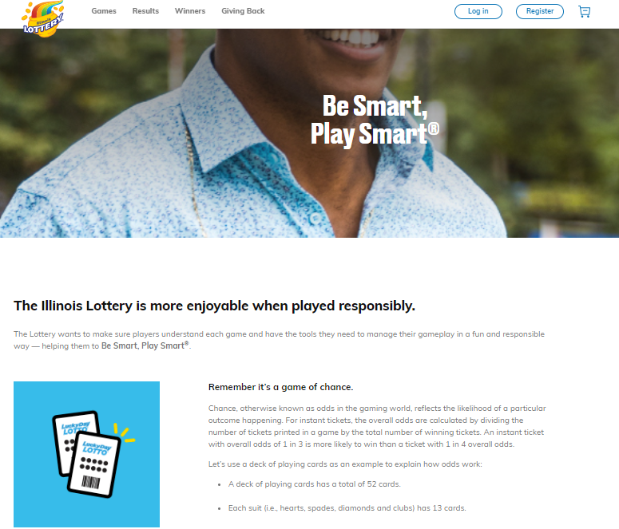
The Responsible Gaming Information Provided to Players Varies Across Jurisdictions
We used the World Lottery Association (WLA) RG Framework (RGF) Certification to identify U.S. Lotteries that have been recognized for their RG commitment and work.
Among the 15 WLA RGF Certified U.S. Lotteries, RG content and format on their respective websites varied quite a bit:
Minimal content: a link and/or contact information to PG help (text and/or PG logo)
Basic: a variety of content (tips, resources) and links to more resources presented in a simple format (text, graphics)
Integrated: provide a robust amount of content in an engaging way (videos, quizzes, calculators, RG tools, tips, gambling and financial education, etc.)
As we’ll see later in this literature scan, it is important to find a balance between content AND visually engaging format.
Details from scanning the 15 WLA certified Lotteries available in the appendix.
Source: World Lottery Association (WLA) website; state lottery websites
Notes:
https://www.world-lotteries.org/services/industry-standards/responsible-gaming-framework/certified-lotteries
WI, NM, NE – link to PG site
CA, GA, PA – text based content
IL, MO, NJ, OR – text/graphics
CO – images/text, interactive tools, link to resources
NJ, TN, TX, Hoosier – text, quiz, embedded videos

Slide 20
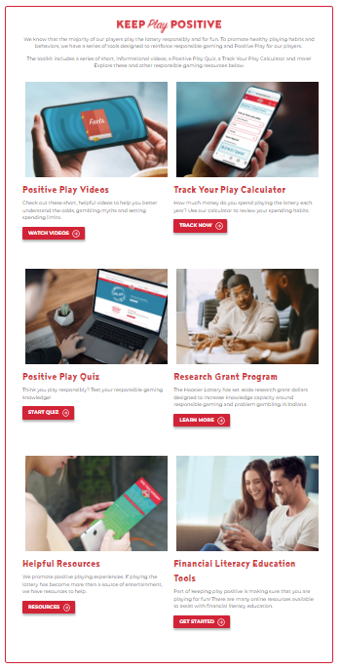
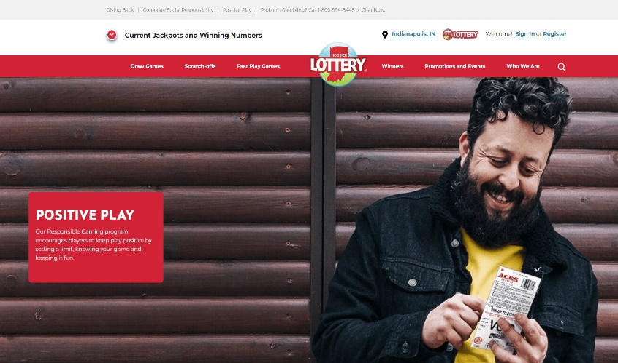
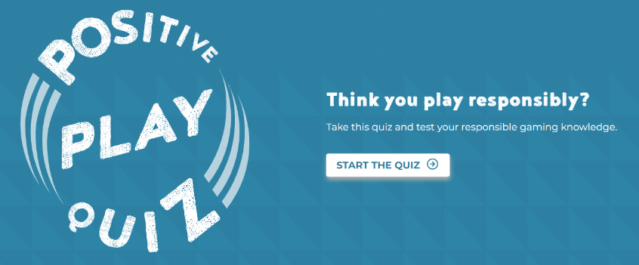

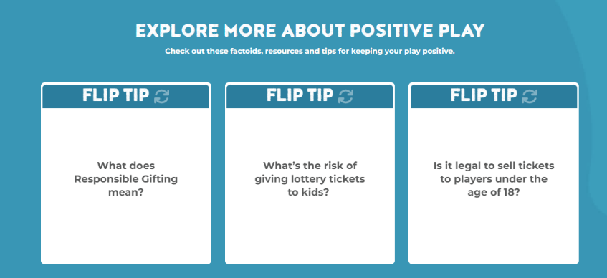
The Responsible Gaming Information Provided to Players Varies Across Jurisdictions
New Jersey, Tennessee, Texas and Hoosier Lottery had well integrated RG content presented as text, interactive tools and embedded videos. Hoosier Lottery integrates Positive Play throughout their RG section, with a quiz to learn more about responsible gaming, tools, calculators, and financial education.
Details from scanning the 15 WLA certified Lotteries available in the appendix.
Hoosier Lottery – Positive Play content integration
Source: World Lottery Association (WLA) website; state lottery websites
Notes:
https://www.world-lotteries.org/services/industry-standards/responsible-gaming-framework/certified-lotteries
WI, NM, NE – link to PG site
CA, GA, PA – text based content
IL, MO, NJ, OR – text/graphics
CO – images/text, interactive tools, link to resources
NJ, TN, TX, Hoosier – text, quiz, embedded videos

Slide 21

Research About Evaluation, Self-Help, and Communication Channels
21

Slide 22
Results from GREO Research
61%
GREO Evidence Insights, an independent knowledge and exchange organization, summarized a study with 262 U.S. gamblers age 18+ who gamble at least once per week and not in problem gambling treatment to understand why they may or may not complete a problem gambling screener provided online:
of gamblers in the study did not take the PG screener
Main Reasons Interested in Taking PG Screener:
Main Reasons Not Interested in Taking PG Screener:
35% of participants wanted to “check in” on their gambling behavior to see if it was causing harm. Note that they did not necessarily think they had gambling problems.
18% said they would take it out of curiosity, but they were not concerned about their gambling behavior.
32% of participants said they wanted to avoid the distress that the screener might cause. They were worried the screener’s results would make them feel shame, guilt, or embarrassment.
19% said they would not want to take it because they did not have gambling problems.
Source: GREO Research Snapshot: Frequent Reasons for and Against Completing a Problem Gambling Screener 2021
Notes:
Peter, S. C., Horn, T. L., McPhail, A., Meyers, A. W., & Whelan, J. P. (2021). Frequent gamblers’ reasons for and against completing a problem gambling screener. Journal of Gambling Studies.

Slide 23
Top Self-Help Strategies by Stage of Change
Gambling Research Australia conducted research on the self-help approach to help address gambling harms. Their assessment included: literature review, audit of 34 gambling-related websites, analysis of 604 PG forum posts, analysis of 85 PG counselling transcripts, two surveys (benchmark n=716 + 30 days post n=410), and interviews with 30 gamblers.
Based on their report A Comprehensive Assessment of Self-Help Strategies and Actions 2013:
“Self-help is the most widely used type of help amongst gamblers, and the first choice of gamblers if a problem has developed.”
“Participants in the earlier stages of change were more likely to use ‘planning’ and ‘setting limits’ strategies”
“While participants in later stages were more likely to use ‘changing thoughts’, ‘health and wellbeing’, and ‘self-assessment’” strategies
Changing Thoughts among the top 5 strategies, regardless of what stage of change you are in
Top actions by those in the Contemplation stage are focused on changing how you think about gambling.
Top 5 Action Uptake in Contemplation Stage
(List of top 30 actions by stage of change in appendix for reference) | Contemplation (n=120)
Accept that gambling needs to change | 84%
Remind yourself of negative consequences of gambling | 81%
Think about how your money can be better spent | 80%
Remind yourself sometimes people win at gambling but system is designed for you to lose | 75%
Remind yourself of the positive consequences of not gambling | 74%
Source: Addictions & Stages of Change Presentation (Maryland.gov); Gambling Research Australia: A Comprehensive Assessment of Self-Help Strategies and Actions 2013
Notes:
About the assessment study:
Phase 1: Identification of strategies
Study 1: Literature Review
• A comprehensive review of Australian and international literature on self-help for gambling problems, with a focus on the types of strategies and actions available and utilised.
Study 2: Audit of Self-Help Strategies Promoted by Gambling-Related Websites
• A comparative review of the self-help strategies and actions promoted by Australian gambling-related websites (n=34), including recommended self-help strategies and descriptions of each.
Study 3: Analysis of Problem Gambling Online Discussion Forums
• An analysis of online forum posts (n=604) where gamblers discussed with each other strategies and actions for limiting or reducing gambling and related harms.
Study 4: Analysis of Problem Gambling Online Counselling Transcripts
• An analysis of self-help strategies and actions as discussed in online counselling sessions (n=85) within the national gambling help online service.
Phase 2: Uptake and Helpfulness of strategies
Study 5: Survey of Self-help Strategies and Actions
• An online survey investigating the perceived helpfulness of self-help strategies and actions amongst a large national sample of current and past gamblers (n=716), including those who reported that they had never had a problem or concern about their gambling, those who had a problem with their gambling in the past, and those that had a current problem. A subsequent online assessment was conducted 4 weeks later among consenting participants (n=410) to determine the uptake of strategies and actions over this time. The measures used in the two surveys are summarised in the Appendix.
Study 6: Interviews with Gamblers
• A qualitative study specifically targeting gamblers within the three groups described above to explore their experiences of using self-help strategies and actions (n=30).

Slide 24

Learnings from Prior RGPG Research
In 2017, the Oregon Lottery conducted research with adult Oregonians reflecting a spectrum of gambling levels from moderate and frequent gamblers to problem gamblers in recovery, to explore whether OSL advertisements launched in the past were effective in increasing awareness about RG practices and resources. This study also explored opportunities to tailor OSL’s messaging and communication channels reflecting the great impact and reach.
The following findings are in alignment with other learnings presented in this document:
YouTube – Considered a great platform when considering treatment, to learn how to get help
Opportunity in the “it affects spouses/family/friends” territory; targeting the community of a problem gambler was a smart approach; community is influential in seeking treatment
It would be helpful for there to be more awareness of specific resources that are available
Demonstrating tactical measures (e.g. setting a time/money limit) works well
Short, engaging, linear stories and straightforward analogies work well
Consider more: social media advertising, YouTube, advertising on ATMs at bars/in stores where tickets are sold
Source: OSL RGPG Message Testing 2017

Slide 25
Learning from the Sober Curious Movement

Slide 26

What is Sober Curious?
Ruby Warrington (author of Sober Curious) started questioning her drinking habits and decided to try Alcoholics Anonymous (AA). At AA, she felt out of place and didn’t identify as an alcoholic, so she set out to explore her drinking habits.
The goal of sober curiosity isn’t sobriety – it is to become more aware of your drinking habits, understand the why’s behind drinking and give flexibility in managing if or when you drink.
Sober Curiosity utilizes the stages of behavior change framework; however, relapse is not part of the change cycle (since sobriety isn’t the goal).
The Sober Curious movement isn’t for those with problematic alcohol consumption behaviors.
Sober Curiosity aligns more closely with the Contemplation, Preparation, Action, and Maintenance stages of change – where the person begins to evaluate themselves (what they’re doing, why they’re doing it, thinking about change).
Source: Sober Curious by Ruby Warrington; Stages of change literature review

Slide 27
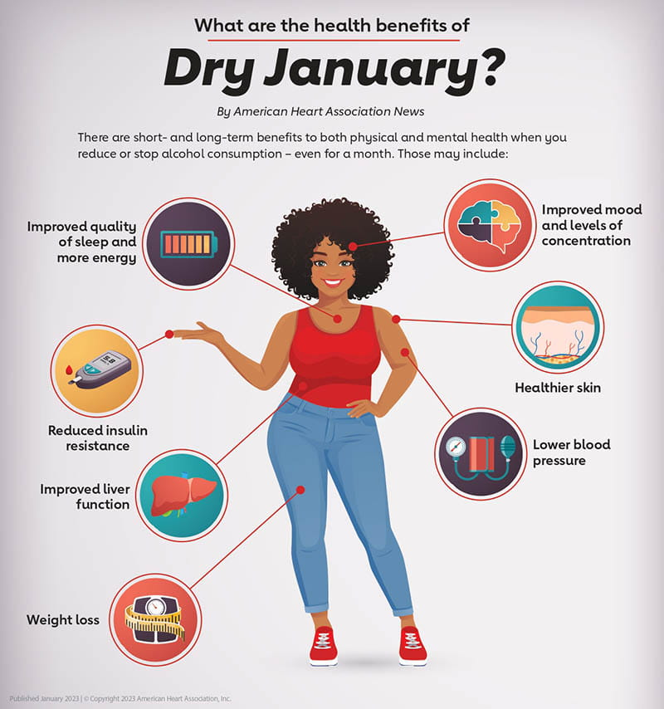
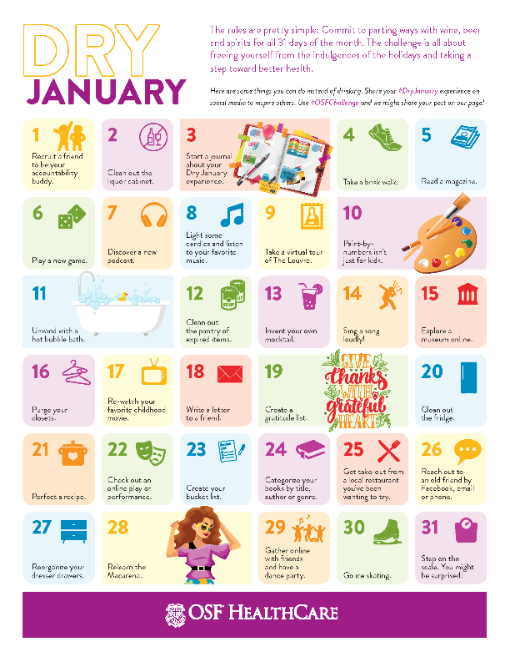
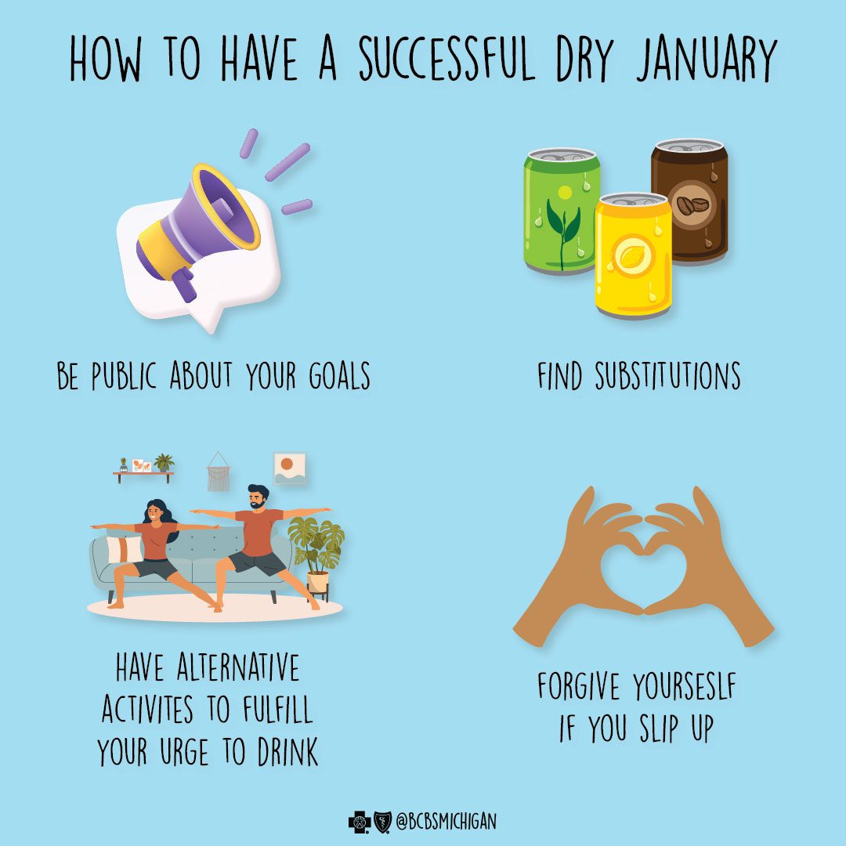

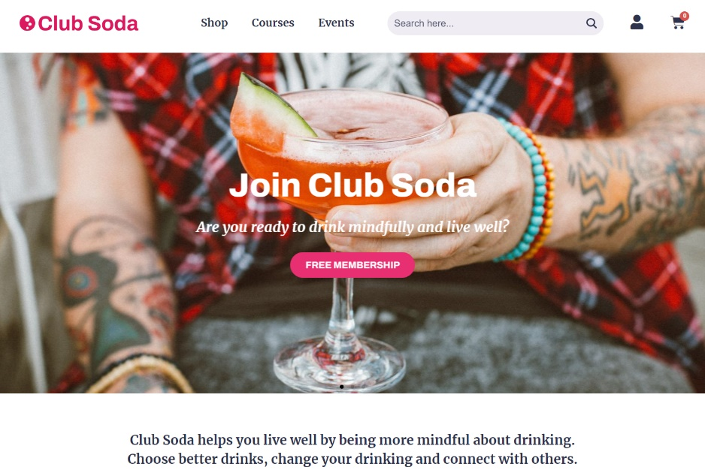
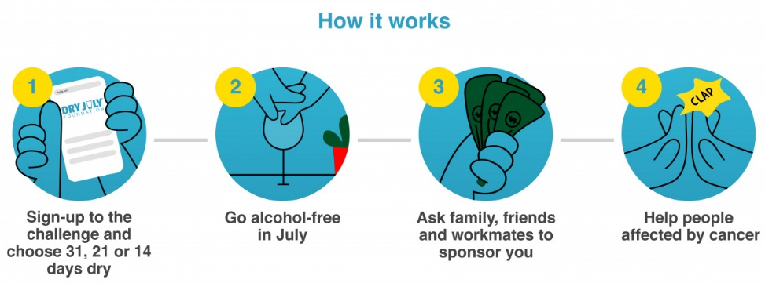
What is Sober Curious? (continued)
Change can be challenging and lonely – for example, when dieting you may avoid eating out, may avoid gathering with friends, avoid celebrations/events, etc.
Drinking is part of everyday life – social events, celebrations (like weddings, graduations), how you unwind at the end of the day, etc.
Social challenges like Dry January, Sober Spring, Dry July, and Sober October have become more commonplace.
Content is easily found, bars offer mocktails, grocery stores have non-alcoholic options, can recruit friends to join the challenge, can find inspiration/support on social media, drink tracking apps (# of drinks, mood, weight), dating apps, books, journals/diaries, etc.
Sample of content and ways to engage available online and/or through social media:
Source: Sober Curious by Ruby Warrington; American Heart Association; OSF HealthCare, Blue Cross Blue Shield Michigan, Dry July Foundation
Notes:
https://www.heart.org/-/media/Images/News/2023/January-2023/0103DryJanuary_Infographic_SC.jpg
https://www.osfhealthcare.org/blog/wp-content/uploads/2019/12/Dry-January-Calendar-2021_FIN.png
https://www.ahealthiermichigan.org/wp-content/uploads/2023/01/DryJanuary-01.jpg
https://www.gannawarra.vic.gov.au/files/assets/public/image-galleries/media-releases/dry-july-2021-002.png?w=1200

Slide 28

Sober Curious Tools and Strategies
“On average, it takes more than 2 months before a new behavior becomes automatic – 66 days to be exact.”*
The Sober Curious movement uses many tools and strategies utilized by other well-being/treatment programs:
Self-reflection / practice mindfulness
Self-care exploration
Meditation
Focus on what you want as much as what you don’t
Make space for new things (rituals, activities, friends, etc.)
Understanding triggers / why you drink
List out what causes you stress
List out things you’ve always wanted to do
Give yourself permission to slow down
Find a sober buddy as your support network
Focus on gratitude
Acknowledge (or document) your achievements
Make it normal not to drink as it is to drink
Source: Sober Curious Reset by Ruby Warrington; *How Long Does it Actually Take to Form a New Habit? By James Clear

Slide 29
Sober Curious Journey (Illustrative)
Case studies and interviews found during this information scan often mentioned individuals initiating their change journey after overindulging – in this case alcohol.
Below is a high-level journey that seems common among those wanting to change their alcohol consumption behavior.
Realizing change is needed after “boozy” December
Self-evaluation / working to change mindset
Contemplation
Preparation
Action/ Maintenance
Finding substitutes/ alternatives
Rely on friends/others for support
Avoiding places with alcohol
Reintroducing places with alcohol
Finding a starting point (e.g. Dry January)
Extending another month
Extending another month or longer
Sobriety / new lifestyle
“All I could think about was drinking”
“Still struggling… worried I had a drinking problem”
“Prove to myself I can do it”
“Hardest thing I ever did…best thing I ever did”
Source: Tom Holland interview – Jay Shetty Podcast; https://youtu.be/GOqEl4ADyVk start at 30:46

Slide 30
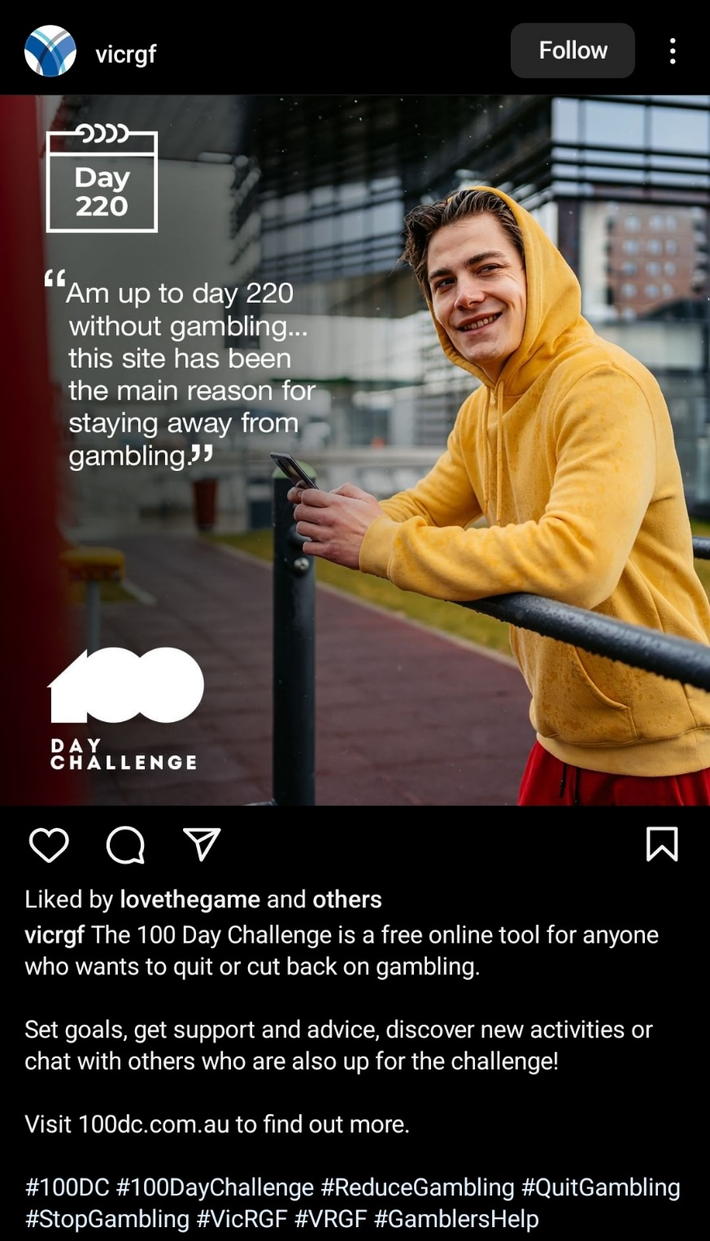
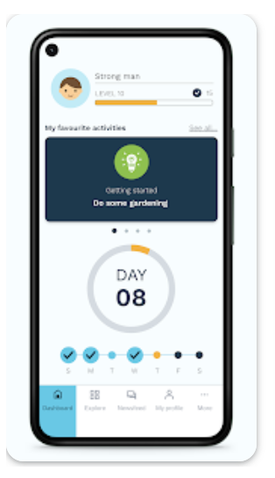
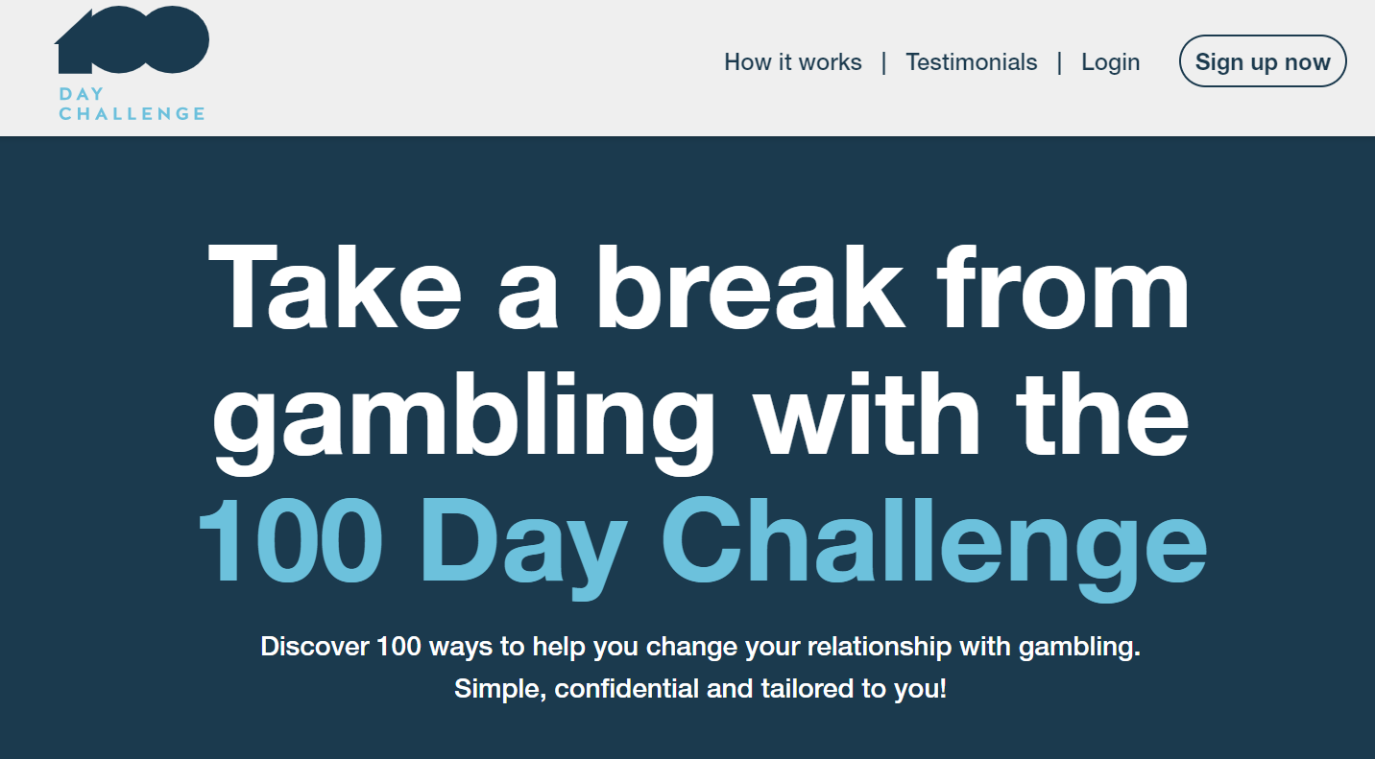
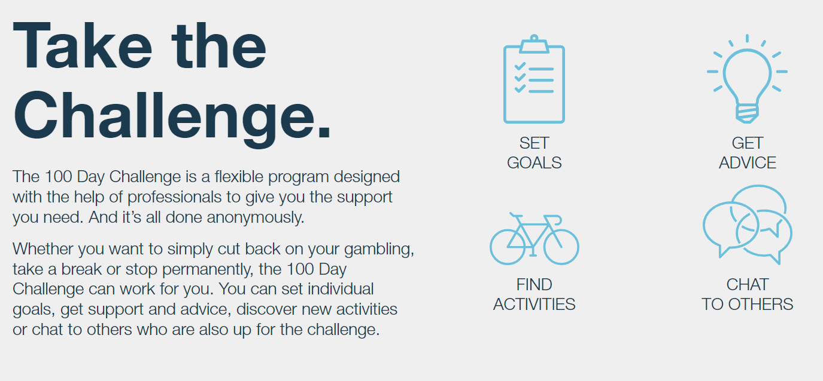
Limited Social Media Challenges in the Gambling Space
An extensive – but not exhaustive - search was conducted to identify similar social media tactics for making a gambling change. One social media gambling challenge was found: 100 Day Challenge (available online/app) to take a break from gambling.
Notes:
https://www.100dc.com.au/

Slide 31
Societal Shift on Mental Health & Well-being

Slide 32
Help Easily Accessible Outside of Traditional Clinical Setting
Talking about mental health and self-care is more commonplace today vs. 5 years ago.
There are a variety of apps available that align with Sober Curious tools/strategies as well as cognitive/experiential approaches to raise awareness and increase concern in the precontemplation/contemplation stages of change.
Talk Therapy | BetterHelp | Change the way people approach their mental health and help them tackle life's challenges by providing accessible and affordable care
Self-Care | Headspace | Through science-backed meditation and mindfulness tools, Headspace helps you create life-changing habits to support your mental health and find a healthier, happier you.
Cognitive Behavior Therapy (CBT) | MoodKit | Uses principles/techniques of CBT; helps you to engage in mood-enhancing activities, identify & change unhealthy thinking, rate & chart mood across time, and create journal entries designed to promote well-being.
Addiction | I Am Sober | For any addiction; track your sober days, it helps you build new habits and provides ongoing motivation by connecting you to a wide network of people all striving for the same goal: staying sober one day at a time.
Positive Thinking | Happify | Helps you relieve stress and think more positively in just a few minutes each day through fun, evidence-based games, and activities.
Gratitude | Gratitude | This app helps to teach you how to love and care for yourself through the power of gratefulness.
Source: App details pulled from specific App website
Free version of the app is available
Notes:
Australia: Reset App - Reset is a free and confidential app that will help you better understand your gambling.
Whether you want to quit or cut back on gambling, Reset is there with you every step of the way.
https://resetapp.com.au/

Slide 33
Moving Forward: Opportunities to Explore Further

Slide 34
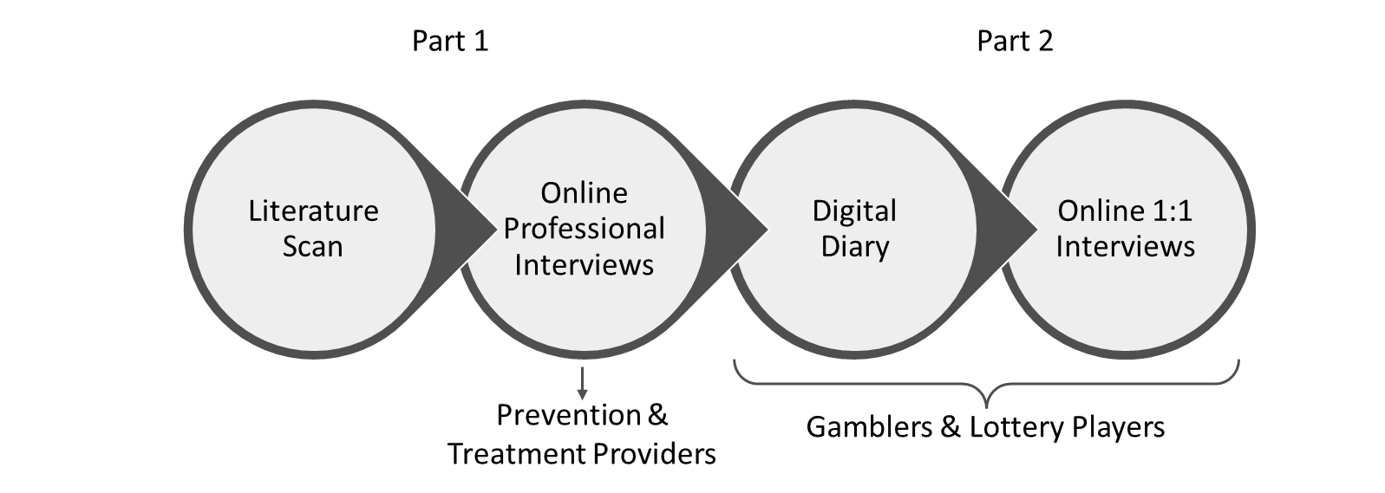

Next Steps:
Interviews with Prevention / Treatment Providers:
Understand from a clinician’s POV: how often do they encounter individuals seeking support other than referral to treatment?
How do these instances tend to be handled today?
What opportunities do they see for better addressing these instances?
What are their thoughts about tools and support to help individuals make desired changes to their gaming without necessarily recommending abstinence?
Is the current system set up to support those with low/emerging gambling concerns? Are there currently defined levels of support for these players?
Have they received input from problem gamblers about what they wish they knew or had access to before needing treatment? (e.g., ‘I wish I had known this was available’)
Explore roles of the operator (OSL) and prevention/treatment providers – how can operators help?
Online Diaries/Interviews with Gamblers Who Have Contemplated a Change:
Gain a deeper understanding of gamblers who have had concerns about their gambling behavior in the past and considered making a change
Gain insights into more proactive forms of support
Understand their journey in their own personal stages and experiences

Slide 35
APPENDIX
35

Slide 36
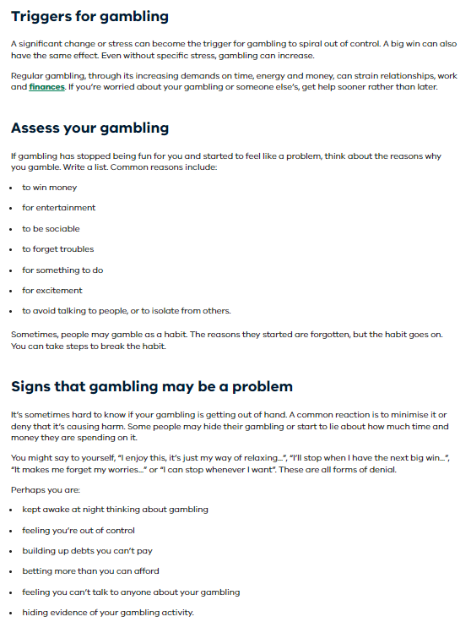
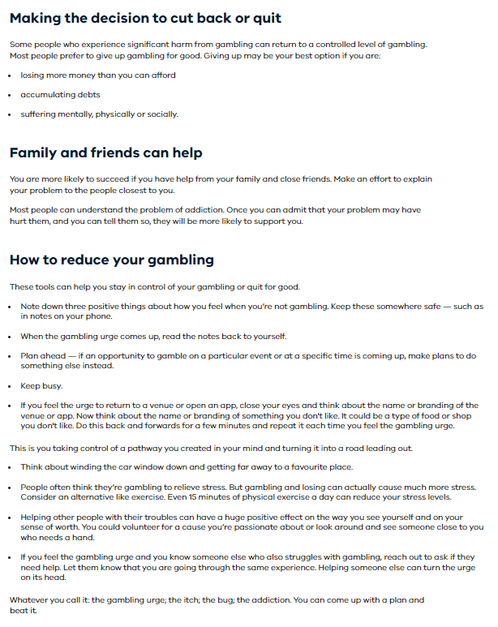
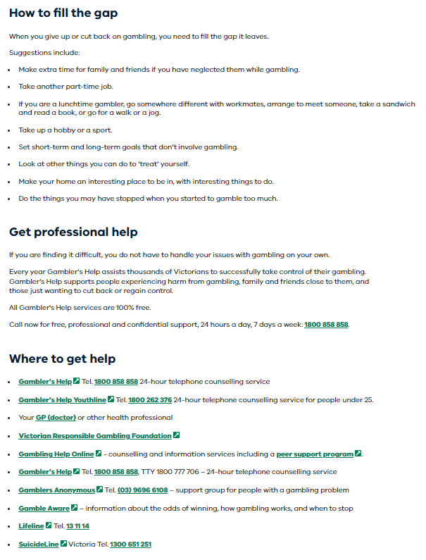
Learnings from Victoria’s Better Health Channel
The Better Health Channel uses the following approach:
Does not assume that the gambler needs and/or is ready for treatment
Meets the gambler where they are in their change journey
Provides a variety of support options, including an assessment tool and information, offering social/entertainment alternatives to gambling, promoting self-care, and providing multiple links to help lines/professional help.

Slide 37
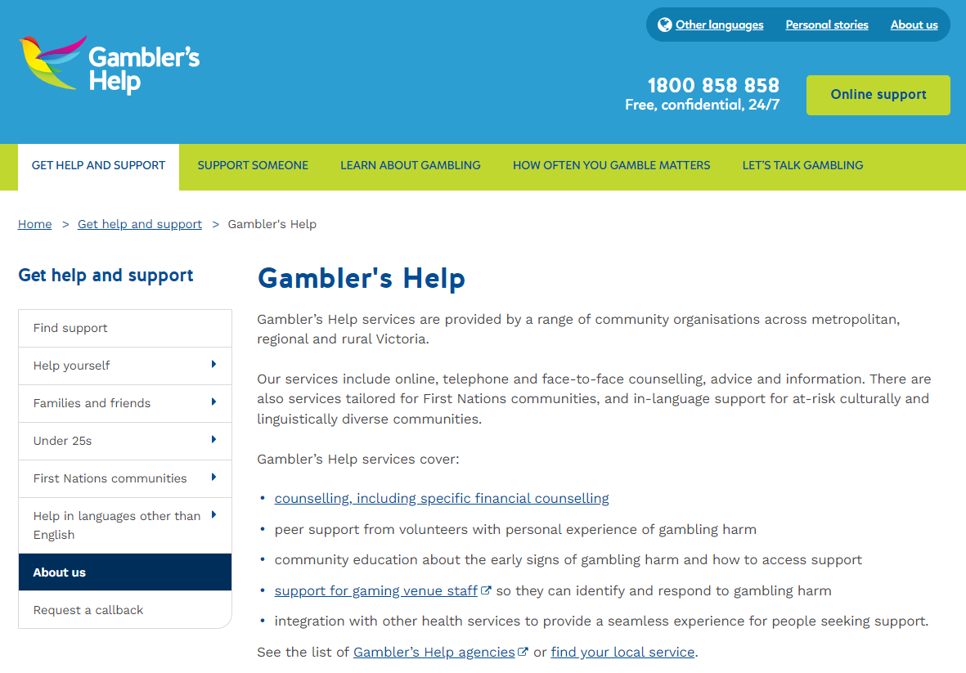
Victoria’s Gambler’s Help Site
Source: Gambler’s Help website

Slide 38
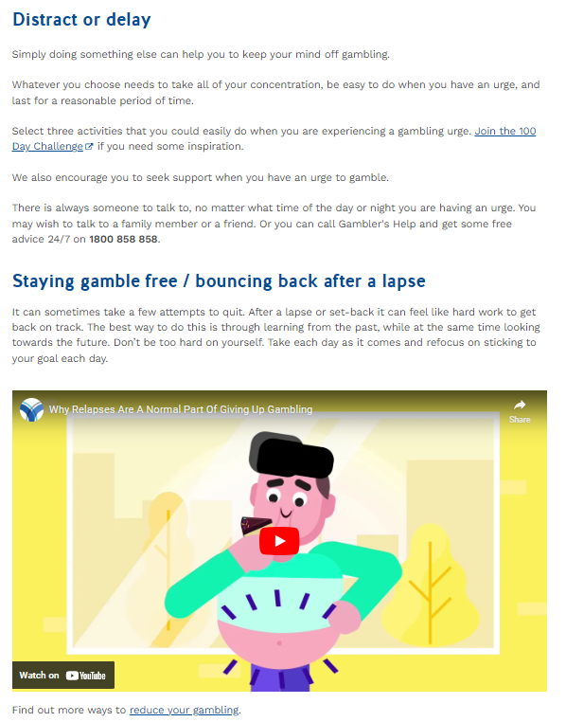
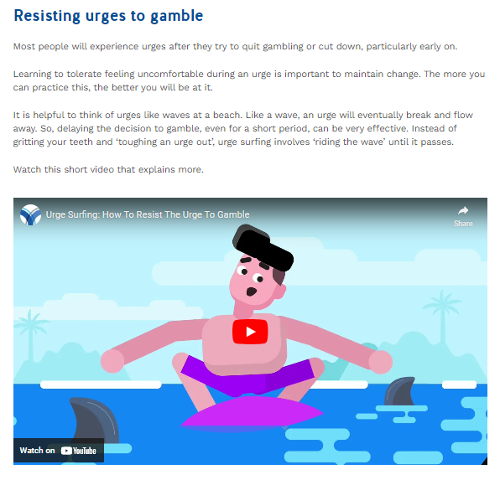
Victoria’s Gambler’s Help Site
Source: Gambler’s Help website

Slide 39
How Are WLA Certified U.S. Lotteries Talking About RG?
The responsible gaming information provided to players vary across jurisdictions – some had minimal information, some had simple text-based information, some had rich and interactive information.
 | CA Lottery | CO Lottery | GA Lottery | Hoosier (IN) Lottery | IL Lottery
How RG Info is Described on Website | Play Responsibly | Know Your Limits | Play Responsibly | Keep Play Positive | Responsible Gaming
Placement of RG on Home Page | Menu at top of page | Menu at top of page | Under rotating content window | Positive Play link at top of page | Link at bottom of page
What RGPG Content is Available on Website? | RG tips, PG help links and contact info, WLA RG certification | PG helpline, PG behaviors to avoid, youth gambling warning, RG tips, link to Gamesense, Gamtalk, Gam-Anon, variety of treatment and support resources | Self-assessment (text, not interactive), debunking myths, online safeguards, RG tips, PG help links and contact info, links to Gam-Anon, Gamblers Anonymous, downloadable RG brochure | Positive Play (PP) videos, track your play calculator, PP quiz, helpful resources, financial literacy education tools, preventing underage play, downloadable resources, connect w/counselor (chat) | RG commitment, RG tips, PG help, myths and facts, player security, online gaming safeguards, RG gaming guide (English and Spanish), links to download or access more info
How is the RGPG Content Presented on Website? | Image, expandable sections of text | Scenic state illustrations, images/text, interactive quiz, link to resources | Tabs for different RG information, mostly text based with some images, | Images, text, embedded videos, organized categories, visually engaging | Text, images/graphics
Special callouts? |  | Provide Gambling and Debt resources; includes tips to prevent Underage gambling |  | Provide Gambling and financial education resources; includes tips to prevent Underage gambling
Source: World Lottery Association (WLA) website; state lottery websites
Notes:
https://www.world-lotteries.org/services/industry-standards/responsible-gaming-framework/certified-lotteries

Slide 40
How Are WLA Certified U.S. Lotteries Talking About RG?
The responsible gaming information provided to players vary across jurisdictions – some had minimal information, some had simple text-based information, some had rich and interactive information.
 | MO Lottery | NC Lottery | NE Lottery | NJ Lottery | NM Lottery
How RG Info is Described on Website | Play Responsibly | Play Smart | N/A | Play Responsibly | Please Play Responsibly
Placement of RG on Home Page | Tab at top of page | Play Smart button at top of page | “Free PG help available” link at top of page | “Responsibility” link at top of page | Info middle of page, links to NM Council of PG
What RGPG Content is Available on Website? | Self-exclusion program, RG commitment, RG tips, annual report, WLA and NASPL/NCPG RG Certificate, contact info to PG help, fraud info/reporting | Tabs: play smarter, know the game, bust the myths, get support (call, text, chat), RG commitment; game odds, how to play info, remaining prizes, embedded videos | Free problem gambling help for Nebraskans at problemgambling.nebraska.gov | Commitment to RG, WLA Certification and WLA process, links to PG resources, gaming tips, embedded videos for PGAM &RG commercial, press releases, underage gambling warning | For RG info go to PG site, helpline, NM Council of PG brochure in English and Spanish
How is the RGPG Content Presented on Website? | Text, graphics, embedded videos | Text, colorful headings, embedded videos | Small font text | Text, simple graphics & images, embedded videos | Text with link to info/brochure
Special callouts? |  | Used distinct color scheme (green/purple) for RG content | No RG tips, just straight to treatment site | Also includes tips to prevent Underage gambling | No RG tips, just straight to treatment site
Source: World Lottery Association (WLA) website; state lottery websites
Notes:
https://www.world-lotteries.org/services/industry-standards/responsible-gaming-framework/certified-lotteries

Slide 41
How Are WLA Certified U.S. Lotteries Talking About RG?
The responsible gaming information provided to players vary across jurisdictions – some had minimal information, some had simple text-based information, some had rich and interactive information.
 | OH Lottery* | OR Lottery | PA Lottery | TN Lottery | TX Lottery | WI Lottery
How RG Info is Described on Website | Play Responsibly | Responsible Gaming | Please Play Responsibly | Play Responsibly | Play Responsibly | N/A
Placement of RG on Home Page | Top of page | Link to RG section at bottom of page | Link at bottom of page | Link at top of page. | Menu under Social Responsibility | No link to RG section available, PG info at bottom of page
What RGPG Content is Available on Website? | Link to gamble responsibly and self-exclusion site; treatment programs, warning signs, time out program, RG commitment, odds, PG help (live chat, phone #, link), OH RG contact info, extensive resources listed (OH+Nat’l), Gamblers Anonymous, gam-anon.org, Problem Gambling Ohio | RG commitment, RG tips, link to help resources, explain odds, RG Impact reports, OPGR.org | RG commitment/ strategy, phone # to PG help, RG links to articles/help, warning signs, link to NCPG screening tool, RG tips/tools | RG commitment, RG tips, RG resources (links, phone #), printable resources, embedded videos, CSR report, RG program update | Getting help (links, phone #), education (Positive Play, FAW, embedded training videos), guiding principles, risks of youth gambling, certifications, advertising guidelines, downloadable brochures/ posters (English & Spanish) | WLA Certification logo, Wisconsin Council on Problem Gambling logo, PG helpline (phone #, text)
How is the RGPG Content Presented on Website? | Graphic carousel highlighting two sites mentioned below; text, links, embedded videos | Text, animated graphics | Text-based with links, no images or graphics | Colorful, graphics, text, embedded video | Menu tabs, text with links to resources, graphics | Logos and text at bottom of page
Special callouts? | Link to more info: Timeoutohio.com and keepitfunohio.com |  |  |  | Includes tips to prevent Underage gambling
Source: World Lottery Association (WLA) website; state lottery websites
*Not WLA RGF Certified; NASPL-NCPG Responsible Gaming Verified
Notes:
https://www.world-lotteries.org/services/industry-standards/responsible-gaming-framework/certified-lotteries
https://www.ncpgambling.org/programs-resources/responsible-gambling/naspl-rgv/

Slide 42
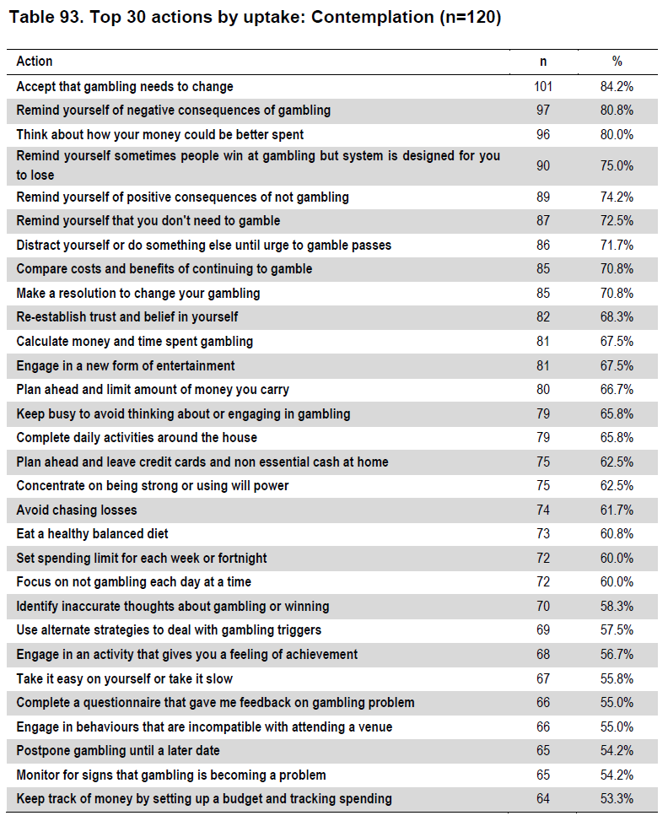
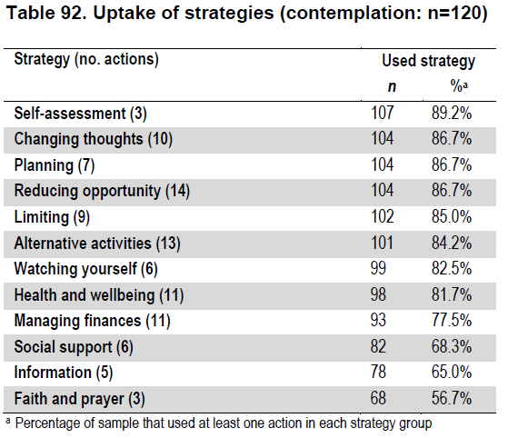
Uptake of Strategies/Actions – Contemplation Stage
Source: Gambling Research Australia: A Comprehensive Assessment of Self-Help Strategies and Actions 2013
Notes:
Hilbrecht, M. (Ed.). (2021). Prevention and Education Evidence Review: Gambling-Related Harm. Report prepared in support of the National Strategy to Reduce Gambling Harms in Great Britain. Greo: Guelph, Canada. https://doi.org/10.33684/2021.006
https://www.sciencedirect.com/science/article/abs/pii/S0306460316303185?via%3Dihub

Slide 43
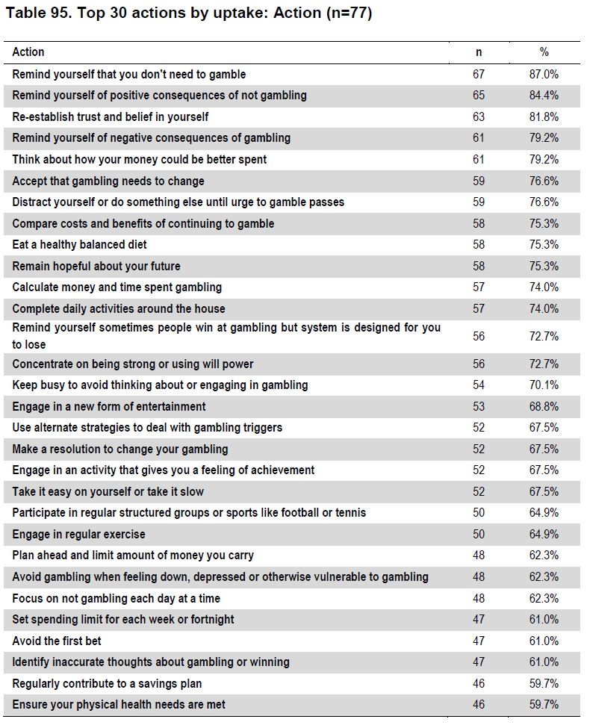

Uptake of Strategies/Actions – Action Stage
Source: Gambling Research Australia: A Comprehensive Assessment of Self-Help Strategies and Actions 2013
Notes:
Hilbrecht, M. (Ed.). (2021). Prevention and Education Evidence Review: Gambling-Related Harm. Report prepared in support of the National Strategy to Reduce Gambling Harms in Great Britain. Greo: Guelph, Canada. https://doi.org/10.33684/2021.006
https://www.sciencedirect.com/science/article/abs/pii/S0306460316303185?via%3Dihub

