Slide 1
Oregon Health Authority Problem gambling treatment follow up
Treatment Provider Webinar

Slide 2
We are excited to be partnering with you all on this treatment follow-up evaluation initiated by the Oregon Health Authority.
Data collected will be used to evaluate program effectiveness and inform any changes that can improve client outcomes and experiences.
This project is only possible if we work as a team. This webinar will introduce the project and outline your role as a treatment provider.
WELCOME!

Slide 3
agenda
Introductions
Project overview
Your role
Contact details

Slide 4
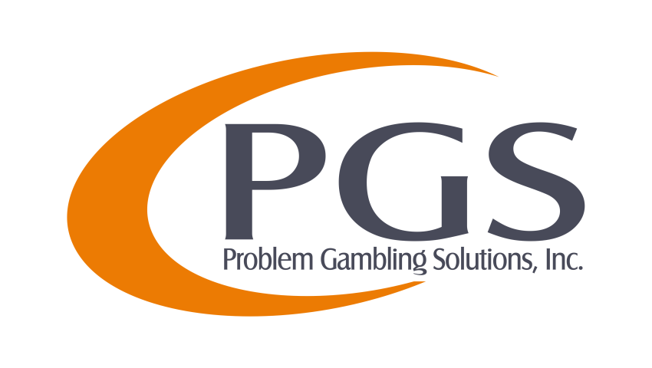
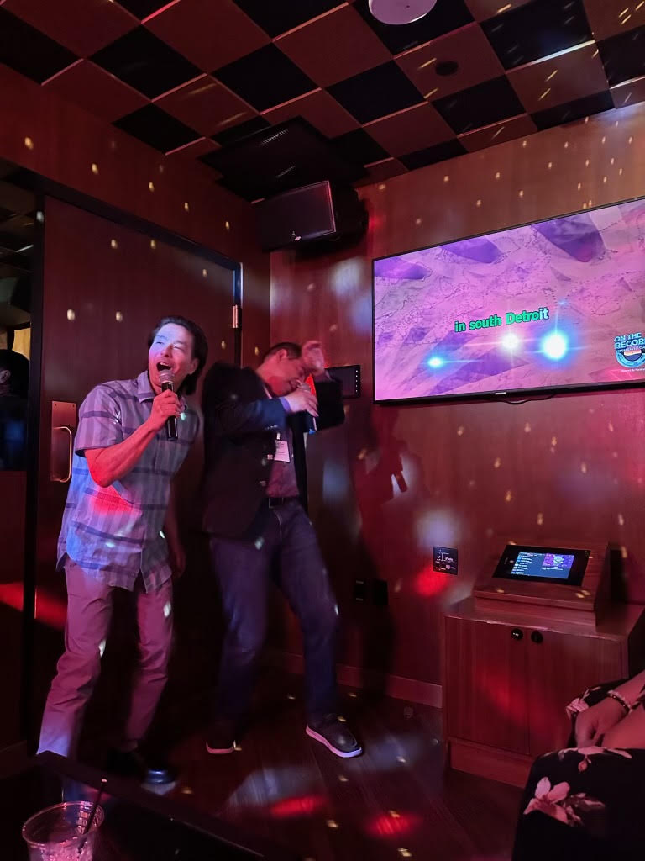
Meet the PGS inc. Team
Principle Consultant: Jeff Marotta, Ph.D., ICGC-II
Data Scientist: Glenn Yamagata, M.A., M.Phil.
Principle Investigator: Paige Reohr, Ph.D.
Paige studied clinical psychology at Pacific University as part of Pacific's Sabiduría Latinx Psychology emphasis.
Paige also works for a nonprofit practice, Mangata Wellness, serving Marion County adolescents and adults with psychotherapy, cognitive assessment, and immigration evaluation services.
Jeff, the one who looks like he is perfecting the art of the ‘standing nap’ has been in the problem gambling profession for over 30 years. He is passionate about attending conferences and expressing his inner and outer voices. Jeff is the President of Problem Gambling Solutions and an internationally known expert in problem gambling service development.
Glenn, the one displaying remarkable microphone swagger, is new to the problem gambling profession, but is widely considered an up-and-coming rockstar in the underground, problem gambling Karaoke scene. Glenn has an MA in Statistics and MPhil in Economics from Yale University and has collaborated with PGS on multiple projects.
Paige has worked as a research assistant for Problem Gambling Solutions, Inc. since 2021.
Notes:
OHA Problem Gambling Services Steering Committee Members
Greta Coe: Problem Gambling Services Manager
Brandie Lyday: Treatment Program Development Analyst
David Corse: Treatment Program Development Analyst

Slide 5
Project Overview
Repeat process, creating an ongoing cycle of surveying, analyzing, reporting, and improving.
5
5. Repeat
Based on analyses and careful consideration, enact changes to improve delivery of OHA problem gambling treatment services.
4
4. Improve
Generate various monthly, quarterly, and annual reports for key stakeholders.
3
3. Report
Analyze data to measure treatment outcomes and identify potential explanatory factors.
2
2. Analyze
Collect client treatment, satisfaction, outcomes, and demographic information.
1
1. Survey

Slide 6
SURVEY
Collect information from clients based on timely client interviews¹.
PERIOD
Treatment (days from admission)
Post-treatment (days since discharge)
CLIENT CONTACT TYPE
0
1-15
30
90
180
365
0
180
365
Project overview / consent
Welcome call
First in-treatment follow-up
Second in-treatment follow-up
Third in-treatment follow-up
Fourth in-treatment follow-up
Exit interview
First post-treatment follow-up
Second post-treatment follow-up
1. Information will also be collected from PG Net. Also, not all clients are expected to be in treatment for 1 year (365 days).

Slide 7
Treatment provider role
INTRODUCE PROJECT TO NEW CLIENTS
(JULY 1)
Discuss benefits of participation
INFORMED CONSENT (provided by evaluation team)
Clients can opt in or decline to participate
ENCOURAGE RETENTION
Fax or secure email consent form
If client agrees to enroll, encourage answering calls:
Call Paige in session to introduce
Encourage client to program Paige’s number (503-270-3902) into their phone
Orient client to project
Can enroll a client at anytime; however, at treatment enrollment is ideal
Even after treatment ends, we can be a source of support and accountability
Ask about the survey experience
If they are thinking about dropped out, revisit the benefits and talk about what they think
Notes:
PG_Tx_Evaluation@problemgamblingsolutions.com

Slide 8
Sample Script
Our agency is participating in an exciting project that relies on client feedback to improve gambling treatment services across the state of Oregon. All gambling treatment clients in Oregon are being asked to share their experience with an independent Oregon based research team. Your participation would not only be used to help future clients, it also provides extra support for you in the form of a clinical researcher periodically checking in with you over time up to two years, including after you complete your time here.
Participation would entail completing no more than seven surveys over the phone over the course of two years to learn more about how helpful your treatment was and what could be done better. Consenting to participation will help improve problem gambling treatment for other Oregonians and you can opt out at any time and it will never affect the care you receive here with me.
There is some more information from the evaluation team here [provide the consent form], and you will notice they put a lot of emphasis on your privacy; not even I will know how you respond to the surveys. This is completely optional and if you do choose to participate, the information you provide will be used to improve problem gambling services for other Oregonians.

Slide 9
Benefits to participation
Clinical Service
Adds to increased accountability that supports recovery. People in recovery do better when there is accountability.
Evaluation for Program Improvement
Clients can give back to their programs. Their services are covered, and this is one way they can feel engaged in returning the favor.
Research
We will be able to use these data to add knowledge to the field about what supports problem gambling treatment engagement and positive outcomes
Key strategy for retention is developing a relationship with the client, which we hope is seen as supportive to their recovery
We are following clients after their treatment with you ends. It is designed so that those needing additional help can get connected, including re-engagement
Providers will be provided with reports including agency-specific feedback from clients, including what they find most and least helpful
Clients may appreciate being able to participate in research. Participants may feel that they give meaning to their suffering to improve care for others.

Slide 10
Key takeaways
Start date: July 1!
This is a team/community effort. To be successful, we need your help enrolling clients into the project.
Consent forms needs to be submitted for every client, whether they agree to participate or not.
Ideally, we would like consent forms introduced during enrollment process
We recognize there are situations where that is not ideal, and we will accept consent forms any time.
If client agrees to participate, encourage them to program the project number into their phone in session
Number: 503-270-3902
“Paige” or “PGS”
Submit consent forms within 2 business days
Fax: 1-503-270-3980
Secure email: PG_Tx_Evaluation@problemgamblingsolutions.com
Let them know we will typically contact them within a week.

Slide 11
Project Contact
Problem Gambling Solutions, Inc.
Primary contact: Paige Reohr
Telephone: 503-270-3902
Fax: 1-503-270-3980
PG_Tx_Evaluation@problemgamblingsolutions.com
OHA Problem Gambling Services
Primary contact: Greta Coe
greta.l.coe@oha.oregon.gov

Slide 12
Questions, thoughts, or concerns?

