Slide 1
Staff wellness program
Clackamas community college
2/13/2023

Slide 2
CCC staff wellness program We want to create opportunities and events for improving the overall health and wellness of our employees at CCC.

Slide 3
CCC Staff wellness program Quarterly staff challenges lunch and learns fitness center staff only locker room chair massage health fairs weekly newsletter

Slide 4
Oebb choice trust wellness grant survey to staff – how can we help support your overall health and wellness during covid? Connect and engage with co-workers What we did: Lunches Kaiser Moda Gift bags

Slide 5
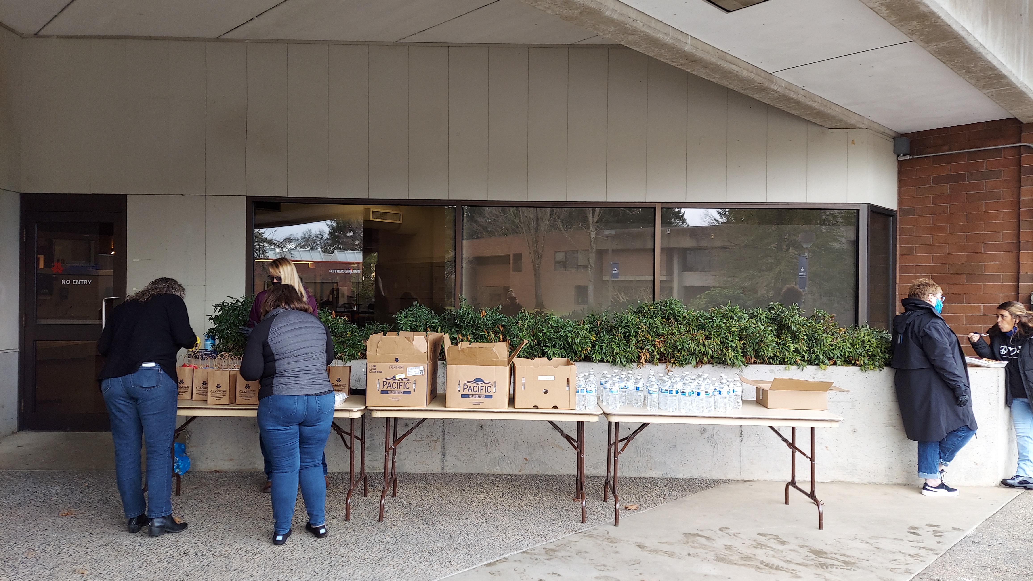
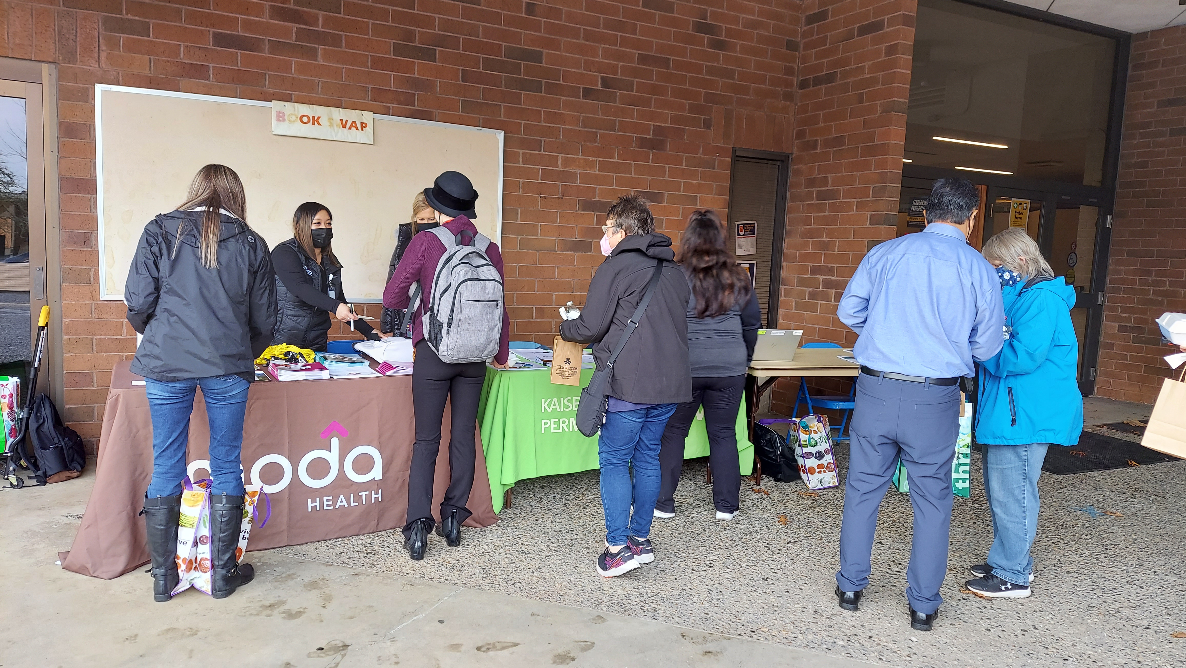
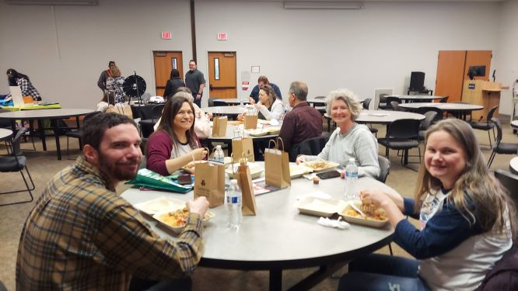
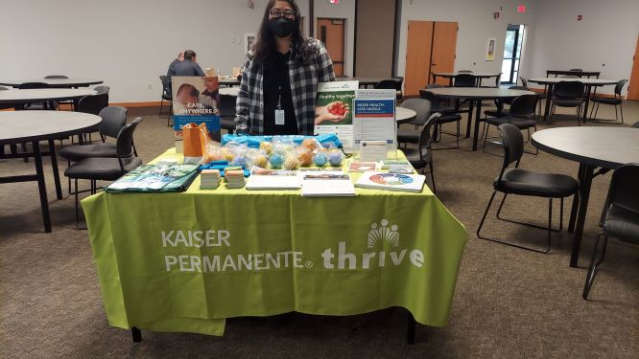
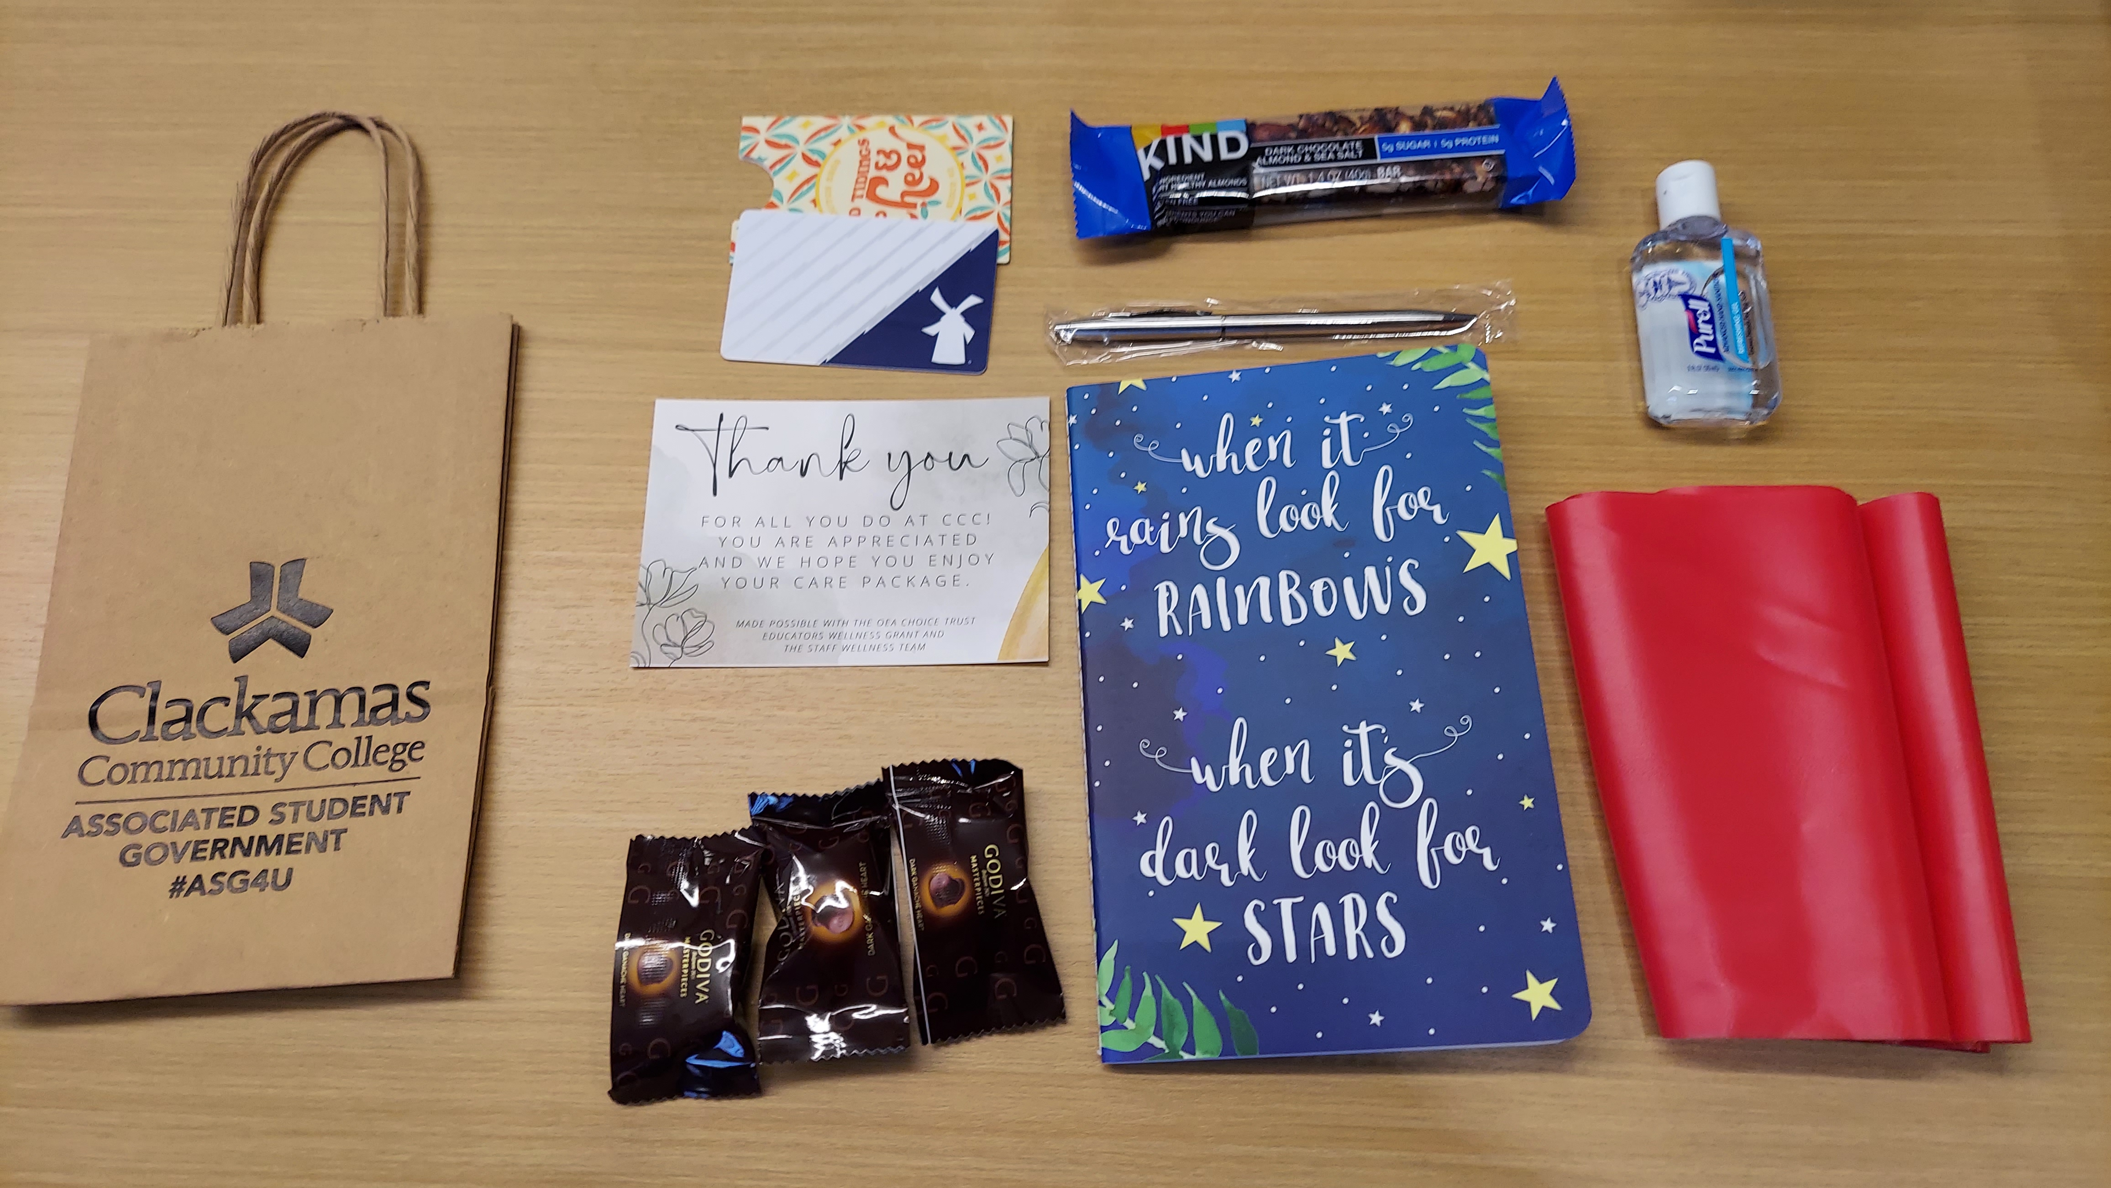
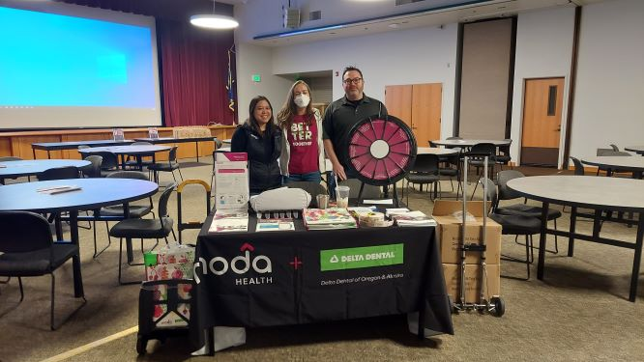
Oebb choice trust wellness grant

