Slide 1
HTO in Action: Healthy Families November 15th, 1:00 – 2:30 pm
Notes:
Good afternoon everyone. Welcome to our fourth HTO in action event. We’re thrilled to have you join us at this series of events we’re convening around Healthier Together Oregon – our State Health Improvement Plan. . Today we’ll be digging into the implementation area of Healthy Families.
Before we begin, a few house keeping items.
Please ensure your lines are muted for the duration of the event.
Cameras on or off
Please introduce yourself in chat –name and pronouns and what brought you to today’s event.
We love an active chat! Share information and thoughts/reactions/resources/make friends/ask questions/
Recorded meeting for sharing with exception of breakouts. Slides and link to recording will be sent after the event.
Liz/Heather – get intros started in chat.

Slide 2
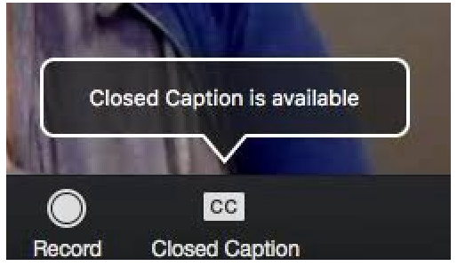
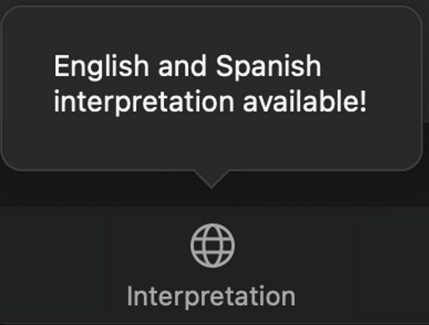
Closed Captioning & Interpretation
Notes:
A note about language accessibility..
Spanish interpretation is available –by clicking interpretation button.
Closed captioning is available in English or Spanish – these links will be posted in the chat.
Heather to copy/paste into chat.
English: https://www.captionedtext.com/client/event.aspx?CustomerID=2697&EventID=4775297
Spanish: https://www.captionedtext.com/client/event.aspx?CustomerID=2697&EventID=4775296

Slide 3
Tribal lands acknowledgment
We acknowledge that what we now call Oregon is the ancestral lands of many Tribes, those now federally recognized and not.
We are here because this land was occupied, and its traditional people were displaced by colonists and settlers. As settlers and/or guests, we recognize the strong and diverse Native communities in our region today, from Tribes both local and distant, and offer respect and gratitude for their stewardship of these lands throughout the generations.
Learn about Oregon’s tribes here: https://native-land.ca/
Notes:
Christy
Before we begin, I want to share OHA’s acknowledgements to community – starting with the tribal lands we all call home.
Liz to share link in chat. https://native-land.ca/
We will provide a link in the chat and we invite you to explore the map you’ll find there to learn about and acknowledge the tribes in and from your community.

Slide 4
OHA Acknowledgements
OHA acknowledges there are institutional, systemic and structural barriers that perpetuate inequity and have silenced the voices of communities over time.
OHA is committed to partnerships, co-creation and co-ownership of solutions with communities disproportionately affected by health issues so they can actively participate in planning, implementing and evaluating efforts to address health issues.
OHA recognizes community-engaged health improvement is a long-term and dynamic process.
OHA is striving to engage with communities through deliberate, structured, emerging and best practice processes.
OHA is striving to make engagement with public health effective for communities, especially those communities that experience institutional, systemic and structural barriers.
Notes:
Christy.
I’d also like to share OHA’s acknowledgements to community.
Thank you all for being here to share with us and with each other how we can advance health equity. Here at OHA we’re trying to do our work differently – and we thank you for your graciousness as we learn.

Slide 5
Purpose of “HTO in Action” events
Advance health equity through increased coordination and alignment of health improvement planning and implementation
Overview of HTO strategies and potential activities, by implementation area
Connect with others across the state doing similar work to identify next steps
Showcase examples of work in progress
Notes:
Christy
Today is the fourth in a series of 8 events we’re putting on to highlight the strategies and activities identified for Healthier Together Oregon or HTO. The purpose of these events to convene partners from around the state who are working to advance health equity. It’s an opportunity to dig a bit deeper into the strategies and activities of this plan, share examples of work in progress and connect with others.

Slide 6
Agenda
Overview of Healthy Families implementation area
Moving forward together –
Breakout rooms for relationship building and dialogue
Examples of HTO in action
Notes:
Christy
In terms of the agenda for today – I’ll first provide a brief overview of HTO and strategies within the healthy families implementation area.
Then – I'll be turning it over to partners who are doing this work. I’m super pleased to welcome folks from the Family Preservation Project, the Black Parent Initiative and the Family Connects program.
Finally – through the magic of Zoom – we’ll have breakouts which will be an opportunity for you all to connect with other people in the state who are invested in this work.

Slide 7
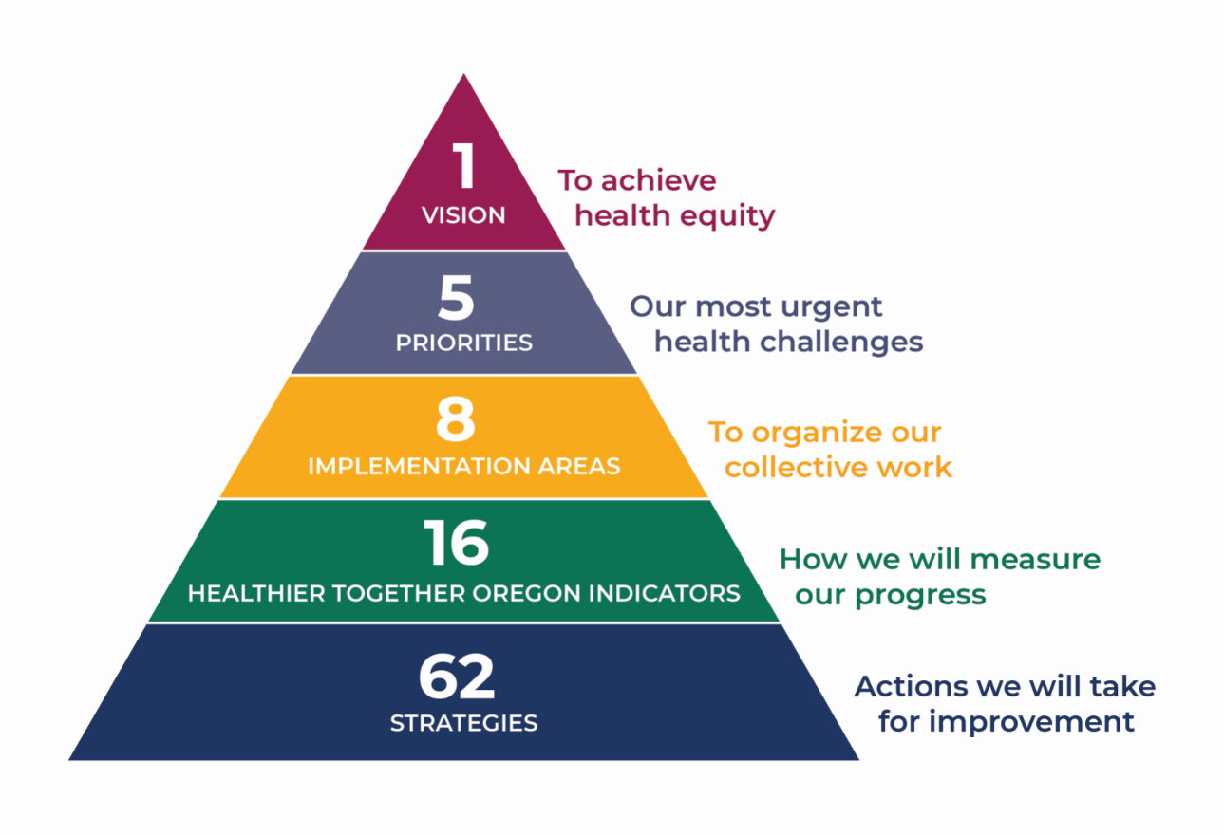
Implementation Framework
Notes:
Christy
For those who are less familiar with the Healthier Together Oregon plan – here’s a framework that summarizes what it encompasses.
HTO is a five year plan to advance health in our state
Five priorities have been identified for the plan – institutional bias, adversity trauma and toxic stress, behavioral health, economic drivers of health such as housing, transportation and living wage jobs, and access to equitable preventive health care. As our subcommittees developed the plan, they often saw the interconnectedness of these areas. For example, we can look at disparities in discipline rates in education with the lens of institutional bias and look at the benefits of restorative justice in schools from a trauma and toxic stress lens, however they are both related to youth.
So in order to organize the aspirational, innovative and exciting ideas that have come out of the subcommittees under each priority, we’ve developed this implementation framework that attempts to speak to this interconnectedness. Eight areas of implementation have been created to help organize this work which we will go over in the next slide. Progress towards our goal of equity will be measured by 16 indicators. And 62 strategies, with underlying activities will be our work.

Slide 8
Priority Populations
Notes:
Christy
The goal of HTO is to advance health equity for these six priority populations that were identified in the State Health Assessment and Indicators.
Liz to provide link to sha in the chat: healthoregon.org/sha

Slide 9
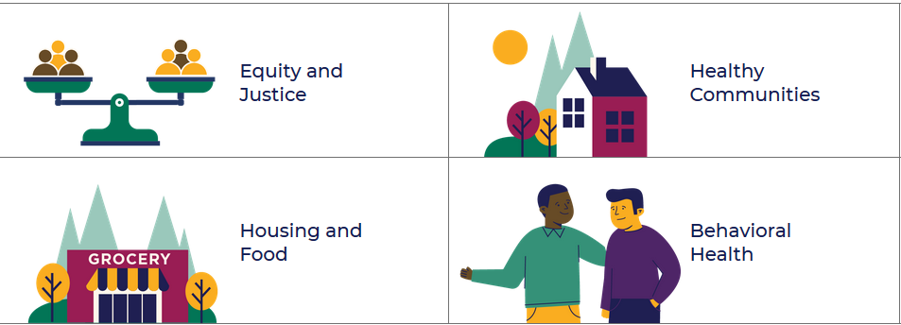
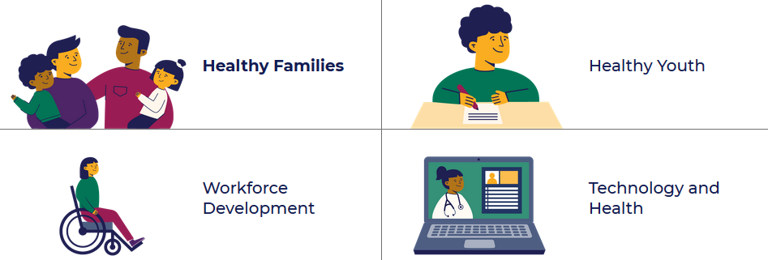
Implementation Areas
Notes:
Christy
As I mentioned there are 8 implementation areas in the plan: …READ areas.
Today’s event will be focusing in on the Healthy Families area of the plan. For information about the other areas – I encourage you to visit the website and/or review recordings from past HTO in action events.
Also see this plan has a tool for recovery and resilience building out of COVID.

Slide 10
Healthy Family Strategies
Notes:
Christy – Strategies within the healthy families implementation are fall into three broad categories of work; childcare and caregiving, access to preventive services, and family resilience.

Slide 11
Strategies and activities
Ensure access to and resources for affordable, high quality, culturally and linguistically responsive childcare and caregiving.
Example activities
Increase funding for childcare assistance
Promote Employment Related Day Care
Invest in universal access to pre-K care
Support use of Relief Nurseries
Expand compensation opportunities for all caregivers
Notes:
There are two strategies related to early childhood and caregiving.
#1 -

Slide 12
Strategies and activities
Expand evidence based and culturally and linguistically responsive early childhood home visiting programs.
Example activities
Implementation of Family Connects and other home visiting programs
Build support base for Oregon Infant Toddler Mental Health Association
Ensure culturally appropriate services through use of traditional health workers
Notes:
The 2nd is…
You’ll hear more about the Family Connects program later on this event.

Slide 13
Resources related to early childhood and caregiving
Family Connects Oregon
Raise Up Oregon: Statewide Early Learning System Plan
Employment Related Day Care
Family Forward Oregon
Oregon Association of Relief Nurseries
Multnomah county’s Preschool for All
OSU’s Early Learning and Education Data
Early Learning Map of Oregon
Notes:
To learn more about these strategies and activities – here are some related links. If there are other resources you’d like to share from your community – please drop those in the chat.
Links for chat:
https://www.familyconnectsoregon.org/
https://oregonearlylearning.com/raise-up-oregon
https://www.oregon.gov/dhs/assistance/child-care/Pages/index.aspx
https://familyforwardoregon.org/
https://www.oregonreliefnurseries.org/ourwork
https://www.multco.us/dchs/preschool-all
https://health.oregonstate.edu/early-learners/supply
https://davidmc.shinyapps.io/oregon-ece-app/

Slide 14
Strategies and activities
Build family resiliency through trainings and other interventions.
Example activities
Expand parent education programs related to attachment and resiliency skills
Support the Oregon Parenting Education Collaborative
Use a broad definition of family
Notes:
The next set of strategies address family resilience.
Such as

Slide 15
Strategies and activities
Use healthcare payment reforms to support the social needs of patients.
Example activities
Create incentives and encourage flexibility to support access to food, housing and transportation.
Use regulatory levers such as health insurance and health system regulation and workforce licensure.
Notes:
This is really about the investments that the health care system can and are making - namely CCOs and non profit hospitals – to address both the social needs and social determinants in their community.

Slide 16
Resources related to family resilience
Oregon Alliance
Oregon Parenting Education Collaborative
CCO Health Related Services
CCO SHARE initiative
Oregon hospital community benefit
Help me Grow Oregon
Family Preservation Project
Notes:
To learn more about these strategies and activities – here are some related links. If there are other resources you’d like to share from your community – please drop those in the chat. You’ll be hearing more about the Family Preservation Project in a bit.
https://www.oregonalliance.org/
https://orparenting.org/
https://www.oregon.gov/oha/HPA/dsi-tc/Pages/Health-Related-Services.aspx
https://www.oregon.gov/oha/HPA/dsi-tc/Pages/SHARE.aspx
https://visual-data.dhsoha.state.or.us/t/OHA/views/CommunityBenefitDashboard/Welcome?:showAppBanner=false&:display_count=n&:showVizHome=n&:origin=viz_share_link&:isGuestRedirectFromVizportal=y&:embed=y
https://oregon.providence.org/our-services/h/help-me-grow-oregon/
https://www.ywcapdx.org/what-we-do/family-preservation-project/

Slide 17
Strategies and activities
Expand reach of preventive services through evidence based and promising practices.
Example activities
Promote access to Naloxone through pharmacy partnerships
Expand syringe exchange programs
Promote long-acting reversible contraception like IUDs
Increase utilization of the National Diabetes Prevention Program
Expand community-based access to vaccination
Notes:
Third bucket of strategies is related to increasing access to equitable preventive services.

Slide 18
Strategies and activities
Increase patient health literacy.
Example activities
Share health literacy training with providers
Consider trainings available online, tailored for different audiences, and with cultural and language considerations.
Notes:
Emphasis here is on training of providers to better support health literacy among their patients.

Slide 19
Strategies and activities
Support Medicare enrollment for older adults through expansion of the Senior Health Insurance Benefits Assistance (SHIBA) program.
Example activities
Expand senior Medicare patrol – volunteers who educate seniors about Medicare fraud and abuse
Provide assistance for people leaving carceral settings
Promote Medicare and Medicare advantage plans
Address transportation barriers

Slide 20
Strategies and activities
Increase access to pre and postnatal care for low-income and undocumented people.
Example activities
Expand awareness of pre-natal care available through CAWEM+ and forthcoming Cover all People
Expand the Oregon Perinatal Care Continuum (PCC) model
Improve access to doulas, especially doulas of color

Slide 21
Strategies and activities
Improve access to sexual and reproductive health services.
Example activities
Expand funding models for expedited partner therapy
Destigmatize need for sexual and reproductive health services
Encourage pharmacists to prescribe and dispense contraception.
Ensure partner services for HIV and STI

Slide 22
Resources related to preventive services
Community Doula Alliance
Oregon Doula Association
OHP Covers Me!
End HIV Oregon
Oregon’s Senior Health Insurance Benefits Assistance
Perinatal Care Continuum Model
Stay Safe Oregon (harm reduction and overdose prevention resources)
Oregon Reproductive Health Program
Black Parent Initiative
Notes:
To learn more about these strategies and activities – here are some related links. If there are other resources you’d like to share from your community – please drop those in the chat. You’ll be hearing more about the Family Preservation Project in a bit.
https://communitydoulaalliance.com/
http://www.oregondoulas.org/ohp
https://www.oregon.gov/oha/HSD/OHP/Pages/OHPcoversme.aspx
https://www.endhivoregon.org/
http://www.centraloregonhealthdata.org/tiles/index/display?id=212917096071191513
https://shiba.oregon.gov/Pages/index.aspx
https://staysafeoregon.com/
https://www.oregon.gov/oha/PH/HEALTHYPEOPLEFAMILIES/REPRODUCTIVESEXUALHEALTH/Pages/index.aspx
https://www.thebpi.org/

Slide 23
HTO in Action Black Parent Initiative
Notes:
Christy
I’m now going to turn it over to three examples of this work in action – starting with the Black Parent Initiative. The Black Parent Initiative is a CBO based in the Portland metro area. The Black Parent Initiative (BPI) was established in 2006 to help families achieve financial, educational and spiritual success. BPI was founded and organized on a large body of educational research that demonstrates the importance of parental and family engagement in attaining educational success for children. I’ll now turn it over to Bahia? (Or someone else) to talk about BPI and specifically the work of the Sacred Roots program which provides culturally responsive doula services.

Slide 24
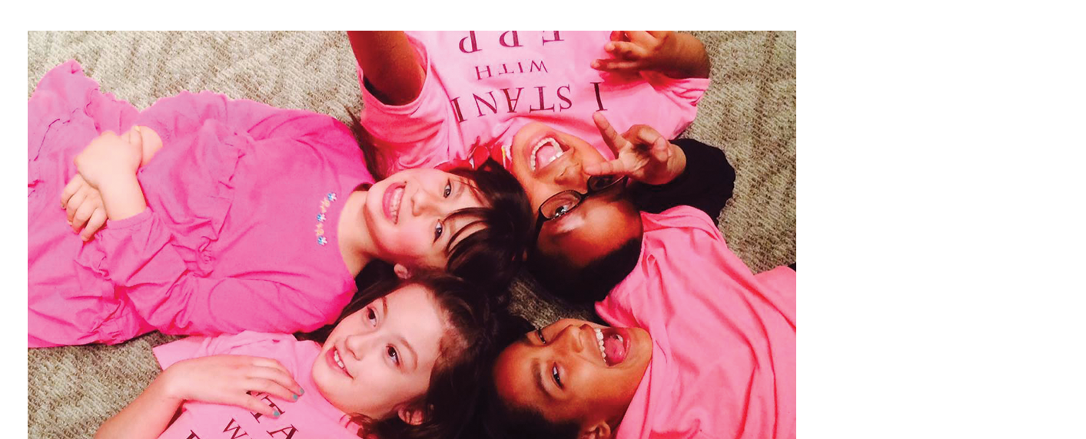
HTO in Action Family Preservation Project
Notes:
Christy
Next up – we have the Family Preservation Project which promotes individual and system level change to reduce the collateral consequences of parental incarceration on children, families, and the community. FPP provides 8 direct service programs, four of which operate inside Coffee Creek Correctional Facility (CCCF) in Wilsonville, Oregon. I’ll now turn it over to Jessica Katz – Project Director for the Family Preservation Project.
Link to video: https://www.youtube.com/watch?v=Z3PIQKTsrQU

Slide 25
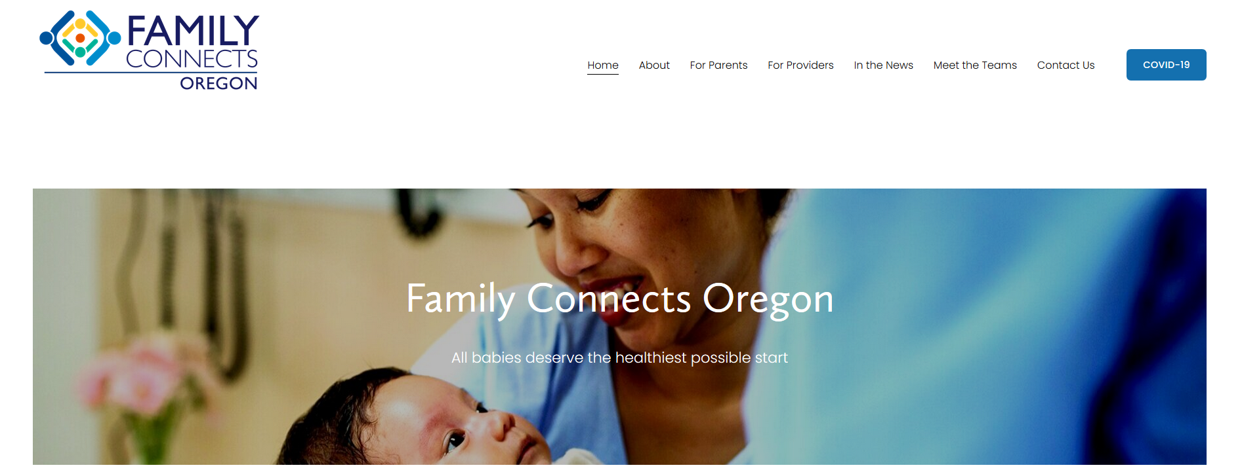
HTO in Action: Example
Notes:
Christy
Finally – we’ll hear a bit more about the Family Connects Program – Oregon’s universally offered home visiting program which was established by the Oregon legislature in 2019. The goal of Family Connects is to offer home visiting to all families in the first few weeks following the birth of a baby. I’ll now turn it over to Cate Wilcox, section manager of OHA’s maternal child and health program to share updates about implementation of this work.

Slide 26
Local examples of action
Relationship building and dialogue
#1 Introductions and networking– Share your name and pronouns, role or agency, and where in the state you are located.
#2 Discuss strategies – Share examples of how your community is advancing these strategies in your community. What do you see happening that is working, or not working?
#3 Discuss priorities – If you could advise our community-based steering committee, the PartnerSHIP, on activities needed in your area, or opportunities for the future you’d like to see in your community, what would you tell them?
Notes:
Now it’s your turn to connect and innovate together. We’ll send the next minutes in break out rooms of 3 or 4 people. This is an opportunity to connect with folks around the state who are doing similar work and generate ideas/connections with others. In your groups, we ask you to discuss these three questions.
Share examples and ideas on the Google Jamboard – there are boards to leave notes for Q2 and Q3.
Liz – post the link to the Jamboard: https://jamboard.google.com/d/1aL_bk3h-1SE1hznRh7Dl4lYYv2lZRyWnWQPvQnJlL3k/edit?usp=sharing

Slide 27
Polling
Polling question: Share one next step you will take as result of this webinar:
Share webinar information with a friend or colleague
Connect offline with someone I met during the event for further conversation
Do more research and reading about a particular strategy or activity
Something else
Notes:
As we wrap up – I’m also curious to know what your next step is.

Slide 28
Thank you & Next Steps
Visit healthiertogetheroregon.org to learn more about HTO
Join us for another event in the series…
Healthy Youth, Wed. January 12, 2022: 10:00 – 11:30am
Equity and Justice, March - TBD
Recording and slides will be emailed to registrants and available on the event website (healthoregon.org/ship)
Email publichealth.policy@state.or.us to get invited to the Healthy Families Basecamp for continued conversation and sharing
Please complete evaluation survey - your feedback will be used to inform future HTO in action events
Notes:
Thank you for joining us today. Thank you to OHCS, Rogue Food Unites and Sage Metro Portland for sharing your inspiring examples of how you’re advancing equity.
We invite you to join us for another event in the series.
Drop HTO in action website in chat: https://www.oregon.gov/oha/PH/ABOUT/Pages/HTO-in-action.aspx
Drop eval link into the chat: https://www.surveymonkey.com/r/3HP8QSV

