Slide 1

EVALUATION:
July 21st
2023
CBO Public Health Equity Funding Outcomes

Slide 3


what we do
We support public health evaluation, research, facilitation, training, planning, and technical assistance
We work with clients who share our values of centering equity and learning together to imagine and create healthier communities

Slide 4


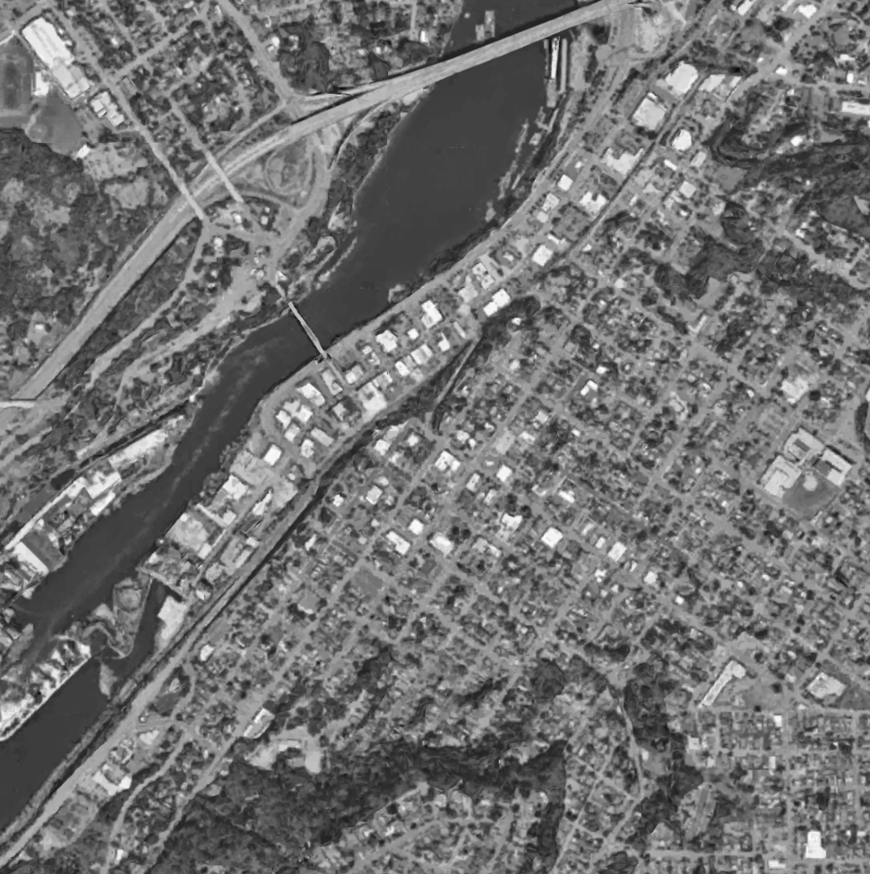
where we are
Our office is located in Oregon City, Oregon. We also have staff in Texas and Colorado.
As an Oregon-based firm, we sit on traditional lands and waterways of the Clackamas, Chinook Bands, Kalapuya, Kathlamet, Molalla, Multnomah, Tualatin, Tumwater, Wasco and many other tribes of the Willamette Valley who made their homes along the Columbia and Willamette Rivers for the last 11,000 years and who continue to live and work here.

Slide 5

Project overview
This project will facilitate the development of an evaluation plan for the new CBO funding opportunity in collaboration with OHA-PHD staff and CBOs.
The evaluation plan will be used by OHA-PHD staff to refine existing systems that collect information on CBO grant activities and allow OHA-PHD to better report on the outcomes of CBO funding to legislators and other audiences.

Slide 6
Project timeline
⚑ = deliverable
2023
2024
JUNE
JULY
AUG
SEP
OCT
NOV
DEC
JAN
PROJECT START-UP
DRAFT DOCUMENTS
GATHER FEEDBACK + FINALIZE
OHA Collaborative Workgroup meetings to develop draft purpose statement and theory of change/logic model
Submit draft purpose statement and theory of change/logic model (July) ⚑
All partner kick-off meeting (CBOs and OHA)
Small group meetings (CBOs and OHA) to workshop purpose statement, theory of change/logic model, and evaluation plan
Documents drafted (September) ⚑
1-2 all partner meetings to review and gather feedback on draft purpose statement, theory of change/logic model, and evaluation plan
Finalize comprehensive evaluation plan and associated materials in English & Spanish (November - January) ⚑

Slide 7



Project deliverables
Shared purpose statement
for the Public Health Equity Funding Opportunity and how the Funding Opportunity aligns with and advances other OHA-PHD strategic initiatives.
Logic model or theory of change
that describes the Public Health Equity Funding Opportunity as a state governmental public health systems change initiative.
Evaluation plan
that includes evaluation questions, measures of success, and data collection approaches

Slide 8
Next Steps
OHA will be reaching out via email with a description of the project and a request for CBO participation
Kick-off meeting with OHA and CBO participants on August 10th from 10:00-11:00 AM to provide more detail about the project

Slide 9
Questions?

Slide 10
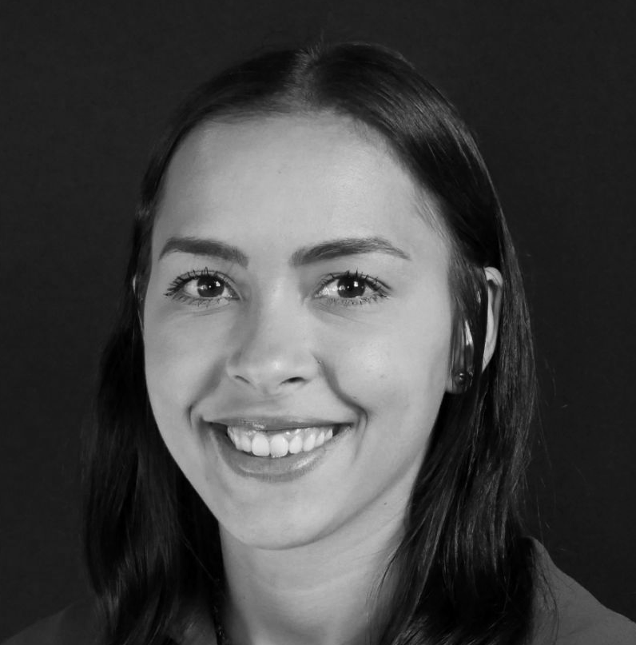
Thank you!
Additional Questions?
Contact Alex Muvua
Alex.muvua@redegroup.co

