Slide 2

Welcome Community Based Organizations!
Please introduce yourselves in the chat box:
Name and Organization
Pronouns (optional)

Slide 3
During our time together…
Closed captioning is available
Simultaneous interpretation is available
This webinar will be recorded
We are hosting multiple virtual trainings about budgets during November and December- you can attend as many as you would like!
- They will cover the same information
Feel free to drop your questions in the chat
Notes:
CET1
Closed captioning is available-the links will be dropped in the chat
This webinar will be recorded
We are hosting multiple of these webinars and Technical Assistance sessions to assist with application questions
Questions will be answered at the end of the presentation, or in a follow up email. Feel free to drop questions in the chat
This funding is for new applicants, currently funded Public Health Equity Grantees do not need to re-apply
Next slide

Slide 4

Areas of focus
Reading your Award Letter
Writing a narrative
Preparing a budget
Notes:
CET1
Veamos la agenda para el dia. Estaremos compartiendo sobre las diferentes partes de esta oportunidad de financiamiento
Quien somos
Quien puede aplicar
Cuales programas serán financiados y cuanta financiación hay disponible
Navegaremos por el sitio web para la solicitud, y veremos los recursos para ayudarle a solicitar
Lo mas emocionante es que puede aplicar para varios programas con solo una solicitud
Nos quedaremos 30 minutos adicionales después de la sesión para preguntas-. Si no alcanzamos a responder a su pregunta, la añadiremos a nuestra guia con preguntas frecuentes que estamos preparando para usted.
Next slide

Slide 5

What did one penny say to the other penny?
Let’s get together and make some cents

Slide 6
Program Element- What are they?
Program Element(s) are the funding sources that make up your award. The number means the same thing as the name.
The name has an associated number
Examples include:
Commercial Tobacco (PE 5003-01) or Modernization (PE 5002-01)
You will find this listed on your
Award letter
Contract
Remit letters

Slide 7
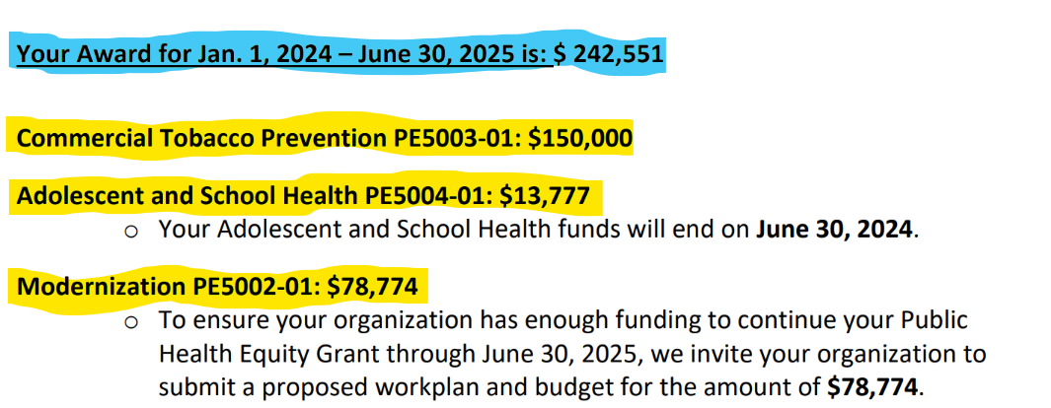
Let’s read your award letter

Slide 8
How many budgets do we need?
Partner A
Partner B
Program Elements
• Infrastructure
• Adolescent & School Health
Partner C
Program Elements
• Communicable Disease Prevention
1 budget
Program Elements
• EPH & Climate Change
• Commercial Tobacco Prevention
• Domestic Wells
3 budgets
2 budgets

Slide 9
Each Program Element needs to match the total award
ASH
$ 50,000
EPH
$100,000
Tobacco $50,000
ASH: Adolescent School Health​ EPH: Environmental Public Health​ Tobacco: Commercial Tobacco
Total Award
$200,000

Slide 10
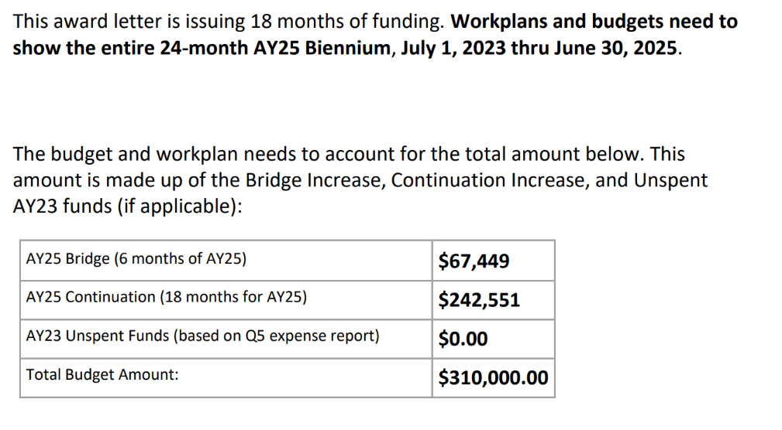
This table represents time periods

Slide 11

All Things Budgets

Slide 12
Importance of a good budget
A budget is a plan you write down to decide how you will spend your monies
Budgets are
Flexible
Tool or Guide
Helps with monthly monitoring

Slide 13
Preparing an Informed Budget
What you need
Goals
Work Plan
Narrative
Budget Template
Program Element Amount(s)
Award Letter Total
Notes:
Dado que esta es una subvención del estado, requerimos publicarla en la plataforma de OregonBuys
Aunque no es necesario que solicite POR MEDIO de OregonBuys, si tiene que tener una cuenta CON ellos, ya que al registrase, le genera un numero de Vendor , cual necesitara para la petición
Diapositivas con instrucciones de como registrarse a OregonBuys También están disponibles en nuestra página de solicitud
La solicitud requiere adjuntos conteniendo formulario de presupuesto de la solicitud y una plantilla del plan de trabajo
También se requieren 2 cartas de apoyo-una plantilla para estas cartas esta disponible en la pagina
Para solicitar, necesita someterla en línea, por medio de nuestra página web para este RFGA
La solicitud está disponible para imprimir si gusta, para vista previa, pero su solicitud actual, necesita ser electrónica por medio del enlace en nuestra pagina web
Un aviso: la solicitud no se guarda en partes, tiene que ser entregada toda completa
Next slide

Slide 14

How do I start?
Grab the workplan
What will it take to accomplish my goals?
Tell your story!

Slide 15
The Budget Narrative
The language or story of money for program activities
Includes description of expenses based on your Workplan
Use the budget template to guide you​
Salaries and Fringe benefits​
Office Supplies
Other​
Contracts​
Equipment​
Travel​
Indirect Rate ​

Slide 16
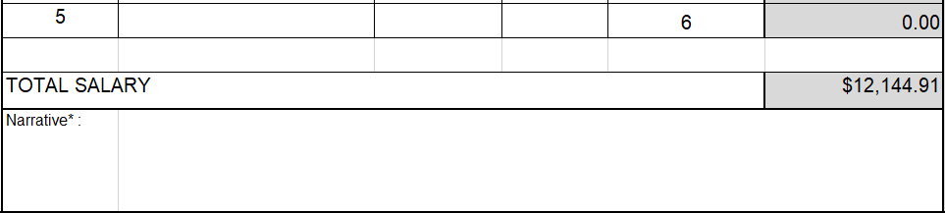
Narratives
The language or story of money for program activities
It's already integrated in your budget template! Woot!

Slide 17

Do the budgets and workplan ALIGN?
Key Questions
Do the budget numbers and the narratives match the activities in the work plan?
Does the narrative have details about how the costs relate to the activities?

Slide 18
There must be a calculation or justification on the budget amounts
Examples:
If there is a line item for food, the workplan needs to include the detail and the purpose of the expense including how many events will be held
Narrative: Snacks $50 for x people X 4 focus groups = $200
Same for travel costs! What’s the purpose?
The details are important!
Be sure it’s tied to the workplan

Slide 19
Salary
Full Time Equivalent or FTE
Position Titles: Who is supporting your goals?
Internships/Fellowships:
Preference in paying students just like staff
Alternative Options: Stipends, gift cards, and cash
Volunteer Appreciation: x persons @ $XX.00
Stipend, gift cards, cash

Slide 20
Salaries
Full Time Equivalent (FTE)

Slide 21
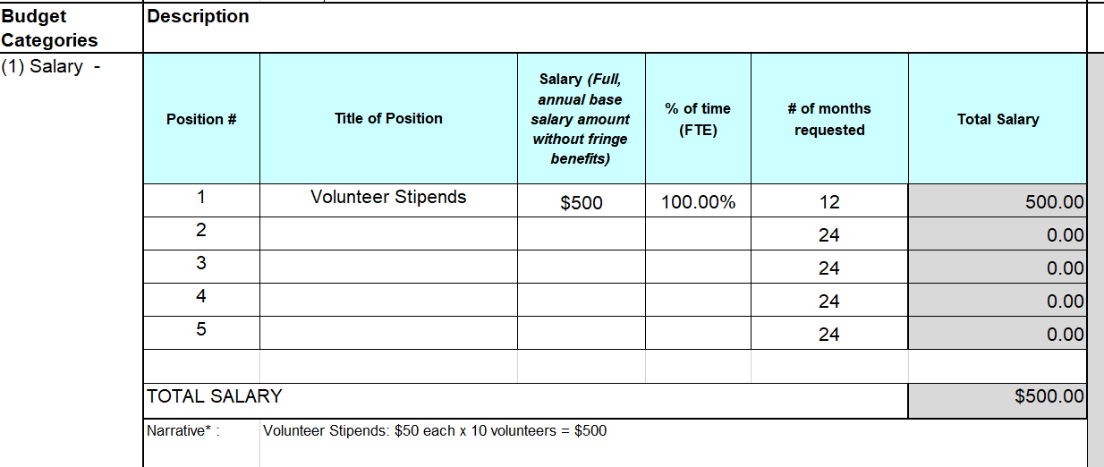
Example for Volunteer Stipends

Slide 22
Fringe Benefits
What’s included?
Social Security + Medicare tax rate = FICA Tax Rate (7.65%)
Unemployment & Workers Compensation
Medical/ Dental
Retirement
Disability
Total Benefits =
National average is around 30%

Slide 23
Fringe Benefits Example
Position # | Total Salary (autopopulated from lines l10-l13 above) | Base if Applicable | % | Total Fringe
1 | $24,099 |  | 20% | $ 4,820
2 | $24,480 |  | 20% | $ 4,896
TOTAL FRINGE |  |  |  | $ 9,716

Slide 24
Equipment
Describe how the equipment relates to the program activities
Examples:
2 Printers: $ each to support the new outreach workers
4 Laptop computers: $ each for the new outreach workers being hired

Slide 25
Office supplies
Include
Do not include
Printer ink
Computer accessories
Paper, pens, highlighters
Binders, folders
Record keeping supplies
Postage/Mailing
Educational/Resource Materials
Printing/Copying
These items belong in 'Other'

Slide 26
Travel and Training
Expenses are allowed if they are within the approved budget
Rates are determined by General Services Administration (GSA) for mileage, meals, and lodging.
Needs to be reasonable – no limos, no private pools
Travel subcategories
Per Diem
Hotel
Airfare
Registration Fees
Mileage

Slide 27
Travel and Training Narrative
Example
Outreach trainings : 2 trainings in effective outreach- $60 per person (2 Employees) + 2 hotel nights at $160/night = Total
Hosting 3 outreach events in Baker County = 339 miles/event
Training fees (related to this grant) for X Staff @ $ X cost each. Please describe the purpose
TOTAL TRAVEL
How many you expect at an outreach event
How does the staff training relate to the program activities

Slide 28

Other Supplies and Services
Description of items separated and how it is used for the grant
Examples:
Food or drinks
Gift cards
Copying and printing
Postage and mailing
Educational or resource materials

Slide 29
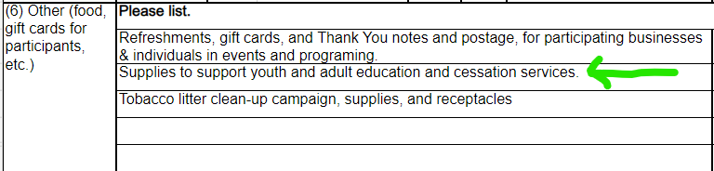
Other

Slide 30
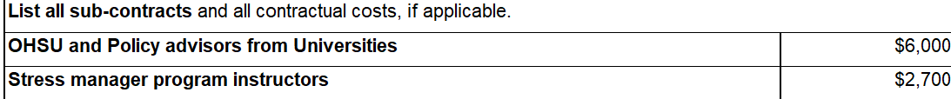
Contracts or Subcontracts
Describe the services being provided

Slide 31
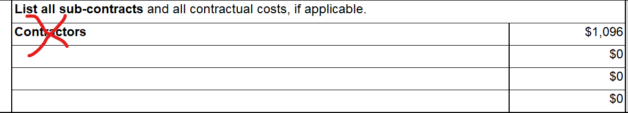
Contracts
Lacking details! Do not do this!

Slide 32
Direct Costs vs Indirect Costs
Direct
Directly related to activities or the program being funded
Indirect
Helps the agency stay open and run the program, but are not directly associated with the program

Slide 33

Which category?
Direct Costs – total items
Indirect Costs- calculated as a %
Staff salaries
Laptop for registration at an event
Outreach and engagement materials
Subcontract with a partner organization
Rent
Operational Costs
Electricity
Phone bills
Internet bills
Water

Slide 34
Indirect Rate
Measured as a %
Use your own established indirect rate
Good range is 10% to 20%

Slide 35

Capital Equipment Not Allowed
High dollar purchase item on single item
More than $5,000
Includes:
Vehicles
Buildings
Repairs to vehicles and Buildings
Machinery –Solar panels

Slide 36

Unallowable expenses
Medical Equipment (used to screen people) Medical Supplies (Vaccines, medications) Capital Improvements

Slide 37
Unallowable Expenses
Direct payments for rent, utilities, food, phone, internet
Purchasing alcohol, tobacco, firearms
Covid-19 wraparound services
Gift cards not be used for purchase of alcohol, tobacco or firearms

Slide 38
Additional Resources for Support
Public Health Equity Grant Website
Fiscal Guidance Document
Lesley Bennett from the Nonprofit Association of Oregon
Lbennett@nonprofitoregon.org

Slide 39
Questions?
Thank you so much for your time and attention today!

