Slide 1
PHAB Workgroup Meeting
Health Equity Framework
October 2, 2024

Slide 2
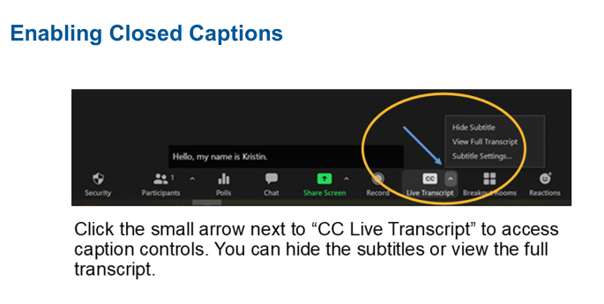
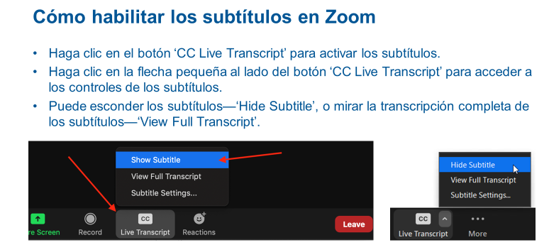
Real-time captioning and transcription service
Send a direct message to Tamby Moore for support with accommodation related questions during this meeting.

Slide 3
Workgroup Agenda
Topic | Purpose | Slide # | Led by | Time
Welcome and introductions | Set tone and integrate new members What to expect today | 1-3 | William | 10 min
Feedback loop and review of group agreements | Center group agreements for today's discussion and discuss feedback | 4-7 | Vanessa | 5 min
Oregon Tribal Public Health Modernization Community of Practice at Warm Springs | To update the workgroup | 8 | Vanessa | 3 min
Timeline Discussion | To adjust expectations/timelines for the project based on needs of the group | 9 | William | 10 min
Large group review | To meet phase one deliverable | 10-12 | William | 20 min
Break | Rest | 13 | All | 5 mins
Small group work | To meet phase one deliverable | 14 | All | 30 min
Feedback | Continue refining process and tools | 15 | All (in small groups) | 2 min
Public comment | Public comment | 16 | William | 3 min
Notes:
If you are OHA staff, please introduce yourself – name, pronoun, visual description and role in the meeting (one of the facilitators goes last and notes the captioners).

Slide 4
Feedback Loop
What was shared? | What was done? | Status/Follow Up
Drop off in attendance has made small group work challenging | Individual outreach to workgroup members by OHA project team | Ongoing
Negative experiences in small group discussion (e.g. contributions minimized, lack of respect) | Group agreements brought back to emphasize workgroup member expectations/conduct; individual follow up | Ongoing
Worksheet roles unclear | Context added to the roles in the worksheet, shared in materials email before workgroup meeting and in small groups during discussion | Open to hearing if this was helpful and/or more feedback to improve role clarity
Notes:
Hello everyone!
I shared this slide last week in detail so I’ll be doing a more summarized version of it this time around.
Feedback #1: We’ve seen a drop off in attendance most recently. We understand things come up in your full time work and lives outside work. We’ve done some individual follow up with workgroup members to reconnect and reassure folks that any time is a good time to plug back into the workgroup. I know that’s helped a bit, but we still have about half of our workgroup absent every meeting. As a project team we’d like to know if there are regular barriers you are facing to attendance, trends. So much of this work is collaborative across partner types and we need to hear all your voices, so understanding any kind of barriers you face really helps us to plan, at least for what we have control over.
We’ve started to also ask if you cannot be here, to please email us letting us know, so we can better plan for activities on our meeting day.
I’m gonna skip #2 and come back to that last b/c it will segue us into our group agreements.
Feedback #3 is about the way the roles were written into the modernization manual, specifically more clarity needed for some. Sara, from our Project Team has reviewed the roles for today and added context and examples where she could. This was sent out as part of the prep materials for today, it is word document, and you can read Sara’s comments. Facilitators will also review these comments in small groups in case you didn’t get a chance to look those over before the meeting.
As always, we are open to hearing if this is helpful or if something else is needed. We’ll be making some time toward the end of our small group work to check in about this.
Feedback #2: As we begin to get into dialogue with different partners in small groups about roles, we could all benefit from revisiting the group agreements that were established at the start of this workgroup. While we don’t expect everyone to agree in this workgroup on a topic/theme, we do expect that all members of this workgroup navigate discussions with curiosity and respect for one another. Every contribution is valid, worthy of consideration and is someone’s truth. And nobody’s truth should be minimized and made to feel unimportant.
We all have a role in shaping a positive collaborative environment by upholding the group agreements. Together we hold each other accountable when we aren’t meeting those expectations. So as follow up to this feedback, we’ll be using the group agreements as reminders about workgroup member conduct and expectations for how we care for one another in this space.

Slide 5
Group Agreements (1 of 3)
Confidentiality
Name and account for power dynamics
Speak your truth and hear the truth of others
Stay engaged (e.g., move up, move back)
Notes:
When we first shared these 4 meetings ago, we went into detail about what they meant, broke it way down. I’m going to read through most of them and focus on elaborating on the few that might need a little more context.
Confidentiality: we can talk about things/concepts, but not people
* Name and account for power dynamics: For those of us who hold power based on dominant identities or our jobs, how are we sharing that power in spaces like these? How are we affirming others given less power?
Speak your truth and hear the truth of others: Every contribution (whether aloud, or in the chat) is valid and is someone’s truth. Can we challenge ourselves to lean into that truth with curiosity and really try to understand it vs. being defensive and discounting it. How do we avoid devaluing people’s truths and making them feel as if their truths don’t matter.
Stay engaged…this work requires intentional participation. This particular domain has felt like an eternity. I get that. I feel that too AND we are almost done and need to push through. Let us remember that there is an end in sight. We are doing great and we still need to push. And in that final push, how can we support each other to see our success through?

Slide 6
Group Agreements (2 of 3)
Slow down to support full participation by all group members
Hold grace around the challenges of working in a virtual space
Experience discomfort
Acknowledge intent, but center impact (ouch/oops)
Notes:
Slow down to support full participation by all group members – we all process and retain information in different ways, some of us may need a little more time to think and reflect. So a reminder to slow down so that everyone’s with us. And as a facilitator, I always welcome help from the group on these kinds of observations. “I noticed we haven’t heard as much from CBOs today. I want to make space if anyone has thoughts they’d like to share.”
Hold grace……Be kind and understanding to one another for different reasons we are interrupted or called away momentarily from a meeting.
*Experience discomfort – A call to lean in and embrace discomfort. Discomfort (while not a pleasant feeling for anyone) can allow you to see a situation differently, give you great insight and also allow growth, if you allow it. Just a reminder that these conversations we are having about roles, not about any one person’s work or their mistakes. Its about the systems that we are all a part of broadly and so we should not take things personally. There is a difference between experiencing discomfort or being uncomfortable and feeling unsafe.
Acknowledge intent, but center impact (ouch/oops) – We center impact because relationships matter. The way you all feel in this space matters. It matters above intentions. Ouch/oops are sorta like code words to say things like, “what you said really hurt me,” or I realized what I said wasn’t the best way to say that. I made a mistake.” B/c sometimes saying those things aloud require a level of vulnerability and trust that we are still working to build with one another.

Slide 7
Group Agreements (3 of 3)
Expect and be okay with non-closure
Learn from previous experience and focus on moving forward
Remember our interdependence and interconnectedness
Share responsibility for the success of our work together
Notes:
Expect and be okay with non-closure – You may not agree on something and sometimes you have to leave it at that, let it be.
*Learn from previous experience and focus on moving forward – For simple things that happen in this workgroup I think it is okay to take the approach of learning from an experience and focus on doing better next time. For more serious situations that play out in this workgroup, please know there is no expectation to “just move forward.” Our Project Team is open to helping you navigate the situation and work with you to consider options that prioritize your psychological safety.
Remember our interdependence… - We all need each other for public health modernization. We cannot do it alone or in silos. Everybody plays a different but critical part.
Share responsibility for the success… - We all have a responsibility to the goals of this group, and we are all needed, so we need to show up and we need to participate, and when we do, our work will be strong. (Take a moment to sit with this.)
Would anyone like to add to the group agreements? Especially workgroup members that were not here when these were created?

Slide 8
Oregon Tribal Public Health Modernization Community of Practice Meeting
September 24-25th in Warm Springs
Collected feedback from Tribal members and staff who work for Tribes (not tribal members) on two domains:
  Health Equity and Cultural Responsiveness
  Community Partnership Development
More detailed share out next meeting (10/16)
Notes:
We wanted to give the group an update about a recent meeting that William and I attended related to this work.
We were invited to the Oregon Tribal Public Health Modernization Community of Practice meeting hosted by the Confederated Tribe of Warm Springs. Much like we are doing in this space with all of you, talking about roles that work in partnership with local public health and state, we did a similar exercise with public health modernization leads for tribes to capture feedback about roles from the perspective of tribal members or people who are not tribal members but that work for tribes.
William and I will prepare a more detailed share back about what we did at this meeting and lessons learned for our October 16th meeting, but wanted to let you know this took place.
A special thank you to Kimberly Lane, Siletz Tribal member and member of this workgroup who helped us prepare for the presentation in Warm Springs. Thank you, Kimberly.

Slide 9
Timeline Discussion
Legislative Deadline: May 2025
Number of meetings until end of Phase One: 6 (including today)
Number of roles to review: 47
Tasks/Deliverables
  Finish Health Equity and Cultural Responsiveness
  Finish Community Partnerships
  Review Companion Document
  How do we stay with our timeline and gather the highest quality information?
Notes:
How do people feel about the current pacing?
We just want you to have this information moving forward
What possible suggestions do you have about maintaining integrity of the work and at the same time moving through?

Slide 10
Large Group Review– 20 mins
Refer to intended outcomes and worksheet questions on slide 11 and 12.
Review Sheet 2 (last 5 roles)
Still working on Health Equity and Cultural Responsiveness Domain

Slide 11
Intended Outcomes and Deliverables
Public Health Advisory Board (PHAB) Health Equity Framework
Intended outcomes
Shared understanding of:
The role of CBOs as part of Oregon’s public health system, separate and distinct but in concert with governmental public health.
How governmental public health and community partners work together to serve community and achieve health equity.
Deliverable
A health equity framework that includes:
A companion document to the Public Health Modernization Manual that describes the role of CBOs to fulfill the foundational capabilities of Health Equity and Cultural Responsiveness and Community Partnership Development.
Notes:
Just for reference, don’t go over in detail

Slide 12
Worksheet
Domain: Health Equity and Cultural Responsiveness
Partner Type | Questions you’ll be responding to:
CBOs, Federally Recognized Tribes, other Health System Partners | -What role can you play to uplift the roles outlined for state and or local public health? -What assets or strengths do you have that could help state and local public health roles be achieved? -What gaps might exist that you could help with?
State and Local Public Health | -Can you support the role outlined by CBOs, Tribes or other Health Systems Partners? What are limitations and work arounds? -How do you work collaboratively to achieve roles in Modernization Manual?
Notes:
Talk about how we are looking into contextualizing roles for the next worksheet – ASK GROUP WHAT KIND OF CHANGES THEY WOULD LIKE TO SEE

Slide 13
Break time!
Notes:
We will now take a 5-minute break. Please return at X:XX pm.

Slide 14
Small Group Breakouts – 30 mins
Refer to intended outcomes and worksheet questions on slide 11 and 12.
Focus on turning response to the state/local public health role into a CBO role (third column on worksheet)
If it’s not a role and more a comment, notetaker will record in another place

Slide 15
Process and Worksheet Feedback
  How would you describe the conversation in the small groups?
  How is this feeling?
  How did it feel to review as a large group?
  Can any part of this be more helpful? If so, how?

Slide 16
Public Comment
Please introduce yourself for the record.
Please keep comments under 3 minutes.

Slide 17
Thank You!
We hope to see you for our next meeting on Oct. 16th!

Slide 18
Feedback Loop
What was shared? | What was done? | Status/Follow Up
1. Putting “transcreation” in plain language | Draft definition of term created. | Complete (draft); Workgroup approval needed
2. Adjust tenses for vision | Vision tenses streamlined in master document. | Complete; Does the group want to get them again or wait until final product?
3. Avoid using acronyms in workgroup materials (e.g., PowerPoint) | Corrected in PowerPoint from 5/17 | Ongoing; n/a
4. Final product look follow up | Sara B. will offer some samples | Complete; will share with group on 5/1
5. Reduce the number of OHA staff in the workgroup meetings | Reduced OHA in meeting to those with active role, meeting date set to create proposal to balance OHA staff and roles for approval. | In progress; Meeting date set for 5/2, moved to 5/7,
Notes:
Transcreated* across languages by people with lived experience and cultural competence.
* Transcreation is the process of adapting messages from one language and culture to another, while maintaining its intent, style, tone and context. Transcreation is more than translation.

Slide 19
Feedback Loop
What was shared? | What was done? | Status/Follow Up
1. Putting “transcreation” in plain language | Draft definition of term created. | Complete (draft); Workgroup approval needed – Fist of 5
2. Reduce the number of OHA staff in the workgroup meetings | Reduced OHA in meeting to those with active role. | Complete. No follow up needed.
3. Worksheet is still confusing | Let’s have a conversation about this.
4. Making ties to the domain feels difficult, not sure what to write that is meaningful. Process still feels hard. | Let’s have a conversation about this.
5. For breakout rooms, provide a link accessible to non-OHA staff to take notes, allow a check box next to existing roles, add new roles | We are huddling about this and will have a solution for this next time we do breakout groups – 6/5. | In progress
Notes:
Feedback Loop - new practice that our team is doing to 1) document feedback, 2) bring information back to the group to show how the feedback is being used.
Skip #1, hold until the end, start with #2.
Note that Faron’s feedback about wanting OHA staff in the room to hear about her organization’s needs (Inter-Tribal Fish Commission) is not listed here, but will add. Having conversations with leadership about more appropriate avenues to address your concern since staff who were asked to leave serve as part of the project team and in most cases do not hold decision making power or influence in a way that could speak to what you’re asking. But I will add and can follow up in a future meeting.
#3 and #4 – came from feedback documented on the worksheets smaller breakout room groups last meeting. #3 – tools, #4 – process.
Acknowledge the tension felt between asking you all to contribute work toward a deliverable, while:
still finding a routine for how we move through the domains,
still trying to figure out how to level set each of the domains (especially when it isn’t an area of expertise for workgroup members) and
wondering if the worksheet is the best tool to get us to that end goal
Ask for you help in identifying what we need to change about our process and our tool to set up everyone for success.
Workgroup knows what it needs
Solutions will also come from within this virtual space
How we get there is making time to talk about it, problem solve together
I propose we have a discussion about this next meeting – June 5th (ample time and internal processors)
We are naturally moving there, All the feedback is pointing us in that direction. #5 gives us concrete solutions to change about the worksheet.
Thank you for being brave to share what you have thus far. It’s all helping us to get to a more refined process, which will give us a better output/deliverable.
Pause for questions/brief comments before Fist of 5 Activity with William.

