Slide 1
PHAB Public Health System Workgroup
November 13, 2024

Slide 2
Agenda
Introductions
Update from PHAB
Overview of feasibility and impact activity
Small group discussions to complete the activity
Plans for final workgroup meeting (Dec)

Slide 3
Introductions
What is one thing you’ve appreciated about this workgroup or our process?

Slide 4
Update from PHAB
PHAB Members in the workgroup
Notes:
In October’s meeting Veronica said she would share back with the workgroup the advice from PHAB on guidance for the formatting of recommendations from the workgroup

Slide 5
Refresh on Workgroup Agreements
Spent time in breakout groups to discuss feasibility and impact grids
Agreement to continue feasibility and impact grids with remaining themes in November
Determined in December the workgroup will use consensus of Fist to 5 method to confirm recommendations to PHAB in January
2-3 Volunteers needed for sharing recommendations with PHAB

Slide 6
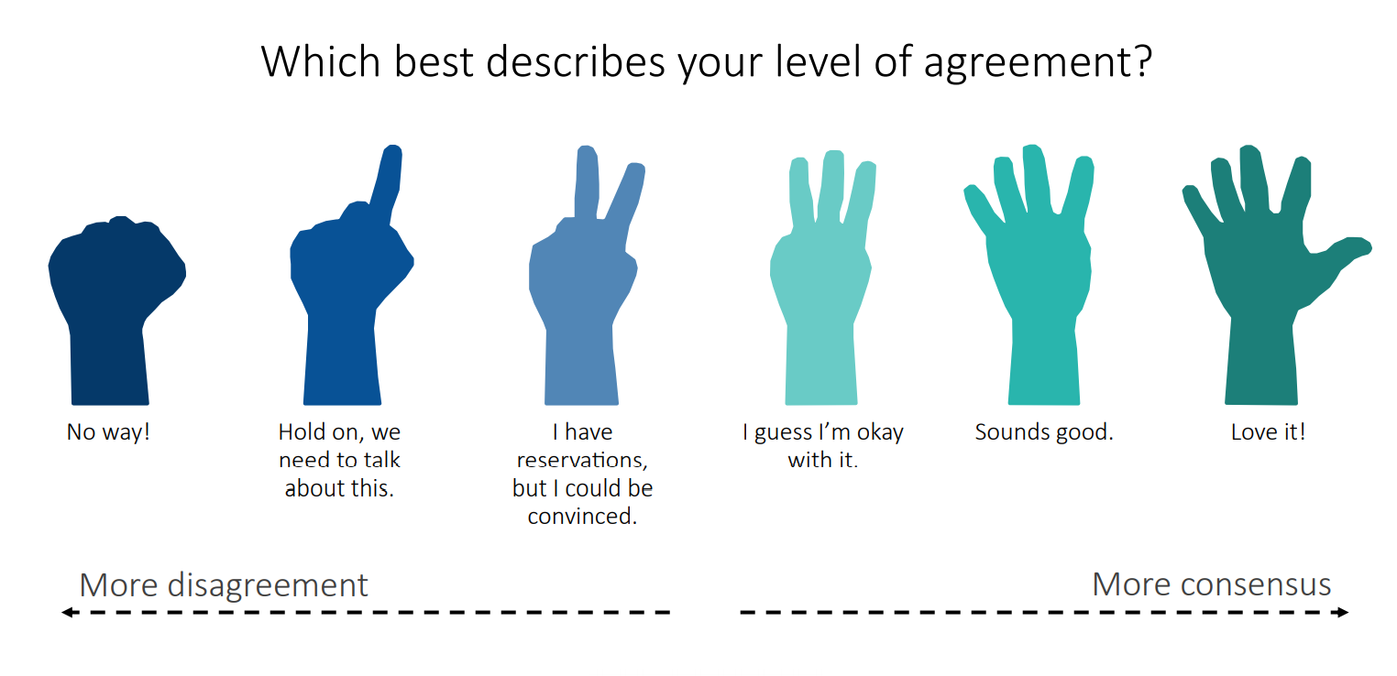
Consensus Decision Making
Whenever there is anything less than a 2 than the group will STOP and talk about the issue some more.
After some time. The group will move to make a decision again.
The idea is move towards agreement.

Slide 7
Feasibility and Impact Activity
Facilitator will open a grid (by Theme)
Workgroup members will review the feedback statements
Discuss and come to group consensus for where each statement belongs in the grid
Determine who will report back on the High Feasibility, High Impact results
Notes:
NHU: Kari can share screen as you explain this so the group can see the grid, and where the statements are and how we will be moving statements to different parts based on their discussion/decision.
Each person will have the grids by email and can open on their own as well if they’d like.
Each room will be staffed with an OHA-PHD facilitator who will provide operational support share their screen, show the grid. Move feedback to the themes, foundational capabilities.

Slide 8
Activity in Breakout Rooms

Slide 9
Break

Slide 10
Activity Debrief
Notes:
Discussion on high feasibility, high impact
Agreement to move forward with consensus for recommendations

Slide 11
Example: Consensus Activity in December
Workforce Theme: Recruitment
Recommendation 1 - Invest in communication and promotion strategies to introduce and invite students into the public health field.
Recommendation 2 - Support and integrate diverse professionals
Recommendation 3 – Invest in local pathways to public health ‘grow your own’ education, certification, training for public health jobs
Workforce Theme: Retention
Recommendation 1 - Address high turnover rates at OHA for positions engaging directly with CBOs and their supervisors.
Recommendation 2 - Expand emergency preparedness workforce training
Recommendation 3 – Invest in system-wide professional development opportunities
Notes:
Is there anything missing? Is there anything glaring that is not here? How many recommendations does the Workgroup want to offer to PHAB?

Slide 12
Next steps
Summary of plans for December (final) workgroup meeting and January PHAB presentation

Slide 13
Summary for December (final) meeting
Between Nov/Dec:
Potential pre-work to December meeting
In response to workgroup member requests, the OHA project team will reorganize recommendations from foundational capability categories to traditional workforce development themes (recruitment, retention, organization development, training, etc.)
OHA project team will send workgroup the top 3-4 recommendations for thew workgroup to review with the understanding that the workgroup will finalize public health system workforce plan recommendations in the December meeting
Dec:
Finalize the outline of recommendations for PHAB
Determine who will present the outline to PHAB

Slide 14
Summary for December (final) meeting
Final Workgroup Meeting December 11th 9:00 AM -11:00 AM
Finalize the outline of recommendations for a public health system workforce plan
Determine who will present to PHAB in the January PHAB meeting

Slide 15
Decisions for PHAB Presentation
January:
Workgroup members who will present the outline to PHAB will coordinate outside of this meeting to prepare for the presentation to PHAB.
The OHA project team will connect those who volunteer to present with the OHA PHAB support team

Slide 16
Public Comment

Slide 17
Thank you so much!

Slide 18
PHAB Workforce Prioritized Workforce Recommendations

Slide 19
Communication
Enhance interagency collaboration: Develop formal communication channels and collaborative platforms among public health agencies across counties.
Enhance workforce capacity for culturally responsive communication: Conduct community needs assessments and build partnerships to develop training and resources for the public health workforce on developing clear, culturally appropriate, and timely health messages for diverse communities.
Build workforce capacity for community engagement: Equip public health staff with skills and resources to effectively engage with diverse communities, including data collection, partnership building, and cultural competency.

Slide 20
Policy & Planning
Invest in inclusive strategic planning: Create a strategic plan for public health that includes input from all relevant partners and contributors across the public health workforce ecosystem.
Enhance workforce capacity for agile planning: Equip public health staff with the skills and tools to develop and implement flexible plans that address emerging public health challenges.
Address workforce recruitment and retention barriers: Collaborate with HR departments to remove organizational and institutional barriers to hiring and retaining public health staff.

Slide 21
Health Equity & Cultural Responsiveness
Diversify the public health workforce: Invest in programs and initiatives to increase the representation of people of color and other underrepresented groups in the public health workforce.
Build workforce health equity capacity: Provide training and development opportunities to equip public health staff with the skills to address health disparities and promote health equity.
Enhance workforce well-being: Implement strategies to prevent burnout and promote resilience among public health staff working on health equity issues.

Slide 22
Community Partnership Development
Invest in workforce partnership development: Create dedicated positions and provide training to build and maintain strong partnerships with community organizations. Identify and advocate for long-term funding to support community partnership initiatives.
Expand workforce capacity in rural communities: Offer targeted recruitment, training, and support for public health staff working in underserved areas.
Develop a framework for partnership evaluation: Create standardized metrics and tools to measure the impact of community partnerships on public health outcomes.

Slide 23
Emergency Preparedness
Expand emergency preparedness workforce training: Provide access to a variety of emergency preparedness training, including FEMA, first aid, and disaster navigation.
Invest in emergency response workforce: Increase staffing levels for critical emergency response positions, such as community health workers, community navigators, and call center staff.
Enhance workforce capacity for service navigation: Equip public health staff with the skills and resources to connect community members with essential emergency services and support.

Slide 24
Assessment & Epidemiology
Build a robust data and evaluation workforce: Increase the number of epidemiologists, data analysts, informaticians, and program evaluators across public health agencies. Advocate for policy changes to allow for remote work positions for data analysts and epidemiologists in rural areas.
Enhance workforce data skills: Equip public health staff with advanced data analysis skills, including big data, small data, qualitative and quantitative methods, and data justice principles.
Invest in public health education and mentorship: Expand opportunities for students and early career professionals to gain experience in epidemiology and assessment through internships, fellowships, and mentorship programs.

Slide 25
Leadership & Organizational Competencies
Develop sustainable public health leadership: Invest in leadership development programs to prepare the next generation of public health leaders and build sustainable organizational succession opportunities.
Support diverse leadership development & retention: Create mentorship and sponsorship programs for public health leaders from historically marginalized and underrepresented backgrounds and populations.
Enhance workforce stability & retention: Implement strategies to reduce turnover and promote long-term career paths in public health.

