Slide 1
PHAB Workgroup
Public Health System Workforce Meeting
June 12th, 2024 9:00 AM – 11:00 AM
OREGON PUBLIC HEALTH DIVISION

Slide 2
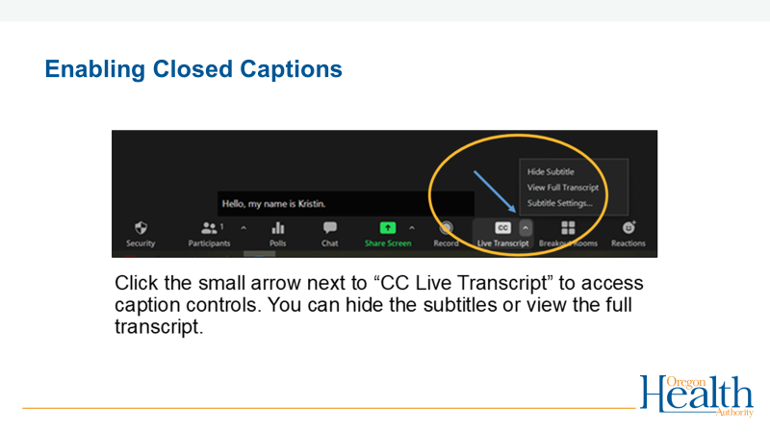
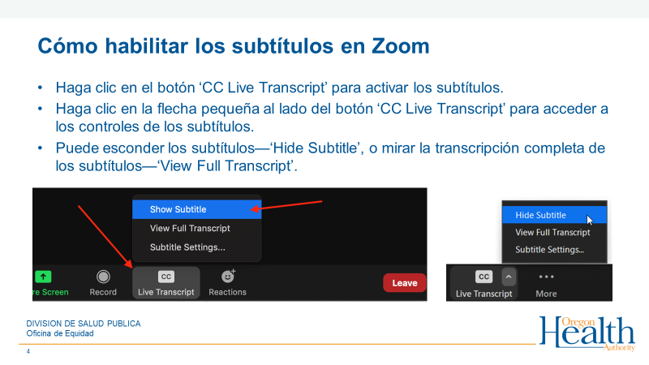
Real-time captioning and transcription service
Notes:
Send a direct message to Tamby Moore for support with accommodation related questions during this meeting.

Slide 3
Alternate Format and Accommodation Requests
Everyone has a right to know about and use Oregon Health Authority (OHA) programs and services. OHA provides free help. Some examples of the free help OHA can provide are:
  Sign language and spoken language interpreters.
  Written materials in other languages.
  Braille.
  Large print.
  Audio and other formats.
To request an alternate format or make an accommodation request for future meetings please contact Tamby Moore: at 503-586-6321, 711 TTY, or tamby.m.moore@oha.oregon.gov 48 hours before the meeting.

Slide 4
Introductions
Facilitator: Nhu To-Haynes
Welcome to all workgroup members

Slide 5
Workgroup Agenda
Topic | Slide # | Led by | Time
Opening (Intros, review agenda, group agreements) | 4-6 | Nhu To-Haynes | 10 mins
Project Overview & Updates | 7-9 | Nhu To-Haynes | 10 mins
Activity- Workgroups Session 1 Debrief All | 10-13 |  | 25 mins 15 mins
Break |  |  | 10 mins
Activity- Workgroups Session 2 Debrief All | 10-13 | Nhu To-Haynes | 25 mins 15 mins
Public Comment |  | Nhu To-Haynes | 10 mins
Closing |  | Nhu To-Haynes

Slide 6
PHAB Group Agreements
Learn from previous experiences and focus on moving forward
Slow down to support full participation by all group members
Stay engaged
Speak your truth and hear the truth of others
Expect and accept non-closure
Experience discomfort
Name and account for power dynamics
Move up, move back
Confidentiality
Acknowledge intent but center impact: ouch/oops
Hold grace around the challenges of working in a virtual space
Remember our interdependence and interconnectedness
Share responsibility for the success of our work together

Slide 7
Project Overview and Update
Presented by: Nhu To-Haynes

Slide 8
This Workgroup is using the framework of Public Health Modernization
To create recommendations for a public health system workforce plan by foundational capability. This hasn’t been done before.

Slide 9
The 2023 $50M Public Health Modernization investment includes development of a workforce plan
Public Health Workforce Development and Retention
  Develop a statewide public health workforce plan ready for implementation
  Retain a local and tribal workforce to meet geographic and culturally specific priorities
  Ensure state capacity to administer grants and contracts, and monitor and evaluate use of funds
  Increase the number of funded CBOs, with a focus on filling known gaps in rural communities and disability communities
https://www.oregon.gov/oha/PH/ABOUT/TASKFORCE/Documents/OHA_053023_Invest.pdf
Notes:
The previous slide included that in 2023 Oregon legislature invested $50M of state funding in public health modernization, a component of that investment includes the development of a workforce plan that supports the workforce of public health system
.
https://www.oregon.gov/oha/PH/ABOUT/TASKFORCE/Documents/OHA_053023_Invest.pdf

Slide 10
Prioritizing workforce needs by foundational capability
The foundational capabilities are the cross-cutting skills and capacities needed by the public health system to support basic public health protections and other programs and activities that are key to ensuring the community’s health and achieving equitable health outcomes.

Slide 11

Project Phases & Timeline
Phase 1:
Analysis: workforce synthesis summaries; workgroup prioritization of needs; OHA gathers direct feedback from the public health workforce
Phase 3:
Phase 2:
Review: workgroup reviews all information (workforce synthesis materials, workgroup input, workforce feedback, state & local public health costing & capacity assessment )
Beyond this project:
Recommendations: workgroup drafts recommendations for a statewide workforce plan, delivers to PHAB
Develop a Statewide Public Health System Workforce Plan based on recommendations
Notes:
The prioritization of needs that you are all doing, in May and June, will be shared as part of the engagement efforts that OHA’s project team is conducting between the months of July-Aug.

Slide 12
PHAB Workforce Workgroup Timeline and Deliverables
Sept
Oct-
Dec
May
June
July
Aug
Workgroup Prioritizes
Workgroup Prioritizes
OHA conducts Community Engagement
OHA conducts Community Engagement
Workgroup receives new information
Workgroup Drafts Recommendations
Workforce needs by Foundational Capability
Workforce needs by Foundational Capability
“Community” defined as: the workforce of the public health system
“Community” defined as: the workforce of the public health system
Delivers to PHAB in December 2024
Summarized community engagement feedback and Costing & Capacity Assessment
Notes:
Phase 2 begins next month. The workgroup will not meet in July or August.
July – Aug is time for workgroup members to review the summary materials of what we currently know about public health workforce (including: synthesis materials developed by WYSAC, workgroup input on workforce needs). Note information that is important to creating recommendations for a workforce plan.
July – Aug OHA’s workforce project team offering opportunities to hear directly from the public health workforce by partner category. If we haven't already, we will be reaching out to workgroup members for guidance on offering these opportunities.
Sept – meeting will focus on summary of feedback from the workforce of the public health system. Costing and Capacity Assessment should be available.
Oct-Dec – meetings focus on supporting the workgroup with drafting recommendations for what needs to go into a workforce plan.

Slide 13
Facilitated Activity
Session 1: Nhu To-Haynes

Slide 14
May PHAB PHS Workforce Workgroup
OHA’s contractor, WYSAC shared the final summaries synthesizing what is currently known about public health workforce from existing reports.
Summaries are available on the PHAB webpage under “Reference Materials”, by category “PHAB Workforce Workgroup”.
July – August spending time in review. (No meeting as a workgroup)

Slide 15
Polling results
Results from the polls were sent by email
Please open this document and refer to it as you engage in discussion in breakout rooms.

Slide 16
Today’s Workgroup Sessions
Activity: 25 minutes to discuss all three foundational capabilities. You can focus all your time on one topic or review all three, the choice is up to the group.
  Session 1:
  Policy and Planning
  Communications
  Health Equity and Cultural Responsiveness
DEBRIEF as a full Workgroup (15 minutes)
Break (10 minutes)
  Session 2:
  Community Partnership Development
  Assessment and Epidemiology
  Emergency Preparedness and Response
Notes:
4 Groups- Please facilitate yourselves (use Workgroup Discussion Questions as guide if necessary)
OHA project support team member will be notetaker & time-keeper

Slide 17
COMMUNICATION – TOP 3 WORKFORCE NEEDS
Improve communication and coordination of efforts among public health system partners across counties. (8)
Craft public health messaging to be relevant and current to 2024,* working with CBOs to develop messaging that resonates with the community. (9)
Increase representation by collecting better data and by including all populations at the table, seeking opportunities to engage, collaborate and share. (8)
POLICY AND PLANNING – TOP 3 WORKFORCE NEEDS
A lack of strategic planning that includes the entire public health ecosystem. (11)
Ability to keep up with real-time planning needs. (10)
Organizational/Institutional barriers such as County HR Systems that create barriers to recruiting, hiring and retaining workforce. (6)
HEALTH EQUITY AND CULTURAL RESPONSIVENESS – TOP 3 WORKFORCE NEEDS
Diversification of public health delivery systems that is more inclusive and culturally focused. (9) AND Racial inequities and nonrepresentation of communities of color and tribal communities in the public health workforce. (7)
Elected leaders may not support health equity work, DEI, and eliminate funding for this work. (6)
Constant community needs leads to exhaustion and distrust when the needles is not moved with short-term investments. (5)

Slide 18
Questions for Small Groups
Is there a top priority that is missing from your perspective?
Who needs to be engaged to understand the priority needs further?
Are there parts of the public health system’s workforce that aren’t being addressed in the prioritized needs?
Notes:
The results from the prioritization polls are being used today to support the discussion by the workgroup. These reflection questions are provided to support the discussion.

Slide 19
Break Time

Slide 20
COMMUNITY PARTNERSHIP DEVELOPMENT – TOP 3 WORKFORCE NEEDS
Lack of long-term funding/sustainability and competing for funding inhibits collaborative work. (7 votes -1st priority)
Small communities do not have as many partners or partners with capacity. (6 votes -2nd priority)
Community partnership is not well defined in terms of meaning and impact. (6 votes - 3rd priority)
EMERGENCY PREPAREDNESS AND RESPONSE – TOP 3 WORKFORCE NEEDS
Foundational FEMA trainings are not accessible to all people and audiences and creates barriers to inclusion. (9)
Funding (8)
Unsure of how and where to locate emergency services and support. (10)
ASSESSMENT AND EPIDEMIOLOGY – TOP 3 WORKFORCE NEEDS
Rural challenges for recruitment/retention. Need remote positions for data analysist and epidemiologists. (11)
Lack of epidemiologists and program evaluation positions – people wearing multiple hats, limited capacity. (11)
Improve public health education to include epidemiology and assessment certifications.(6) AND Cannot grow and mentor professionals.(5)

Slide 21
Facilitated Activity
Session 2: Nhu To-Haynes
Notes:
Small group discussions – breakout rooms will be open for 25 minutes, we will ask you to consider the following questions:
Is there a top priority that is missing from your perspective?
Who needs to be engaged to understand the priority needs further?
Are there parts of the public health system’s workforce that aren’t being addressed in the prioritized needs?

Slide 22
Questions for Small Groups
Is there a top priority that is missing from your perspective?
Who needs to be engaged to understand the priority needs further?
Are there parts of the public health system’s workforce that aren’t being addressed in the prioritized needs?
Notes:
The results from the prioritization polls are being used today to support the discussion by the workgroup. These reflection questions are provided to support the discussion.

Slide 23
Public Comment

Slide 24
Closing
Next meeting – September 11th 9:00 – 11:00am
Adjourn

