Slide 1
The Business Case
for Health & Wellness
Date, Venue
Presenter Name, Title

Slide 2
Roadmap for Today
Worksite Wellness: A worthwhile investment
What works?
Oregon’s commitment to Wellness at Work
Notes:
Wellness@Work Quiz – as warm up if desired

Slide 3
Health Insurance Premium Increases Outpace Inflation and Growth in Workers’ Earnings 1999–2011
Source: Kaiser/HRET Survey of Employer-Sponsored Health Benefits, 1999-2011. Bureau of Labor Statistics, Consumer Price Index, U.S. City Average of Annual Inflation (April to April), 1999-2011; Bureau of Labor Statistics, Seasonally Adjusted Data from the Current Employment Statistics Survey, 1999-2011 (April to April).
Notes:
The cost of health insurance has more than doubled over the past 10 years, far outpacing wages or overall inflation.

Slide 4
If Food Were Health Care
If food prices had risen at the same rates as medical inflation since the 1930s:
1 dozen eggs $80.20
1 roll toilet paper $24.20
1 dozen oranges $107.90
1 pound bananas $16.04
1 pound of coffee $64.17
Total for 5 items: $292.51
Source: American Institute for Preventive Medicine 2007
Notes:
Here’s some social math: This slide, based on 2007 premiums, understates what we’d be spending if food were health care. (Take some time to look at the slide. If shown with the quiz, point out the cost of a roll of toilet paper.)

Slide 5
Medical Costs: Tip of the Iceberg
Direct Medical Costs
Medical
Pharmaceutical
Visible
Costs
Indirect Costs
Missed Work
Presenteeism
Short-term Disability
Long-term Disability
Workers’ Compensation
Non-Visible Costs
Indirect Medical Costs = Two-to-Three Times Direct Medical Costs
Source: William B. Baun, EPD, CWP, FAWHP University of Texas MD Anderson Cancer Center
Notes:
When it comes to employee health, the cost of health care is but the tip of the iceburg. Lost productivity and increased disability and workers’ compensation claims are two or three times the medical costs.
(If using the quiz, point out the indirect costs are two to three times medical costs.)
(Consider asking the audience): What do we mean by presenteeism? “The lights are on and nobody’s home.”

Slide 6
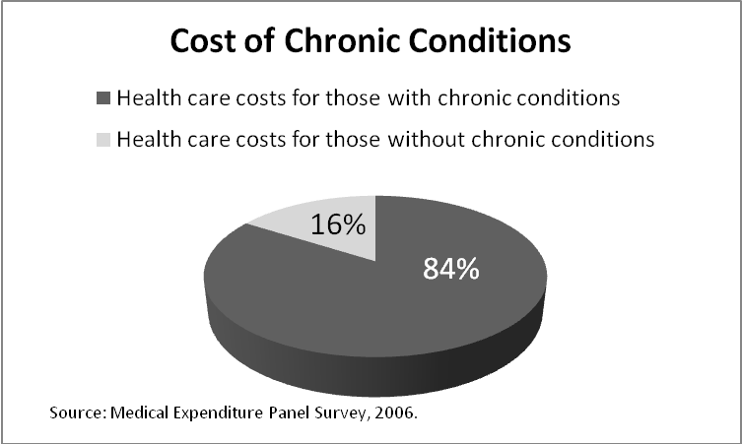
Annual Toll of Chronic Disease in Oregon
19,000 lives
$16 billion in health care costs
Countless hours of missed work
Notes:
Chronic disease, such as cancer, arthritis, and diabetes, takes an enormous toll on Oregonians—in terms of health, life, and costs. People with chronic conditions account for 84 percent of our health care costs. As the obesity epidemic is growing in Oregon and nationwide, so is the economic burden. More than one-third of the increase in Oregon’s health care spending over the past ten years is due to the obesity epidemic. (a study for the Northwest Health Foundation by Emory University.) (If using the quiz, point out that chronic disease accounts for 84 percent of health care spending.)

Slide 7
Top Two Causes of Preventable Disease and Death
Tobacco Use
Every year, 7,000 Oregonians die from smoking
For every tobacco-related death, another 20 people are sick
Cost: $2.4 billion in health care costs and lost productivity
Obesity
Nearly two-thirds of Oregon adults are overweight or obese
Cost: $781 million in direct medical costs
One-third of the increase in Oregon’s health care spending between 1998 and 2005 is due to the obesity epidemic
Notes:
The two key causes of preventable disease and death are also the biggest drivers of health care costs. (Review data on slide.) The good news is that we know how to reduce tobacco use and obesity. And you can make a difference at your workplace. (If using the quiz, point out that the top three causes of preventable disease and death are tobacco use, physical inactivity and poor nutrition. Physical inactivity and poor nutrition are the primary causes of obesity.)

Slide 8
Oregon’s Young People:
Our Future Work Force
Diagnosis of childhood chronic diseases almost quadrupled over past four decades
Childhood obesity more than tripled in past 30 years
1 in 3 children will develop diabetes over their lifetime, given current trends
If the trend continues, today’s young people could be the first generation to live shorter lives than their parents.
Source: Prevalence of obesity/overweight data source is 2007 Oregon Healthy Teens Survey
Daniels SR, Arnett DK, Eckel RH, et al. Overweight in children and adolescents: pathophysiology, consequences, prevention, and treatment. Circulation. April 19 2005; 111 (15): 1999-2012
Notes:
Tomorrow’s workforce face even greater health challenges. Increased obesity, leading to diabetes, cancer, and other chronic disease, points to the tragic conclusion in this slide: “If the trend continues, today’s young people could be the first generation to lever shorter lives than parents.” By modeling healthy environments at work, parents are more likely to create healthy environments for their children—our future workforce.
Source: Prevalence of obesity/overweight data source is 2007 Oregon Healthy Teens Survey
Daniels SR, Arnett DK, Eckel RH, et al. Overweight in children and adolescents: pathophysiology, consequences, prevention, and treatment. Circulation. April 19 2005; 111 (15): 1999-2012

Slide 9
Why Wellness at Work?
Employees spend nearly half their waking hours at work.
Environment shapes habits.
Most Oregonians want to be healthy!
Did you know that …
74% of Oregon smokers want to quit.
90% of overweight and obese Oregon adults want to lose or maintain weight.
Notes:
Why worksites? Because the places we live, work and play can make a difference in our health. And most Oregonians want to be healthy.
Source: 2010 Oregon BRFSS.

Slide 10
Wellness at Work:
An Economic Imperative
A comprehensive, strategically designed investment in employees’ health pays off.
Lowers health care costs by 26%
Reduces sick leave by 27%
Reduces workers’
compensation costs
by 32%
Return on Investment
For every $1 spent on wellness programs, an average of $5 (range of $2–19) is saved.
Source: Chapman LS. The Art of Health Promotion: Meta-evaluation of worksite health promotion economic return studies: 2005 update. Am J Health Promotion, 19 (6), July/Aug 2005
Notes:
Investing in a comprehensive worksite wellness program, not only can improve the health of employees, you can reduce health care costs, sick leave, and workers’ compensation claims. (Quiz: For every $1 spent on a comprehensive wellness program, an average of $5 is saved.)

Slide 11
Wellness at Work:
A comprehensive, integrated worksite wellness program
Source: NGA Center of Best Practices
Notes:
What does a comprehensive worksite wellness program look like? It’s essentially developing a culture of health where individuals work in environments that support health and have the benefits or services to help them prevent or manage chronic diseases.

Slide 12
How Others Have Done It …
Boeing adopted tobacco-free policy and turned smoking shelter into bicycle parking
City of Albany rented garden plot for $20; spent another $20 for vegetable starts for healthier eating and physical activity
Duckwall Pooley cut workers’ compensation costs in half by incorporating stretching into workday

Slide 13
What is Worksite Wellness?
Worksite Wellness
An organized, employer-sponsored initiative designed to support employees (and their families) to adopt behaviors that reduce health risks, improve quality of life, maximize personal effectiveness and benefit the organization’s bottom line.
Health
A state of physical, mental and social well-being; not merely the absence of disease or infirmity.
Wellness
A lifelong journey, an active process of making choices and commitments to be healthy and well.
Notes:
With health care costs going out the roof, there’s plenty of talk about health, wellness, and worksite wellness. This slide offers some definitions. When designing a worksite wellness program, we can strive for both health and wellness. The successful initiative fosters employee engagement to achieve “Better health at a lower cost.”

Slide 14
Can You Make it Easier for Employees?
To be tobacco free
Eat well
Move more
Take charge of their health
YES!

Slide 15
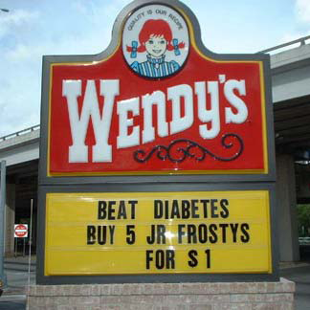
Policy, Environment and Systems Change
“It is unreasonable to expect that people will change their behavior easily when so many forces in the social, cultural, and physical environment conspire against such change.”
– Institute of Medicine
Notes:
Lip service alone won’t make a difference.

Slide 16
Wellness at Work:
An Economic Imperative
Attract and retain healthy employees
Boost employee productivity
Chip away at rising health care costs
Notes:
Studies show that your wellness commitment can energize employees and help your bottom line.
Chipping away: Health care cost per person decrease about $153 with every decrease in the number of risk factors, and increase close to $350 with every increase in the number of risk factors. (O’Donnell, M.P. (2002). Employer’s financial perspective on workplace health promotion in Health promotion in the workplace, third edition, M.P.
O’Donnell, ed. Albany, NY: Delmar.)

Slide 17
Oregon’s Commitment to
Wellness at Work
A statewide initiative to create healthier worksites guided by leaders from business, public health, health care, and education
Contributes to:
Better health
Better care
Lower costs
Notes:
Wellness@Work was launched in 2008 with public and private partners committed to better health at a lower cost for working Oregonians. (SPEAKER: This might be a place to include goals for your county, organization or sector.)

Slide 18
Join the Wellness at Work Movement
Centers for Disease Control
National Healthy Worksite: http://www.cdc.gov/NationalHealthyWorksite/
Community Guide: http://www.thecommunityguide.org/obesity/workprograms.html
Preventing Chronic Disease: www.cdc.gov/pcd/issues/2009/apr/08_0195.htm
Healthier Worksite Initiative: http://www.cdc.gov/nccdphp/dnpa/hwi/
U.S. Chamber of Commerce’s Healthy Workforce Program: http://www.uschamber.com/reports/healthy-workforce-2010-and-beyond
Small Business Wellness Initiative: http://www.sbwi.org/employers.asp
National Business Group on Health: www.businessgrouphealth.org/
Wellness Councils of America (Welcoa): http://www.welcoa.org/
American Heart Association: http://startwalkingnow.org/start_workplace.jsp
Employment Law Information Network: www.elinfonet.com
Notes:
There are lots of great tools and resources you can use for free. Also, don’t forget to talk with your local public health department, health insurer or workers’ compensation carrier to see what other resources might be available to you.

Slide 19
What is a Culture of Health?
“The way we do things around here.”
“In a culture of health, employee well-being and organizational success are inextricably linked.”
http://www.centervbhm.com/lb/workset.html

Slide 20
Visit healthoregon.org/wellness@work
Notes:
Wellness@Work partners set out to create an action-oriented website easier for employers of all sizes and types to find proven wellness solutions. You’ll find the assessment tool, resources, stories, and model policies. Also, as you take your wellness journey, send your story through the website to inspire others.
Speaker: If you are planning to do a tour of the website, here are some places to visit:
Take the Assessment (box under the Move More on home page.) Refer to Assess Your Needs and Priorities, which explains the best way to get tailored recommendations on what to do at your workplace.
Build a Culture of Health (Top right-hand-box) Let’s get going.
Walk through the four steps
Go through one of the modules
Show Put it in writing, list of model policies
Show success stories
Urge audience to add their stories through the link on the home page.
Thank you!

