Slide 1


Tobacco Retail Evaluation
Jill Hutson
Alex Muvua
Notes:
ALEX: Welcome to the Tobacco Retail Evaluation webinar. I am Alex Muvua. Jill Hutson and I will be presenting on this webinar.

Slide 2



Notes:
ALEX: Today we’re talking about a report on PHASE ONE of the tobacco retail evaluation. First, I want to acknowledge the study authors and..

Slide 3
Notes:
ALEX: a number of people who worked on the evaluation.
Also, I wanted to remind you that you can access the full PHASE ONE report on the retail environment page of the HPCDP Connection website.
Web link: webpage http://www.oregon.gov/oha/PH/DISEASESCONDITIONS/CHRONICDISEASE/HPCDPCONNECTION/TOBACCO/Documents/TREReport11-2017.pdf

Slide 4
Learning Objectives
By the end of the webinar, participants will be able to:
  Describe key elements of Oregon’s Tobacco Retail Evaluation (TRE).
  Identify ways to use findings from Phase One (July 2016 – Oct. 2017) of the Tobacco Retail Evaluation in local and state policy work.
  Outline expectations for grantee participation in TRE Phase Two evaluation activities.
Notes:
ALEX: The learning objectives for today’s webinar are to”
Describe key element of Oregon’s Tobacco Retail Evaluation
Identify ways to use findings from Phase One in local and state policy work and
Outline expectations for grantee participation in TRE Phase Two evaluation activates.

Slide 5
Zoom Webinar Technology Test
Raise your hand if you went out of town over the holidays
In the chat box type where you went during the holidays or if you stayed home type that in
Poll:
  What is your current position?
  How long have you been in your current position?
Notes:
ALEX: Before we review the phase one evaluation I want to introduce a few of the interactive features for our webinar today. The chat, Q&A, and raise hand features can be accessed by clicking the icons found in the black rectangle at the top or bottom of your screen.
Chat
The chat feature allows you to send a message to the host, panelists, and attendees. If you have a comment you would like to make to the host, panelists, or the entire group you can type the comment in here and the host and participants will be notified to look at the chat box.
Q & A
The Q&A feature can be used to type in questions to the host or panelists throughout the webinar. The host and panelists can then choose to answer your question by typing into the Q&A window or by answering verbally.
Raise Hand
You can raise your hand by selecting this icon during the webinar to indicate that you need something from the host. For our purposes we will use this feature to indicate that you would like to speak out loud to either ask a question or make a comment. The host can then enable the participant to speak through the webinar.
Polling
When polling is used the host will begin the polling and the polling question will appear on your screen. You will then have the opportunity to select your answer. After the host has closed the polling the results will be displayed on the screen.
So for practice, please raise your hand if you went out of town over the holidays.
In, the chat box type where you went during the holidays or if you stayed home type that in.
Lastly, please answer two polling questions.

Slide 6
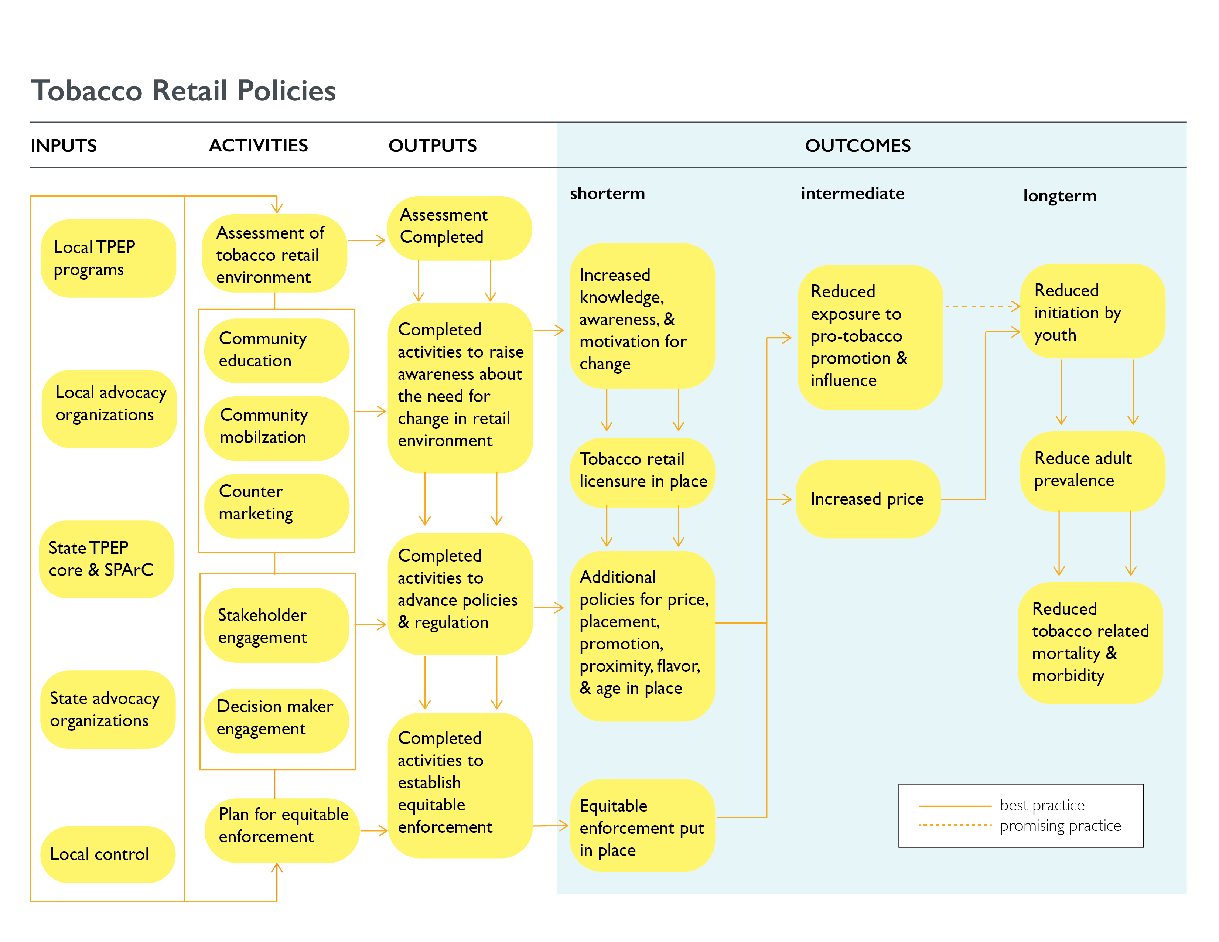
Notes:
ALEX: This logic model was developed by the Tobacco Retail Evaluation User Panel to describe the theory of change for Tobacco Prevention and Education Programs funded and supported by HPCDP to reduce tobacco use throughout Oregon. As a part of the Tobacco Retail Evaluation, local tobacco program coordinators reviewed this logic model examining its specific application to their TPEP work.

Slide 7
Notes:
Jill:
When we conduct evaluations we start with an idea about HOW the evaluation will be used because our main goal is to product evaluation result that will be USEFUL and USED.
This evaluation was guided by a User Panel. A user panel is a group of individuals, who represent the Primary Intended Users
The Primary intended users of this evaluation are HPCDP and County/Local Health Departments in Oregon

Slide 8
TRE Phase 1: July 2016 - Oct. 2017
Key Evaluation Questions and Data Sources
Notes:
Jill:

Slide 9
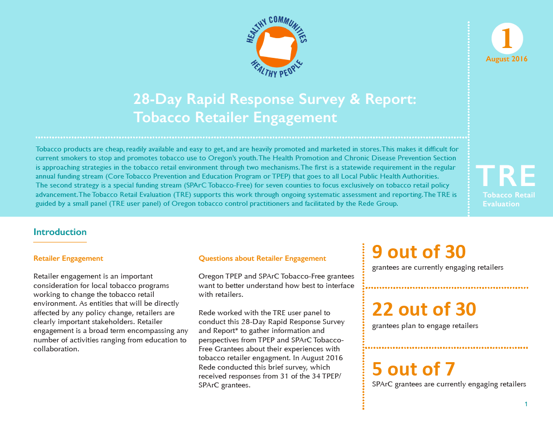
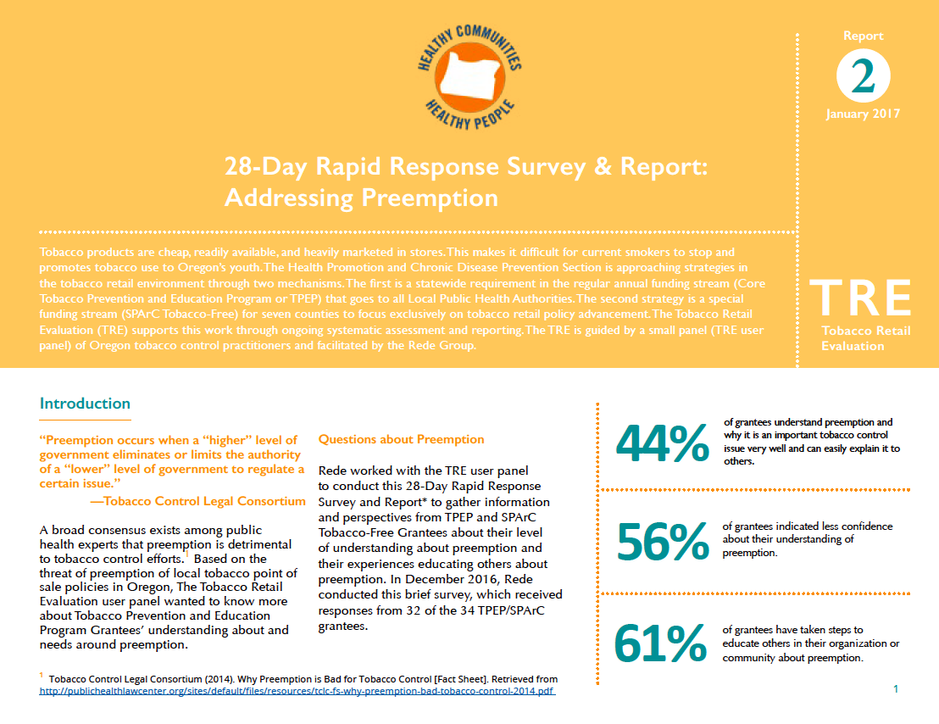
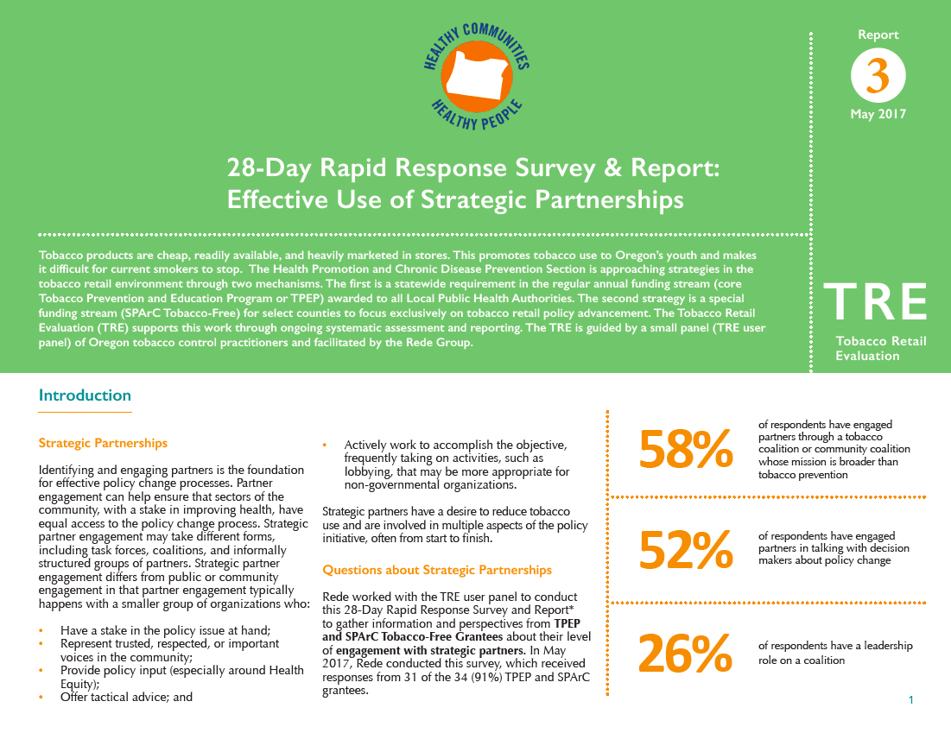
Ongoing Evaluation Feedback: Develop methods and tracking mechanisms quickly as outcomes emerge and respond, in a timely fashion, to critical questions or issues that arise.
  28-Day Rapid Response Survey and Report
Notes:
JILL

Slide 10
Poll: 28-Day Rapid Response Survey & Reports
Notes:
JILL

Slide 11
Tobacco Retail Evaluation Phase 1 Findings
Notes:
JILL

Slide 12
Essential Elements for Advancing Tobacco Retail Policy
Expert Interviews
A list of 18 potentially important elements was developed by Rede and the User Panel
The evaluation team surveyed 12 local and 8 national tobacco retail environmental policy experts who:
  Had recent success in passing tobacco retail policy
  Were geographically diverse
The experts were asked to rate elements based on how important they were for passing local tobacco retail policy, and explain why those elements are important.
Notes:
JILL: Essential elements included things like: Support of leadership within your agency; paid media; and engaged youth.

Slide 13
Findings: Essential Elements
Expert Interviews
  Critical Elements:
  Legal and policy support
  An active coalition
  An ability to identify and frame the problem
  Local public health agency capacity and authority to build awareness, lead programs, or drive policy
  Political will
  Awareness among policy makers and others about the extent and impact of tobacco at the point-of-sale
  Support of leadership within the agency
Notes:
JILL: 20 national and local experts who had recent successes in passing tobacco point-of-sale policies indicated that the following elements are necessary for passing such policies:
We think this information can be very useful in developing your own campaigns. This evaluation provides some indication of where local tobacco programs should focus efforts.

Slide 14
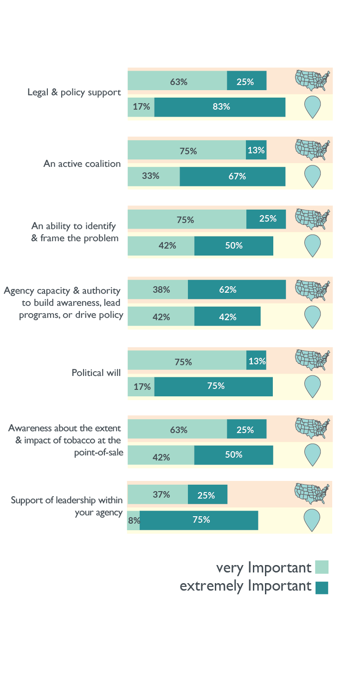
Findings: Essential Elements
Expert Interviews
Very Important
Extremely Important
Notes:
JILL

Slide 15
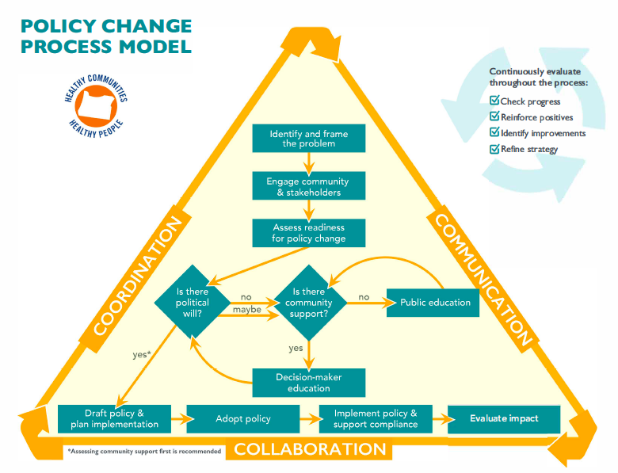
Progress in Advancing Tobacco Retail Policies
Point-in-time Assessment (PIT)
Two point-in-time assessments (October 2016 and June 2017) administered to all local tobacco programs to identify their current stage for their tobacco retail policy initiatives.
PIT Assessments were based on the HPCDP Policy Change Process Model
Notes:
ALEX: As part of the phase one evaluation, the study team evaluated progress in advancing tobacco retail policies. Two point-in-time assessments were administered to all local tobacco programs to identify their current stage of policy change for their tobacco retail initiatives. The HPCDP Policy Change Process Model was used to identify their stage of policy change.
The policy change process model was originally developed for the Tobacco-free Properties Evaluation in Counties or ToPPEC by a group of primary intended users. The model was then adapted by the phase one TRE user panel for application in the tobacco retail evaluation.

Slide 16
Policy Change Process Model (PCPM)
Notes:
ALEX: This depiction of the Policy Change Process Model shows the number and type of policy initiatives at each stage of the policy change process model at point-in-time and point-in-time 2. The white boxes indicate the number and type of policies at each stage of the process at PIT 1 and the blue boxes show the data at PIT 2. The increase in number of policies at further stages in the process shows progression through the policy change process given the short period of time between assessments.

Slide 17
Findings: Progress
Changes from PIT 1 to PIT 2
At the local tobacco program level
Over half (55%) of the local tobacco programs (n=29) had one or more policy initiatives that progressed one or more stages through the policy change process.
One fourth (28%) of the local tobacco programs (n=32) added a new policy strategy during the interval between PIT 1 and PIT 2.
Two thirds (63%) of the local tobacco programs with an undecided policy initiative at PIT 1 (n=8) declared that they were working on a best practice tobacco retail policy strategy at PIT 2.
Notes:
ALEX: The point-in-time assessments showed that over half of the local tobacco programs had one or more policy initiatives that progressed one or more stages through the policy change process, a little over a fourth of programs added a new policy strategy that they were working on between PIT 1 and PIT 2, and two thirds of programs that had not decided on a policy initiative at PIT 1 declared they were working on a best practice tobacco retail policy at PIT 2.

Slide 18
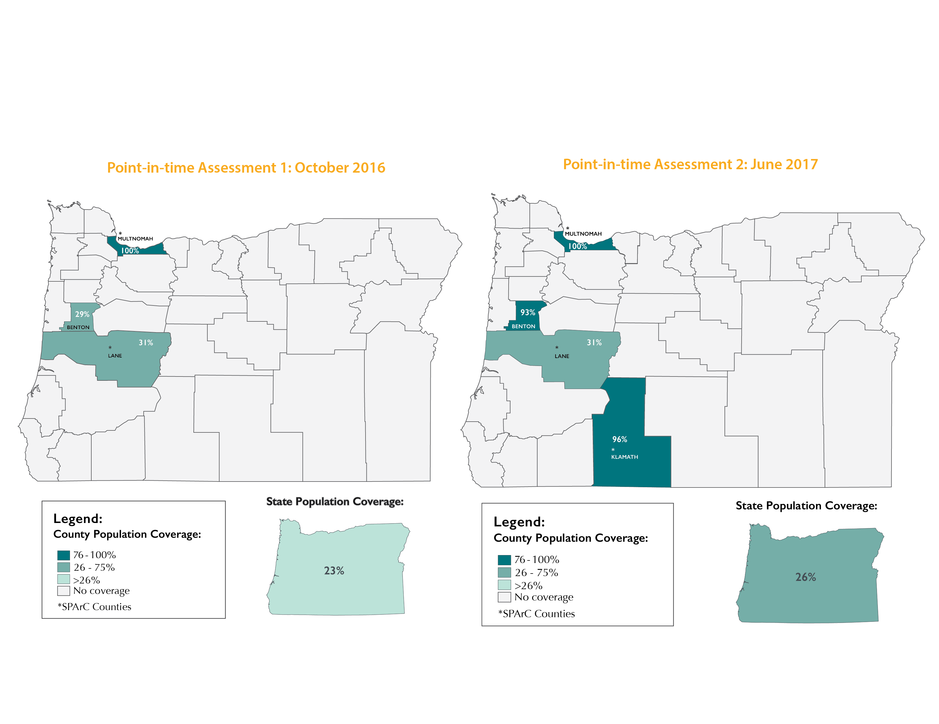
Retail License Policy Coverage: Comparison PIT 1 & PIT 2
Notes:
ALEX: The maps on this slide compare the proportion of the county populations and the proportion of the state of Oregon’s population covered by tobacco retail licensure policies in PIT 1 & PIT 2. As you can see at PIT 1 23% of the state’s population was covered by tobacco retail policies and eight months later 26% of the population was covered.

Slide 19
Tobacco 21 Policy Coverage:
Comparison PIT1 & PIT 2 (+ two months)
Notes:
ALEX: This next set of maps compares the proportion of the county population and the proportion of the state of Oregon’s population covered by policies that raise the minimum legal sales age of tobacco products to 21 in PIT 1 & PIT 2. Oregon passed a statewide Tobacco 21 policy two months after PIT 2 was conducted.

Slide 20
Challenges to Advancing Tobacco Retail Policy
Focus Groups
Three focus groups to identify the most significant challenges for local tobacco programs in passing tobacco retail policies:
  One with 4 HPCDP staff
  One with 3 HPCDP managers
  One with 6 local tobacco program coordinators
Notes:
JILL

Slide 21
Findings: Challenges
Focus Groups
Most Significant Challenges – Local Tobacco Program Coordinators
Lack of buy-in from local elected officials and community leaders
Lack of local tobacco program coordinator knowledge and confidence about the topic of tobacco retail policy
Difficulty finding organizations or individuals in the community to champion the tobacco retail environment policy change
Notes:
JILL: During focus group interviews local program coordinators identified the following significant challenges

Slide 22
Findings: Challenges
Focus Groups
Most Significant Challenges – HPCDP Staff and Mangers
HPDCP managers and staff noted that local tobacco programs face significant challenges in navigating the local political environment and securing engagement from local officials.
HPCDP staff believed that some local program coordinators might lack expertise in the subject matter and policy change process, leading to a lack of confidence in tackling the issue with persons in higher leadership positions.
In addition, HPCDP staff opined that employee turnover at HPCDP and in local tobacco program coordinator positions has challenged the work of passing tobacco retail policies.
Notes:
JILL:

Slide 23
Findings: Challenges
Reasons for Lack of Progress Between PIT 1 and PIT 2
Notes:
JILL:

Slide 24
Summary of Conclusions
TRE Phase 1
This evaluation identified seven elements that are likely to be critical in advancing local tobacco retail environment policy.
Local tobacco programs experience a complex and diverse set of challenges to advancing tobacco retail environment policy strategies.
Local tobacco programs’ focus on tobacco retail environment policy is resulting in gains toward policy adoption.
Local tobacco programs that have had SPArC Tobacco-Free funding, in addition to TPEP Core funding, were far more likely to advance tobacco retail policies.
The HPCDP Policy Change Process Model is an effective tool for measuring local progress on policy change initiatives.
Notes:
ALEX:
As a summary of TRE Phase 1 the evaluation identified seven elements that are likely to be critical in advancing local tobacco retail environment policy,
Local tobacco programs experience a complex and diverse set of challenges to advancing tobacco retail environment policy strategies,
Local tobacco programs’ focus on tobacco retail environment policy is resulting in gains toward policy adoption,
Local tobacco programs that have had SPArC Tobacco-Free funding, in addition to TPEP Core funding, were far more likely to advance tobacco retail policies,
And the HPCDP policy change process model is an effective tool for measuring local progress on policy change initiatives.

Slide 25
QUESTIONS about TRE PHASE ONE?
Notes:
ALEX: Are there any questions about TRE Phase One? Please type your questions into the Q&A or chat. You may also raise your hand if you would like to ask your question verbally.

Slide 26
Oregon Tobacco Retail Evaluation Phase 2
Notes:
JILL:

Slide 27
Key Evaluation Questions
TRE Phase 2: Jan. 2018 – June 2019
1. Are there essential elements (such as, funding, staff resources, community readiness, or staff training and technical assistance) that communities must have in place to move tobacco retail policies policy forward? If there are, what are they?
2. What are the barriers to passing strong tobacco retail policies?
3. In what ways did TPEP grantees make progress toward adopting tobacco retail policies?
Notes:
JILL:

Slide 28
Evaluation Activities
TRE Phase 2: Jan. 2018 - June 2019
  Start-up webinar (today)
  Three to four, 28-Day Surveys (with follow-up webinars)
  PIT 2 (Summer 2018) and PIT 4 (April 2019)
  10-15 “Key Elements” interviews (local)
Notes:
JILL:

Slide 29
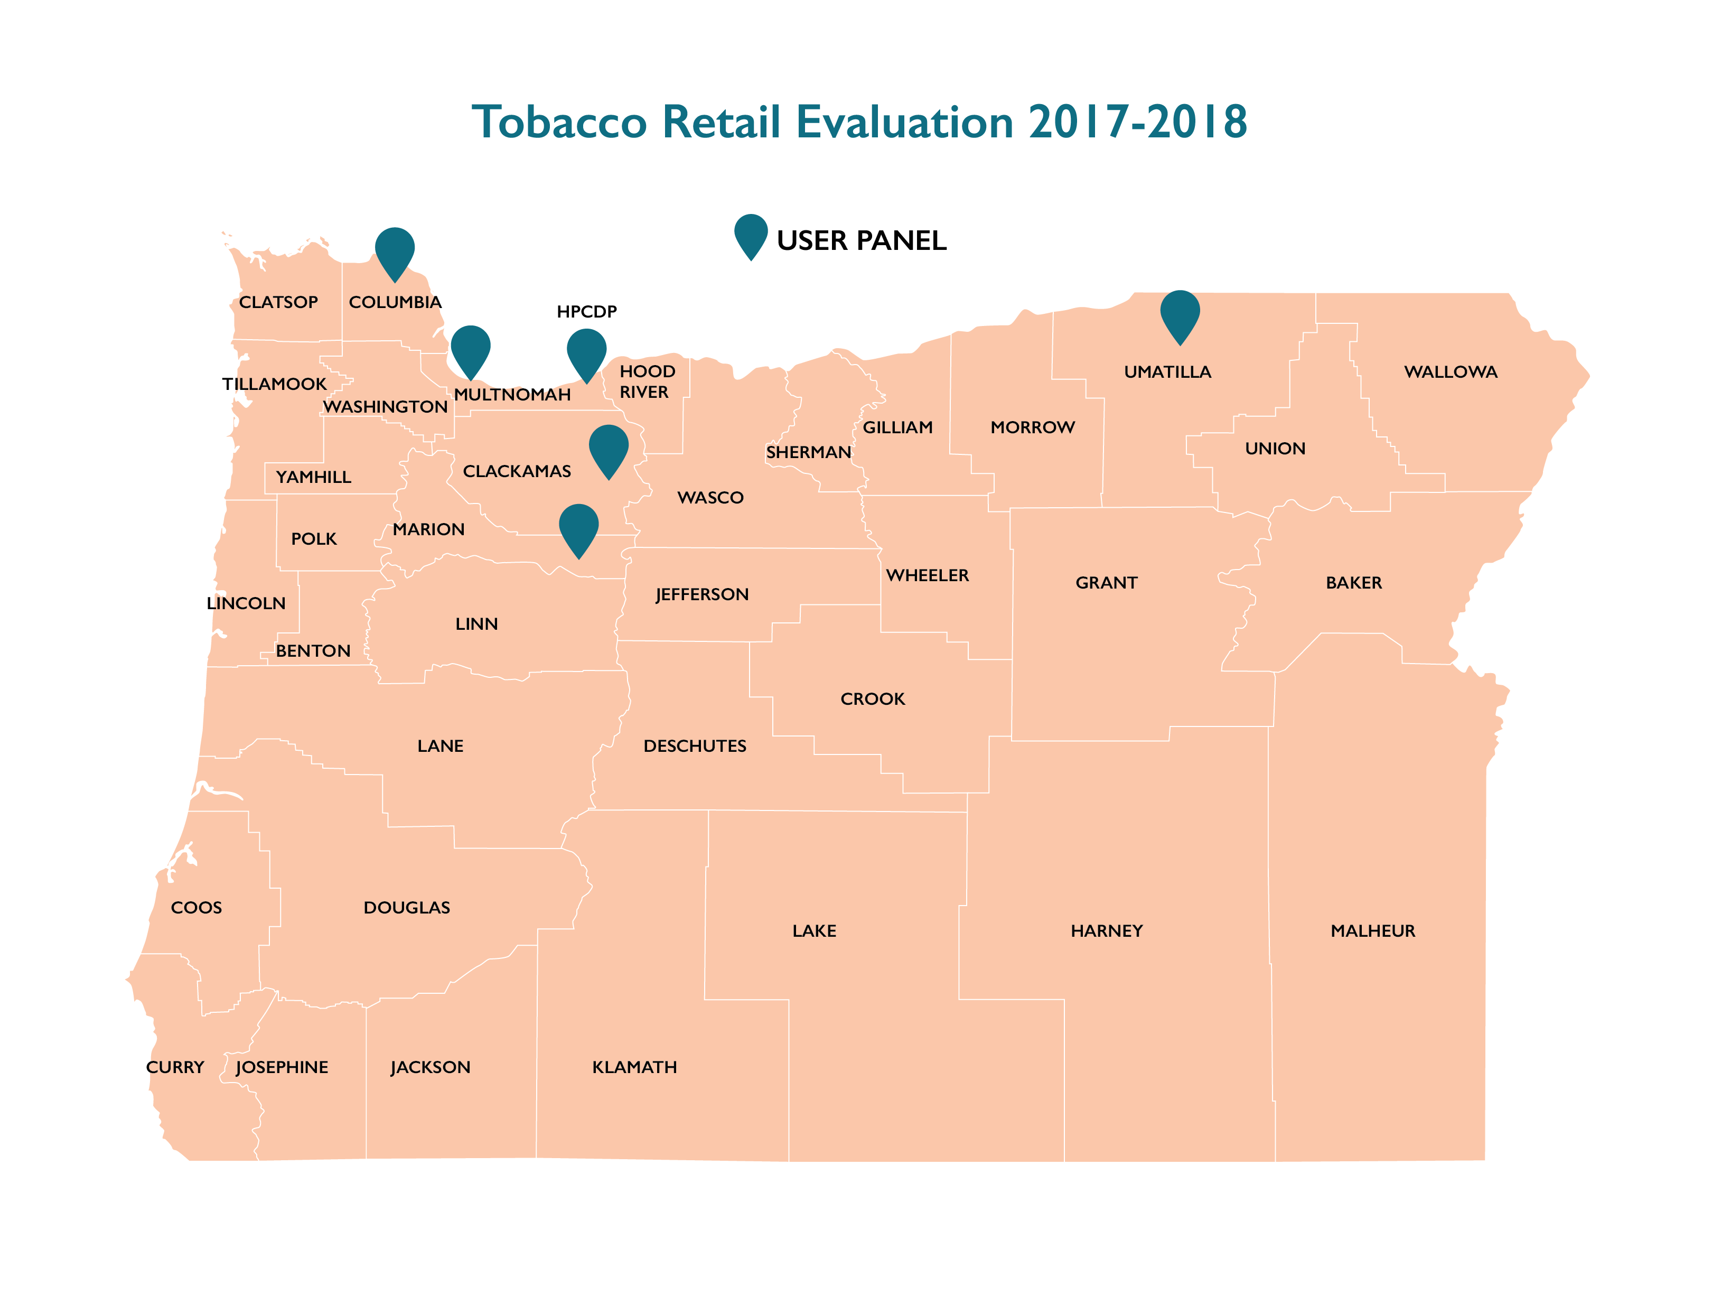
Evaluation User Panel
TRE Phase 2: Jan. 2018 – June 2019
Notes:
JILL:

Slide 30

Questions
For questions regarding the Tobacco Retail Evaluation contact:
Jill Hutson jill.hutson@redegroup .co 503-764-9696
Notes:
JILL

