Slide 1
Tobacco Retail Licensure Grantee Training Bend, OR 5.20.15
Olivia Quiroz, Senior Policy Specialist
Community Wellness & Prevention Program
Multnomah County Health Department

Slide 2
OVERVIEW
Project Goals
Milestones Achieved
Communication Strategies

Slide 3
Project Goals
Implement policy changes in the retail environment aimed at reducing youth access and use of tobacco & nicotine
Allocation of resources to build community capacity with Upstream Public Health and partners from the Oregon Health Equity Alliance (OHEA)
Conduct a comprehensive tobacco retail assessment in Multnomah County
Inform policy makers to take action

Slide 4
SPArC Milestones Achieved
Assessed over 400 tobacco retailers in Multnomah County
Applied health equity lens framework
Momentum and community engagement
Multnomah County bans e-cig sales to minors and vaping indoors

Slide 5
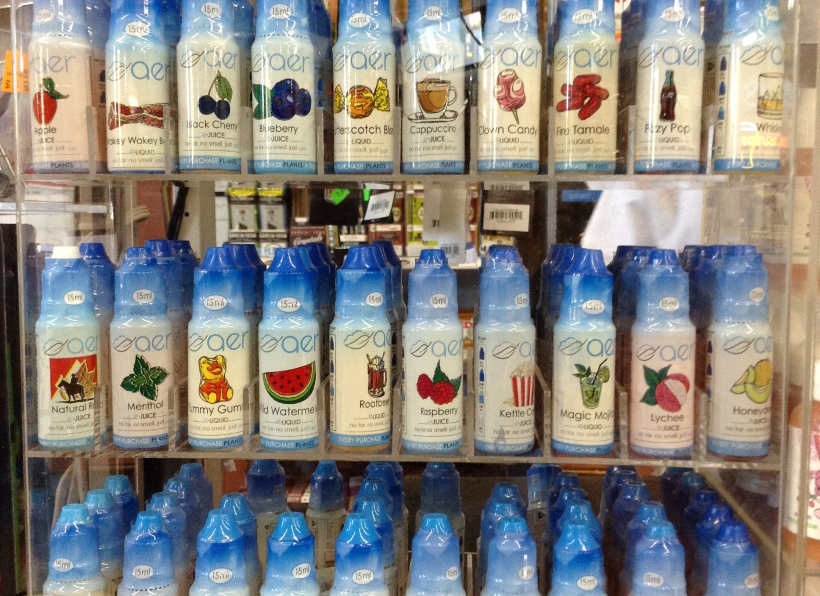
Creating a Buzz
Observations from the Field
“Show and Tell”
Tobacco Media Tracking
Notes:
Visiting tobacco retail stores
Chair visits retail store
Oregon Health Equity y Partners conduct assessments and become change agents and share personal connections to tobacco stories

Slide 6
MCHD Sweet Deceit Campaign
Notes:
The health department launched a Sweet Deceit campaign in October of 2013, aimed at teens and their parents that draws attention to the harms of flavored tobacco
products, as well the marketing tactics used by the tobacco industry that draw in young smokers.
We developed a partnership with Providence, Rhode Island to use/adapt the Sweet Deceit concept to use locally in Multnomah County. We developed a poster series, fast facts document, and fact sheet, and distributed these materials to schools, School Based Health Centers, Health Clinics, County sites, Community Centers, Multnomah County libraries, and community based organizations. The campaign also resulted in earned media with television and radio interviews.

Slide 8
Tobacco Prevention Messages
Protect our Youth
Increase public awareness of youth use and access to tobacco and e-cigarettes
Increase youth protection through changes in the retail environment for tobacco and e-cigarettes products
Notes:
Expand Multnomah County’s Smokefree Workplace Law to include e-cigarettes
Prohibit sales of e-cigarette devices and liquids to minors
Prohibit the use and possession of e-cigarettes by minors

Slide 9
E-Cigarettes and the Growing Concern of Health Impacts
Nicotine Addiction
Notes:
Flavored tobacco may taste sweet, but the health effects are anything but sweet. Bright foil wrapping, tins that look like candy tins and sweet flavors like chocolate, strawberry, tropical fruit and vanilla don't change the fact that tobacco is harmful. Flavored tobacco is just as addictive and dangerous as non-flavored tobacco.
All tobacco products contain nicotine, an addictive chemical that makes it very hard to quit using tobacco.

Slide 10
Unregulated Tobacco Retail Environment
Notes:
The number of tobacco and nicotine products is increasing dramatically
•Youth are increasingly using these products
•Multnomah County has one of the highest illegal sales rate of cigarettes to minors

Slide 11
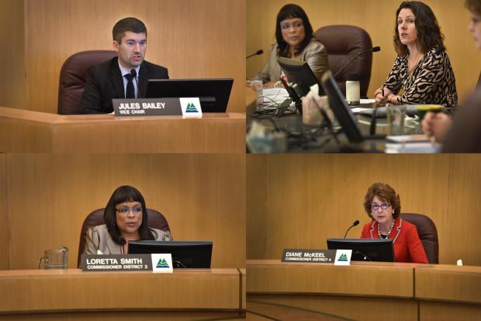
Public Hearings
Kayse Jama urged commissioners to pass the e-cigarette ordinance while holding his children. On his left, another father, and vape shop owner Paul Bates, asked the board for exemptions.
“We do not want to create the next generation of nicotine addicts,’’ - Chair Kafoury.
Notes:
Multnomah County Commissioners voted to restrict e-cigarettes and vaping to protect children and public health.
In a 5-0 vote, the board passed an ordinance that prohibits minors from buying and using inhalant delivery systems, such as e-cigs and vape pens.
The law took affect on April 5, businesses will be prohibited from selling the devices to people under age 18. And vaping won’t be allowed in workplaces where smoking is prohibited.
“My primary concern is protecting kids from exposure to these products,’’ Chair Deborah Kafoury said at Thursday’s meeting. “And I want to ensure that people who choose not to vape are protected at work.”
More than 300 comments were gathered online about the proposed regulation.

Slide 12
Tobacco Prevention Change Agents
http://smokefreeoregon.com/oregonians/

Slide 13
Thank You!
Visit our “It Starts Here” website
www.multco-itstartshere.org
&
Facebook Page
www.facebook.com/ItStartsHere

