Slide 1
Tobacco use is going down on a statewide level…
Per capita cigarette pack sales in Oregon and the U.S., Fiscal Year 1993-2014
Notes:
Between fiscal years 2012 and 2014, population consumption of cigarettes among Oregonians decreased by eight percent. Figure 1 illustrates this outcome along with the overall decreasing trend of cigarette pack consumption since 1996 when Measure 44 passed, which raised the tobacco tax and funded the Tobacco Prevention and Education Program (TPEP). Since TPEP’s inception, Oregon’s population cigarette consumption has declined by 56 percent.

Slide 2
…yet many communities still experience
tobacco-related health inequities.
Examples of smoking rates for specific groups:
People with mental health and addictions disorders: up to 90%
Homeless population: 80%
Inmates of US prisons and jails: 70-80%
American Indians and Alaska Natives: 35%
African Americans: 33%
Rural communities (e.g. Lincoln county): 33%
Oregon Health Plan members: 31%
Notes:
The first three bullets are national estimates and should be interpreted with caution. 2014 BRFSS data on the Medicaid smoking rate is compared to non OHP members.

Slide 3
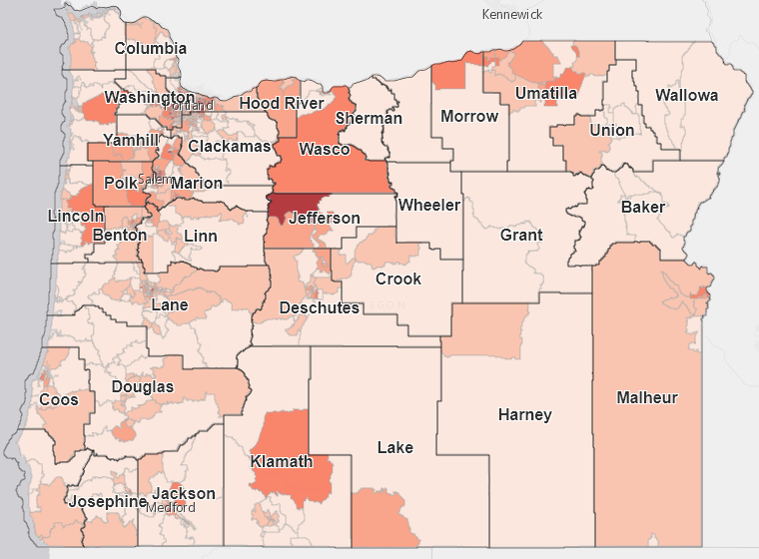
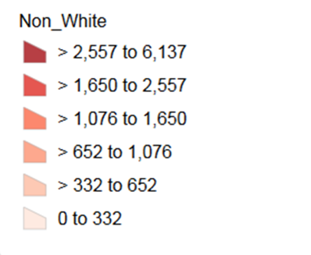
Oregon’s population is increasingly diverse
Racial/Ethnic Diversity
Count by Census Tract
Source: http://arcg.is/1QX8WCw
2014 American Community Survey
Census Tracts: 5 Year Estimates
Notes:
This map illustrates how racial/ethnic diversity exists all over the state of Oregon – not just the metro area or the I-5 Corridor. Where do we see places around Oregon that have higher diversity counts?
Examples:
-Jefferson County – Warm Springs Tribe.
-Klamath County – Klamath Tribe.
-Wasco, Hood River, Malheur counties – Latino population.
Note: This map is calculated based on racial/ethnic diversity in census tracts – which looks at the size of area based on size of the population. Census tracts are so small that we can’t see them at the state level (e.g. Portland Metro area is very diverse, but doesn’t appear that way on this zoomed out map). What’s most pertinent about this map is that we see that there’s diversity in many parts of the state.

Slide 4
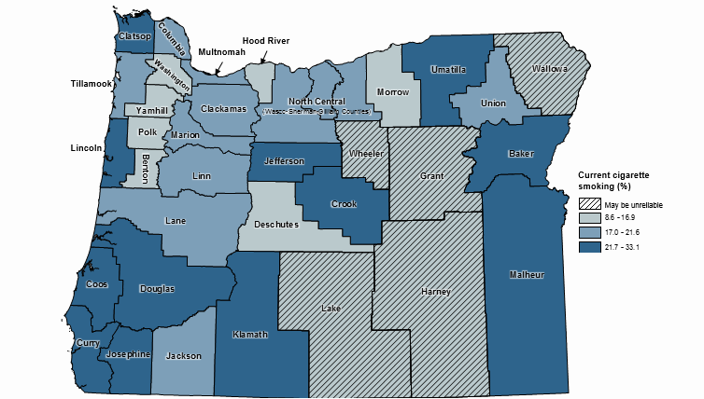
Adult cigarette smoking by county, 2010-2013
Source: Behavioral Risk Factor Surveillance System, 2010-2013
Notes:
Where is there overlap with counties that have a high smoking rate and counties that have high racial/ethnic diversity?

Slide 5
Small Group Activity
Break into small groups (30 min)– each group should include participants from a mix of regions. Use the discussion guide to answer questions.
2. Report back highlights from small groups (5 min).

Slide 6
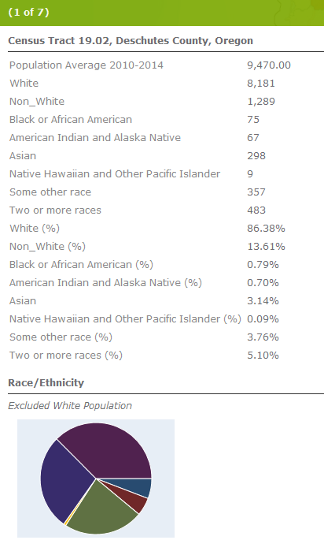
Oregon diversity: U.S. census 2014 estimates
Source: http://arcg.is/1QX8WCw
2014 American Community Survey
Census Tracts: 5 Year Estimates
Notes:
This is a tool developed for Regional Health Equity Coalitions to talk about racial and ethnic data in their regions. It may be a useful resource to you as well.

