Slide 1


Building and Supporting Effective Self-Management Referral Systems
Notes:
OHA

Slide 2
Agenda
Topic | Time
Welcome | 9:00 AM – 9:15 AM
Understanding Organizational Cultural Differences | 9:15 AM – 10:30 AM
Stretch Break | 10:30 AM – 10:45 AM
Planning Effective Self-Management Referral Systems | 10:45 PM – 12:00 PM
Working Lunch | 12:00 PM – 1:00 PM
Quality Improvement (QI) in Health Systems | 1:00 PM – 2:15 PM
Physical Activity Break | 2:15 PM – 2:45 PM
Communication Styles and Strategies | 2:45 PM – 3:30 PM
Stretch Break | 3:30 PM – 3:45 PM
Engaging Your Partners | 3:45 PM – 4:15 PM
Wrap Up | 4:15 PM – 4:30 PM
Notes:
OHA

Slide 3
Learning Objectives
Find key similarities and differences between organizational cultures
Describe the process of “closed loop” referral processes
Learn quality improvement tools
Develop effective communication strategies for working with partners and adjustment of communication
Notes:
OHA

Slide 4
Self-Management Programs in our Work
Stanford self-management programs (Living Well / Tomando Control, Diabetes Self-Management Program)
National Diabetes Prevention Program
Enhance Fitness Program
Walk With Ease
Oregon Tobacco Quit Line
Notes:
OHA

Slide 5
Welcome - Introductions
YOUR NAME
YOUR ORGANIZATION
YOUR ROLE
Notes:
OHA

Slide 6
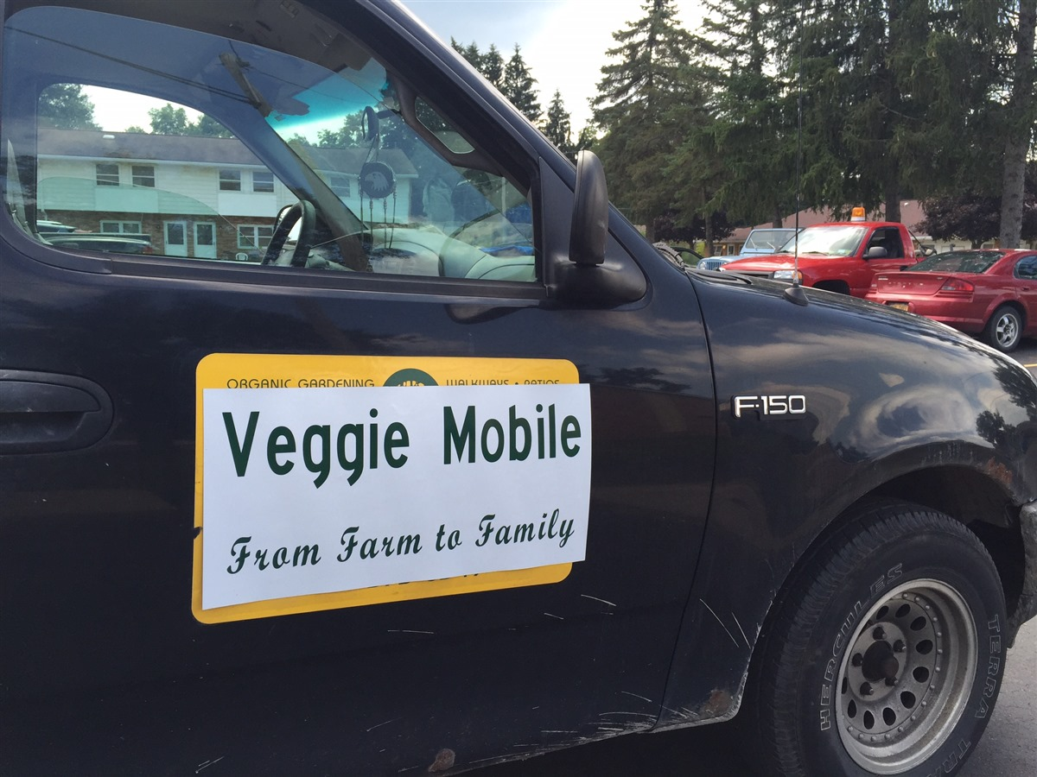
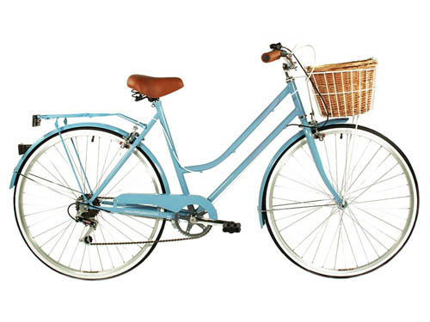

What do you brake for?
Who you are?
What community are you from?
During your busy days and life, what is something that slows you down?
What is something that makes you pause?
What do you brake for?
Notes:
OHA

Slide 7
UNDERSTANDING ORGANIZATIONAL CULTURAL DIFFERENCES
Notes:
SUSAN

Slide 8
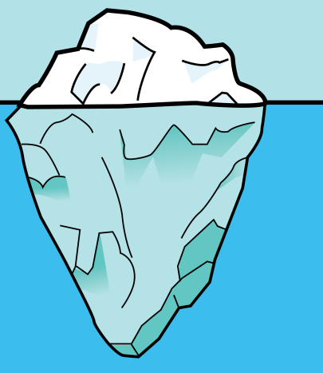
What is Organizational Culture?
Organizational Culture is:
The way people within an organization do things
What people do when no one is looking
Unconscious perceptions
Values derived from underlying assumptions
Lessons learned and passed onto others
Iceberg Model: what is below the water line sinks ships
Behaviors and norms that are visible and tangible
Personal values and attitudes that are less visible
but talked about
Underlying beliefs and assumptions that are
subconscious and invisible
Notes:
SUSAN

Slide 9
Why is Understanding Organizational Culture Important?
Understand Organizational Culture
Adapt Communication Style
Lead System Change
The concept of organizational culture is important in understanding the behavior of individuals in organizations as they manage social changes
Notes:
SUSAN

Slide 10
Understanding Organizational Cultures
While there is no single "type" of organizational culture, and cultures can vary widely from one organization to the next, common elements do exist:
Dominant Characteristics
Personal, like a family; entrepreneurial, risk taking; competitive, achievement oriented; controlled and structured
Values
Loyalty and mutual trust; commitment to innovation, development; emphasis on achievement and goal accomplishment; formal rules and policies
Leadership
Mentoring, facilitating, nurturing; entrepreneurial, innovative, risk taking; no-nonsense, aggressive, results oriented; coordinating, organizing, efficiency oriented
Strategic Emphasis
Human development, high trust, openness; acquisition of resources, creating new challenges; competitive actions and winning; permanence and stability
Criteria of Success
Development of human resources, teamwork, concern for people; unique and new products and services; winning in the marketplace, outpacing the competition; dependable, efficient, low cost
Notes:
SUSAN

Slide 11
Overcoming Organizational Cultural Barriers
Barriers | Potential Solutions
Lack of Leadership Support | Facilitate contact with others successful in deploying the methodologies
Resistance or Skepticism from Stakeholders / Staff | Develop stakeholder / staff analysis and use a team-based problem-solving approach
Hesitancy to Invest Time and Money | Create a business case supported by sound data
Shortage of Internal Resources to Lead Change Initiatives | Enlist outside help with partners and others to drive initial projects or receive training and mentoring in conjunction with projects that produce immediate results
Waning Commitment or Flavor-of-the-Month Syndrome | Implement a solid communication plan that reaches all levels of the organization, and build momentum through early, visible wins
Lack of Clarity of Roles and/or Lack of Accountability | Adopt management systems and structures that clearly link projects and performance with overall strategies
Notes:
SUSAN

Slide 12
What is my organizational cultural environment?
Follow these steps:
  Review Tool 1: Understanding Cultural Differences in your Toolkit
  Identify the elements of your organizational culture
  Record each element on the grid
  Reflect on the cultures of your partner organizations (CCO’s and community clinics)
  Identify the similarities and differences between the cultures
  Share at your table
  Post Training Homework – reach out to your partners to learn more about their organizational cultures and ask your partners about their perspective of their culture
Notes:
Laura B.

Slide 13
PLANNING EFFECTIVE SELF-MANAGEMENT REFERRAL SYSTEMS
Notes:
SUSAN

Slide 14
What is a closed loop referral process?
1. Organizations
meet to discuss
support for patient.
10. Provider uses letter for follow-up with patient in
goal-setting.
2. Clinician introduces opportunity to patient.
9. Coordinator mails patient letters to provider with program explanation.
3. Patient agrees and commits to treatment.
8. As part of treatment program, patient writes a letter to provider describing what he/she has learned.
4. Referral sent
to organization —
HIPAA compliant.
5. Coordinator contacts referred patient and enrolls in treatment.
7. Patient attends treatment.
6. Coordinator communicates with practice weekly regarding patients and status.
Notes:
SUSAN

Slide 15
Future Closed Loop Referral Process
Sarah Worthington - Deschutes
1. Approach and set up agreements with area clinics
10. Provider uses letter for follow-up with patient in goal setting
2. Clinic generates list of patients with diagnostic criteria*
9. DCHS staff uses online portal to generate letters updating providers on patient progress
3. Clinic staff review list to identify appropriate patients*
8. Patients attend DPP; DCHS staff facilitate workshops and use online portal to manage data
4. Clinic staff contact patient* and create referral in EHR (or fax)
5. DCHS staff pulls list of referrals from EHR or fax
7. DCHS staff meets with patients to complete intake interview
6.DCHS staff contacts patients to assess readiness and enroll in DPP when appropriate
Notes:
SUSAN

Slide 16
My Closed Loop Referral Process Journey
Sarah Worthington - Deschutes
What we learned about our current state:
Referral workflow must minimize burden on clinic staff
What we designed for our future state:
Diagnostic criteria for DPP referral
Protocol for recruiting/recommending patients
Provide updates to providers on DPP patient progress and/or completion
We set the following process improvement goals:
Work with IT to streamline EHR closed-loop follow-up
Improve provider outreach, ID provider champions
We made the following process changes:
Clinic staff will ID one person to maintain/update class attendance
The changes had this impact:
Increased referrals and more proactive follow-up by clinic staff
Notes:
SUSAN

Slide 17
My Closed Loop Referral Process
Renee Mulligan - Lane
Senior & Disability Services presents to Community Health Center & Trillium staff about Living Well and Referral Form (Current)
Information added to EHR. Provider uses the returned form to follow up with patient in goal-setting (just getting forms back now)
Patient Care Coordinator at CHC or Trillium introduces Living Well opportunity to patient (Current)
Bottom portion of the referral form is completed by the Living Well coordinator and faxed back to CHC with patient’s workshop attendance, completion, type of goals set, & movement on action plans (current)
Patient agrees to have Referral Form sent to SDS
(Current)
As part of the program, patient sets weekly goals and creates an action plan (current)
Referral Form is faxed to SDS – HIPAA Compliant (Current)
Patient Attends program (Current)
Living Well Coordinator contacts referred patient and attempts to enroll them in the program (Current)
Living Well Coordinator communicates with CHC if they are unable to reach patient or they decline to enroll (Current)
Notes:
SUSAN

Slide 18
My Closed Loop Referral Process Journey
Renee Mulligan - Lane
What we learned about our current state:
Many providers don’t know about Chronic Disease Self-management Programs
Current funding sources are not sustainable
What we designed for our future state:
Closed loop referral system for Living Well programs between CHCs and SDS
We set the following process improvement goals:
Increase CHC and Trillium referrals to Living Well with Chronic Conditions
Develop system for closed loop referral
Expand programming to include Living Well with Chronic Pain and Living Well with Diabetes
We made the follow process changes:
Improved referral form with return information for provider
The changes had this impact:
Increase in the number of referrals from CHC and Trillium to Living Well
Next Steps
Expand consortium to include other partners: providers, payers and programs
Create MOU’s for each partner organization
Create Strategic Plan and Communication / Marketing Plan
Expand programming efforts to include Spanish language opportunities
Seek sources and systems to support sustainable funding
Notes:
SUSAN

Slide 19
What is my referral process today?
Follow these steps:
  Review Tool 2: Planning the Work in your Toolkit
  Reflect on the current process for one program area
  Compare the current process to the example provided
  List ideas to improve the current process
  Share at your table
Notes:
Laura B.

Slide 20
LUNCH
TABLE QUESTIONS
Notes:
OHA

Slide 21
IMPROVING QUALITY IN HEALTH SYSTEMS
Notes:
SUSAN

Slide 22
Quality Improvement (QI) Principles
Quality improvement is the science of process management
If you cannot measure it…You cannot improve it
The right data in the right format at the right time in the right hands
Notes:
SUSAN

Slide 23

Quality Improvement (QI) Tools
Value Stream Maps
5 Why’s
Brain-
storming
Kanban
Kaizen
A3
One Piece Flow
Poka-Yoke
Affinity Diagram
5 S
Workload
Balancing
Pull System
Standard Work
Visual
Manage-
ment
Plan – Do – Study - Act
Root Cause
Fishbone Diagram
Pull System
Pareto
Charts
Spaghetti Diagrams
Voice of the Customer
Gemba
Walk
Notes:
SUSAN

Slide 24
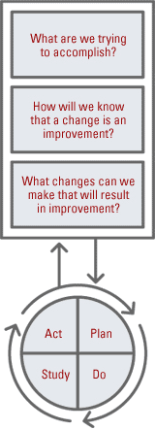
Quality Improvement (QI) Example
The PDSA cycle is shorthand for testing a change by developing a plan to test the change (Plan), carrying out the test (Do), observing and learning from the consequences (Study), and determining what modifications should be made to the test (Act).
PDSA is the “action” portion of the Model for Improvement shown at right.
Notes:
SUSAN

Slide 25
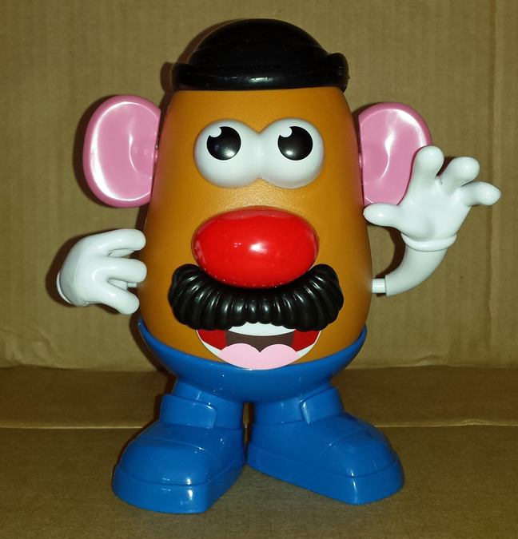
Quality Improvement (QI) Cycle
Key Questions for a Quality Improvement Cycle
What are we trying to accomplish (Aim or long-range goal)?
How will we know that a change is an improvement
How will we measure the test?
What changes can we make that will lead to improvement?
Notes:
SUSAN

Slide 26
Mr. Potato Head Key Concepts
• Rapid, small scale PDSA testing builds profound knowledge quickly.
• Planning a test, including prediction and measurement, increases learning.
• Planning and measurement are easy to do efficiently and routinely.
• Collaboration aids knowledge building and speeds learning for improvement.
• Testing creates knowledge faster than discussion and planning.

Slide 27
Mr. Potato Head Objectives
• Understand rapid cycle PDSA testing
• Understand how theory and prediction aid learning
• See how to collect real-time measurement
• Appreciate the opportunity for collaborative learning

Slide 28
Mr. Potato Head Roles
Builder: Construct Mr. Potato Head to reflect the photo exactly.
Timekeeper: Clock starts when the tester touches Mr. Potato Head. Clock stops when tester stops touching Mr. Potato Head AND says, “Time!”
PDSA Scribe: Scribe track team’s data on PDSA tracker form.
Inspector: Inspectors assigns a score of one (1) – three (3).
Score of 1 - One or more of the required pieces are not on Mr. Potato Head.
Score of 2 – All pieces are on Mr. Potato Head, but one or more pieces is grossly out of place.
Score of 3 - All pieces are on Mr. Potato Head and positioned correctly.
For each cycle, make a “plan” to test a change idea and capture the time and accuracy scores predicted for the test. Tables may “do” their test and complete the “study” and “act” phases including documentation. Teams will wait for the facilitator’s instructions before initiating another test.

Slide 29
Mr. Potato Head Instructions:
Pick team name.
Assign roles to team members (Builder, Timekeeper, PDSA scribe, Inspector)
3. Build Mr. Potato Head as fast and accurately as possible
4. Record your results and pass to “runner”
5. Teams stop after each test to study results by comparing their actual time and accuracy score with their predictions. Additionally, discuss any observations.
6. Based on your test, should you adapt the change idea for another test, adopt it, or abandon it.
7. After third improvement loop consider:
    Why is assembling something such as a Mr. Potato Head with a team a valuable way to learn about iterative tests of change?
    Why is measurement a critical component of PDSA cycles?

Slide 30
What is PDSA?
Follow these steps:
  Review Tool 3: Improving The Quality in your Toolkit
  Follow the instructions as just described for the Mr. Potato Head Exercise:
  After each improvement loop consider:
    Why is assembling something such as a Mr. Potato Head with a team a valuable way to learn about iterative tests of change?
    Why is measurement a critical component of PDSA cycles?
  Share your results with the group
Notes:
Laura B.

Slide 31
COMMUNICATION STYLES AND STRATEGIES
Notes:
SUSAN

Slide 32
Communication Styles
Each person's communication style is a unique combination of their own innate skills and those learned through experience.
Good Communicators
Adapt Their Style
To Suit the Message, Environment and Exchange
Individuals may favor a particular way of communicating yet they can shift their behavior to other communication styles to suit a particular situation.
Notes:
SUSAN

Slide 33
Why is Adapting Communication Style Important?
Understand Organizational Culture
Adapt Communication Style
Lead System Change
The concept of adapting communication styles is important to support greater understanding and alignment in goals
Notes:
SUSAN

Slide 34
Communication Styles
Combination Do you use a combination of the four?
Connective
Do you connect and empathize with others?
Logical
Do you follow a logical path?
Thinking
Do you take time to think and respond?
Active
Do you take an active role in the communication?
© www.free-management-ebooks.com 2013. All Rights Reserved
Notes:
SUSAN

Slide 35
What is my communication style?
Follow these steps:
  Review Tool 4: Making the Connection in your Toolkit
  Read the following statements – check the boxes for those that you feel best describes how you like to behave when communicating with others
  Once you have read through all the statements look at the number of checks you have in each section
  Reflect on the natural communication style of your organization
  Share at your table
Notes:
Laura B.

Slide 36
Communication Styles
Connective
Logical
Approachable
Empathetic
Intuitive
Subjective
Considerate
Thinking
Strong Opinions
Extreme Language
Practical
Realistic
Active
Objective
Controlled
Seeks data and facts
Less concerned with emotions
Direct / animated
Quick to decide
Confident
Language for impact
Notes:
SUSAN

Slide 37
How can I adapt my communication style?
Follow these steps:
  Review Tool 4: Making the Connection in your Toolkit
  Think of a difficult conversation (personal or work). Determine which styles fit that conversation
  If you could revisit this conversation, use the grid to think through the changes to your approach, overarching message and talking points
  Breaking into groups of two, brief your partner on the situation
  Share your message and talking points
  Get feedback from your partner on how effective they felt you were
  Once you are finished, switch and do the “real play” in your partners situation
Notes:
Laura B.

Slide 38
TOOL #4: Making the Connection
Adapting your communication style, how was this experience different?
What were the challenges or difficulties adapting your communication style?
Any insights or possible future applications related to adapting your communication style?
Notes:
OHA

Slide 39
ACTION PLANNING
Notes:
SUSAN

Slide 40
30-60-90 Day Plan Approach
Follow these steps:
  Review Tool 5: Engaging Your Partners in your Toolkit
  Think about the activities you want to accomplish in the next 30-60-90 days
  List the activities you plan to accomplish within the next 30-60-90 days
  Identify the timing of the activity – when you plan to have the activity complete
  Identify the owner of the activity – this may be shared within your partnerships
Notes:
Laura B.

Slide 41
WRAP UP
Notes:
OHA

Slide 42
3-2-1 REFLECTION
Reflections on what I learned today
3
Specific things I learned from the day
2
Specific new strategies / tools I can use
1
New thing I will try in the next month
Notes:
OHA

Slide 43
Thank you.
For letting us help you take your next leap forward.
Notes:
OHA

Slide 44
APPENDIX: HANDOUTS FOR EXERCISES
Notes:
OHA

Slide 45
TOOL #1: Understanding Organizational Cultural Difference
While there is no single "type" of organizational culture, and cultures can vary widely from one organization to the next, common elements do exist:
Dominant Characteristics
Personal, like a family; entrepreneurial, risk taking; competitive, achievement oriented; controlled and structured
Values
Loyalty and mutual trust; commitment to innovation, development; emphasis on achievement and goal accomplishment; formal rules and policies
Leadership
Mentoring, facilitating, nurturing; entrepreneurial, innovative, risk taking; no-nonsense, aggressive, results oriented; coordinating, organizing, efficiency oriented
Strategic Emphasis
Human development, high trust, openness; acquisition of resources, creating new challenges; competitive actions and winning; permanence and stability
Criteria of Success
Development of human resources, teamwork, concern for people; unique and new products and services; winning in the marketplace, outpacing the competition; dependable, efficient, low cost
Notes:
SUSAN

Slide 46
TOOL #3: Improving the Quality
Builder will make Mr. Potato Head
Notes:
OHA

Slide 47
TOOL #3: Improving the Quality
PDSA scribe will fill out this Table
Notes:
OHA

Slide 48
TOOL #3: Improving the Quality
Timekeeper will time the build and record the results for each PDSA test
Good
Notes:
OHA

Slide 49
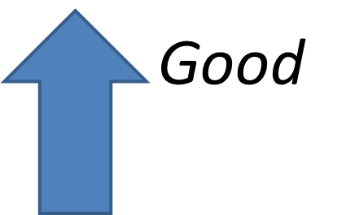
TOOL #3: Improving the Quality
Inspector will judge the build and record the results for each PDSA test
Notes:
OHA

