Slide 1
Media Communications, Social Marketing & Earned Media
In Three Parts

Slide 2
Part 1: Definitions

Slide 3
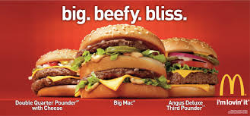
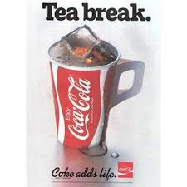
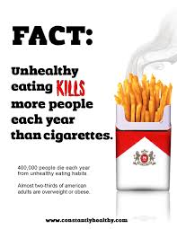
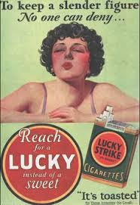
Notes:
Corporations have been hiring marketing agencies to advertise “health” for decades.
And their ads have taken various approaches to selling their “healthy” choice.
But, what is health communications and social marketing, really?

Slide 4
Health Communications
Health communication is defined as the study and use of communication strategies to inform and influence individual and community decisions…that enhance health
Notes:
Let’s start with a definition:
“That enhance health” is key.
Health communications is more than marketing a product, or service, which promises health – it is translating science-based data into meaningful communications for individual and community decision.
The scope of health communication includes disease prevention, health promotion, health care policy, and the business of health care as well as enhancement of the quality of life and health of individuals within the community.
Implementing health communications means that you use a variety of channels (TV, digital, print, out of home, etc.) to deliver a targeted or tailored messages to specific segments among varied audiences, including individuals, communities, health professionals, special groups, and policy makers.

Slide 5
Social Marketing
Social marketing is the use of strategic marketing practices “…to influence social behaviors not to benefit the marketer, but to benefit the target audience”
Notes:
Social marketing is customer centered and focuses on three major decisions: segmentation, targeting, and positioning.
Guided by these decisions, the “marketing mix” (or 4 Ps of marketing: place, price, product and promotion) is developed to produce the desired responses in the target markets.
Eight established benchmark criteria have been widely accepted as essential components of social marketing efforts: consumer orientation, insight, behavioral objectives, segmentation, exchange, competition, marketing mix, and theory.
Buy using communications and social media, we seek to use the mass reach tactics of corporations and industry to foster positive health outcomes.

Slide 6
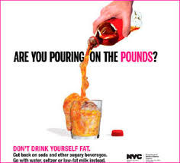
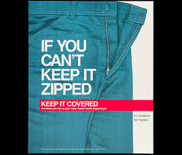
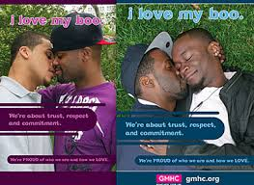
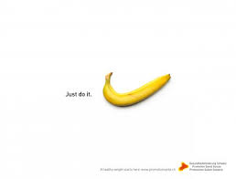
Notes:
You really can’t talk about social marketing for health (in my opinion) without talking about sexual health.
Through social marketing, there has been great success in the distribution of 1) condoms and 2) messages to promote safer sex (limiting # of partners, partner fidelity, and abstinence).
Social marketing shouldn’t be confused with social media advertising.

Slide 7
How do we use health communication and social marketing?
Health education
Communication for policy change
Notes:
In the HPCDP section, we have both health education and policy change communication campaigns.
We currently have two communication campaigns with a policy change focus: SFO and PMO
We have one communication campaign with a health education focus: STY
Before June 2016, we only had policy change communications.
legislative mandate, we were tasked with creating a health education campaign to prevent youth and young adult marijuana use.

Slide 8
Example of a health education campaign
https://youtu.be/qbCyPBZYdWk
Notes:
What was the health education message delivered in this video?
What values did the video strike with the target audience?
What else did you notice?

Slide 9
Example of a policy change campaign
https://youtu.be/63AlKO2_SJ8
Notes:
Who was the intended audience for this video?
What is the policy change this video addresses?
What differences did you notice between the health education campaign video and this policy change video?
What else did you notice?

Slide 10
What’s this?
https://youtu.be/2cfo4Nblmp8
Notes:
Discussion – thoughts and ideas about where this falls between education and policy change.

Slide 11
The Community Guide
Health communication and social marketing are recommended based on strong evidence of effectiveness when multiple channel communication is coupled with distribution of free or reduced-price health –related products
Mass reach health communication is recommended based on strong evidence of effectiveness in:
Decreasing the prevalence of tobacco use
Increasing cessation and use of available services such as quitlines
Decreasing initiation of tobacco use among young people
Notes:
Based on strong evidence of effectiveness for producing intended behavior changes, the Community Preventive Services Task Force recommends health communication campaigns that use multiple channels, one of which must be mass media, combined with the distribution of free or reduced-price health-related products (defined above).
The Community Preventive Services Task Force recommends mass-reach health communication interventions based on strong evidence of effectiveness in:
Decreasing the prevalence of tobacco use
Increasing cessation and use of available services such as quitlines
Decreasing initiation of tobacco use among young people
Evidence was considered strong based on findings from studies in which television was the primary media channel. Economic evidence shows mass-reach health communication interventions are cost-effective, and savings from averted healthcare costs exceed intervention costs.

Slide 12
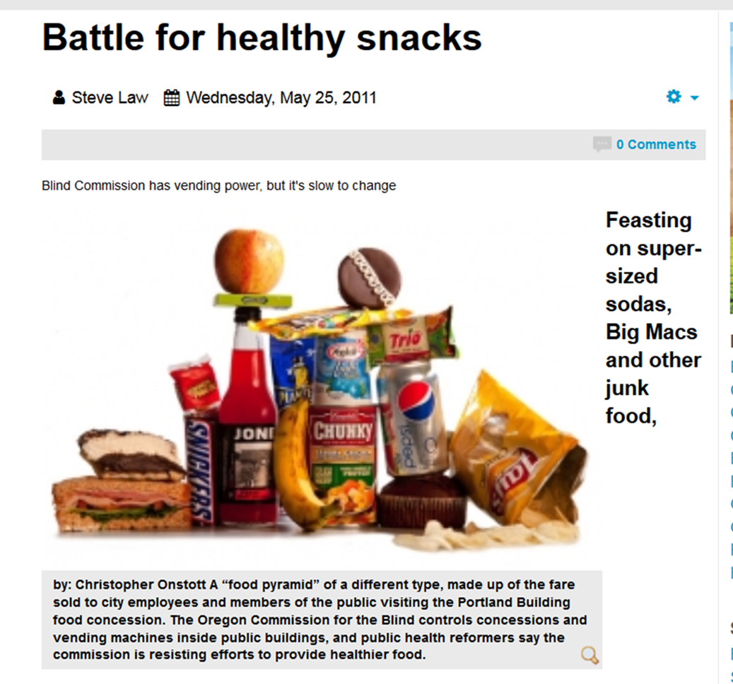
What is Earned Media?
Publicity gained through promotional efforts other than paid media advertising

Slide 13
Why Earned Media?

Slide 14
Why Earned Media?
US Media Coverage of Tobacco Industry Corporate Social Responsibility Initiatives.
Journal of Community Health (July 6, 2017, Epub ahead of print).
Most coverage appeared in local newspapers
CSR initiatives unrelated to tobacco, with non-controversial beneficiaries, were most commonly mentioned
Coverage was largely positive
Tobacco control advocates were infrequently cited as sources and rarely authored opinion pieces
When tobacco control advocate voices were included, coverage was less likely to have a positive slant.
Countering the media narrative of “virtuous companies” doing good deed could be particularly beneficial.
Notes:
Content analysis of 649 US

Slide 15
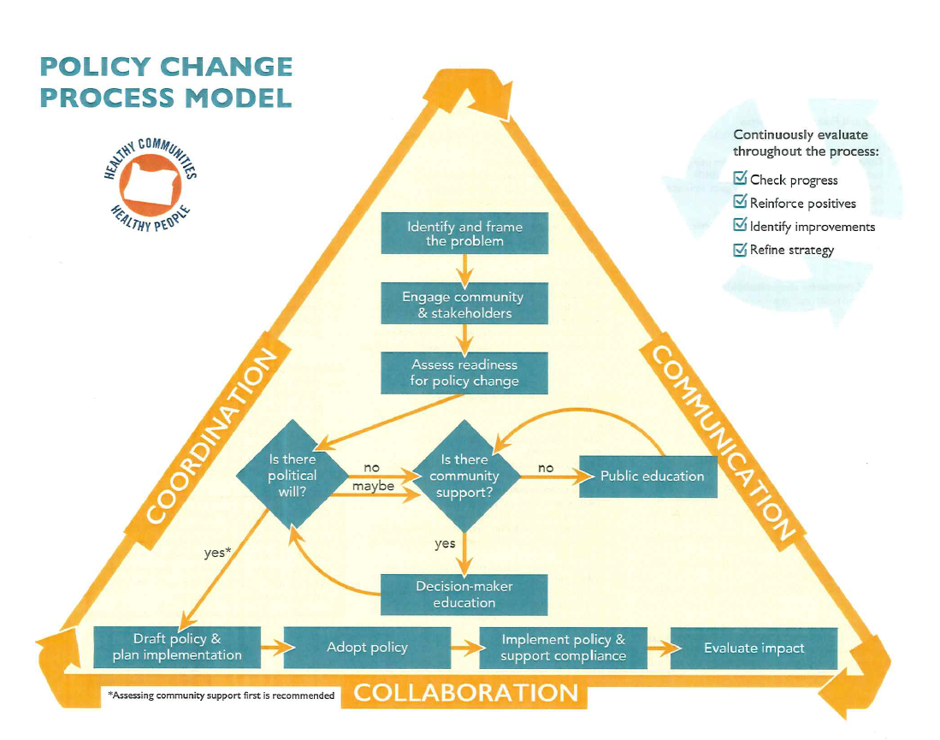
Notes:
Where can Earned Media be important in the policy change process?

Slide 17
Comprehensive Program Model
Combine and integrate educational, clinical, regulatory, economic, and social strategies at local, state, or national levels
Create a platform:
Community programs
Health systems, worksite wellness
Communications
Self-Managements supports, including screening and early detection
Diffusion and adoption of evidence-based practices.
Notes:
Comprehensive tobacco control programs are coordinated efforts to implement population-level interventions to reduce appeal and acceptability of tobacco use, increase tobacco use cessation, reduce secondhand smoke exposure, and prevent initiation of tobacco use among young people.
Assistance to community-based organizations and coalitions to pursue local programs and policies to reduce tobacco use and secondhand smoke exposure
Partnerships at local and state levels to engage health systems and providers, businesses, and public and private agencies and organizations, in an effort to broaden the reach and impact of tobacco control interventions
Mass-reach health communication interventions to inform individual and public attitudes about tobacco use and secondhand smoke
Cessation services, such as quitlines, to help tobacco users in their efforts to quit
Information and technical assistance to support the diffusion and adoption of evidence-based practices (e.g., smoke-free policies, affordable and accessible cessation services, increased tobacco product prices, and decreased tobacco product marketing and availability)

Slide 18
Communications in Public Policy
https://youtu.be/m1Grdu9MIZA
Notes:
Communications is embedded throughout the public policy change process.
The CEO for WWP & Government Policy Practice articulates the need for governments to use communications to target issues and bring about the right social outcome in partnership with the community.
Let’s have a listen.

Slide 19
Part 2: Smokefree Oregon

Slide 20
Framework
Tobacco is the leading cause of death in Oregon
Tobacco is the leading cause of disease in Oregon
The tobacco industry spends millions marketing and promoting its products
Most Oregonians don’t smoke

Slide 22
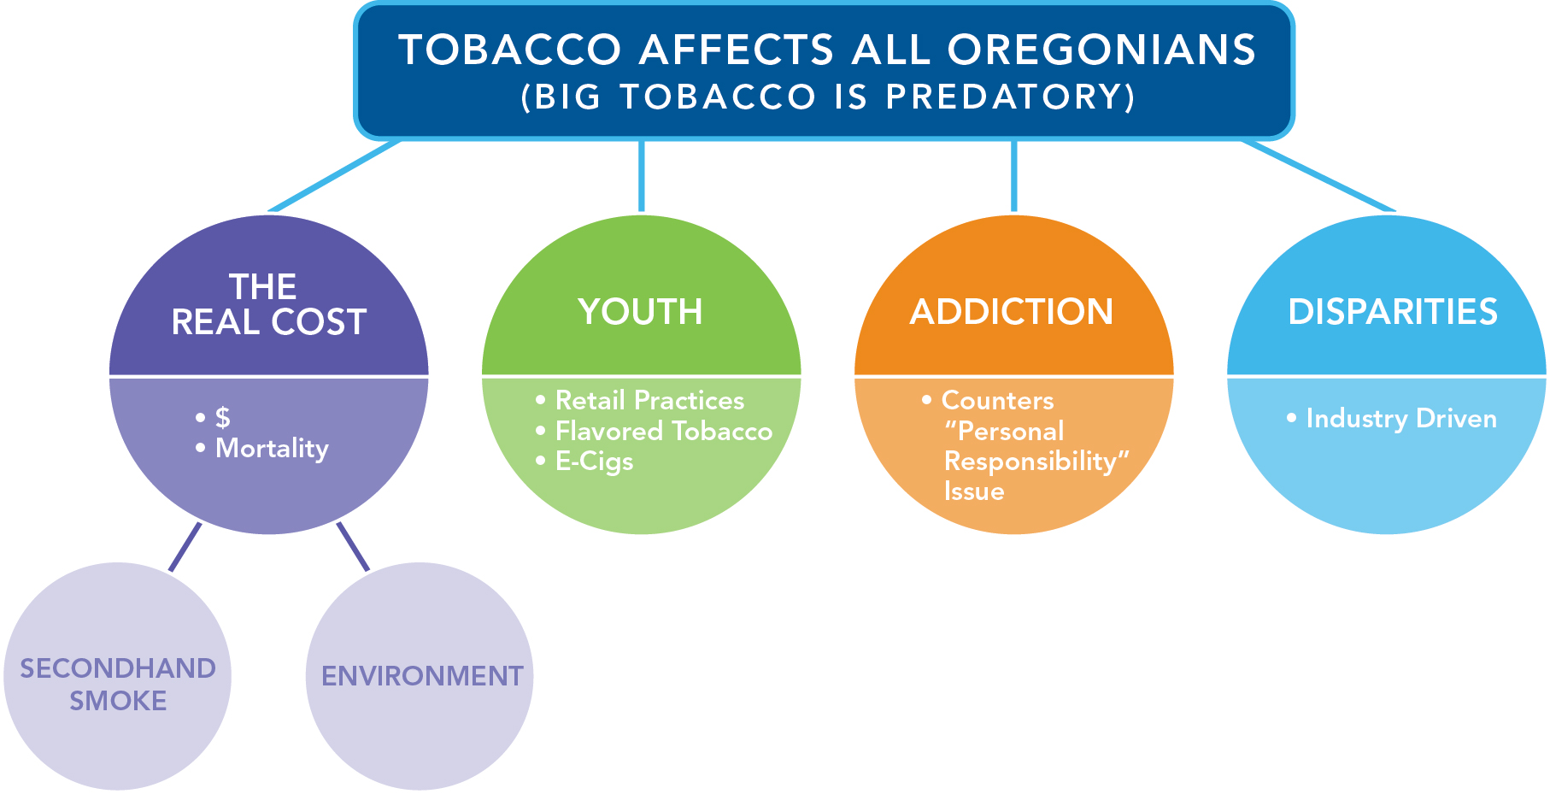

Slide 23
Audience Research
7 Focus Groups
Smokers, general population, youth
Medford, Portland, Woodburn
Online Panel
400-500 general population
Covering the entire state

Slide 24
Focus Group Key Findings
Non-smokers need connection
Intentional and targeted marketing of Big Tobacco not clear, yet
Re-frame the role of Big Tobacco
People who smoke appreciate not being villainized
Environmental message resonating
Notes:
Predatory nature
Unclear from smoker and non-smoker standpoint

Slide 25
What didn’t work
Big Tobacco playing by the rules
Creative that’s confusing, boring or lacking emotion
Painting Big Tobacco as evil without evidence
Tree angle to the environment
Not as much as other angles

Slide 26
Single Sentence
Tobacco affects your children, your health, your pocketbook, your environment and your community. Tobacco affects you.

Slide 27
Leveraging values
Family
Opportunity
Fairness
Honesty
Compassion
Health

Slide 28
Notes:
How we tell the story
Television
Grassroots/earned media
Social
Print
Radio
Out-of-home

Slide 29
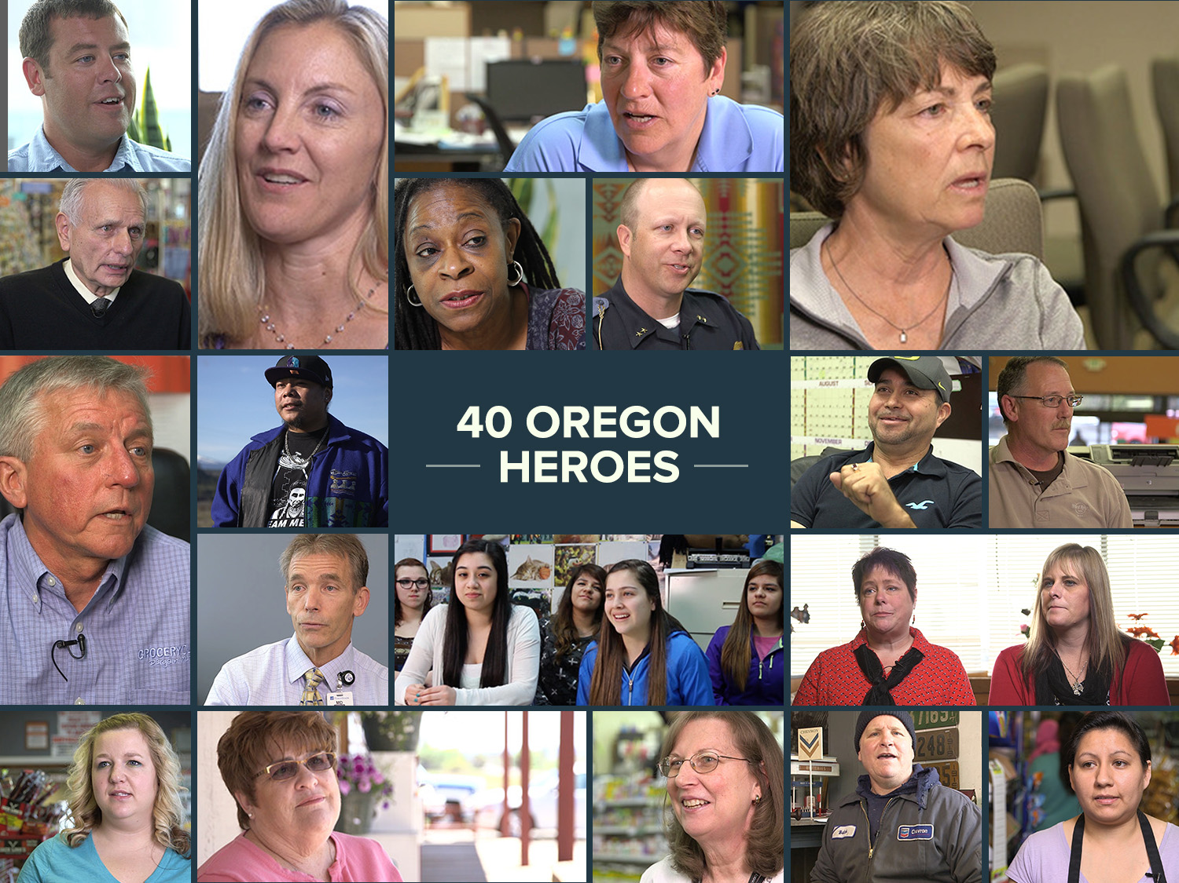
Notes:
How we work on media comms at the state level
How we worked with local grantees to find, develop, and use these stories locally and statewide

Slide 30
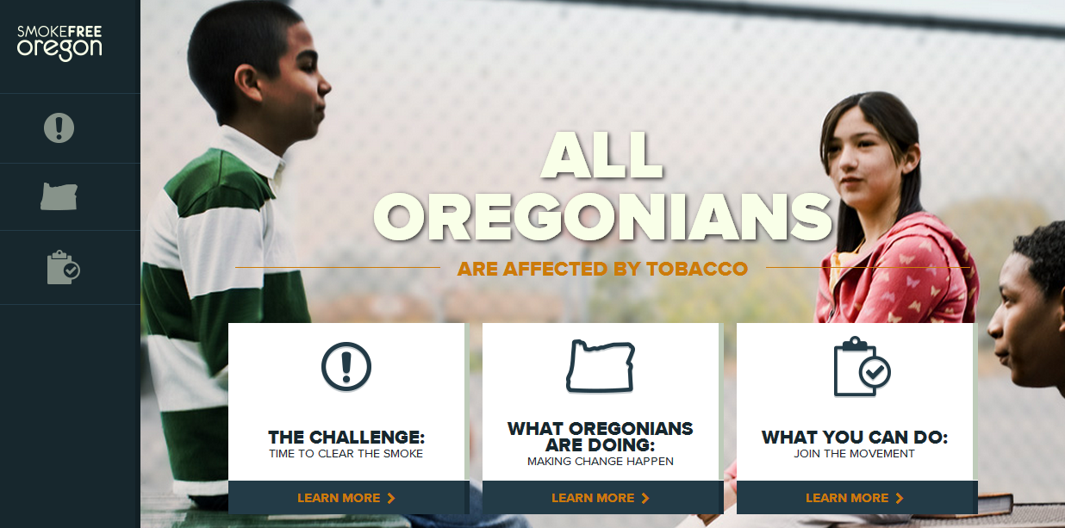
Website

Slide 32
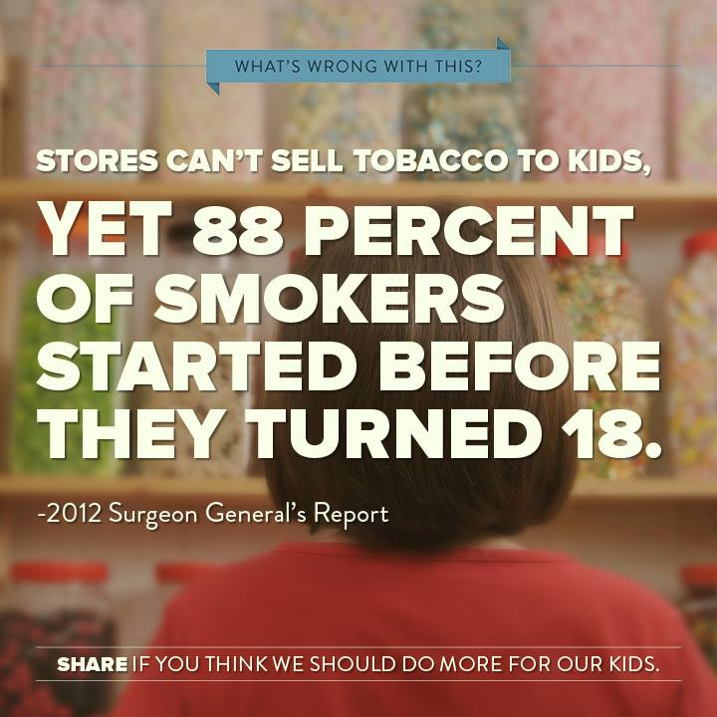
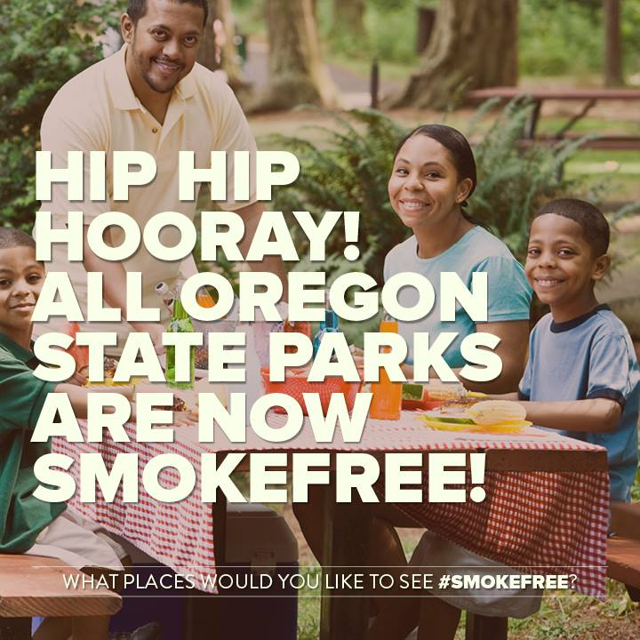
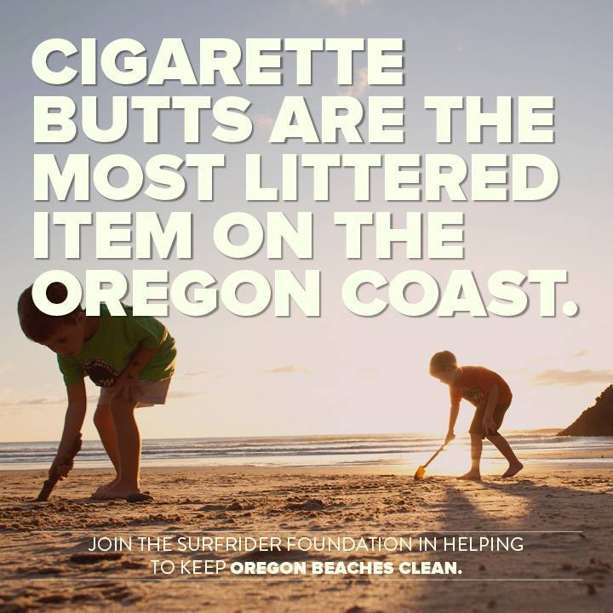
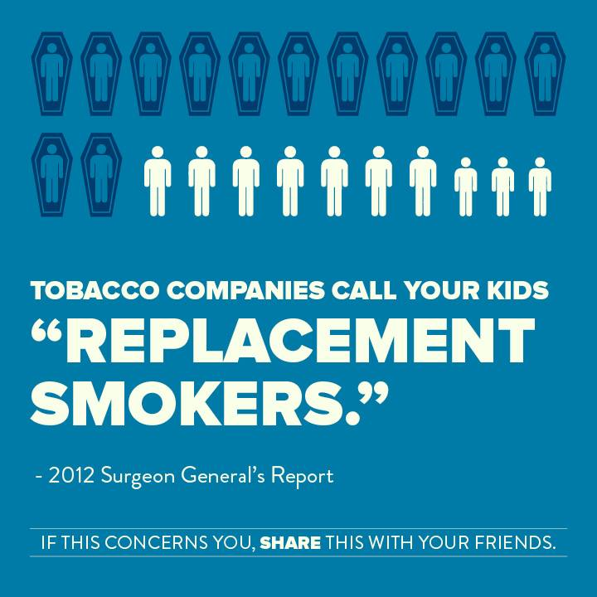
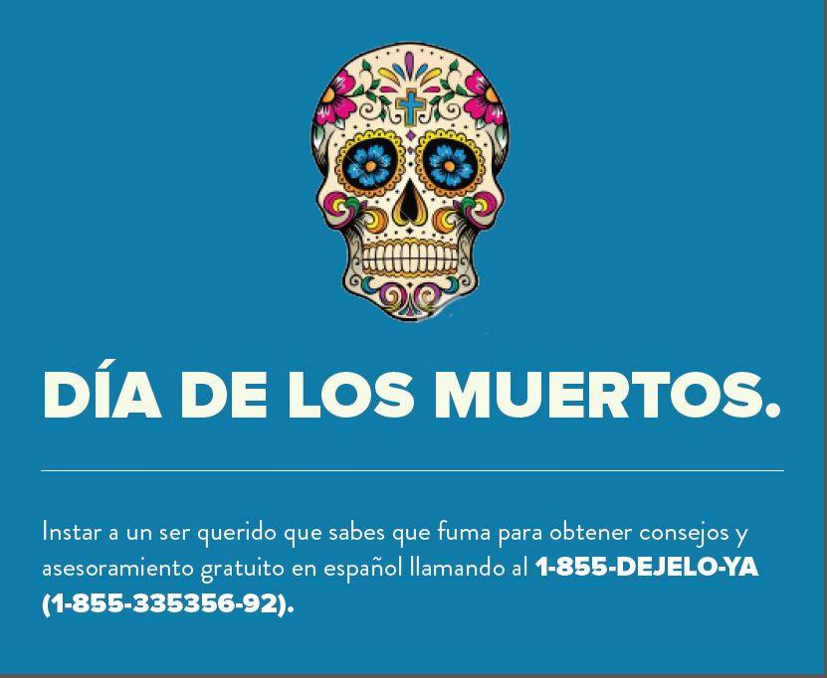
Social media

Slide 33
Earned Media Opportunities

Slide 34
Part 3: Alcohol and Drug Prevention

Slide 35
Working in table groups
Try to make your table a mix of participants: TPEP, ADPEP, SPF-PFS, DFC, RHECs, HPCDP staffers
Select a facilitator, timekeeper, and note taker
We’ll share back ideas at the end of the session
Discuss the following questions:
What is the story of alcohol use in Oregon?
What is the theme? Who are the characters? What is the plot?
Who are the (s)heros?
Who or what are the villains?
What is the ending for the story?

