Slide 1
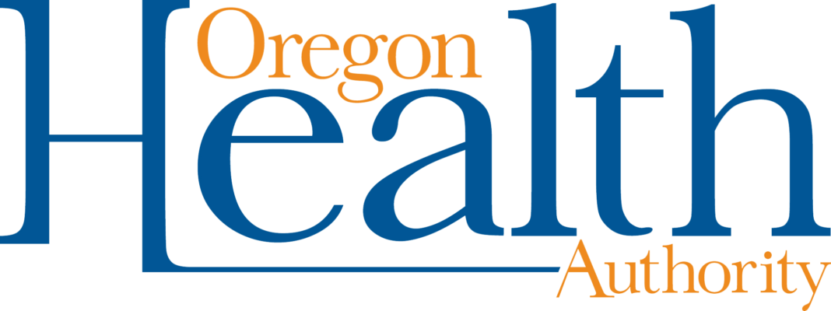
Navigating the PDMP Data Dashboard

Slide 2
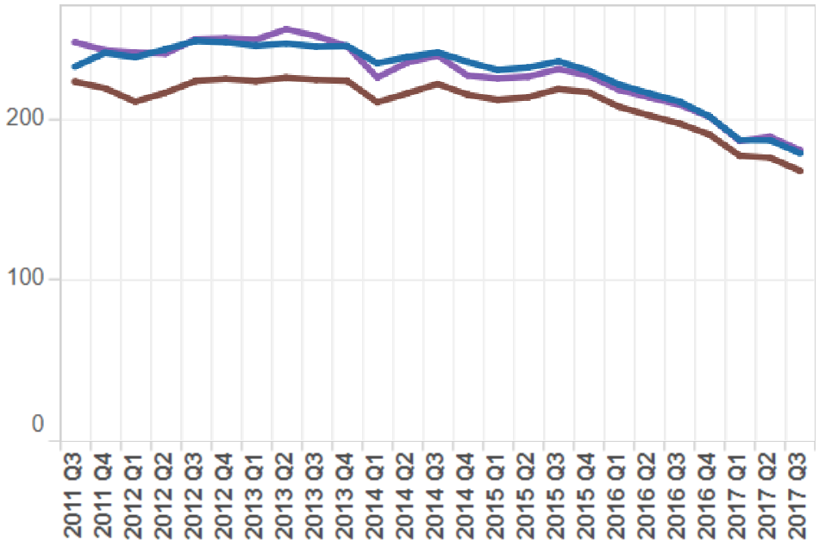
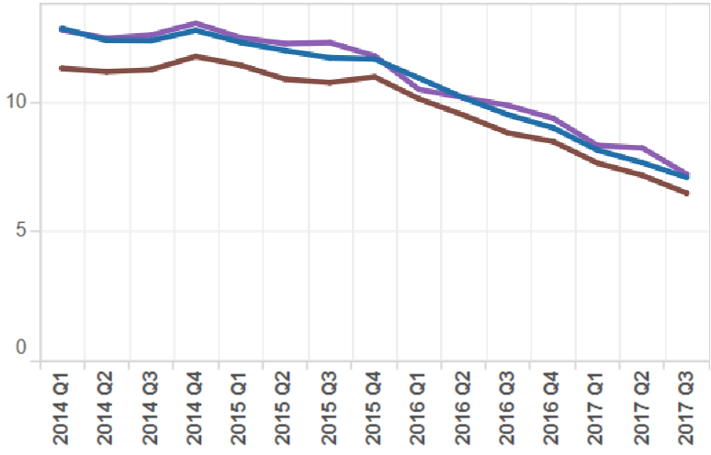
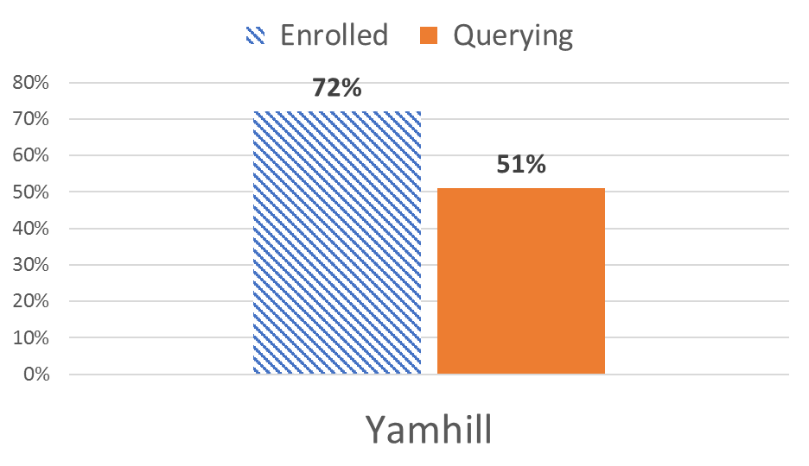
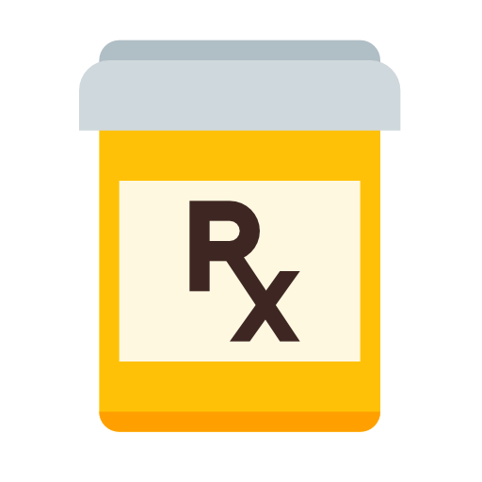
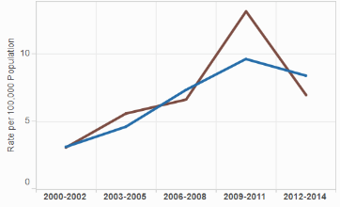
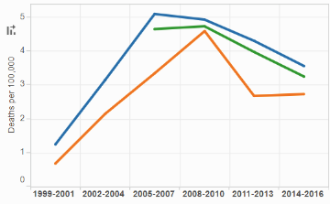
PRESCRIPTION DRUGS
Yamhill County
Data from Oregon PDMP, Vital Records, and Hospital Discharge Dataset
Updated 11/02/2017
Yamhill Opioid Prescription Fills by Age
Individuals Receiving High Dose Opioids (>90 MED)
Individuals per 1,000 Residents
Fills Per 1,000 Residents
Individuals per 1,000 Residents
Top Opioid Prescribers
PDMP Measures in 2017 Q1
Controlled Substance Prescribing 2017 Q3
*Opioid (Non-tramadol) in Yamhill County
18,977
Prescriptions fills, which represents about 22% of the fills in the region (Marion, Polk, Yamhill).
8,477
Individuals receiving opioids, which represents about 8.2% of the county’s population.
Opioid Overdose Hospitalizations
Opioid Overdose Deaths
Rate per 100,000 Population
Rate per 100,000 Population
Technical Note: Counties with smaller populations may have rates suppressed due to small numbers.

Slide 3
PRESCRIPTION DRUGS
[Region/ Counties]
Data from Oregon PDMP, Vital Records, and Hospital Discharge Dataset
Updated 11/02/2017
________Opioid Prescription Fills
Individuals Receiving High Dose Opioids (>90 MED)
Prescribing by Drug Class
Under “Prescribing Measures by County”
Select Counties or Region
Prescribing measure should be set to “Individuals Receiving Drug per 1,000 Residents”
Risky Prescribing Measures
Under “Prescribing Measures by County
Select Counties or Region
Prescribing measure should be set to “>90 MED Individuals per 1,000 Residents from a Single Fill”
Individuals per 1,000 Residents
Fills Per 1,000 Residents
Individuals per 1,000 Residents
Top Opioid Prescribers
PDMP Measures in 2017 Q1
Controlled Substance Prescribing 2017 Q3
*Opioid (Non-tramadol) in _____County
00,000
Prescriptions fills, which represents about 00% of the fills in the region.
00,000
Individuals receiving opioids, which represents about 00% of the county’s population.
Pharmaceutical Opioid Overdose Hospitalizations
Pharmaceutical Opioid Overdose Deaths
Overdose Hospitalizations
Under “Overdose Hospitalizations by County”
Select Counties or Regions
Overdose Hospitalization Drug Type should be set to “Pharmaceutical Opioids”
Overdose Deaths
Under “Overdose Deaths by County”
Select Counties or Regions
Overdose Death Drug Type should be set to “Pharmaceutical Opioids”
Rate per 100,000 Population
Rate per 100,000 Population
Technical Note: Counties with smaller populations may have rates suppressed due to small numbers.

Slide 4
PRESCRIPTION DRUGS
[Region/ Counties]
Data from Oregon PDMP, Vital Records, and Hospital Discharge Dataset
Updated 11/02/2017
________Opioid Prescription Fills
Individuals Receiving High Dose Opioids (>90 MED)
Individuals per 1,000 Residents
Fills Per 1,000 Residents
Individuals per 1,000 Residents
Top Opioid Prescribers
PDMP Measures in 2017 Q1
Controlled Substance Prescribing 2017 Q3
*Opioid (Non-tramadol) in _____ County
00,000
Prescriptions fills, which represents about 00% of the fills in the region
00,000
Individuals receiving opioids, which represents about 00% of the county’s population.
Pharmaceutical Opioid Overdose Hospitalizations
Pharmaceutical Opioid Overdose Deaths
Rate per 100,000 Population
Rate per 100,000 Population
Technical Note: Counties with smaller populations may have rates suppressed due to small numbers.

Slide 5
Right Click Graph
Select “Edit Data”
Update County Name
Update Enrolled and Querying Data
Under PDMP Data Dashboard – PDMP Measures
Hover over desired County for “Percent of Top Prescribers Querying Percentage
Change Measure to “Percent of Top Prescribers Enrolled”
Copy Graph
Right Click and Paste as Picture

Slide 6
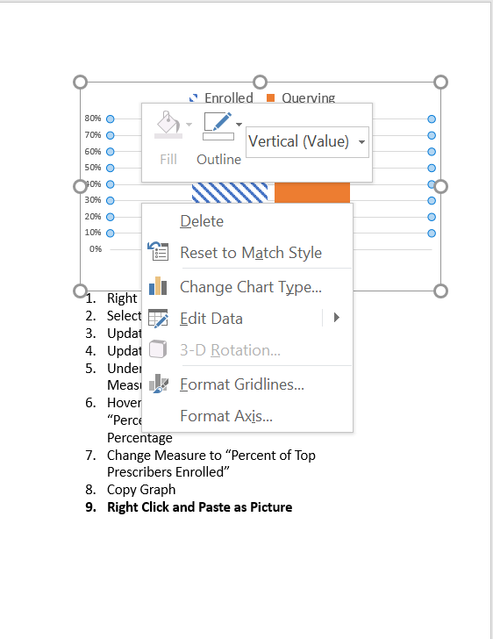

Slide 7
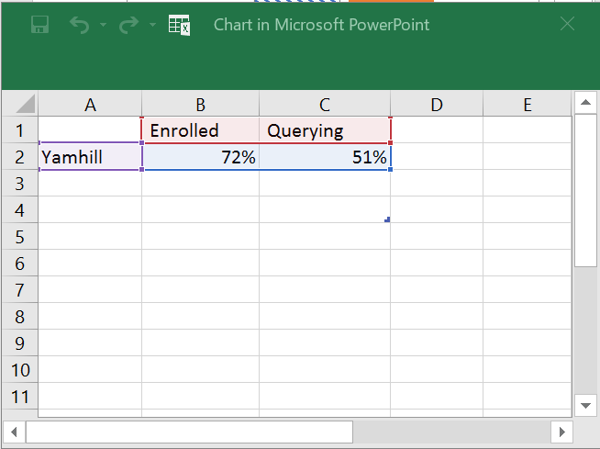

Slide 8
Contact
Sarah Shin
AmeriCorps VISTA
Statewide Opioid Data and Outreach
Injury & Violence Prevention Program
OREGON HEALTH AUTHORITY
Desk: 971-673-1105
Sarah.Shin@dhsoha.state.or.us

