Slide 1
What's Killing Oregonians? Public Health Policies for Tobacco & Alcohol
Katrina Hedberg, MD, MPH
State Health Officer
HPCDP Grantees and Contractors Annual Meeting
November 2017

Slide 2
Overview
Leading drivers of death in Oregon
Strategies to prevent the harm of tobacco & alcohol
Potential for a policy response
Mobilizing across substance areas to drive change

Slide 3
Leading causes of death in Oregon
Over 40% of all deaths in Oregon are caused by cancer and heart disease
Source: Oregon death certificates (2016)
Notes:
Number of deaths (2016 death data)
Alcohol induced deaths include: alcoholic mental/behavioral disorders, degeneration of nervous system, polyneuropathy, alcoholic myopathy, cardiomyopathy, gastritis, liver disease, chronic pancreatitis, alcohol in the blood, accidental poisoning by alcohol, intentional self-poisoning, and poisoning of undetermined intent. Note: disorders included here are also included in other cause of death categories.

Slide 4
Actual causes of death
Nearly 1 in 3 deaths in Oregon are caused by tobacco, obesity, or alcohol each year.
1500
1400
Notes:
About 75% of tobacco related deaths are caused by cancer, cardiovascular diseases, and respiratory diseases.
Alcohol use deaths calculated using ARDI.
These categories are not mutually exclusive.
Source: What is Killing Oregonians? The Public Health Perspective CD Summary 61, no. 15 (July 17, 2012) http://public.health.oregon.gov/DiseasesConditions/CommunicableDisease/CDSummaryNewsletter/Documents/2012/ohd6115.pdf

Slide 5
Behavior Disease
Tobacco Use
Physical Activity
Diet
Alcohol
Heart Disease
Stroke
Cancers
Diabetes

Slide 6
Health risk factors among Oregon adults
Source: 2016 Oregon BRFSS
Notes:
Oregon BRFSS 2016 (unadjusted)

Slide 7
Strategies to prevent harms of tobacco & alcohol use
Notes:
Tobacco use is an incredibly useful model to learn from because so much research has been done, and so many different interventions and strategies have been extensively evaluated. We don’t have this level of evidence for just about any other public health practice area.

Slide 8
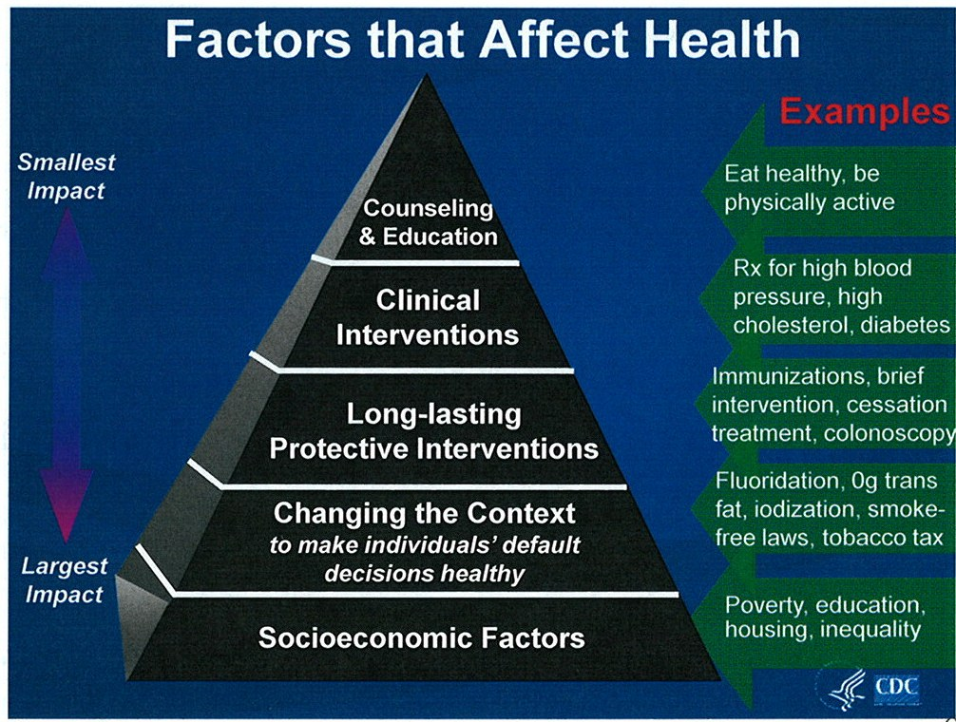
Notes:
We know what has the largest impact on health, and that is addressing socio-economic factors and changing the context.
Context referres to the places where people live, work, learn and play. Examples of changing the context include removing transfat from foods (something that the FDA recently did), iodized salt, and smokefree laws.

Slide 9
How can we change the context?
Product
Placement
Promotion
Price
Notes:
Public health can change context significantly by countering industry marketing and product promotion in four key areas: Product, Placement, Promotion and Price.

Slide 10
State Health Improvement Plan
Prevent and reduce tobacco use
Slow the increase of obesity
Improve oral health
Reduce harms associated with alcohol and substance use
Prevent deaths from suicide
Improve immunization rates
Protect the population from communicable dz

Slide 11
Notes:
HPCDP’s Health places healthy people framework is a vision of what healthy context in Oregon could look like. It includes:
Statewide policies put healthy options within reach of all people (healthy foods and clean drinking water; safe walking routes, active transportation and recreation options, and protect everyone from unhealthy options and influences (marketing and promotion)
Public health interventions that help people eat better, move more, live tobacco free, and take care of themselves so they can live healthier lives and do the things they enjoy.
Every Oregon community, all people have access to health options where they live, work, play and learn. Local policies, systems and environments put health within reach today and for future generations.
State, local and tribal governments collaborate with community partners to put health within reach of all people in Oregon.

Slide 12
Tobacco use: evidence-based policies
Notes:
Tobacco use is an incredibly useful model to learn from because so much research has been done, and so many different interventions and strategies have been extensively evaluated. We don’t have this level of evidence for just about any other public health practice area.

Slide 13
Tobacco use
Despite declines in use, tobacco is still the No. 1 preventable cause of death
Tobacco costs $2.5 billion per year in medical expenditures and lost productivity
Use of non-cigarette tobacco products on the rise (e-cigs)
Notes:
2.5 billion from 2017 Oregon Tobacco

Slide 14
Cigarette smoking and e-cigarette use over time
11th grade cigarettes
Adult cigarette
8th grade cigarettes
11th grade e-cigarettes
8th grade e-cigarettes
Source: Oregon BRFSS; Student Drug Use survey, Youth Risk Behavior Survey, Oregon Healthy Teens
Notes:
Adults - Oregon BRFSS 2016 (age-adjusted)
Youth - Student Drug Use Survey (1996, 1998, 2000); Youth Risk Behavior Survey (1997, 1999); Oregon Healthy Teens
(2001–2009, 2011, 2013, 2015, 2017);
-88% of adult cigarette smokers report that they started smoking before turning 18.
-Youth smoking is influenced by the prevalence of adult smoking and social norms.
-One group of smokers cannot be addressed without the other.

Slide 15
Cigarette smoking among adults by education level
Source: 2016 Oregon BRFSS
Notes:
Oregon BRFSS 2016 (age-adjusted).

Slide 16
Cigarette smoking among adults by race and ethnicity
Source: 2010-2011 Oregon BRFSS Race Oversample
Notes:
Oregon BRFSS Race Oversample 2010-2011 (age-adjusted).

Slide 17
Smoking during pregnancy
Source: Oregon Birth Certificates UPDATE
Notes:
Oregon birth certificate data. Smoking during any trimester.

Slide 18
Flavored tobacco use
Source: 2016 Oregon BRFSS; 2017 Oregon Healthy Teens (UPDATE)
Notes:
HOW DID WE DO THIS FOR BRFSS? I THOUGHT THESE WERE NOT COMPATIABLE
Rodney – the data aren’t embedded here for me to change –
2017 OHT 8th = 57%, 11th = 64%
2016 BRFSS young adult = 51%, Adult = 19%
(Past 30 day (OHT) or past year (BRFSS) use of flavored tobacco or vaping products; among current tobacco users)
Among all tobacco, products with flavors, particularly electronic cigarettes, little cigars, and hookah are considerably more popular among youth and young adults than of older adults. Over half of Oregon youth that use tobacco, use flavored tobacco; this is in contrast to about 15% of adult tobacco users. This suggests flavors are a key component for initiation among youth and young adults.
Current tobacco use and related topics among 8th and 11th graders, Oregon 2015. Oregon Healthy Teens 2015. https://public.health.oregon.gov/DiseasesConditions/ChronicDisease/DataReports/Documents/datatables/ORAnnualOHT_Tobacco.pdf
Tobacco use and related topics among adults, Oregon 2014. Behavioral Risk Factor Surveillance Systems (2014). https://public.health.oregon.gov/DiseasesConditions/ChronicDisease/DataReports/Documents/datatables/ORAnnualBRFSS_tobacco.pdf
Myers, Matthew L.,” New Study Finds Over 40 Percent of Youth Smokers Use Flavored Little Cigars or Cigarettes, Shows Need for FDA to Regulate All Tobacco Products.” Campaign for Tobacco-Free Kids. Oct. 22 2013

Slide 19
Tobacco marketing
$1 million per hour in the United States
More than $100 million annually in Oregon retail environment
More than 50% of Oregon youth visit a convenience store 1+ times per week
3 in 4 youth exposed to tobacco advertising in stores
Notes:
The tobacco industry spends over one million dollars per hour on promotion in the United States. Since 2002, cigarette companies have been spending billions nationwide on price discounts and special promotions so that retailers can sell their cigarettes cheaper and keep tobacco products on their shelves. In exchange for promotions retail stores are contracted to follow tobacco company requirements on placement of products and advertising at specific locations within the stores in order to display the special prices prominently. Since 2011, the tobacco industry in Oregon has spent more than $100 million dollars annually on marketing in the retail environment in Oregon. Oregon convenience stores and tobacco discount stores are the most common locations for purchasing cigarettes.
Seen tobacco advertising on a storefront or inside a store:
8th Grade Youth (71.0%), 11th Grade Youth (77.9%), Adult (57.0%)
Visit convenience stores one or more times in a week:
8th Grade Youth (58.4%), 11th Grade Youth (57.4%), Adult (NA)
“Broken Promises to Our Children, A State-by-State Look at the 1998 State Tobacco Settlement 16 Years Later”. Campaign for Tobacco Free Kids. December, 2014.
http://www.tobaccofreekids.org/content/what_we_do/state_local_issues/settlement/FY2015/2014_12_11_brokenpromises_report.pdf

Slide 20
Annual marketing expenditures in Oregon over time (in Millions $)
Source: Laura Bach, “STATE-SPECIFIC ESTIMATES OF TOBACCO COMPANY MARKETING EXPENDITURES 1998 to 2014.” Campaign for Tobacco-Free Kids, November 28, 2016
Notes:
The tobacco industry spends over one million dollars per hour on promotion in the United States. Since 2002, cigarette companies have been spending billions nationwide on price discounts and special promotions so that retailers can sell their cigarettes cheaper and keep tobacco products on their shelves. In exchange for promotions retail stores are contracted to follow tobacco company requirements on placement of products and advertising at specific locations within the stores in order to display the special prices prominently. Since 2011, the tobacco industry in Oregon has spent more than $100 million dollars annually on marketing in the retail environment in Oregon. Oregon convenience stores and tobacco discount stores are the most common locations for purchasing cigarettes.
Seen tobacco advertising on a storefront or inside a store:
8th Grade Youth (71.0%), 11th Grade Youth (77.9%), Adult (57.0%)
Visit convenience stores one or more times in a week:
8th Grade Youth (58.4%), 11th Grade Youth (57.4%), Adult (NA)
“Broken Promises to Our Children, A State-by-State Look at the 1998 State Tobacco Settlement 16 Years Later”. Campaign for Tobacco Free Kids. December, 2014.
http://www.tobaccofreekids.org/content/what_we_do/state_local_issues/settlement/FY2015/2014_12_11_brokenpromises_report.pdf

Slide 21
Tobacco - Price
Consumption decreases as price increases
Youth and those living with fewer financial resources experience the greatest benefit
Notes:
Oregonians established a tax on tobacco products with public health significance in 1996, and established the Tobacco Prevention and Education Program.
Intervention Definition: Interventions to increase the unit price for tobacco products include public policies at the federal, state, or local level that increase the purchase price per unit of sale. The most common policy approach is legislation to increase the excise tax on tobacco products, though legislative actions and regulatory decisions may also be used to levy fees on tobacco products at the point of sale. Other policies that might influence tobacco product prices were not considered in this review.
The Community Preventive Services Task Force recommends interventions that increase the unit price of tobacco products based on strong evidence of effectiveness in reducing tobacco use. Public health effects are proportional to the size of the price increase and the scale of implementation.

Slide 22
Tobacco – Smokefree Policies
Reduce exposure to secondhand smoke
Reduce the prevalence of tobacco use
Increase the number of tobacco users who quit
Reduce the initiation of tobacco use among young people
Reduce tobacco-related morbidity and mortality, including acute cardiovascular events
Notes:
Oregon has had a comprehensive Indoor Clean Air Act, also called the Smokefree Workplace Law, since 2009. This means that the majority of Oregonians don’t have to breath secondhand smoke while they are at work.
Smokefree laws and policies [read slide content]
The value of smokefree air is no longer debated. The vast majority of Oregonians agree breathing secondhand smoke is dangerous – some even believe that it is more dangerous than smoking.
Smokefree policies also shape an expectation that we, as a society, don’t use tobacco.

Slide 23
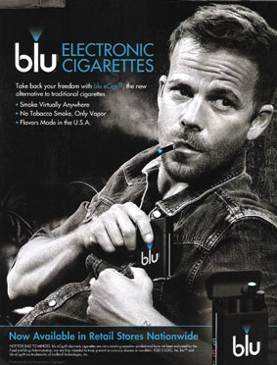
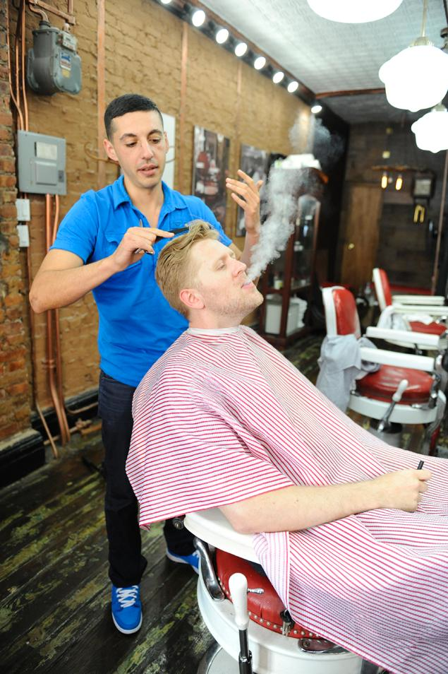
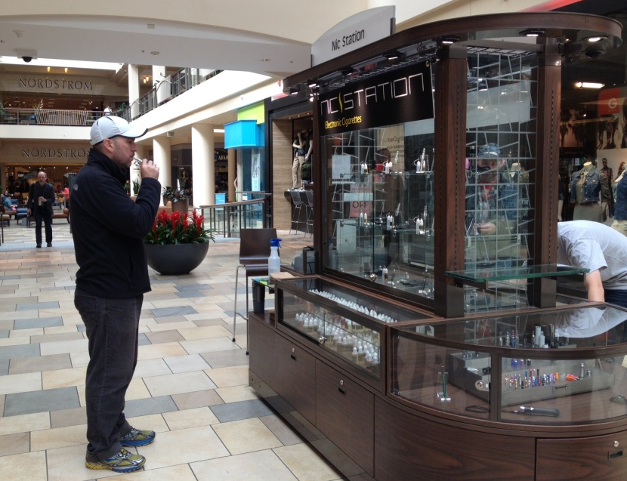
E-cigarette policies: Treat like tobacco
Restrict advertising, commercials on TV
Restrict location for smoking
Restrict location of sales
Restrict flavors
Notes:
-Kids can’t tell the difference between e-cigarettes and cigarettes in these ads. Can you?
-Unregulated promotion of nicotine products has the potential to foster the norm that e-cigarettes and conventional cigarettes are acceptable.
-The growing and unregulated market has attracted the Big 3, allowing them to enter marketing on TV after 40 years of being banned.

Slide 24
TPEP’s Comprehensive Approach
Community Programs
Quit Line
Public Awareness & Education
Data and accountability

Slide 25
Tobacco Program goals
Reduce tobacco use among adults
Reduce tobacco consumption (per capita packs and individual daily consumption)
Increase cessation rates
Reduce tobacco use among young people
Reduce exposure to second hand smoke
Reduce tobacco morbidity and mortality
Notes:
Comprehensive tobacco control programs are coordinated efforts to implement population-level interventions to reduce the appeal and acceptability of tobacco use, increase tobacco use cessation, reduce secondhand smoke exposure, and prevent initiation of tobacco use among young people.
Programs combine and integrate evidence-based educational, clinical, regulatory, economic, and social strategies at local, state, or national levels.
Comprehensive tobacco control programs most often include administrative support, surveillance, evaluation, and program monitoring. Programs are typically organized and funded at the state level to provide a platform for effective implementation of the following components:
Assistance to community-based organizations and coalitions to pursue local programs and policies to reduce tobacco use and secondhand smoke exposure
Partnerships at local and state levels to engage health systems and providers, businesses, and public and private agencies and organizations, in an effort to broaden the reach and impact of tobacco control interventions
Mass-reach health communication interventions to inform individual and public attitudes about tobacco use and secondhand smoke
Cessation services, such as quitlines, to help tobacco users in their efforts to quit
Information and technical assistance to support the diffusion and adoption of evidence-based practices (e.g., smoke-free policies, affordable and accessible cessation services, increased tobacco product prices, and decreased tobacco product marketing and availability)
Some programs may have authority to implement policies directly, such as restrictions on tobacco product marketing and availability, and smoke-free policies.
In addition to the things on the slide, comprehensive tobacco control programs can increase program funding over time to increase or speed reductions in tobacco use across population groups.

Slide 26
39.3
Notes:
We can see that in Oregon, the comprehensive tobacco prevention approach has worked.

Slide 27
Excessive drinking: alcohol control policies
Notes:
Excessive drinking includes binge drinking, heavy drinking, and any drinking by pregnant women or people younger than age 21.
Binge drinking, the most common form of excessive drinking, is defined as consuming
For women, 4 or more drinks during a single occasion.
For men, 5 or more drinks during a single occasion.
Heavy drinking is defined as consuming
For women, 8 or more drinks per week.
For men, 15 or more drinks per week.
Most people who drink excessively are not alcoholics or alcohol dependent.

Slide 28
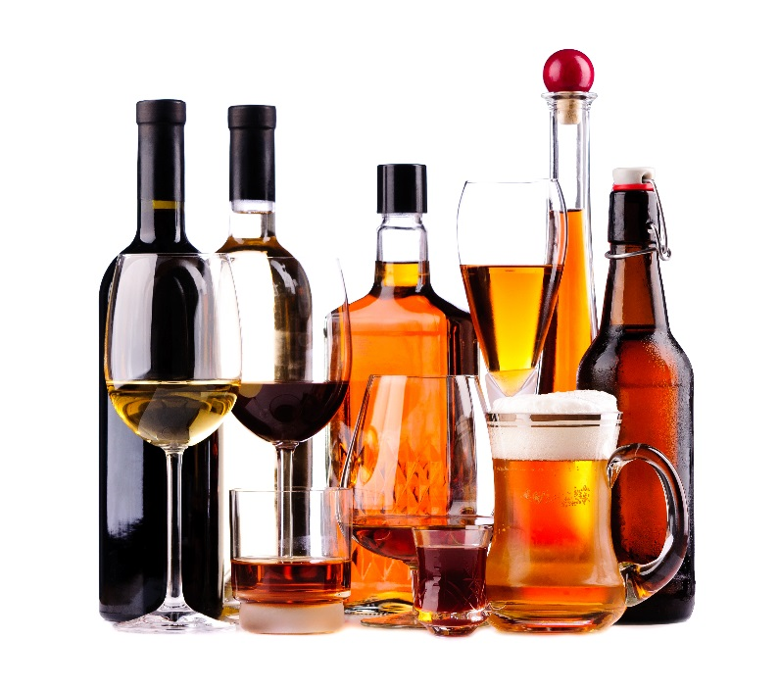
Alcohol Adverse Impact
3rd leading cause of preventable death in US
88,000 deaths annually
Economic costs: $249 billion in 2010
Notes:
Data sources:
Mokdad, A.H.; Marks, J.S.; Stroup, D.F.; and Gerberding, J.L. Actual causes of death in the United States 2000. [Published erratum in: JAMA 293(3):293–294, 298] JAMA: Journal of the American Medical Association 291(10):1238–1245, 2004. PMID: 15010446
https://www.cdc.gov/features/costsofdrinking/index.html. Last accessed on 10/18/2017.

Slide 29
Adverse Health Effects: Alcohol
Acute effects:
  poisoning, injury, dis-inhibition (violence, STDs)
Chronic effects:
  dependency, heart and liver disease, pancreatitis, cancer, fetal alcohol syndrome

Slide 30
Alcohol-related deaths over time
Rate per 100,000 residents
Source: Oregon death certificates (UPDATE)
Notes:
Source: Oregon death certificate data. Alcohol related deaths are calculated using CDC’s Alcohol Related Disease Impact (ADRI) methodology. This is a State Public Health Indicator. 2014 still latest available as of Oct 2017.

Slide 31
Alcohol-related deaths by sex and age
Rate per 100,000 residents
Source: Oregon death certificates (2014) (UPDATE)
Notes:
Source: Oregon death certificate data (2014). Alcohol related deaths are calculated using CDC’s Alcohol Related Disease Impact (ADRI) methodology. This is a State Public Health Indicator. 2014 still latest available as of Oct 2017.

Slide 32
Alcohol-related deaths by race/ethnicity
Rate per 100,000 residents
Source: Oregon death certificates (2014) (UPDATE)
Notes:
Source: Oregon death certificate data (2014). Alcohol related deaths are calculated using CDC’s Alcohol Related Disease Impact (ADRI) methodology. Estimates are age-adjusted. This is a State Public Health Indicator. 2014 still latest available as of Oct 2017.

Slide 33
Binge drinking over time
11th graders
Adults
8th graders
Source: Oregon BRFSS; Oregon Healthy Teens (UPDATE)
Notes:
Adults - Oregon BRFSS, age-adjusted
Youth – OHT
Adult binge drinking is defined as consuming 4+ drinks for women or 5+ drinks for men on 1+ occasions in the past 30 days.
Youth binge drinking is defined as consuming 5+ drinks within a couple of hours on 1+ days in the past 30 days.

Slide 34
Binge drinking among adults by sex and age
Source: 2016 Oregon BRFSS
Notes:
Oregon BRFSS 2016. Estimates by sex are age-adjusted; by age is unadjusted.
We see large disparities by sex and age – no large differences by education. No adult data by race unfortunately.

Slide 35
Binge drinking among teens by race and ethnicity
Source: 2017 Oregon Healthy Teens
Notes:
Source: Oregon Healthy Teens 2015. Race and ethnicity categories are mutually exclusive.
Youth binge drinking is defined as consuming 5+ drinks within a couple of hours on 1+ days in the past 30 days.

Slide 36
Type of alcohol consumed among 11th graders who drink alcohol
Source: 2017 Oregon Healthy Teens
Notes:
Flavored alcoholic drinks – link to tobacco
During the past 30 days, what type of alcohol did you usually drink?
Liquor (such as vodka, rum, scotch, bourbon, or whiskey)
Beer
Flavored alcohol drinks (such as lemon vodka, coconut rum)
Wine (not wine coolers)

Slide 37
Alcohol marketing
Exposure to advertising increases youth initiation and consumption
More than $6 billion spent nationally on advertising and promotions
More than half of Oregon youth visit a convenience store at least once per week
Notes:
Assuming that this hasn’t updated but please check,
Increased exposure to adverting and marketing is linked to increased underage drinking initiation and increased underage consumption*
(*)Anderson et al Alcohol 2009:44:229-43
Nationwide, alcohol advertisers spent $2 billion on alcohol advertising in those media that are measured (television, radio, print, outdoor, major newspapers and Sunday supplements) in 2005.
Source:Nielsen Adviews.
Working from alcohol company documents submitted to them, the Federal Trade Commission estimated in 1999 that the alcohol industry's total expenditures to promote alcohol (including through sponsorship, Internet advertising, point-of-sale materials, product placement, brand-logoed items and other means) were three or more times its expenditures for measured media advertising. This would mean that the alcohol industry spent approximately $6 billion or more on advertising and promotion in 2005
Source: Federal Trade Commission, Self-Regulation in the Alcohol Industry, Appendix B: Alcohol Advertising Expenditures, iii.
http://www.camy.org/resources/fact-sheets/alcohol-advertising-and-youth/

Slide 38
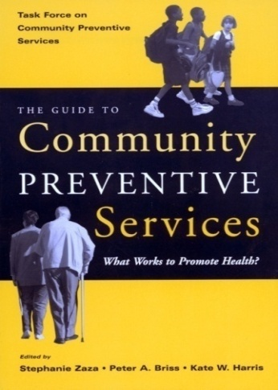
Alcohol Policies
Dram shop liability
Limiting hours of sale
Regulate outlet density
Enhanced enforcement
prohibiting sales to minors
No privatization of sales

Slide 39
Alcohol - Price
As price increases, consumption decreases across all alcohol types and age groups
Higher prices are consistently related to:
  Fewer motor vehicle crashes and fatalities
  Less alcohol-impaired driving
  Less mortality from liver cirrhosis
  Less all-cause mortality
Notes:
We know what works, both from tobacco, and from studies in other places. A public health policy approach to pricing is recommended by the CDC.
The Community Preventive Services Task Force recommends increasing the unit price of alcohol by raising taxes based on strong evidence of effectiveness for reducing excessive alcohol consumption and related harms. Public health effects are expected to be proportional to the size of the tax increase.
http://www.thecommunityguide.org/alcohol/increasingtaxes.html
Effects were also seen for measures of violence, sexually transmitted diseases, and alcohol dependence.
Oregon hasn’t increased alcohol taxes since 1977.
Yet, Oregon has not increased alcohol taxes since 1977. (this bullet needs more detail)

Slide 40
Alcohol – Advertising policies
Restrict outdoor advertising to locations where children are not likely to be present (i.e., not near schools, public parks/playgrounds, churches)
Restrict advertising on retail outlet windows and outside areas
Prohibit advertising on state-owned property, including college campuses
Notes:
These recommendations for a public health approach to reduce youth exposure to alcohol advertising were developed by the CDC’s Community Guide and CDC’s Alcohol program.
in particular,
Alcohol advertisements in magazines
Beer advertisements on television
Alcohol advertisements on the radio
A small percentage of alcohol brands is responsible for half of youth exposure**
(**)Center on Alcohol Marketing and Youth
Spending on alcohol advertising on digital media is rapidly increasing.
Could we start to see a decline in excessive drinking in Oregon if we all focused on a smaller set of evidence-based public health policy strategies?

Slide 41
Alcohol success – binge drinking among youth
11th graders
Adults
8th graders
Source: Oregon BRFSS; Oregon Healthy Teens

Slide 42
Notes:
Per capita alcohol consumption among those aged 14 and older

Slide 43
Mobilizing across substance areas to drive change
Notes:
Tobacco use is an incredibly useful model to learn from because so much research has been done, and so many different interventions and strategies have been extensively evaluated. We don’t have this level of evidence for just about any other public health practice area.

Slide 44
Cross cutting policy areas
Retail environments
Marketing and promotion
Price
Flavoring
Notes:
We can see from the previous slides that these public health strategies to reduce consumption of these three products share some important components having to do with
Where people buy the product
Where and how people are encouraged to buy the product
How much the product costs
How palatable the product is – and all these products use flavoring and/or sugar to increase palatability.

Slide 45
Comprehensive Approach
Community Programs
Clinical interventions
Public Awareness & Education
Data and accountability

Slide 46
Questions?
For questions about this presentation, please contact
Sarah Hargand or Vicky Buelow
Sarah.hargand@dhsoha.state.or.us
victoria.h.buelow@dhsoha.state.or.us
971-673-0984

